Slide 1
Developing of an automatically regulated
Micro-Channel-Plate-Assembly-System for a Residual Gas X-ray Beam Position Monitor
Intermediate report
Huan Wang
Developing of an automatically regulated
Micro-Channel-Plate-Assembly-System
for a Residual Gas X-ray Beam Position Monitor
DESY, 7th August 2015

Slide 2
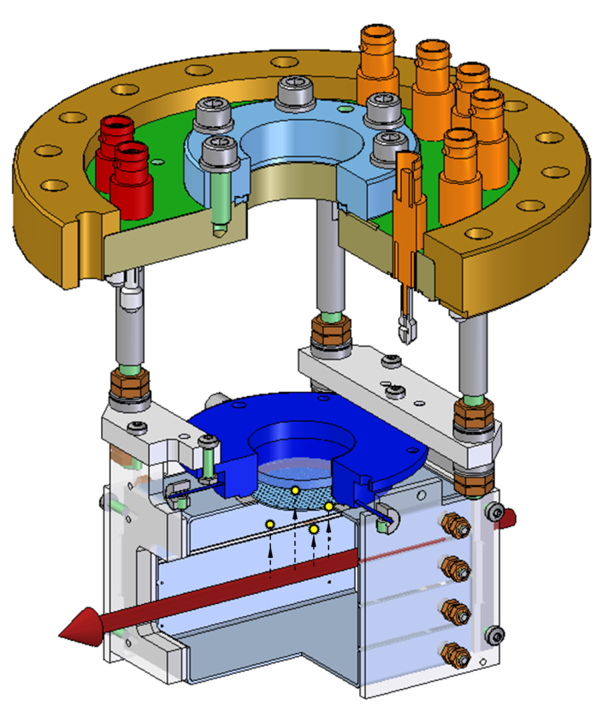
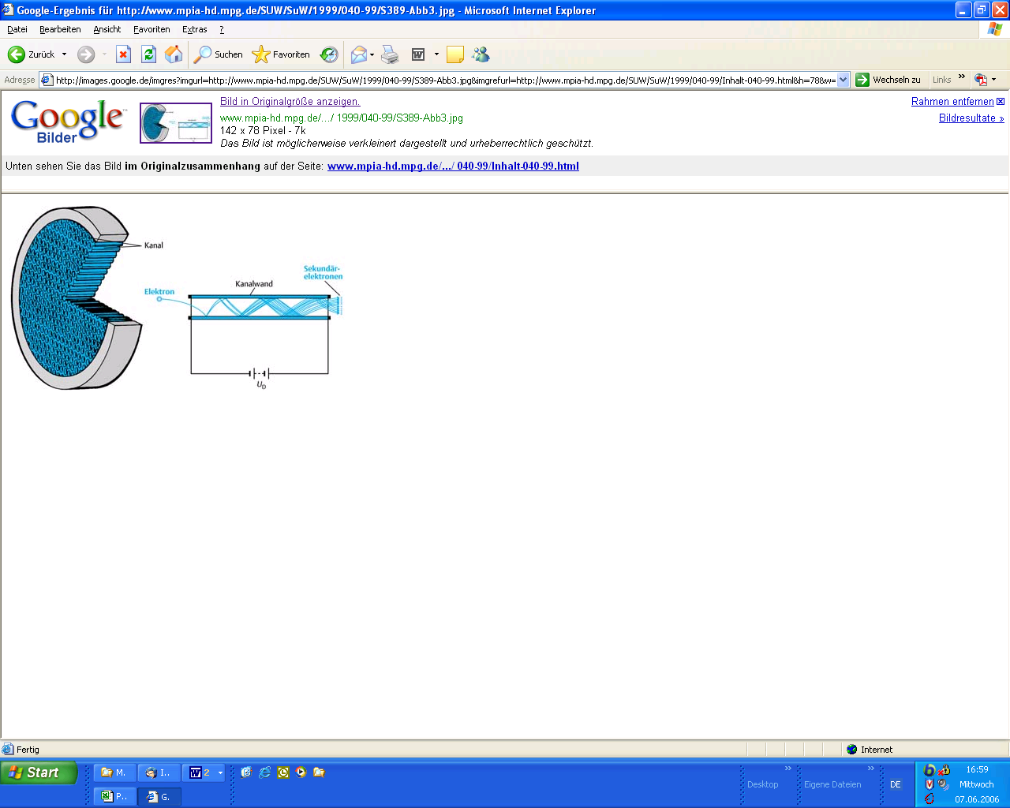
2.Micro-Channel-Plate
1.Residual Gas X-ray Beam
Position Monitor(RGXBPM)
3.Power supply - MPod

Slide 3
A brief Flow Chart of the program
Control based on two limits:
Too low current - unable to detect
Too high current - damage to MCP & screen
start
Check current /0.1s
≤ maximum
limit ?
NO
Change voltage
YES
continue

Slide 4
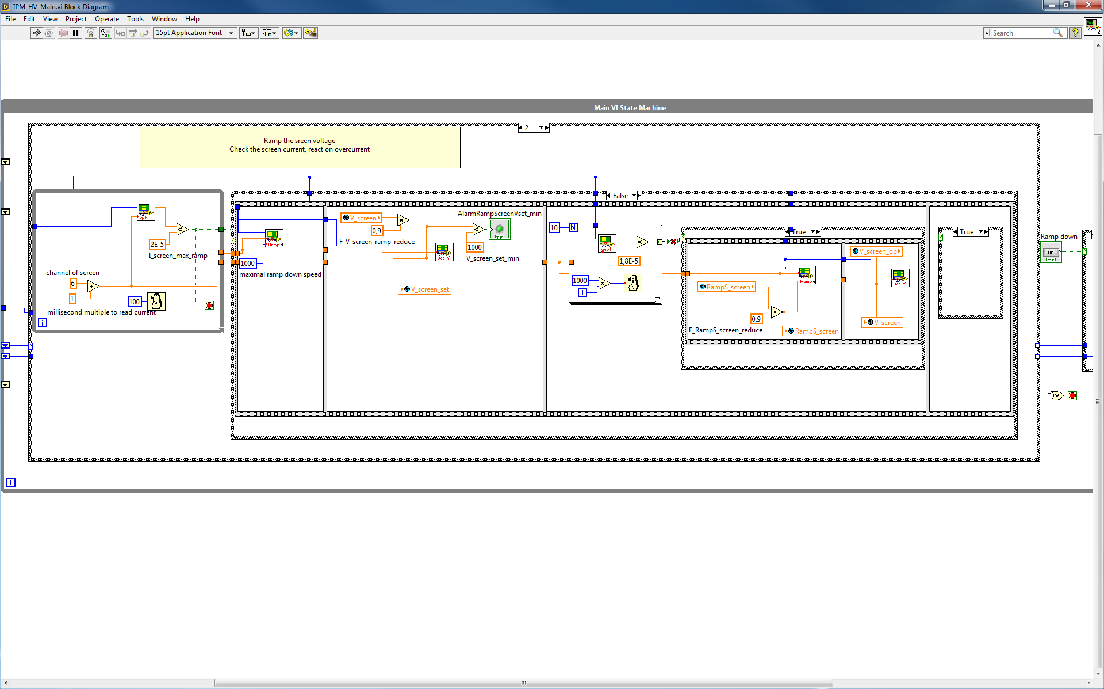
Print screen of labview

Slide 5
Next to do
Debugging
Data logging

