Slide 1
Study track density in ITK layers using simple G4 simulation with scoring planes
Custom simulation based on Geant 4.10
Physics samples:
VH, H → bb (established measurement process, intermediate energy jets, fwd activity)
and
t₁t₁ → tt χχ with m(t₁) = 700 GeV (discovery process, highly boosted jets, central production) at 13 TeV propagate final state particles in G4 in 2 T magnetic field.
Generate hits on tracker scoring planes and calculate closest distance for hits originating from
different particle tracks in G4 EventAction;
Count nb of hits originating from different particle tracks falling within same r/o block;

Slide 2
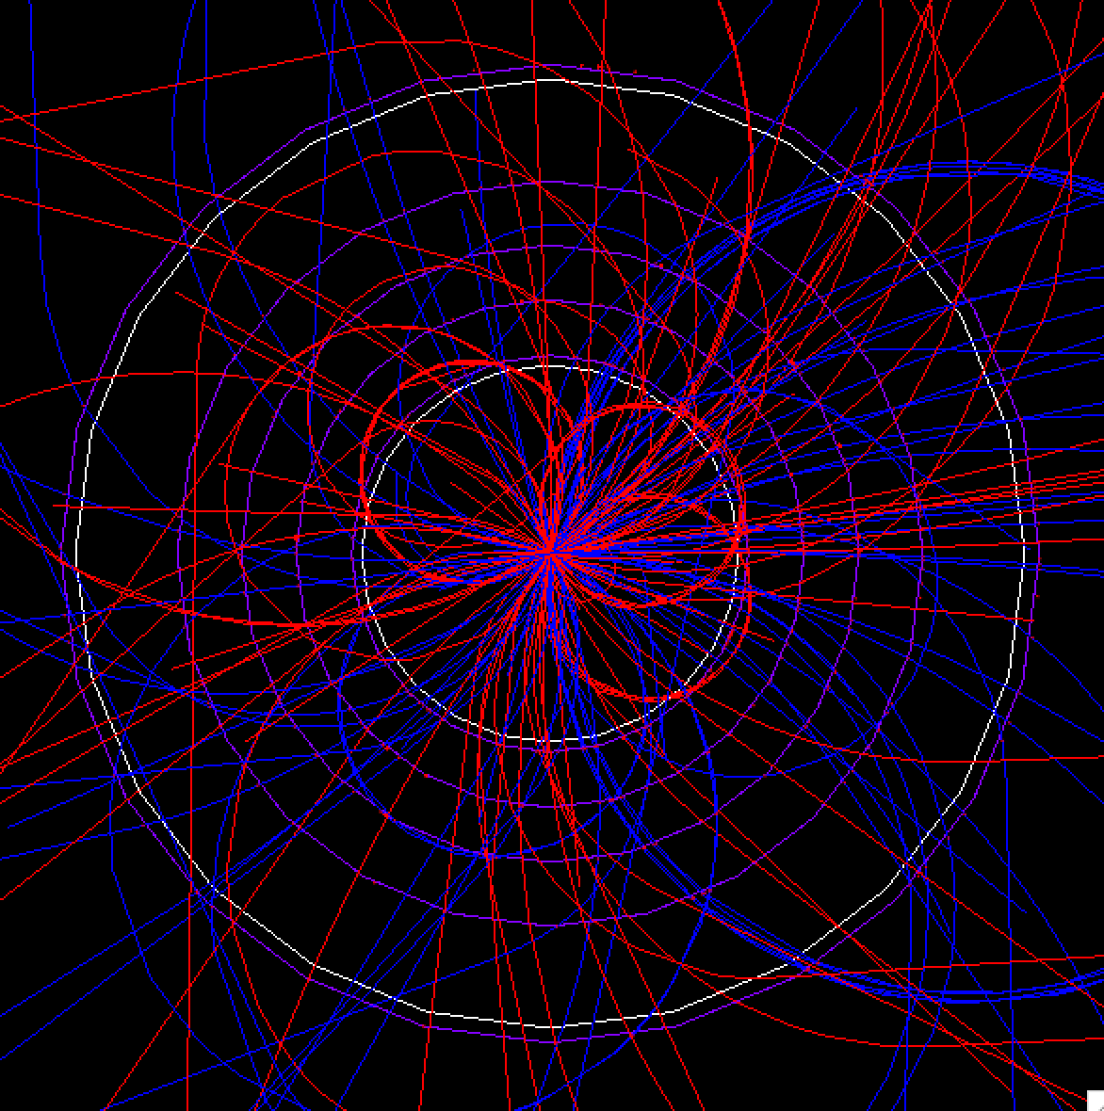

Slide 3
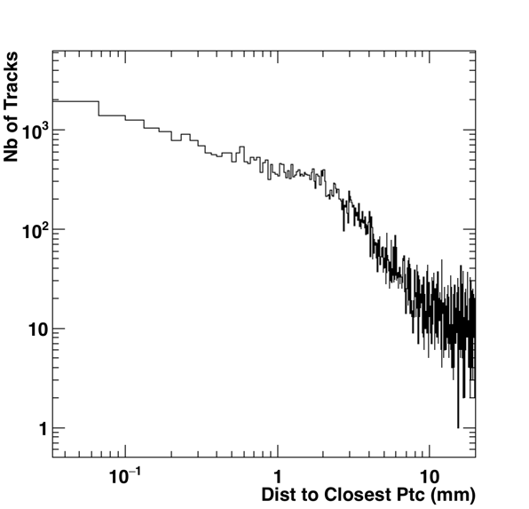
Track Minimum Distance on Layer 1 in t₁t₁ Events

Slide 4
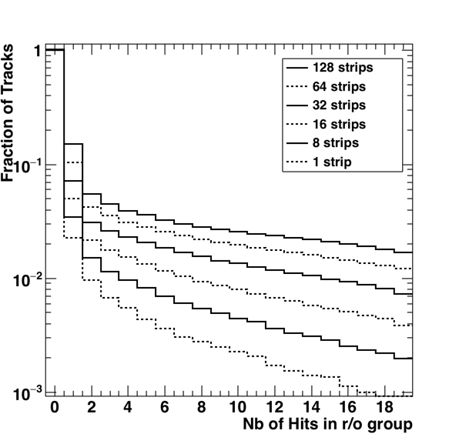
Layer 1

Slide 5
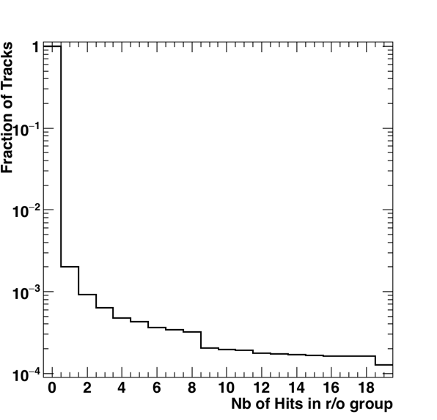
Occupancy along Strip – Layer 1

