Slide 1
Update on HVStripV1 analysis
Luigi Vigani
Oxford

Slide 2
Current Situation
MB01, MB03 and MB06 had the big capacitor removed
More than 60V bias applied
MB03 and MB06 irradiated at Birmingham at about 10¹⁵ n_{eq}
MB03 and MB06 in freezer at Oxford
MB06 to be sent to Glasgow

Slide 3
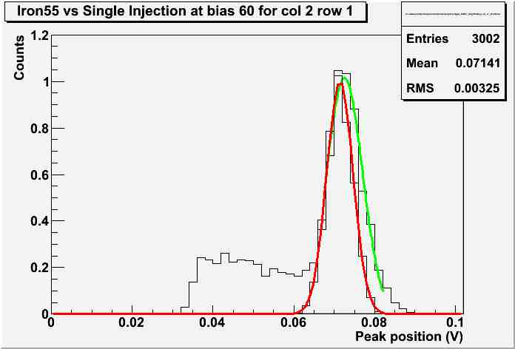
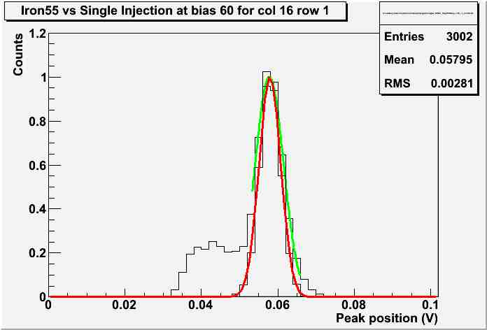
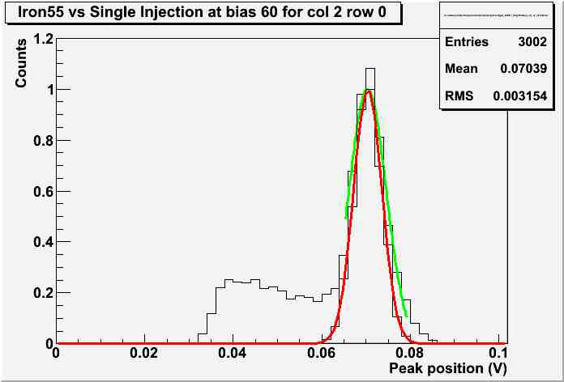
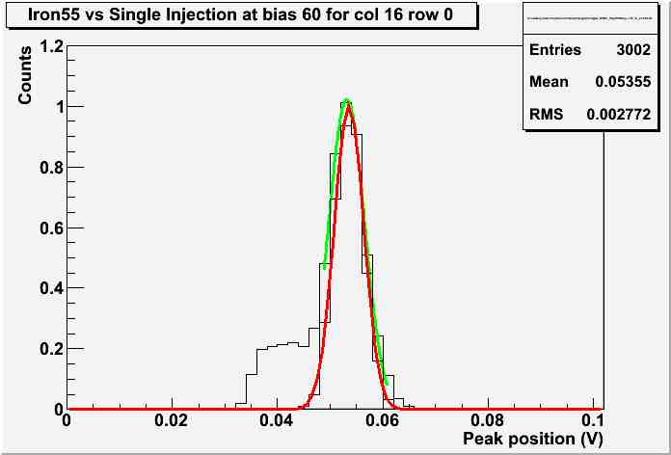
Single Injection
Fe⁵⁵ peak reproduced with injection at a fixed voltage (calculated from the number of electrons produced by the Fe⁵⁵ X-ray)
Peak should be in the same position, Fe⁵⁵ sigma should be higher due to statistical fluctuations
(2,1)
4 Pixels scanned
Bias 60V
(16,1)
Green: Iron55 Red: single injection
Peak positions match within 10%
Noise due to statistics goes as square root of number of electrons (~1680) and must be subtracted in square
Given that, Fe⁵⁵ noise is 20% higher than injection
(2,0)
(16,0)

Slide 4
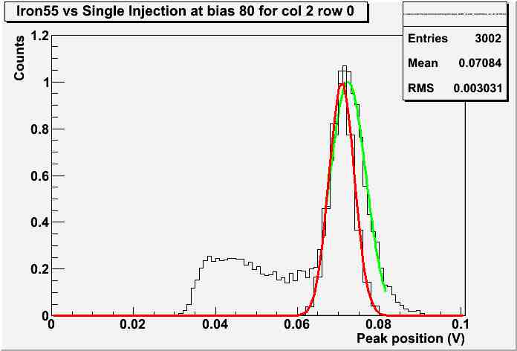
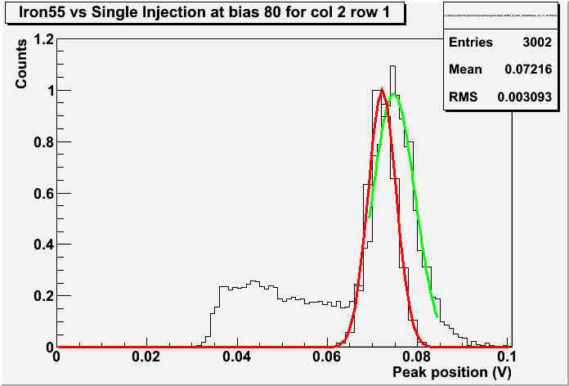
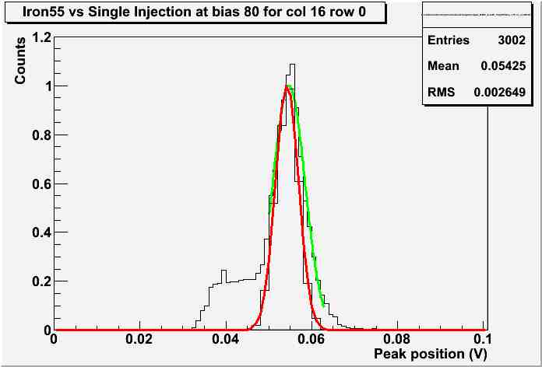
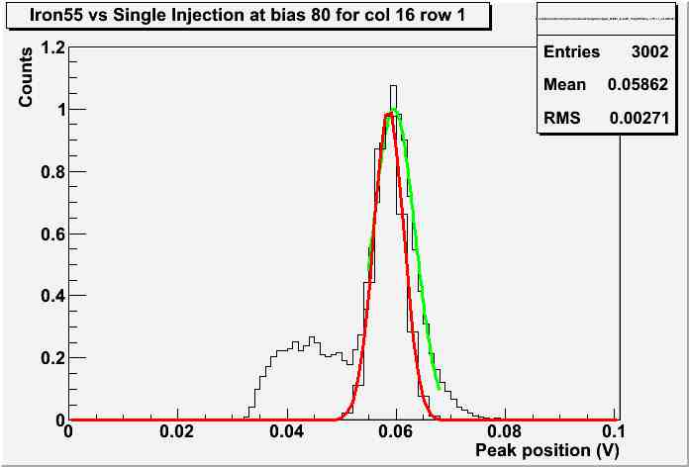
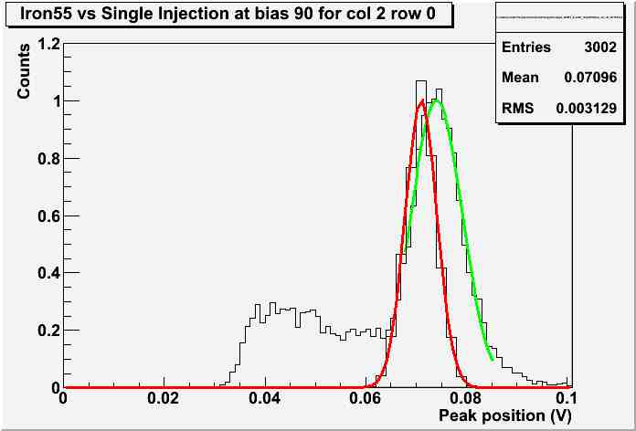
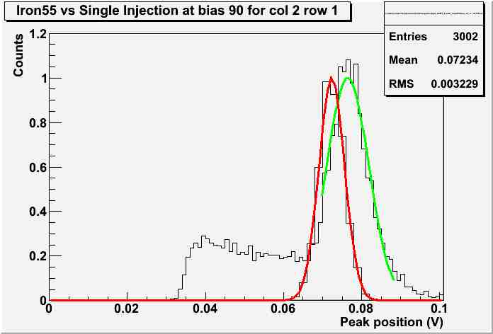
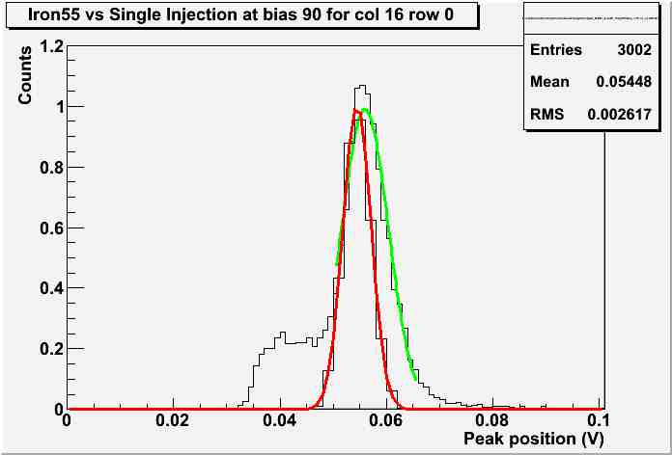
Single Injection at higher bias
Bias 80V
(2,0)
(2,1)
(16,0)
(16,1)
Bias 90V
Fe⁵⁵ shifts to higher value with respect to single injection

Slide 5
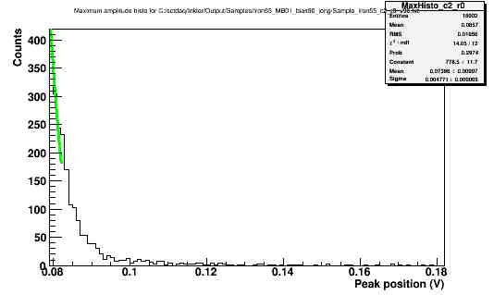
Single Injection at higher bias
Other noticeable fact: a tail appears at bias 90:
Never seen before
In addition: at 90V leakage current was already getting higher (about 80 nA)

Slide 6
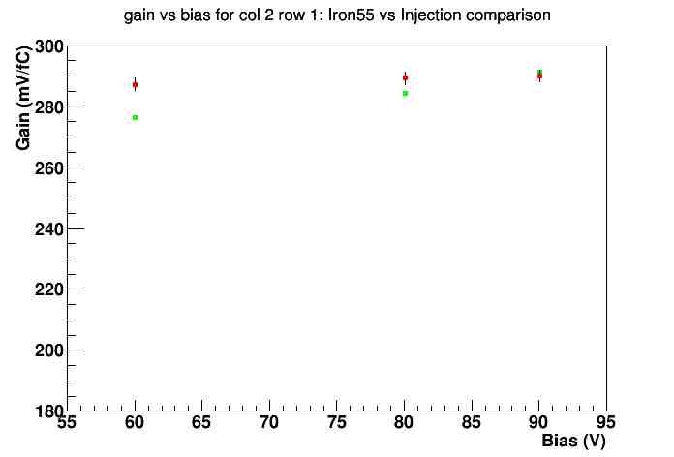
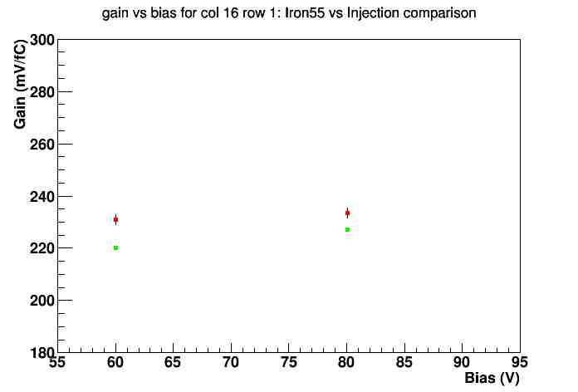
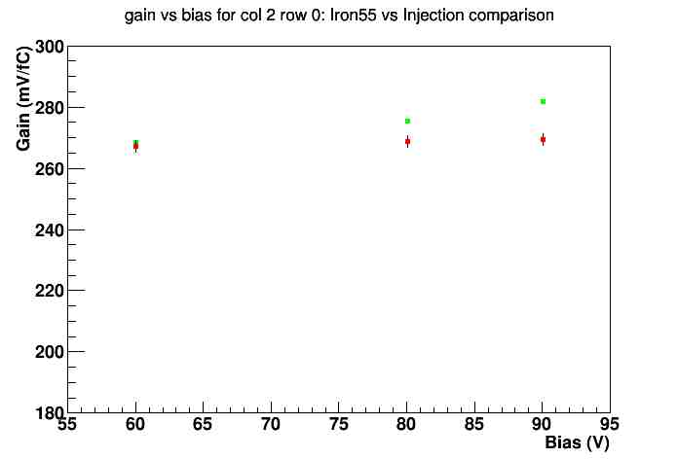
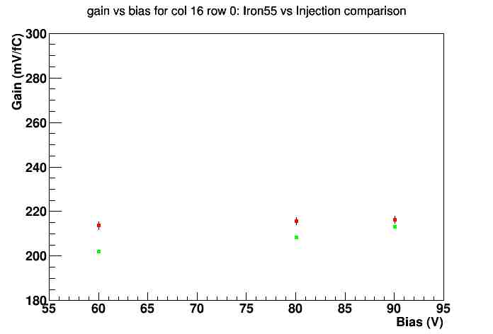
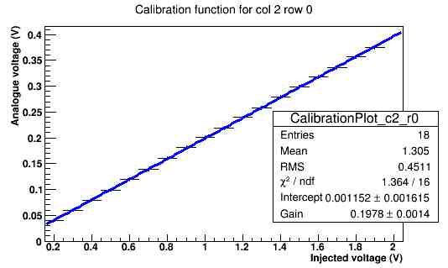
Bias scan on MB01: gain
Comparison between the two usual ways of calculating the gain (Fe⁵⁵ and multiple injections)
Slight difference between Fe⁵⁵ and injection
Fe⁵⁵ increases faster than injection
We have to take into account the intercept in the gain fit with injection:
Green: Iron55 Red: injection

Slide 7
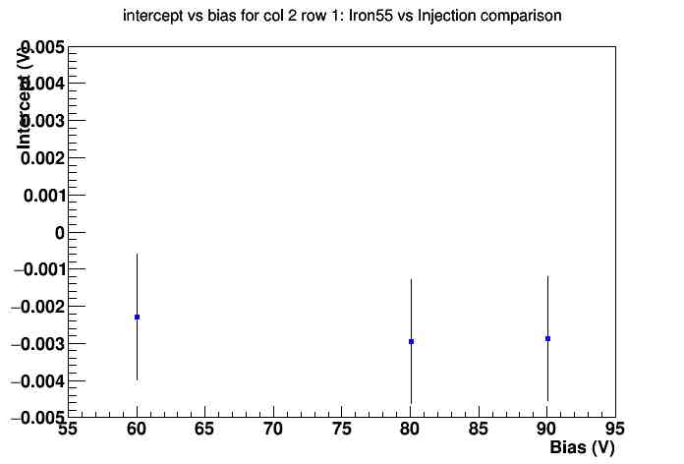
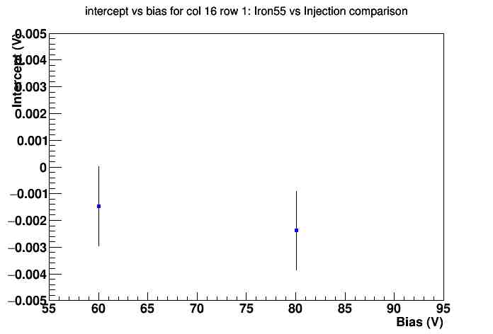
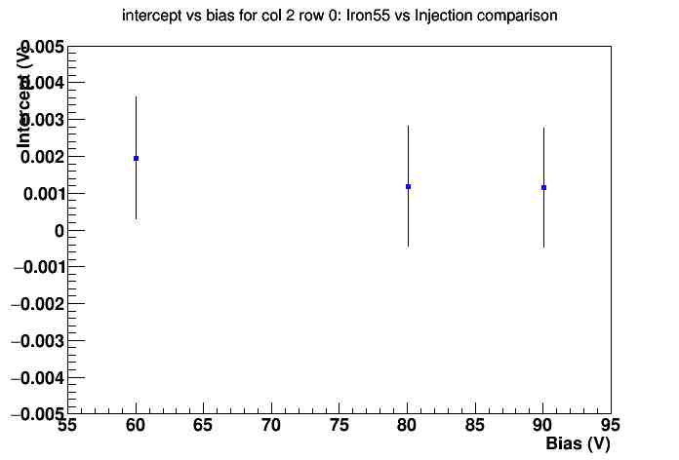
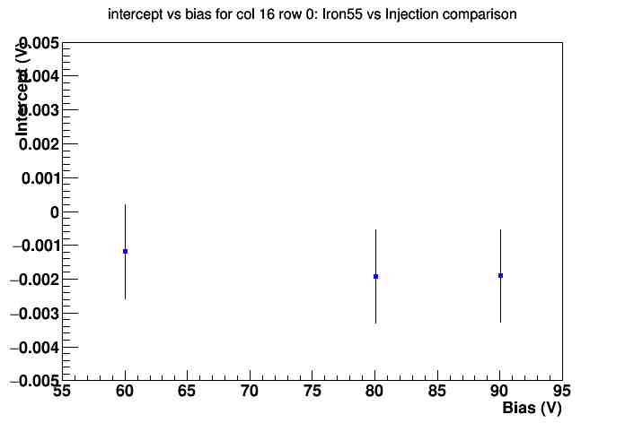
Bias scan on MB01: gain intercept
Intercept parameter as a function of bias voltage
A slight variation:
Calculate the expected injection voltage that reproduces the Fe⁵⁵ peak (as in slide 3)
Predict the output
Divide it with the observed one (real source)
This value should be 1…

Slide 8
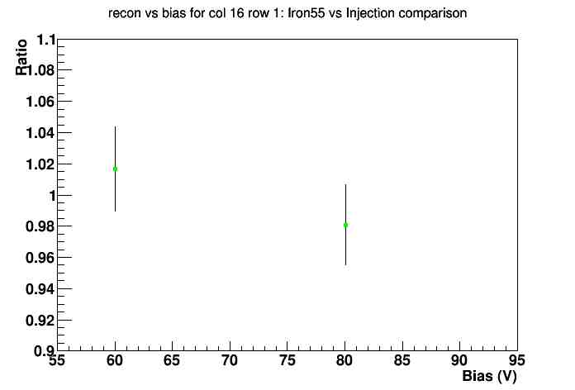
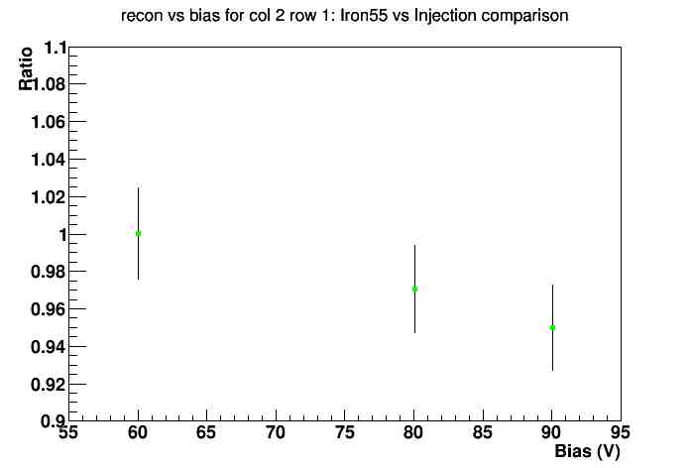
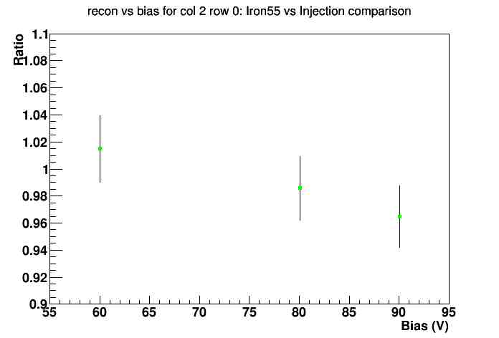
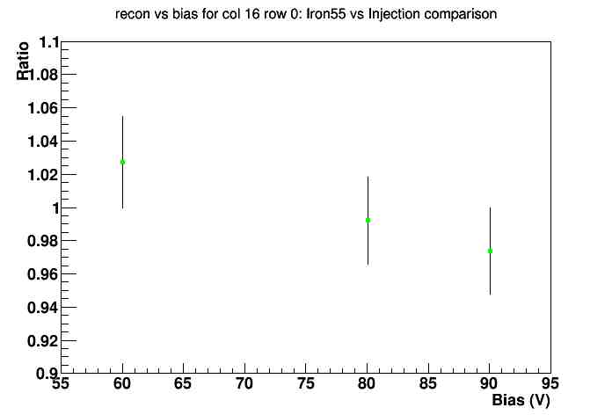
Bias scan on MB01: predicted over observed
It is about 1 for 60 and 80V bias
It decreases as the bias increases (extra charge production?)
It is significantly below 1 at 90V bias

Slide 9
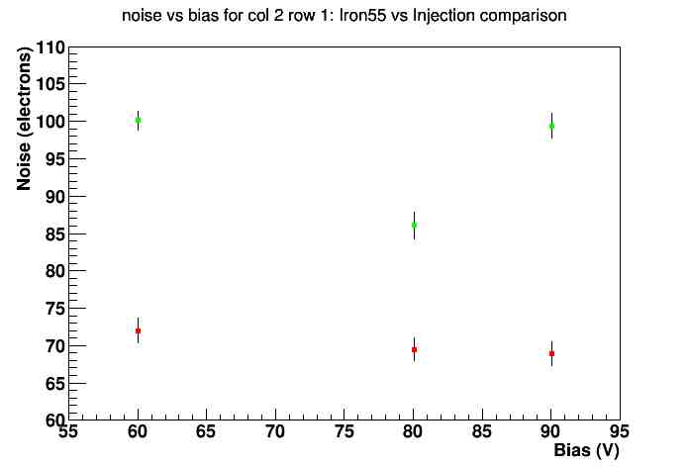
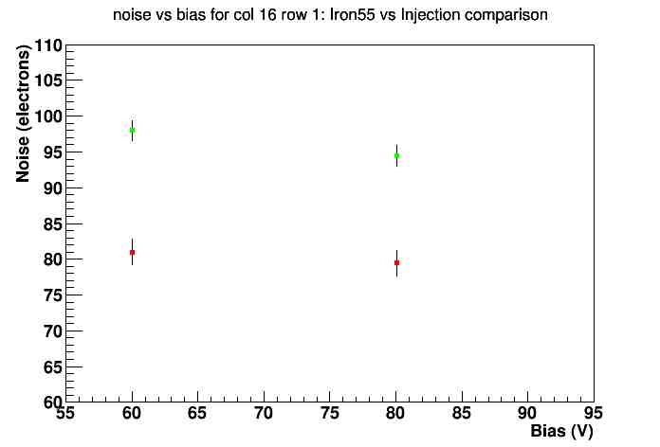
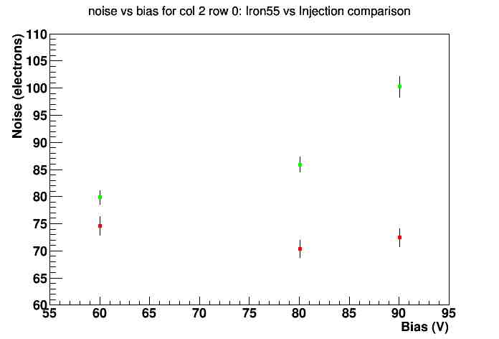
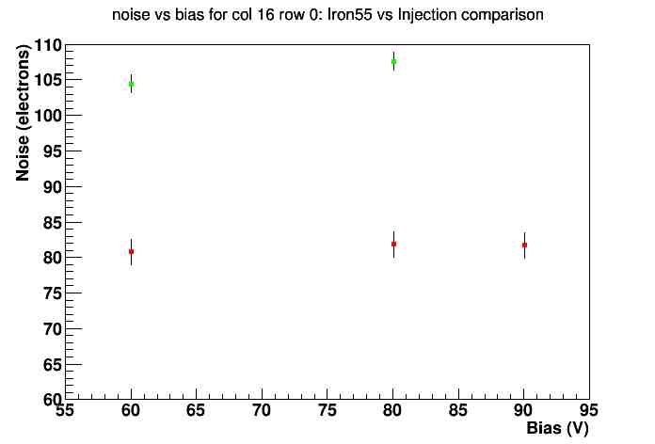
Bias scan on MB01: noise
Fe⁵⁵ noise significantly higher, even after subtracting the statistical contribution
Injection noise can be considered flat
Green: Iron55 Red: injection

Slide 10
Current scan
For higher biases: HV supply in current mode:
Leakage Current | Bias
-30 nA | -93.9V
-50 nA | -94.7V
-100 nA | -95.7V

Slide 11
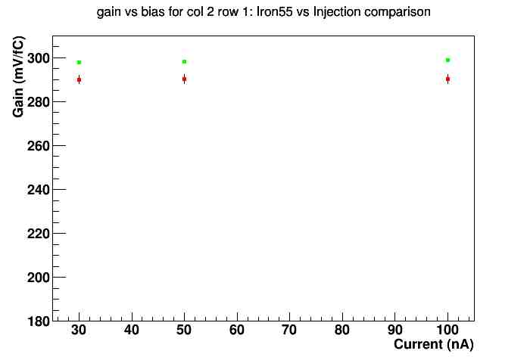
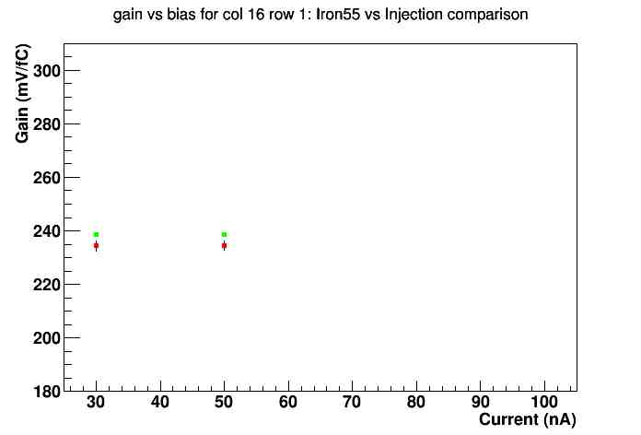
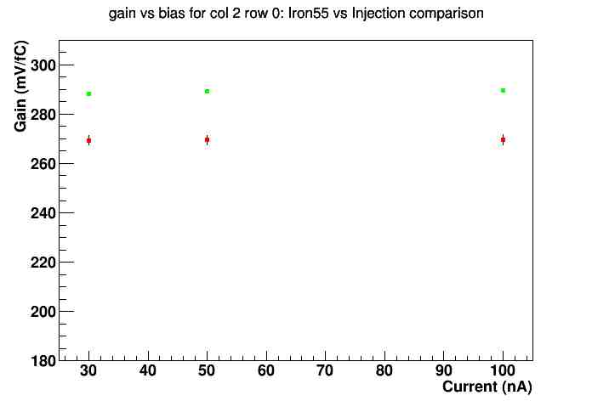
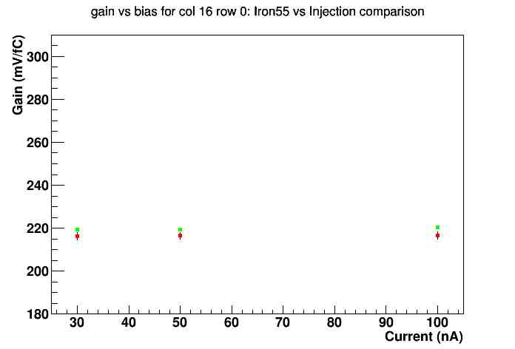
Current scan on MB01: gain
Comparison between the two usual ways of calculating the gain (Fe⁵⁵ and multiple injections)
Fe⁵⁵ flatter
Closer distributions
Green: Iron55 Red: injection

Slide 12
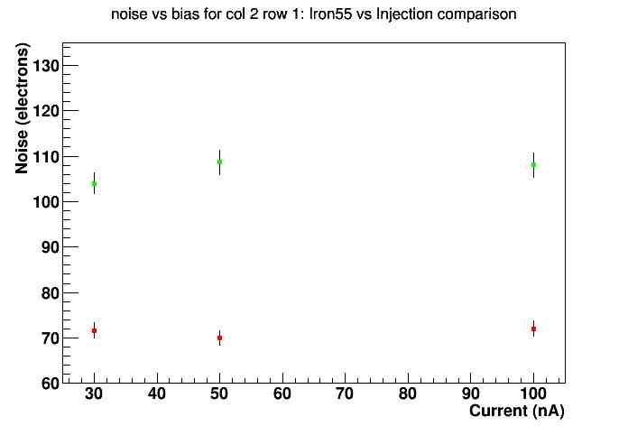
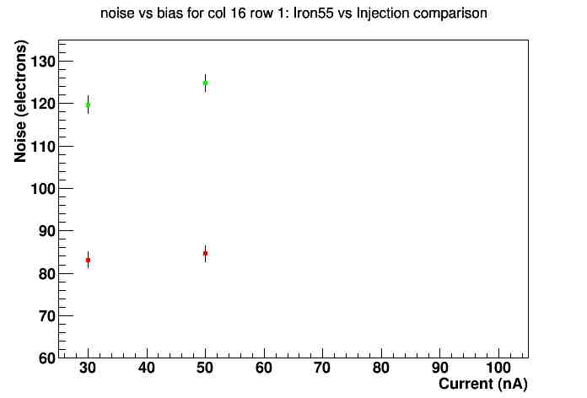
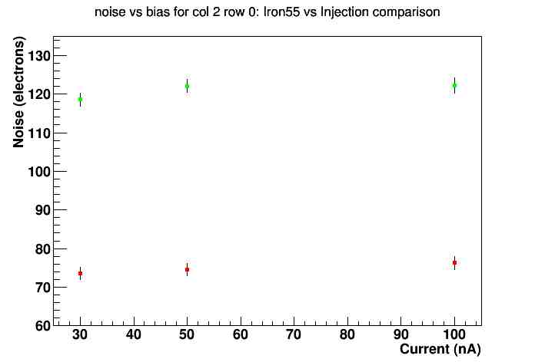
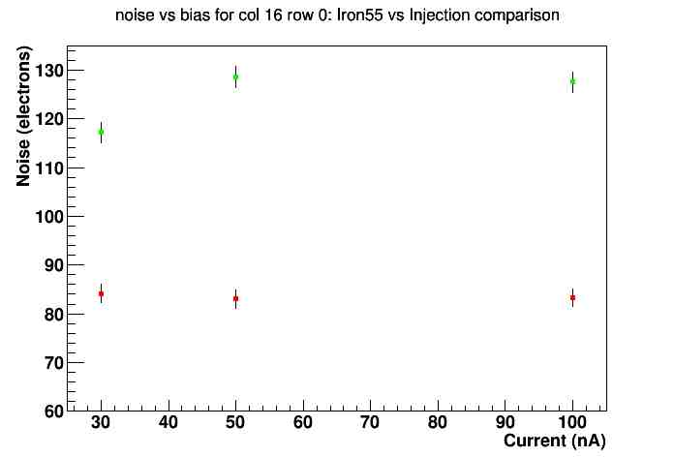
Current scan on MB01: noise
Fe⁵⁵ noise significantly higher
Injection noise can be considered flat
Fe⁵⁵ noise almost flat

Slide 13
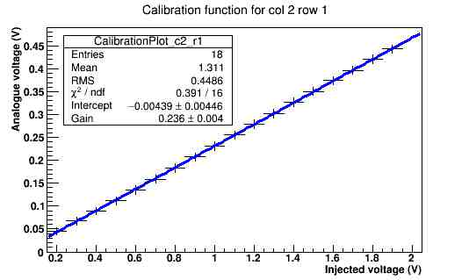
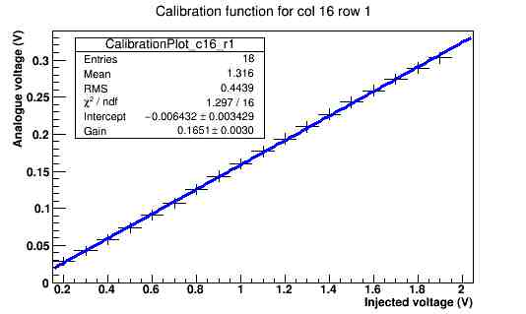
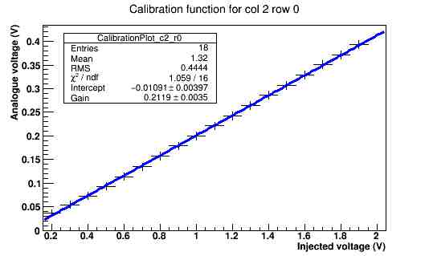
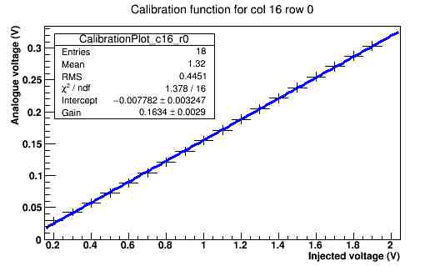
Some data on irradiated MB06
Good news: leakage current at -40°C is less than 10 nA (HV supply’s resolution)
Calibration with injection taken at 60V bias.
DAC 6 set to 5: lower s/n ratio
Regular
behavior

Slide 14
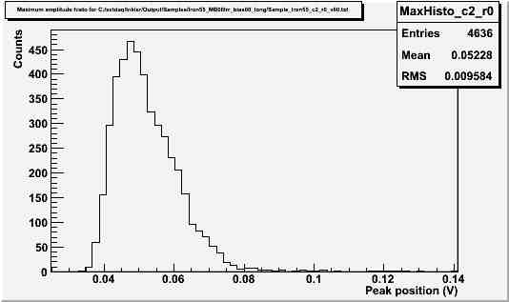
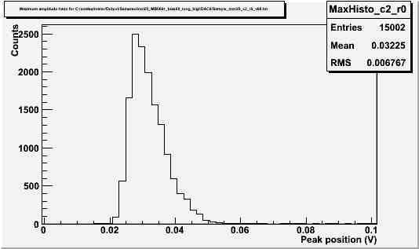
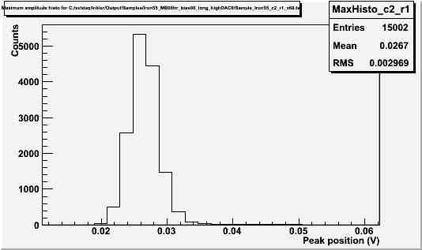
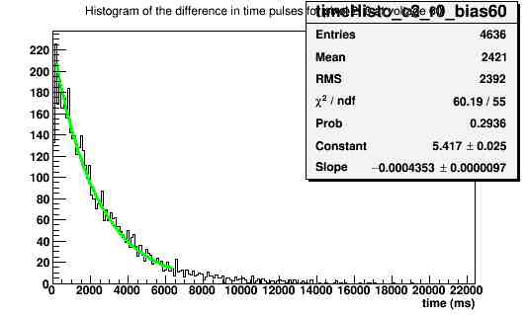
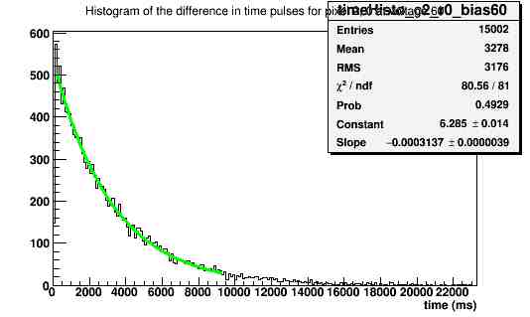
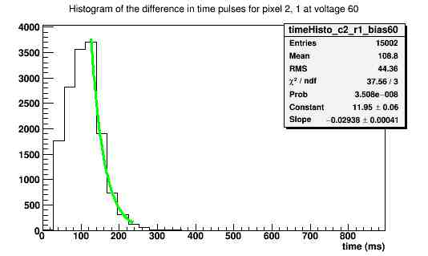
Some data on irradiated MB06
Bad news: still no Fe⁵⁵ peak visible.
(2,0) with DAC6 set to 5
(2,0) with DAC6 set to 60
(2,1)
From injection calibration, peak should sit here
Distributions of time difference between one event and the next one:
The time difference distribution is still the one typical of a radioactive source…
Mainly noise…

Slide 15
Conclusions
Fe⁵⁵ spectrum compared with a calibrated single injection
MB01 analyzed with charge injection and Fe⁵⁵ up to more than 90V bias
Breakdown at about 95V.
For higher bias, MB01 analyzed with HV power supply in current mode
MB06 shows a good calibration profile, but still no Fe⁵⁵ peak.

Slide 16
Backup slides

Slide 17
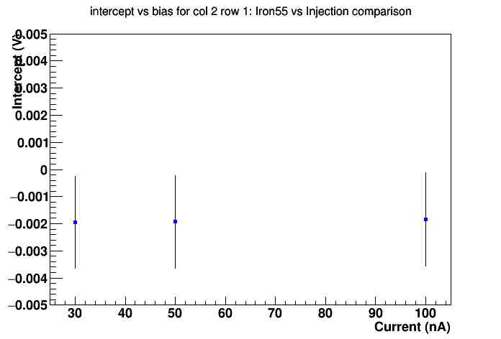
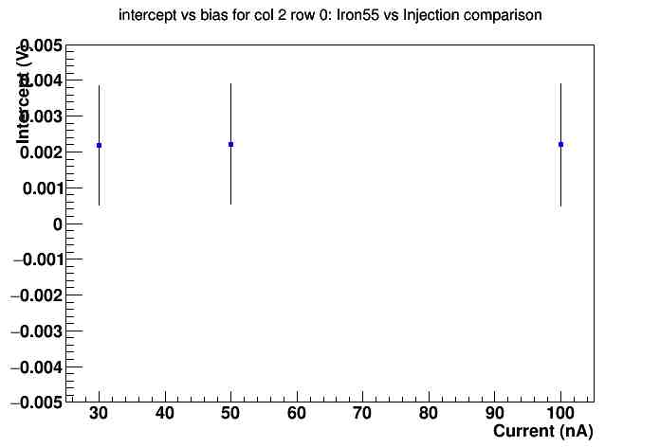
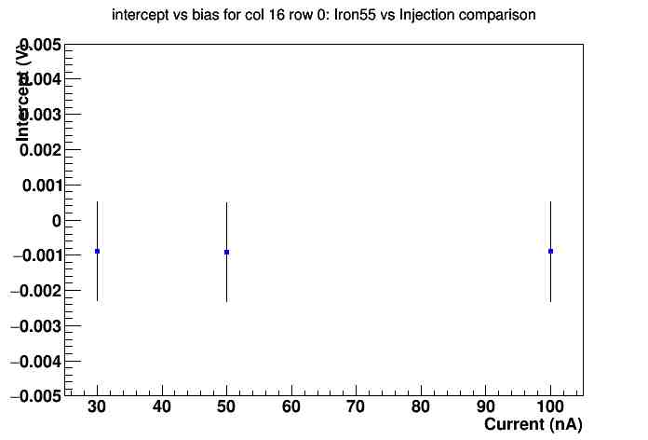
Current scan on MB01: gain intercept

Slide 18
Current scan on MB01: predicted over observed
Measured value is constantly higher than predicted

