Slide 1
Post-Irradiation Testing at Glasgow
R. Bates, C. Buttar, K. Kanisauskas, D. Maneuski
ATLAS Strip CMOS Regular Meeting
July 21, 2015

Slide 2
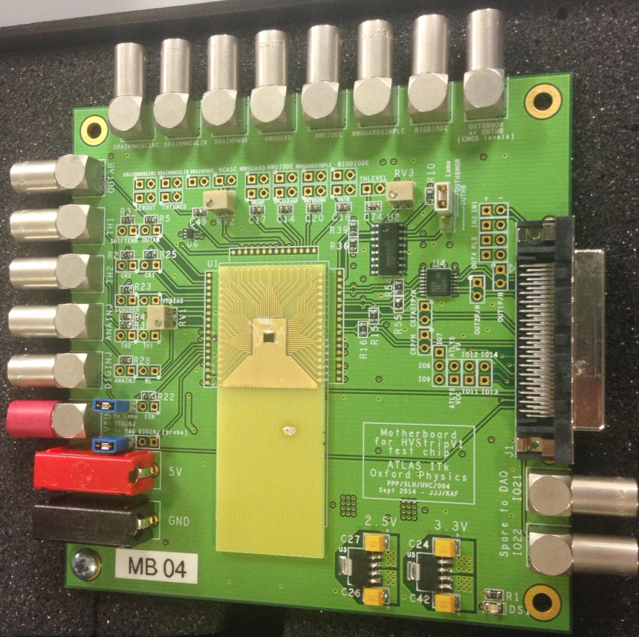
Introduction
MB04 was irradiated at Birmingham back in January up to 7.64×10¹⁴n_{eq}/cm²
The chip was annealed for 80min at 60°C at Cambridge
I-V and noise measurements were done on HVStripV1 MB04
In addition, Sr-90 spectra was also observed

Slide 3
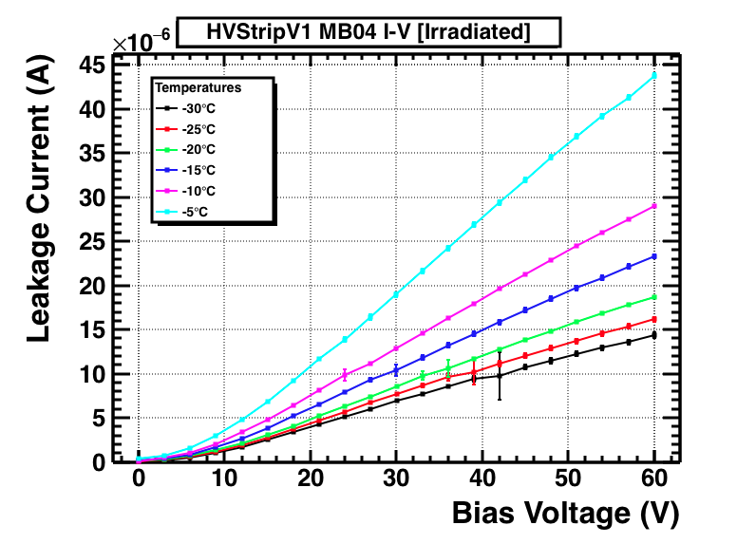
I-V Measurements
Leakage current measurements as a function of bias voltage were done at several temperatures in the environmental chamber
Bias step was set to 3V and the delay time after each step was 2 min in order to allow the current level to settle down
1000 data points were acquired at each bias step
≈10-15min were allocated before starting I-V measurement for the chip to reach the temperature

Slide 4
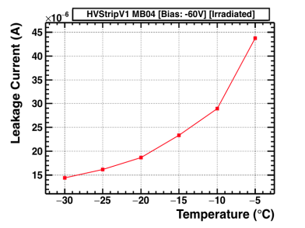
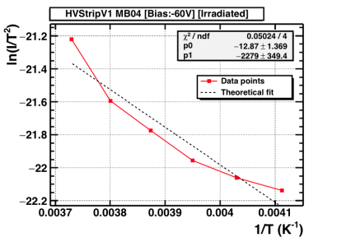
Temperature Dependence
Subset of the I-V data was used to plot leakage current dependence on temperature at constant bias voltage of -60V.
Data points were fitted with I = C × T² × exp(-E_{g}/2kT) function
Extracted bandgap from the fit was E_{g}= 0.39eV, i.e. much lower than that of Si at room temperature (E_{g}=1.12eV)
Clearly data points do not follow the straight line in ln(I/T²) vs 1/T plot (maybe need to make changes to measurement method?)

Slide 5
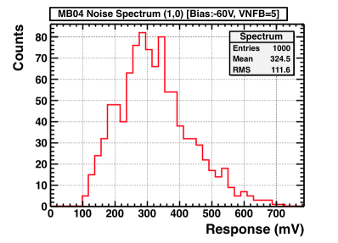
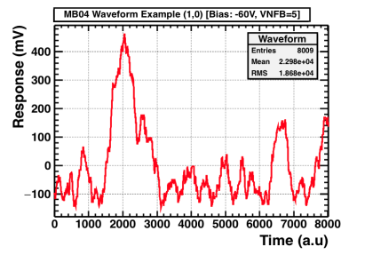
Noise Measurements (1)
Noise measurements were done at -20°C at -60V, -30V and 0V bias (acquisition of 1000 waveforms per pixel using free trigger)
Relatively large RMS was observed for all the pixels (typical RMS value for non-irradiated chip ≈1.5mV)
However, noticeable improvement was observed when VNFB (feedback resistance) DAC was set to 60 (close to its max value), as it was observed earlier in Cambridge

Slide 6
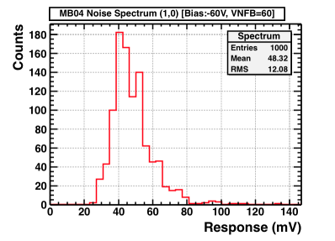
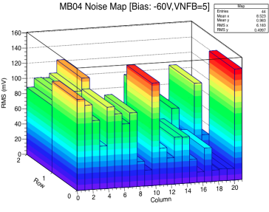
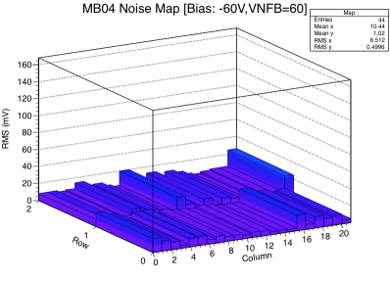
Noise Measurements (2)

Slide 7
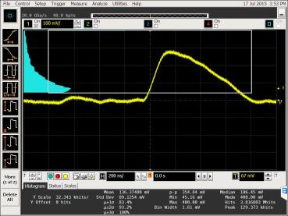
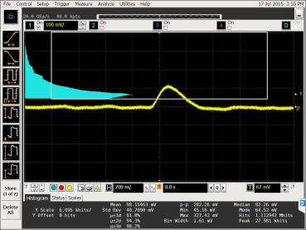
Sr-90 Spectra
Col 3 Row 0
Col 15 Row 0
Sr-90 spectra was observed at 30V bias (VNFB=60), however, triggering was set only on AmpOut
This gives an indication that the chip is still working
The next step is to set the proper MIP setup and acquire data for a couple of pixels at several bias voltages

Slide 8
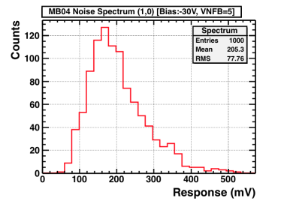
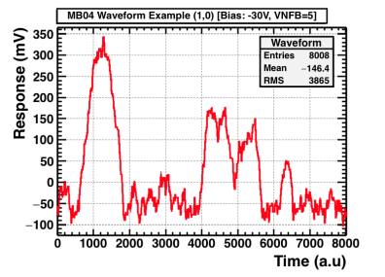
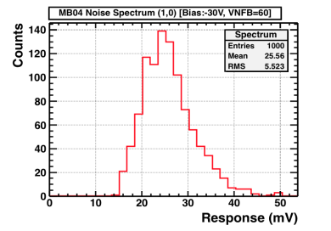
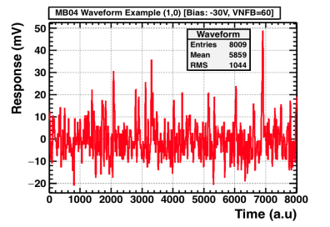
Backup Slides (1)

Slide 9
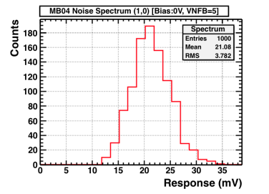
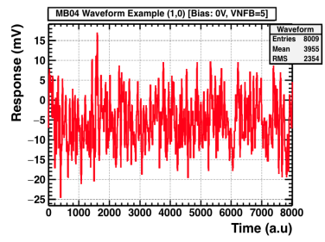
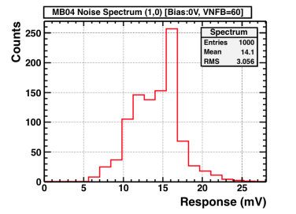
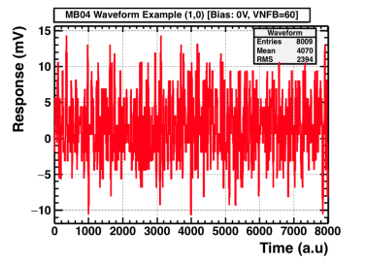
Backup Slides (2)

