Slide 1
Status of test kit 21 July 2015
K. Arndt, T. Huffman, J. J. John, R. Plackett with help from many colleagues

Slide 2
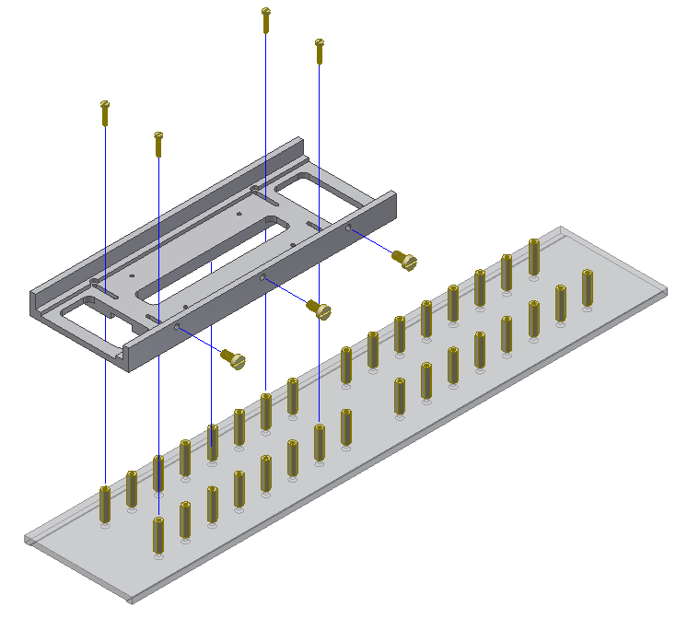
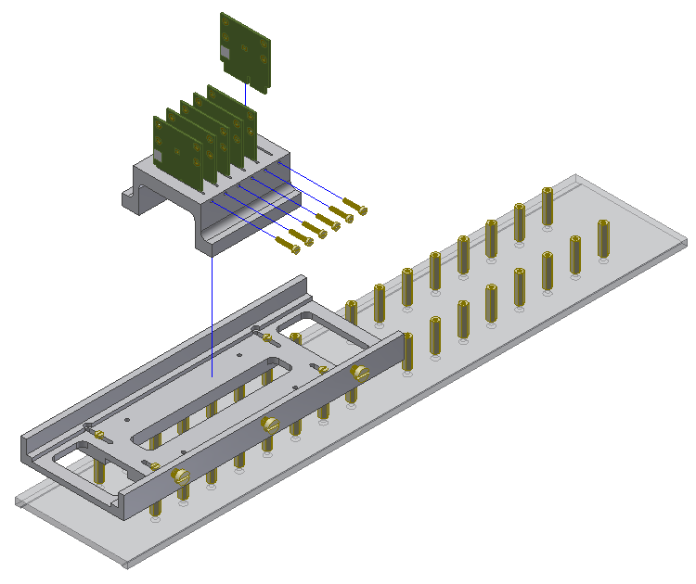
Hardware for irradiation at PS
Holder to irradiate several CHESS-1 daughterboards in the beam at PS, designed by Kirk Arndt with input from Todd Huffman, Richard Plackett and Federico Ravotti at CERN.
Support rail and daughterboard holder to be made of clear polycarbonate
Screws made of nylon
Should be ready at end of July
support rail
d/b holder
CERN PS standard table

Slide 3
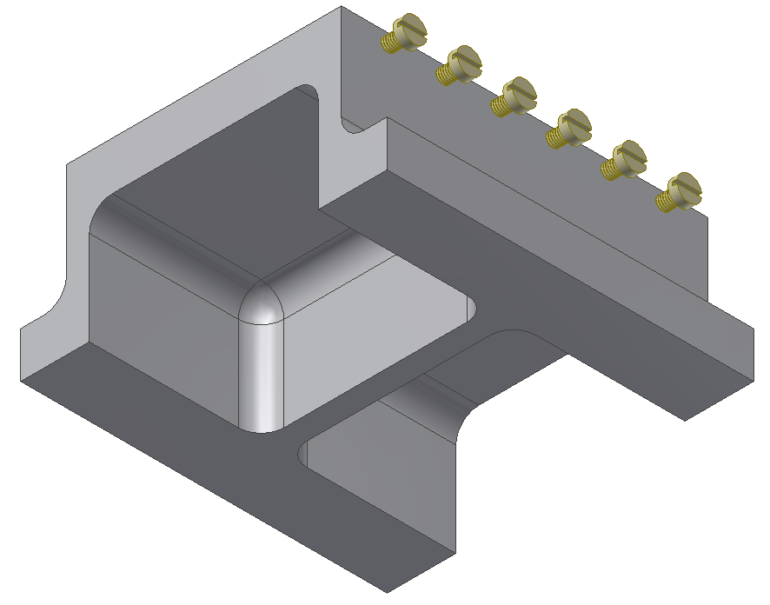
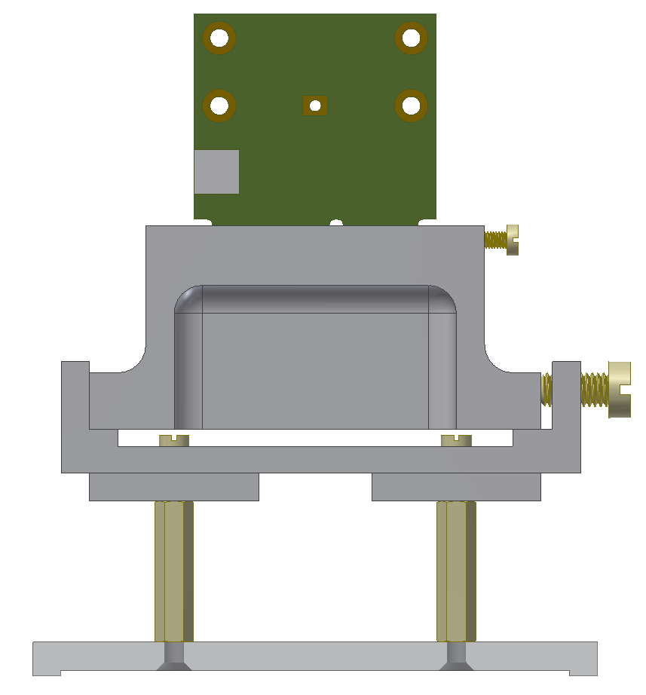
Hardware for irradiation at PS, continued
d/b holder seen from below
whole assembly, side view

Slide 4
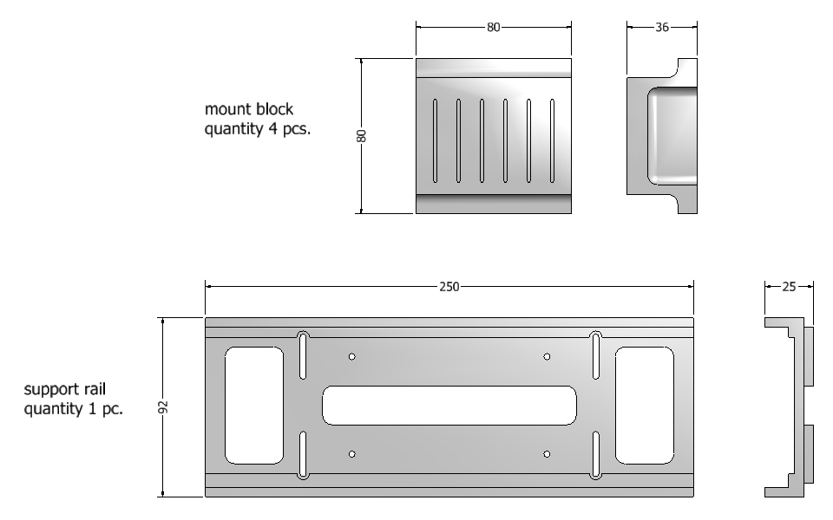
Hardware for irradiation at PS, continued
drawings

Slide 5
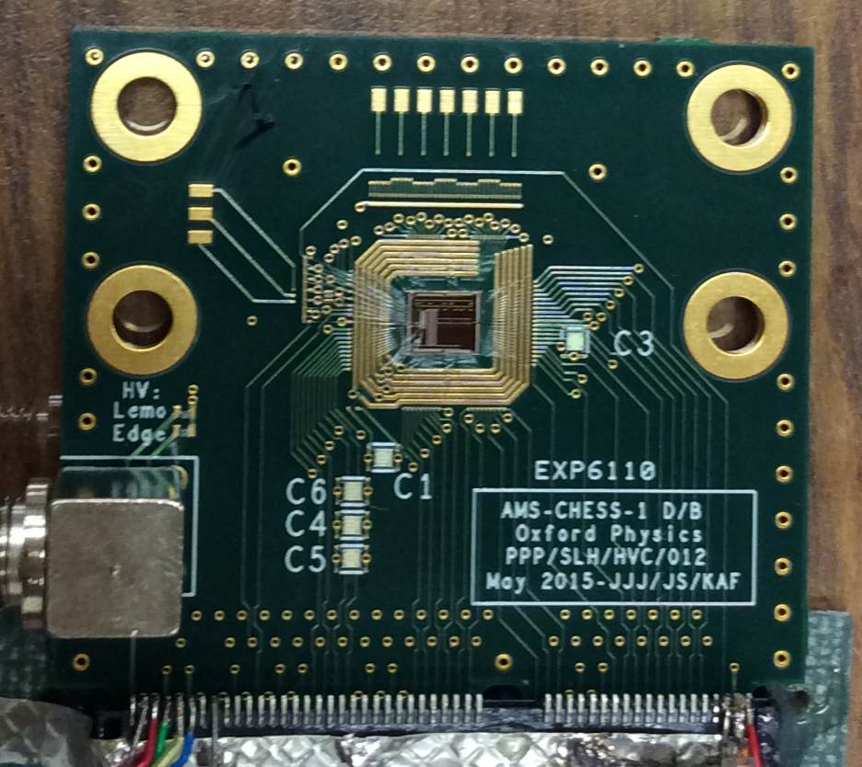
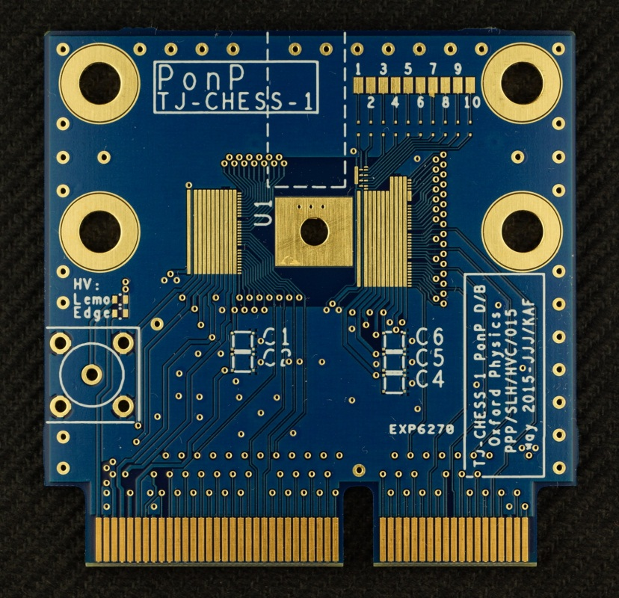
Daughterboards
AMS-CHESS-1 d/b bonded at SCIPP
TJ-CHESS-1 PonP d/b manufactured
Starting work on PonN d/b, based on PonP d/b.
PonN footprint design next.

Slide 6
Motherboard
Will upload draft schematics shortly.
Minor updates to passives (R, C) needed, then into layout.
CHESS hardware needs?
Planning quantities now. Have heard from:
Argonne, DESY, Glasgow, Ljubljana, Oxford, RAL (PPD and TD), SCIPP
Do any other institutes plan to test AMS-CHESS-1 or TJ-CHESS-1 chips?
Please let me know, thanks.

