Slide 1
CHESS1 testing

Slide 2
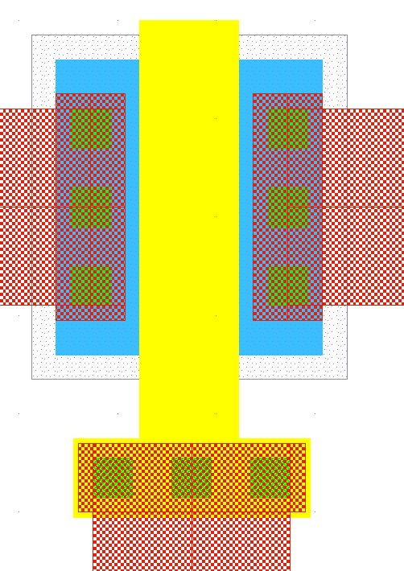
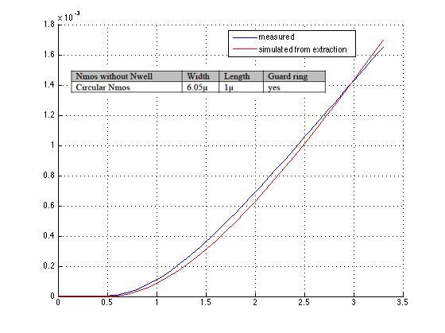
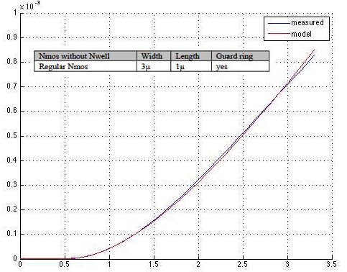
CHESS1 NMOS - unirradiated
Current
to cont.
Smaller gain

Slide 3
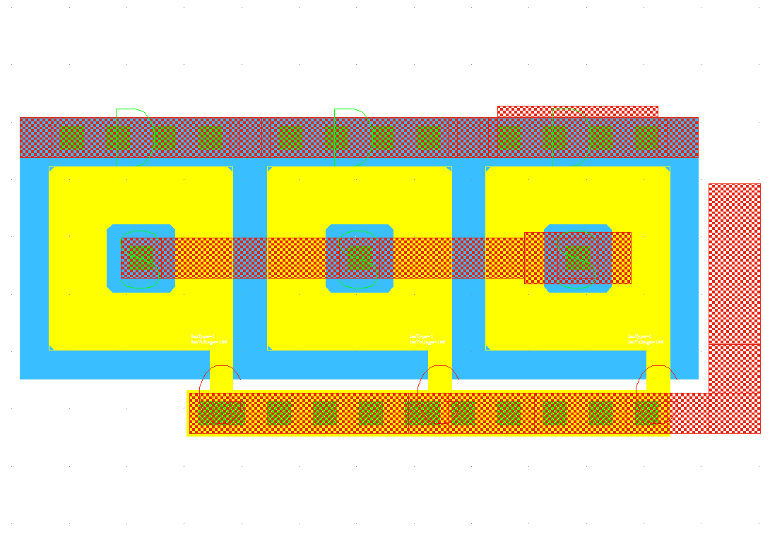
CHESS1 NMOS – higher current

Slide 4
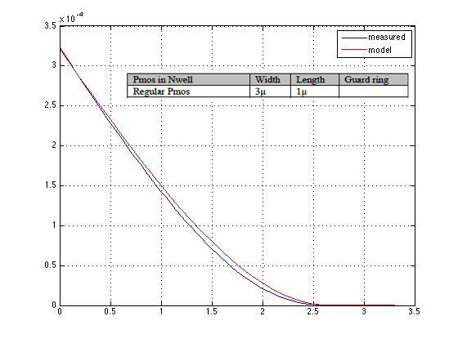
PMOS CHESS1 - unirradiated

Slide 5
CHESS1 bonded for testing
Measured:
3Mrad irradiated
Looks nice no? Thanks Jaya John and Forest!

Slide 6
CHESS2 amplifier
IFB
3.3
3.3
Load
Out
Casc
InSF
In

Slide 7
Setup
9ns falltime
Pulser
CHESS1
Scope
Buffer

Slide 8
Configuration used
Bias | Description | Config1 (V) | Config5 (V)
VNBias | Bias for the NWELL | 0.340 | 0.340
Casc | Cascode voltage | 2.6 | 2.6
VPLoad | Pmos Load voltage | 2.1 | 2.1
iN | Amplifier bias current | 1.0 | 1.0
iNSF | Source Follower Bias | 0.57 | 0.57
iFB | Feedback current | 2.664 | 2.53

Slide 9
Gain – config1
Gain seems to be quite reproducible.

Slide 10
Rise time config1
Rise time difference:
- State of the circuit:
Perfect circuit in simulation
3MRad irradiated sample in reality
- Output capacitance:
6p used in simulation
?? In reality

Slide 11
FWHM config1
FWHM difference:
- State of the circuit:
Perfect circuit in simulation
3mRad irradiated sample in reality
- Output capacitance:
6p in simulation
?? In reality

Slide 12
Noise config1
Noise difference:
Unexplained increase of the noise with larger input signals
Slow decaying high Z node??
…
More measurement to be done, in particular with no signal.
Unexplained region

Slide 13
Config1 to Config5
Config5 higher reset current:
Lower noise
Faster reset
Smaller gain
Faster pulse
Let’s verify that: …
Bias | Description | Config1 (V) | Config5 (V)
VNBias | Bias for the NWELL | 0.340 | 0.340
Casc | Cascode voltage | 2.6 | 2.6
VPLoad | Pmos Load voltage | 2.1 | 2.1
iN | Amplifier bias current | 1.0 | 1.0
iNSF | Source Follower Bias | 0.57 | 0.57
iFB | Feedback current | 2.664 | 2.53

Slide 14
Gain config1 – config5
Gain decreases from config1 to config5 as expected.
Config5 [3MRad] seems to have much higher gain than anticipated.
To be understood.
Measurement of un-irradiated sample needed.

Slide 15
FWHM config1 – config5
FWHM decreasing from config1 to config5 as expected.
Simulation done here with a load = 1pF
FHWM increases with the input capacitance in simulation
Load used probably too low. 6pF maybe more realistic.
Estimation of the load capacitance needed.
Measurement of un-irradiated sample needed.

Slide 16
Rise time config1 – config5
Rise time decreases from config1 to config5 as expected.
Big discrepancies in rise time measured vs simulated.
In part due to bad model of load capacitance.
Again estimation of the load capacitance needed.
To be done with un-irradiated samples.

Slide 17
Noise config1 – config5
Noise decreases from config1 to config5 as expected.
Seems to be a problem of coupling between signal and noise
To be investigated
To be done with un-irradiated samples.

Slide 18
SNR config1 – config5
SNR increases from config1 to config5 as expected.
Expect better SNR once noise is understood.
To be measured on un-irradiated samples.

Slide 19
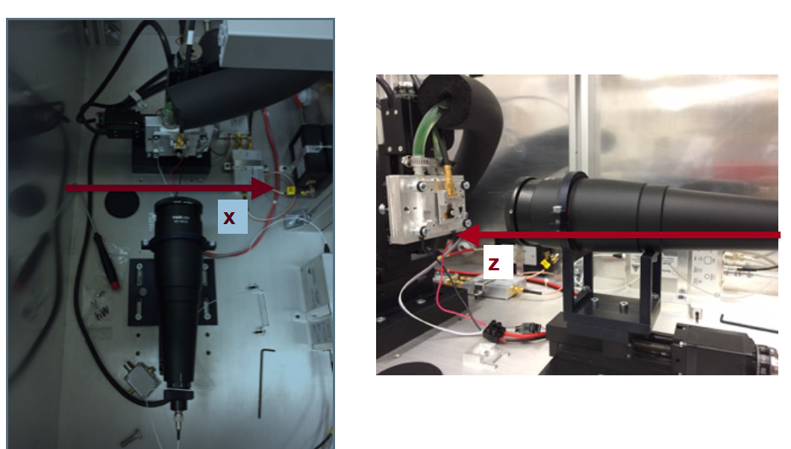
TCT laser system

Slide 20
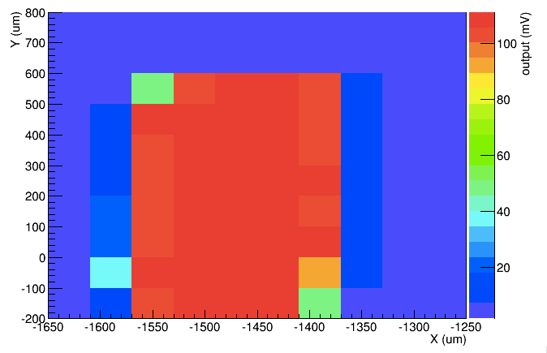
Laser scan on a 45µm x 800µm pixel.
Non-optimized laser spot size. We have no good idea of what the spot size is here.
10MIP of laser signal
0V HV bias
We see a roughly 800µm long structure.
Active arrays are alive. More precise measurements to come.

Slide 21
Summary
Schedule for NMOS and PMOS irradiation being decided - end of September at CERN if possible [after ITk would be great].
Isolated amplifier measured in depth for 1MRad and 3MRad CHESS1. Agreement between measurement and simulation is not great but not completely crazy either. Need to be done with un-irradiated CHESS1 to be in controlled situation. Does anyone have any left?
Noise of CHESS1 need to be understood better.
Active arrays in CHESS1 are alive. Adjustment of the TCT laser in progress and more results to come.

