Slide 1
An update on measurements
with irradiated CHESS-1 chip
I. Mandić et al.,
Jožef Stefan Institute, Ljubljana, Slovenia

Slide 2
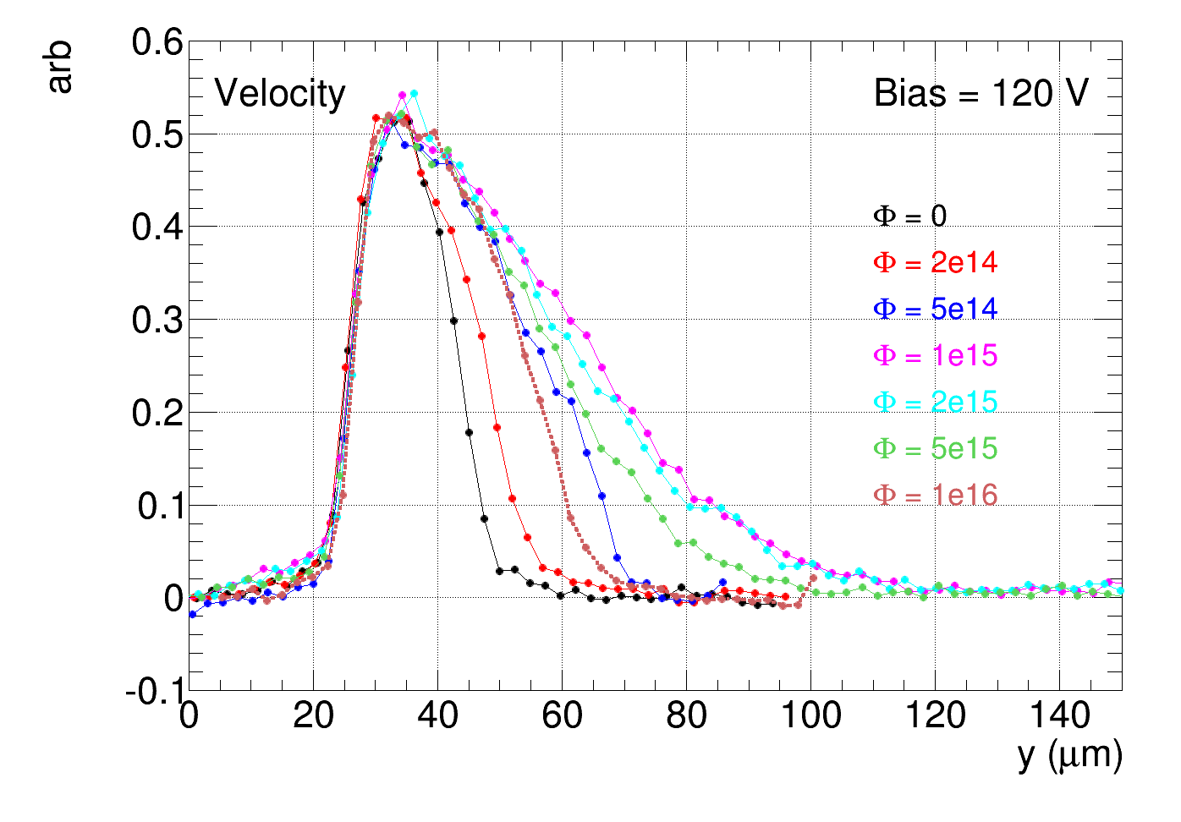
New irradiation step: total fluence 1e16 n/cm²
E-TCT, velocity profile
at 1e16 depleted layer still thicker than before irradiation

Slide 3
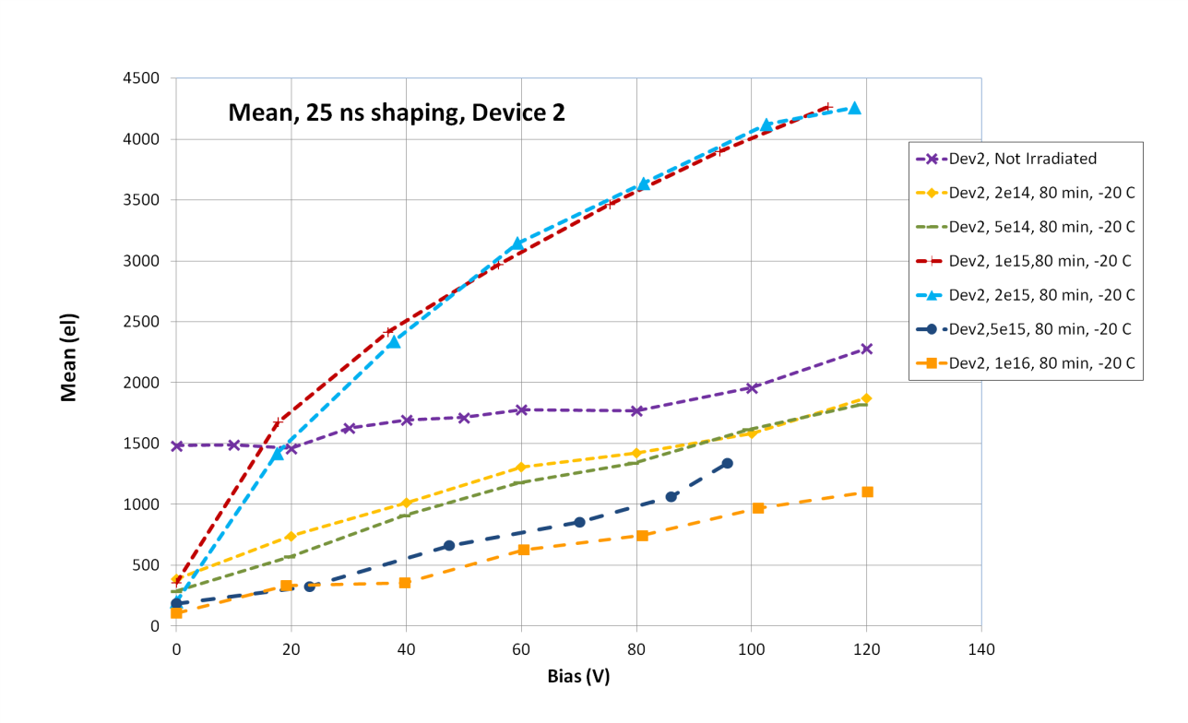
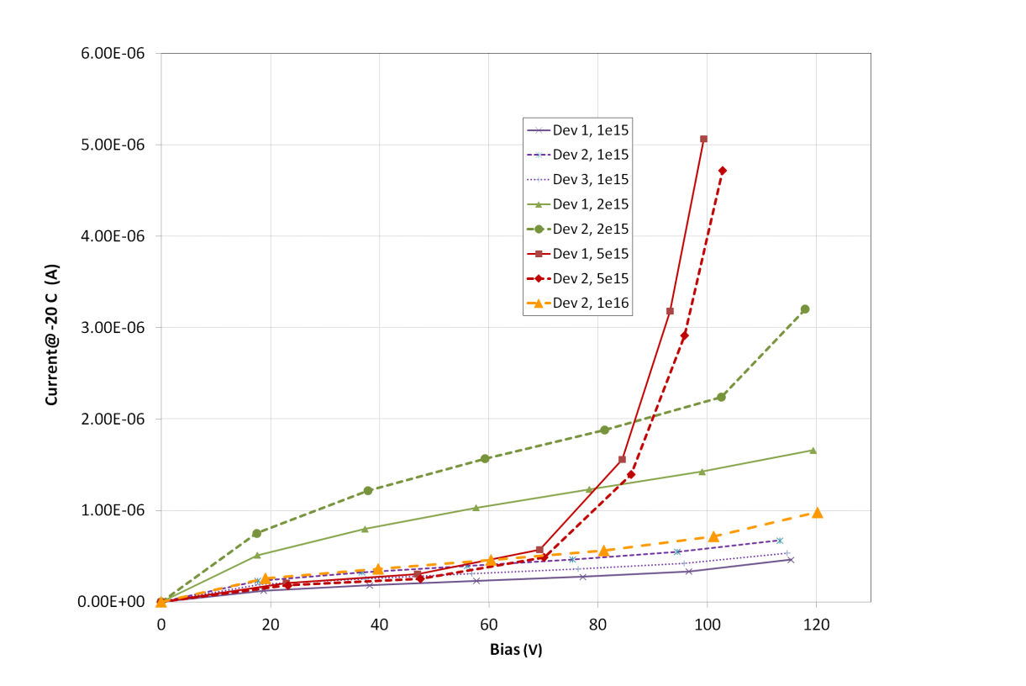
Sr-90
charge collection smaller
than at 5e15
Current
no current increase at
higher bias voltage

Slide 4
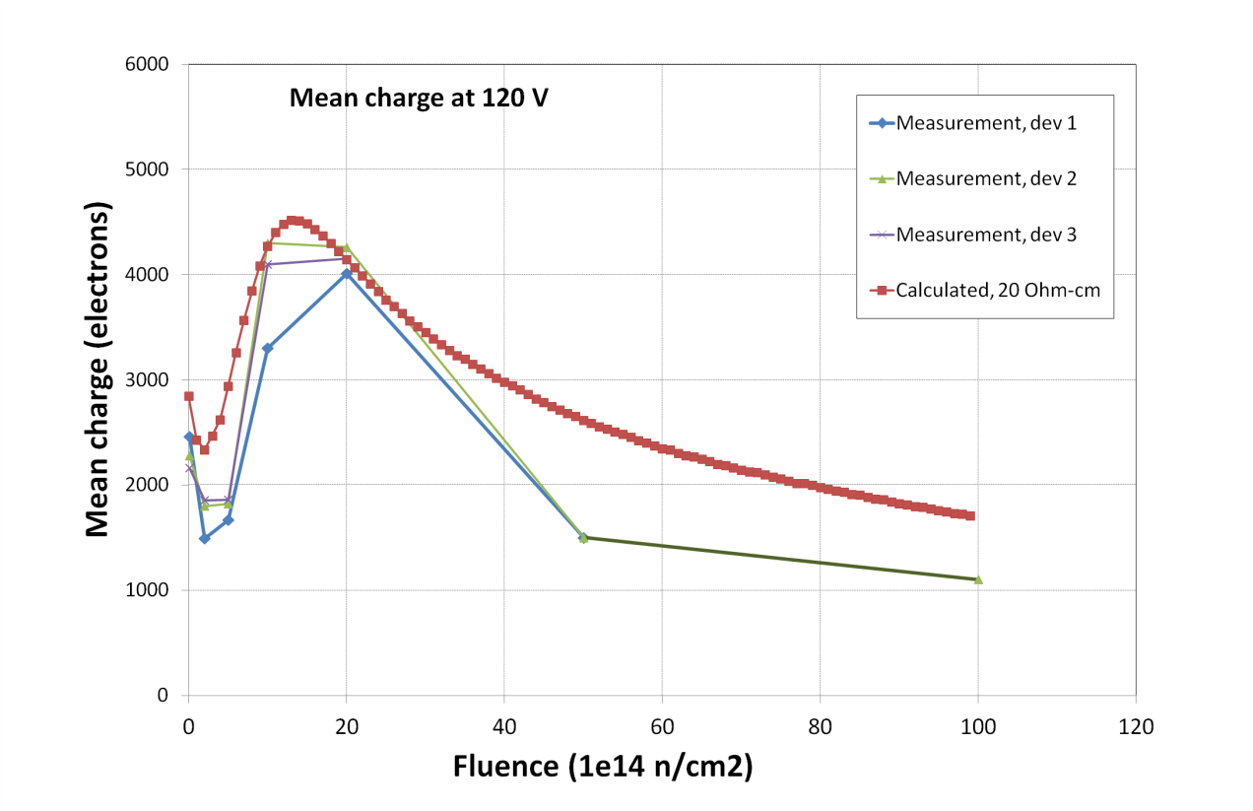
approximately as expected

