Slide 1
Update on HVStripV1
Luigi Vigani
oxford

Slide 2
Current situation
2 samples, MB06 and MB03 irradiated at about 10¹⁵ n_{eq} at Birmingham
MB06 pre-irradiation characterization done at Glasgow
MB03 pre-irradiation characterization done at Oxford
MB06 partially studied at Oxford
MB06 sent to Glasgow for further studies
MB03 data taking currently starting

Slide 3
MB06 data
Some Fe⁵⁵ spectrum collected at bias of 60, 80 and 87
Increasing it, the leakage current would become higher than 100 nA
3 channels used: (2,0),(2,1),(16,0)
(2,1) seemed the most promising, with highest gain
DAC6 set to 5 (high signal, high s/n) and 60 (low signal and s/n)

Slide 4
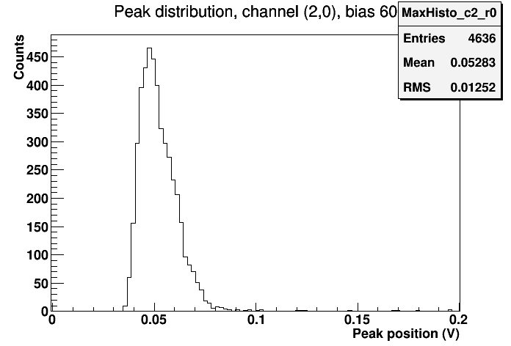
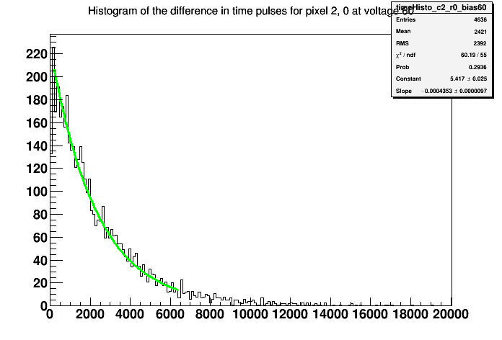
MB06 data, bias 60V, DAC6 = 5
Only channel (2,0)
Expected peak
No peak seen Source behavior

Slide 5
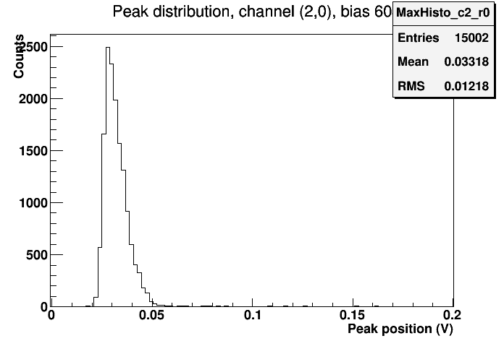
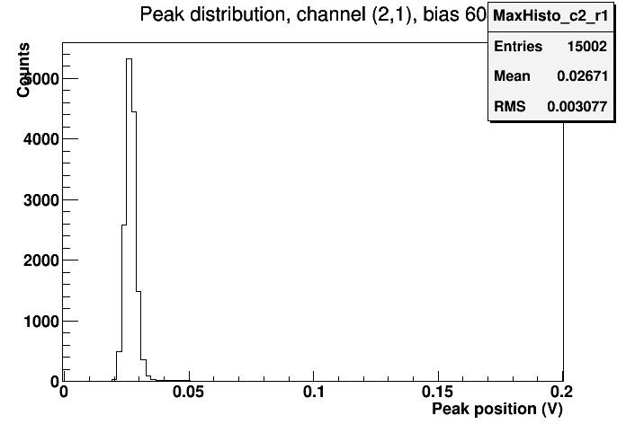
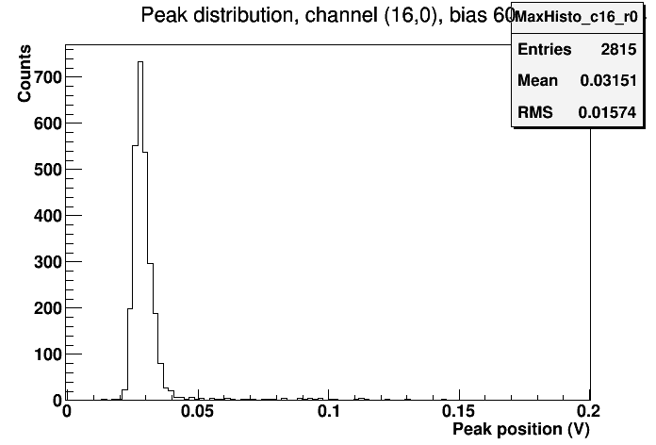
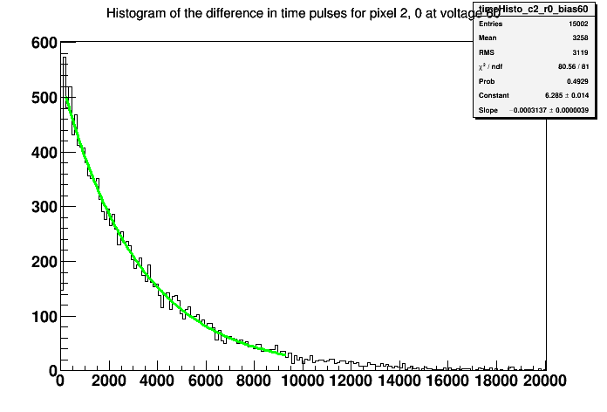
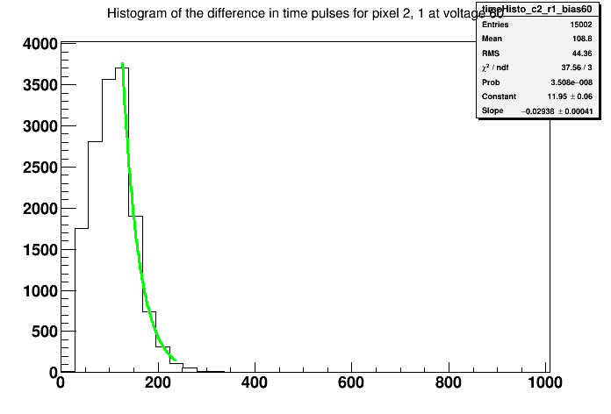
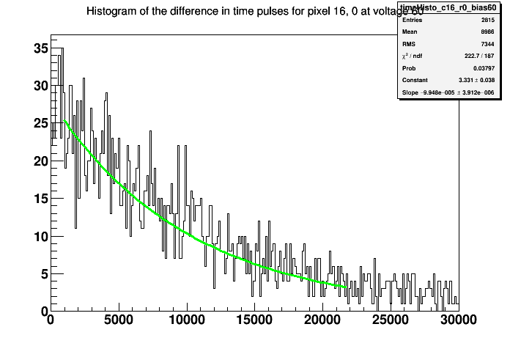
MB06 data, bias 60V, DAC6 = 60
(2,0) (2,1) (16,0)
Time distribution Spectrum
Mostly noise… (threshold too low)

Slide 6
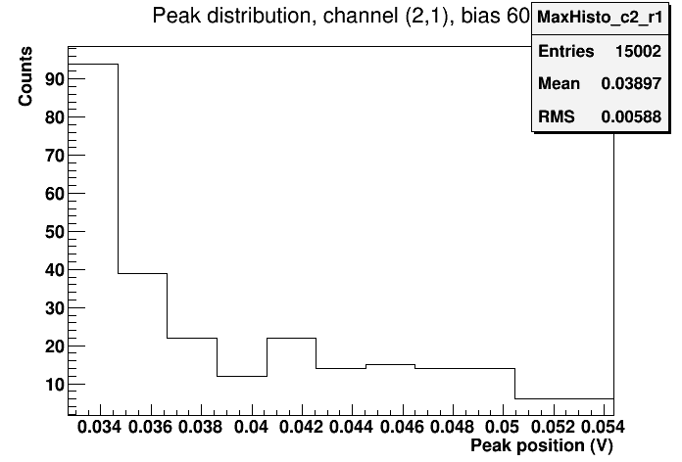
MB06 data, bias 60V, DAC6 = 60
Focusing on the tail of channel (2,1)…

Slide 7
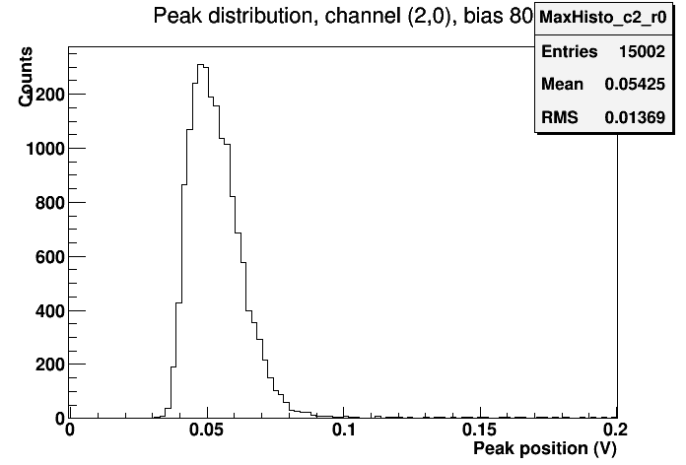
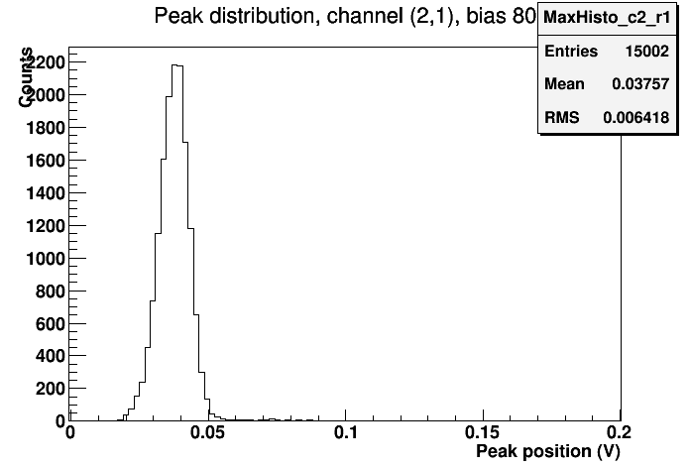
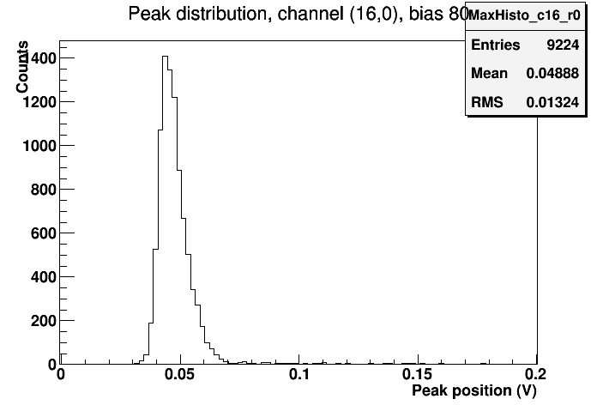
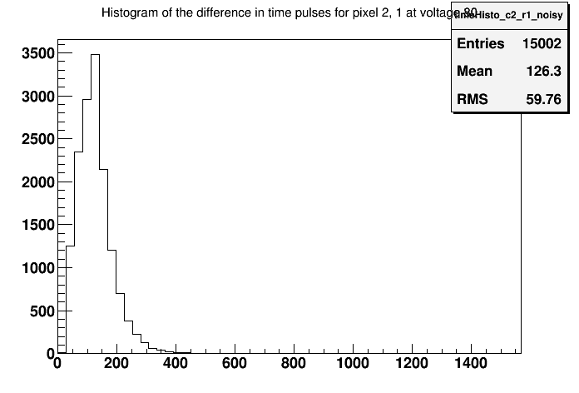
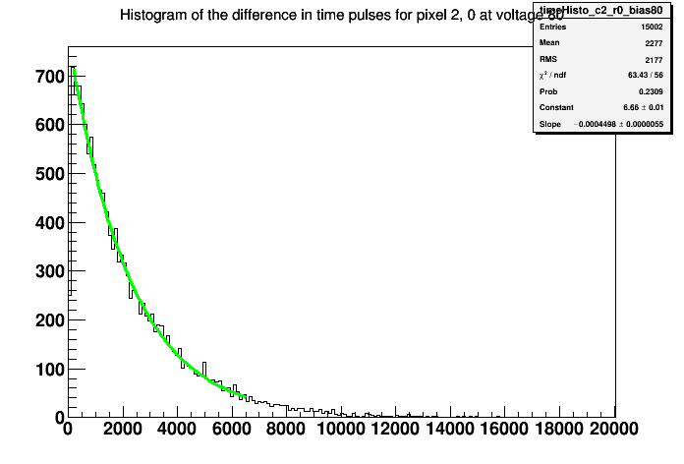
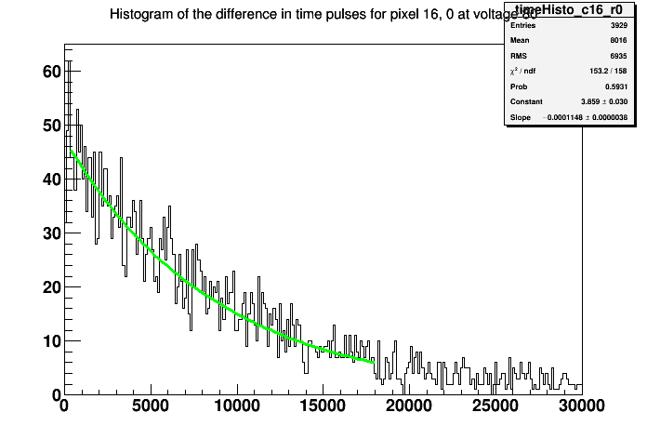
MB06 data, bias 80V, DAC6 = 5
(2,0) (2,1) (16,0)
Time distribution Spectrum
Mostly noise… (threshold too low)

Slide 8
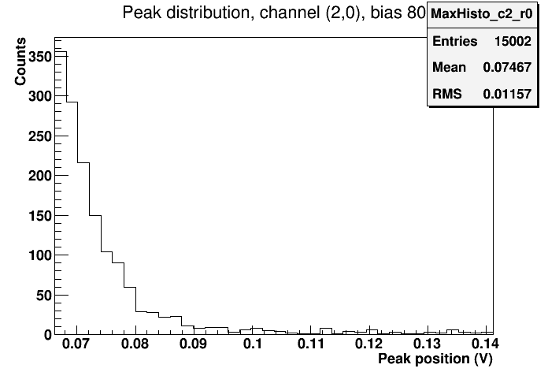
MB06 data, bias 60V, DAC6 = 60
Focusing on the tail of channel (2,1)…

Slide 9
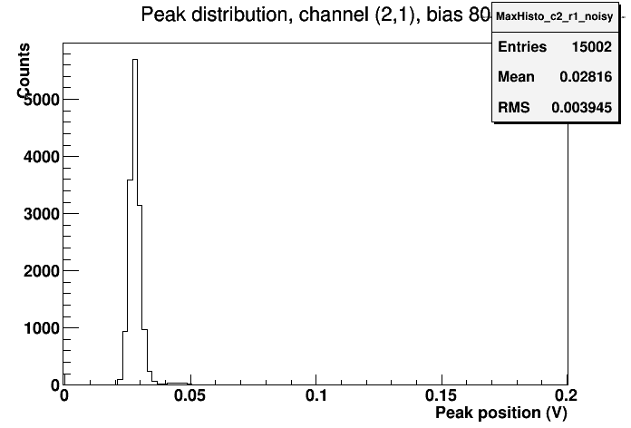
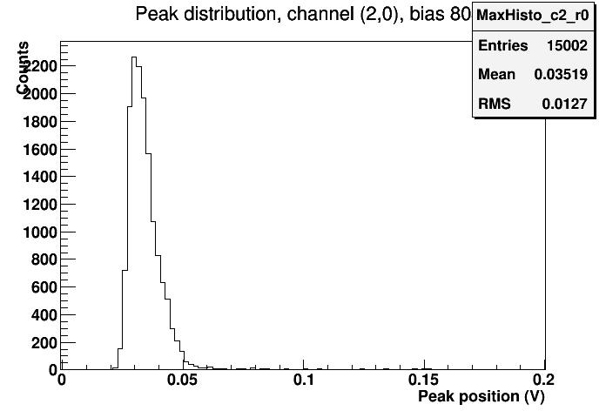
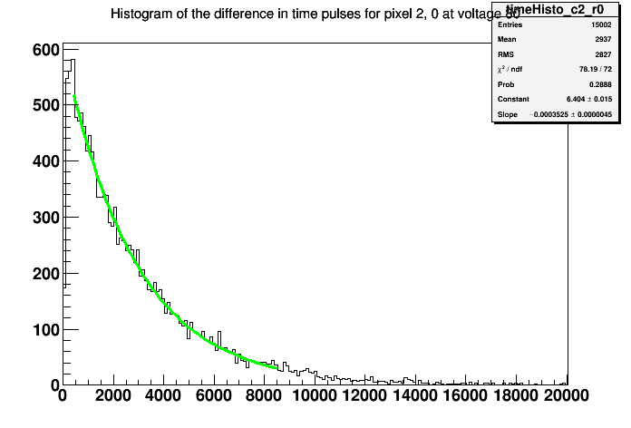
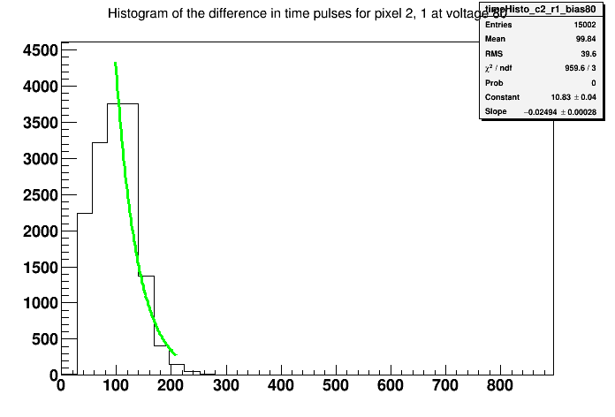
MB06 data, bias 80V, DAC6 = 60
(2,0) (2,1) (16,0)
Time distribution Spectrum
Mostly noise… (threshold too low)

Slide 10
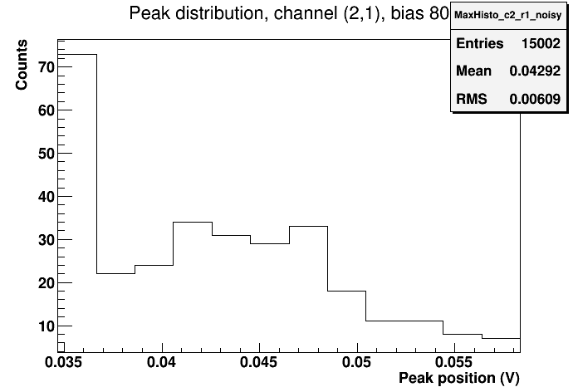
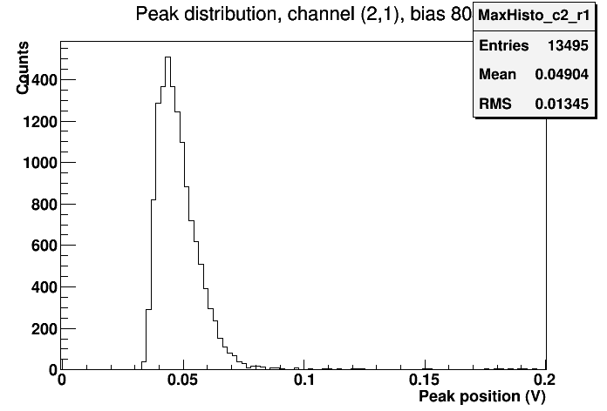
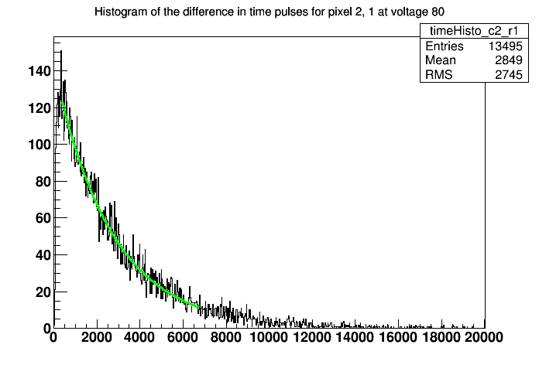
MB06 data, bias 80V, DAC6 = 60
Focusing on the tail of channel (2,1)…
Could it be a peak?
Set the threshold higher… Time profile of the source

Slide 11
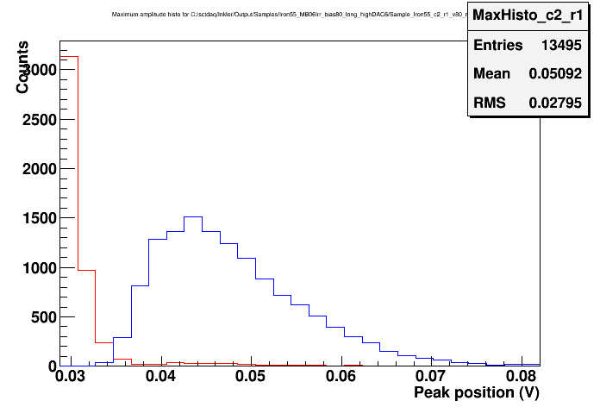
MB06 data, bias 80V, DAC6 = 60
Superimposing noise and source
We can state we distinguish Fe⁵⁵ from the noise!

Slide 12
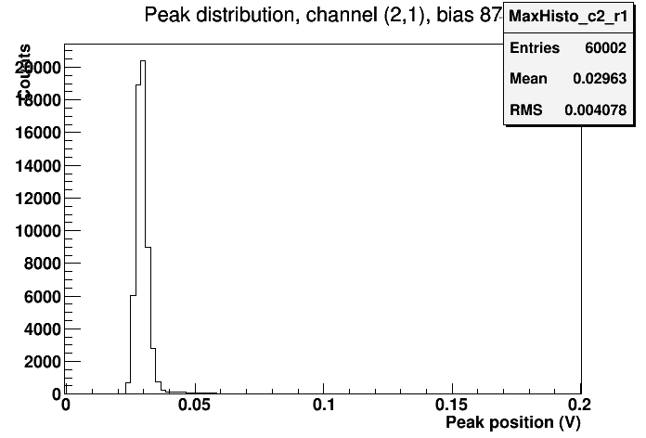
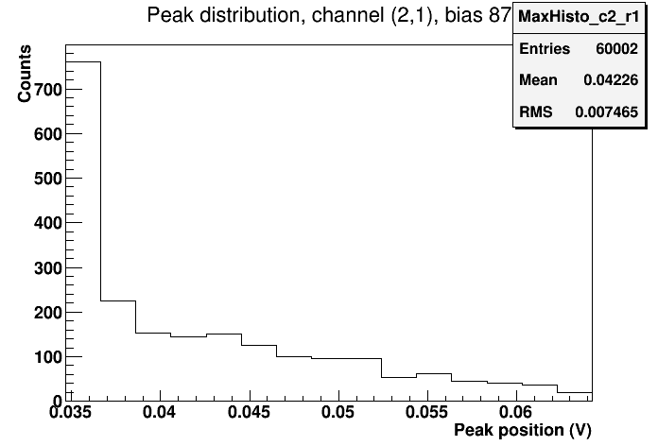
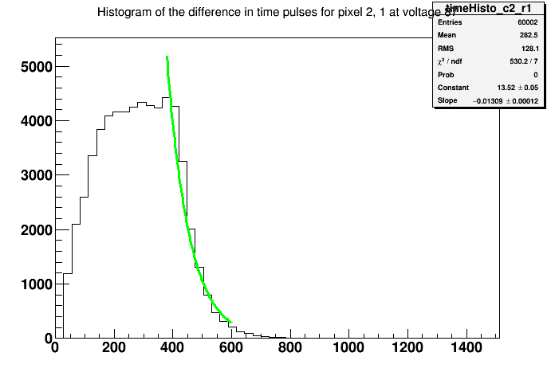
MB06 data, bias 87V, DAC6 = 60
Trial with lot of events on channel (2,1) at low threshold
Zoom
Time distribution Spectrum
Peak not so defined… noise too high?

Slide 13
MB03 data
At the moment MB03 is in the freezer hooked-up to the DAQ
Leakage current slightly higher than MB06 (about 70 nA at -40 degrees)
This one seems to be irresponsive, as no signal is extracted even from charge injection
It had a low gain even before irradiation
More work on it the next days

Slide 14
Conclusions
MB06 seems to have survived irradiation very well:
Leakage current very low (below 10nA at -40 degree)
It can be biased up to about 87V without great increase in current
At 80V bias we can see Fe⁵⁵ spectrum very well on one channel
We can’t say the same on MB03
Production problems?
Condensation on connections?
If it can’t be recovered we will verify it…

