Slide 1
Status of test kit 4 August 2015
T. Huffman, J. J. John with help from many colleagues

Slide 2
Status
Motherboard
Had review of schematics by e-mail with Todd and Jens – thank you for useful inputs.
Board in layout now - see schedule on next page.
Firmware: have assistance of a colleague in Oxford, to do in parallel.
PonN Daughterboard
Footprint now in final iterations.
Schematics later this week, then into layout.

Slide 3
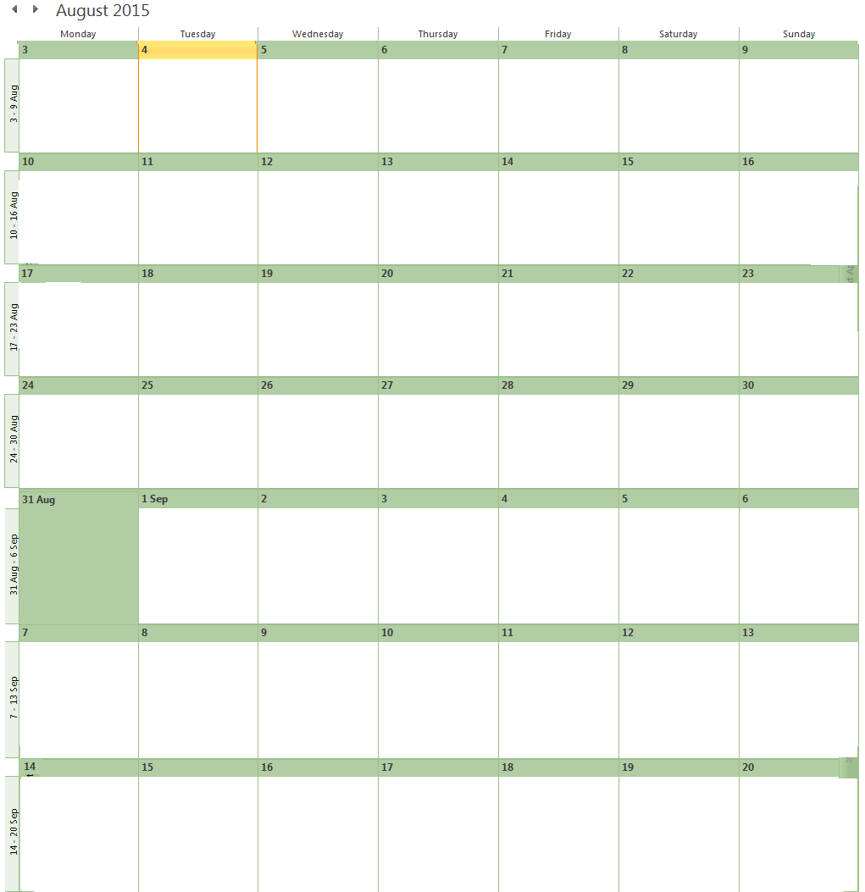
Schedule
Motherboard layout
PonN d/b schematics
M/b layout contingency
Submit m/b
PonN d/b layout
Motherboard firmware
M/b manufacturing (10 days)
Submit
PonN
d/b
Order m/b components this week
Motherboard firmware
M/b manufacturing (10 days)
Receive m/b components
Motherboard firmware
Receive m/bs
Set up pick and place,
Verify with dry run
Bake m/bs
+ compnts (24 hrs)
P&P
P&P
Connectors
Test and integrate firmware (~5 days)

