Slide 1
Testing CHESS1
Vitaliy Fadeyev, Zach Galloway , Herve Grabas
Alexander Grillo , Zhijun Liang , Abe Seiden
Jennifer Volk, Forest Martinez-Mckinney
University of California, Santa Cruz

Slide 2
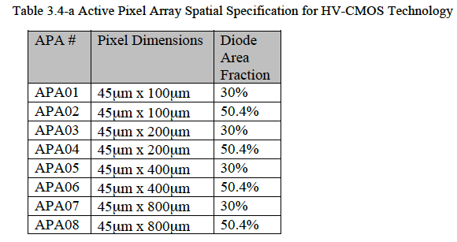
Reminder of active pixel in HV CHESS1 chip
Active pixel=passive pixel + built-in amplifier
4X4 pixel array
This talk will focus on the active pixel array APA08
8-Nwell inside one pixel
Pixel dimensions is 45X800 um
Zoom in one pixel in APA08

Slide 3
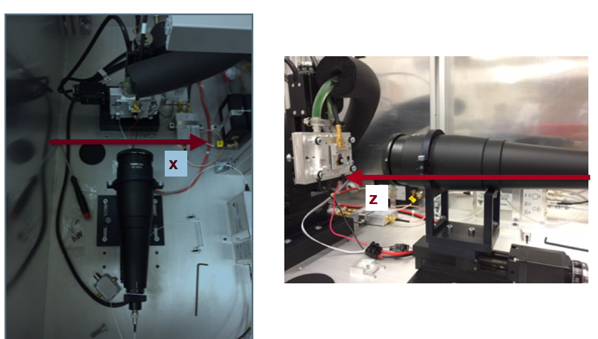
Reminder to TCT system
Commissioning Transient Current Technique (TCT) system in UCSC
Laser injection for CMOS chess1 active array

Slide 4
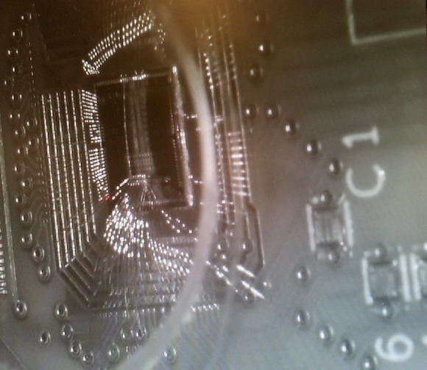
2D laser scan
Laser beam spot

Slide 5
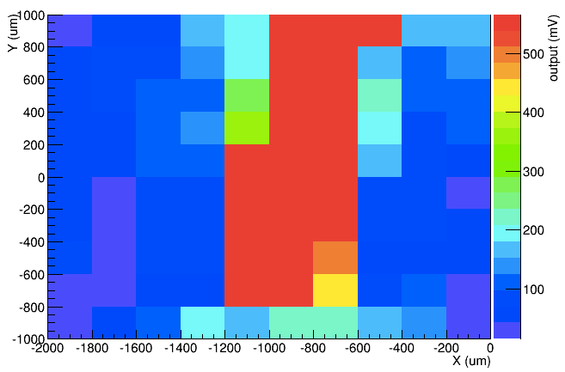
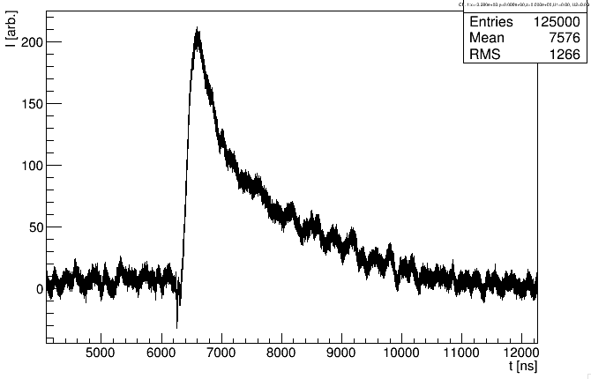
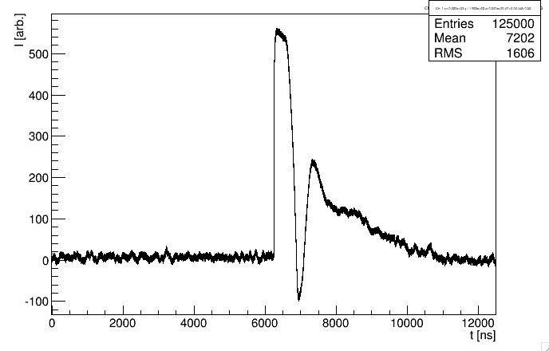
First scan
Using red laser
Shooting on one pixel in APA08 active array
Out of pixel region
Inside the pixel

Slide 6
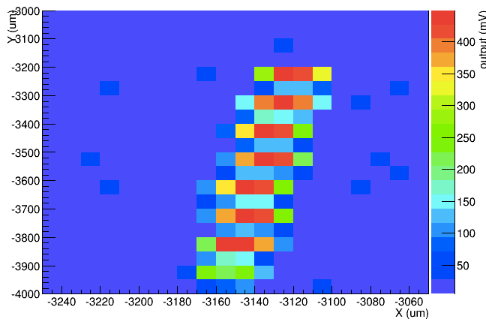
Refined laser scan on one segment of activity pixel
Expected 8 N-well in one segment
Red region is N-well
Laser beam size seems is small enough to see the metal between two N-well.

Slide 7
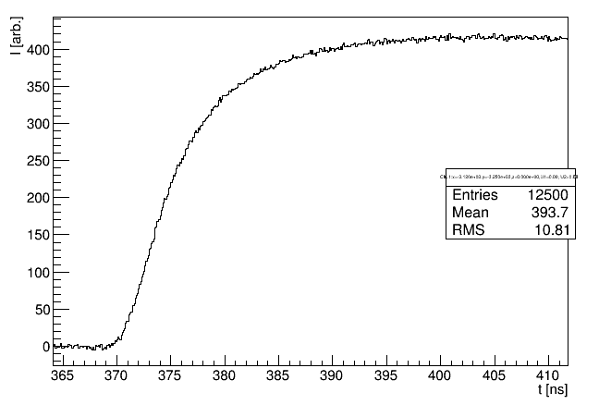
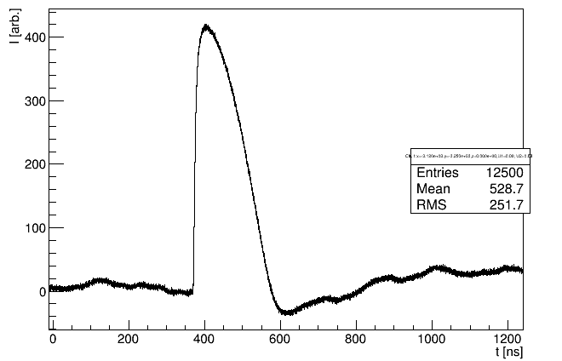
Signal pulse shape
Very fast rise time (~15ns)

Slide 8
Introduction
Use the metal between N-wells for laser focusing

Slide 9
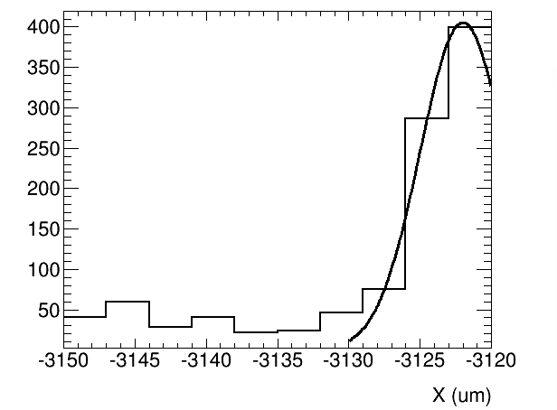
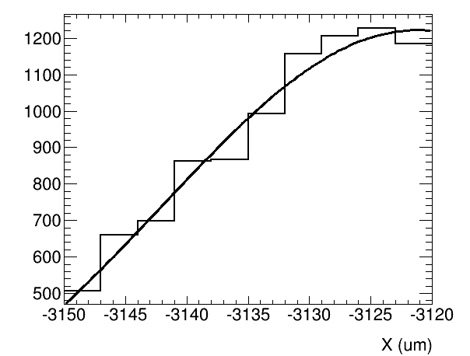
Beam spot size in different Z
Signal size (mV)
Z=-500um
Z=100um
Signal size (mV)
The peak is limited by X scan range

Slide 10
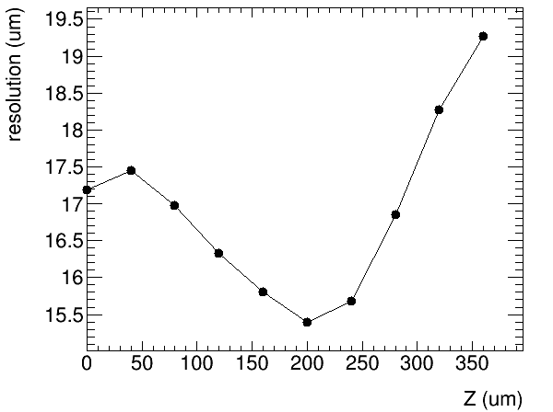
Beam spot size in different Z

Slide 11
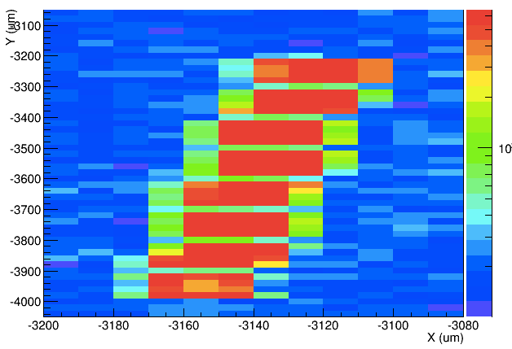
Laser scan in one pixel after focusing
Red region is the N-well.
Can see all 8 N-well inside one pixel
Metal layer between each N-well.
More metal is on the bottom N-well
Due to Built-in amplifier

Slide 12
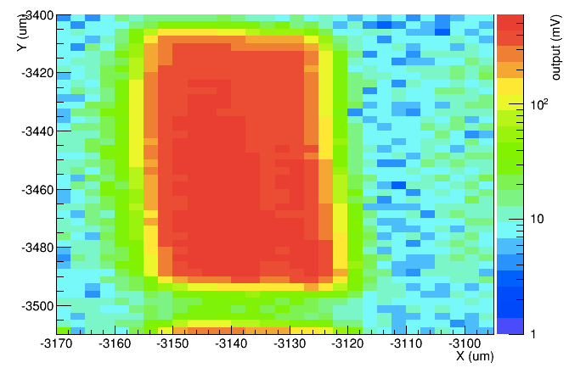
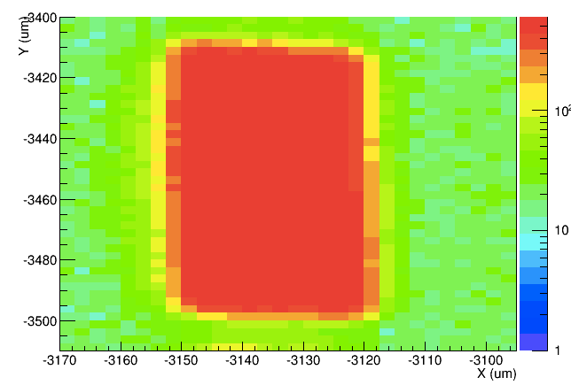
Zoom in one N-well
Very good uniformity inside N-well
Diffusion is reduced
When biased
V_bias=60V
V_bias=0V

Slide 13
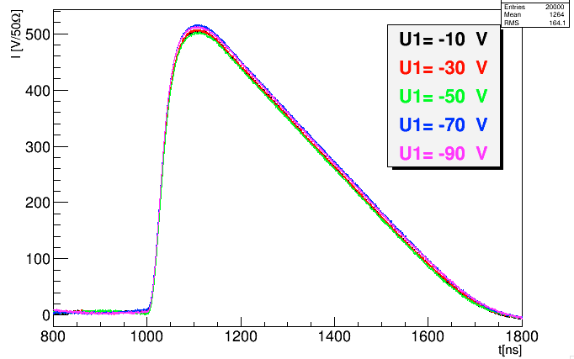
V_bias scan
Signal response has no clear dependence of zon V_bias
Likely to be laser power is too high
built-in amplifier has been saturated

Slide 14
Summary
Testing one of pixel in active array
2D scan shows good signal response uniformity
Next step
Reduce laser power to study the signal response to MIP
Study the bias voltage dependence

