Slide 1
Post-Irradiation Testing at Glasgow
R. Bates, C. Buttar, K. Kanisauskas, D. Maneuski
ATLAS Strip CMOS Regular Meeting
August 18, 2015

Slide 2
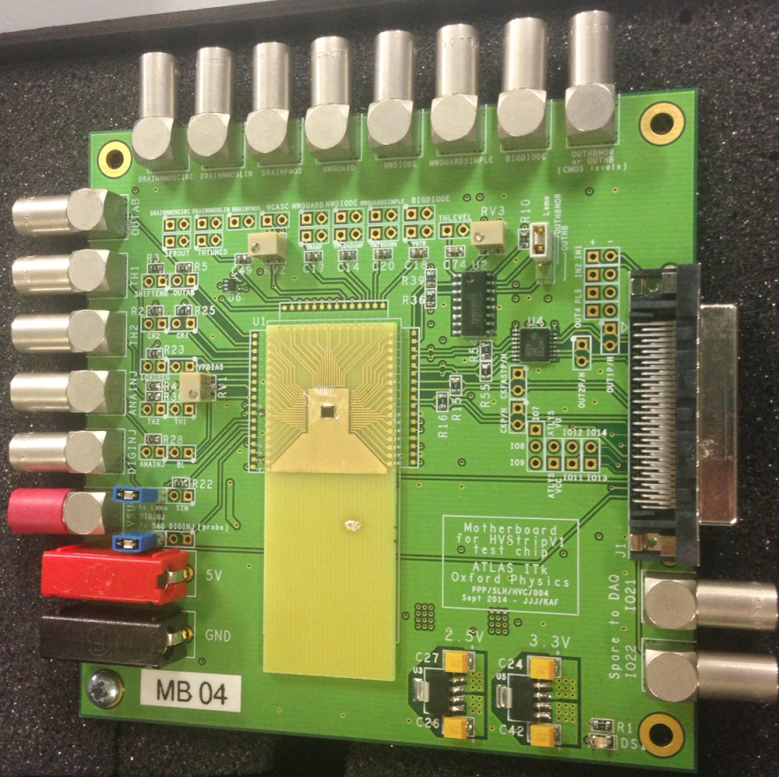
Introduction
I_{d}-V_{g} characteristics were measured of MOSFETs on irradiated MB04
FETs are still showing typical behavior after irradiation with protons up to 7.64 × 10¹⁴ n_{eq}/cm²
I-V measurements at several temperatures were done on irradiated MB06
Currently higher leakage currents compared to initial measurements at Oxford are being observed

Slide 3
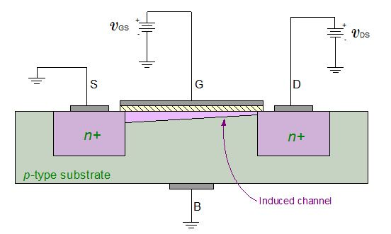
MOSFET Measurements (1)
HVStripV1 contains NMOS Linear, NMOS Enclosed and PMOS Linear FETs
During post-irradiation measurements the FETs were operated in saturation mode
Therefore I_{d}-V_{g} behavior is described by 1st order Shockley model in saturation mode I_{d}=β/2 ×(V_{g} – V_{t})²
Gate and Drain terminals were biased and measurements were done using two Keithley 2410 power supply units
Source terminal is biased from within the chip and is held at constant value (V_{s}=0V for NMOS and V_{s}=3.3V for PMOS)

Slide 4
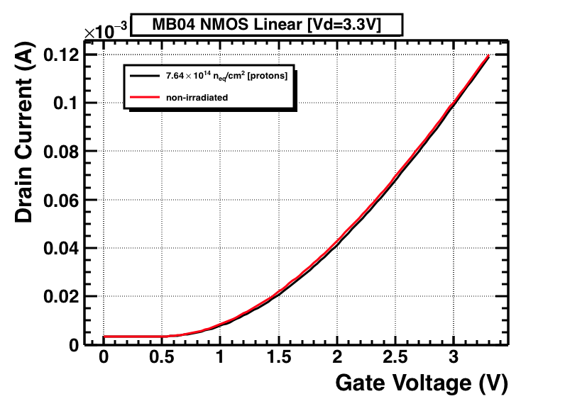
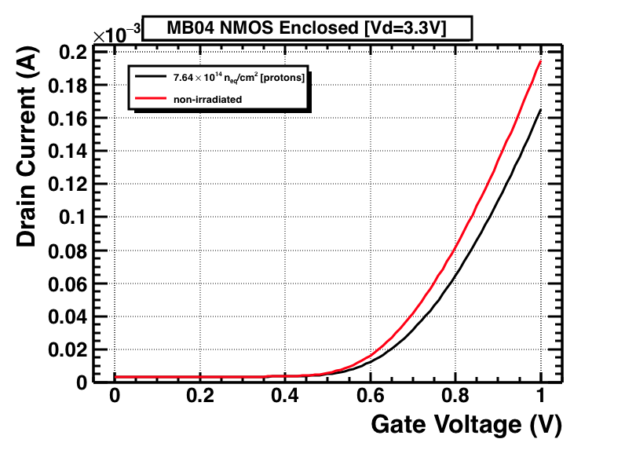
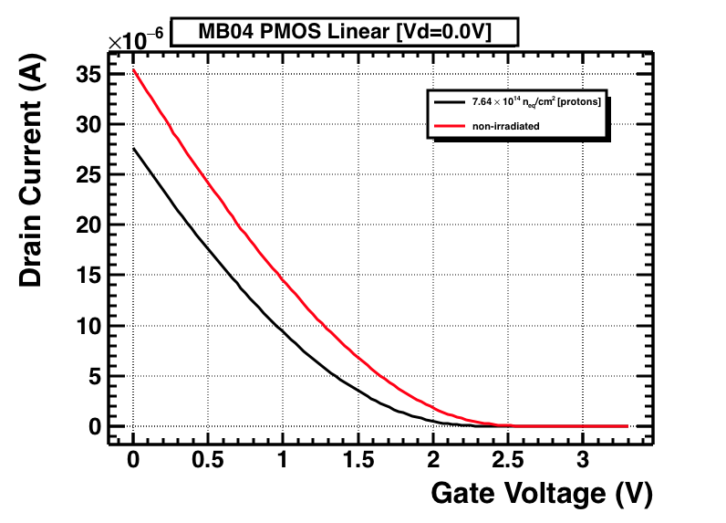
MOSFET Measurements (2)
Both sets of measurements were done at room temperature
Notable change is observed in PMOS characteristics
Small change is observed in NMOS characteristics which is also reflected in V_{th} shift

Slide 5
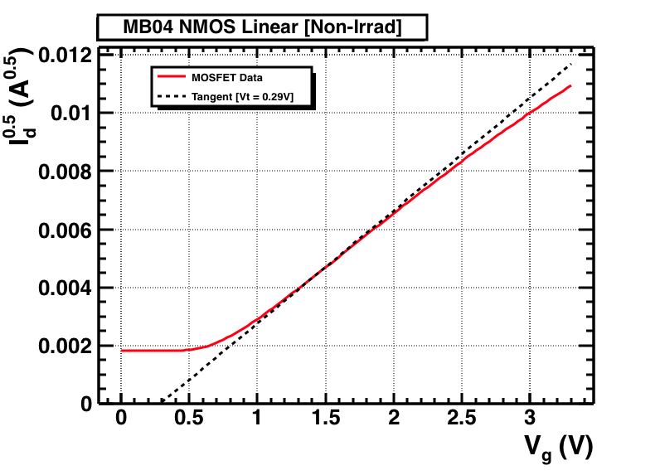
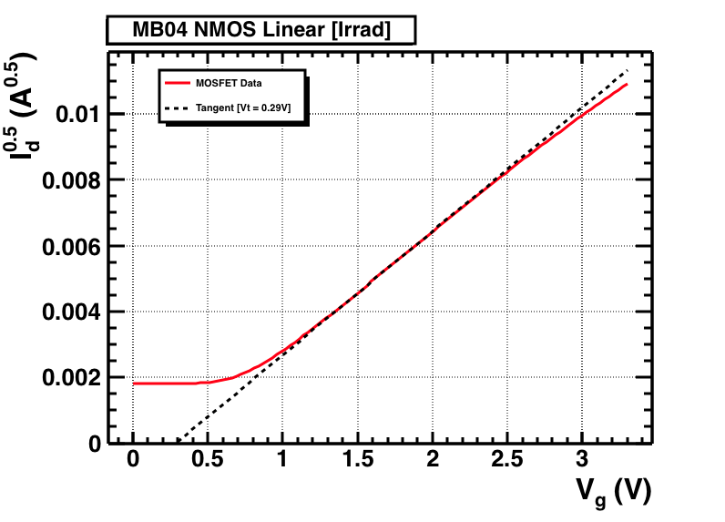
MOSFET Measurements (2)
The extrapolation method in saturation region (ESR) was employed in order to extract threshold voltages
Almost no change is observed both for NMOS Linear and NMOS Enclosed FETs

Slide 6
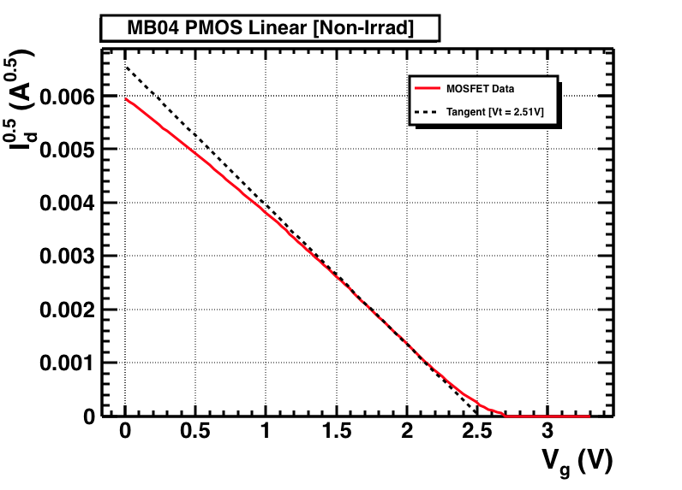
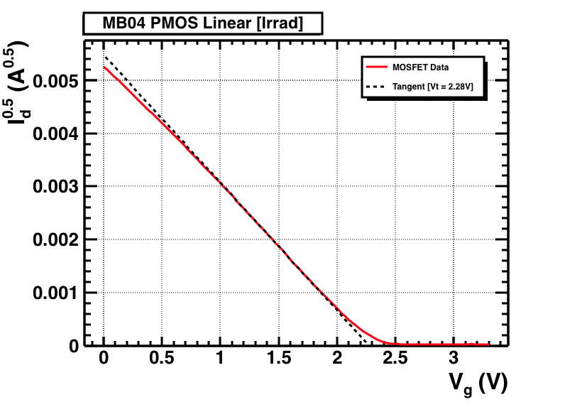
MOSFET Measurements (3)
Table of Threshold Voltage Shift
,where|ΔV_{th}| = |V_{t_irrad} – V_{t_non-irrad}|

Slide 7
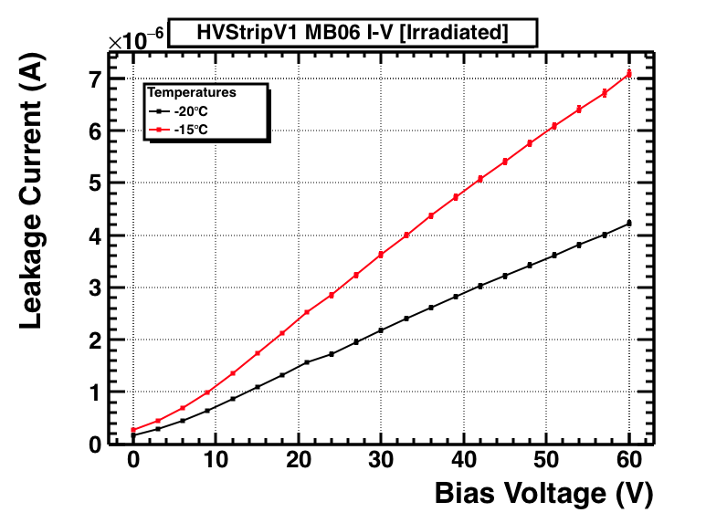
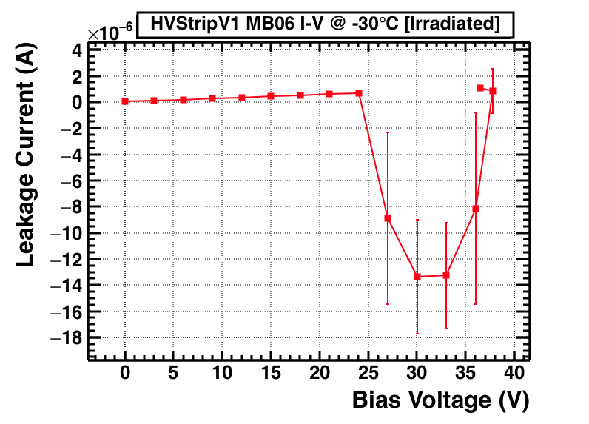
MB06 I-V Measurements
Currently leakage current in order of μA is being observed at -60V bias
Unusual I-V characteristic is observed at temperatures below -20°C
A couple of attempts to perform I-V measurements at -30°C resulted in the curve presented above

