Slide 1
Status of test kit
18 August 2015
T. Huffman, J. J. John
with help from many colleagues

Slide 2
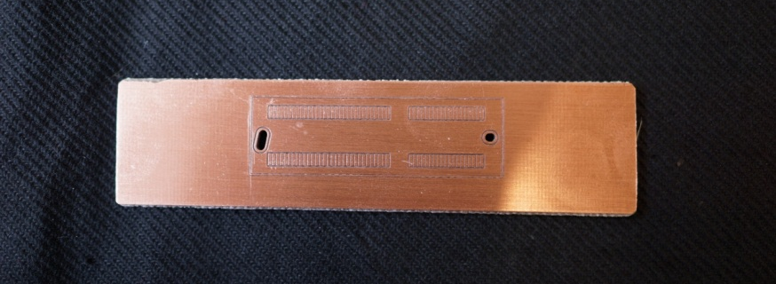
Status
Motherboard
In layout, progressing well.
Edge connector footprint successfully prototyped in copper (milled circuit board – thanks to Pete Hastings in Oxford)
Will complete layout before the end of
this week, get quote, then manufacture.
Will order components this week.
PonN Daughterboard
Layout finalised.
Need to do last review this week, but is lower priority than motherboard, so it may need to wait until September.
E.g. checking the wire-bonding is a bit time-consuming.

Slide 3
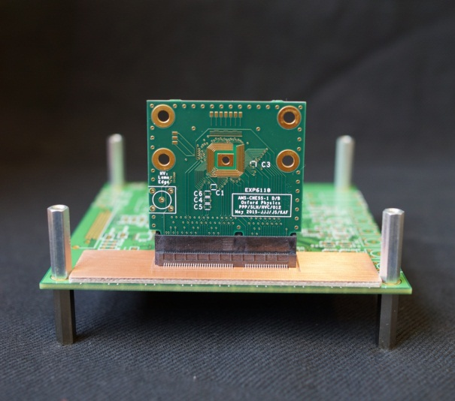
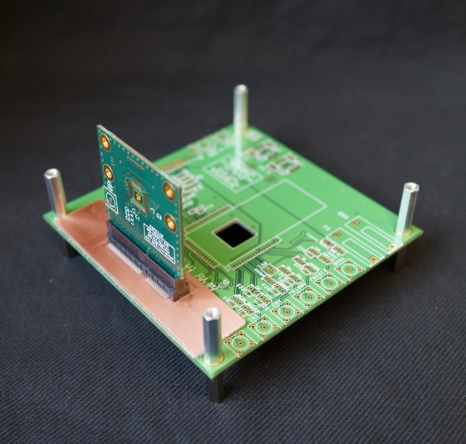
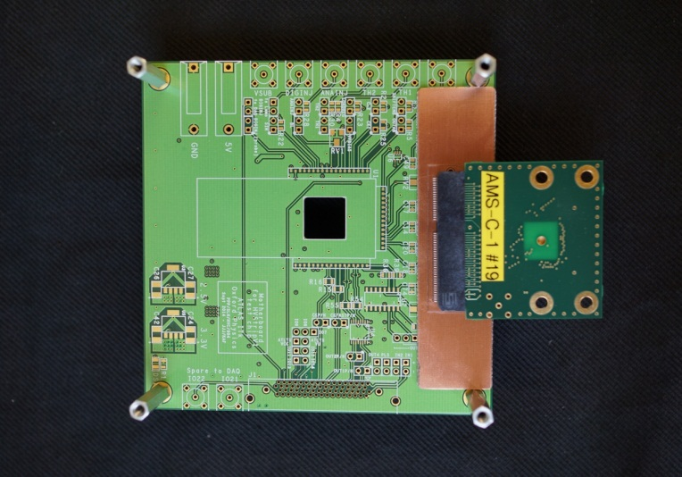
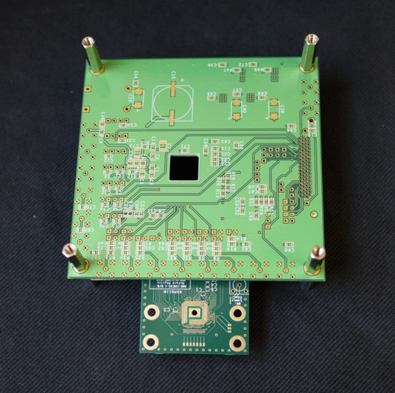
Mock-ups of two orientations
1. Daughterboard perpendicular to motherboard
This is using the HVStripV1 motherboard as a mock carrier to demonstrate the orientations.
2. Daughterboard parallel to motherboard – for bench probing
Motherboard is inverted compared to perpendicular orientation, due to Samtec connector design

Slide 4
CHESS-1 motherboard requests
Please let me know of any changes or missing requests, thanks.
Institute | Number | SMA or Lemo? | Orientation?
Argonne | 1 | ? | ?
Beijing (IHEP) (pending export discussions) | 1 | ? | ?
DESY | 1 | ? | ?
Glasgow | 2 | ? | ?
Llubljana | 1 | ? | ?
Oxford | 3 (2 for chip testing, 1 for developing cooling system) | Lemo | TBC: 2 parallel, 1 perpendicular
RAL | 3 (2 for PPD chip testing, 1 for chip designers’ tests (TD)) |  | TBC: 2 parallel, 1 perpendicular
UCSC (SCIPP) | 2 | SMA | 1 of each

