Slide 1
Beta test of CHESS1 chip
Vitaliy Fadeyev, Zach Galloway , Herve Grabas
Alexander Grillo , Zhijun Liang , Abe Seiden
Jennifer Volk, Forest Martinez-Mckinney
University of California, Santa Cruz

Slide 2
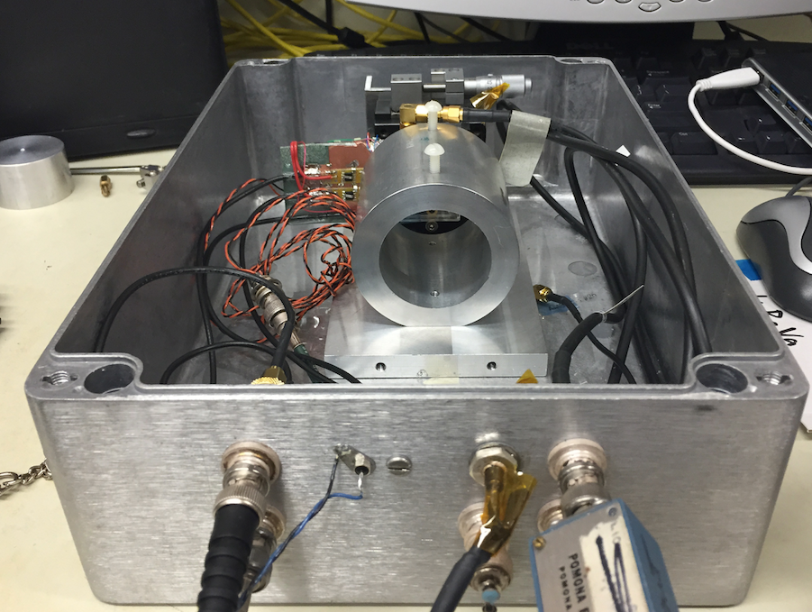
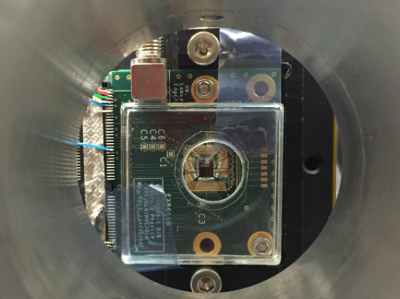
Beta test setup
CHESS1 chip Mount on daughter board from Jaya John
Sr90 beta source is used
Trigger rate ~0.1 Hz
CHESS chip Biased at 110V

Slide 3
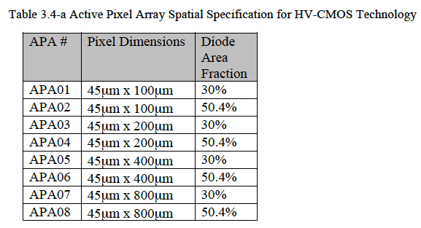
Reminder of active array in CHESS1 chip
Active array APA08 is used
Channel 7,8 is connected for readout
Self trigger
Trigger on pixel 8

Slide 4
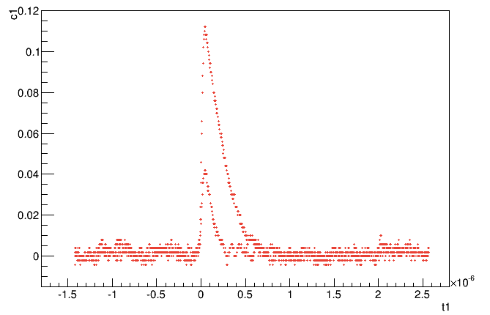
Pulse shape in charge sharing case
Output(V)
df
Ch1
Ch2
Time (s)

Slide 5
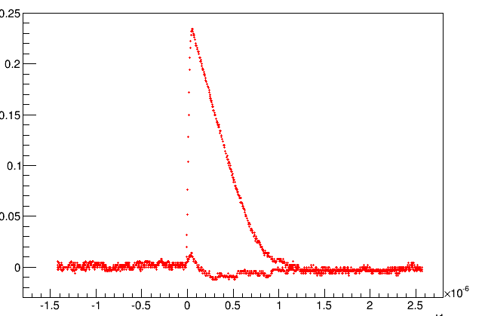
Pulse shape in usual case without charge sharing
Output(V)
Ch1
Ch2
Time (s)

Slide 6
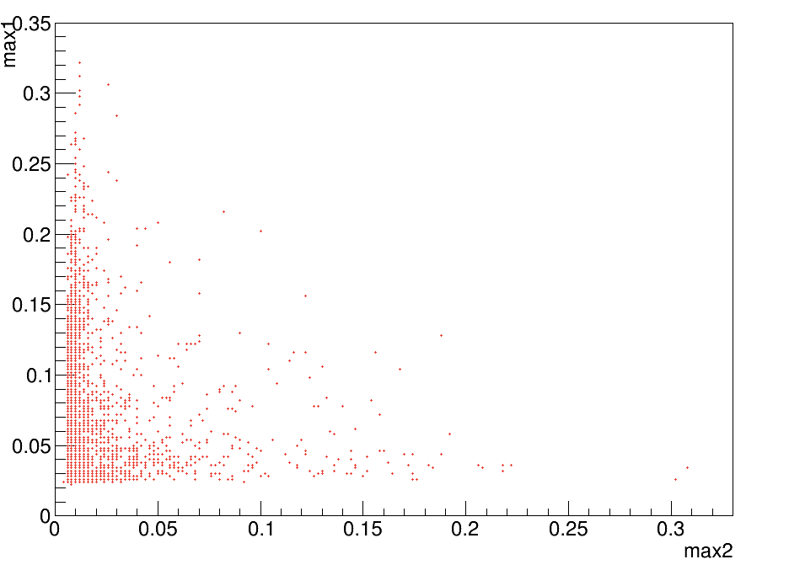
Correlation in signal amplitude between two pixel
Ch1 amplitude (V)
Charge sharing events
Ch2 amplitude (V)

Slide 7
Summary
observe significant signal from active pixel in beta source test
Next step :
Quantify the landau peak position of MIP in beta test
Quantify the fraction of charge sharing between pixels
Reduce the readout noise by optimizing the built-in amplifier configuration.

