Slide 1
ATLAS CMOS Strip
Regular meeting
18/08/2015
HR-CHESS2 update
D. Das, STFC-RAL, UK
18/08/2015
Notes:
1

Slide 2
Architecture Demo Chip
Block Diagram

Slide 3
Technical Specifications
Summary
Close to HR-CHESS spec (Physics requirements!)
Specifications below for one block:
Technology: TowerJazz 180 nm
Voltage supply: 1.8/3.3V
Wafers: Epitaxial
Epi resistivity/thickness: up to 25um/up to >1kOhm cm *
Segment size: 40umx800um (Segments could contain smaller pixels *)
Number of strips: 128
Number of segments per strip: 32
Readout speed ≥ 320 Mbit/sec
Output buffers: LVDS with adjustable bias current and CM level
Maximum number of hits per strip: 1 + overflow flag
Maximum number of hits in block: 8
Size of data output per strip: 13 bits
Format of data output: 5 (segment) + 1 (segment overflow flag) + 7 (strip address) bits
* pending results from HR-CHESS1

Slide 4
4
Pre-Amplifier diagram
Leakage Compensation
Active Feedback

Slide 5
5
Continuous reset
Leakage Compensation
Active Feedback

Slide 6
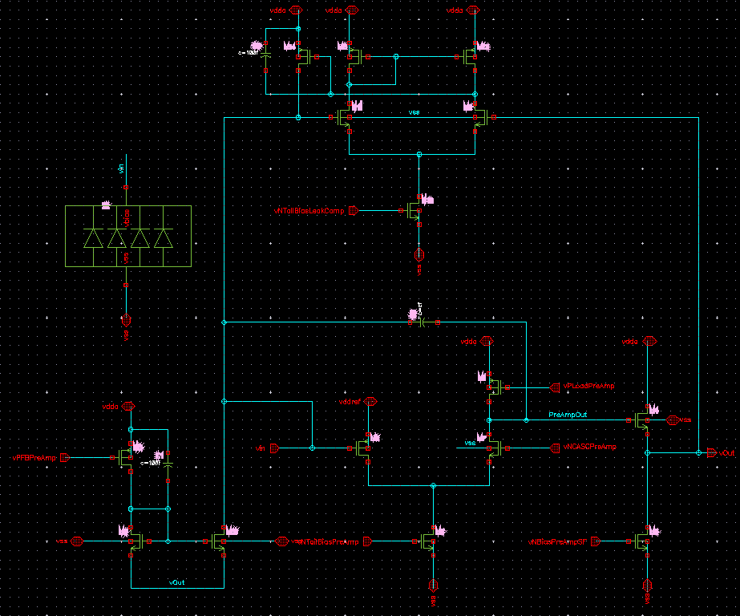
6
Pre-Amplifier schematic
Leakage Compensation
Folded Cascode Pre-Amplifier
Active Feedback

Slide 7
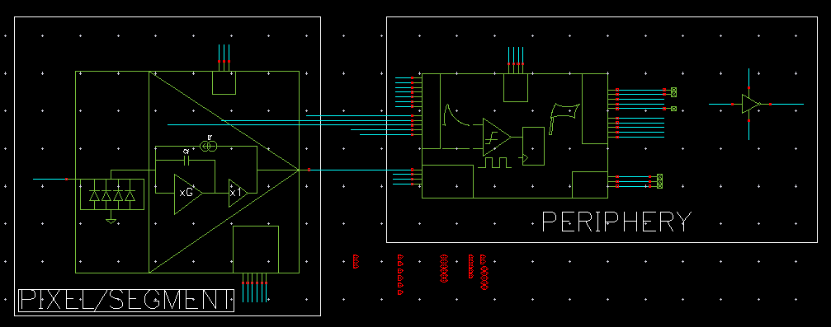
Front-end schematic
x32 in 1 complete column

Slide 8
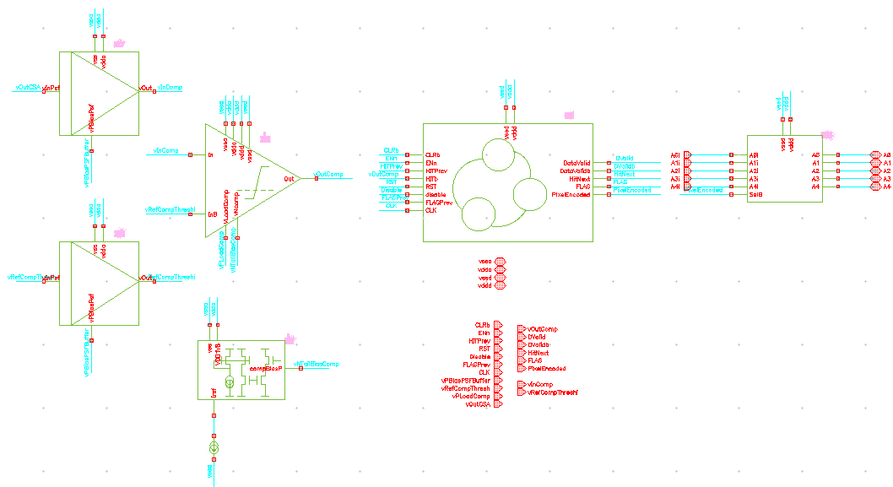
Front-end (periphery) schematic
HIT Latching and
HIT Encoding Logic
Pixel/Segment
Address

Slide 9
Comparator schematic
Initial Trial
Didn’t exactly meet the time-walk requirements of <16ns

Slide 10
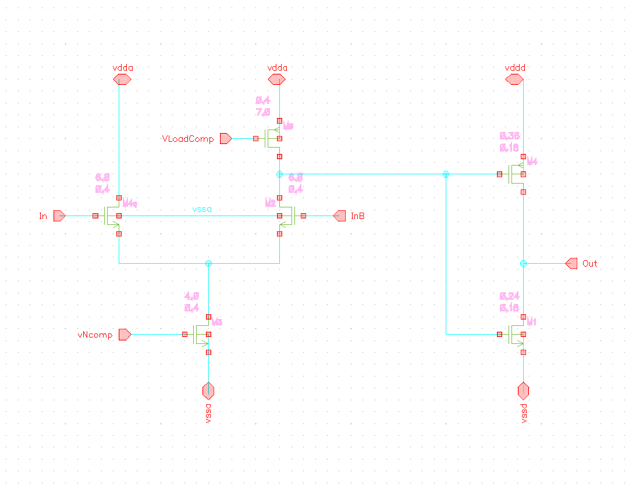
Comparator schematic
We liked!
Same as HV-CHESS, see Herve’s review presentation
Meets time-walk requirements of <16ns, see later
Power Consumption < 15µW

Slide 11
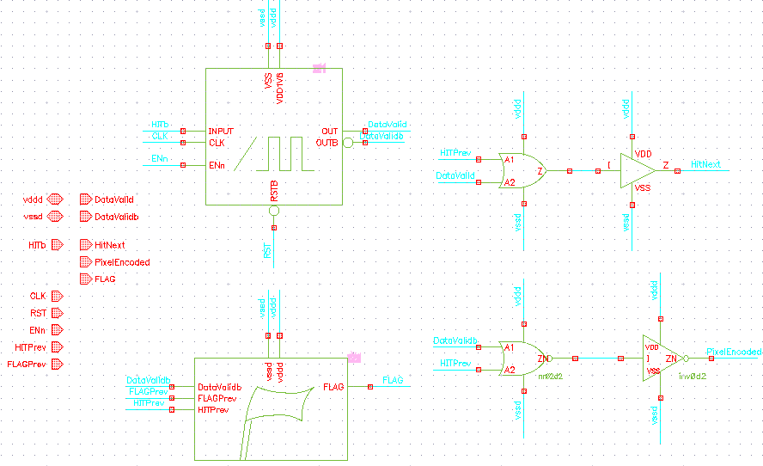
Front-end (periphery) logic schematic
EDGE
FLAG

Slide 12
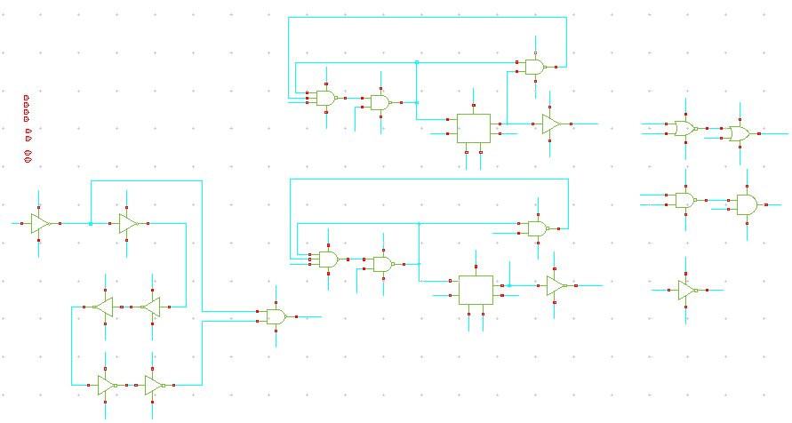
Edge Detector
schematic

Slide 13
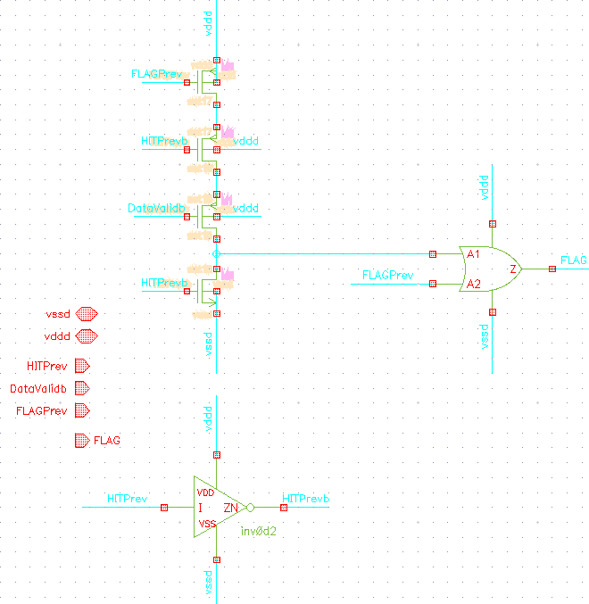
FLAG Logic
schematic
Same as HV-CHESS, see Herve’s review presentation

Slide 14
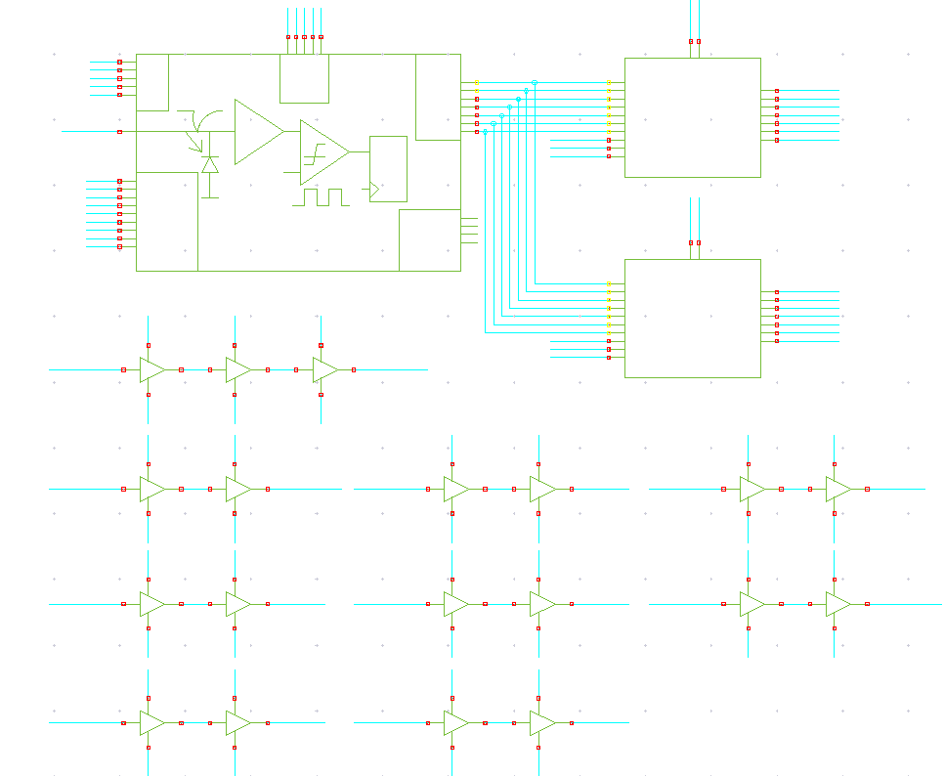
Complete column schematic
REG 1
7-bit
5-bit pixel address
1-bit FLAG
1-bit to indicate strip was hit
1 column of front-end
REG 2
7-bit
We need two 7-bit registers
to hold data from 2 successive
bunch crossings

Slide 15
15
Pre-Amplifier Spec Achieved
 | MIN | MAX | NOM | FAST | SLOW | SF | FS
CG [µV/e] @1000e- | 52.31 | 63.79 | 57.24 | 52.31 | 63.79 | 55.89 | 57.24
Trise [ns] (10% to 90%) | 9.8 | 16.03 | 11.95 | 9.8 | 16.03 | 13.13 | 11.95
Noise [e-] | 47 | 51 | 50 | 51 | 47 | 50 | 50
Phase Margin [º] | 70.01 | 74.42 | 70.76 | 70.01 | 73.31 | 74.42 | 70.76
Open Loop Gain [dB] | 50.6 | 58.8 | 56.96 | 52.5 | 58.83 | 50.59 | 56.96
Power [µW] | 13.44 | 19.71 | 16.647 | 19.71 | 13.44 | 15.381 | 16.648
Leakage Compensation
Active Feedback
Optimised design over all process corners
Leakage current tolerance up to 10nA
Overload recovery within 15usec for 1Me- signal

Slide 16
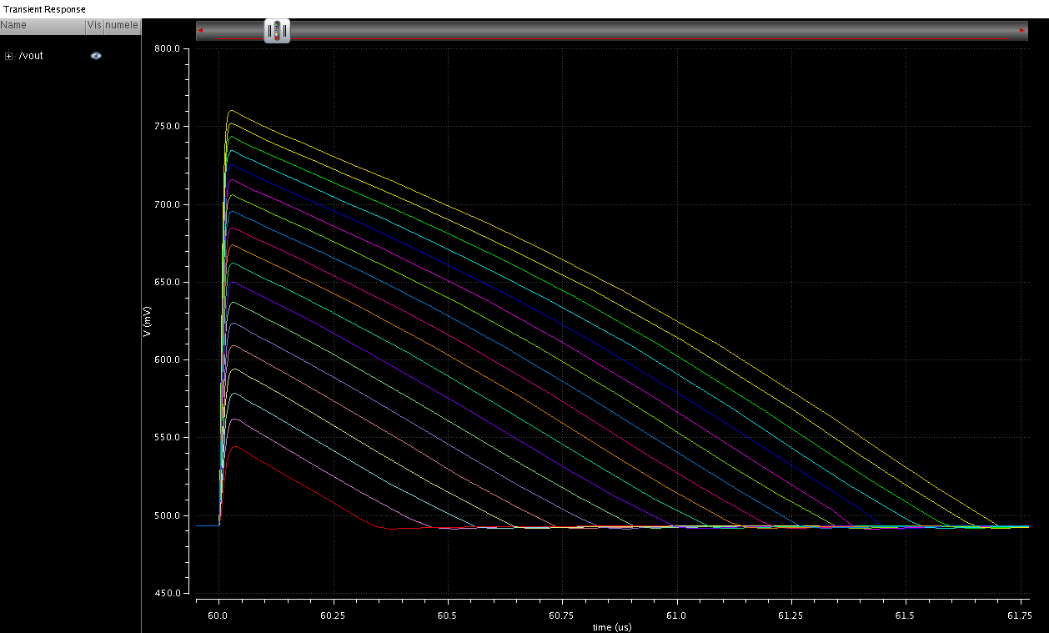
Vout vs Signal
(500e- to 5000e-)

Slide 17
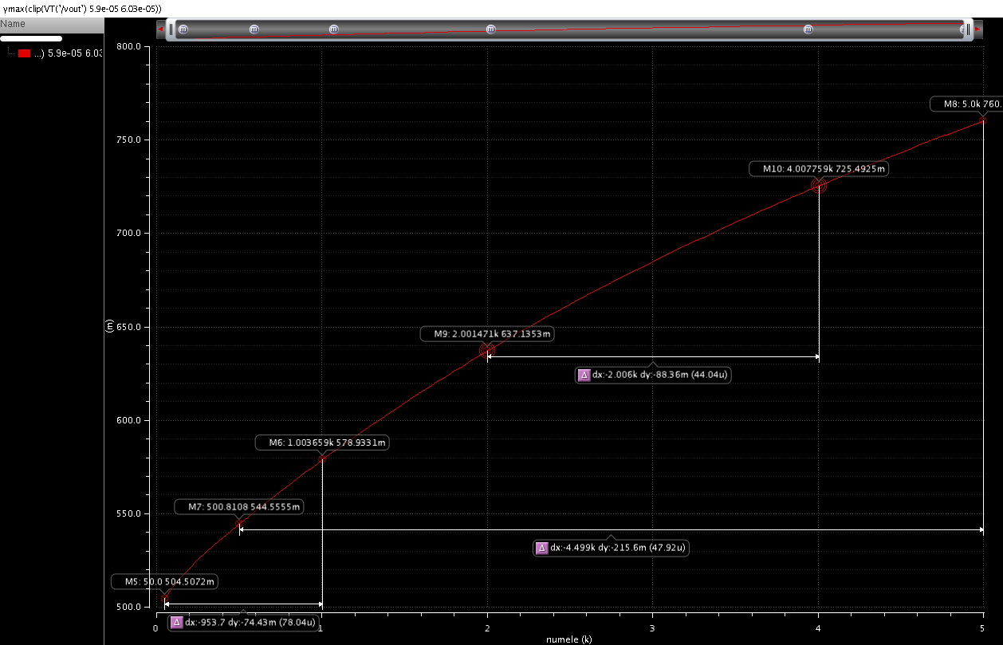
Conversion Gain [uV/e] vs Signal (50e- to 5000e-)

Slide 18
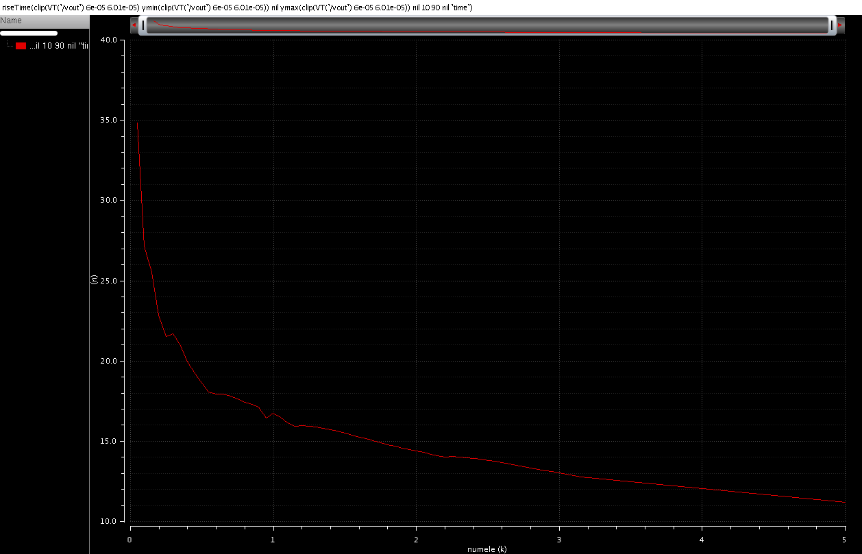
Trise vs Signal
(10% to 90%)

Slide 19
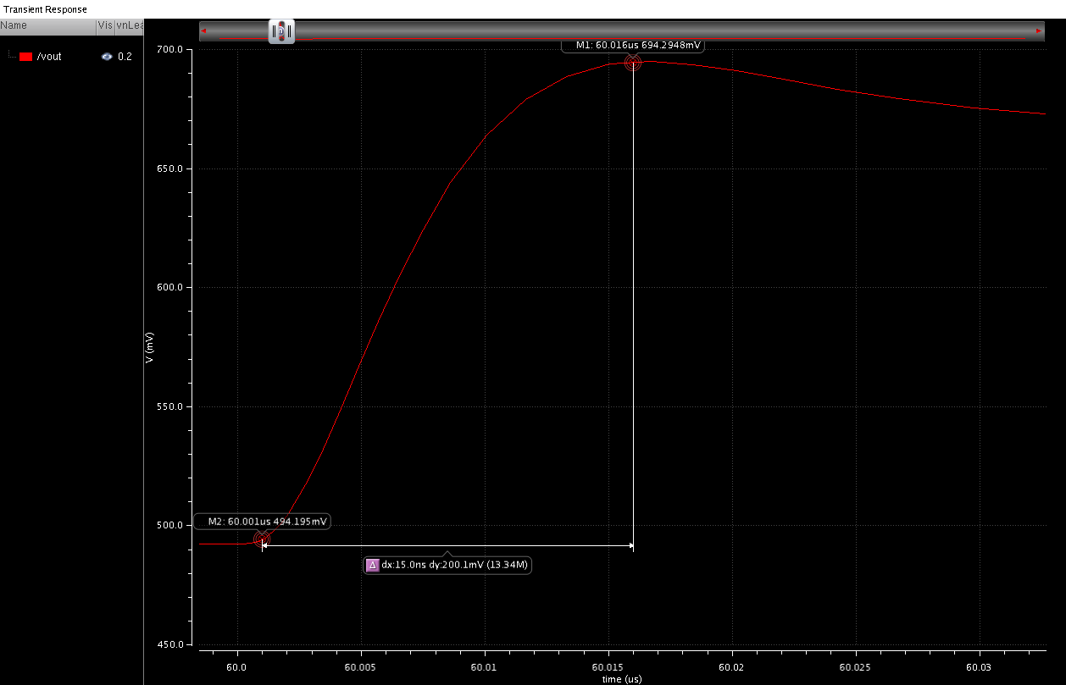
Trise vs Signal
(from baseline up to peak)

Slide 20
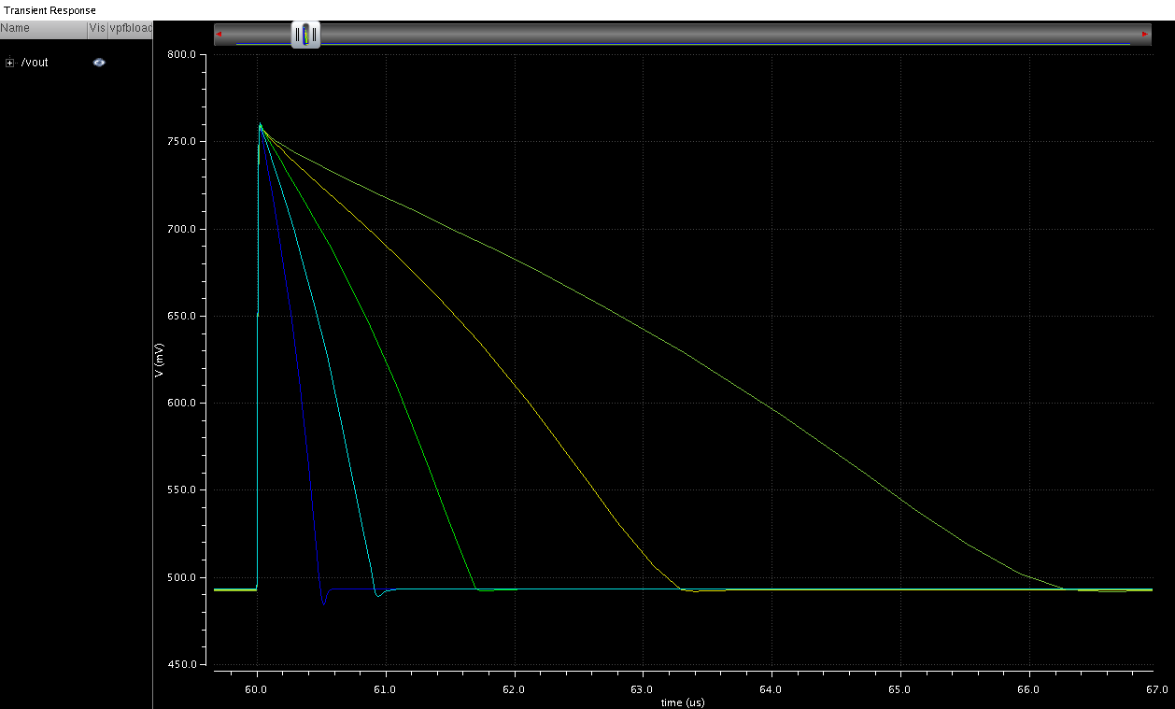
Pre-amp Discharge Control
(5Ke-)
Changing vPLoadFBPreAmp by 100mV in steps of 25mV

Slide 21
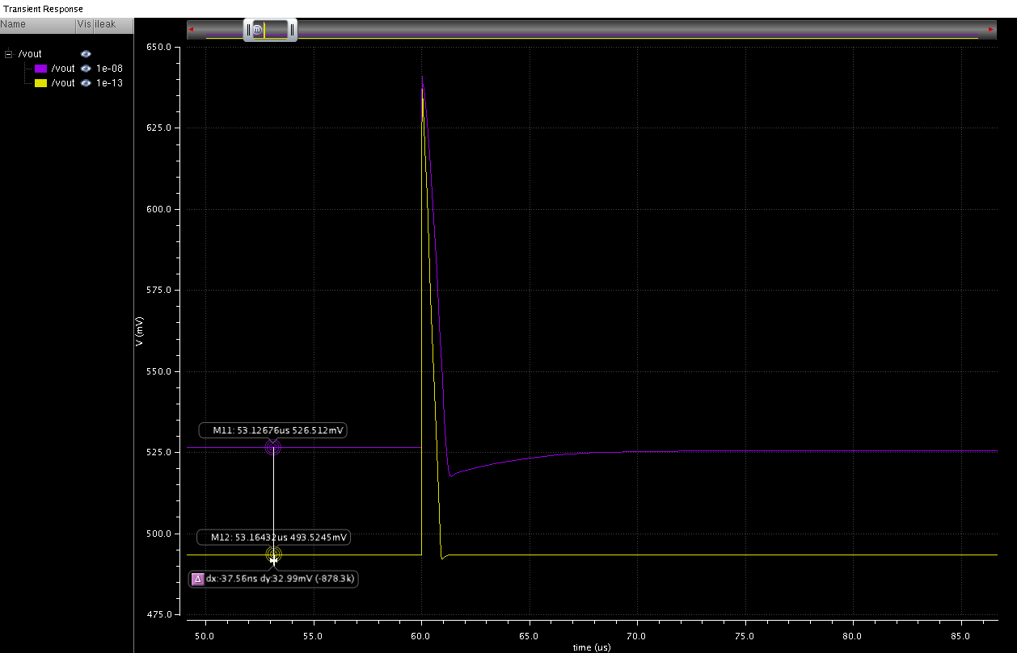
Vout without leakage Compensation
(0.1pA to 10nA)

Slide 22
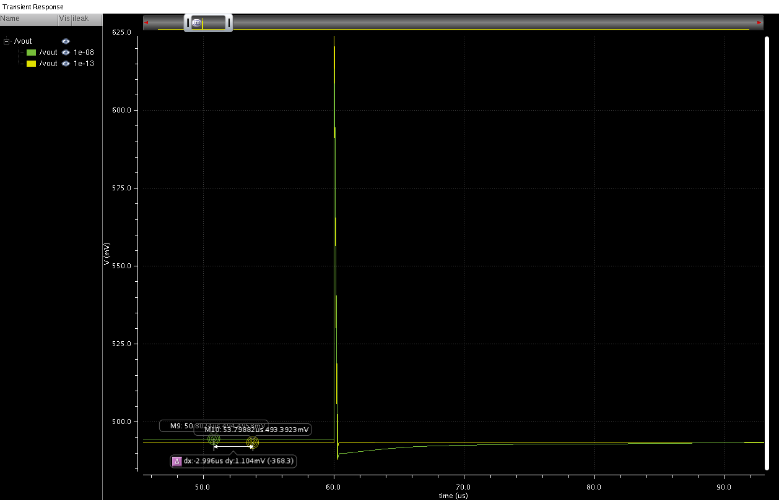
Vout with leakage Compensation
(0.1pA to 10nA)

Slide 23
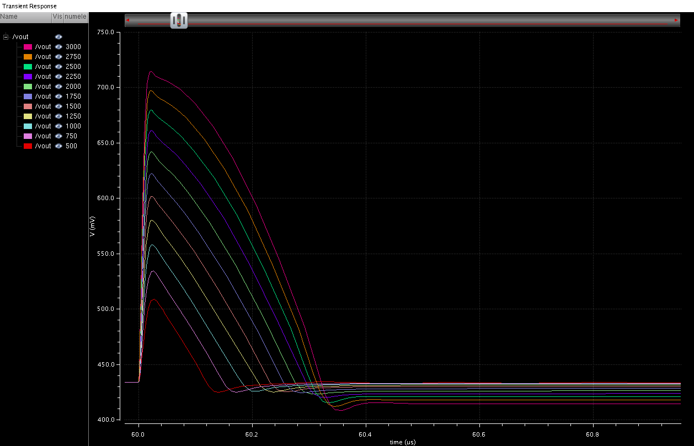
Vout with leakage Compensation
@10nA leakage current

Slide 24
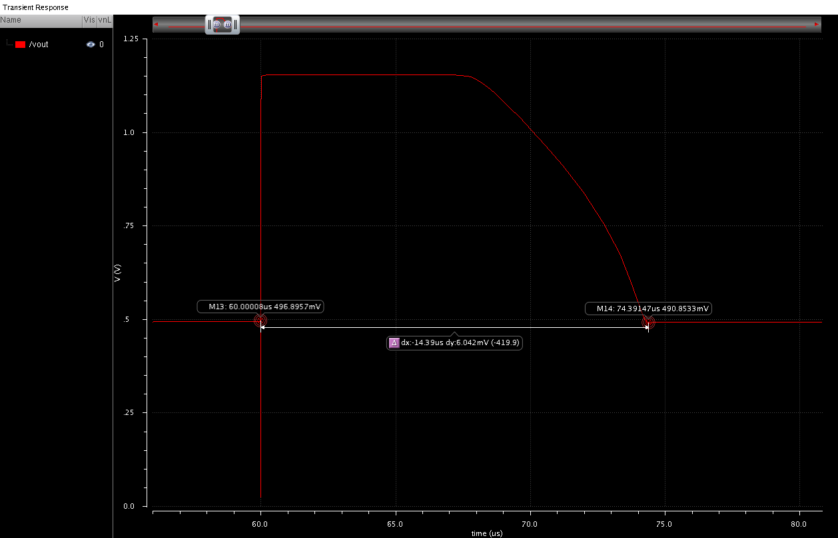
Overload Recovery
@1Million e-
Return to base line within 15µs

Slide 25
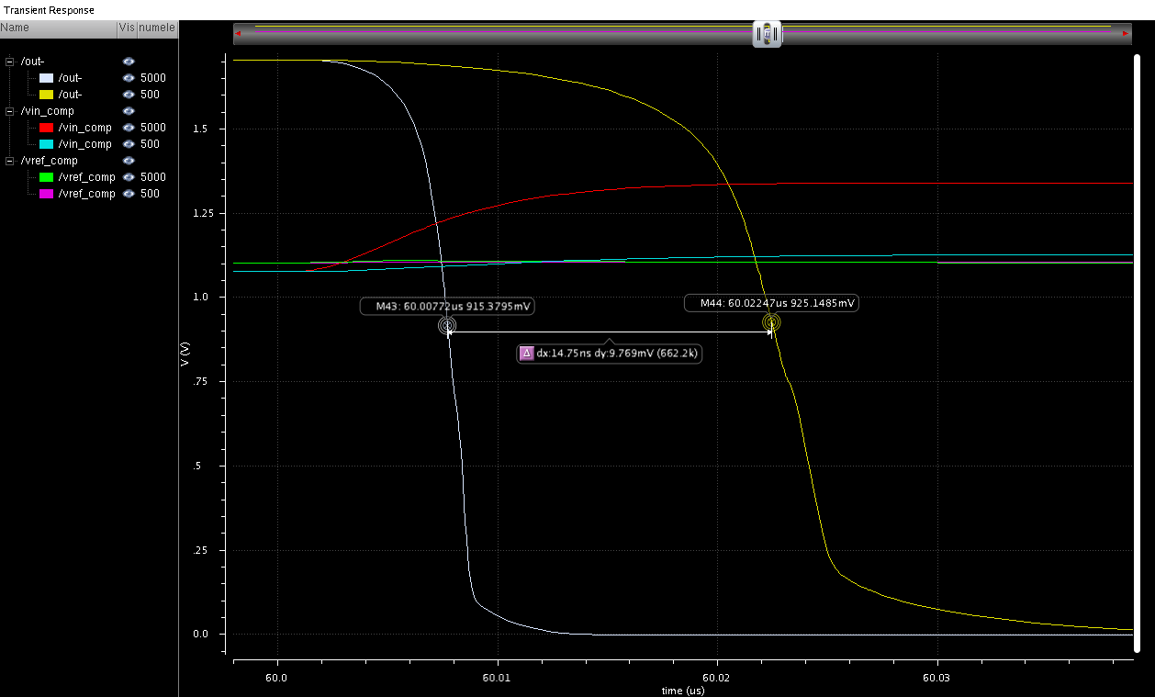
Time-Walk
(Threshold @ 275e-)

Slide 26
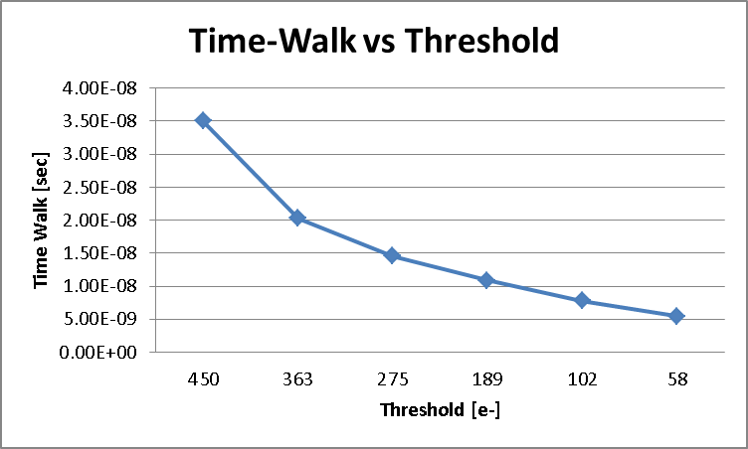
26
Time-Walk vs Threshold
Leakage Compensation
Active Feedback
Minimum Signal: 500 e-
Maximum Signal: 5000 e-

Slide 27
27
Top-Level Simulation
32x128 Segment Array
+
Discriminators
+
HIT Encoding
STRIP Encoding
+
Data Output Block
+
4-to-1 Mux
Leakage Compensation
Active Feedback
NOT Simulated in this block:
Calibration
Bias Generation
CONFIG REG/SPI
PLL
LVDS

Slide 28
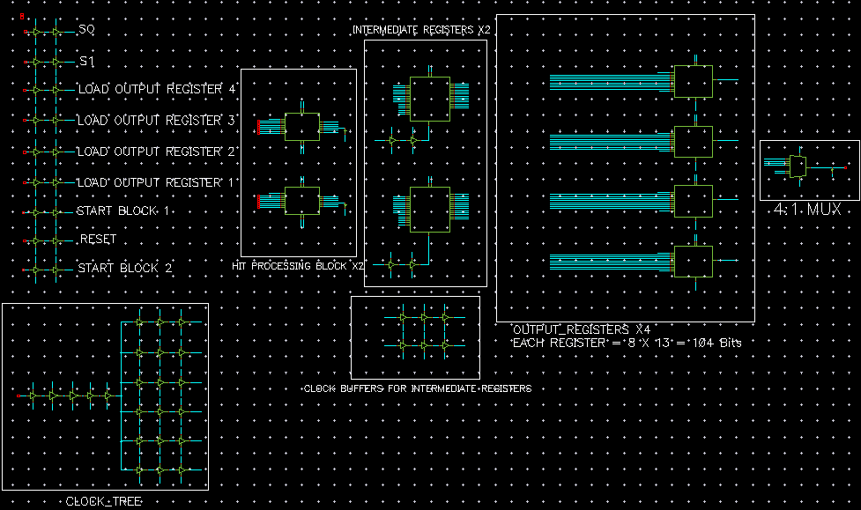
Strip Encoding and HIT Readout Block
Notes:
28

Slide 29
Top-Level Simulation
We simulated the Top-Level schematic.
We simulate 3 Strips being hit
For each strip the last Segment/Pixel was hit
7-bit Strip address Gray coded.
Goal is to read out these 3 hits and output their address inside 2 bunch crossing periods or 50 ns.
Clock period used in simulation is 320 MHz
The Hit addresses corresponding to each bunch crossing are then stored and readout through LVDS stages every 25 ns.
Table below shows the Hit locations and corresponding 7-bit Strip address (Gray coded).
Hits | Data 6 | Data 5 | Data 4 | Data 3 | Data 2 | Data 1 | Data 0 | Strips
1 | 0 | 0 | 0 | 0 | 0 | 0 | 0 | 0
2 | 0 | 0 | 0 | 0 | 1 | 1 | 0 | 4
3 | 0 | 0 | 0 | 1 | 1 | 0 | 1 | 9
Data 4 | Data 3 | Data 2 | Data 1 | Data 0 | Segment
1 | 0 | 0 | 0 | 0 | 32
Notes:
29

Slide 30
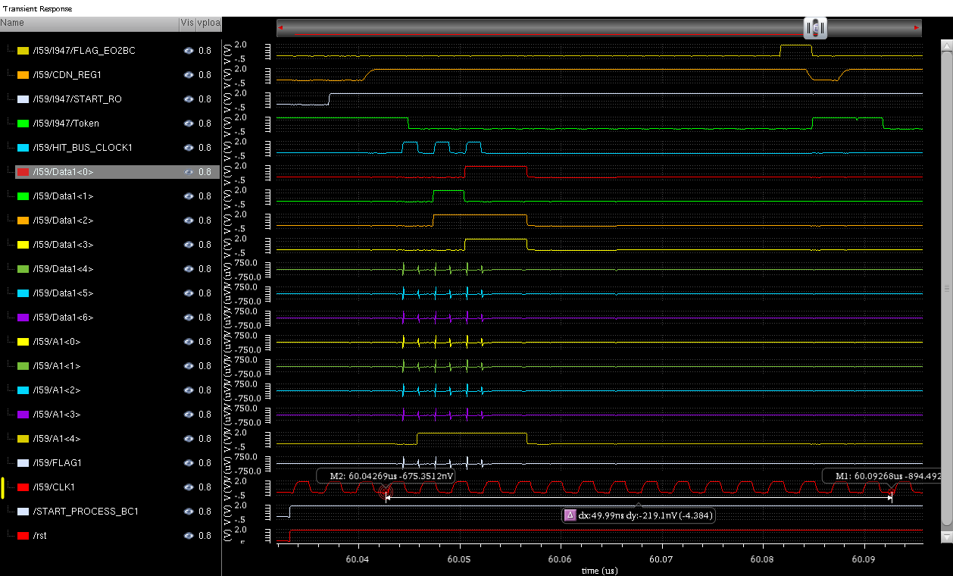
Strip HIT Detect & Address Output
Strip: 0 4 9
Notes:
30

Slide 31
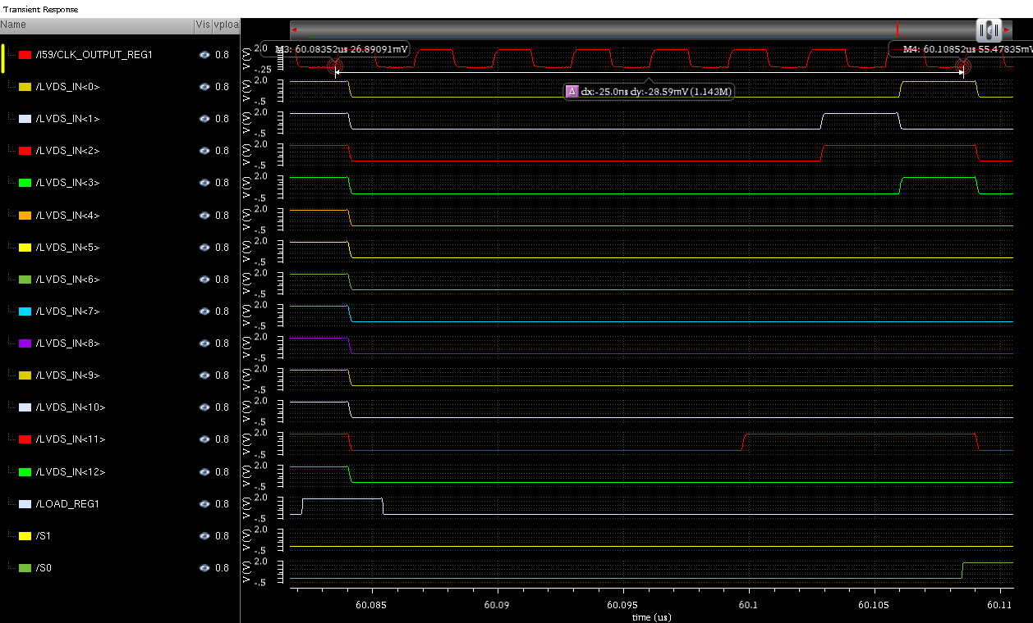
Output to LVDS
Strip: 0 4 9
Notes:
31

Slide 32
Where we are, current status
Block | Schematic | Simulation | Layout | Verification
Pixel/Segment | Partial | Partial | Partial | No
Pre-Amplifier | Done | Done | No | No
Comparator | Done | Done | No | No
Hit Encoding | Done | Done | No | No
Complete Front-end | Done | Done | No | No
Complete Column | Done | Done | No | No
128 Columns | Done | Done | No | No
Strip Encoding | Done | Done | No | No
Data Output | Done | Done | Partial | No
PLL | Done | ? | Yes | ?
LVDS Rx/Tx | Done | Partial | Partial | No
Calibration | No | No | No | No
Bias DACs | Partial | No | Partial | No
Config Reg/SPI | No | No | No | No
Full Chip | Partial | Partial | No | No

Slide 33
Final Sensor
Additional Blocks
Additional Requirements
On top of the above, the sensor will also require the following features.
Comparator 4-bit threshold trimming
Analogue pre-amp channel output for monitoring one channel
Test Structures (Isolated PreAmps, Passive Pixels, Digital Blocks etc)
LVDS current control to save power
Provisions to test CMOS data output transmission

