Slide 1
Chess2 Meeting Status
August 14th 2015
P. Caragiulo, C. Tamma, A. Dragone, C. Kenney, P. Grenier, Su Dong
(* pietroc@slac.stanford.edu)

Slide 2
Hit Encoding – Processing the Strip Encoding
0
8xbit0 lines
8xbit1 lines
8xbit2 lines
…
row0
x
x
x
x
1
+
row1
x
x
x
x
0
+
row2
x
x
x
x
0
+
row3
x
x
x
x
0
+
row4
x
x
x
x
1
+
row5
x
x
x
x
1
+
row6
x
x
x
x
0
+
row7
x
x
x
x
0
+
row8
x
x
x
x
0
+
row9
x
x
x
x
1
+
8b Memory
8b Memory
8b Memory
Write Memory

Slide 3
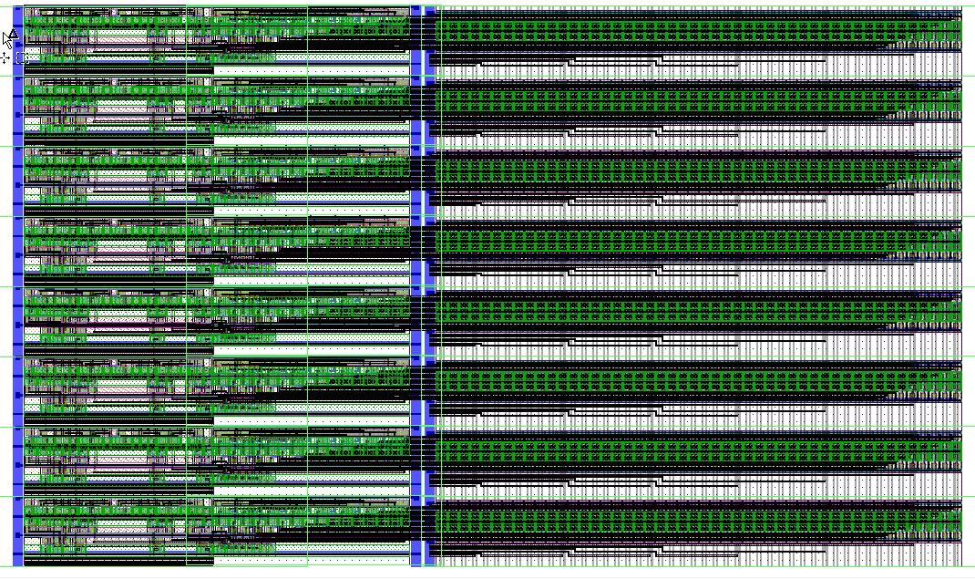
Hit Encoding – Processing the Strip Encoding
Adders
Bus Line Selector
Bus Lines

Slide 4
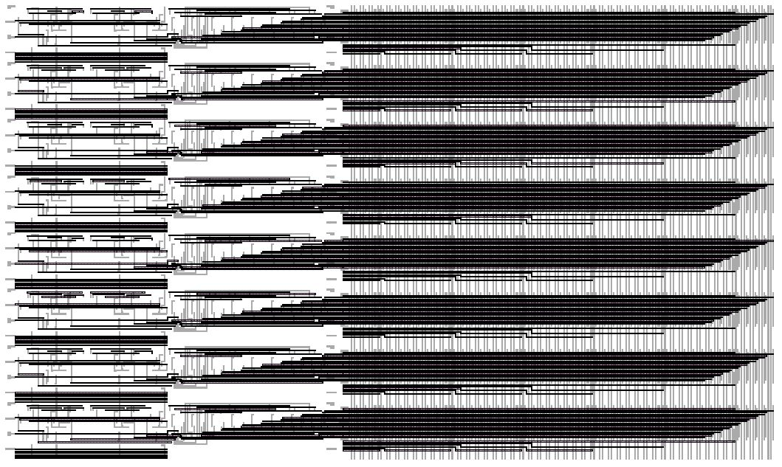
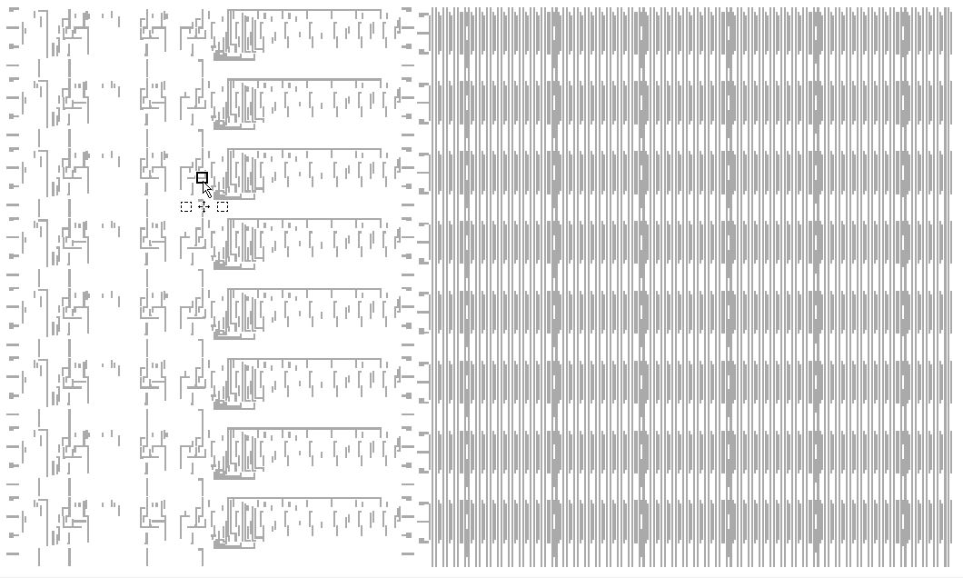
Hit Encoding – Processing the Strip Encoding

