Slide 1
CHESS2
Design SLAC – UCSC – KIT

Slide 2
CHESS2 pixels
Injection
IFB
RowENB
RAMWrEn
ColENB
3.3
1.8
Th
1/2
Load
Casc
1/2/4/8
Comp
InSF
In

Slide 3
RAM cell
PMOS added to RAM cell to allow configuration from 1 up 128 cells in parallel.
Disconnects the inverter from driving the DataIn line during configuration.
Simulation OK: with the additional PMOS we can configure a full row or a full column with a single SACI command (see SLAC presentations).
Load
DataIn

Slide 4
Pixel geometry
Amplifier.
Half comparator.
RAM controlled -
- charge injection
Row/Col selection
Trim RAM
Trim DAC
8 connected NWELLs
50% diode fraction
P-contact around each NWELL
120V rules
Size to be adjusted to strip length

Slide 5
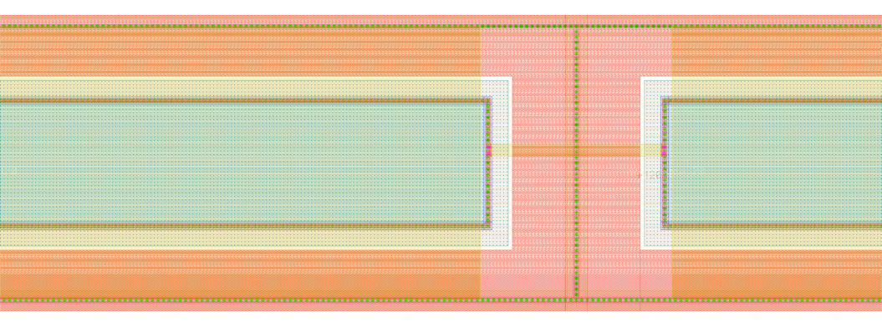
Pixel M3 lines
Metal 3
32 Signal
+
1 Row select
+
1 Injection
7.5µm space
for connectivity

Slide 6
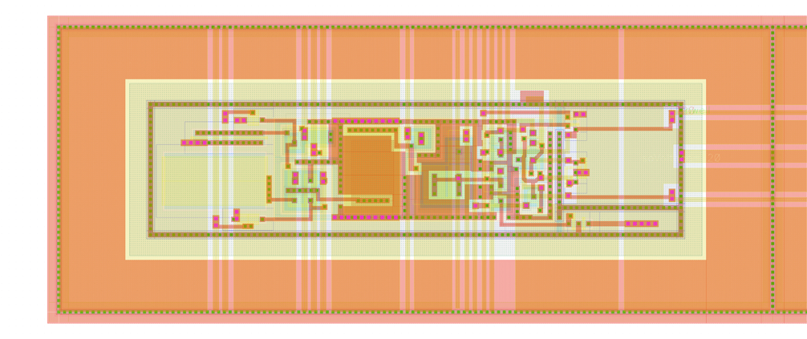
Amplifier & ½ comparator
Amplifier
AC
coupling
½ Comp.
Inj. RAM
Row/Col sel.
Amplifier & Comp. bias analog lines
Digital RAM & Inj. lines

Slide 7
Amplifier & ½ comparator control signals
Supply
Col sel.
Row sel.
Injection
Amplifier
AC
coupling
½ Comp.
Inj. RAM
Row/Col sel.
Bias from DACs - periphery

Slide 8
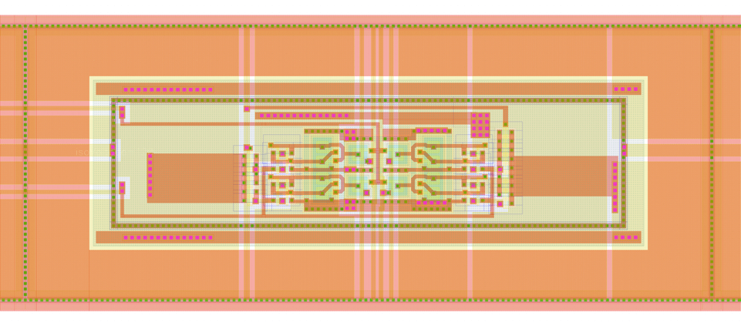
Trim RAM & Trim DAC
x2 & x4
current sources
x1 & x8
current sources
Trim current
to ½ comp.
4bit TRIM RAM

Slide 9
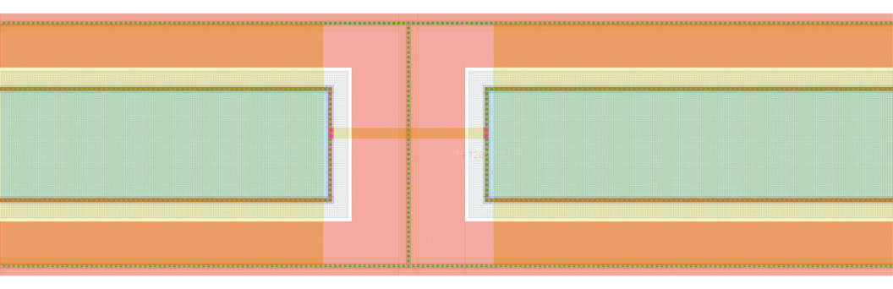
NWELLs interconnect
M2 NWELL shield (gnd/vdd)

Slide 10
Modification since the review
Pixels
- NWELL bias scheme modified to reduce the noise (observed during CHESS1 testing).
- Layout modified to include additional pmos in the RAM cell.
- Further layout modification required when chaining the 32 pixels.
- Reduced the size of the pixel and optimized power distribution (wider traces).
Periphery
- Large layout changes required for assembly of the 32 chained encoders (very difficult layout with 2 metals available only).
- pmos included in the RAM cell.
- Small Schematic and layout adjustment to reduce number of controls required, conserving the same functionality.

Slide 11
CHESS periphery
Kill sig.
HitPrev
HitNext
Hard coded pixel address
Reset
1/2
5 bit hit address
Sel
1 bit hit to encoding
Hit Latch
Ck
Hit Flag Logic
1 bit hit flag
RowENB
RAMWrEn
ColENB
x32
Comparator latching
Hit encoding

Slide 12
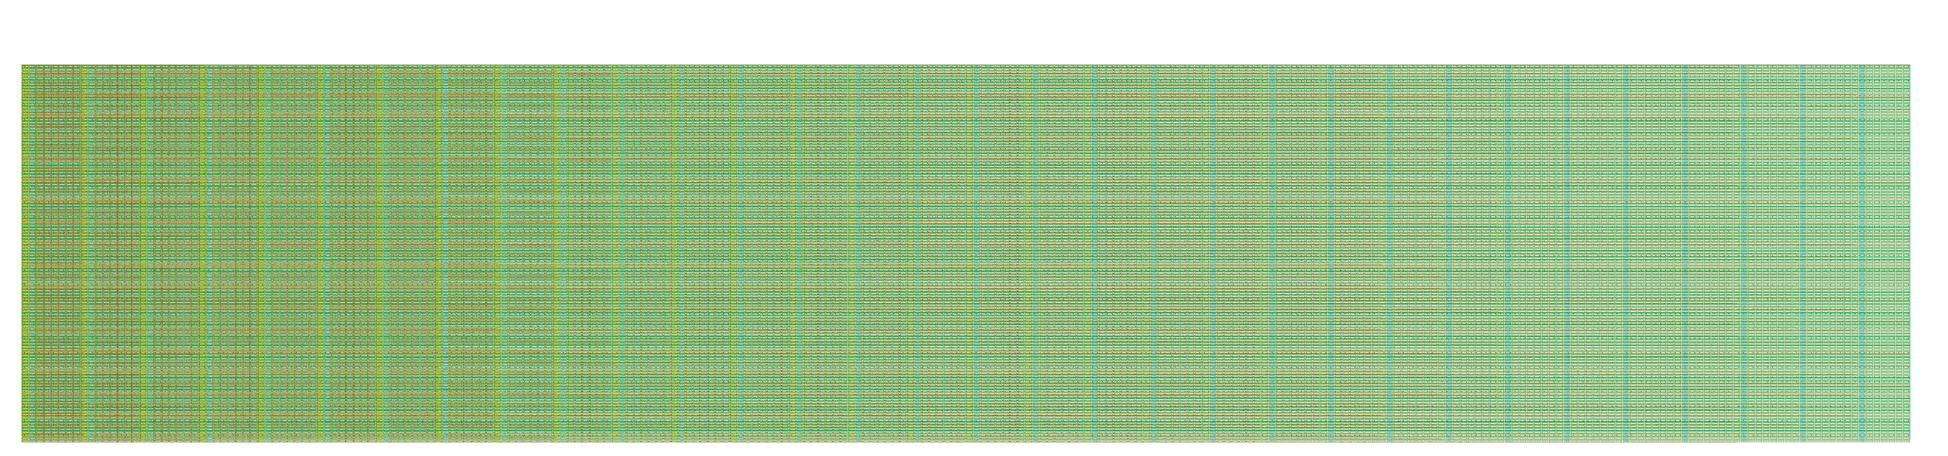
CHESS2 assembly – 128 connected pixels

Slide 13
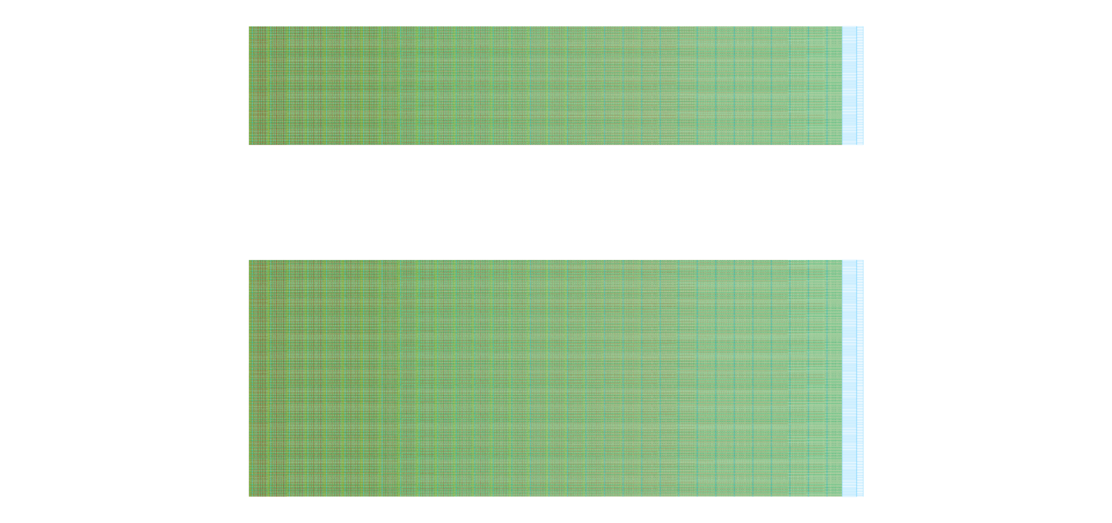
CHESS2 – 3 array of pixels and encoding periphery. Strip encoding to be connected.

Slide 14
Last things to do
- Bias pads layout and on chip decoupling.
- Bloc assembly and routing.
- Global power distribution and routing – decoupling where we can.
- Global DRC and LVS.
- Global simulations.

Slide 15
CHESS2 architecture
Column Decoder
128 x 32
pixels
Half Comparator,
Latch & Hit encoding
Strip Encoder
Global DACs
Matrix
Pointers
SACI
Configure
CHESS2
Control Logic
…
Global Registers
Row Decoder
LVDS TX
…
LVDS output
Records Hits
Select 1 Hit/Strip
Select 8 Hits
DONE
DONE
Doesn’t reflect actual size or placement

