Slide 1
TCT measurements with CHESS-1 chip
I. Mandić et al.,
Jožef Stefan Institute, Ljubljana, Slovenia

Slide 2
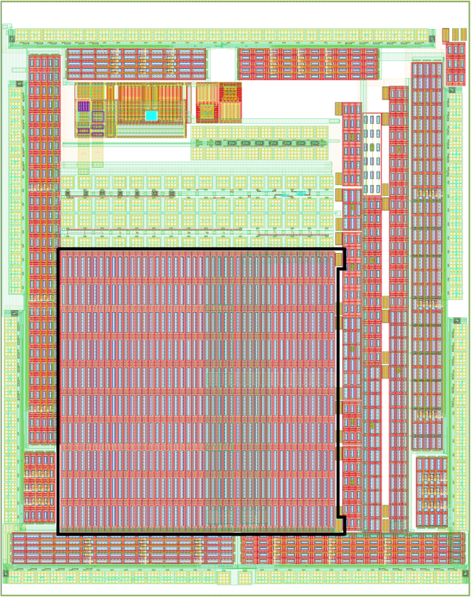
Top -TCT with passive pixel array on Chess 1
measured with chip irradiated to 2e15 with neutrons
Chess1
PPA # | Pixel width | Pixel length | Diode Area Fraction | Metal opening ratio
PPA09 | 45μm | 100μm | 30% | 13.0%
Substrate
45 um
Periphery
Signal
100 um

Slide 3
connections
narrow (FWHM ~ 7 μm) laser beam directions
perimeter to HV
(and readout)
Chess1
Beam Edge-TCT
Beam direction
Top- TCT
to ground
signal to HV and readout via Bias-T
TOP TCT
HV
scope
GND
substrate
Beam direction E-TCT
Beam direction

Slide 4
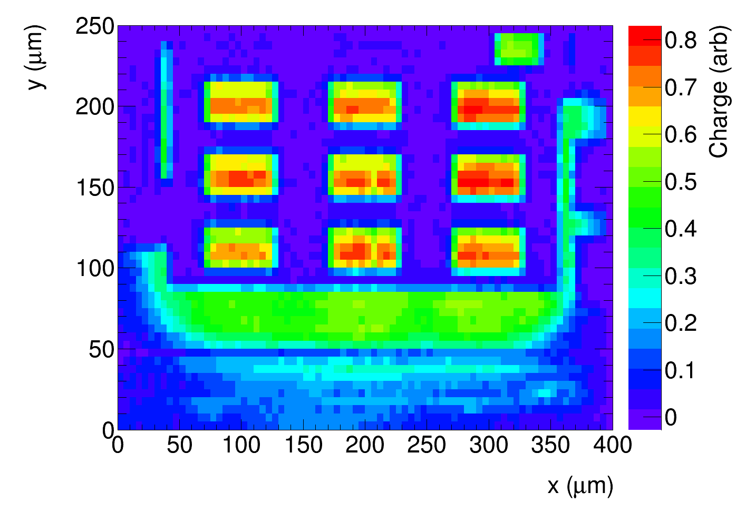
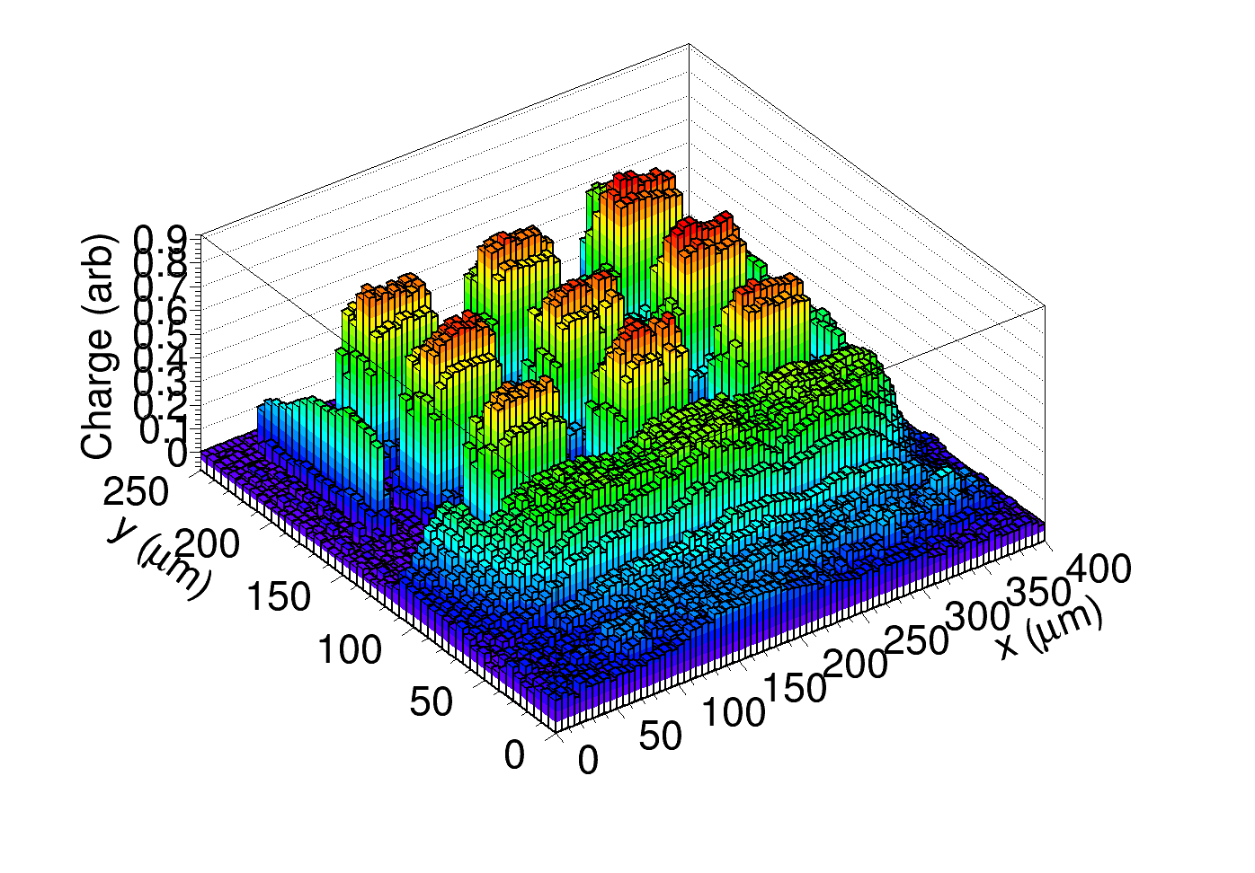
Top TCT
all pixels (signal and periphery)
connected to readout, bias 120 V
plots show charge
(integral of the induced current pulse in 25 ns)
vs. laser beam position
Beam direction
Substrate
45 um
Periphery
y
Signal
x
100 um
Metal
No metal
Same plot in lego version
45 μm
100 μm
is this region part of the structure?
not seen on the other side

Slide 5
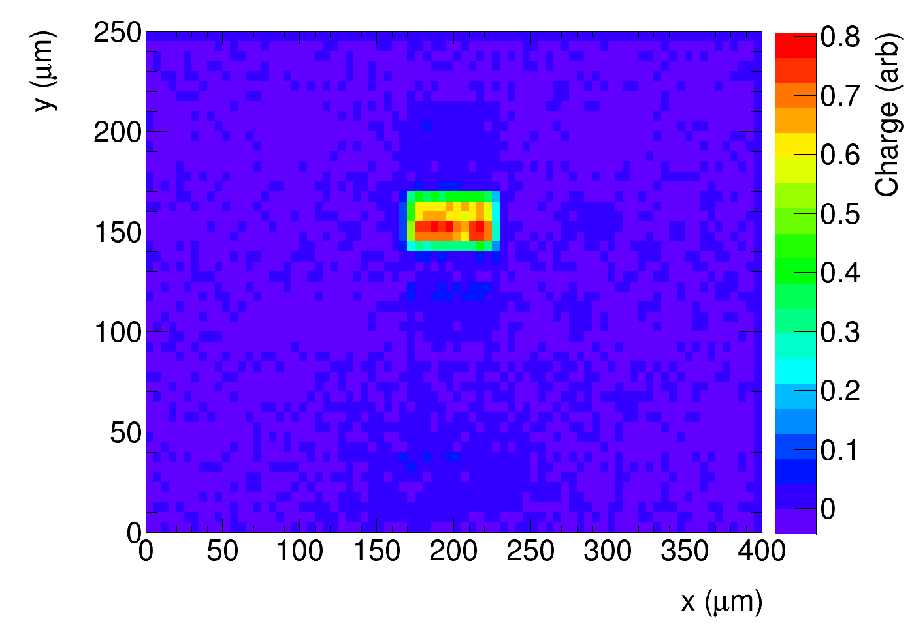
Top TCT
all pixel read out
only signal pixel read out
Beam direction
Substrate
45 um
Periphery
Signal
100 um
Periphery + signal to HV and readout
Only signal to readout:
(all pixels to HV):
45 μm
100 μm
no cross talk, no charge
from the low edge

Slide 6
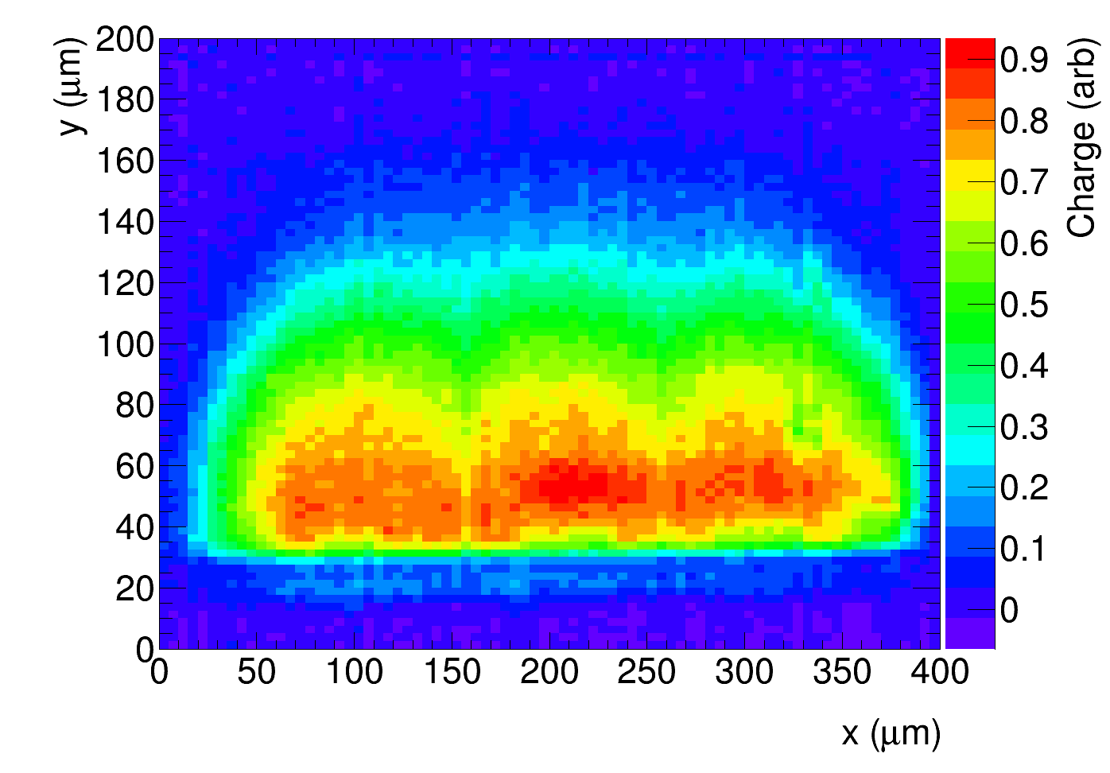
Edge and Top TCT
charge vs. beam location
Depth (μm)
Edge TCT:
from E-TCT it can be seen
there is only small drop of collected charge
in the region between pixles
gaps in Top TCT are because of metal
Top TCT
45 μm
100 μm
E-TCT laser beam

Slide 7
Summary
TCT measurement with narrow laser beam directed to the top of PPA9 structure
(irradiated with 2e15 neutrons, bias 120 V)
can clearly see the 3x3 pixel structure
large part of the structure covered by metal
question to chip designers: is (smaller) charge seen on the lower edge of the array
generated inside of the PPA9 array or outside (and if this could be a problem) ?

