Slide 1
HVStripV1 Post-Irradiation Testing
R. Bates, C. Buttar, K. Kanisauskas, D. Maneuski
ATLAS Strip CMOS Regular Meeting
September 1, 2015

Slide 2
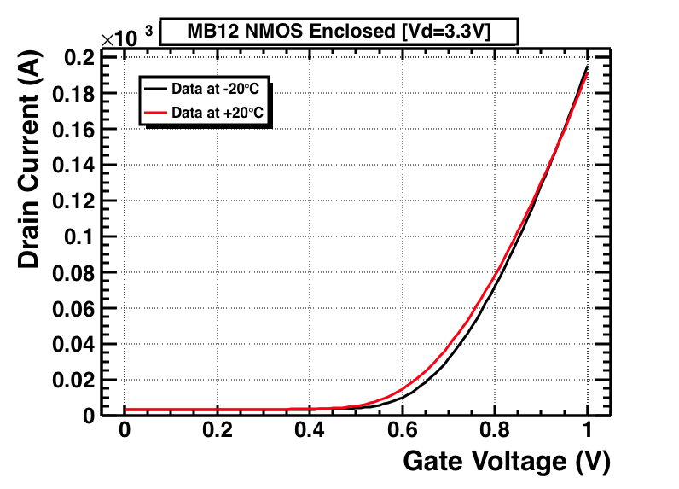
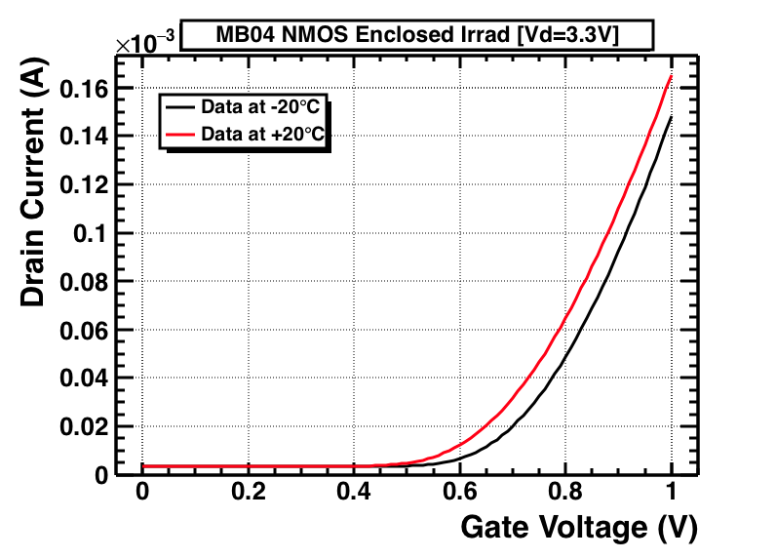
MOSFET Measurements (1)
Non-irradiated
Irradiated
Measurements of MOSFETs were repeated at two different temperatures in order to observe change in V_{th}
Two HVStripV1 samples were investigated – MB04 (irrad) and MB12 (non-irrad)
As before the transistors were operated in saturation region giving the relation

Slide 3
MOSFET Result Summary (2)
MB12 (non-irrad)
MB04 (irrad)
Stronger V_{th} dependence on temperature was observed for irradiated sample (especially for p-channel MOSFET)
V_{th} variation with temperature is mainly due to carrier generation in the substrate (decrease in V_{th} by ≈ 2mV/1K)
PMOS change in Vth for irradiated sample is larger due to irradiation effects

Slide 4
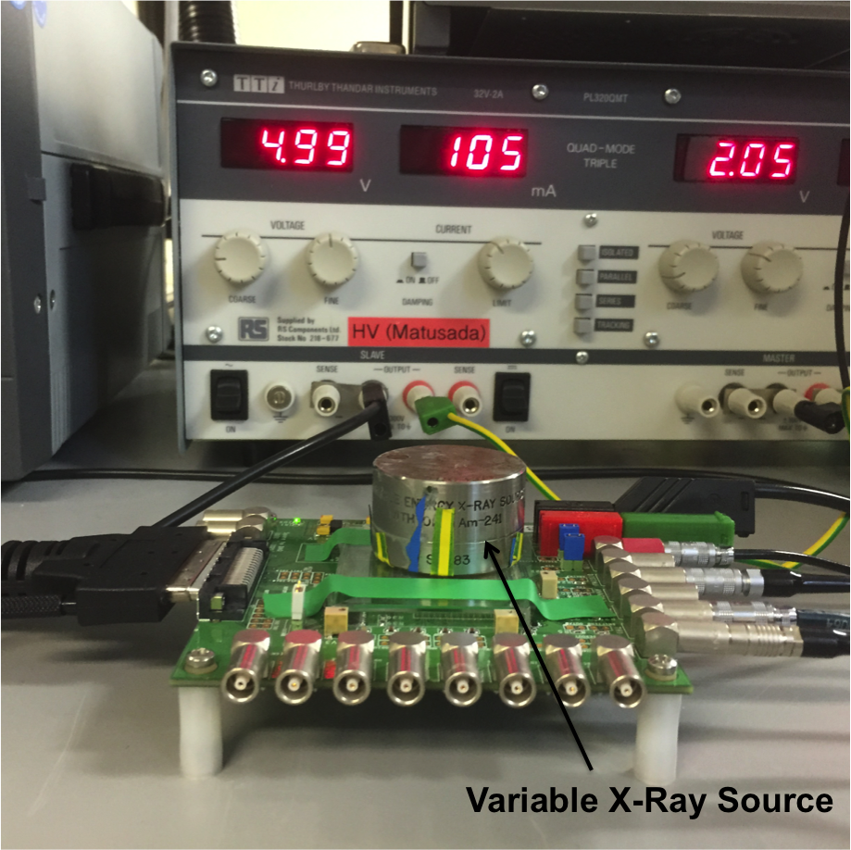
X-Ray Measurements (1)
Several X-Ray measurements were done for irradiated MB06 chip at -20°C using variable X-Ray Source
Pixels of interest were (5,0) and (12,0) because of the existing set of pre-irradiation data
Cu, Rb, Mo, Ag, Ba and Tb targets are available
Since we were unable to observe Fe-55 peak (≈5.9keV), measurements began with Mo (K_{α}≈17.5 keV)
In addition, noise spectra over the threshold was recorded to ensure that the actual X-rays were observed

Slide 5
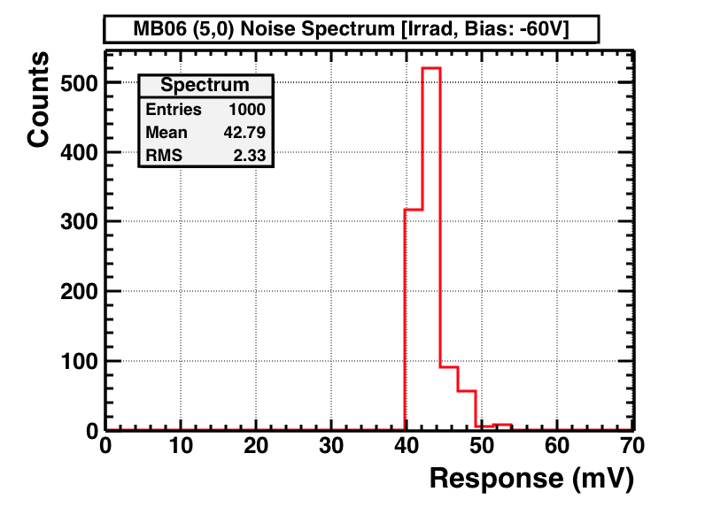
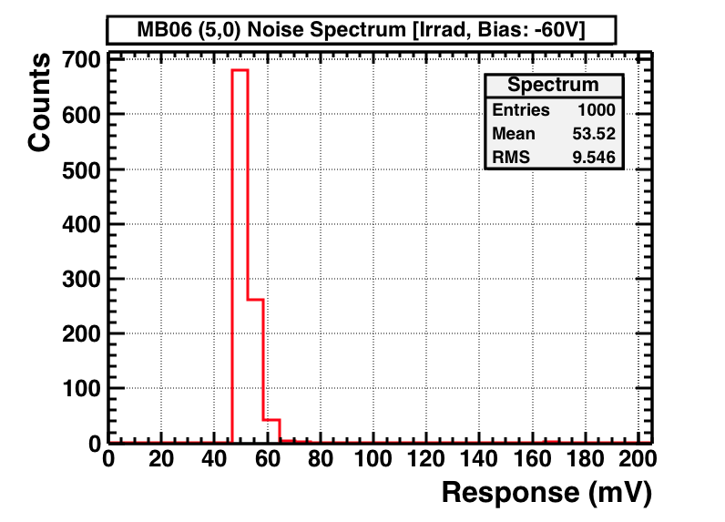
X-Ray Measurements (2)
Trigger rate: 5.076 Hz
Trigger rate: 0.133 Hz
Above histograms represent noise spectra above threshold (no source was placed on the sensor during the measurement)
Noise trigger rate at 60mV for (5,0) was 0.0017 Hz (not enough points acquired for the histogram)
When variable X-ray source with Mo target was placed the trigger rate at 60mV for (5,0) jumped to 0.0829 Hz

Slide 6
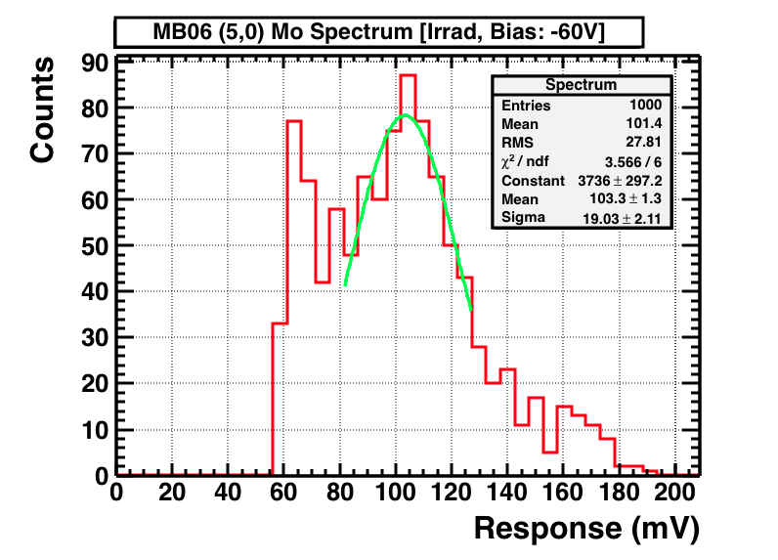
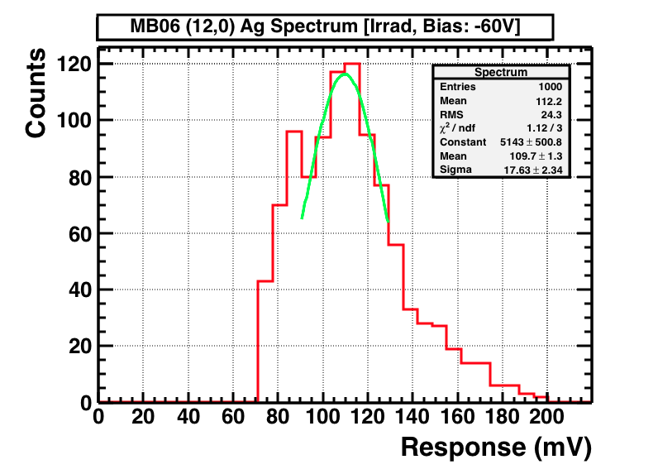
X-Ray Measurements (3)
Mo and Ag spectra were acquired for (5,0) and (12,0) respectively at -60V bias
Mo K_{α}≈17.5 keV and Ag K_{α}≈22keV lines correspond to ≈4860e⁻ and ≈6100e⁻
The Gaussian fit was done in order to extract gain values (mV/fC) for (5,0)
Drop in gain almost by half was observed for both pixels when compared to Fe-55 pre-irradiation data at the same bias (see next slide)

Slide 7
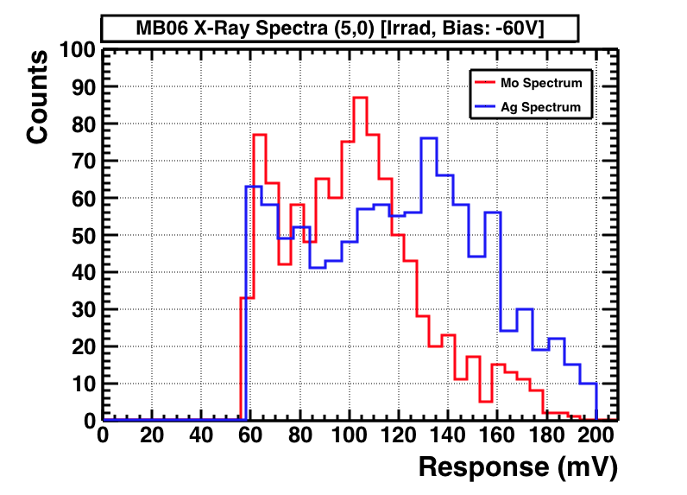
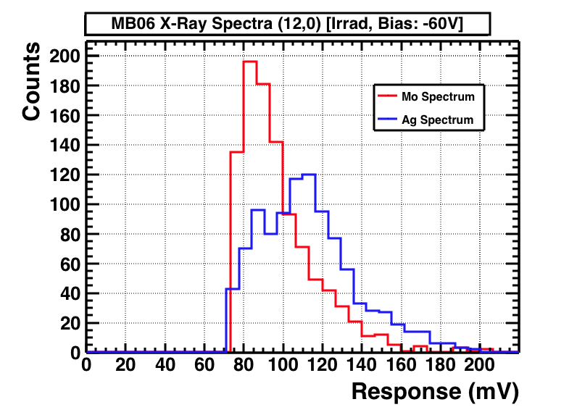
X-Ray Measurements (4)
likely to be a fraction of the Mo peak + noise
Possible Ag K_{α} Line
Change in Gain Result Summary

Slide 8
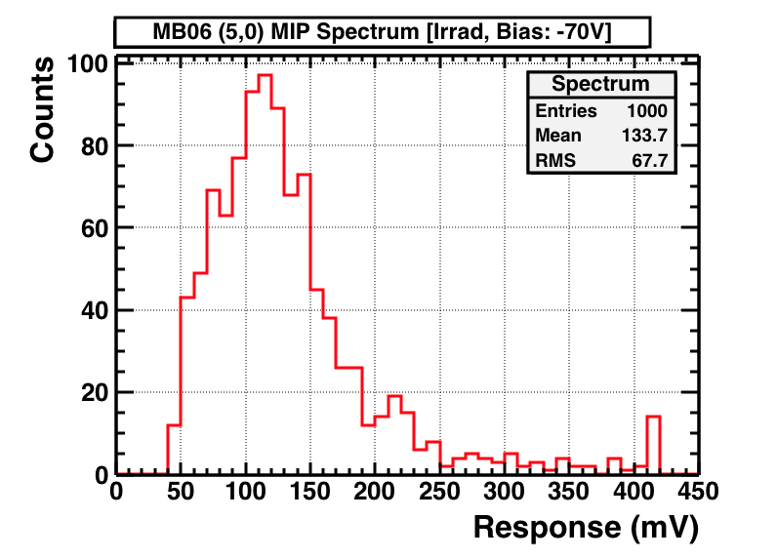
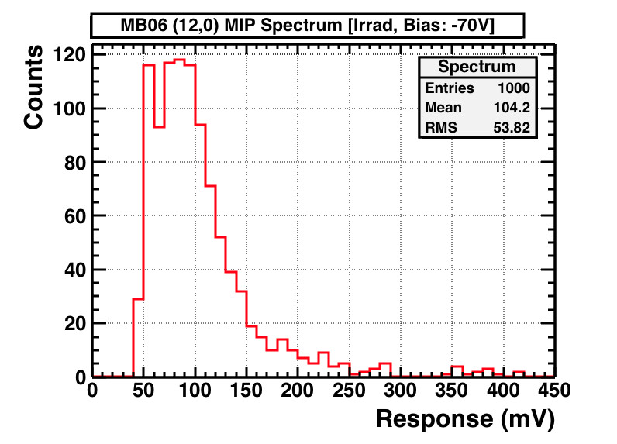
MIPS (Sr-90)
MIP measurements were done within [-10,-80] bias voltage range for (5,0) and (12,0)
Landau peak observed for (5,0) while for (12,0) it seems that higher bias voltage is required
More detailed analysis to be presented next time

