Slide 1
Status of test kit 1 Sept. 2015
T. Huffman, J. J. John with help from many colleagues

Slide 2
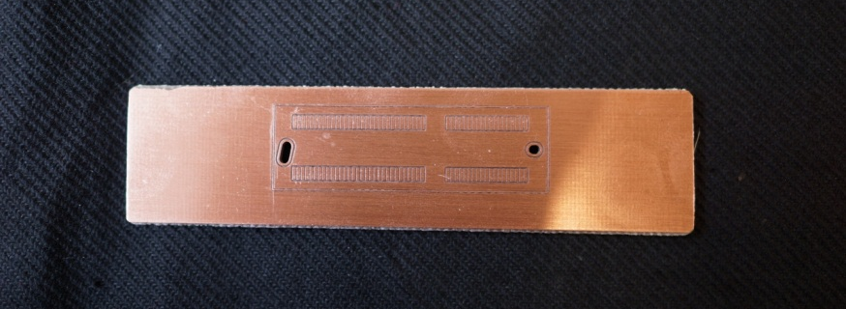
Status
Motherboard
Edge connector footprint successfully prototyped in copper (milled circuit board – thanks to Pete Hastings in Oxford)
Layout is COMPLETE! (next slides)
Going out for quotes today (5 day and 10 day turn around)
Plan to make 30 boards (might not stuff 30 though, 15 to start??)
PLEASE CAST LOOK OVER THE LAYOUT – by end of tomorrow! (02/09/2015)
Files on Link or can e-mail them to anyone interested.
PonN Daughterboard
Layout finalised.
Next up – awaits Jaya John’s return.

Slide 3
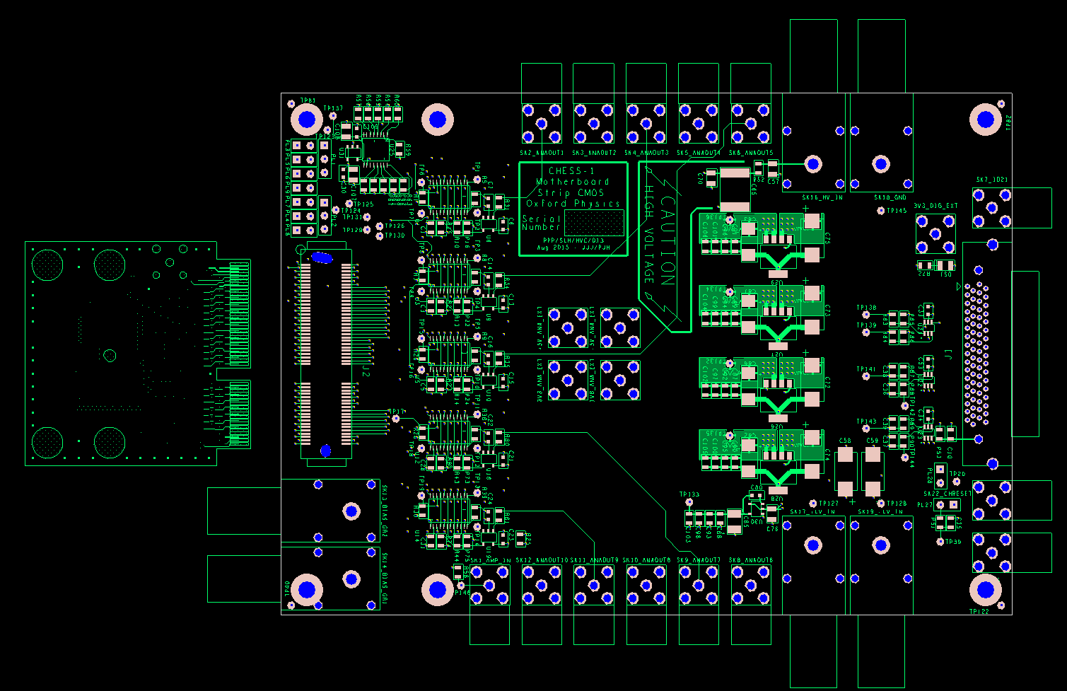
CHESS1 Motherboard Top-side
Pepi-on-P daughter card shown in edge-connection orientation.

Slide 4
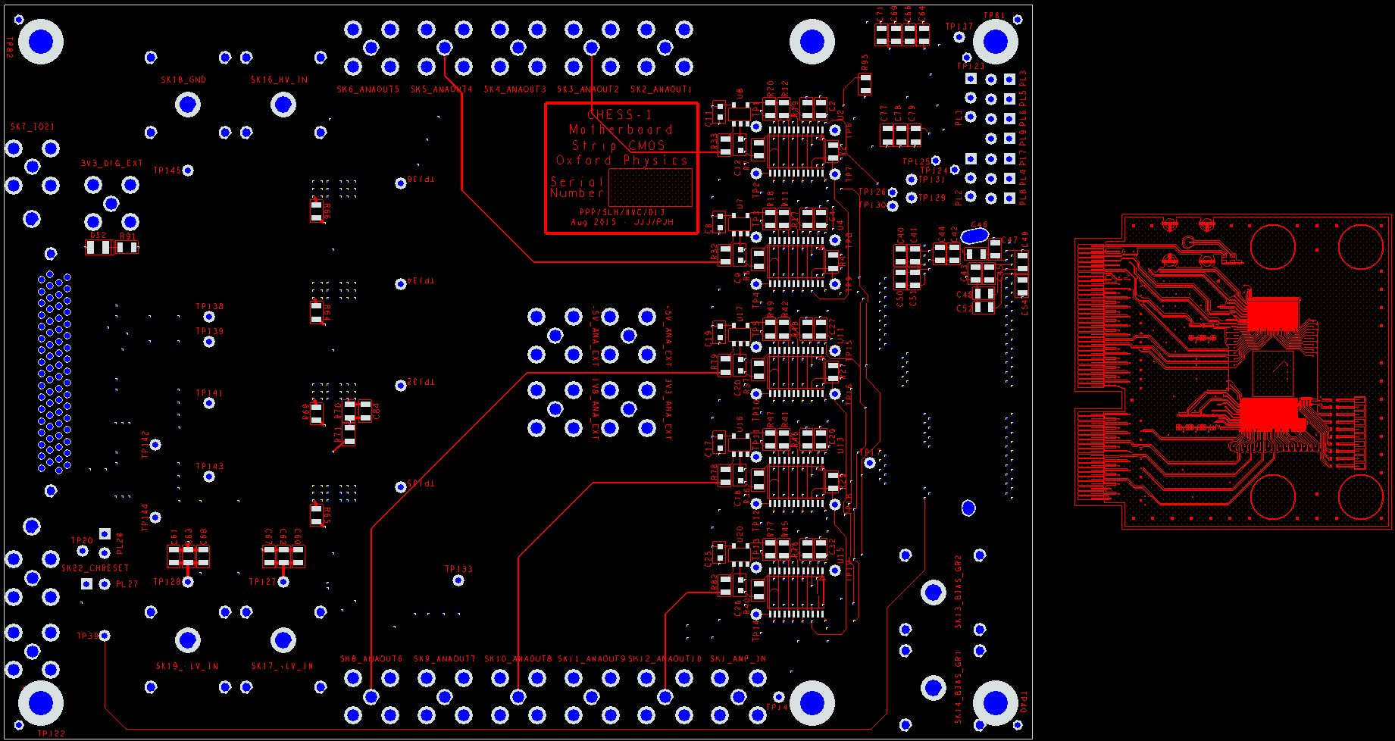
CHESS1 Motherboard - underside

Slide 5
CHESS-1 motherboard requests
State of play: Please let me know of any changes or missing requests, thanks.
Institute | Number | SMA or Lemo? | Orientation?
Argonne | 1 | Lemo | parallel
Beijing (IHEP) (pending export discussions) | 1 | ? | ?
DESY | 1 | ? | ?
Glasgow | 2 | SMA | 1 of each
Llubljana | 1 | ? | ?
Oxford | 3 (2 for chip testing, 1 for developing cooling system) | Lemo | TBC: 2 parallel, 1 perpendicular
RAL | 3 (2 for PPD chip testing, 1 for chip designers’ tests (TD)) | SMA | TBC: 2 parallel, 1 perpendicular
UCSC (SCIPP) | 2 | SMA | 1 of each

Slide 6
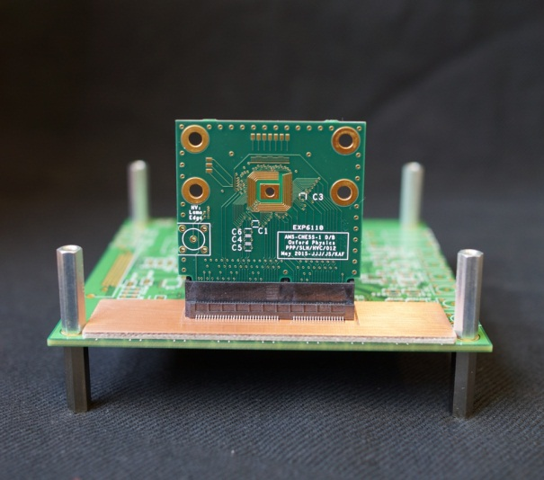
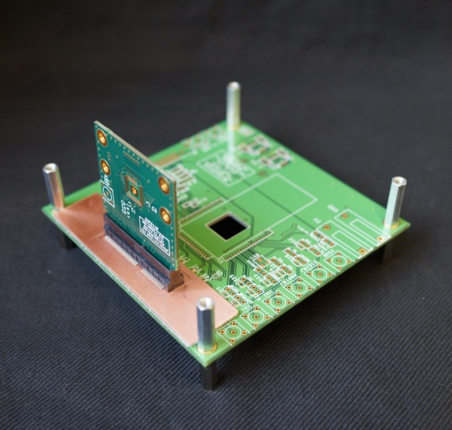
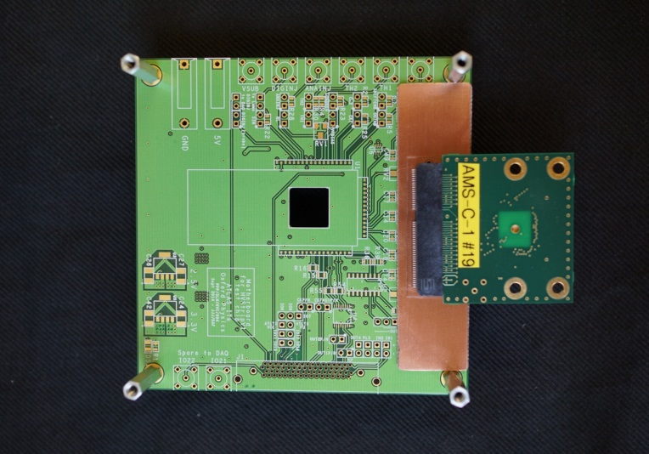
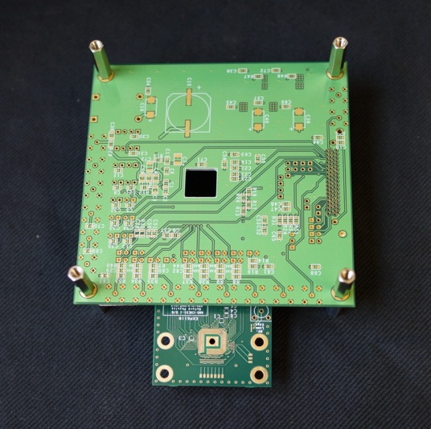
Mock-ups of two orientations
1. Daughterboard perpendicular to motherboard
This is using the HVStripV1 motherboard as a mock carrier to demonstrate the orientations.
2. Daughterboard parallel to motherboard – for bench probing
Motherboard is inverted compared to perpendicular orientation, due to Samtec connector design

