Slide 1
Beta test of CHESS1 chip
Vitaliy Fadeyev, Zach Galloway , Herve Grabas
Alexander Grillo , Zhijun Liang , Abe Seiden
Jennifer Volk, Forest Martinez-Mckinney
University of California, Santa Cruz

Slide 2
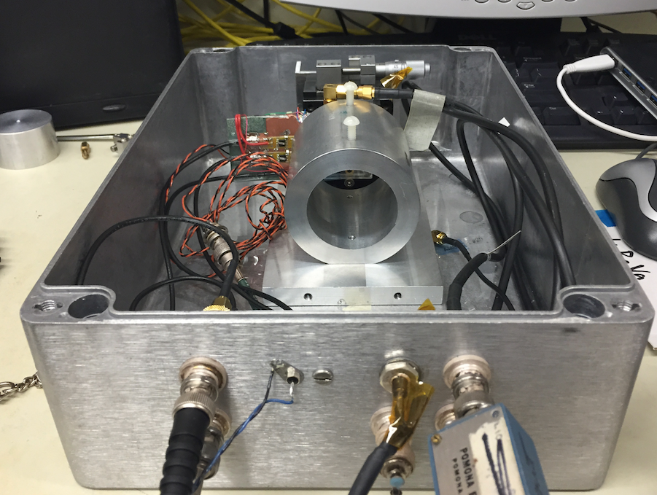
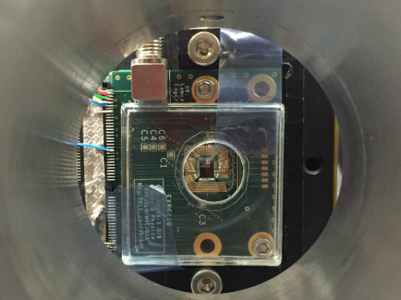
Beta test setup
CHESS1 chip Mount on daughter board from Jaya John
Sr90 beta source is used
Trigger rate ~0.1 Hz , self trigger
CHESS chip Biased at 110V

Slide 3
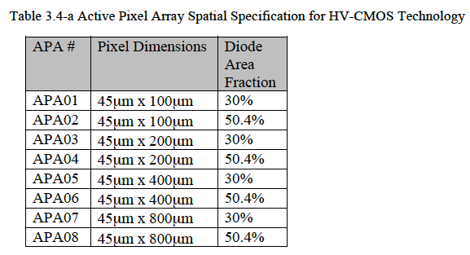
Reminder of active array in CHESS1 chip
Active array APA08 is used
Channel 7,8 is connected for readout
Self trigger
Trigger on pixel 8

Slide 4
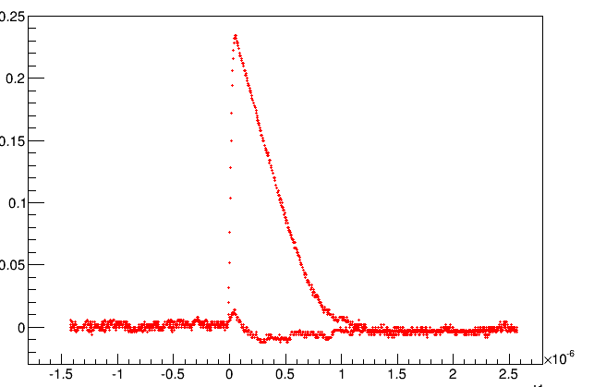
Pulse shape in usual case
Output(V)
Ch1
Ch2
Time (s)

Slide 5
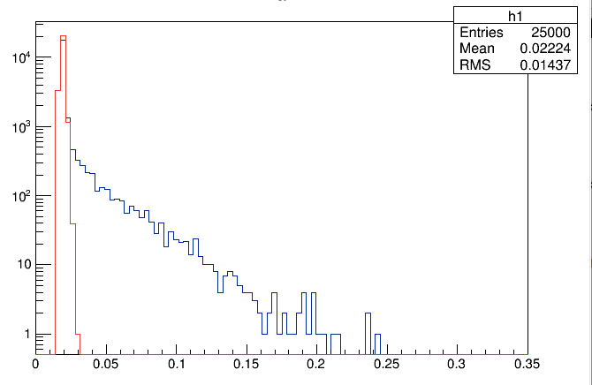
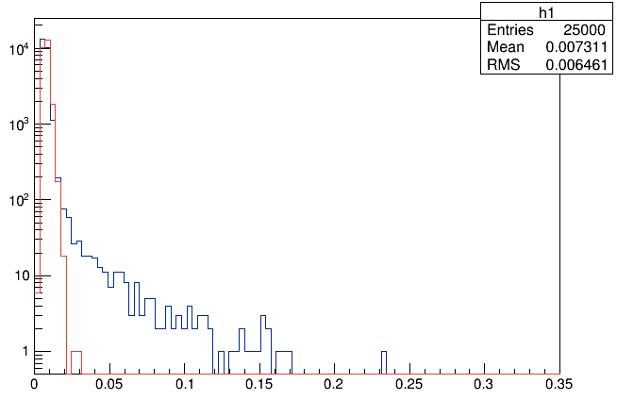
Signal amplitude distribution
No visible MIP peak yet
Self triggering on channel 1.
The noise peak (red curve) is obtained without beta source
Beta signal+BG
Background noise
Beta signal+BG
Background noise
Ch1 amplitude (V)
Ch2 amplitude (V)

Slide 6
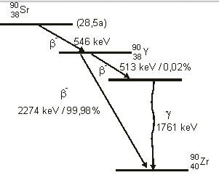
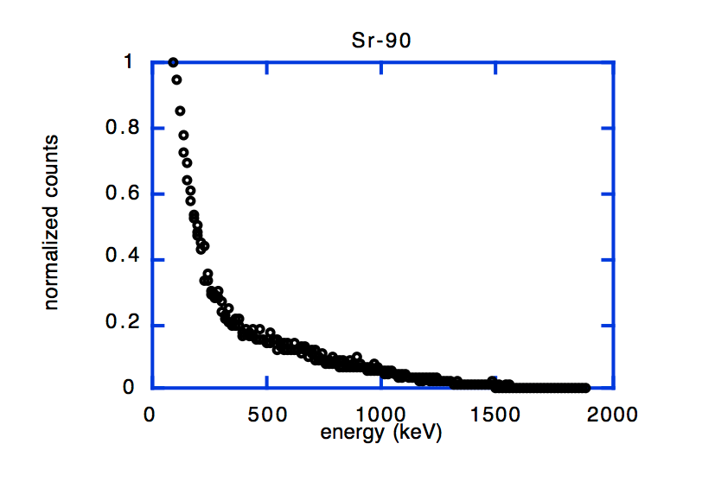
Why no MIP peak ?
SR90 Beta source we used has lots of low energy electrons.
Self triggering includes both low energy electrons and high energy electrons -
dE/dx of these low energy electrons are different from MIP.
We need to select to high energy electron ( MIP )

Slide 7
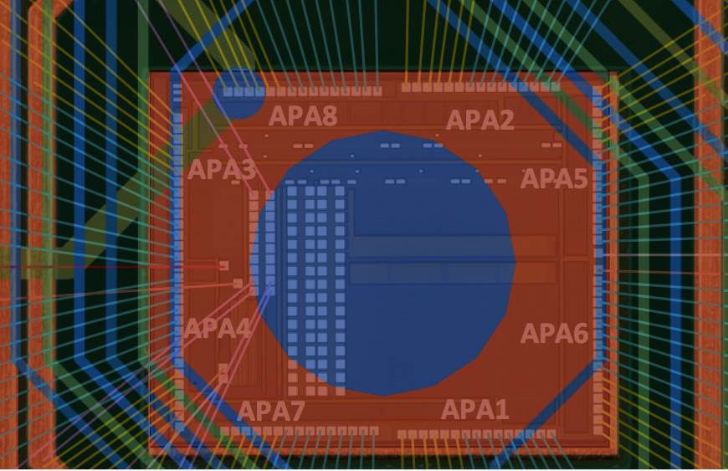
New setup for beta testing
Try to add scintillator in the setup
Use scintillator trigger to select the high energy electron
Met a problem that
The hole in daughter board is not big enough
Electron can not go through APA08 and hit scintillator
Blocked by the board.
The plan is Milling part of the board
Sr90
CHESS1
Daughter board
Scintillator

Slide 8
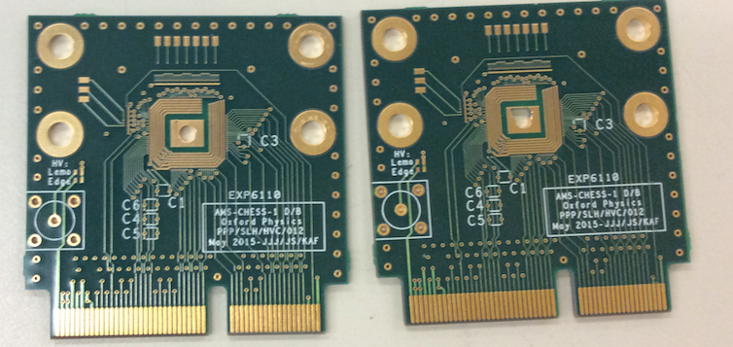
Milling the daughter board
Milling part of the daughter board
So that beta particle can go through pixel array APA08.
Before Milling
After Milling

Slide 9
Summary
Observe significant signal from active pixel in beta source test .
Still trying to find the MIP peak yet.
Self triggering does not work well
Need to select high energy electrons from Sr90 by using Scintillator trigger
Milling part of the daughter board.
So that beta particle can go through pixel array APA08.
Going to bond a CHESS1 chip on this new board.
Next step :
Quantify the landau peak position of MIP in beta test
Quantify the fraction of charge sharing between pixels
Reduce the readout noise by optimizing the built-in amplifier configuration.

Slide 10
backup

Slide 11
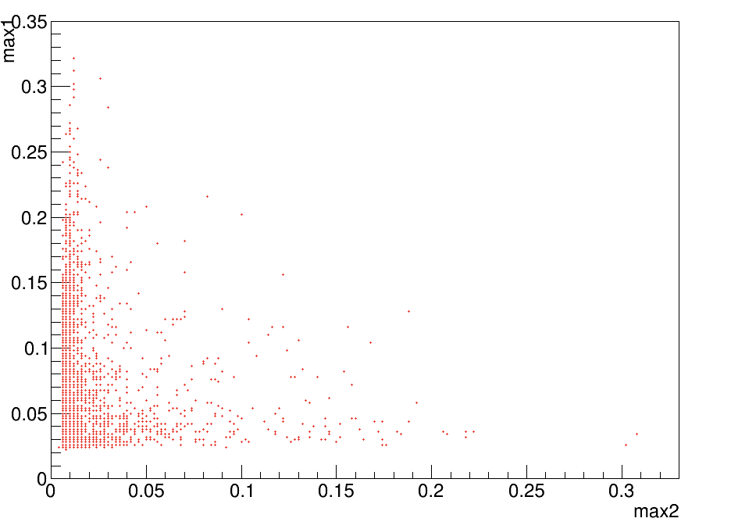
Correlation in signal amplitude between two pixel
Ch1 amplitude (V)
Charge sharing events
Ch2 amplitude (V)

