Slide 1
ATLAS CMOS Strip
Regular meeting
01/09/2015
HR-CHESS2 update
D. Das, STFC-RAL, UK
01/09/2015
Notes:
1

Slide 2
Design Update
Almost done with Top-Level schematic simulation, seem to be able to
detect and read out up to 8-hits within 1 BX across all process corners from
a 32x128 array.
Plan to start layout of the different blocks early this month, starting with
with the digital STRIP encoding block. Still waiting on test results from
HR-CHESS1 chip to get an idea of the pixel/segment geometry so hope
to start optimisation and layout of the pre-amplifier/analogue front-end for
from HR-CHESS2 in early October.
Plan to organise a Design Review in September, preparing documentation.

Slide 3
Response to Questions
In the list of spec it was mentioned that the epi thickness is up to 25µm, is this a strong limit?
No this is not a strong limit, we can increase the thickness to collect more signal.
2. Given your pixel volume are you sure a leakage current tolerance of 10nA is sufficient?
Not completely sure, it is based on what the test engineers measured for similar structures. But the leakage current tolerance of the pre-amplifier increases up to 1µA if the temp is decreased to -40°C. See results later.
3. Are you worried about hit-processing in 25ns?
No. But with the design I have, I can correctly detect max 8-hits if I reserve 2 BX periods for the STRIP ENCODING block. Ultimately I read-out the 8 hits in 25 ns or 1BX. It is a synchronous system and the delay is well characterised for the blocks.

Slide 4
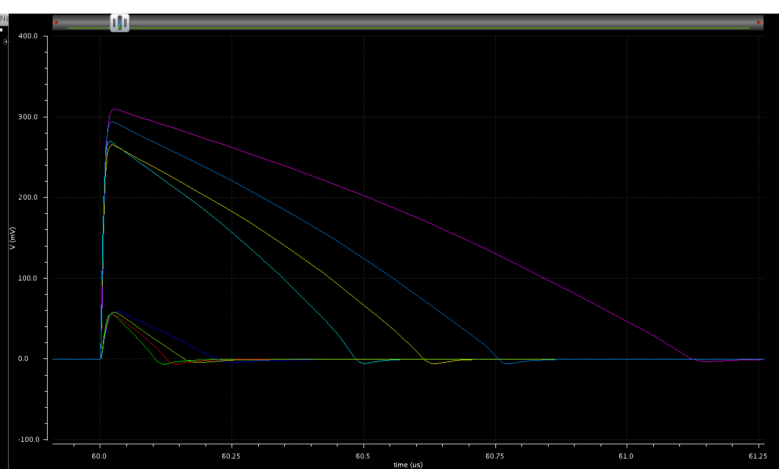
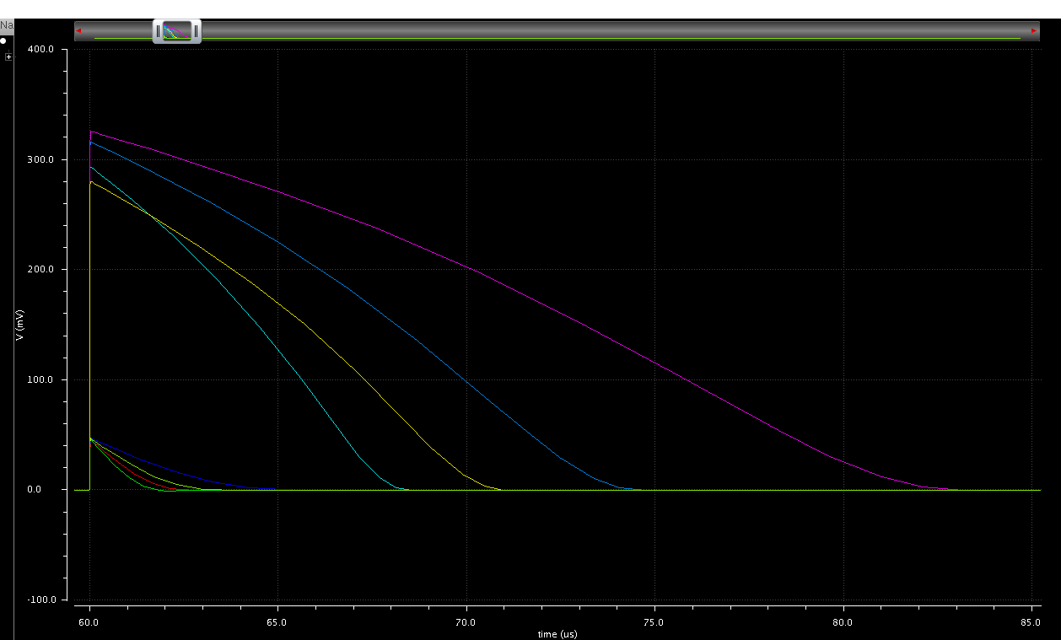
Pre-Amplifier performance
all pulseshapes overlaid
DC component removed
all pulseshapes overlaid
DC component removed
T = +40°
T = -40°
Signal at Pre-Amp output from 500e- to 5Ke- in 2 steps
All process corners
Ileakage = 0A

Slide 5
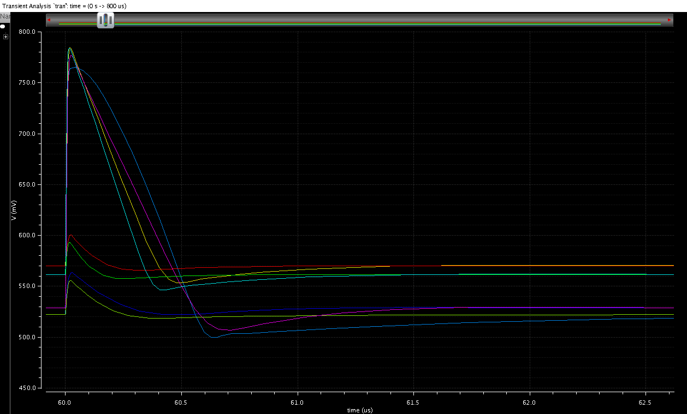
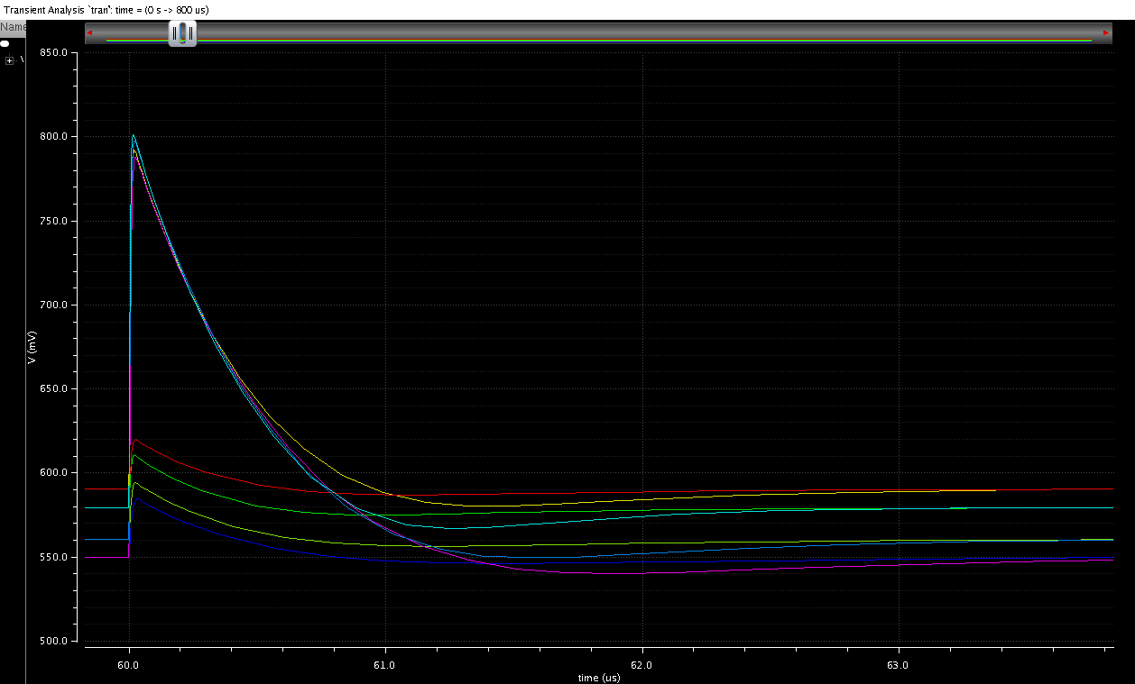
Pre-Amplifier performance
with leakage current
Ileakage = 10nA
Ileakage = 10nA
T = +40°
T = -40°
Signal at Pre-Amp output from 500e- to 5Ke- in 2 steps
All process corners

Slide 6
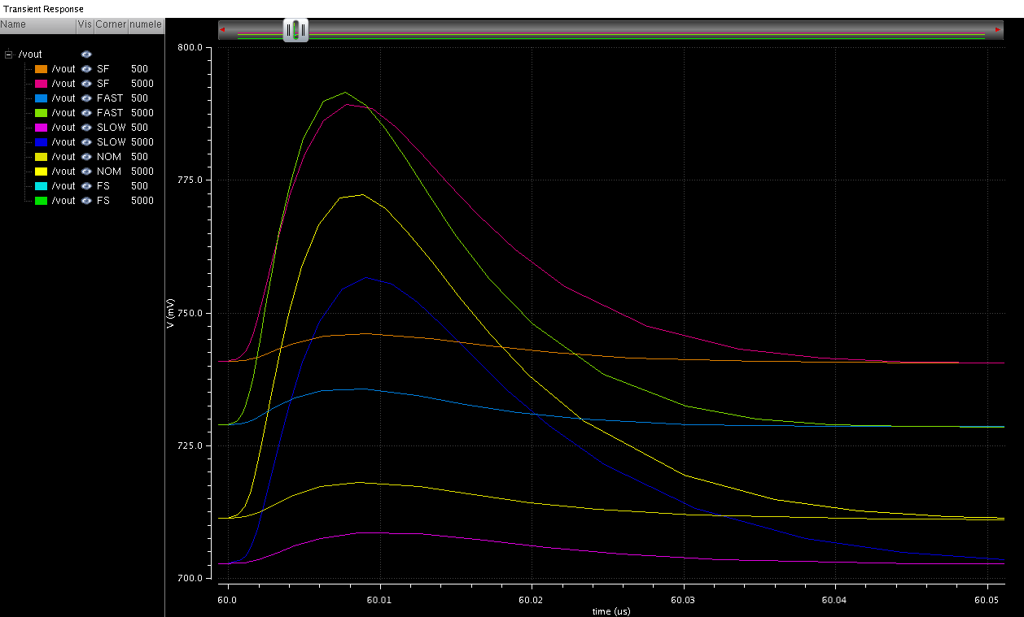
Pre-Amplifier performance
with leakage current
Ileakage = 1µA
T = - 40°
Signal at Pre-Amp output from 500e- to 5Ke- in 2 steps
All process corners
Gain drops significantly

Slide 7
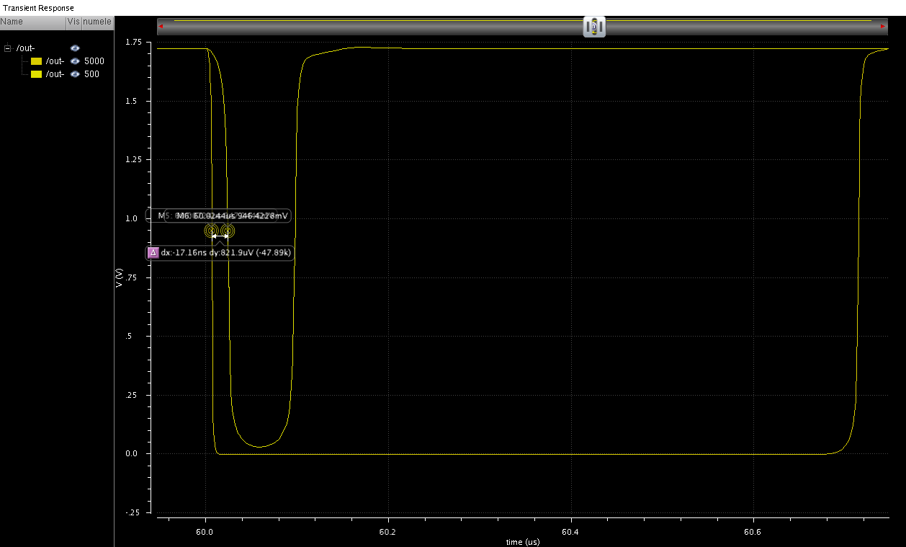
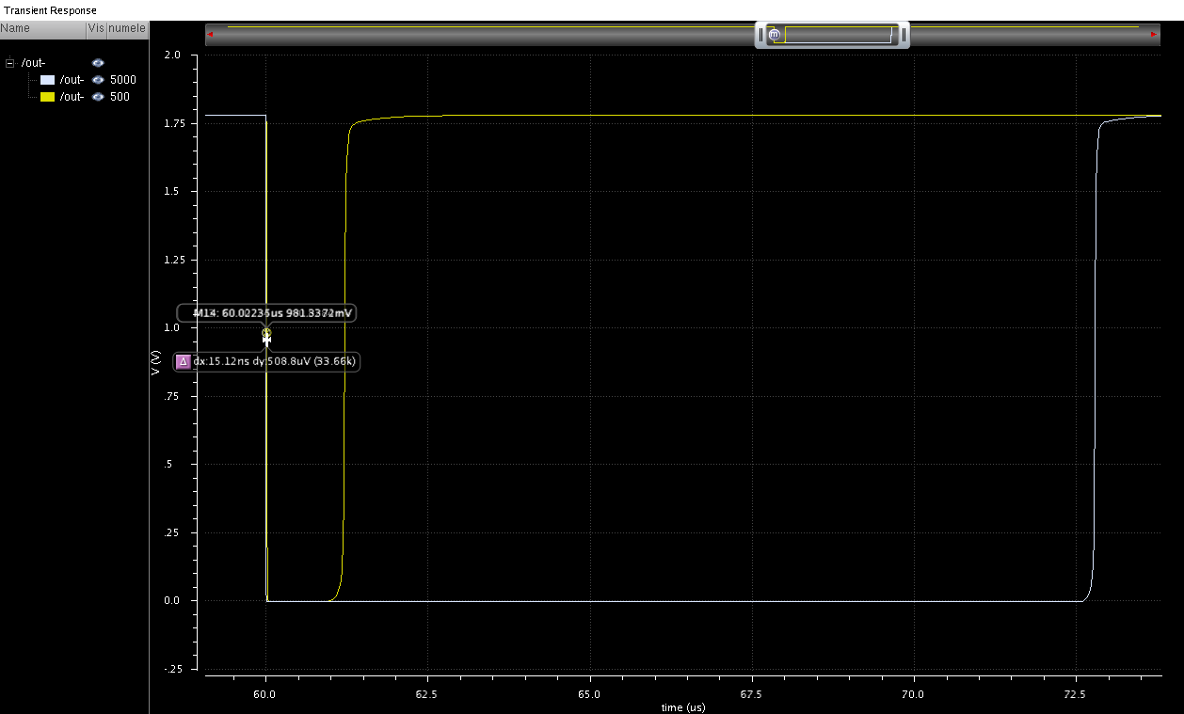
Time-Walk at different Temp
Nominal Corner
Ileakage = 10nA
Ileakage = 10nA
T = +40°
Time-Walk = 17ns
T = -40°
Time-Walk = 15ns
Comparator output for 500e- and 5Ke- with threshold set at 275e-
~1ns charge injection time

Slide 8
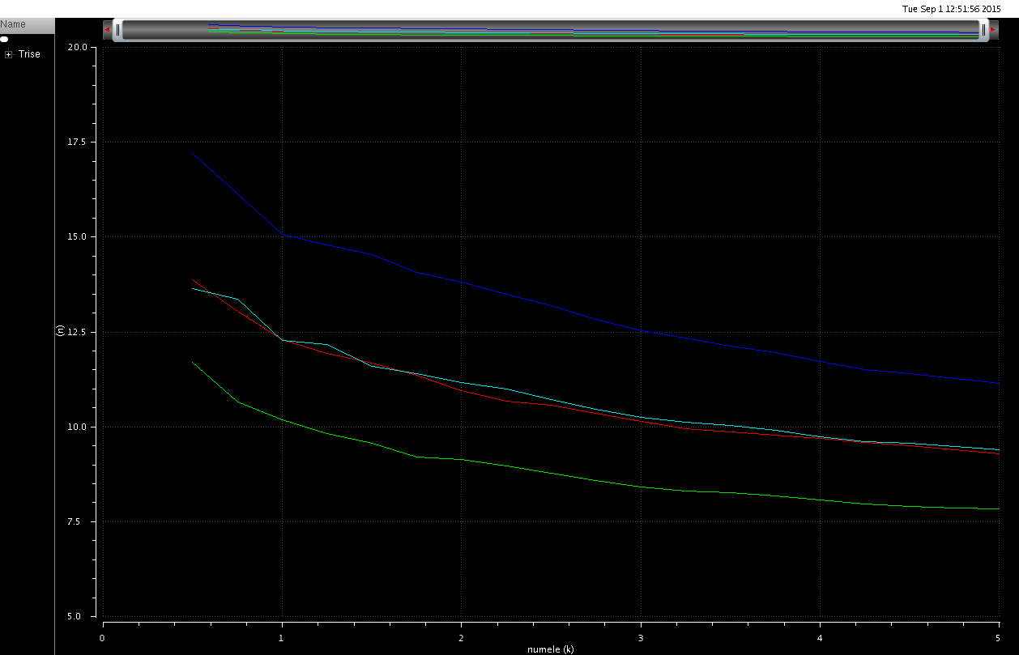
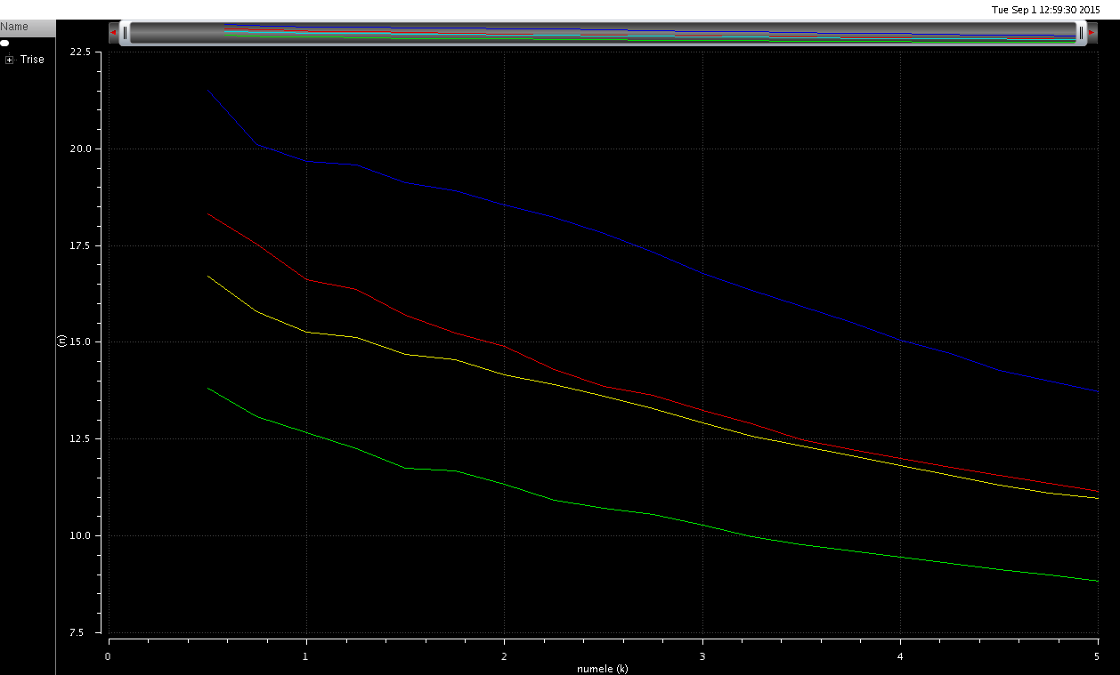
Trise vs signal
T = +40°
T = -40°
Signal at Pre-Amp output from 500e- to 5Ke- in 250e- steps
All process corners (NOM, FAST, SLOW, SF, FS)
Ileakage = 0A
Trise increases as Temp decrease

Slide 9
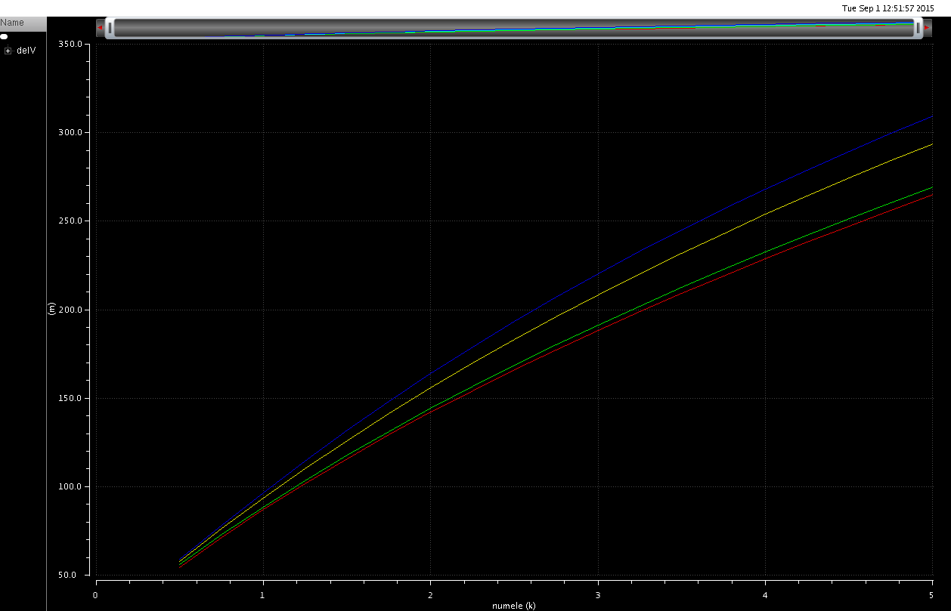
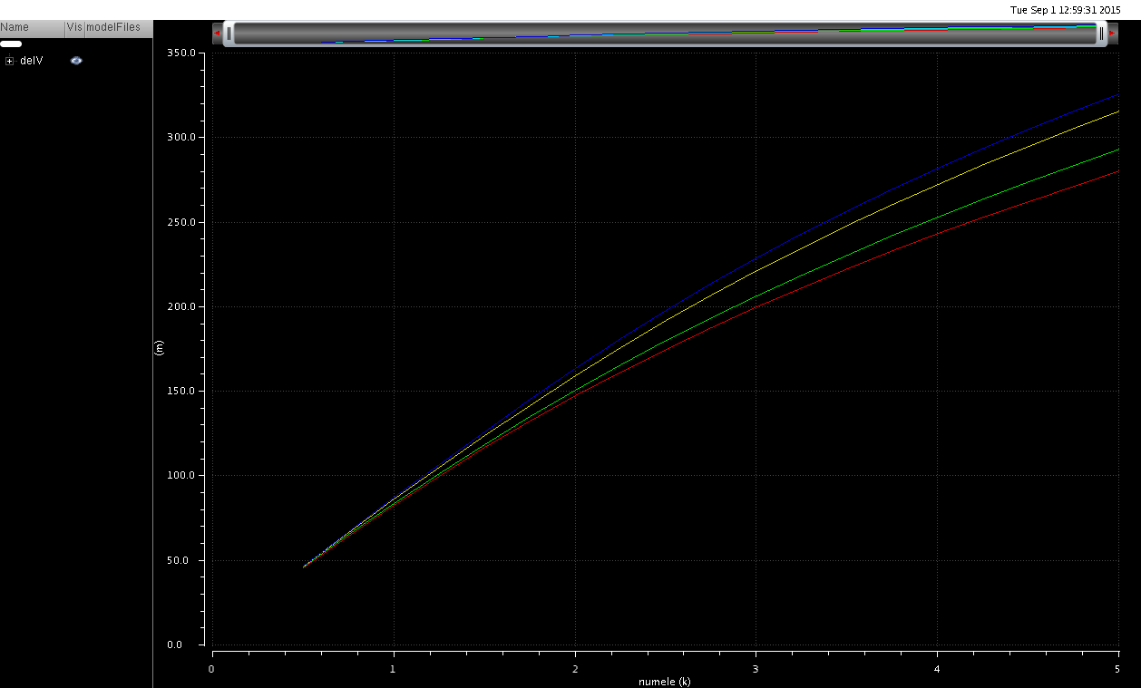
Output pulse amplitude vs signal
T = +40°
T = -40°
Signal at Pre-Amp output from 500e- to 5Ke- in 250e- steps
All process corners (NOM, FAST, SLOW, SF, FS)
No significant change in gain

Slide 10
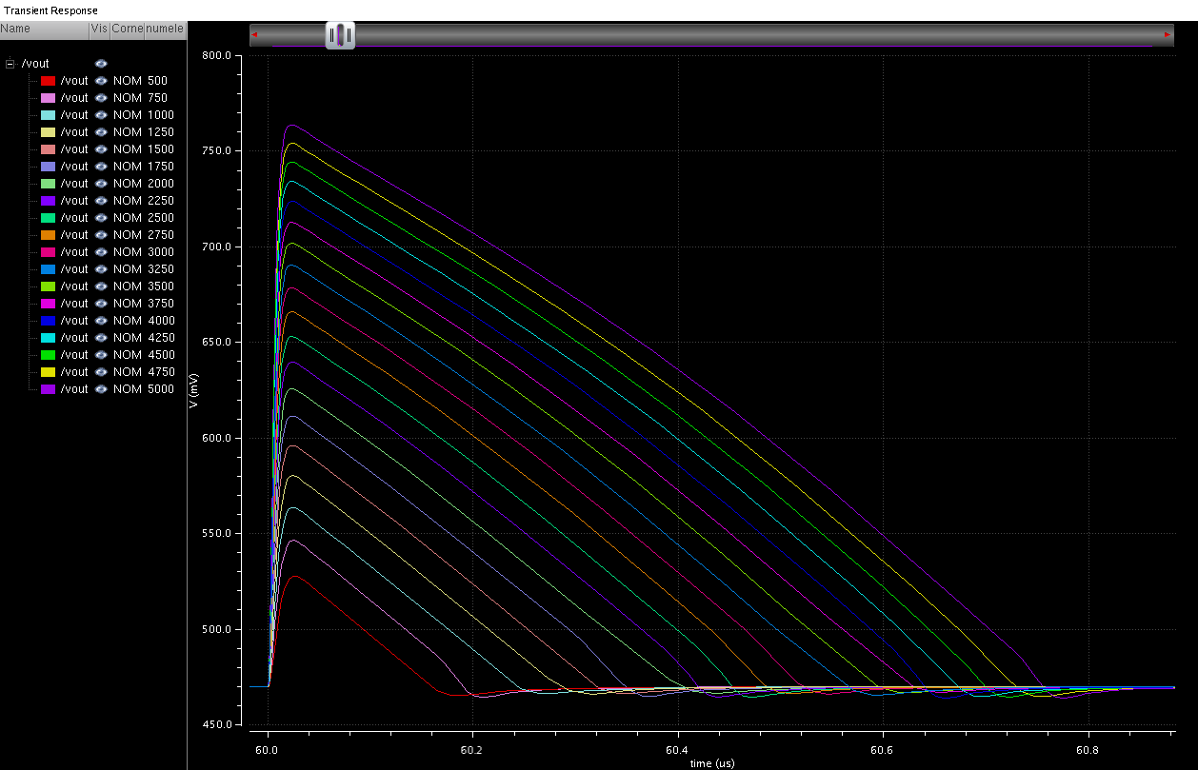
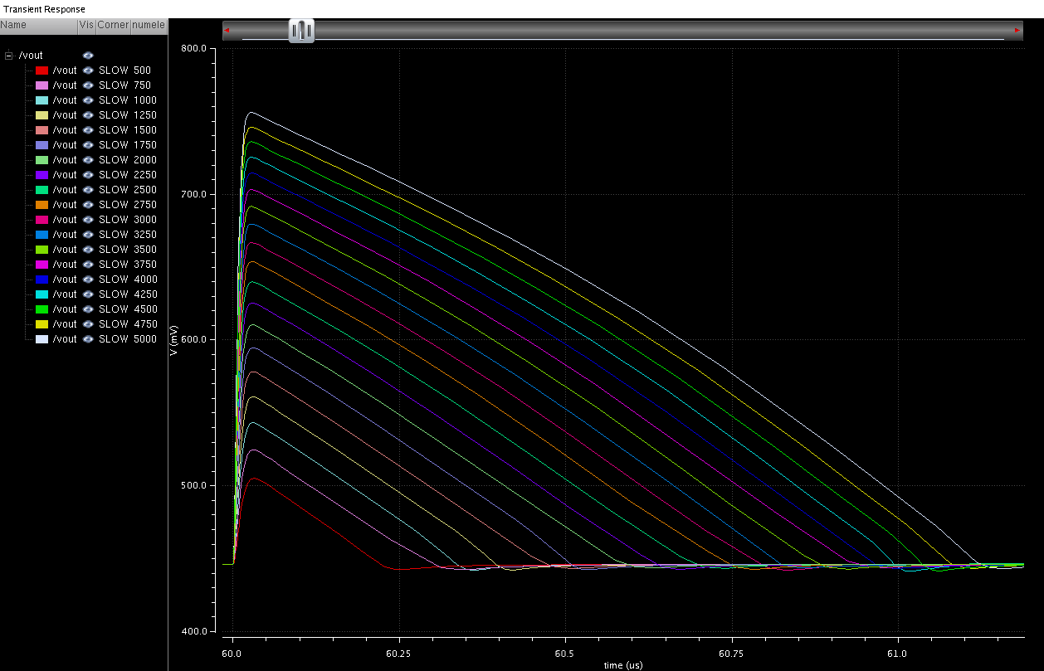
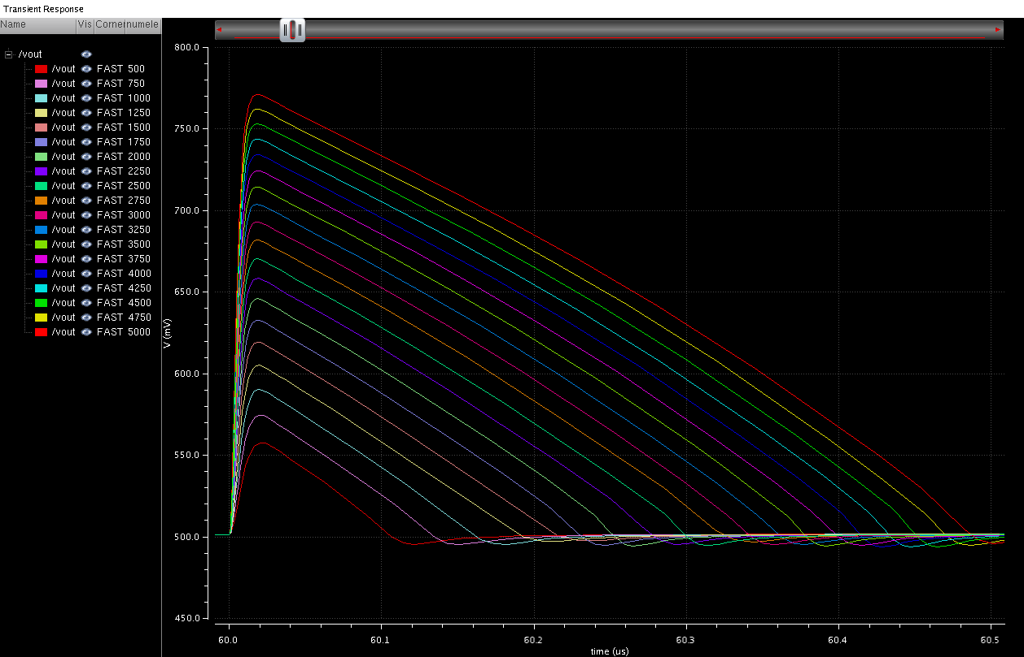
Output pulseshapes vs signal
Temp = +40°
FAST
NOM
SLOW
Signal at Pre-Amp output from
500e- to 5Ke- in 250e- steps
Ileakage = 0A

Slide 11
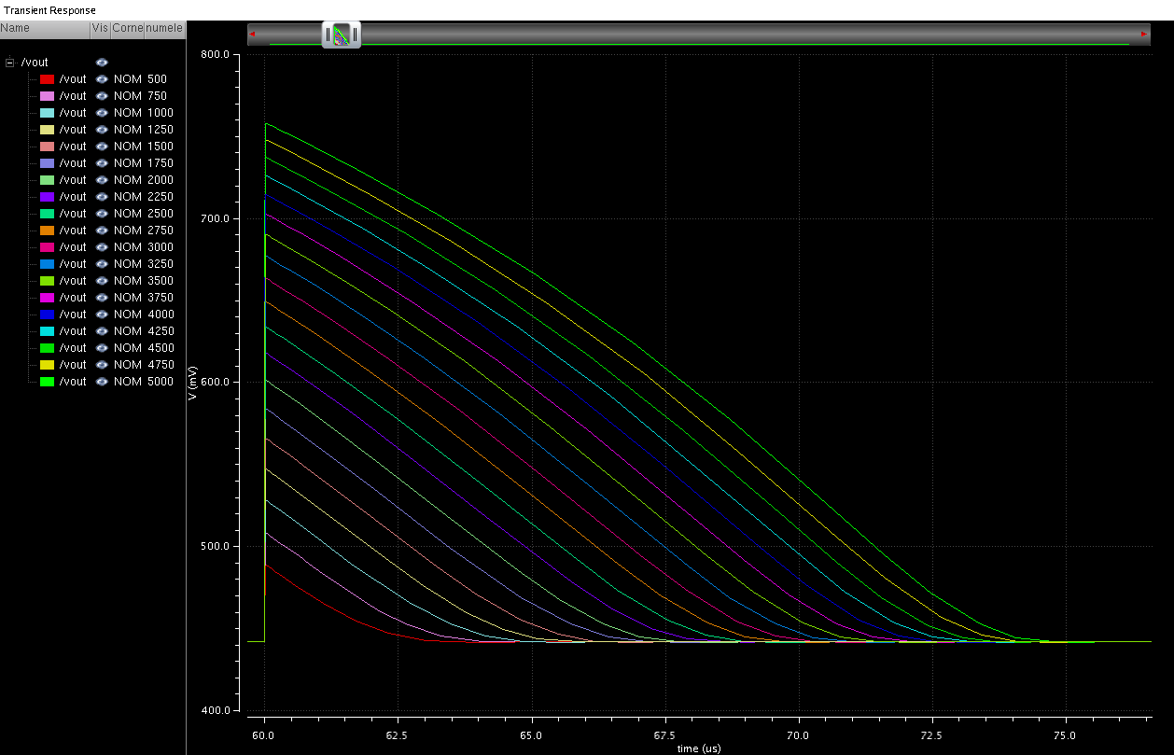
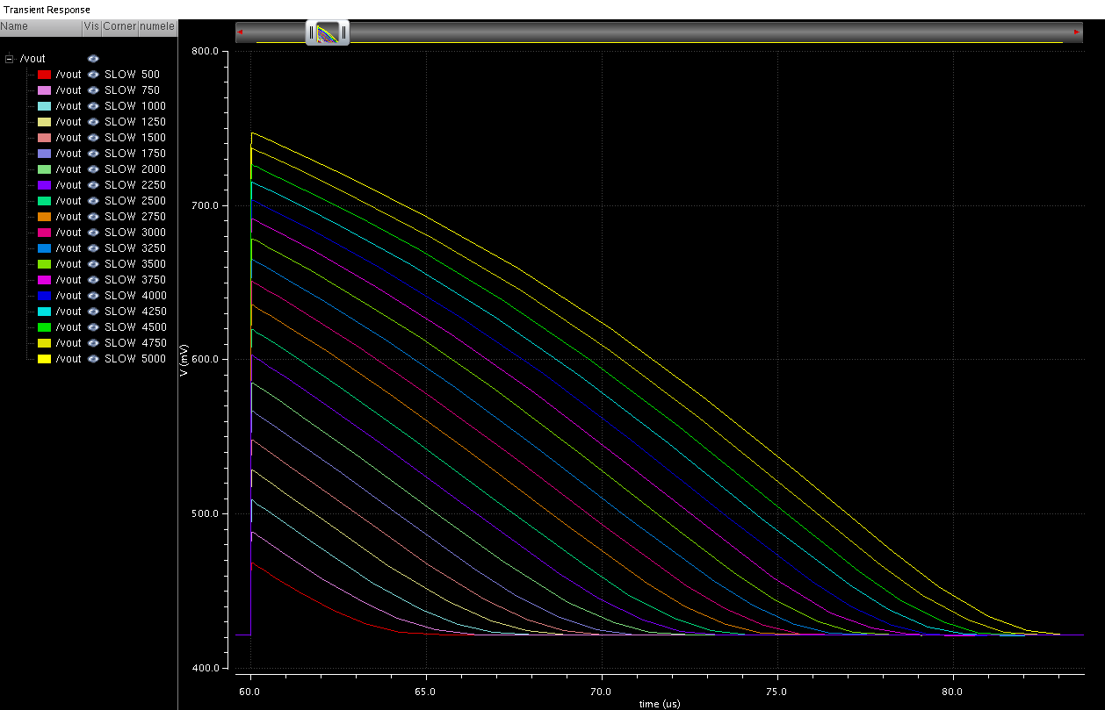
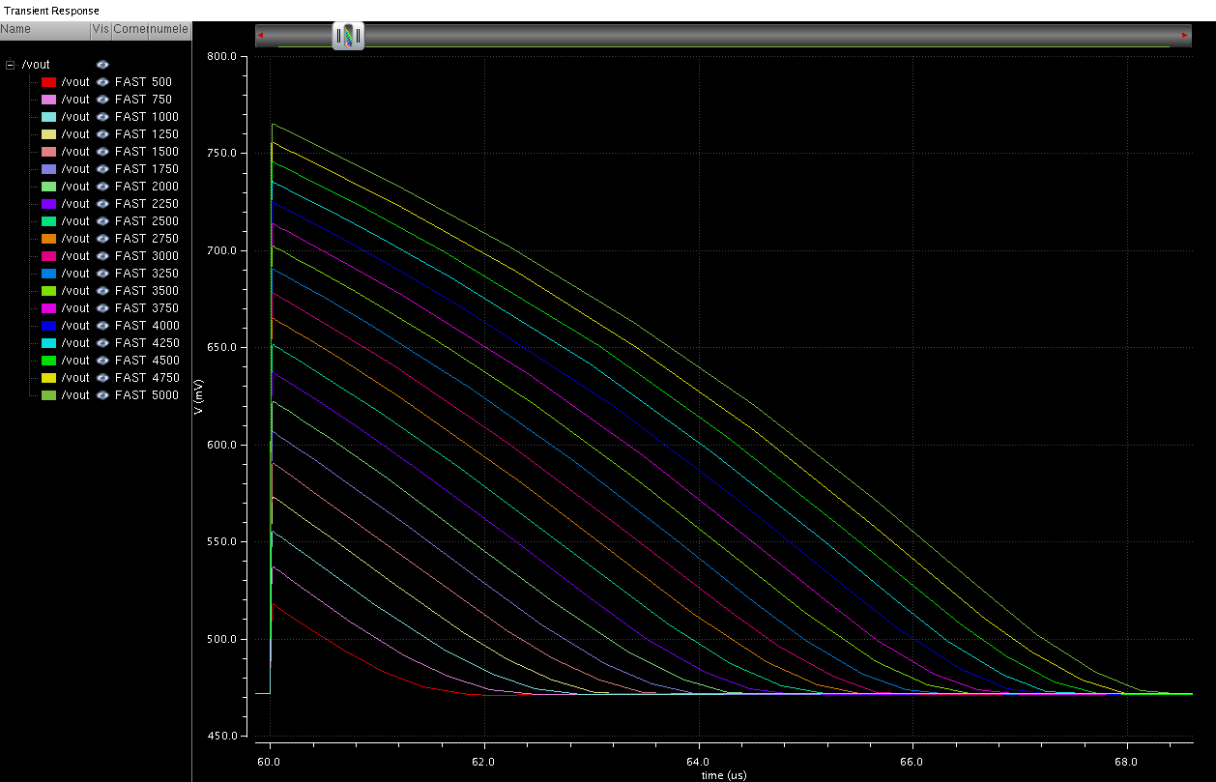
Output pulseshapes vs signal
Temp = -40°
FAST
NOM
SLOW
Signal at Pre-Amp output from
500e- to 5Ke- in 250e- steps
Ileakage = 0A

Slide 12
Conclusions
The pre-amplifier seems to be robust across all process corners and
temperature extremes
Leakage current: up to 10nA, also looked at 1uA
Temperature: -40°C to +40°C
All functional process corners
Need to simulate time-walk across all process corners

