Slide 1
B2ACCESS
LSDMA AAI Workshop, KIT
Jens Jensen
STFC Rutherford Appleton Lab
30 September 2015
Some slides by Willem Elbers and
Johannes Reetz

Slide 2

AAI approach
username & passwd
x.509
OpenID
Unicore
Contrail
google
Multi
(LoA)
SAML
Authorization
Server
EUDAT CA
IDP₁
IDP₂
Attributes
Authz
attributes
SLCS
(uid + attributes)
IDP_{n}
B2ACCESS UserDB
(B2ACCESS uids)
ldap
……..
……..
……..
SAML
DN: EUDAT uid
Attributes:
Community uid
…

Slide 3
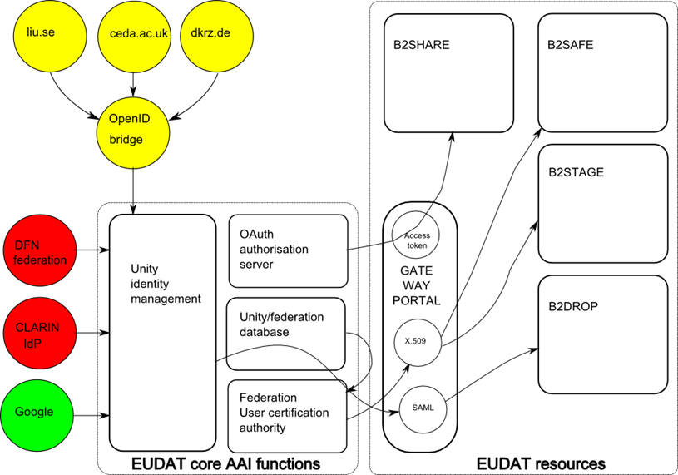




B2ACCESS service op‘d by JSC status Sept 2015
Central Registry
GOCDB
EUDAT services

Slide 4
Purpose
Several authentication methods supported
X.509 (SLCS) with SAML attributes
  Used to drive GridFTP
  Used to access B2SAFE (based on iRODS)
OAuth2
  Simple authorisation (few attributes)
  Used with B2SHARE (based on Invenio)
SAML
  Web SSO profile
  Used with B2DROP

Slide 5
Current State
Production Instance @ FZJ
  up and running:
    https://b2access.eudat.eu:8443/home/home
    https://b2access.eudat.eu:8443/admin/admin
Integration
  Identity Providers
    Unity accounts, Social Identities, SAML Federations
  Service Providers
    B2SHARE, using OAUTH
    GOCDB, using SAML
Notes:
* Supported social identities:
Google
* Supported SAML federations:
DFN?
CLARIN in progress
* Service providers have been integrated in the staging environment. As soon as the production deployment is finished, the production services should be integrated.

Slide 6
Current State
Groups and Attributes
  Management per B2 service
  Document available at [1]
Level of Assurance
  Based on the Identity Provider used to log in
  Social identity = lowish
  SAML = highest
    Generally academic accounts, federation policies
Finalising documentation
  End-user documentation under review
  Service integration documentation under construction
[1] https://confluence.csc.fi/download/attachments/51880268/B2ACCESS-GroupsandAttributes.pdf

Slide 7
Integration Activities
Service Providers
  B2SAFE (based on iRODS)
    Based on short lived certificates
    Authorization records are still an open question
  B2DROP (based on OwnCloud)
    Web-based approach based on SAML
    Non web-based scenario requires further analysis
  Data Project Coordination Portal
    Based on SAML
Notes:
B2SAFE
B2DROP
DPCP

Slide 8
Integration Activities
Identity Providers
  EduGain
    Code of Conduct
    Jülich will negotiate with EduGain
  Client Certificates (IGTF)
    Can provide high(est) level of assurance
  Community IDPs
    Needed for communities / IDPs outside of EduGain
    E.g. CLARIN’s IdP, Umbrella

Slide 9
Integration Activities
Infrastructures
  Collaboration with AARC
    Currently in the process of discussing the current state of EUDAT and defining requirements for the AARC project
  Collaboration with EGI, PRACE, LSDMA?
    Especially with respect to the integration with B2STAGE
    Investigate cross infrastructure delegation: A user has data in PRACE and wants to utilise EUDAT service or vice versa.
Notes:
AARC requirements (not finalised):
- There should be harmonisation of the attributes which will be used by the scientific communities for cross e-Infrastructure collaboration.
- Scientific Communities should be able to provide attributes for their members in an interoperable way. Due to the lack of community based attribute providers, e-Infrastructures have to provide this functionality for the collaborating communities.
- A Level of Assurance framework both for authentication and for attribute release.
- What type of privacy statement should a service use? AARC should offer a best practice term and conditions that service providers (operated in the R&E) should use.

Slide 10
Future Plans
Ongoing goals
  Integrate more service providers
  Integrate more identity providers
  Resolving issues
    Usability
    Missing features
    Addressing security concerns
  Distributed Authorization Records
  Start analysis to investigate requirements
  Based on work from EUDAT1: Attribute Authorities provided by communities

Slide 11

Actions for Today
Share our stuff…!
Look for multi-hatted people
Find common ground and work together
B2ACCESS can be used by other projects !
Most of our docs are readable (and writable) only with authentication ☹
http://hdl.handle.net/11304/daa5df62-6753-11e5-9bb4-2b0aad496318

Slide 12
URLs
Contact: jens.jensen -@- stfc.ac.uk
Test systems
  B2ACCESS
    https://b2access.fz-juelich.de:8443/home/home
  Certificate portal
    https://eudat-aai.fz-juelich.de:8445/oauth-demo/get_token.jsp
Production
  https://b2share.eudat.eu/
Software (Shiraz to help set up!)
  http://unity-idm.eu/
  https://bitbucket.org/eudataai/
  Shiraz Memon <a.memon -@- fz-juelich.de>

