Slide 1
Second MT Student Retreat
Karlsruhe Institute of Technology
07. – 08. March 2016
Djorn Karnick

Slide 2






Participation
18 Registrants

Slide 3
The Retreat
Scientific talks
PowerPoint presentations
Overhead projector presentations
Thanks to all speakers
N. Divani-Veis, U. Einhaus, O. Fedorchuk, F. Hinder, B. Kehrer,
R. Pausch, P. Schönfeldt, K. Steiniger, W. Tan
Discussion about working conditions
Dinner & get-together
Tour: ANKA synchrotron radiation facility

Slide 4
Scientific Talks
ARD
Measurement of Electric Dipole Moments in Storage Rings
Simultaneous detection of longitudinal and transverse beam signatures
Design study for an FEL by Traveling-Wave Thomson-Scattering
Radiation as synthetic diagnostic in the particle-in-cell code PIConGPU
DTS
Automatic design and optimization of ultrasound imaging system
A TPC readout with Timepix and pads
Investigations of the long-term stability of a GEM-TPC
Development of GEM-tracking detector for PANDA Experiment

Slide 5
Discussion: Most pressing issues
Funding of PhD student positions:
scholarships (temporarily) substitute regular funding
Short-termed employment contracts discourage PhD students
to pursue a postdoc position after graduation
Proceeding of projects when students have finished
  No overlap period when a new student continues the work
  Potential successor starts from scratch
A mentoring for students would be desirable
A representative should be assigned to connect to
Helmholtz administration → Helmholtz Juniors

Slide 6
Result of Survey
Very good
Good
Average
Turnout approximately a third of participants

Slide 7

Result of Survey
Do you consider participating again next year?
Turnout approximately a third of participants

Slide 8
Result of Survey
Remarks
The plenary discussion is all fine –
but to whom the results will be directed?
Improvement
Introduction of speakers, topics and audience
→ general introduction session
A Helmholtz Juniors representative should also speak
Clear schedule for contributions
  It would help if participants consented to submit a
  contribution well before Friday afternoon ;)

Slide 9
Acknowledgments
MT Administration Team
Saskia Baier, Christiane Buchwald and Antje Martin
Department of Mathematics
Ingrid Lange and Dr. Klaus Spitzmüller
Co-organizers
Paul Malek, Patrik Schönfeldt, Wei Yap Tan
Prof. Marc Weber
All participants and contributors!

Slide 10
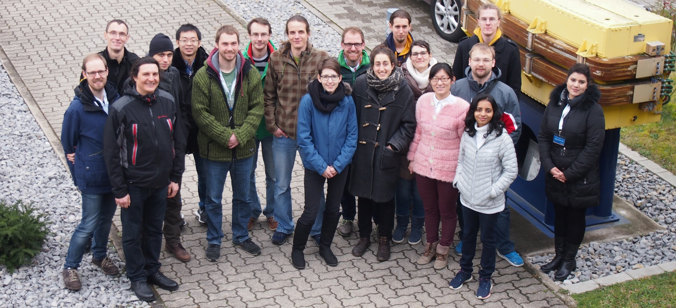
Summary
Retreat was a success!
Large variety of scientific topics
Extensive and constructive discussion
Ratio of participants from topics ARD and DTS was balanced

Slide 11
Thank you for your attention!

