Slide 1


Report on the joint
Pohang XFEL – SwissFEL – European XFEL workshop on commissioning
Bolko Beutner, Winni Decking, Matthias Scholz (DESY)
Notes:
How to edit the title slide
Upper area: Title of your talk, max. 2 rows of the defined size (55 pt)
Lower area (subtitle): Conference/meeting/workshop, location, date,
your name and affiliation,
max. 4 rows of the defined size (32 pt)
Change the partner logos or add others in the last row.

Slide 2
Introduction
Satellite meeting held after FEL2015 in Daejeon
About 20 participants from PAL, PSI, DESY, and SLAC
Topics
  Inform about strategies, boundaries, and schedule
  Identify areas of collaboration
  Discuss exchange of information and personel
  Establish communication links
  Define action items
Preparation: Questionnaire
https://indico.psi.ch/categoryDisplay.py?categId=224
Notes:
Before you start editing the slides of your talk change to the Master Slide view:
Menu button “View”, Master, Slide Master:
Edit the following 2 items in the 1st slide:
1) 1st row in the violet header:
Delete the existent text and write the title of your talk into this text field
2) The 2 rows in the footer area: Delete the text and write the information
regarding your talk (same as on the Title Slide) into this text field.
If you want to use more partner logos position them left
beside the DESY logo in the footer area
Close Master View

Slide 3
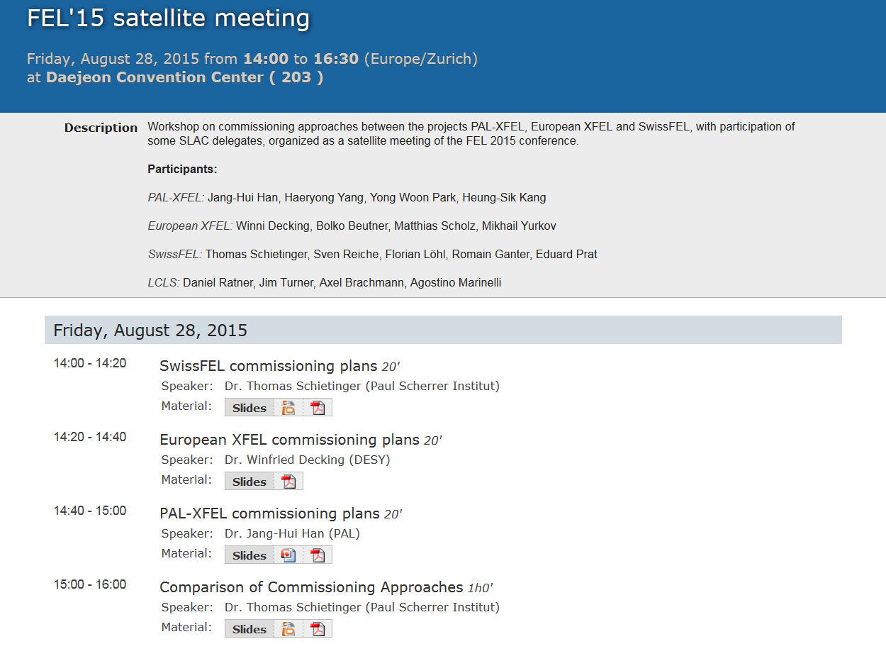
Introduction
Notes:
Before you start editing the slides of your talk change to the Master Slide view:
Menu button “View”, Master, Slide Master:
Edit the following 2 items in the 1st slide:
1) 1st row in the violet header:
Delete the existent text and write the title of your talk into this text field
2) The 2 rows in the footer area: Delete the text and write the information
regarding your talk (same as on the Title Slide) into this text field.
If you want to use more partner logos position them left
beside the DESY logo in the footer area
Close Master View

Slide 4




Main Input from

Slide 5
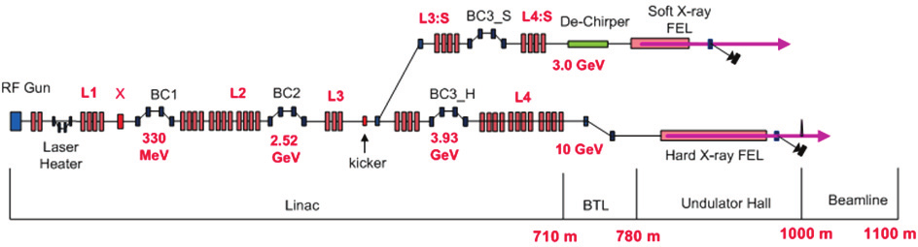
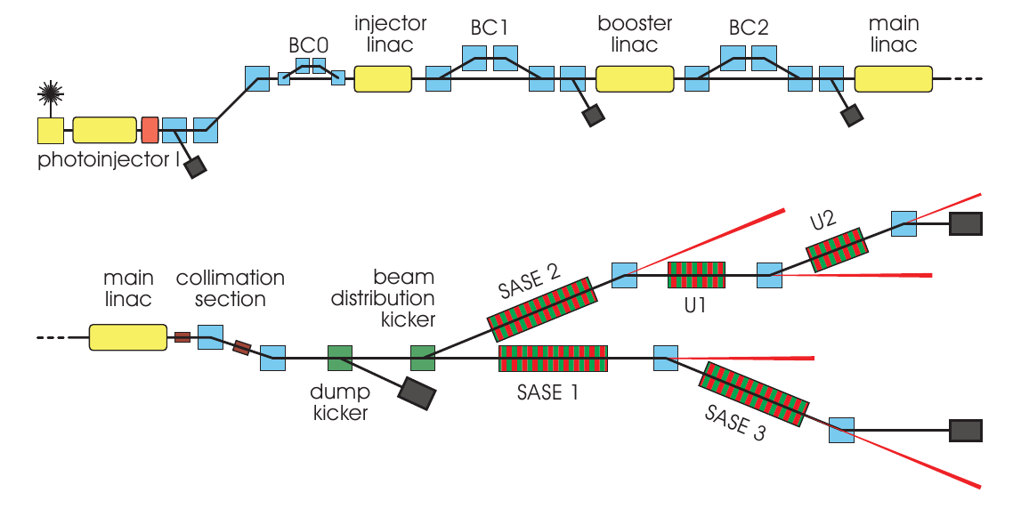
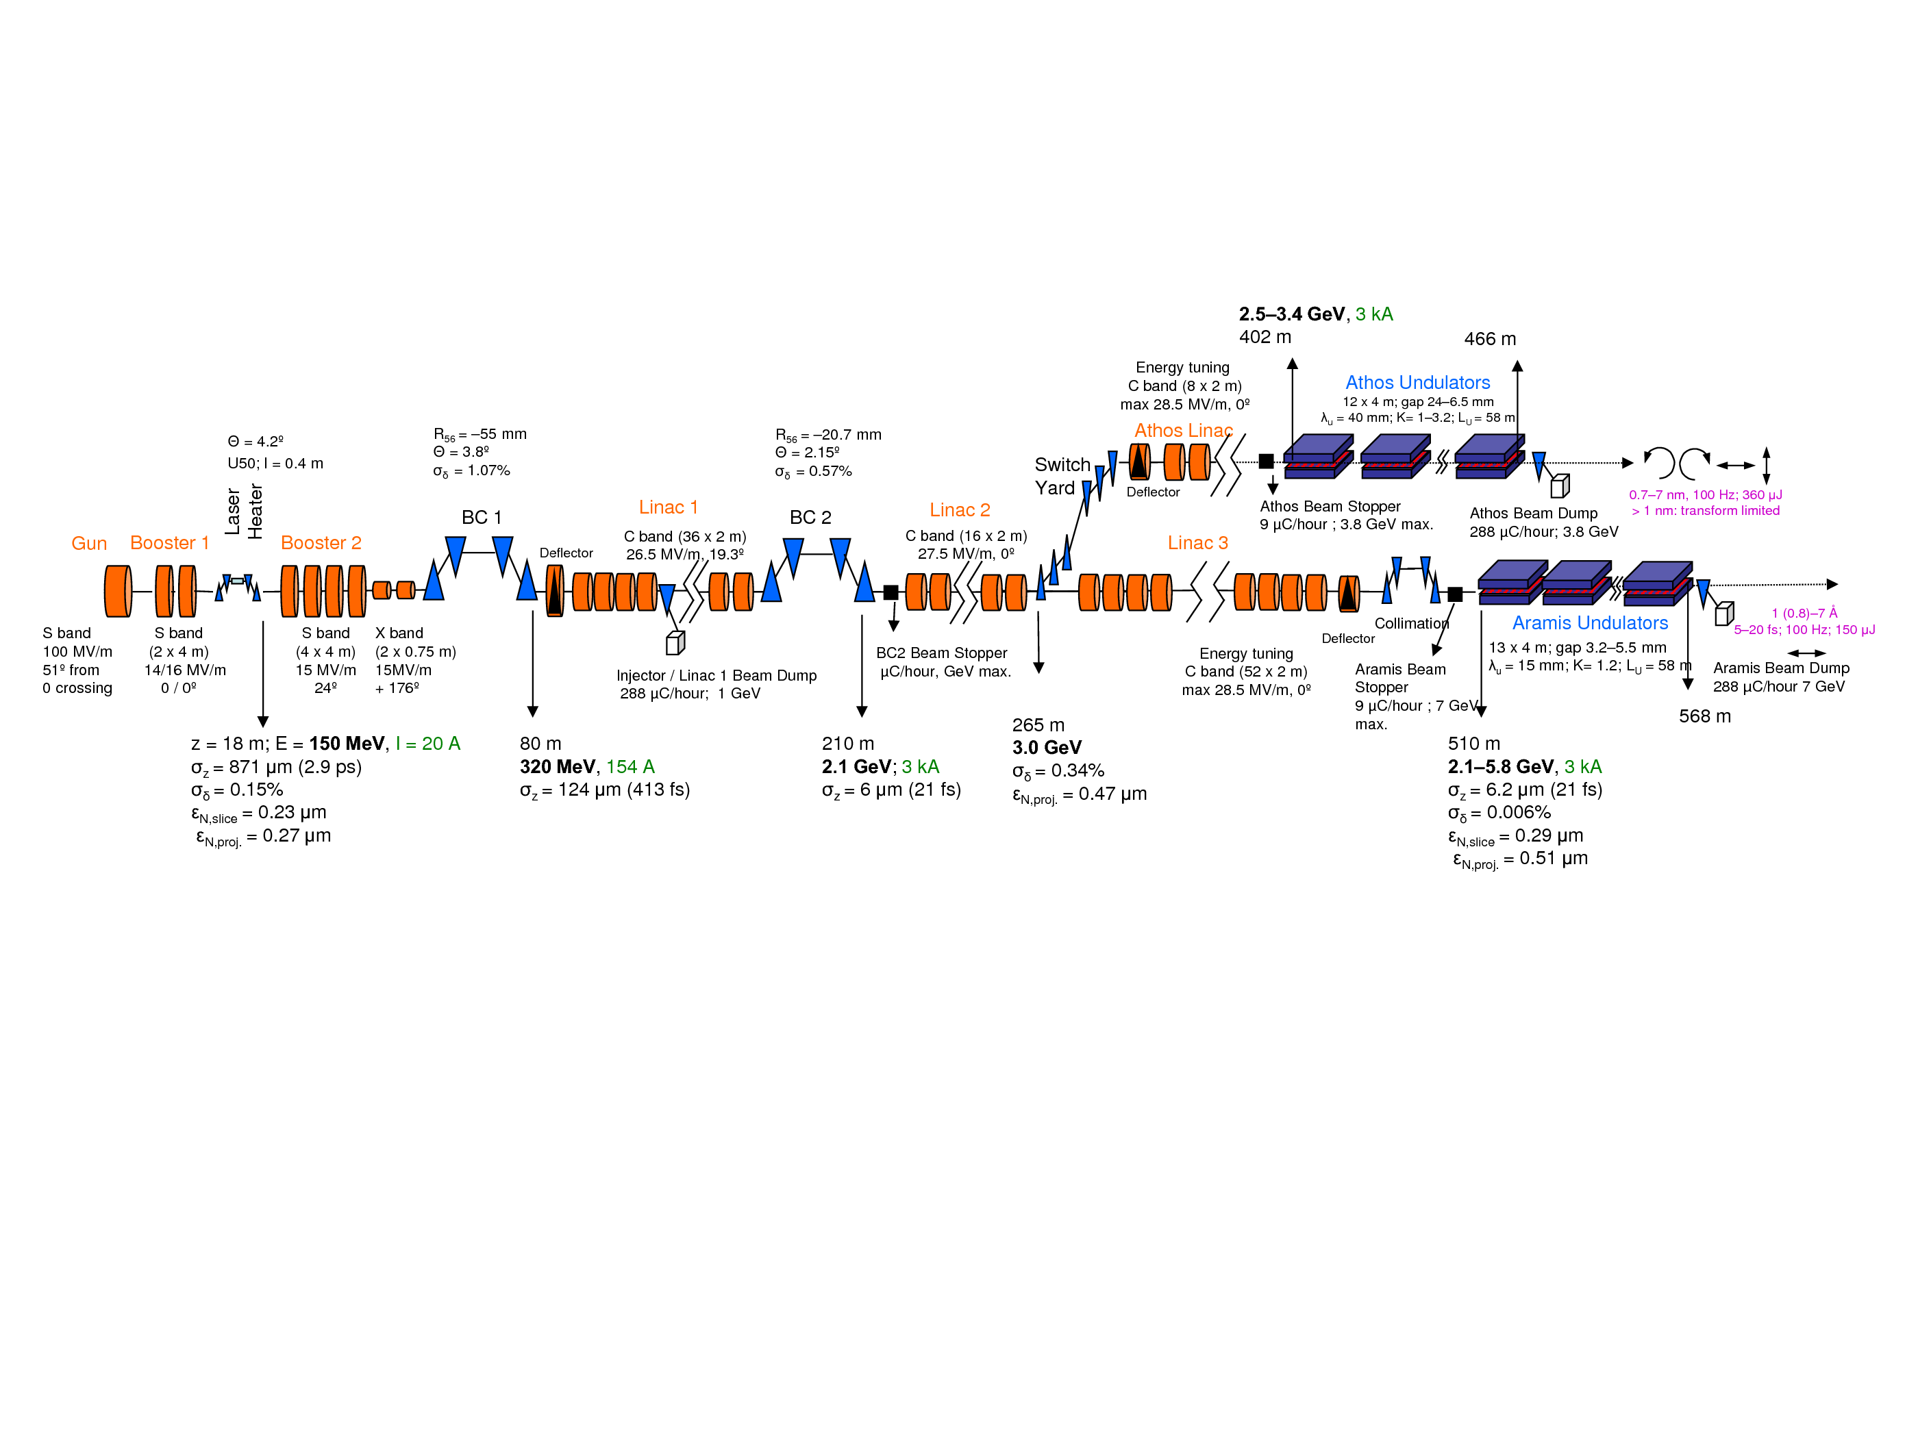
Machine Layout
PAL XFEL
1100 m
Standard S-Band
10 GeV
~ 200 W beam power
2 Undulators
European XFEL
3300 m
SC L-Band
17.5 GeV
~ 1 MW beam power
3 Undulators
800 m
New C-Band
5.8 GeV
~ 100 W beam power
1 Undulator
SwissFEL

Slide 6
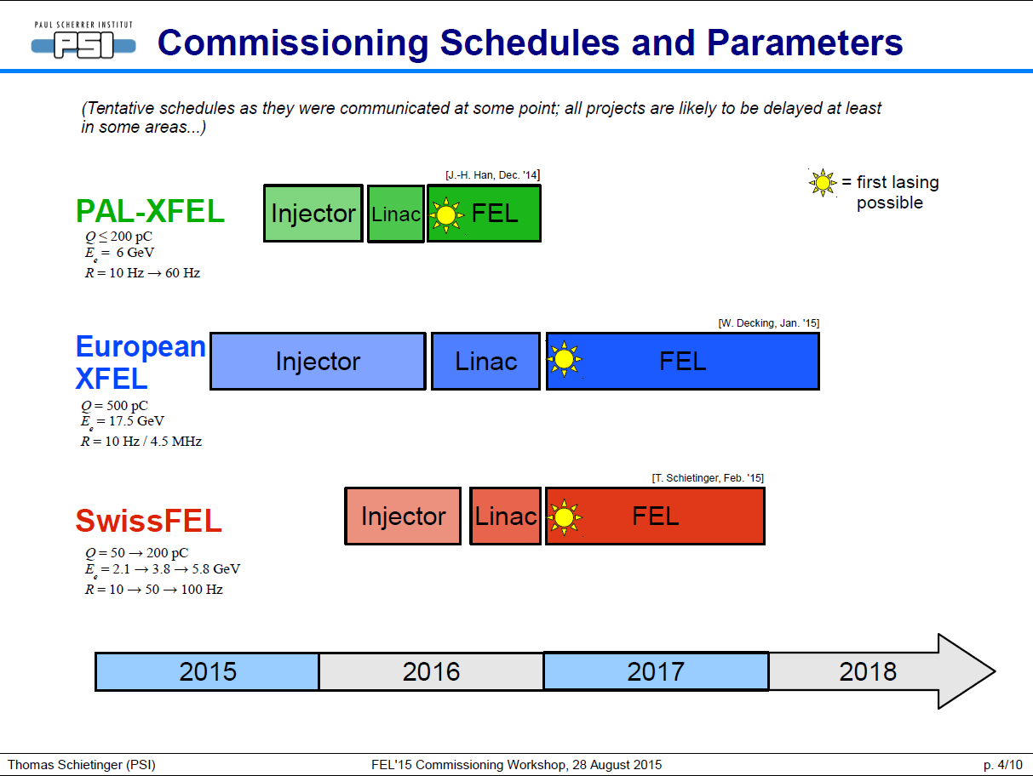

Slide 7
Commissioning Milestones and Schedule
  First milestone of XFEL commissioning (June 2016):
  0.25 nm SASE radiation with 6 GeV electron beam
  6 GeV beam at linac end (Gun&L0: 100% gradient; L1, L2: 80%; L3a, L3b, L4: 60%)
  Repetition rate 10 Hz
  Relaxed beam parameters
      200 pC is nominal, but 100 pC or lower bunch charge is an option
      Gun drive laser with a Gaussian longitudinal profile
      Less peak current (weaker bunch compression) for weaker collective effects
  Second milestone of XFEL commissioning (December 2016):
  Hard X-ray 0.1 nm SASE with 10 GeV beam
  Soft X-ray 3 nm SASE
  200 pC, 20 pC
  Demo experiments
  Repetition rate 10 Hz
 | 2015 |  |  |  | 2016
 | S | O | N | D | J | F | M | A | M | J | J | A | S | O | N | D
Injector install in XFEL, S&A
Linac component install, S&A
Undulator component install, S&A
Injector commissioning
Linac RF conditioning (10 Hz)
Linac beam commissioning
FEL commissioning
Maintenance
6 GeV
10 GeV

Slide 8
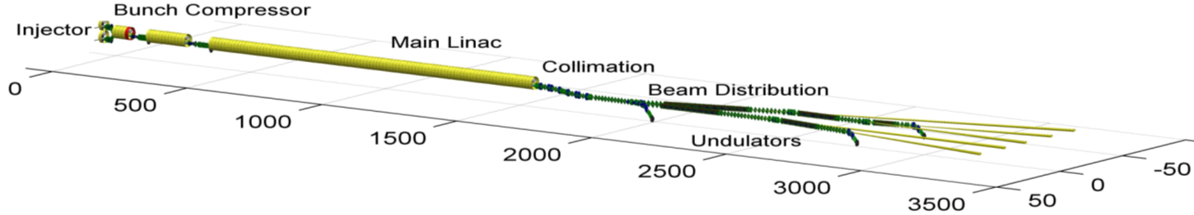

Beam Commissioning Schedule
2014
2015
2016
2017
2018
First e-beam out of RF gun installed at XFEL
Injector cooldown
Linac cooldown
SA1
SA3
SA2
Start user operation
Full TDR performance
1st lasing possible
e⁻
Gun and injector laser com.
Injector com. up to full XFEL performance (varying charges and bunch patterns, laser heater, slice diagnostics, intra-train feedbacks, automated procedures)
Initial linac com. with reduced performance
Continued accelerator com. to full performance (high beam power, bunch length flexibility, multiple bunch properties per rf-pulse, full wavelength tuneability, ….)
γ
Beam line and experiment com.
. First user operation

Slide 9
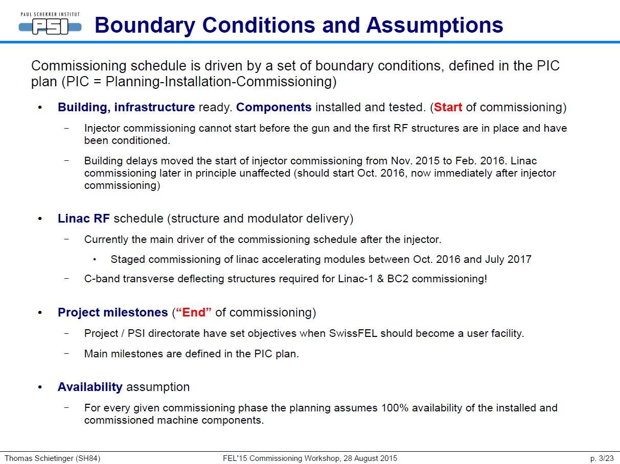

Slide 10
ARAMIS Commissioning – Overview
see MOP017!

Slide 11
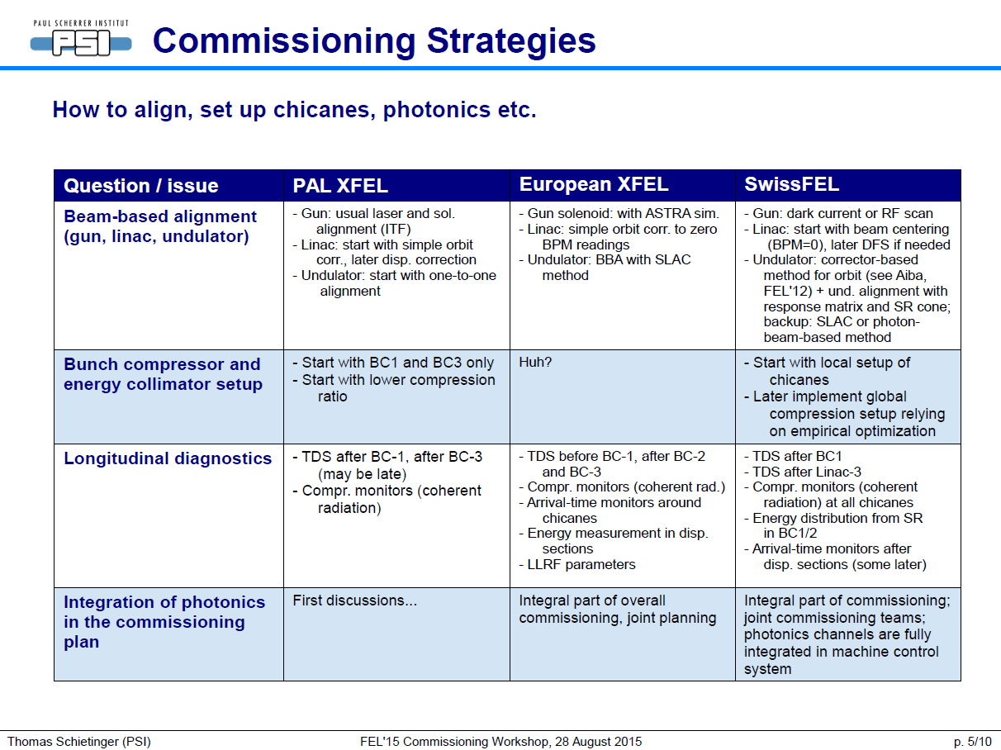

Slide 12
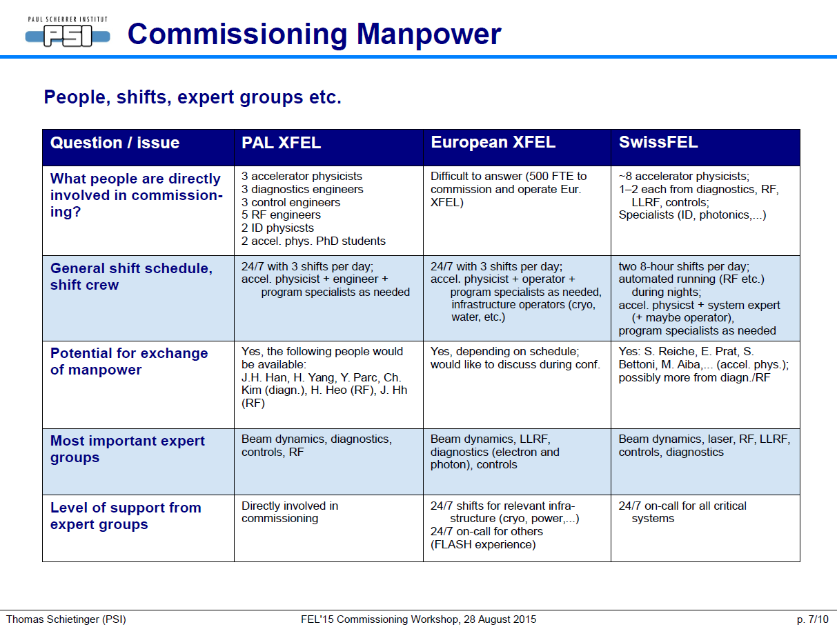

Slide 13
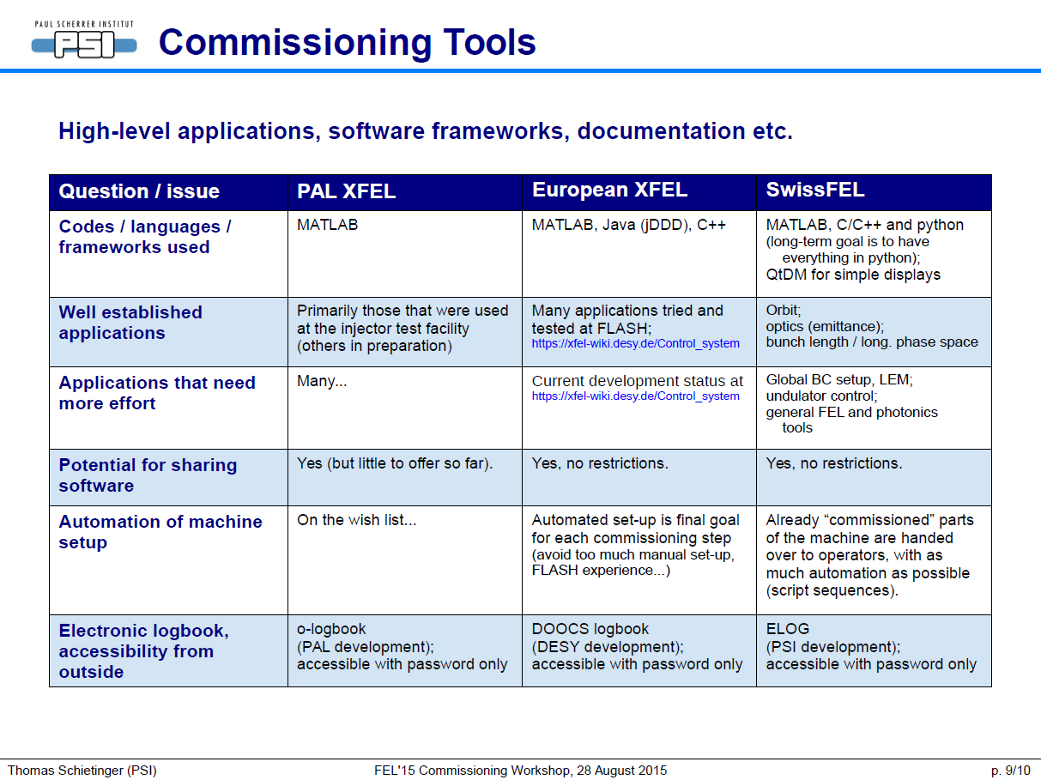

Slide 14
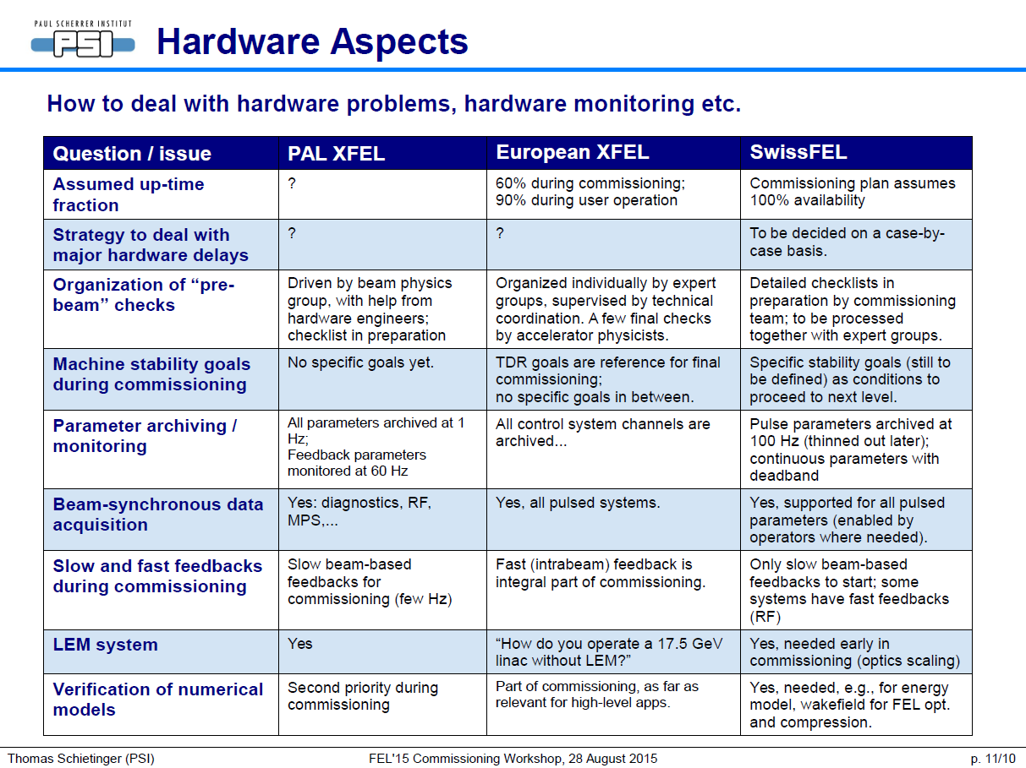

Slide 15
Summary
Exchange of Personnel
  Difficult because of parallel schedules
  Most likely based on ‘business trip model’ (i.e. 2 weeks)
  Great interest from LCLS to join European XFEL commissioning for longer periods
  Plan to provide some “dry training” for visitors beforehand
  Action: Provide a list of specialists with their respective fields of expertise to give an “inventory” for possible exchanges

Slide 16
Summary
Exchange of Software/Procedures:
  Exchange of software difficult because of control system/machine peculiarities
  Pragmatic approach is to base software exchange on personnel exchange
  Procedures: collect task procedures from running facilities (LCLS, SACLA, FLASH, Fermi) if available (SLAC delegates promise to make them available)
Communication
  Meet again during 5-way meeting in October
  Action: Make logbooks, Wikis, etc. accessible
  Exchange moderated shift summaries on the public web to keep others informed

