Slide 1
The universal PCI Express Device Driver for MTCA.4
L.Petrosyan

Slide 2
The Universal PCI Express Device Driver
User Application
Basic PCI Express functionality
Mapping memories
Read, write and some common ioctl
Error handling
Hot Plug
Standards or Guidlines functionalty
Standard Registers Set
SHAPI Registers Set (PICMG)
PICMG Standard Device Model
PCIe HotPlug functionality
Device specific but has common API
DMA
Device specific functionality
API
API
DriverAPI
DriverAPI
Device Driver
Device Driver
PCI Express
Device
PCI Express
Device

Slide 3
The Universal PCI Express Device Driver
User Application
Split Device Driver into two parts follow the Linux Device Driver stacking Model
Add all common functionality and API into universal part
Basic PCI Express functionality
Standards or Guidlines functionalty
Add Common API for Device specific functionality into universal part but keep functionality in Device Driver side
Device specific but has common API
API
API
API
Common API
DriverAPI
DriverAPI
Device Driver
Universal
Device Driver
Device Driver
PCI Express
Device
PCI Express
Device

Slide 4
The Universal PCI Express Device Driver
User Application
this approach facilitates creation of new drivers and user applications
The Device Driver created on the top of universal driver has all necessary PCI Express functionalty
It could be binded to any PCI Express Device
echo „10EE:0088“ > /sys/bus/devices/xxx/driver/new_id
facilitates integration of new devices into the existing software
API
API
API
Common API
DriverAPI
DriverAPI
Device Driver
Universal
Device Driver
Device Driver
PCI Express
Device
PCI Express
Device 10EE:0088
PCI Express
Device

Slide 5
The Universal PCI Express Device Driver
Drivers and tools set
OS (device drivers)
User applications
UPCIEDEV base level driver
MTCAMONITOR
API header:
read (structure rw)
write (structure rw)
ioctrl (structure io)
DMA (structyre dma_io)
Read
Write
Common IOCTRL
DMA
PCIEDEV top level driver
PCIe ID 10EE:0088
Functions:
attuch (PCIe IDs)
io_map()
remove()
read()
write()
ictrl() (slot, info, bit …)
Functions:
ictrl()
read_dma()
write_dma()
common

Slide 6
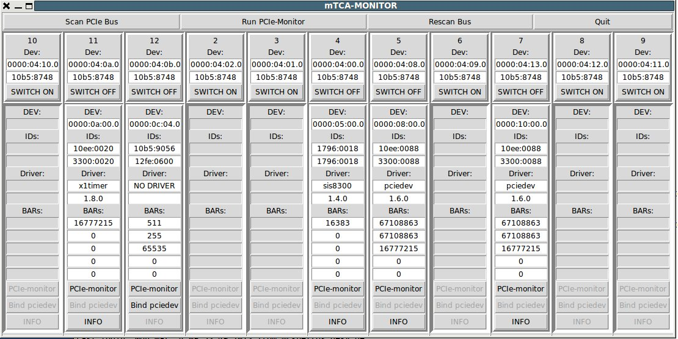
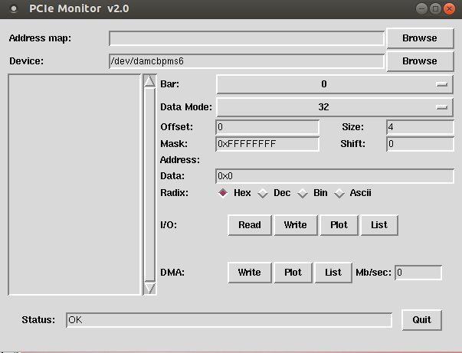
The Universal PCI Express Device Driver
MTCAMONITOR
MTCAMONITOR shows all
Attached AMC(PCIe) boards
And provides read/write access

Slide 7
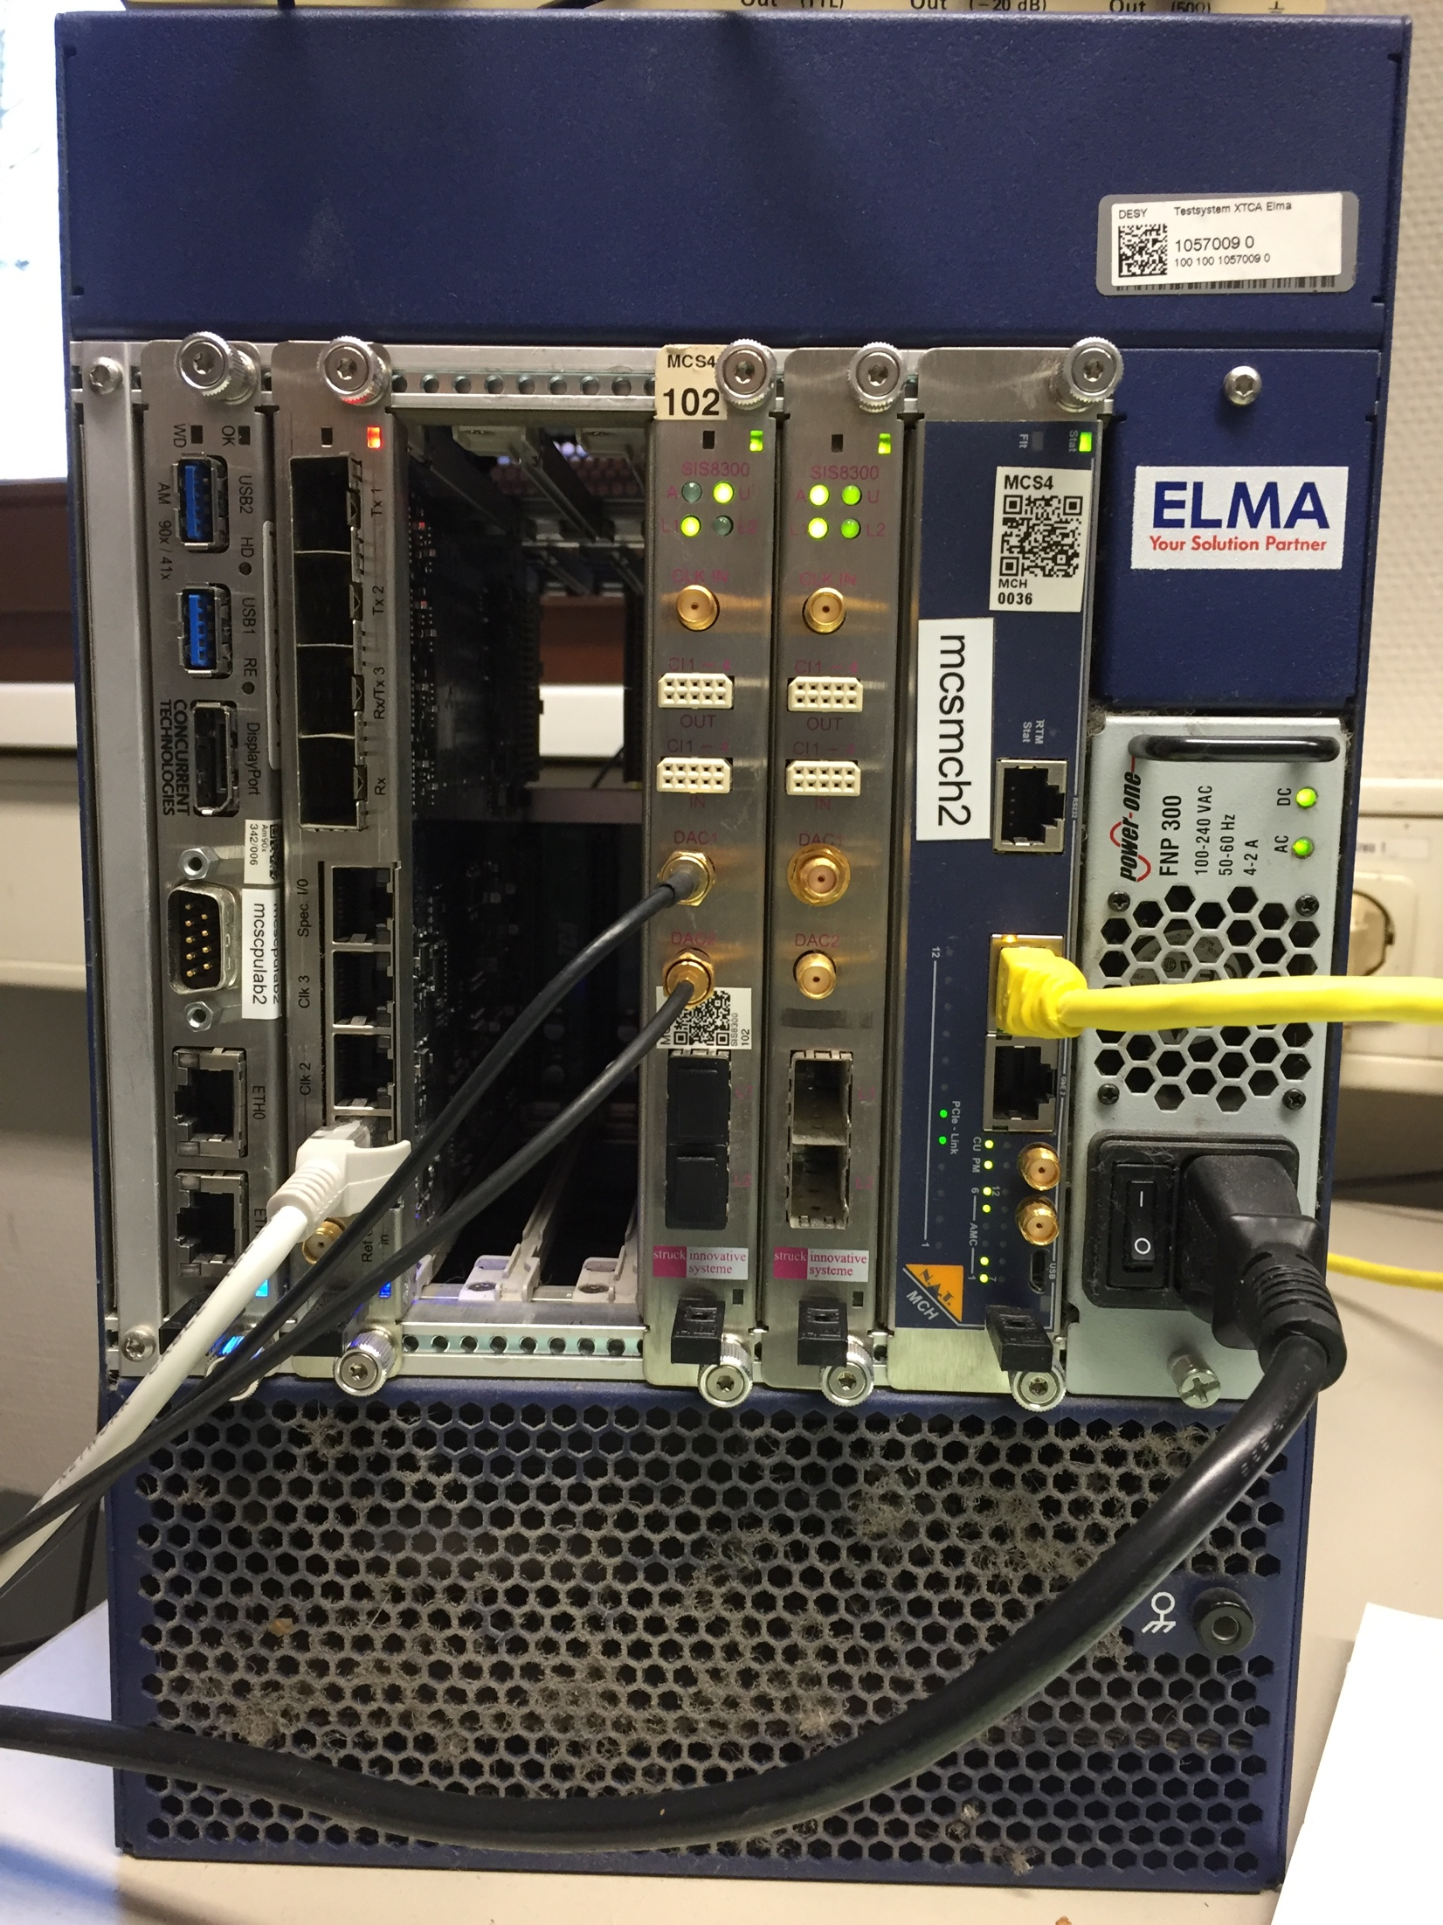
The Universal PCI Express Device Driver
X2TIMER MODULE
FPGA FW based on DESY START_UP PROJECT
Has separate device driver, but based on the universal
driver API
PCIe ID 10EE:0020
SIS8300 BOARD LCBPM
FPGA FW based on DESY START_UP PROJECT
PCIe ID 10EE:0088
SIS8300 DIGITIZER
STRUCK FW with DMA R/W
PCIe ID 1796:0018, 1796:0019

Slide 8
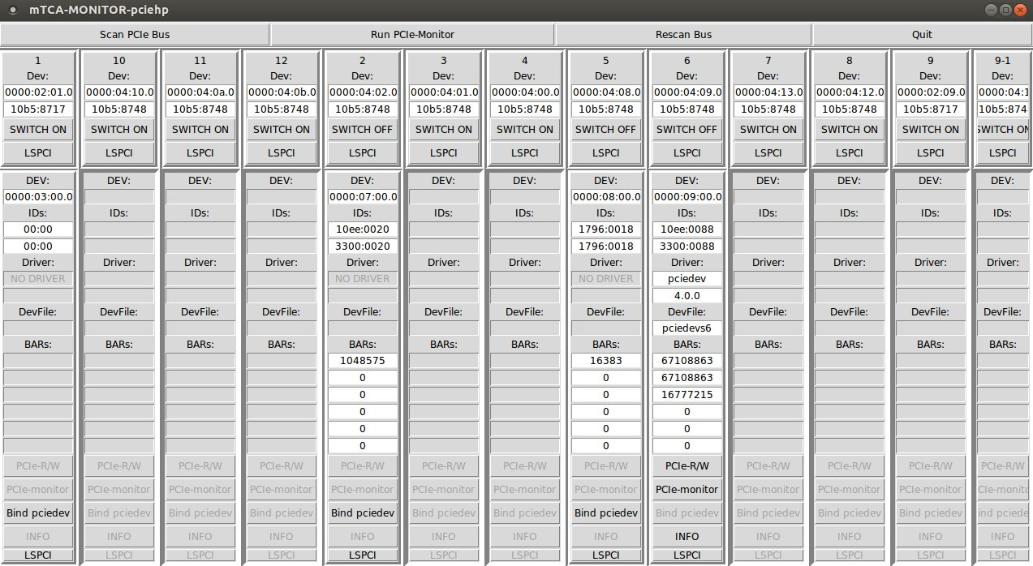
The Universal PCI Express Device Driver
Switch ON the crate
SIS8300 board with the LCBPM project was binded to pciedev driver.
No drivers for X2TIMER and SIS8300 with the STRUCK FM boards
The “Bind pciedev” button activated for the boards which has no driver binded
We can bind pciedev driver to X2TIMER and SIS8300 boards

Slide 9
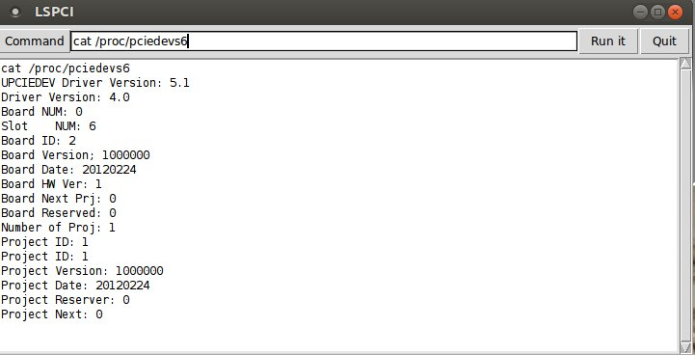
The Universal PCI Express Device Driver
We can get board information pushing “INFO"

Slide 10
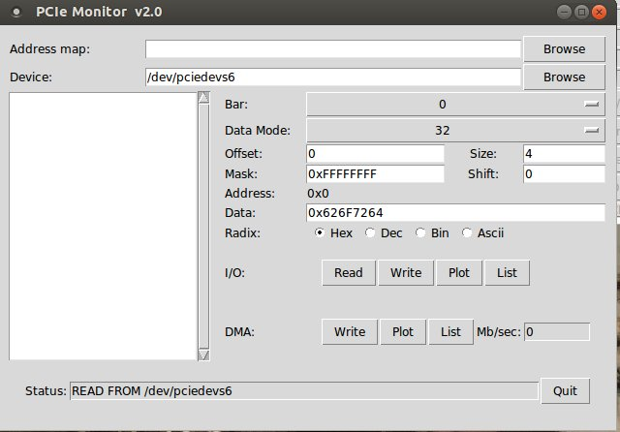
The Universal PCI Express Device Driver
We can read from and write to board

Slide 11
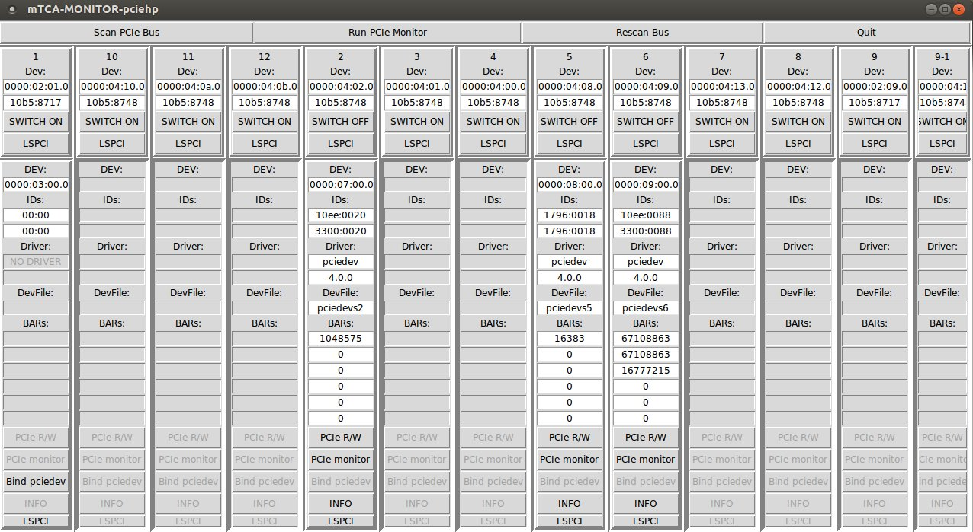
The Universal PCI Express Device Driver
pciedev driver attached to X2TIMER and SIS8300 boards

Slide 12
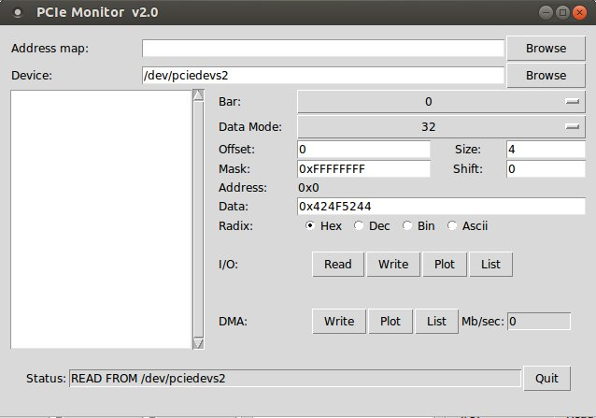
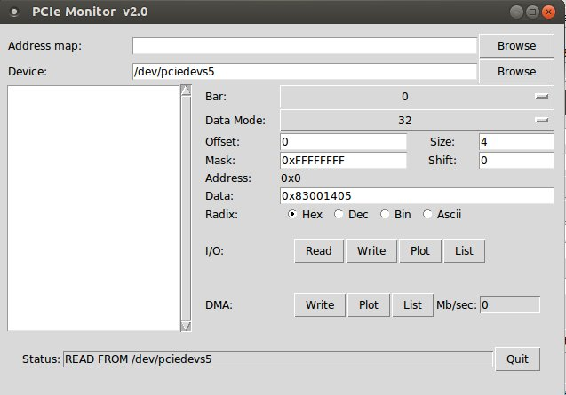
The Universal PCI Express Device Driver
We can read from and write to the boards

Slide 13
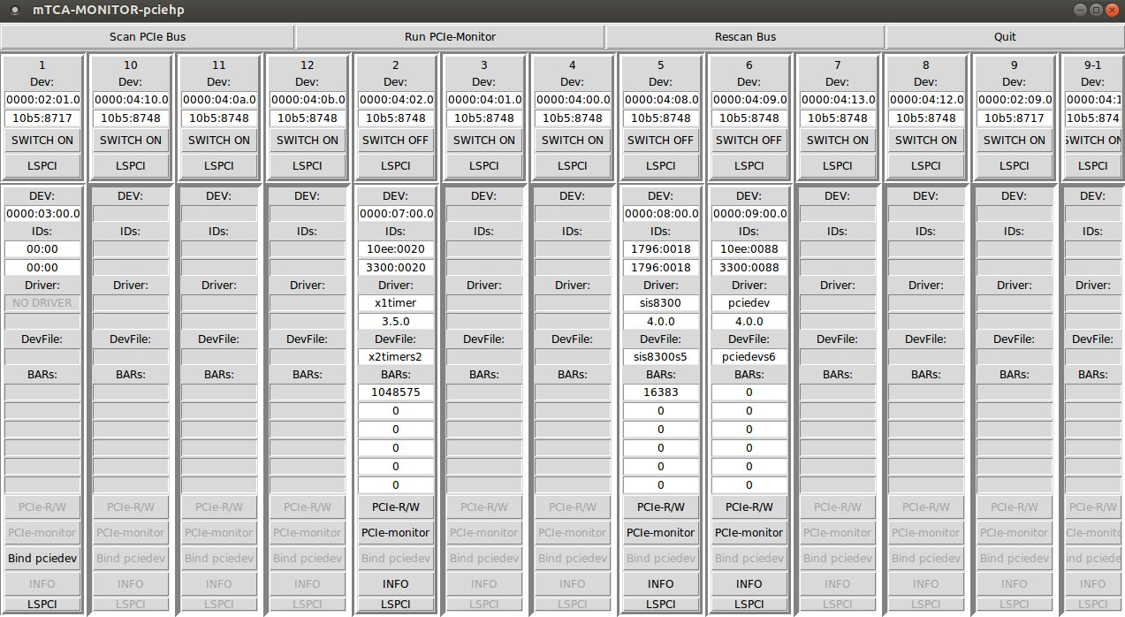
The Universal PCI Express Device Driver
Custom drivers:
X1TIMER driver:
Separate driver created
does not use the upciedev
functionality but based on the
upciedev API.
SIS8300 driver:
Based on the upciedev driver
added only IOCTRL for DMA.
SIS8300 LCBPM project:
pciedev driver.
Three different boards, three
Drivers one user application.

Slide 14
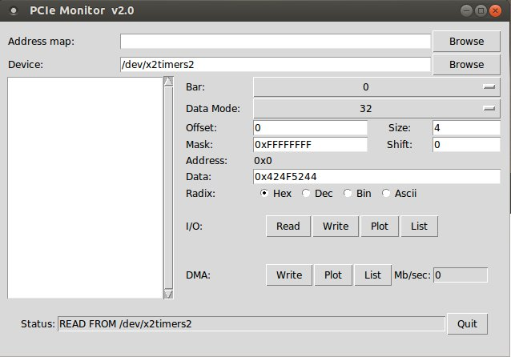
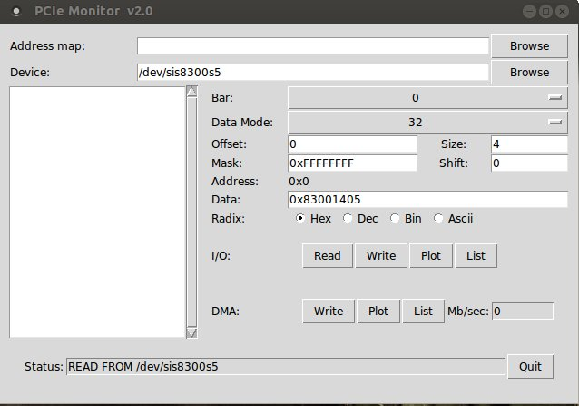
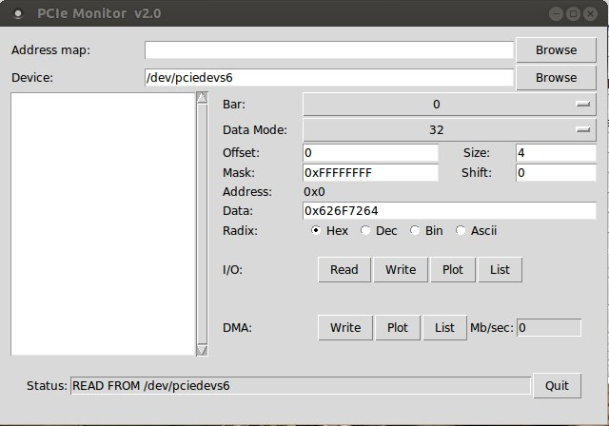
The Universal PCI Express Device Driver
We have read/write access
to the boards

Slide 15
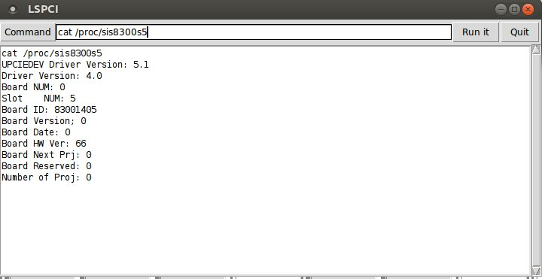
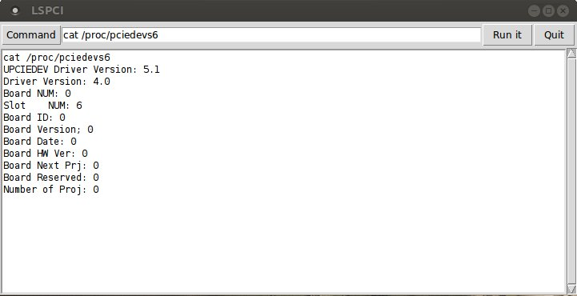
The Universal PCI Express Device Driver
We could get all information

Slide 16
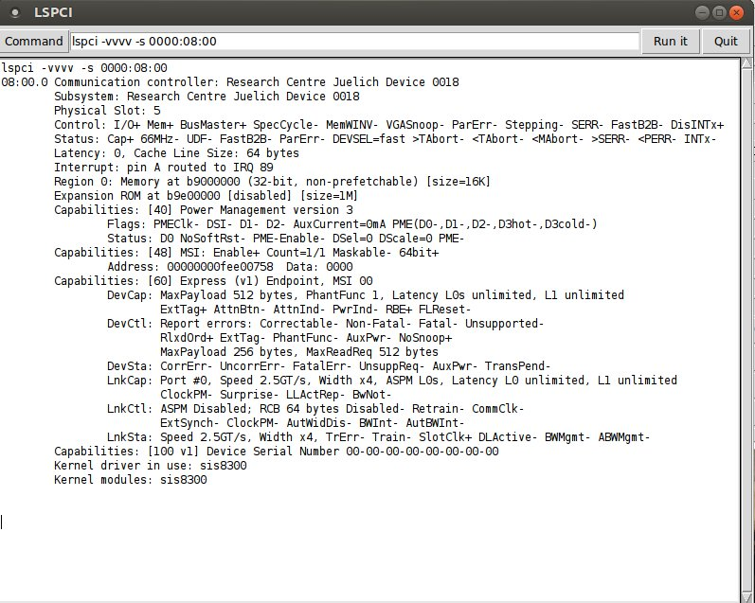
The Universal PCI Express Device Driver
Fast access to lspci for current
board

Slide 17
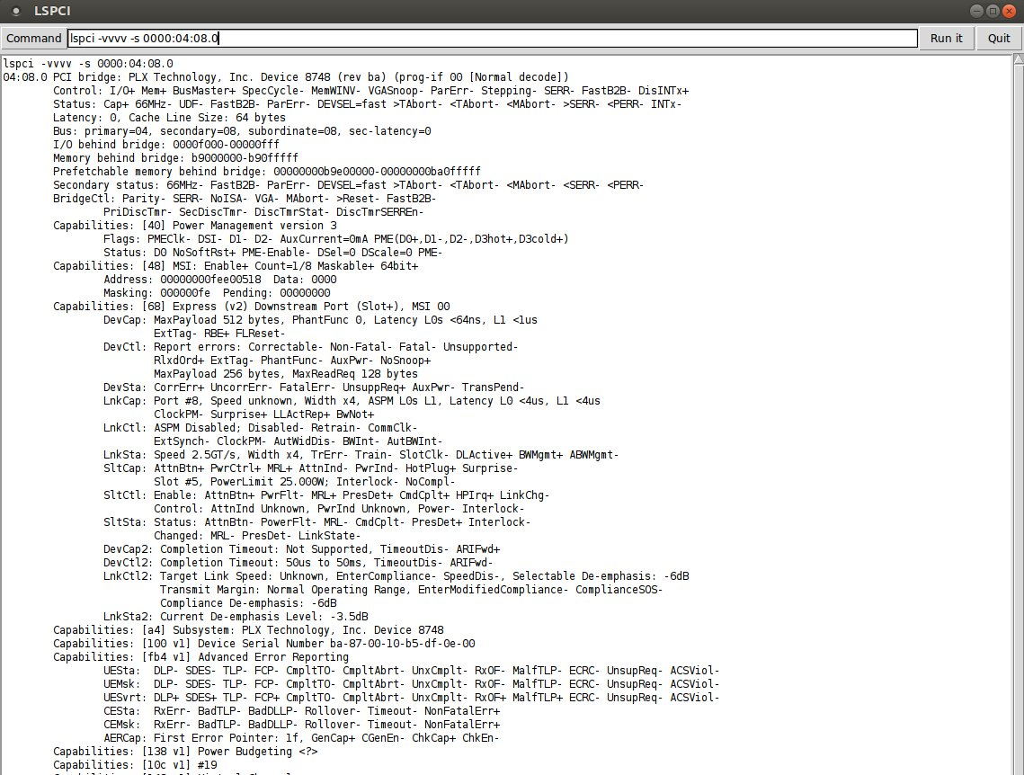
The Universal PCI Express Device Driver
Fast access to lspci for current
MCH PCIe Switch port

Slide 18
The Universal PCI Express Device Driver
Status
this architecture was developed in DESY group MCS4 and till today with success is used
the following drivers, tools and libraries are developed used
PCIEDEV
(MPS, BLM
DAMC2)
X2TIMER
SIS8300
DAMCBPM
(DMAC2)
LCBPM
(SIS8300)
TAMC100
TAMC200
ESD ADIO
MTCA TOOL
DOOCS UTCApcielib
(O.Hensler)
TAMC532
Use only Basic Functionality
Use Common API
Contains Device specific part
UPCIEDEV
Common API

Slide 19
The Universal PCI Express Device Driver
THANK YOU

