Slide 1
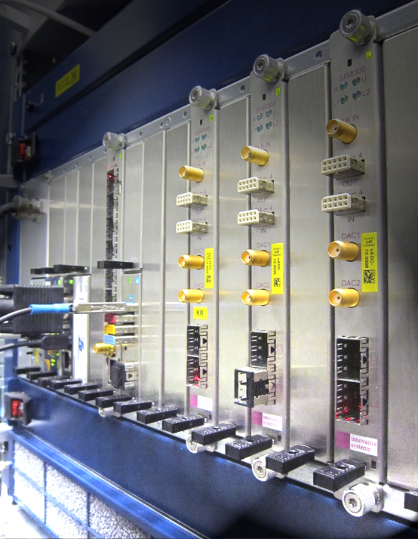
Production- and In-System- Programming of MTCA Boards
Michael Fenner
Machine Beam Controls (MSK)
DESY, 10 Dec. 2015

Slide 2
Introduction
Hardware Installation for European XFEL is a huge logistical challenge.
Hundreds of boards have to be tested, programmed, maintained and serviced.
Boards are living → more than one revision is around, patches are applied (software / hardware) → constant changes
Solutions needed for:
Automated Programming of all memories on MTCA boards (post-production)
→ done with programming scripts
In-field-update of all memories of MTCA boards
→ done with hpm files and ipmitool

Slide 3
Basis: All Software under Revision Control (SVN)
Before we talk about automation, we have to talk about version control and version numbering
We need a solution to track changes and identify versions
Ensure correct version on all in-filed boards
Change history & List of missing fixes
We use SVN for version control
→ developers synchronize regularly to the database
→ they leave comments which each change
→ we “tag” everything that is final (to go back to it)

Slide 4
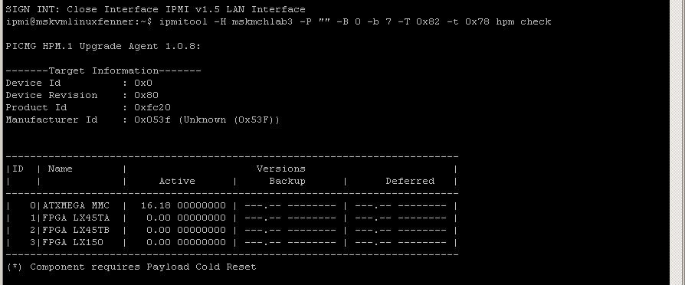
MMC V1.00: Version Number query with IPMItool

Slide 5
Automated Version Numbering
Version Number from SVN is put into each build & HPM is generated
1. Pre-Built-Script creates a Version Information File (version.h)
2. Post-build script creates hpm file for in-system update
Each programming file contains its SVN Build number → tracking
Build outputs two files that can be programmed
via JTAG (lab)
or remotely via ipmitool

Slide 6
Automated Version Transfer with SVN WCREV

Slide 7
Post-Production programming
Needed a possibility to automate MTCA board programming
Atmel Tools do not support scripting
Use Free tool „AVR DUDE“ to script that programming and AVR dragon programmer
Programming of FRU
Programming of FUSES
Programming of Bootloader
Programming of Standard application
USE standard Xilinx Impact Batch mode (from free Xilinx ISE Lab Tools)
Programming of CPLD

Slide 8
Programming Script for Post-Production Programming

Slide 9
In-Field Update of Memories
MMC hpm files directly come out of make process → ipmitool
FPGA .bit files come out of build process; We offer a command-line based conversion tool „bin2hpm“
Directly accepts bit files (no .MCS FLASH files etc.)
Creates .hpm files for ipmitool
Option: compresses down to 10%~30% of initial file size (proprietary with MMC V1.00)

Slide 10
Example: FPGA firmware update through IPMItool

Slide 11
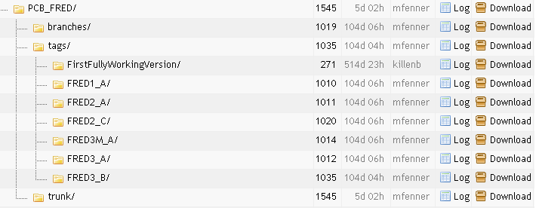
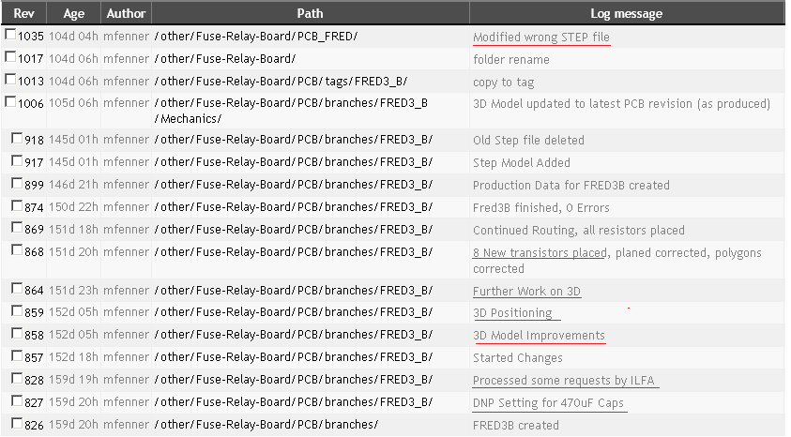
Version Control also applied to Hardware
All Hardware and Firmware is kept in SVN Database
All old versions are available („One tag for each board“)
Documentation of changes
Benefits:
Engineers can work on their local hard drive
All Board revisions are accessible
Traceability
Backup
Possible to easily share work

Slide 12
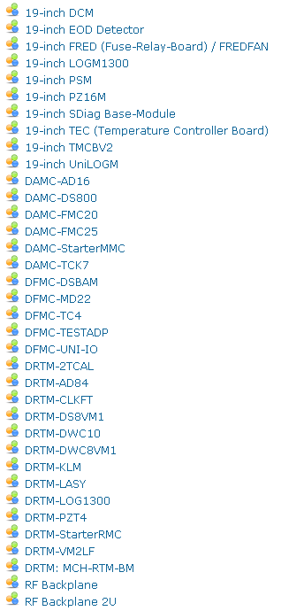
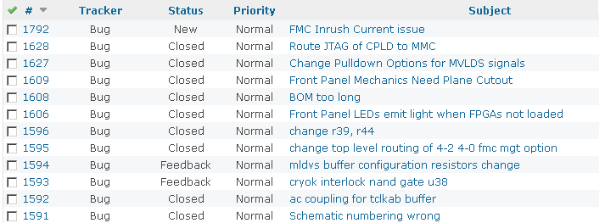
Basis 2: Bug Tracking
Bugs are tracked with Redmine (browser-based)
Any group member can report
All issues are collected and processed for next revision
Shared with Partners (Export)

Slide 13
Conclusion
We maintain management firmware AND hardware data in SVN
A complete history including all versions is available
We track bugs and prepare new revisions with Redmine
We have introduced a fully automated firmware post-production programming process (for all on-board memories: FPGA and MMC)
We have implemented IPMI-based programming in-the-filed for FPGAs and MMC
We offer a command-line based, scriptable tool to convert build outputs to hpm-files
We are able to script-program large production batches
Thank you!

