Slide 1
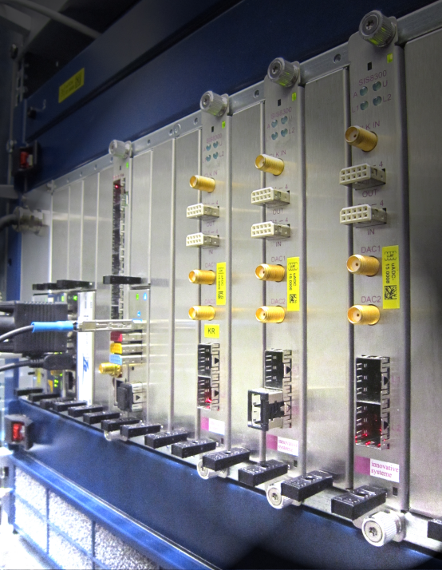
Follow up on the Helmholtz Validation Fund
''MicroTCA.4 for Industry"
and workshop organization
Dr. Holger Schlarb
MSK, DESY
DESY, 09.12.2015

Slide 2

History of MicroTCA@DESY
2
Nov. 2005: Reliability Workshop in Grömitz, Germany
  Joint meeting with ILC (intern. linear collider, 33km, 500GeV)
Dec. 2007: European XFEL Crate-Standard Workshop
  MicroTCA and ATCA was defined to be used
Mar. 2009: First PICMG Meeting “xTCA for Physics”
  Hardware group: rear I/O and timing
  Software group: standardization of interfaces for FPGAs…OPsys
Oct. 2011: Official announcement of PICMG Specification
  “MTCA.4 Enhancements for Rear I/O and Precision Timing“
Jul. 2012: Start of Helmholtz Validation Fund till Dec. 2014
  „MicroTCA.4 for Industry“
Jan. 2014: Reestablish HW/SW PICMG working groups ➔ R. Larsen, SLAC
2015-16: Production / Installation of MicroTCA controls for European XFEL
➔ Talk K. Rehlich / Ch. Schmidt
Notes:
Before you start editing the slides of your talk change to the Master Slide view:
Menu button “View”, Master, Slide Master:
Edit the following 2 items in the 1st slide:
1) 1st row in the violet header:
Delete the existent text and write the title of your talk into this text field
2) The 2 rows in the footer area: Delete the text and write the information
regarding your talk (same as on the Title Slide) into this text field.
If you want to use more partner logos position them left
beside the DESY logo in the footer area
Close Master View

Slide 3
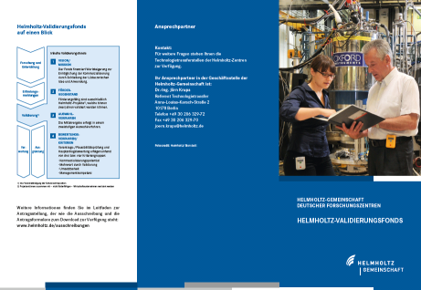
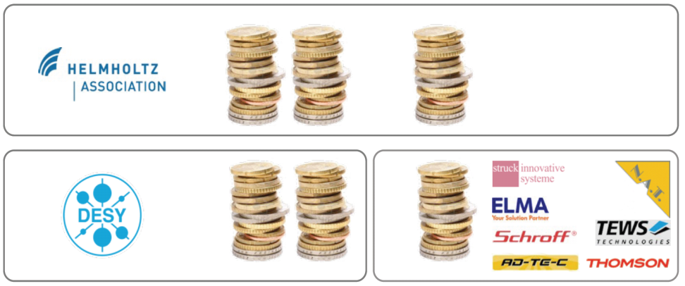






Helmholtz Validation Fund “MicroTCA for Industry”
3
What is the HGF validation fund?
Finance instrument to support the spin-off and technology transfer from scientific, technical inventions or developments from HGF centers to the industry and society
Main objectives of “MicroTCA for Industry” project:
Establish MicroTCA.4 electron crate system
  In accelerator community
  Industrial branches
  Scientific community
by reducing the market entry barriers and foster MTCA.4 to industry
Boundaries: 4 Mio (50% HGF) max 2 years, HVF0016: 07/2012 – 12/2014
successfully
50%
7 partners
+ 6 new partners
30%
20%
Notes:
Before you start editing the slides of your talk change to the Master Slide view:
Menu button “View”, Master, Slide Master:
Edit the following 2 items in the 1st slide:
1) 1st row in the violet header:
Delete the existent text and write the title of your talk into this text field
2) The 2 rows in the footer area: Delete the text and write the information
regarding your talk (same as on the Title Slide) into this text field.
If you want to use more partner logos position them left
beside the DESY logo in the footer area
Close Master View

Slide 4
Work packages and program “MTCA.4 for Industry”
4
AP1: Industrialize modules of the RF control system
AP1.1 Revision of existing modules
    AP 1.1.1 Field Detection (uDWC)
    AP 1.1.2 Controller (uTC)
    AP 1.1.3 RF driver unit (uVM)
    AP 1.1.4 Local RF-Generation (uLOG)
AP1.2 Cost opt. for Single Cavities Applications
    AP 1.2.1 Field detector with RF driver (uDWC-VM)
    AP 1.2.2 High-end Digitizer (DAQ-LNC)
AP1.3 Extending Portfolio in Frequency
    AP 1.3.1 Field detector with RF driver (uVM, 0.35-6GHz)
    AP 1.3.2 Local RF-Generation (uLOG, 0.35-6GHz)
    AP 1.3.3 RTM with local clock circuit (uCLK-RTM, 10–350MHz)
    AP 1.3.4 Global clock generation (uCLK-eRTM, 10-350MHz)
AP1.4 Supplementary systems for RF control
    AP 1.4.1 Multi-channel Direct RF-sampling (uDS800)
    AP 1.4.2 AMC carrier with motor/RTM with Piezo driver (uFMC20)
AP1.5 Introduction of RTM-RF Backplane
AP 1.5.1 Development of RTM-RF Backplane concept
AP 1.5.2 Crate integrated RF source (uOSC_eRTM)
AP2: Completion of MTCA.4 for industry and institutions
AP2.1 Extension of product portfolio for MTCA.4
    AP2.1.1 Industrial production of timing module
    AP2.1.2 2 GSPS, 4 channel , 12bit ADCs on RTM & AMC
    AP2.1.3 32 ch., 40MSPS, AMC-RTM with analog shaping capability
    AP2.1.4 Management low noise power supplies
    AP2.2 EMI optimization and classification of MTCA.4 components
    AP2.2.1 EMI test board development
    AP2.2.2 EMI current distribution in MTCA.4 crate
    AP2.2.3 Optimization of crate-contact transitions
    AP2.2.4 Shields for AMC/RTM boards
    AP2.2.5 EMI Bypass-concept
    AP2.2.6 Vibration studies and vibration reduction
    AP2.2.7 EMI classification of AMC and RTM boards commercially available
    AP2.2.8 AMC Backplane/connector/board development towards 10Gbit/sec
    AP2.3 Application of MTCA.4 in industry
    AP2.3.1 Integrated klystron life-time and LLRF system
  AP2.4 Evaluation of MTCA.4 market
    AP2.4.1 Market evaluation for industry
    AP2.4.2 Market evaluation for institutes
    AP2.4.3 Optional industry order after evaluation
  AP2.5 Integral test of MTCA.4 in large facility, availability, failure analysis
    AP2.5.1 Inter-compatibility of boards/sub-systems, radiation, remote controllability
> 50 sub-projects were
carried out and completed
> 40 hardware developments
33 new products were developed
suitable for the market:
  24 are available by industry
  6 still pending
  3 on demand
AP3: Marketing & Support
AP3.1 Support and consultancy
    AP 3.1.1 Continues guidance and consultance
    AP 3.1.2 Tutorials
AP3.2 MicroTCA user guide
AP3.3 Marketing and exhibitions
AP3.4 MTCA.4 annual workshop
Notes:
Before you start editing the slides of your talk change to the Master Slide view:
Menu button “View”, Master, Slide Master:
Edit the following 2 items in the 1st slide:
1) 1st row in the violet header:
Delete the existent text and write the title of your talk into this text field
2) The 2 rows in the footer area: Delete the text and write the information
regarding your talk (same as on the Title Slide) into this text field.
If you want to use more partner logos position them left
beside the DESY logo in the footer area
Close Master View

Slide 5
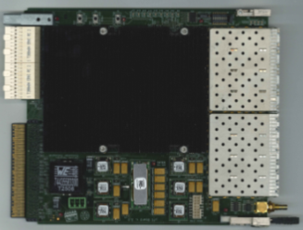
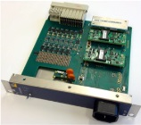
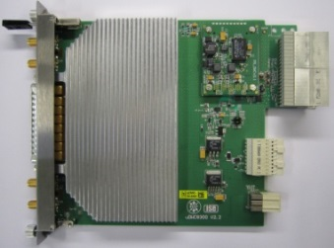
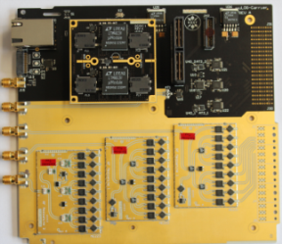
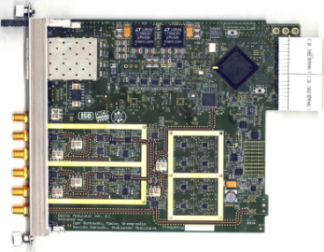
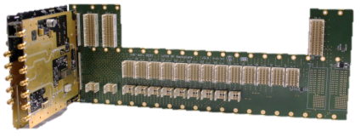
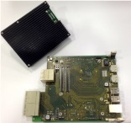
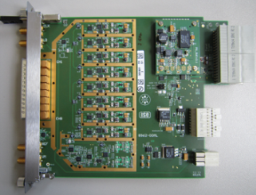
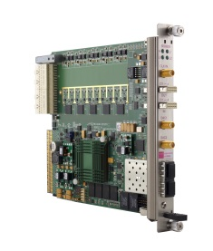
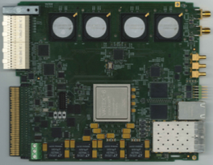
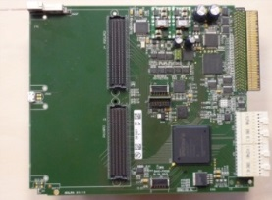
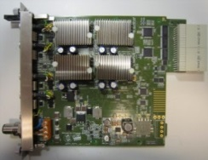
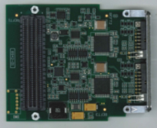
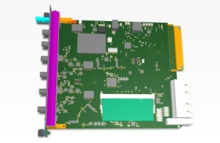
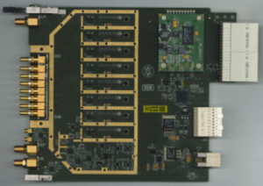
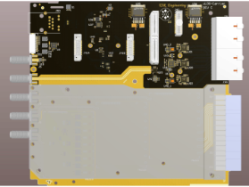
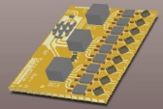
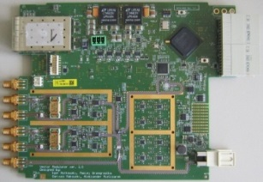
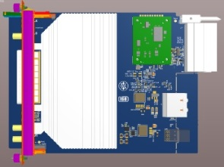
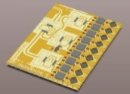
AP1: RF controls boards
5
LLRF controls: rapid portfolio extension was possible through modularity…
➔Talk K.Czuba/V. Dirksen
Standard RF Modules (used by FLASH & XFEL)
Struck GmbH
Vadatech
Dynamique
Ready for licence
NAT-RPM-PSC
Tbd.
DRTM-DWC10
DAMC-TCK7
DeRTM-LOG1300
DRTM-VM2LF
RF Backplane
Single cav. extension
Supplementary module extension
NAT-MCH-RTM-RF
RF source
Struck GmbH
Stuck GmbH
EicSys
Ready for licence
CAEN-els
updated
Sintec
DRTM-DWC8VM1
SIS8325
DAMC-FMC20
DRTM-PZT4
DFMC-MD22
SAMC-DDS1400
DAMC-DS800
~ MHz
Frequency extension
6 GHz
0.35-0.7GHz
Struck GmbH
evaluation
On demand
Ready for licence
Stuck GmbH
Design phase
DeRTM-CLK
3-6GHz
DRTM-DS8VM1
DRTM-VM2HF
DRTM-DWC8VM1HF
DRTM-DWC10HF
DeRTM-LOGLF/HF
2013-2015 through Validation Fund: almost all modules are now available by industry
2014/15 many improvements w.r.t. performance, features and additional functionalities

Slide 6

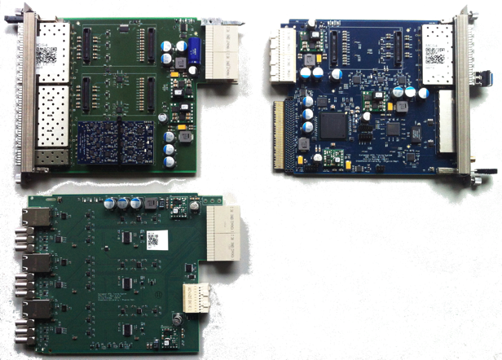
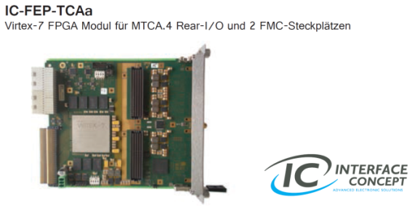

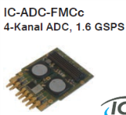
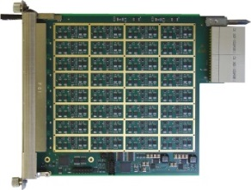
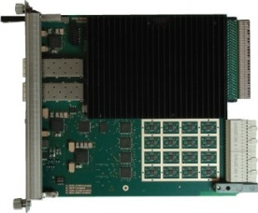



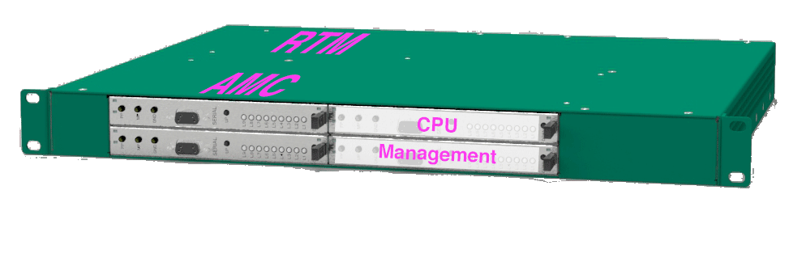
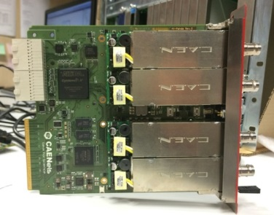

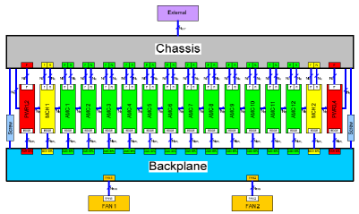


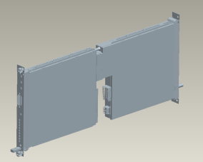
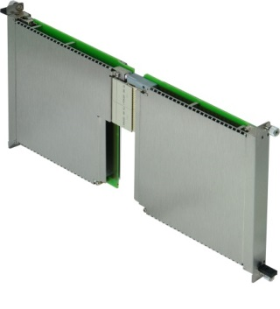


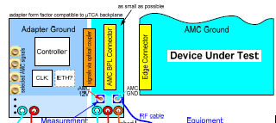
AP2: Completion of the MTCA.4 for industry and institutes
6
ps-timing distribution
High end FMC-carrier / 4ch 1.6GSPS
RTM Shaper - AMC 32 ch ADC 12/14bit
TAMC532-TM
TAMC532
Available
Available
Available N.A.T.
X2TIMER
RTM_TRIG1
High voltage AMC
Generic linux driver for MicroTCA
Open source !
Topics:
Linux kernel driver & libraries
Efficient DMA transfer
Hotplug capability
Set of test cases
Test suite for automated driver test
Redesign of API implementation
Market entry starter kit (1HE)
HV-Panda
Available
Available
  EMI/EMC
MicroTCA.4 ground modelling
Requires for quantitative
measurements & classification
specialized setup!
Project launched: Q2/15

Talk H-H. Ibowski
Notes:
Before you start editing the slides of your talk change to the Master Slide view:
Menu button “View”, Master, Slide Master:
Edit the following 2 items in the 1st slide:
1) 1st row in the violet header:
Delete the existent text and write the title of your talk into this text field
2) The 2 rows in the footer area: Delete the text and write the information
regarding your talk (same as on the Title Slide) into this text field.
If you want to use more partner logos position them left
beside the DESY logo in the footer area
Close Master View

Slide 7
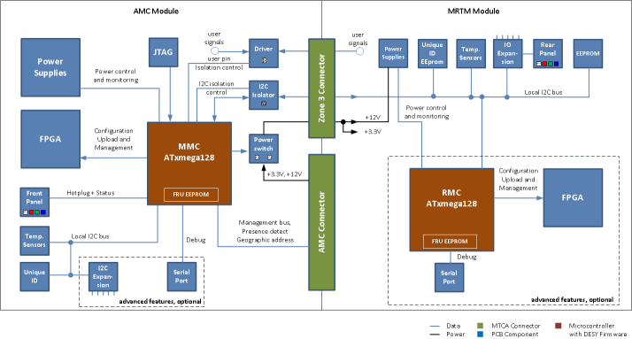
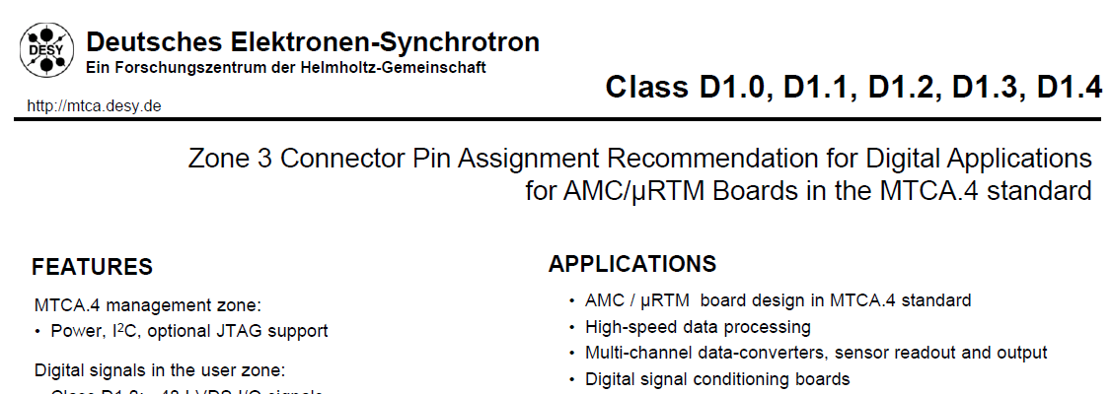
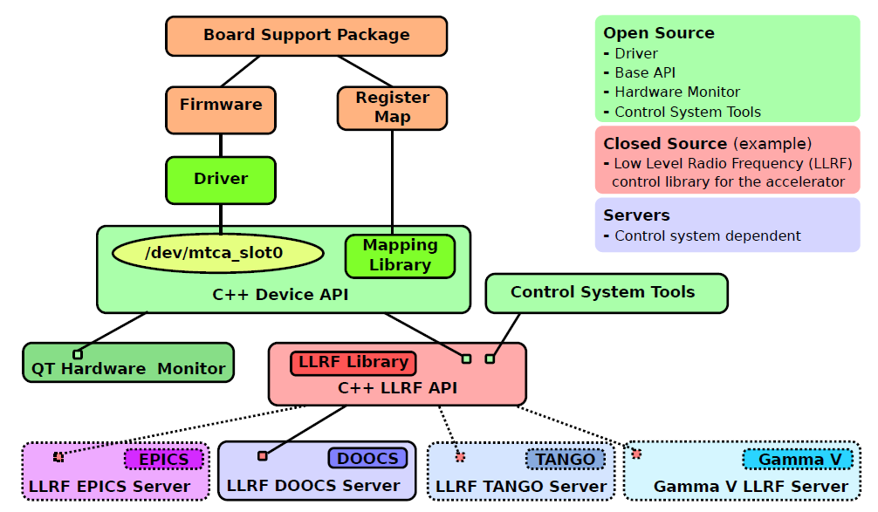
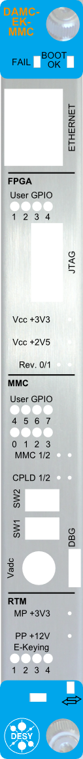
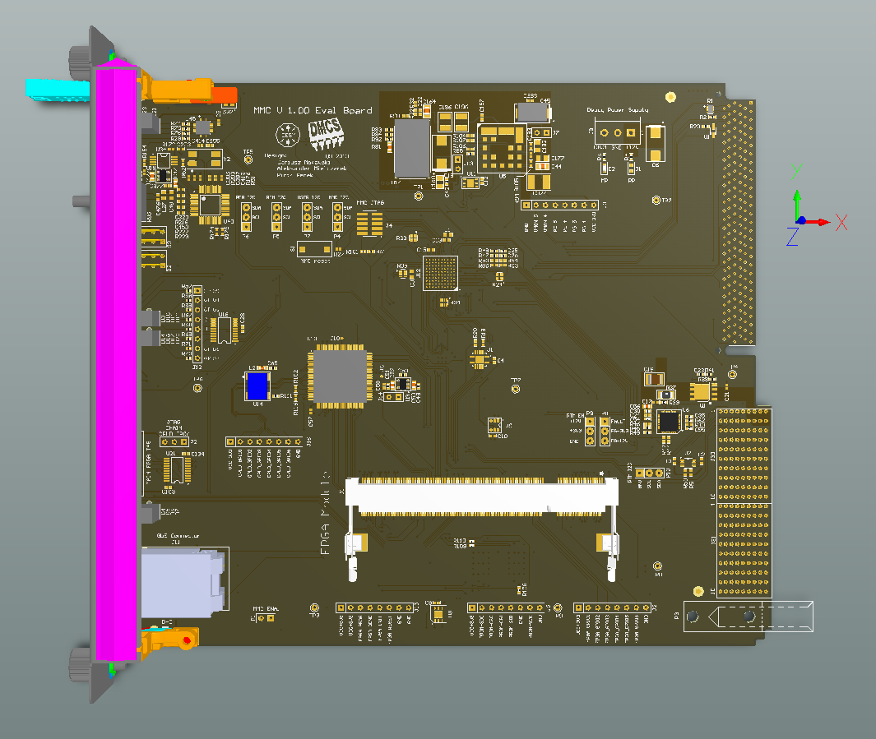
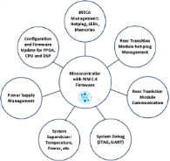
AP2: Completion of the MTCA.4 for industry and institutes
7
AP2: missing standards / critical items / open issues / misc. barriers…
Zone 3 Recommendation
MMC Altium designer templates
MMC Template
MTCA.4, open software framework
MMC Starter Kit (AMC/RTM) available
Talk N. Shezhad
MMC code development
Interlock integration….
Meanwhile widely
adopted…
Notes:
Before you start editing the slides of your talk change to the Master Slide view:
Menu button “View”, Master, Slide Master:
Edit the following 2 items in the 1st slide:
1) 1st row in the violet header:
Delete the existent text and write the title of your talk into this text field
2) The 2 rows in the footer area: Delete the text and write the information
regarding your talk (same as on the Title Slide) into this text field.
If you want to use more partner logos position them left
beside the DESY logo in the footer area
Close Master View

Slide 8
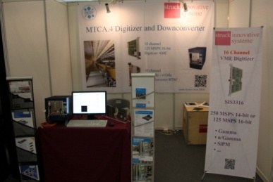
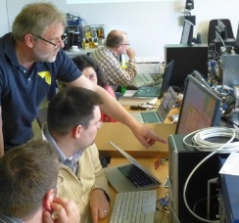
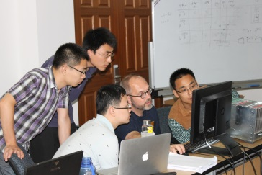
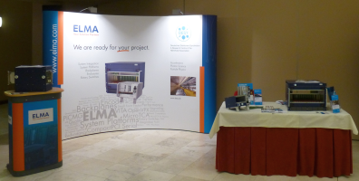
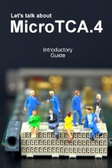
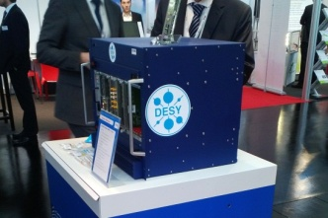
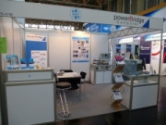


AP3: Support / Consulting / Marketing
8
  MTCA.4 support and consulting
    FAQ/Hotline
    Direct support
    Tutorial, every 2 month “hands on”
    6 in 2013
    8 in 2014 (4 advanced)
    7 in 2015 (4 advanced)
  MicroTCA.4 Introductory guide
    Booklet published by DESY/NAT: work in progress
  Products marketing & information
  4th MicroTCA.4 workshops (2012-2015)
  Marketing on industrial exhibitions/ Face-to-face meetings
  28 (+11) in 2013
  16 (+16) in 2014
  2 (+4) in 2015
  Interoperability / Integration
    AIW24 Pentair, Straubenhardt @ Nov 2013
    AIW25 DESY, Hamburg @ Apr 2014
    AIW26 Vadatech, Henderson @ Oct 2014
    Integration WS, DESY @ Dec 2014
    Integration WS, DESY @ Dec 2015
MTCA Tutorials at DESY (05/2013)
& Shanghai (09/2014)
IPAC 2013 Shanghai
Embeddedworld 2013
Nürnberg
TWEPP 2013 Perugia
European Microwave
Week2013
Webpage URL http://mtca.desy.de/
Notes:
Before you start editing the slides of your talk change to the Master Slide view:
Menu button “View”, Master, Slide Master:
Edit the following 2 items in the 1st slide:
1) 1st row in the violet header:
Delete the existent text and write the title of your talk into this text field
2) The 2 rows in the footer area: Delete the text and write the information
regarding your talk (same as on the Title Slide) into this text field.
If you want to use more partner logos position them left
beside the DESY logo in the footer area
Close Master View

Slide 9

Perspectives MicroTCA@DESY 2015+
9
2015 DESY Directorate approved funding to continue “MicroTCA” @ DESY
Activities (strongly reduced compared to HVF):
  Future enlarge MicroTCA product portfolio through licensing
  Continuation PICMG efforts (HW/SW)
  Marketing / support / consultancy
  Investigate future funding options
Most promising: Applied to „Helmholtz Innovation Labs” initiative
Interface between industrial and research centers
Close interaction between Scientists and Industry & users/customer
Funding: 5 Mio total (50%/50%)/ 5 years!
Target of submit application:
Service & Support
Creation of set of turn key system
Decision taking: Q1-Q2/2016
Notes:
Before you start editing the slides of your talk change to the Master Slide view:
Menu button “View”, Master, Slide Master:
Edit the following 2 items in the 1st slide:
1) 1st row in the violet header:
Delete the existent text and write the title of your talk into this text field
2) The 2 rows in the footer area: Delete the text and write the information
regarding your talk (same as on the Title Slide) into this text field.
If you want to use more partner logos position them left
beside the DESY logo in the footer area
Close Master View

Slide 10

Cooperation Networking
10
Follow to HVF Consortium was discussed
Tuned out to be challenging due to personal constrains at DESY
But:
  Initiated discussion to apply for “ZIM-Cooperation Network”
  ZIM = Zentrales Innovationsprogramm Mittelstand
  Targeted toward small and medium companies in Germany, but
  not limited to Germany / KMU’s when sufficient KMU partners joined already
Found very competent partner for funding consultancy and managing of a “MicroTCA Cooperation Network”
See booth industrial exhibition → EurA Constance AG
Notes:
Before you start editing the slides of your talk change to the Master Slide view:
Menu button “View”, Master, Slide Master:
Edit the following 2 items in the 1st slide:
1) 1st row in the violet header:
Delete the existent text and write the title of your talk into this text field
2) The 2 rows in the footer area: Delete the text and write the information
regarding your talk (same as on the Title Slide) into this text field.
If you want to use more partner logos position them left
beside the DESY logo in the footer area
Close Master View

Slide 11
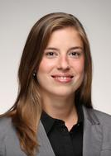
11
Workshop organization
Katharina Kull
Notes:
Before you start editing the slides of your talk change to the Master Slide view:
Menu button “View”, Master, Slide Master:
Edit the following 2 items in the 1st slide:
1) 1st row in the violet header:
Delete the existent text and write the title of your talk into this text field
2) The 2 rows in the footer area: Delete the text and write the information
regarding your talk (same as on the Title Slide) into this text field.
If you want to use more partner logos position them left
beside the DESY logo in the footer area
Close Master View

Slide 12
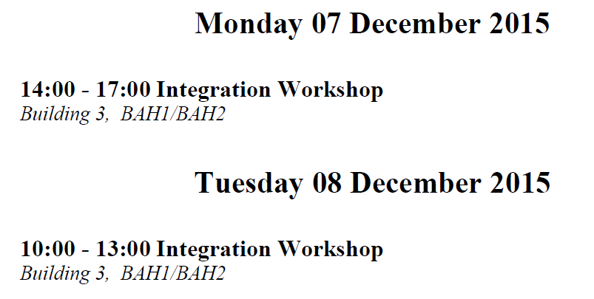
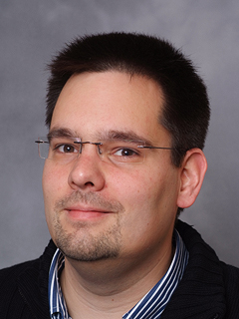

Workshop program:
12
Michael Fenner
Goal:
Opportunity to test your application with vendors on different platform configurations
Well received,
> 20 participants
➔ Will be continued next year
Notes:
Before you start editing the slides of your talk change to the Master Slide view:
Menu button “View”, Master, Slide Master:
Edit the following 2 items in the 1st slide:
1) 1st row in the violet header:
Delete the existent text and write the title of your talk into this text field
2) The 2 rows in the footer area: Delete the text and write the information
regarding your talk (same as on the Title Slide) into this text field.
If you want to use more partner logos position them left
beside the DESY logo in the footer area
Close Master View

Slide 13




Workshop program:
13
Kay Rehlich
Target audience:
Part 1:
New comers to MicroTCA.4 standard
Part 2:
Advanced users
Well received,
> 50 participants
➔ Will be continued next year
Notes:
Before you start editing the slides of your talk change to the Master Slide view:
Menu button “View”, Master, Slide Master:
Edit the following 2 items in the 1st slide:
1) 1st row in the violet header:
Delete the existent text and write the title of your talk into this text field
2) The 2 rows in the footer area: Delete the text and write the information
regarding your talk (same as on the Title Slide) into this text field.
If you want to use more partner logos position them left
beside the DESY logo in the footer area
Close Master View

Slide 14

Workshop locations
14
XFEL
Notes:
Before you start editing the slides of your talk change to the Master Slide view:
Menu button “View”, Master, Slide Master:
Edit the following 2 items in the 1st slide:
1) 1st row in the violet header:
Delete the existent text and write the title of your talk into this text field
2) The 2 rows in the footer area: Delete the text and write the information
regarding your talk (same as on the Title Slide) into this text field.
If you want to use more partner logos position them left
beside the DESY logo in the footer area
Close Master View

Slide 15

General Information
15
DESY/XFEL tour
Meeting point ➔ in front of the registration desk
Takes about an hour
Guides you to European XFEL facilities

Slide 16


Workshop Dinner
16
Wednesday, December 9th in Villa Mignon
blue dot on your name badge = dinner registration
Shuttle busses starting from 18:45 in front of
CFEL and 18:50 at DESY main gate
Bring a jacket the reception is outside!
More information in abstract booklet

Slide 17

General Information
17
WLAN
Name: MTCA-Workshop
Password: MTCA-Workshop-2015
Next Workshop:
7th/8th of Dec. 2016!

Slide 18
18
Wish you an informative
and pleasant
4th MTCA Workshop
Thanks for attention
Notes:
Before you start editing the slides of your talk change to the Master Slide view:
Menu button “View”, Master, Slide Master:
Edit the following 2 items in the 1st slide:
1) 1st row in the violet header:
Delete the existent text and write the title of your talk into this text field
2) The 2 rows in the footer area: Delete the text and write the information
regarding your talk (same as on the Title Slide) into this text field.
If you want to use more partner logos position them left
beside the DESY logo in the footer area
Close Master View

