Slide 1
Slice Emittance Diagnostics
(with Transverse Deflecting Structures)
B. Beutner, C. Gerth, M. Scholz
XFEL Commissioning Meeting
23 September 2015
Notes:
How to edit the title slide
Fill in the text written in brown

Slide 2
Outline
Introduction:
  - Slice emittance
  - Bunch diagnostics with a TDS
How to measure emittance
Methods: Quad Scan vs. Multi-Screen
TDS diagnostics at European XFEL
Hardware
- TDS System
- Screen Stations
- Kicker Magnets
Outlook: Commissioning Plans

Slide 3
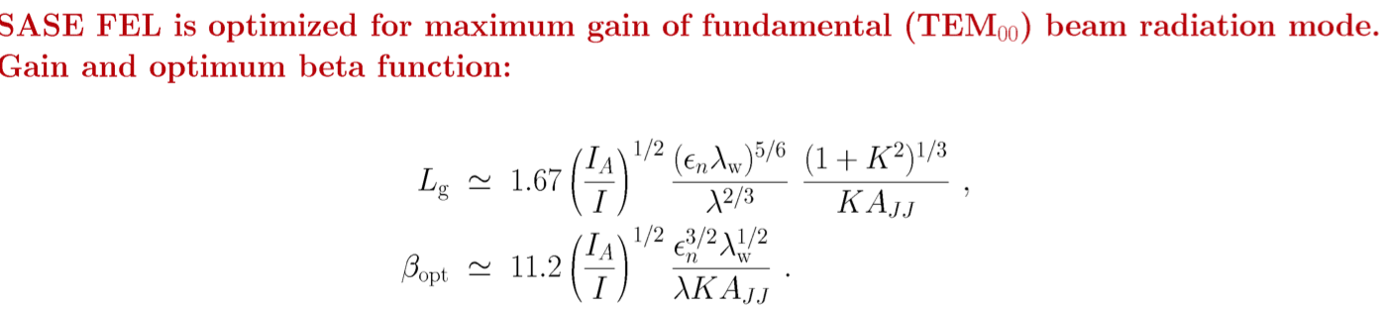

1. Introduction: Emittance
(M. Yurkov)
=> Bunch current I (longitudinal profile) and transverse emittance ε_{n} are important for SASE FELs
The emittance may vary along the bunch:
What matters for a SASE FELs is the slice emittance:
Emittance: Area of all beam particles in transverse phase space (x, x’ plane).
Statistical (rms) emittance:

Slide 4
1. Introduction: S2E Simulation (I. Zagorodnov)
Long. phase space
Current I, slice emittance ε_{x,y}
Q=250 pC
bunch head
Bunch compressors are the enemies of emittance due to emission of coherent synchrotron radiation:
Large increase in projected emittance in the bending plane (here about factor 3)
Slice emittance in bending plane larger y than in x => measure slice emittance in bending plane

Slide 5
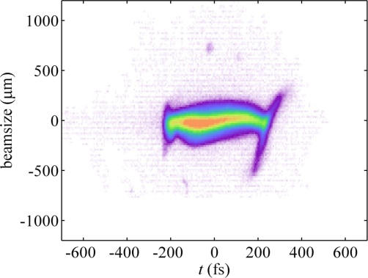
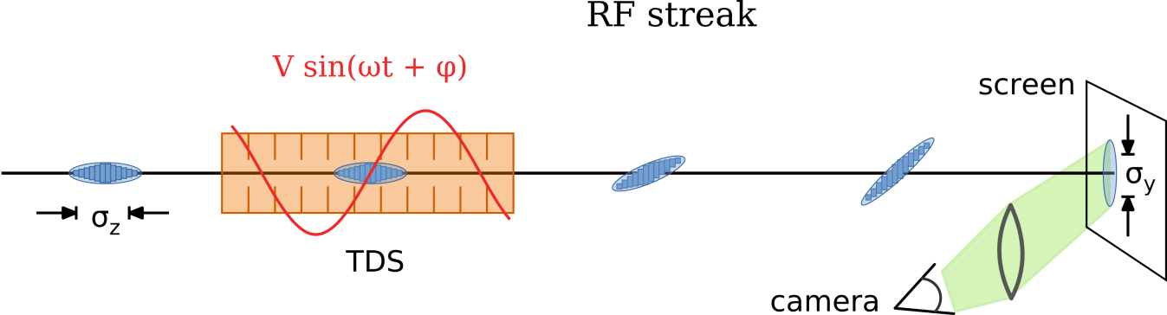
1. Introduction: TDS measurements principle
Transverse Deflecting Structure (TDS) + screen station
  z → (t →) y: longitudinal profile, slice emittance
y~z/t
x
simple direct measurement (when you have everything in place and working)
=> accelerator technology, analysis of beam images
complex/expensive system => choose right location during design of the accelerator
(not shown above: modulator/klystron, waveguides, LLRF system, temp. regulation TDS, vacuum system, personnel interlock, …, quadrupoles)

Slide 6

1. Introduction: TDS time resolution
Transverse Deflecting Structure (TDS) + screen
  z → (t →) y: longitudinal profile, slice emittance
ΔΦ_{y}
β_{y}(s₀ )
β_{y}(s)
TDS (rms) time resolution: with
K_{y} => TDS: V_{y} = TDS Voltage, ω : TDS Frequency
R₃₄ => Dedicated beam optics for good time resolution: beta functions β and phase advance Φ

Slide 7
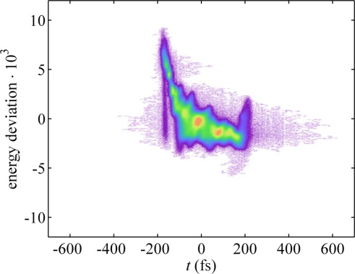
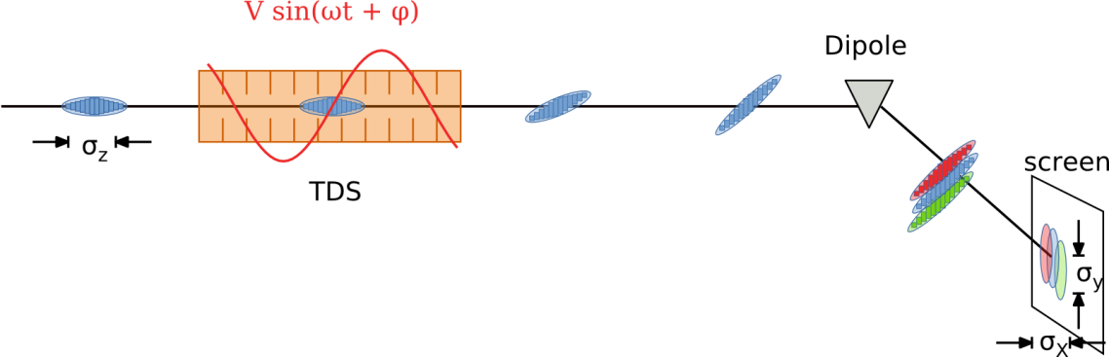
1. Introduction: Longitudinal Phase Space
Transverse Deflecting Structure (TDS) + screen
  z → (t →) y: longitudinal profile, slice emittance
TDS + dipole (dispersive section) + screen
  z → (t →) y: longitudinal profile, E → x: longitudinal phase space

Slide 8
2. How to measure emittance?
Definition of emittance with beam moments
reference point 0

Slide 9
2. How to measure emittance?
Definition of emittance with beam moments
Beam size at point is measured
i
reference point 0
measurement point i

Slide 10
2. How to measure emittance?
Definition of emittance with beam moments
Beam size at point is measured
i
Transfer matrix (beam optics)
R^{i} = R^{i}_{quad} R^{i}_{drift} R^{i}_{quad} …
Transfer matrix R^{i}
reference point 0
measurement point i
Quad, Drift, etc…

Slide 11
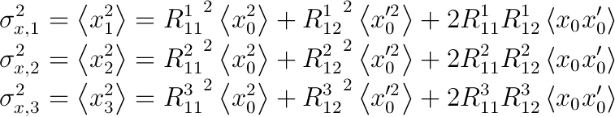
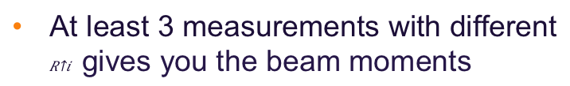
2. How to measure emittance?
Definition of emittance with beam moments
Beam size at point is measured
i
Transfer matrix (beam optics)
R^{i} = R^{i}_{quad} R^{i}_{drift} R^{i}_{quad} …
At least 3 measurements with different $R^{i}$ gives you the beam moments
Transfer matrix R^{i}
reference point 0
measurement point i
Quad, Drift, etc…

Slide 12


3. Quad Scan vs. Multi Screen Method
Quad Scan
Transfer matrix
reference point 0
measured
Quad, Drift, etc…

Slide 13


3. Quad Scan vs. Multi Screen Method
Quad Scan
Transfer matrix ,
reference point 0
measured
Quad, Drift, etc…

Slide 14


Quad Scan vs. Multi Screen Method
Quad Scan
Transfer matrix , ,
reference point 0
measured ,
Quad, Drift, etc…

Slide 15


3. Quad Scan vs. Multi Screen Method
Quad scan
Transfer matrix , ,
reference point 0
measured ,
Quad, Drift, etc…
Multi Screen
Transfer matrix
measured
reference point 0
Quad, Drift, etc…

Slide 16


3. Quad Scan vs. Multi Screen Method
Quad scan
Transfer matrix , ,
reference point 0
measured ,
Quad, Drift, etc…
Multi Screen
Transfer matrix ,
measured
reference point 0
Quad, Drift, etc…

Slide 17


3. Quad Scan vs. Multi Screen Method
Quad scan
Transfer matrix , ,
reference point 0
measured ,
Quad, Drift, etc…
Multi Screen
Transfer matrix , ,
measured ,
reference point 0
Quad, Drift, etc…

Slide 18
3. Quad Scan vs. Multi Screen Method
Comparison of Quad Scan and Multi Screen Method at the SwissFEL Injector Test Facility
M. Yan, …, B. Beutner et al., FEL’14, THP088
M. Yan, PhD. thesis
Quad Scan:
+ Many measurements by changing quad currents => small statistical error
- Beam changes downstream of quad
(=> beam losses)
Multi Screen:
- Small number of screens / measurements
(- Small beam sizes in FODO lattice)
+ Possibility of on-line measurements
Commissioning Strategy:
Set up of accelerator with (high-resolution multi-) quad scan method
Monitor emittance changes with (on-line) multi screen method

Slide 19
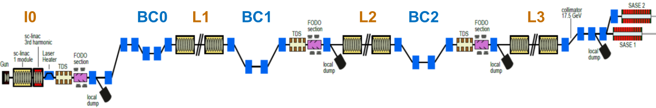
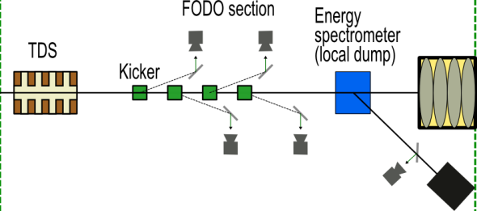
4. TDS diagnostics at European XFEL
2.
3.
Measurement of longitudinal profile, slice emittance and long. phase space after BCs:
3 dedicated diagnostic sections with dedicated beam optics
Super-conducting linac offers the possibility of (semi-) parasitic emittance measurements:
‘steal’ 4 bunches with a kicker out of the bunch train and deflect them onto off-axis screens
Energy Spectrometer for longitudinal phase space measurements (INJ: hori., B1/B2: vert.):
‘Streak’ direction of TDS perpendicular (INJ: vert., B1/B2: hori.)
Ideal tool for setting up of accelerator phases and amplitudes during commissioning
Notes:
Before you start editing the slides of your talk change to the Master Slide view:
Menu button “View”, Master, Slide Master:
Edit the following 2 items in the 1st slide:
1) 1st row in the violet header:
Delete the existent text and write the title of the EoI for WPnumber
2) The row in the footer area: write the institute name
Close Master View

Slide 20
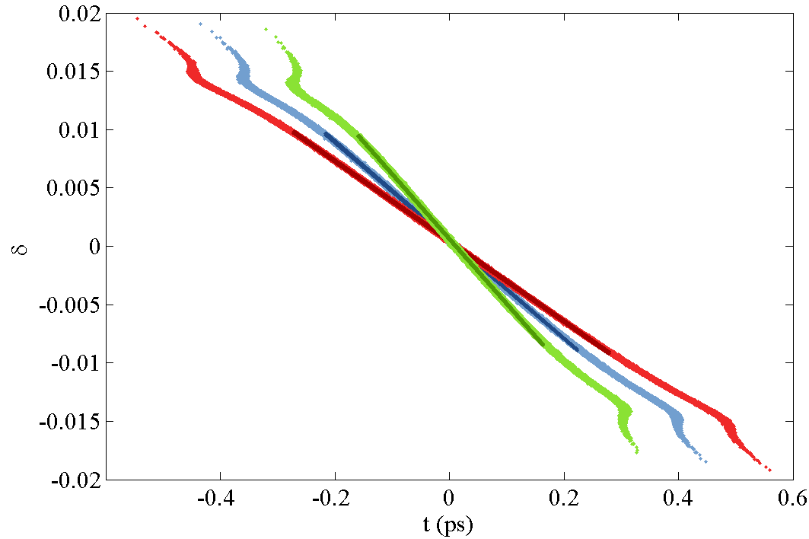
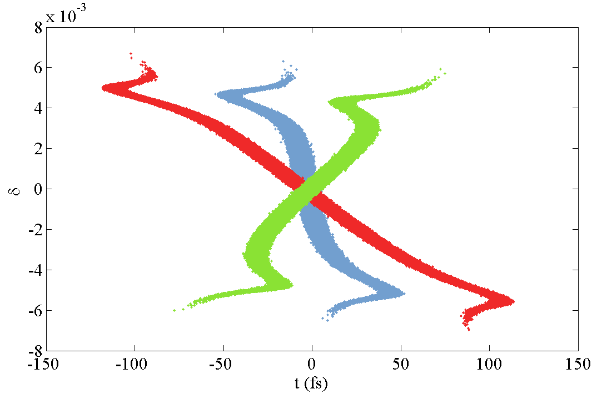
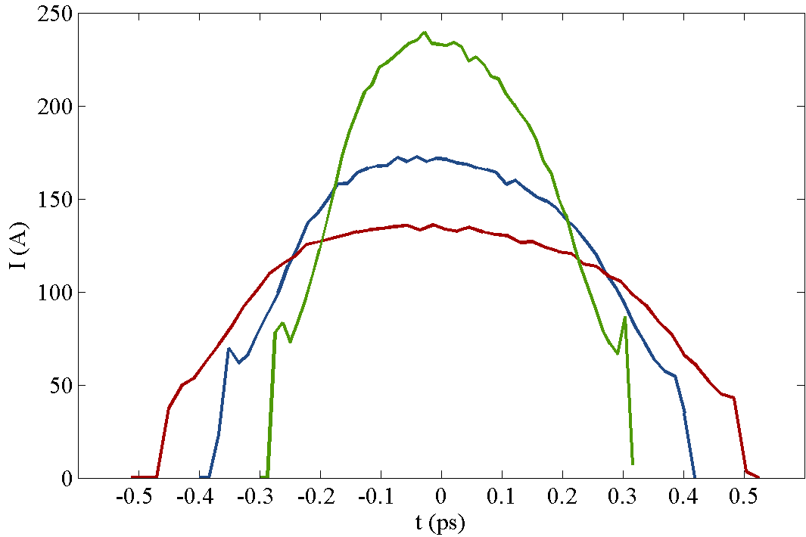
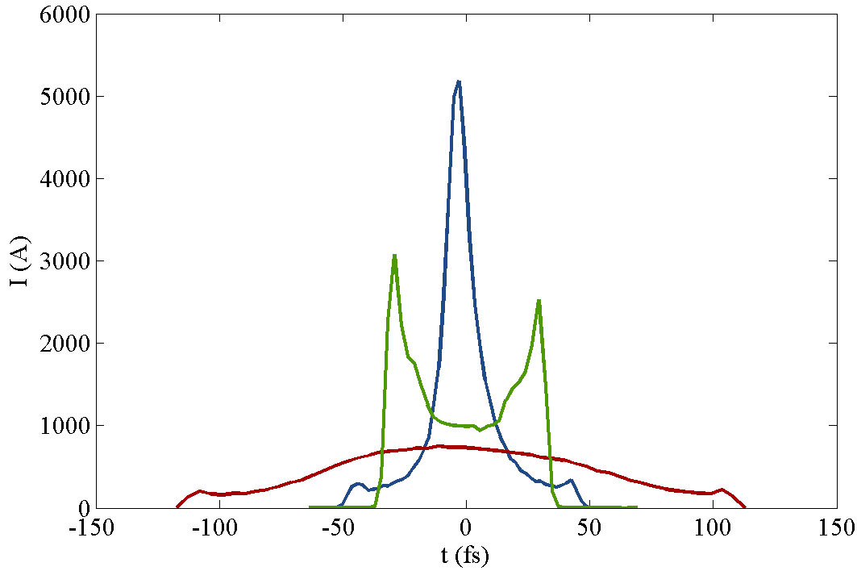
4. TDS diagnostics at European XFEL
 | A1 phase (degree)
(a) | working point
(b) | +0.35
(c) | -0.35
100pC, 1M particles
I. Zagorodnov
Long.
Phase
Space
Long.
Profile
Notes:
Before you start editing the slides of your talk change to the Master Slide view:
Menu button “View”, Master, Slide Master:
Edit the following 2 items in the 1st slide:
1) 1st row in the violet header:
Delete the existent text and write the title of the EoI for WPnumber
2) The row in the footer area: write the institute name
Close Master View

Slide 21
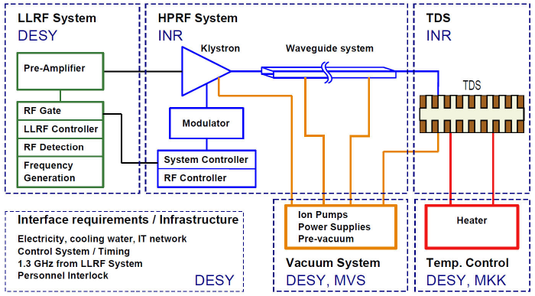
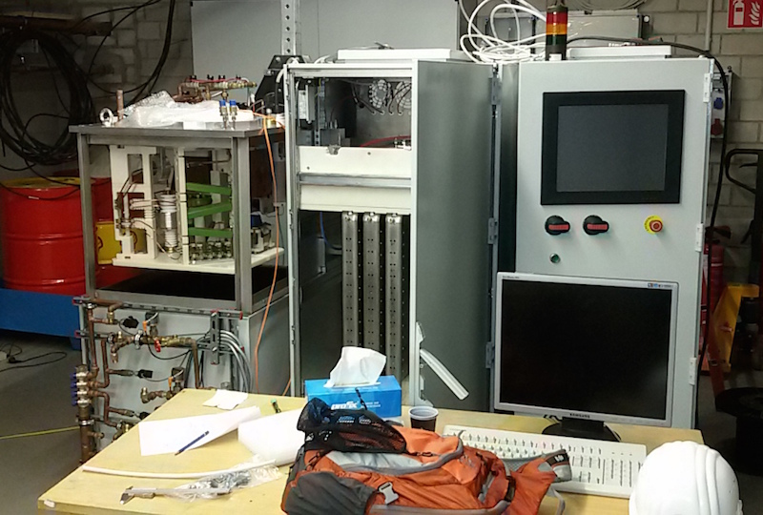
5. Hardware: TDS System
Installation INR modulator in XSE UG5 R22a
3
2
1
6
4
5
TDS (INR): Design and manufacturing by Inst. for Nuclear Research (INR), Troitsk, Russia.
(PITZ: in operation,) INJ: installed, BC1: CO₂ cleaned, BC2: cups manufactured, to be brazed
High-Power RF system (INR):
(PITZ: ScandiNova K1 in operation)
INJ: INR Modulator is being installed in XSE UG5 R22a
BC1: Manufacturing started at INR
BC2: Modulator (K1.5) ordered from ScandiNova (delivery 06/2016)
LLRF System (DESY, MSK): ‘standard’ LLRF system for single cavities (e.g. XFEL Gun, REGAE, …)
Vacuum System (DESY, MVS): Integration into XFEL Vacuum System
TDS Temperature Control (DESY, MKK): Similar as for LOLA @ FLASH
General Infrastructure (DESY): …

Slide 22
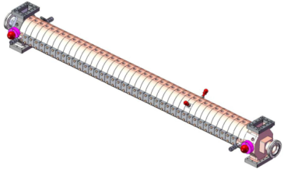
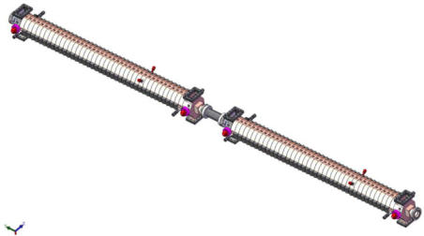
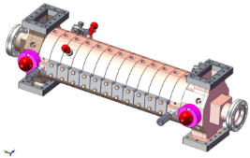
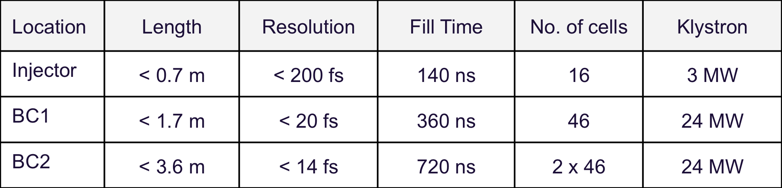
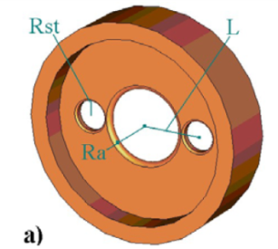
5. Hardware: TDS Parameters
TDS Voltage => Powerful commercial klystron
TDS Frequency => As high as possible
Wakefields => Iris > 40.5 mm => TDS Frequency < 4GHz
Streak 1 - 4 bunches within bunch train => short filling time
=> S-Band at 2.997 GHz
(fTDS = 332 * fMO)
=> Travelling-wave structure
One cup design

Slide 23
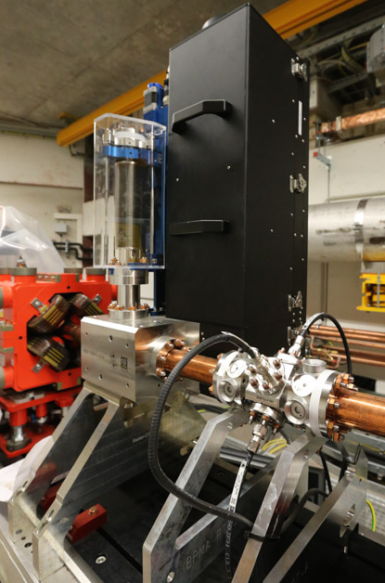
5. Hardware: Screen Stations (WP-17, MDI)
Courtesy of D. Noelle
LYSO scintillator screen mounted 90º to the beam and observed at ‘non’ OTR angle
=> Suppression of COTR by spatial separation
Ch. Wiebers et al., IBIC13, WEPF03
Screen station in the XFEL injector

Slide 24
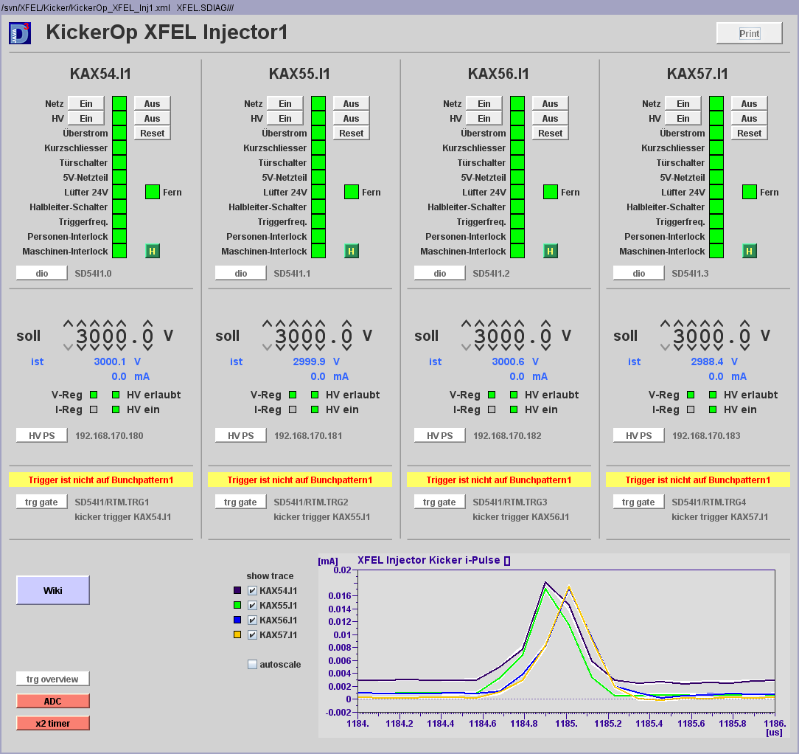
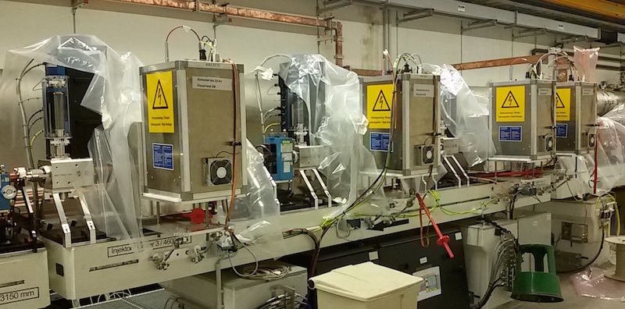
5. Hardware: Fast Kicker Magnets
Courtesy of F. Obier
All TDS kickers have been manufactured
Maximum length of 350 mm defined by bunch repetition rate of 4.5 MHz (380 ns half sine wave)
=> 2 kickers in series required in BC2 to achieve sufficient kick strength (two pairs installed)
=> online slice emittance measurements not possible
4 TDS kickers in the XFEL injector are in operation

Slide 25
5. Hardware: Summary #1
M. Yan, PhD. Thesis 2015
This table will answer questions such as
How many TDS?
How many kickers?
Which streak direction?
Which kick direction?
…

Slide 26
5. Hardware: Summary #2
1) TDS System: TDS (MIN), high-power RF (MIN), LLRF (MSK), vacuum (MVS), temp. regulation (MKK), Front-end DOOCS server (MCS), general infrastructure
2) TDS Diagnostics: TDS System + fast kickers (MIN) + screen stations (MDI)
3) TDS Measurement: Dedicated beam optics + High-level Control Software for the operation of TDS diagnostics and the evaluation of physical parameter (bunch current, slice emittance, …)
=> MPY, MXL (B. Beutner, M. Scholz et al.)
Example: Optimized beam optics for slice emittance monitor in BC1 (30/76-FODO):
Large β_{x} at TDS
Small β_{x} at screen
About μ_{x} = 90º for TDS to screens
Small μ_{x} between screens
Cover Δμ_{y} ≈ 0º – 130º for emittance
…

Slide 27
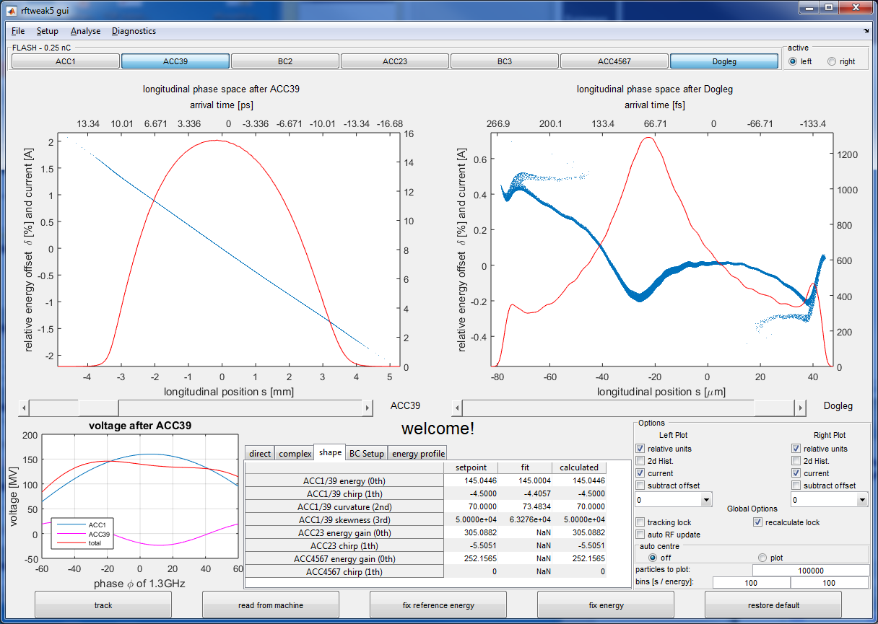
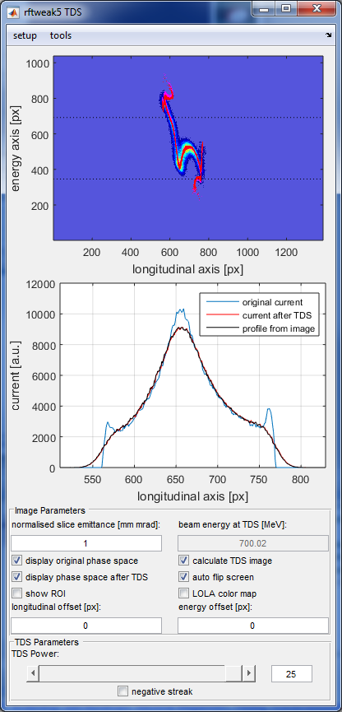
27
6. Commissioning: TDS Measurement Modeling

Slide 28
28
6. Commissioning: Overview
Measurements of projected emittances with basically the same infrastructure (servers, cameras, etc)
  Beam optics is matched to design (destructive)
  Diagnostic works
In parallel: TDS system technical commissioning (LLRF, RF, Modulator, Klystron, etc.)
First TDS measurements w/o kickers, single bunch
  Refinement of image analysis algorithms
Commissioning and deployment of DOOCS servers to allow semi-parasitic measurements
  Time structure (timing: TDS, kicker, cameras, gun lasers)
  Kicker automation
  Semi-parasitic bunch length measurements (works at FLASH)
Phase space optimization towards TDR goals
  Destructive electron beam tomography (4D)

Slide 29
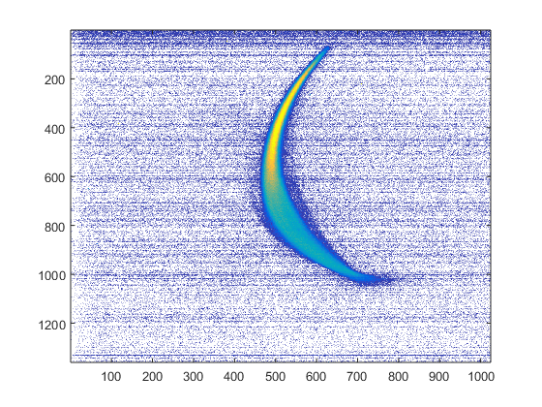
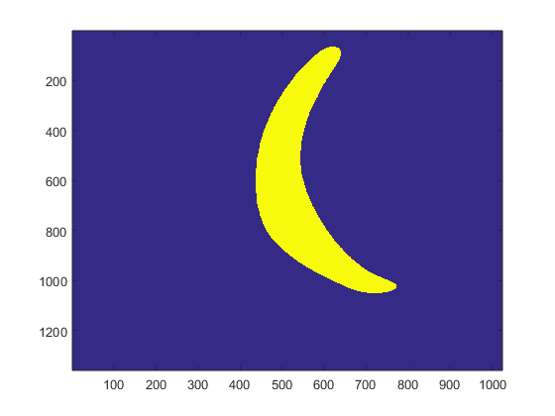
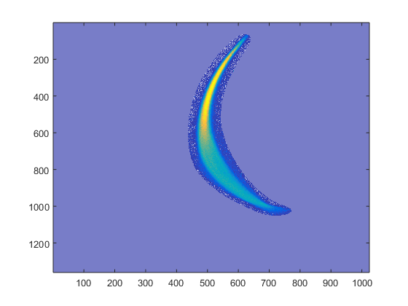
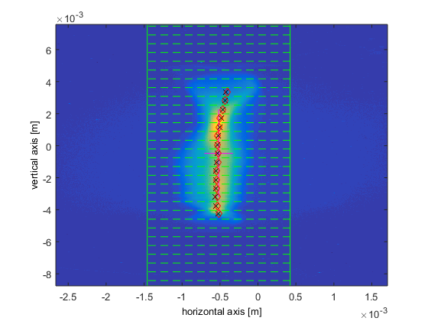
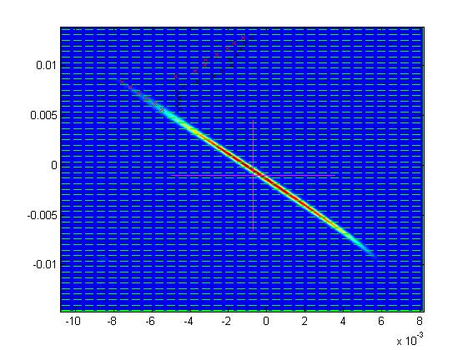
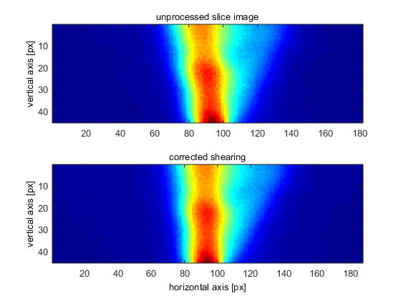
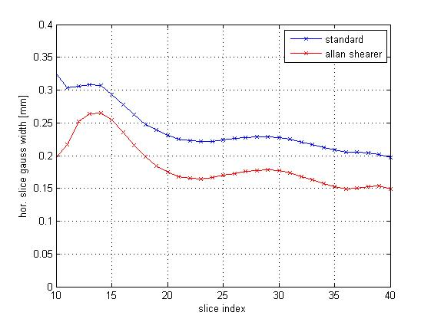
29
6. Commissioning: Image Analysis
Image analysis code is available (Roehrs, Behrens, Yan, BB)
Experience from FLASH, SFITF, LCLS, ...
Fine tuning of hardware
specific parameters
automised mask-of-interest to enable efficient RMS spot size analysis
Shearing of beamlets to mitigate effects from beam tilts or dispersion on chirped beams
Slicing of beam images for slice resolved analysis
Raw data
Correlation correction
slice gauss width [mm]
slice index

Slide 30
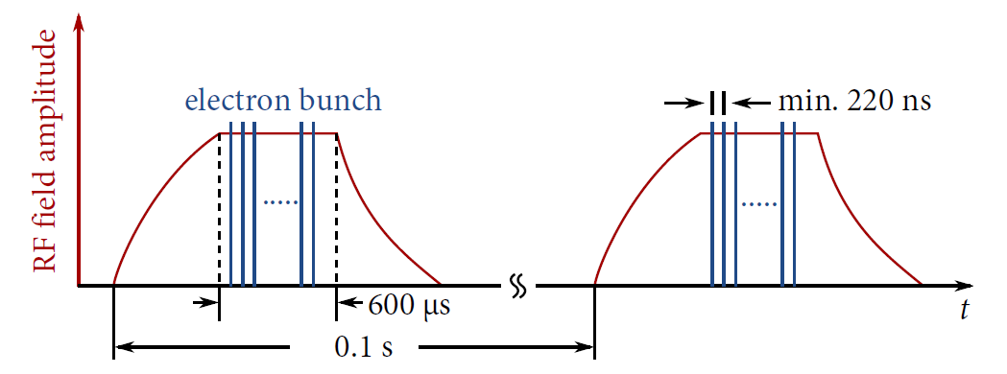
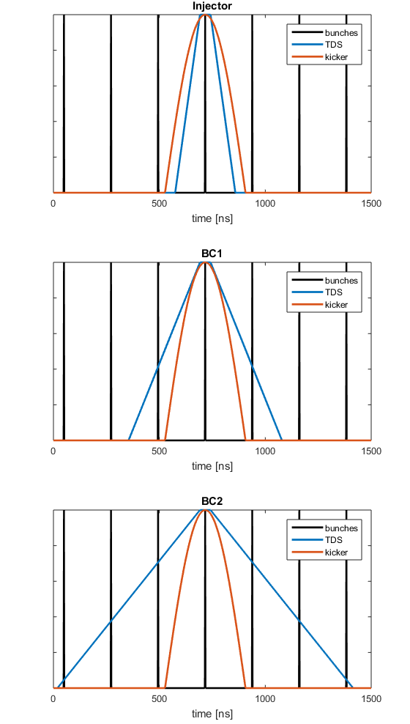
30
6. Commissioning: “Pulse Stealing Mode”
Example: 4.5 MHz mode, single-bunch streak (50 ns flat-top)
Semi-parasitic operation of TDS in parallel to FEL operation using electron beam kickers
Up to 4 bunches can be streaked at 1MHz (3.5 us flat-top duration)
At BC1 and BC2 more than one bunch is affected by the TDS
=> implications for machine protection (MPS)
Trailing bunches of FEL sub-trains are analysed (as in FLASH)
SASE 1 SASE 2
fill and stabilisation (about 100 us)
beam RF pulse (600 us)
modification of RF parameters
(about 50 us)
charge / voltage
time
analysed by TDS

Slide 31
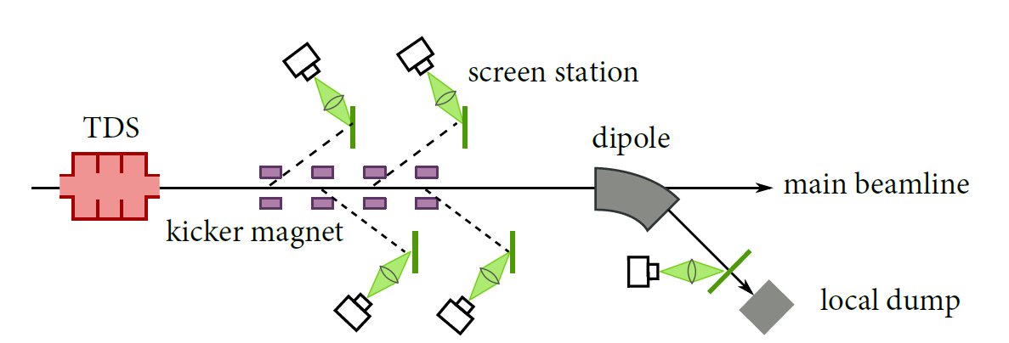
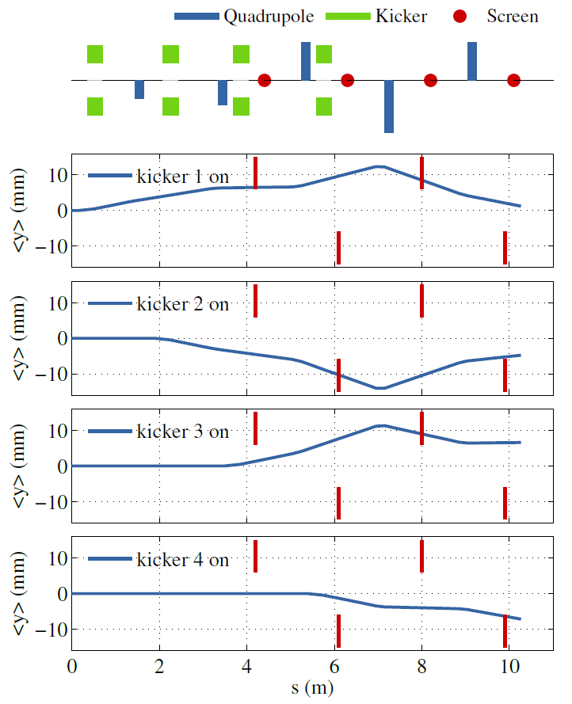
31
6. Commissioning: Bunch Kicker Pattern
  Four bunches (at 1 MHz) can be streaked with the TDS systems
  Beam trajectories for kicked bunches on the first two screens intersect with the last two screens
Example: Injector and BC1
Option 10 Hz:
To avoid overlapping beam spots the number of bunches streaked per shot (10 Hz) can be reduced to 2 or even one.
An advantage of the 2.5 Hz option would be that always the same bunch along the train is streaked and analysed.
=> scans along the train / intra-train stability studies
bunch train 1
Option 5 Hz:
bunch train 1
bunch train 2
Option 2.5 Hz*:
bunch train 1
bunch train 2
bunch train 3
bunch train 4
* Mandatory for BC2

Slide 32
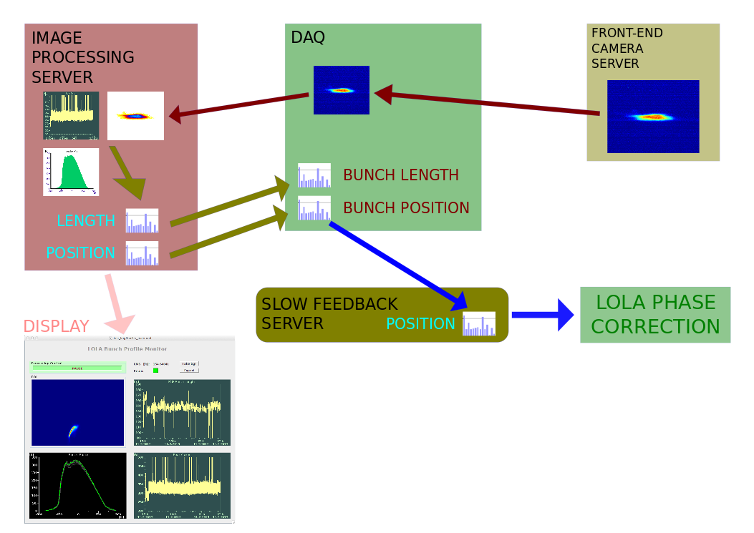
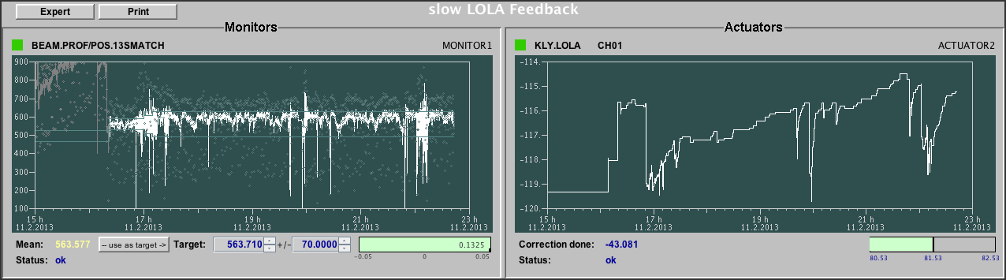
32
6. Commissioning: Slow TDS phase feedback
Phase change of bunches at TDS due to drifts/FEL tuning => bunch wanders off screen
Data Storage
During SASE User Operation

Slide 33
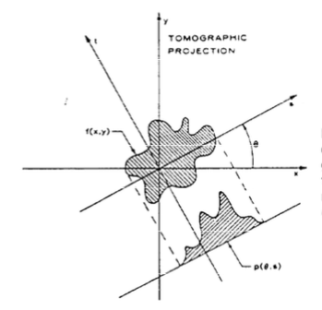
33
Tomographic Reconstruction, MENT Algorithm
C. T. Mottershead, IEEE Transactions on Nuclear Science, Vol. NS-32, No. 5, October 1985.
Topographic techniques allow the reconstruction of 2D function values f(x,y) from a set of line integrals through the point (x,y).
The Radon Theorem guarantees an unique solution for f(x,y) for a suitable set of projections.
The maximum entropy (MENT) algorithm requires a comparatively small number of projections for the reconstruction (Minerbo, Computer Graphics and Image Processing 10, 48-68, 1979).
The plots on the right show a reconstruction using the MENT algorithm for different numbers of projections.
Code for the reconstruction of the measurement data is available and tested (J. J. Scheins, TESLA Report 2004-08).

Slide 34
Motivation for Tomographic Reconstruction of the Transverse Phase Space
34
M. Röhrs, DESY-THESIS-2008-012
Advanced studies of phase space dynamics are possible with tomographic reconstruction.
Example FLASH (without 3rd harmonic module):
  Plots a) and b) on the left hand side show the reconstructed horizontal phase space distribution. The measured slice emittances of this distribution could not explain the achieved SASE pulse energy.
  After reconstructing the phase space one was able to identify a subset of particles mainly contributing to the SASE process (Plots c) and d) ). The smaller emittance of these particles was in line with the SASE pulse energy measurements.
  CSR effects led to the development of a “tail” in the horizontal phase space. This dynamics could be imaged with tomographic methods.
F. Löhl, DESY-THESIS 2005-014

Slide 35
35
Electron Beam Tomography in the XFEL Injector
It was shown* that the optics elements and the TDS existing in the European XFEL injector can be applied for measurements providing data for the tomographic reconstruction of the horizontal phase space.
A quadrupole scan rotates the electron beam in the horizontal phase space (x,x’) at the position of the observation screen by 180 degree.
Unlike for emittance measurements, the x-axis projections of the pictures taken at the screen are used for the tomographic reconstruction.
Certain requirements on the beta functions at the positions of the TDS and at the observation screen are give in order to improve the TDS streak and the data capture.
18 different quadrupole setups were calculated to scan the horizontal betatron phase. All requirements on beta functions are fulfilled. The plots below describe the these setups.
Beta functions at the position of the TDS in the injector.
Beta functions at the last screen in the diagnostic section.
Normalized gradients of the quadrupoles used for the scan.
* TUP068, Proceedings of FEL2015, Daejeon, Korea

Slide 36
Thank you for your attention

Slide 37
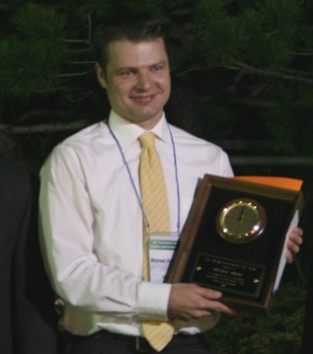
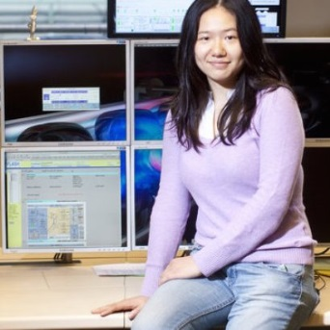
6. FLASH: Publications, PhD studnets and Prizes with LOLA
Publications with TDS / LOLA:
Time-resolved electron beam phase space tomography at a soft x-ray free-electron laser,
Phys. Rev. STAB 12, 050704 (2009),
M. Röhrs, C. Gerth, H. Schlarb, B. Schmidt, and P. Schmüser
Generation and Characterization of Electron Bunches with Ramped Current Profiles in a Dual-Frequency Superconducting Linear Accelerator,
Phys. Rev. Lett. 108, 034801 (2012),
P. Piot, C. Behrens, C. Gerth, M. Dohlus, F. Lemery, D. Mihalcea, P. Stoltz, M. Vogt
Electron Beam Profile Imaging in the Presence of Coherent Optical Radiation Effects,
Phys. Rev. STAB 15, 062801 (2012),
C. Behrens, Ch. Gerth, G. Kube, B. Schmidt, S. Wesch, M. Yan
Constraints on photon pulse duration from longitudinal electron beam diagnostics at a soft x-ray free-electron laser, Phys. Rev. STAB 15, 030707 (2012),
C. Behrens, N. Gerasimova, C. Gerth, B. Schmidt, E. A. Schneidmiller, S. Serkez, S. Wesch, and M. V. Yurkov
Recent Applications of Longitudinal Phase Space Diagnostics, ICFA Beam Dynamics Newsletter Dec (2012),
Christopher Behrens and Christopher Gerth
Ca. NN Jacow Proceedings at Conferences
PhD Students (Preise und Auszeichnungen):
Dr. Michael Röhrs
2008 Young Scientist Award at FEL Conference (mit 1000$ dotiert)
2008 PhD
Dr. Christopher Behrens
2012 PhD. mit Auszeichnung (500€ Prämie)
Minjie Yan
2012 Otto-Stern-Preis des Fachbereichs Physik der Uni Hamburg (mit 300€ dotiert)
2015 PhD (proposed for ‘mit Auszeichnung‘)

Slide 38
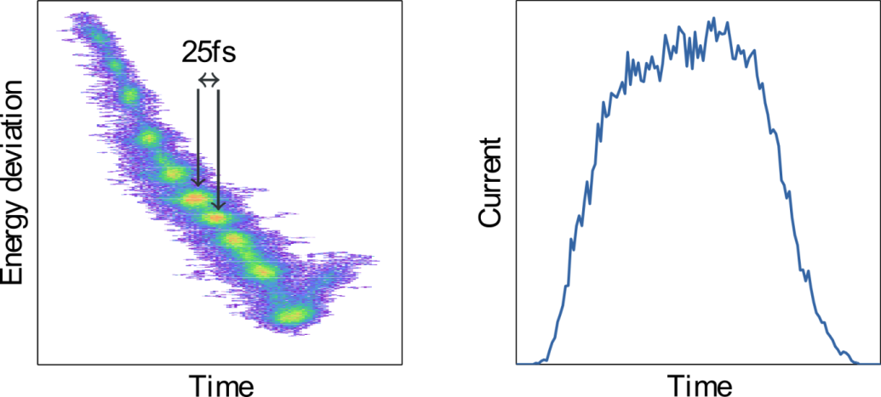
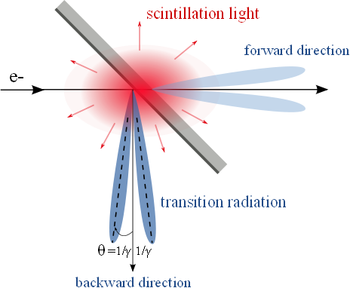
5. Hardware: Screen Stations: COTR
FLASH spectrometer
COTR at LCLS, FLASH
Spatial separation
(unwanted) Micro-bunching (due to LSC) can be seen in TDS measurements at FLASH
(in contrast to wanted micro-bunching in SASE undulators)
Micro-bunching at optical wavelengths leads to the emission of coherent OTR (COTR) and renders beam size measurements impossible
=> LCLS Commissioning
(Phys. Rev. ST Accel. Beams 11, 030703 (2008), Sec. XI Unexpected Physics)
Remedy:
1) Suppression of micro-bunching => laser heater
2) Suppression of COTR by spatial separation => scintillator screen observed at ‘non’ OTR angle
Notes:
Before you start editing the slides of your talk change to the Master Slide view:
Menu button “View”, Master, Slide Master:
Edit the following 2 items in the 1st slide:
1) 1st row in the violet header:
Delete the existent text and write the title of the EoI for WPnumber
2) The row in the footer area: write the institute name
Close Master View

Slide 39
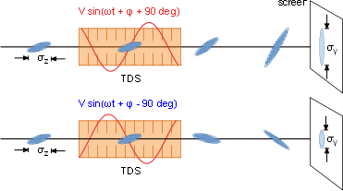
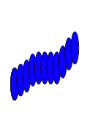
6. FLASH: Longitudinal Profile Reconstruction
An initial tilt y’(z) in the streak plane, e.g. due to wakefields or CSR, leads to an over- or underestimation of the longitudinal profile:
y´
z
By measuring the profiles at both the positive (+90deg) and negative (-90deg) zero-crossings of the TDS, the correct longitudinal profile can be reconstructed.
(H. Loos, “Reconstruction of a filamentary phase space from two projections”)
Notes:
Before you start editing the slides of your talk change to the Master Slide view:
Menu button “View”, Master, Slide Master:
Edit the following 2 items in the 1st slide:
1) 1st row in the violet header:
Delete the existent text and write the title of the EoI for WPnumber
2) The row in the footer area: write the institute name
Close Master View

Slide 40
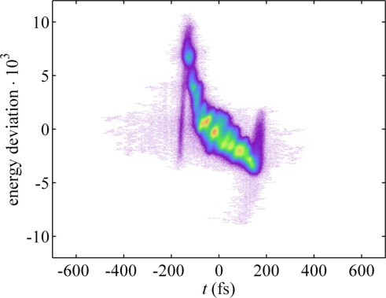
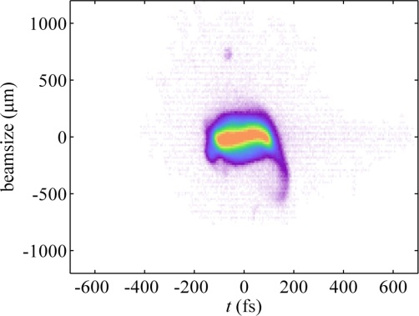
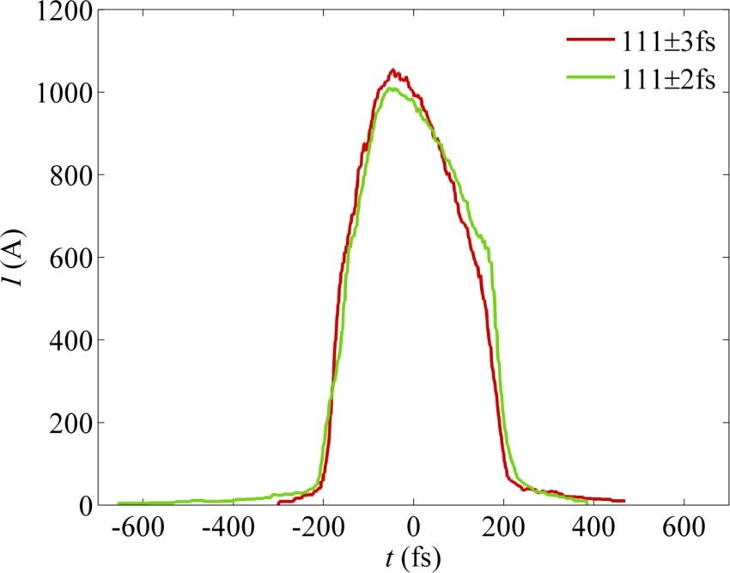
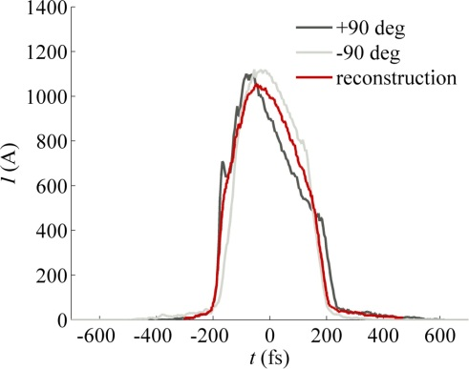
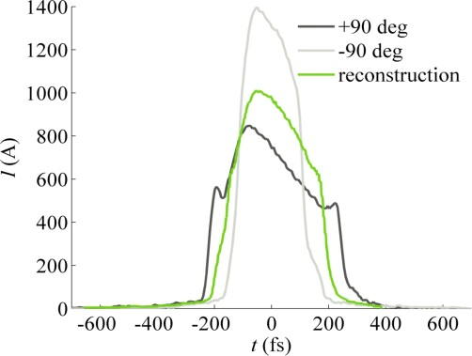
6. FLASH: Profile Reconstruction: Compression Setting 1
Spectrometer
Straight
Resolution
SDUMP ~15fs
SMATCH ~45fs
Very different profiles measured at SMATCH for different zero-crossings. But the reconstructed profile is in
good agreement with SDUMP.
+90 deg
122±4 fs
140±5 fs
-90 deg
103±6 fs
86±4 fs
Notes:
Before you start editing the slides of your talk change to the Master Slide view:
Menu button “View”, Master, Slide Master:
Edit the following 2 items in the 1st slide:
1) 1st row in the violet header:
Delete the existent text and write the title of the EoI for WPnumber
2) The row in the footer area: write the institute name
Close Master View

Slide 41







6. FLASH: Profile Reconstruction: Compression Setting 2
Resolution
SDUMP ~10fs(at +90deg)
~20fs (at -90deg)
SMATCH ~36fs
Large energy spread: >2%
(beam was cut off at the SDUMP screen edge)
SMATCH station limited due to resolution
Spectrometer
Straight
74±4 fs
84±4 fs
+90 deg
64±5 fs
58±5 fs
-90 deg
Notes:
Before you start editing the slides of your talk change to the Master Slide view:
Menu button “View”, Master, Slide Master:
Edit the following 2 items in the 1st slide:
1) 1st row in the violet header:
Delete the existent text and write the title of the EoI for WPnumber
2) The row in the footer area: write the institute name
Close Master View

