Slide 1
SHiP Experiment „Search for Hidden Particles“
Caren Hagner Universität Hamburg

Slide 2
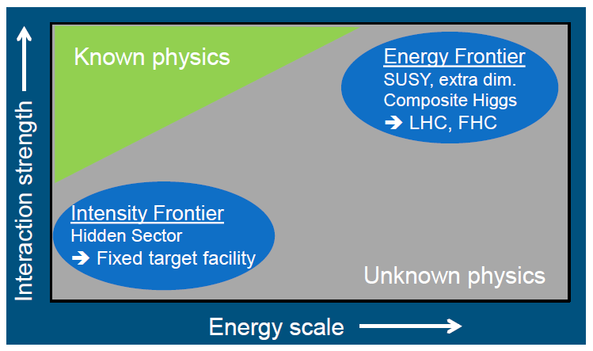
Suche nach neuer Physik

Slide 3
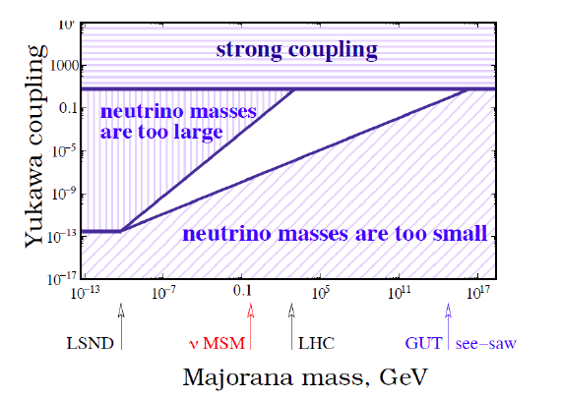
Erzeugung von Neutrinomassen: See-saw Mechanismus
Majorana Masse M, Dirac Masse m_{D} ≈ Y_{iα} <Φ>
Beispiel: M ≈ 1GeV und m_{v} ≈ 0.05eV -> m_{D} ≈ 10keV und Y_{iα} ≈ 10⁻⁷
Kleine Neutrinomassen: Sehr große Skala M oder sehr kleine Kopplung Y_{iα}

Slide 4
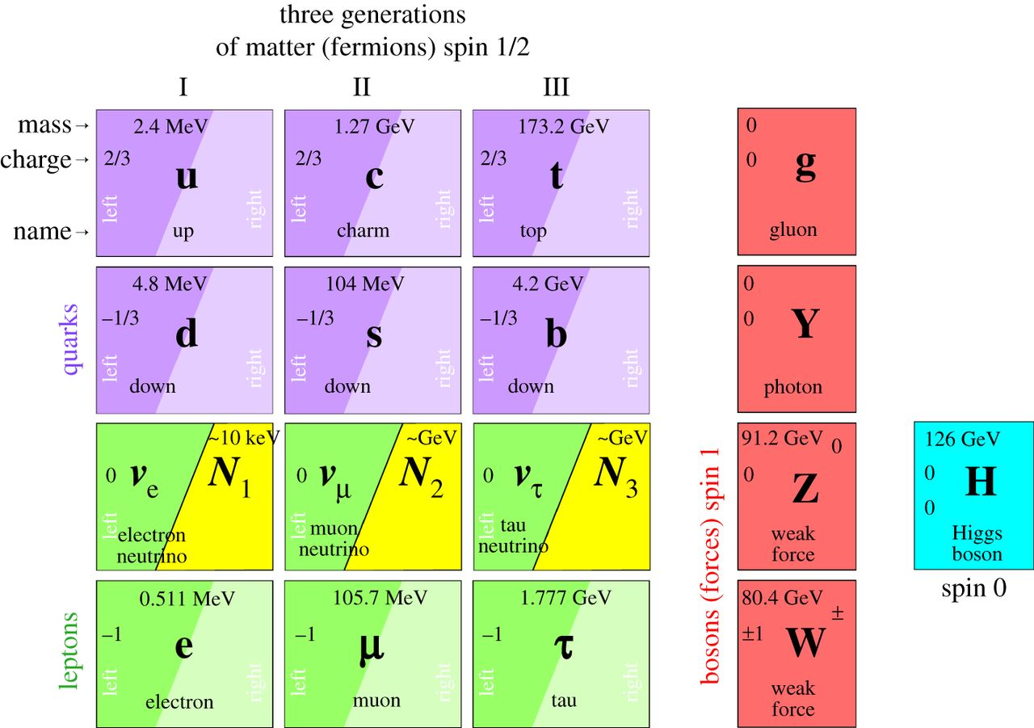
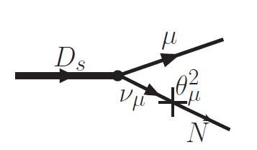
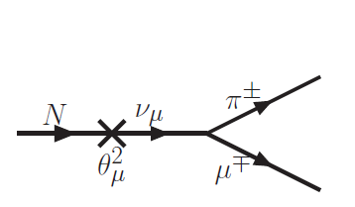
Neutrino Portal and Heavy Neutral Leptons
Add 3 right-chiral counterparts N₁, N₂, N₃ „sterile neutrinos“ Heavy Neutral Leptons (neutral with respect to SM gauge interactions)
could explain:
v oscillations
why neutrino masses are small
baryon asymmetry
dark matter
vMSM (T.Asaka, M. Shaposhnikov PLB620(2005)17
10keV
1GeV
1GeV

Slide 5
SHiP Experiment
Proposal for a new facility at CERN SPS:
General purpose Hidden Sector (HS) detector
v_{τ} facility
235 experimentalists from 45 institutes and 15 countries + CERN
Technical Proposal submitted in April (arXiv:1504.04956)
Physics Proposal signed by 80 theorists (arXiv:1504.04855)
Addendum to Technical Proposal (Oct 2015) (CERN-SPSC-2015-040/SPSC-P-350-ADD-2)
SPSC review process ongoing
Future: TDR ready in 2018 (start data taking 2027)

Slide 6
Signal & Background

Slide 7
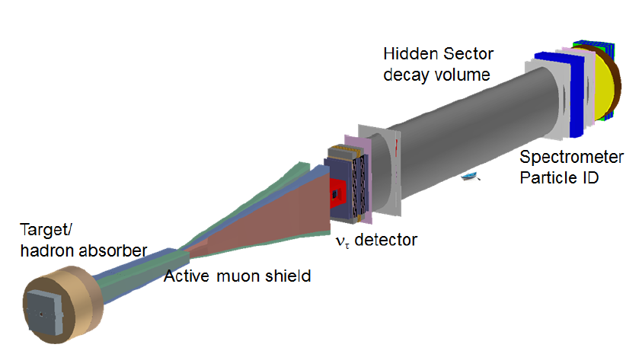
SHiP Experiment
High Intensity beam dump experiment: K, D, B mesons
Long-lived, weakly interacting particles require large decay volume
Spectrometer, Calorimeter, PID
Signature:
isolated vertex of charged tracks inside fiducial volume
candidate momentum pointing to target
no VETO
ca. 150m

Slide 8
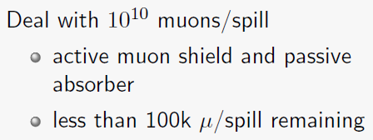
SHiP Experiment
2x10²⁰ protons on target in 5 y
Mo (4 λ_{int}) - W (6 λ_{int}) target
peak power 2.5 MW, water cooled
challenging radiation issues

Slide 9
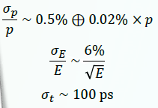
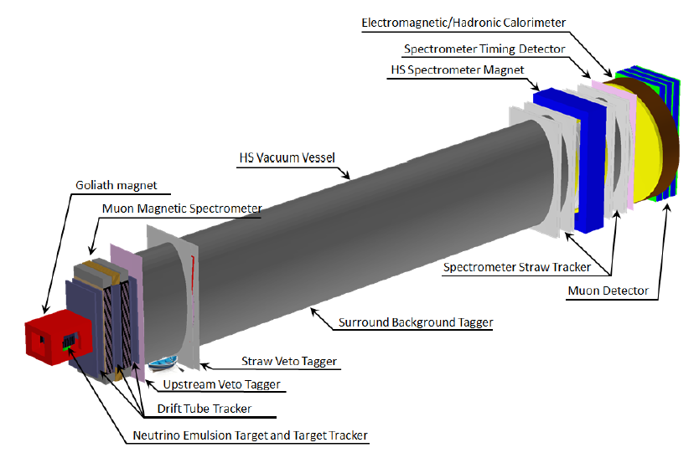
SHiP: Hidden Sector Detector
spectrometer resolution:
5m x 10m x 50m elliptical vessel
vacuum: 10⁻³ mbar
5m horizontal straw tubes

Slide 10
Neutrino production

Slide 11
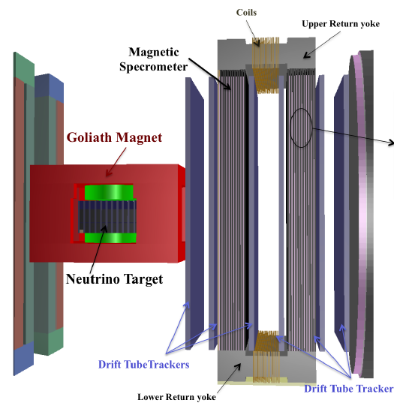
Tau Neutrino Detector
use OPERA expertise + several parts recycled
≈7k v_{τ} interactions
first detection of anti- v_{τ}
v_{τ} cross section measurement
HNL normalization with v_{e}
charm physics with τ
proton structure function

Slide 12
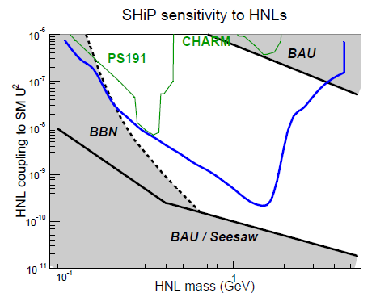

Slide 13
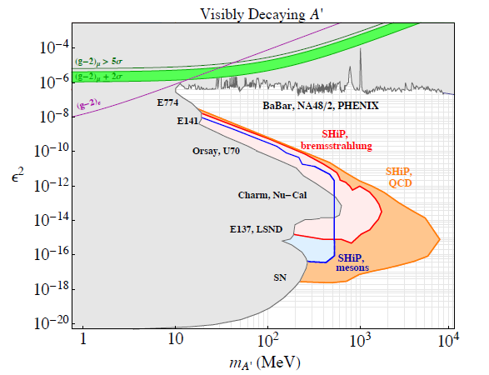
Sensitivity to dark photons (updated for addendum to TP)
Dark photons from: p bremsstrahlung, light meson decays
Decays to l⁺, l⁻,

Slide 14
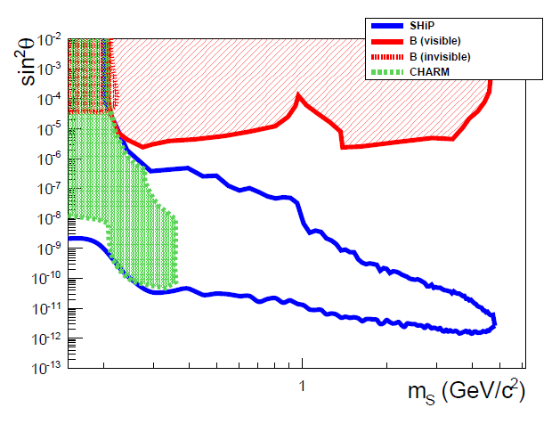
Sensitivity to dark scalar
Sources: B mesons
Coupling to Higgs with mixing parameter sin²ϑ, decaying in

Slide 16
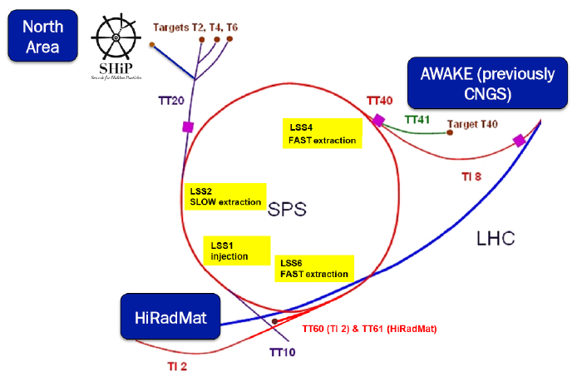
SHiP am CERN

Slide 17
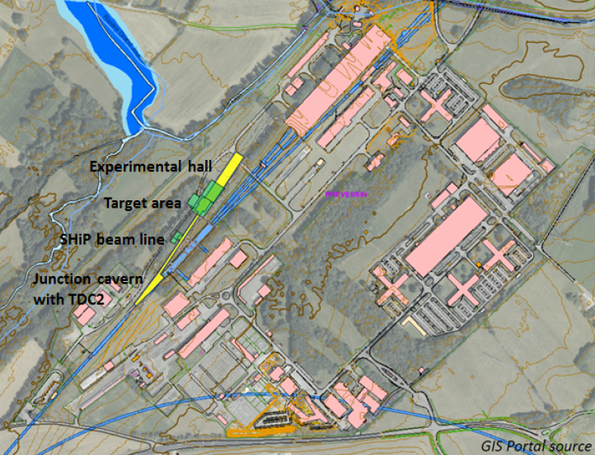
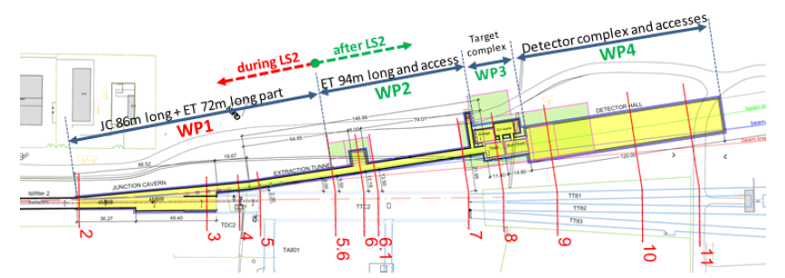

Slide 18
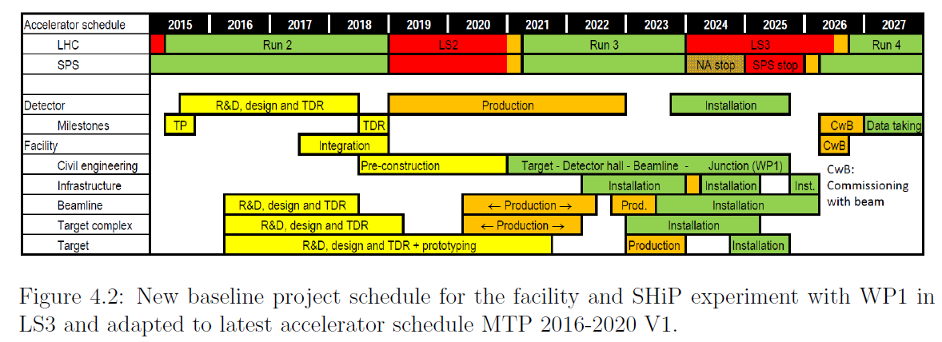
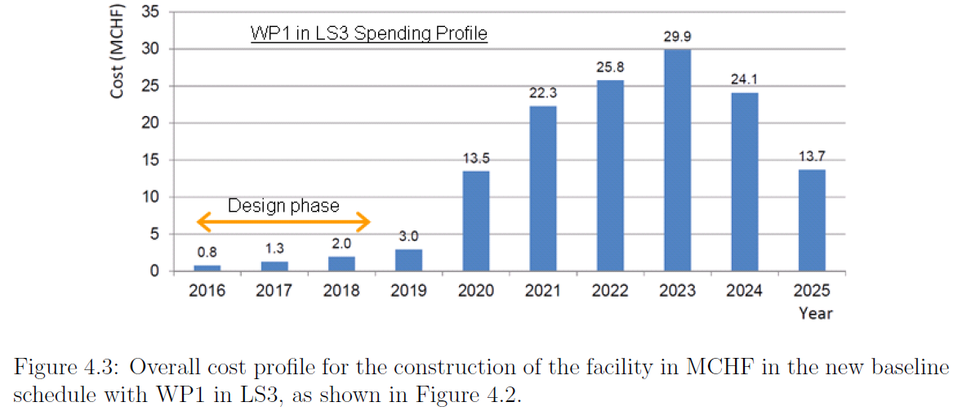
Zeitplan & Kosten (aus Addendum to Technical Proposal, 19/10/2015)
Facility Gesamt: 136MCHF
CE engineer
Beamline
Target
muon shield
services
(Detektor: TauNeutrino 12 MCHF HS Detektor 47 MCHF)
Notes:
WP1: Junction cavern + 70m beam line (21 months)

Slide 20
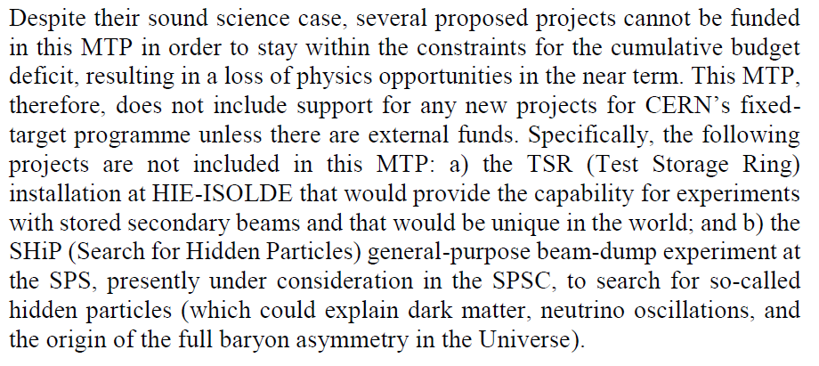
CERN MTP 2016-2020

