Slide 1

Netzwerk Teilchenwelt – an integral part of basic research
Michael Kobel, TU Dresden
Institute of Nuclear and Particle Physics
KET Jahrestreffen
21.11.2015

Slide 2
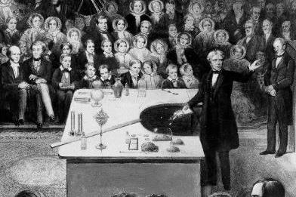
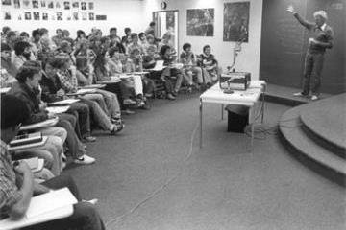
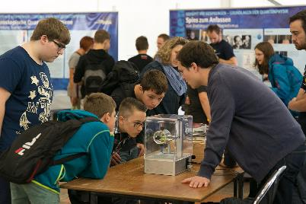
If science is going to fully serve its societal mission in the future, we need to both encourage and equip the next generation of scientists to effectively engage with the broader society in which we work and live.
Education&Outreach (E&O)
M. Faraday, 1825 L. Lederman, 1980ies Highlights der Physik, 2013
Alan Leshner, past CEO AAAS

Slide 3
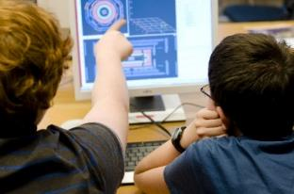
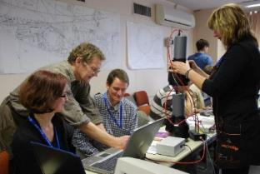
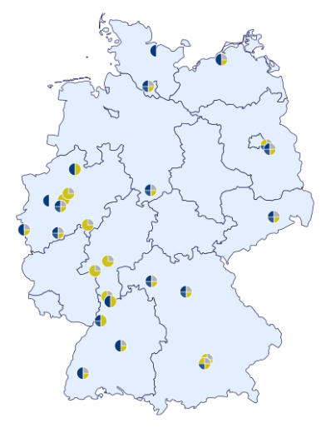
Netzwerk Teilchenwelt
Multi-level program for
  high school students, aged 15-19
  teachers/trainers
at schools, school labs, science centers…
  170 – 200 events per year
  2010-13: ~ 14.000 students, ~ 1.200 teachers
Established and successful structure
(mostly) BMBF funded 2010-2015
26 research labs participate
Project coordination:
  TU Dresden: overall coordination
  HEP topics, teaching material, training
  DESY, Zeuthen: Astroparticle coordination
  CERN: workshop support

Slide 4
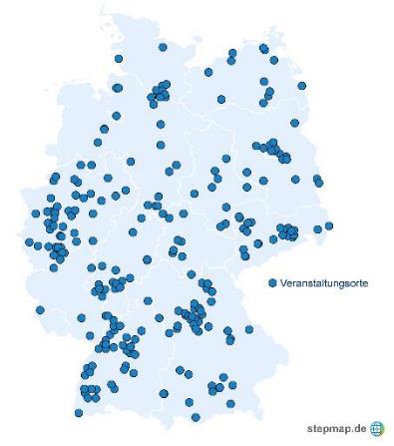
Worldwide unique combination
Joining experts from science, didactics, science communication and teachers
Fostering general education
and excellence in science
Reaching out to the farthest countryside
Following the research in “real time”
Contact with authentic data and
real (young) scientists
  Cross-topical program bridging
  Particle/nuclear/hadron/astroparticle physics
Particle Physics
Astro-particle physics
Hadron and nuclear physics
Netzwerk Teilchenwelt

Slide 5


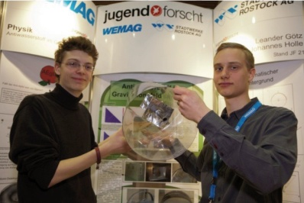
The double pyramid concept
Research
Participation
Training at CERN
Active contributions
Running own projects
Par ticipation in
introductory
events
Research work
Network
Program
(CERN)
Qualification
Program
Basic
Program
Research
Theses
CERN-Workshops
Project weeks
Active contributions
Proliferation of experiences
School projects
Masterclass
participation
(particle physics-, International-, Astroparticle-Masterclasses)
Teachers
Students

Slide 6
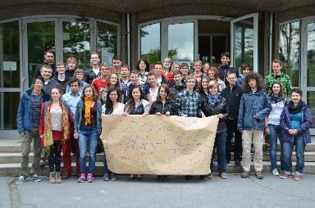
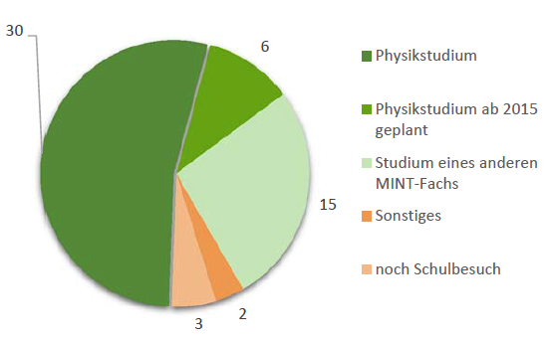
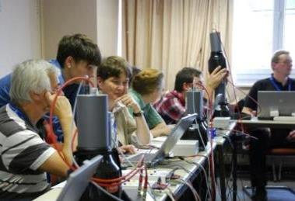
Benefits for all stakeholders
Students
  Inspired and fascinated by doing own measurements/research
  Meeting scientists (role model)
  Direct contact to research labs
  Alumni organisation
  Consolidating decision to study physics
    „NTW helped me a lot in deciding to study physics. I learned how exciting physics can be, outside of school.“
Teachers
  Training
  Exchange with colleagues and scientists
  Encouragement to include particle physics in school
  Material for lessons

Slide 7
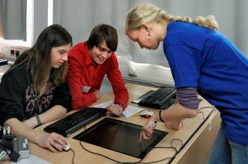
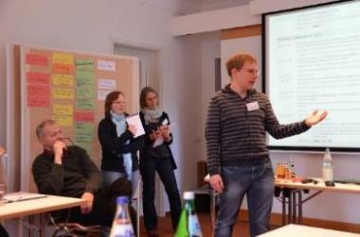
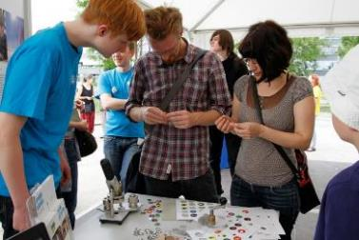
Benefits for all stakeholders
Facilitators
  See the relevance of their work to society
  Soft skills:
  science communication, didactics
  Training provided (2.5 d workshop)
  Broader view:
  (particle – astro, theory – experiment)
Research labs
  Increased public appreciation and visibility
  Contact to future students
  Support:
  (experiments, material, organisation, …)

Slide 8
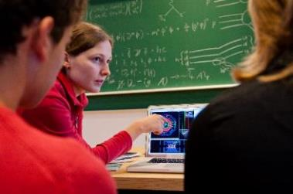
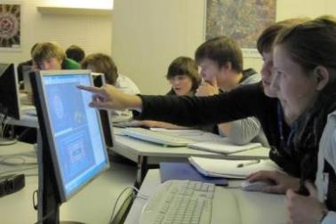
Astro-/Particle Physics Masterclasses
1 day in schools, also school labs, exhibitions (~100 p.a.)
facilitators = PhD students
agenda:
  introductory talk
  (standard model, accelerators, detectors)
  measurements with real data
  using same tools as researchers
    Since 2010: ATLAS and CMS
    Since 2011: ALICE, CosMO and Kamiokanne
    Since 2013: LHCb
    Since 2014: Auger MC (own development)
    Since 2014: participation in IceCube MC
    TOTEM in 2016(?)
    …

Slide 9




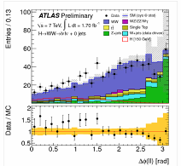
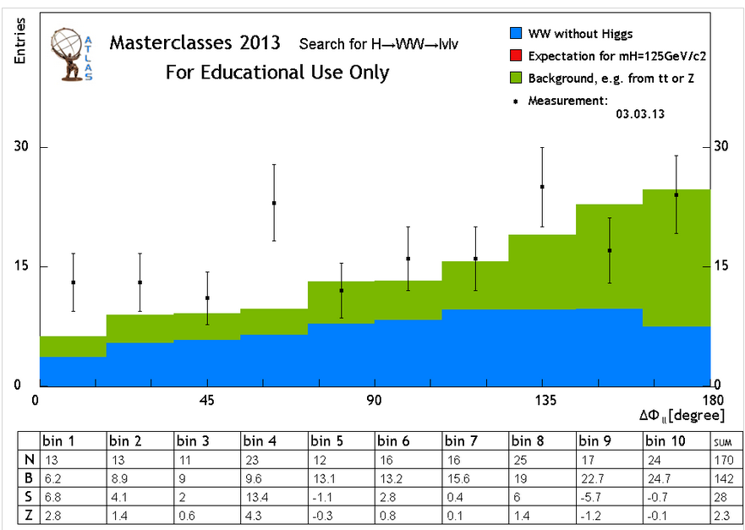

Example: Analysis with real LHC data
www.physicsmasterclasses.org/index.php?cat=physics
ATLAS
  W path (W⁺/W⁻ + H→WW)
  Z path (Z, Z’, … )
CMS
  J/Ψ data quality
  W,Z,H analysis
ALICE
  Strange Particles
  Modification Factor R_{AA}
LHCb
  Charm lifetime
TOTEM (to come)
  pp diffraction pattern
Rich spectrum of tasks
  Check data quality
  Event displays, identify particles
  Histograms (Mass, angles)
  Draw conclusions
Freely accessible
for education purposes
Continuously following research progress
  2012: simulated Higgs events
  2013: real Higgs candidates
  …

Slide 10
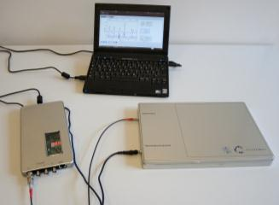
Astroparticle activities
Scintillator experiment „CosMO“ and „Kamiokanne“
  loan to schools (after teachers training)
  Variety of measurements:
    angular distribution
    coincidence
    muon lifetime (2 signals within 20 μs)
    study particle showers
Cloud chamber sets
New Web experiments
  Auger data
  New portal: cosmic@web at DESY 2016
Expanding: International Cosmic Day
DAQ board
Scintillator
Photomultiplier

Slide 11
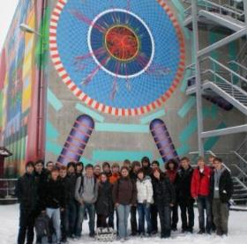
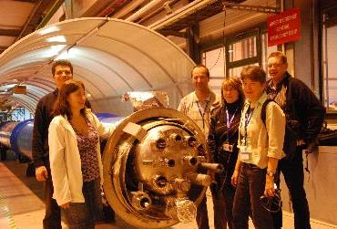
CERN Workshops + Project Weeks
Students
60 students in two annual workshops
(3 days) https://indico.cern.ch/event/373094/
10 students in project weeks
(14 days) https://indico.cern.ch/event/295068/
  own research projects, e.g. Medipix detector, CLOUD, ATLAS trigger system,
  lifetime B-Meson, LHC beam steering,
  ASACUSA, track finding, …
Teachers
40 teachers in two annual workshops
(5 days) https://indico.cern.ch/event/360086/
  big motivation for activities
  very effective training in modern physics

Slide 12
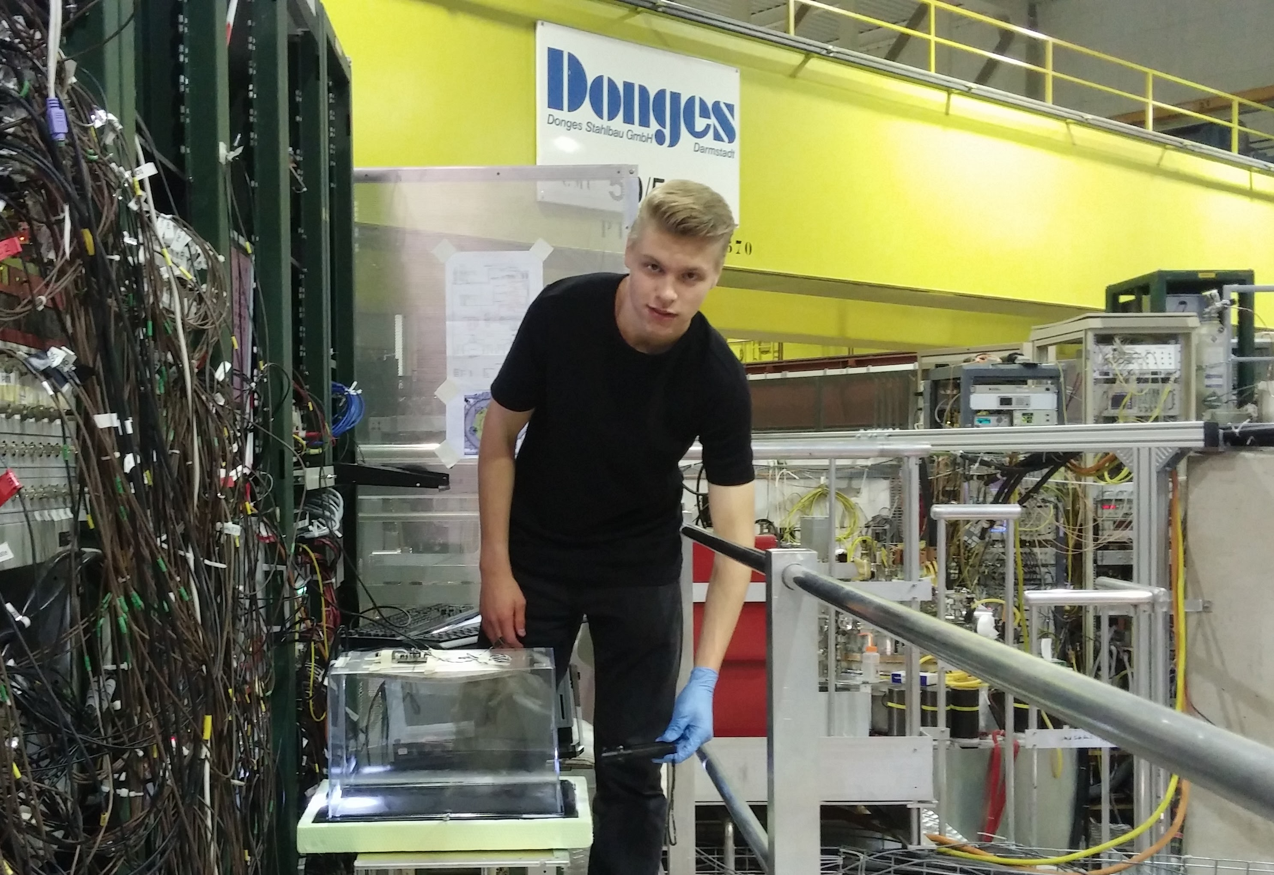
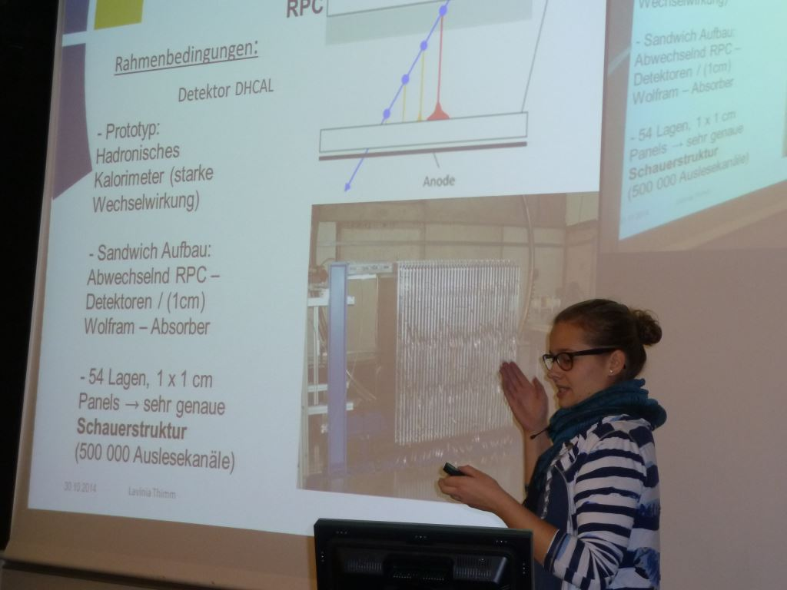
Research Projects
research projects for 3 -10 months
often part of final school examinations
work on own measurements,
possible continuation at project week
tutors: PhD students/ physicists
at universities and teachers
Several awards (2-4 per year!)
  „Jugend forscht“
  Dr. Hans Riegel-Fachpreis
  Von Ardenne Physikpreis
2015 : „Untersuchungen der Frag-
mentationen und Entstehungsprodukte von Antiproton-Titankern-Kollisionen sowie Annihilationen in Photoplatten“ und „Untersuchungen der Teilchenpro-duktionen und -bahnen bei der Injektion von Antiprotonen im AD “
www.teilchenwelt.de/mitmachen/jugendliche/projekt-,%20fach-und%20forschungsarbeiten/

Slide 13

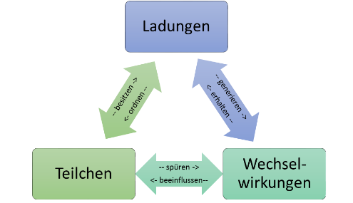
Teaching Material
particle physics for schools,
comprising 300 pages text, exercises, work sheets
  Interactions, charges and particles
  Research methods in HEP
  Cosmic rays
  Micro courses
Finalized few weeks ago,
to be printed and distributed to teachers
Establishing a standardized terminology
Future project aims:
  Training of trainers (also: Fachleiter)
  Training for teachers

Slide 14
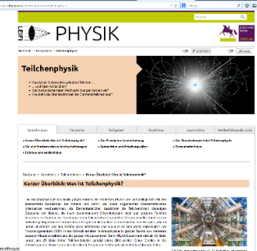
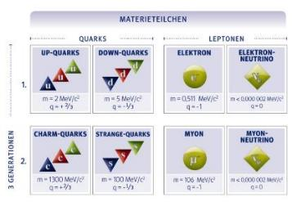
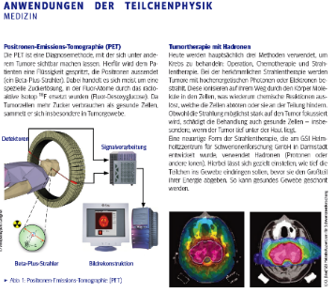
More material
  LEIFI Physik:
  Largest German physics school portal
Netzwerk Teilchenwelt: correction and update of particle physics section
www.leifiphysik.de/themenbereiche/teilchenphysik
Supporting material
for facilitators and teachers
Particle Profiles
Background information and worksheets
www.teilchenwelt.de/material/materialien-fuer-lehrkraefte/

Slide 15



Funding:amount and uncertain(!) prospects
Basis: 2 funding periods BMBF 2010-2015
  falling profile: 360k€ -> 180 k€ / year
  Aim: get additional sponsors
  Ending with „wrap-up“ funding in 2016
More sponsors (over the years)
  Joachim Herz (72 k€) up to 25%/a
  Tschira (24k€)
  TU Dresden (> 20k€)
  W&E Heraeus (7 k€) … (more contacts established)
Own contributions of participating labs/unis:
  DESY+HAP: 0.5 FTE funded
  In-kind personnel: 147 people with 8.7 FTE in total
  Many SHK, infrastructure and in-kind invest/travel (> 20 k€)
Need for financing this cross-topic E&O: ~ 240k€ /a
  =1.2% of collaborative BMBF HEP funding
  =0.95% of collaborative BMBF HEP + Astroparticle funding
  =0.6% of collab. BMBF HEP + Astropart. + H&K funding

Slide 16
Thoughts for the future
Netzwerk Teilchenwelt is
  cross-topic, role model, transferable to other fields
  has established, worth-to-sustain structures
  has several years-long project-oriented phases
    Setup
    Building cosmic ray experiments
    Following research results at LHC
    Expanding scope (Auger, Icecube, …)
    Creating synergies w/ Open Data Portal, IPPOG, etc.
    Systematic didactic reduction of research results
    Proliferation in school curricula, teacher training etc.
    Alumni and teacher engagement (Kindergarten and more )
  Typical working cycles of long-term collaborative research (Verbundforschung)

Slide 17
Summary
Sharing the excitement of scientific discoveries with the public is integral part of basic research.
Close connection to collaborative research (Verbundforschung) would be consistent.
Netzwerk Teilchenwelt in an established and extremely successful E&O program with cross-topic activities (particle/nuclear/hadron/astroparticle physics),
reaching out to thousands of students and
hundreds of teachers per year in all regions of Germany.
Through a win⁴-situation (students, teachers, facilitators, research labs) these E&O programs create a positive impact for the whole field.

Slide 18
Weitere Informationen:
www.teilchenwelt.de
Materialien für die Schule:
www.teilchenwelt.de/material
www.leifiphysik.de/themenbereiche/teilchenphysik
Für Vermittler:
www.teilchenwelt.de/material/materialien-fuer-vermittler

