Slide 1
CHESS2 Design Status
ATLAS Strip CMOS Meeting
September 29th 2015
P. Caragiulo*, C. Tamma, A. Dragone, C. Kenney, P. Grenier, Su Dong, H. Grabas, V. Fadeyev
(* pietroc@slac.stanford.edu)

Slide 2

Outline
CHESS2 ASIC Architecture and Specifications
Pixel
Read-Out
  Hit Encoding
  Serializer
  LVDS TX/RX
Configuration
  SACI
  Control Unit
    Global Register
    Row and Column register for pixel selection
    Row and Column decoders
    Digital control signal distribution

Slide 3
CHESS2 ASIC Architecture
Column Decoder
128 x 32
pixels
Half Comparator,
Latch & Strip encoding
Hit Encoding
Global DACs
Matrix
Pointers
SACI
Control Logic
Global Registers
Row Decoder
Serializer
LVDS TX/RX
Acquisition
Encoding
Configuration and Calibration
Read-out

Slide 4
Specifications
 | Specs
Substrate resistivity | 20Ohms to 1000Ohms
Substrate high voltage bias | 120V
Pixel size | 40µm x ~800µm
Number of pixel per strip | 32
Number of strips | 128
Timing resolution | 25ns
Maximum number of hits per strip | 1 + flag
Maximum number of hits per 128 strips | 8
Readout speed | 320MHz
Additional constraint | Rad-hard design
Slide from H. Grabas

Slide 5
CHESS2 pixel
Injection
IFB
RowENB
RAMWrEn
ColENB
3.3
1.8
Th
1/2
Load
Casc
1/2/4/8
Comp
InSF
In
Slide from H. Grabas

Slide 6
Hit Encoding and Read-out blocks
INPUTS
for each row the hit encoder has:
column address (5b) + double hit (1b)
hit
every 25ns
HIT ENCODER
detect the pixel address of the first 8 hits
OUTPUTS
It returns:
8x
every 25ns
INPUTS
It receives:
column address (5b) + double hit (1b) + row address (7b)
LVDS TX
Parallel transmission of the 13b lines
every 3.125ns
OUTPUTS
It returns:
column address (5b) + double hit (1b) + row address (7b)
every 3.125ns

Slide 7
Hit Encoding – Processing the Strip Encoding
0
row0
x
x
x
x
1
+1
SKIP
row1
x
x
x
x
0
+1
SKIP
row2
x
x
x
x
0
+1
SKIP
row3
x
x
x
x
0
+1
SKIP
closed switch
row4
x
x
x
x
1
+1
SKIP
open switch
row5
x
x
x
x
1
Control lines
+1
SKIP
row6
x
x
x
x
0
+1
SKIP
row7
x
x
x
x
0
+1
SKIP
row8
x
x
x
x
0
+1
SKIP
row9
x
x
x
x
1
+1
SKIP
8b Memory

Slide 8
Hit Encoding – Processing the Strip Encoding
reset
Write Memory
+1
500ps
SKIP
25ns
150ps
Bit line settling
4ns
time
Write Bit
300ps
Time to get the bit lines ready is based on number of hits
Can be as high as 64ns if are all hits.
We are interested in the first 8 hits so the worst case using this architecture is when we have no hit on the first 120 rows and hit on the last 8 rows -> 22ns
Avoid ghost from previous cycle
introducing a reset phase

Slide 9
Write Memory and Reset Line Signal
WriteMemory
t₁
t₃
Line Reset
t₂
Programmability on Reset Delay (t₁), Reset Duration (t₂) and Reset-Write Distance (t₃)

Slide 10
Hit Encoding – Processing the Strip Encoding
Find first 8 hits in 128 rows
2x Find first 8 hits in 32 rows (2 stage in a pipeline-like behavior)
11 x 8b Memory
11 x 8b Memory
Serializer
13 x 8b Memory
Serializer
11 x 8b Memory
11 x 8b Memory
Worst case scenario:
22ns
7.6ns

Slide 11
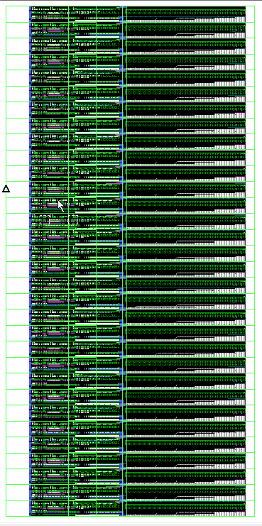
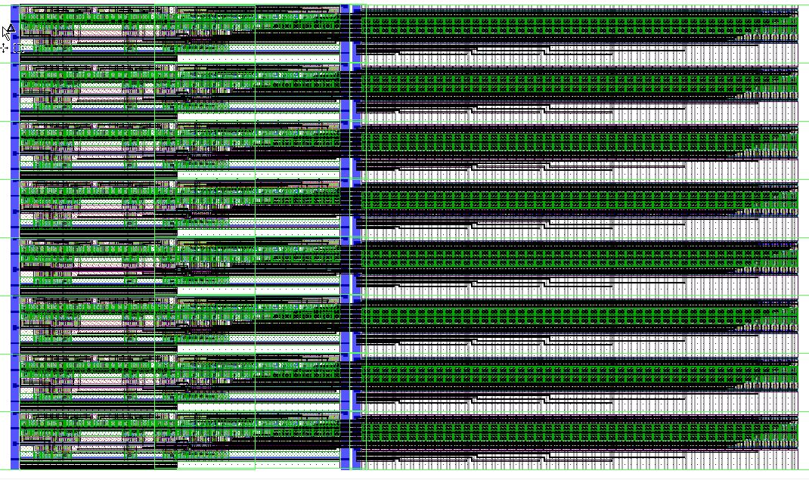
Fast Adder x32 (Layout)
600 µm
Adders
Bus Line Selector
Bus Lines
1280 µm

Slide 12
LVDS TX/RX and Sync
Sync pad
13
13
Serializer
13x LVDS Driver
13
320MHz Clock
1 LVDS Receiver

Slide 13
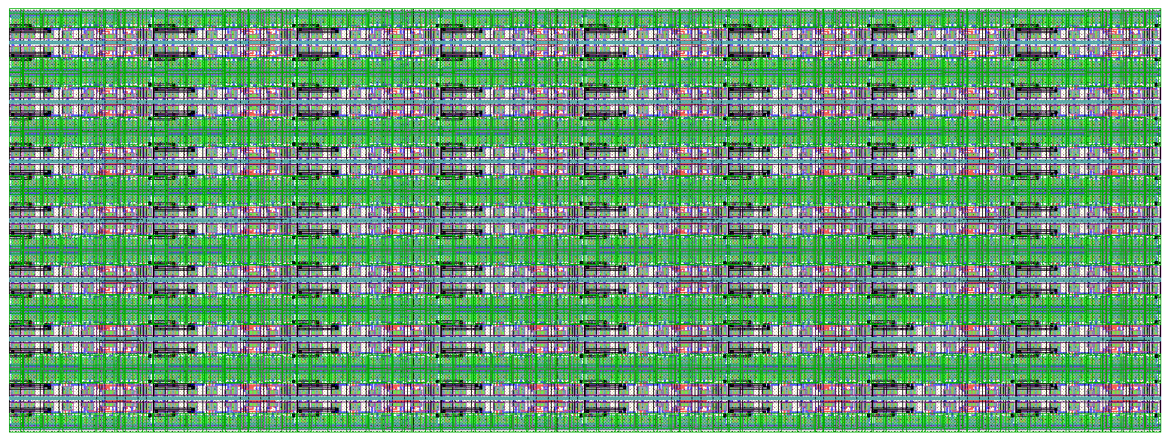
Serializer
p
PISO 1b
p
p
PISO 1b
PISO 1b
p
p
PISO 1b
PISO 1b
p
p
PISO 1b
PISO 1b
p
PISO 1b
s
o
s
o
s
o
s
o
s
o
s
o
s
o
s
o
8 x 13 1bit PISO Cell.
Parallel input with 25ns period (synchronized to the 40MHz external clock).
Serial Output has 3.125ns period (synchronized to the 320MHz external clock).
400 µm
150 µm

Slide 14
LVDS Driver – Simulated Performance
Schematic simulated at all condition (wo,wz,ws,wp) at room temperature.
Specs | Typical | Min | Max
Differential Output Voltage (@ R_{LOAD} =100Ω) | 600mV
Output Common Mode | 1.2V | 0.5 | 2.8
Current | 3mA | 0.2mA | 3.5mA*
Speed | 320MHz |  | 500MHz
Supply | 3.3V
* Can meet standard LVDS requirements.

Slide 15
LVDS Receiver - Performance
Schematic simulated at all condition (wo,wz,ws,wp) at room temperature.
Specs | Typical | Min | Max
Differential Input Voltage (@ R_{LOAD} =100Ω) | 600mV
Output Common Mode | 1.2V
Input Current | 3mA*
Speed | 320MHz |  | 500MHz
Supply | 3.3V
* Can meet standard LVDS requirements.

Slide 16
SLAC ASIC Control Interface (SACI)
Serial Interface with handshake protocol
5 Signals
  3 shared: saciClk, saciCmd, saciRsp.
  1 dedicated select line per slave: saciSelL.
  1 Reset Line (RstL) can be shared with the ASIC Global Reset.
Operated between 0V and 3.3V
Allows multiple SACI on same bus (parallel mode).
Row Pointer
Column Pointer
Global Registers
Control Logic
ACK
CLK
EXEC
R/W
CMD[0..6]
ADDR[0..11]
DATA[0..31]
SLAC ASIC Control Interface (SACI)
SACIcmd (serial signal):
RstL
saciSelL
saciClk
saciCmd
saciRsp
SET (1bit)
1
RW (1bit)
R/W
CMD (7bit)
CMD
ADDR (12bit)
ADDR
DATA (32bit)
DATA

Slide 17
SACI – Multiple ASIC connection
SACI Response<0:3>
SACI-0
SACI-1
SACI-2
SACI-3
RSP
RSP
RSP
RSP
CLK
CMD
SEL
CLK
CMD
SEL
CLK
CMD
SEL
CLK
CMD
SEL
Shared Clock
Shared Command
Sel0
Sel1
Sel2
Sel3
Response line can be shared if only 1 SACI is selected when the command arrives.

Slide 18
SACI - Commands
SET (1bit)
1
RW (1bit)
RW
CMD (7bit)
CMD
ADDR (12bit)
ADDR
DATA (32bit)
DATA
RW | CMD | ADDR | DATA | Function
0/1 | 1 | Register Address | Data | Read/Write Global Register
1 | 4 | 0 | Data | Write Matrix
0/1 | 5 | 0 | Data | Read/Write Pixel
1 | 8 | 0 | 0 | START Matrix Configuration
0 | 0 | 0 | 0 | END Matrix Configuration
1 | 2 | 0 | 0 | Write all Columns (used to configure a single row)
1 | 3 | 0 | 0 | Write all Row (used to configure a single column)
The ASIC decodes the command last 4 bits. Any given command longer than 4 bits will be interpreted as a 4 bit command.
18

Slide 19
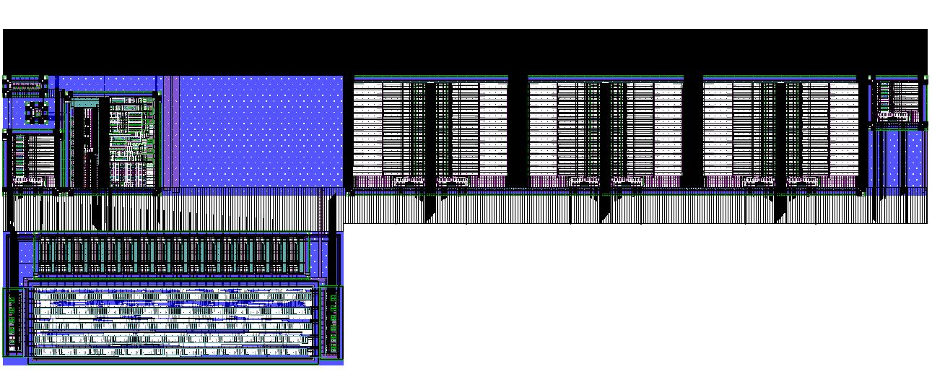
Control Unit
2000 µm
Global Register
Row and Column register for pixel selection
SACI
Command Logic
Digital control signal distribution
700 µm

Slide 20

Control Unit
+
+
Rad Hard Register
Bus to ASIC
+
Command Decoder
Command Logic
Rad Hard Bits
DataBus to Matrix
Buffers
Col
Reg
Command Logic
Pixel Write
Row Reg
SACI System
Bits
Bits
Logic
Logic
DATABUS Buffer
Logic
Internal Bus
CMD, CLK Buffer
SACI Core
ADDRESS Buffer

Slide 21
Next step toward the submission
Individual blocks have been simulated and pass LVS and DRC
Integration of top level blocks
Full chip simulation and verification

Slide 22
Additional Slides
Additional Slides

Slide 23
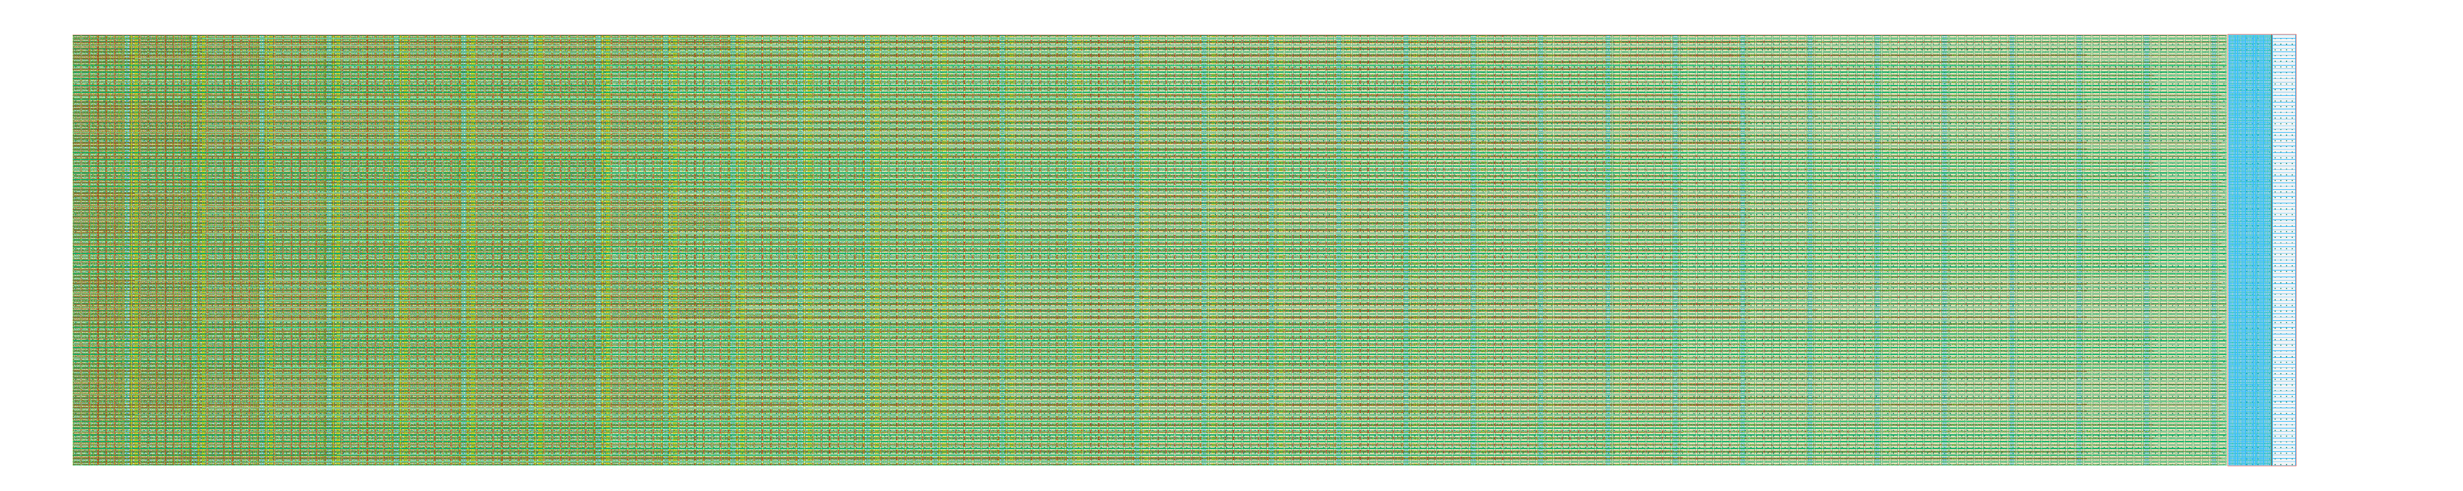
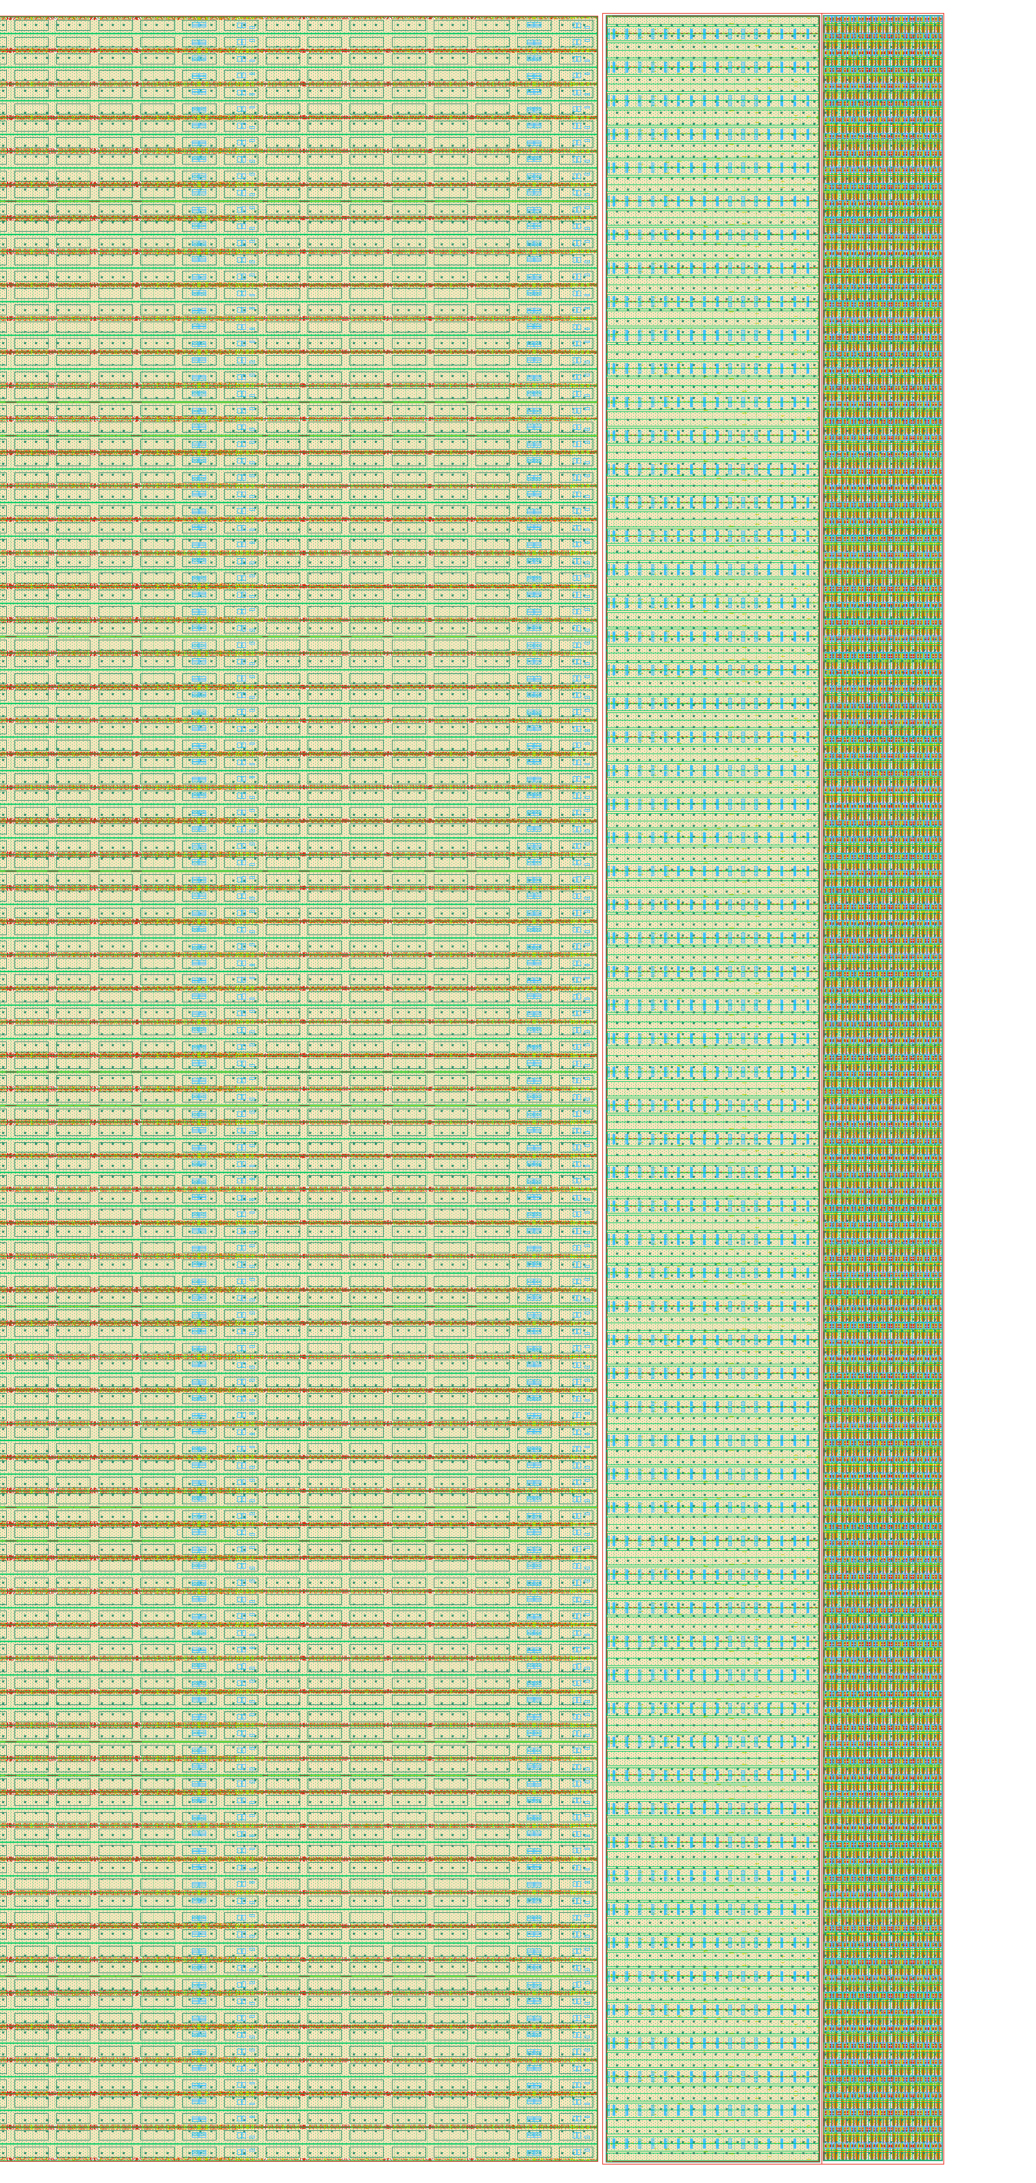
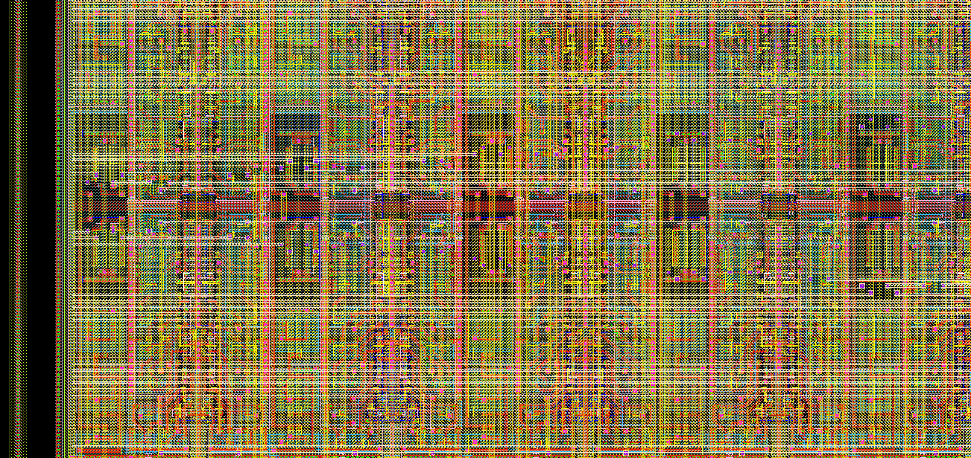
Matrix and Strip Encoding Layout
Images from H. Grabas

Slide 24
Address and Databus buffer
Address and Command Buffer
Sending address and command to the command logic only when the EXEC signal is HIGH in order to save power.
Databus Buffer
Guarantees that SACI is writing the data bus only in WRITE mode and it is reading the data bus in READ mode.
Writing and reading of the data bus are permitted only when the EXEC signal is HIGH in order to save power
SACI is reading the data bus only when the ACK signal is HIGH in order to avoid buffer high current consumption when the bus is floating.

Slide 25
Column and Row Selection Register
Row Selection Register
Column Selection Register
7 bits row register and 5 bits column register that store row and column pointers.

Slide 26
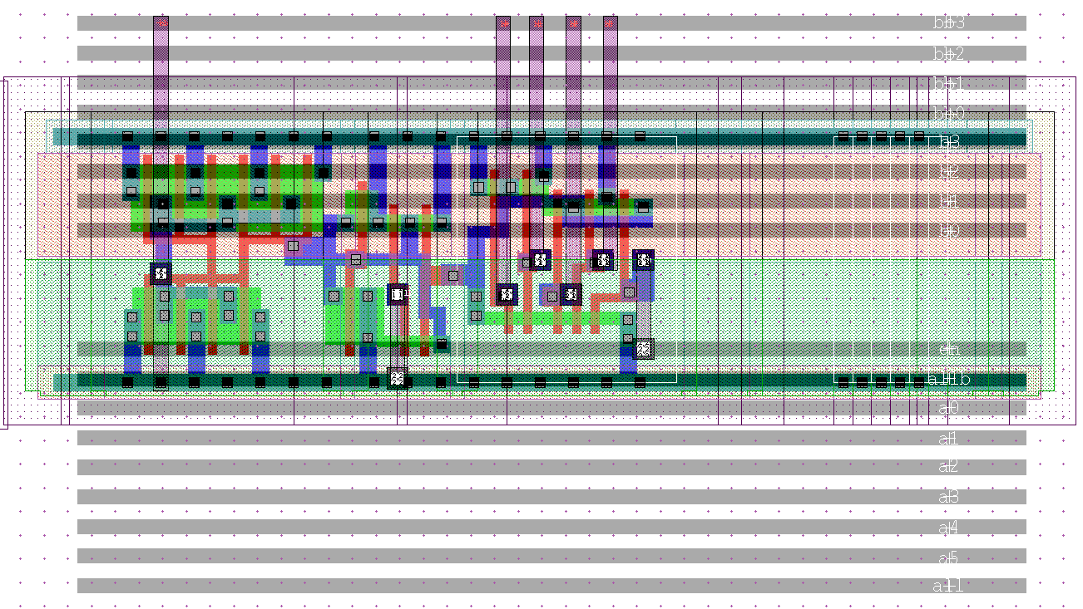
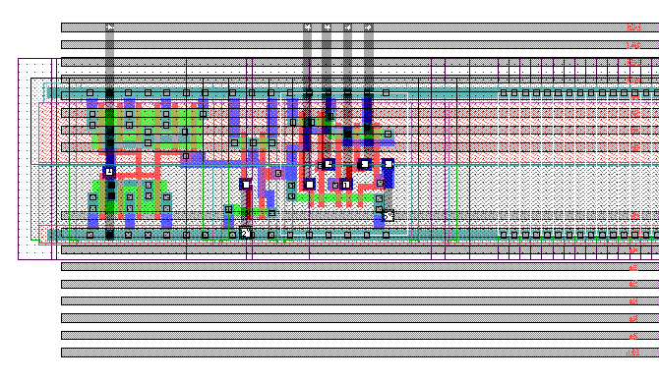
Column and Row decoders
Row decoders
Column decoders
Decode the digital word coming from the row and column selection register in 1 hot digital output.
Allow single row, single column or matrix configuration.
Row decoder is synchronous with the CCKpix clock.

Slide 27
SACI - Signals
SACIclk
SACIselL
SACIcmd
SACIrsp
SACIrstL
SACIcmd (serial signal):
SET (1bit)
1
RW (1bit)
R/W
CMD (7bit)
CMD
ADDR (12bit)
ADDR
DATA (32bit)
DATA
SACIrsp (serial signal):
SET (1bit)
1
RW (1bit)
1
CMD (7bit)
CMD
ADDR (12bit)
ADDR
Write Mode
SET (1bit)
1
RW (1bit)
0
CMD (7bit)
CMD
ADDR (12bit)
ADDR
DATA (32bit)
DATA
Read Mode

Slide 28
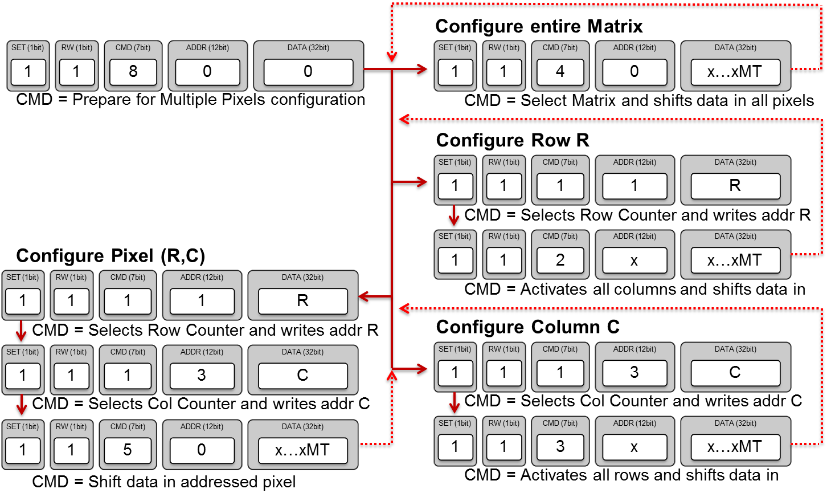
Pixels Configuration
Matrix configuration time pixel by pixel is: 110ms
SET (1bit)
1
RW (1bit)
0
CMD (7bit)
8
ADDR (12bit)
0
DATA (32bit)
0
CMD = End Configuration

Slide 29
Global Register Map
The registry store the ASIC configuration settings needed for the DACs and the control unit.
Radiation tolerant register.
Set the initial condition to guarantee correct DACs and control unit settings using the global reset signal (GR).

Slide 30
Global Registers Configuration
- WRITE Configuration Registers:
SET (1bit)
1
RW (1bit)
1
CMD (7bit)
1
ADDR (12bit)
ADDR
DATA (32bit)
DATA
- READ Configuration Registers:
SET (1bit)
1
RW (1bit)
0
CMD (7bit)
1
ADDR (12bit)
ADDR
DATA (32bit)
x

Slide 31
Hit Encoding – Processing the Strip Encoding
+1
+1
500ps
500ps
SKIP
SKIP
150ps
150ps
Bit line settling
Bit line settling
4ns
0.8ns
Write Bit
Write Bit
300ps
300ps
Worst case scenario:
22ns
7.6ns

