Slide 1
Status of test kit 29 Sept. 2015
T. Huffman, J. J. John with help from many colleagues

Slide 2
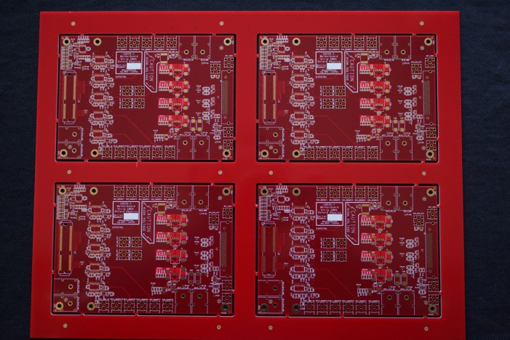
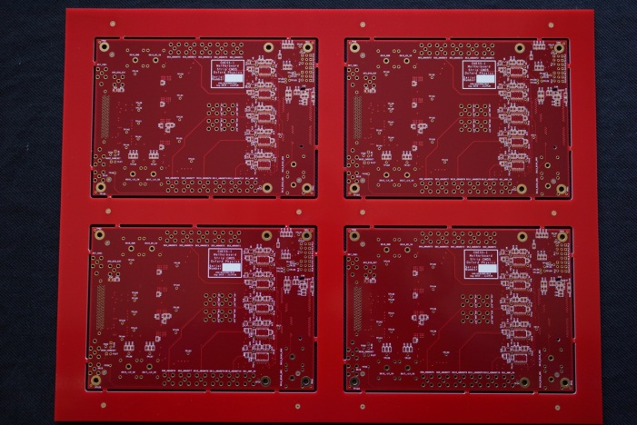
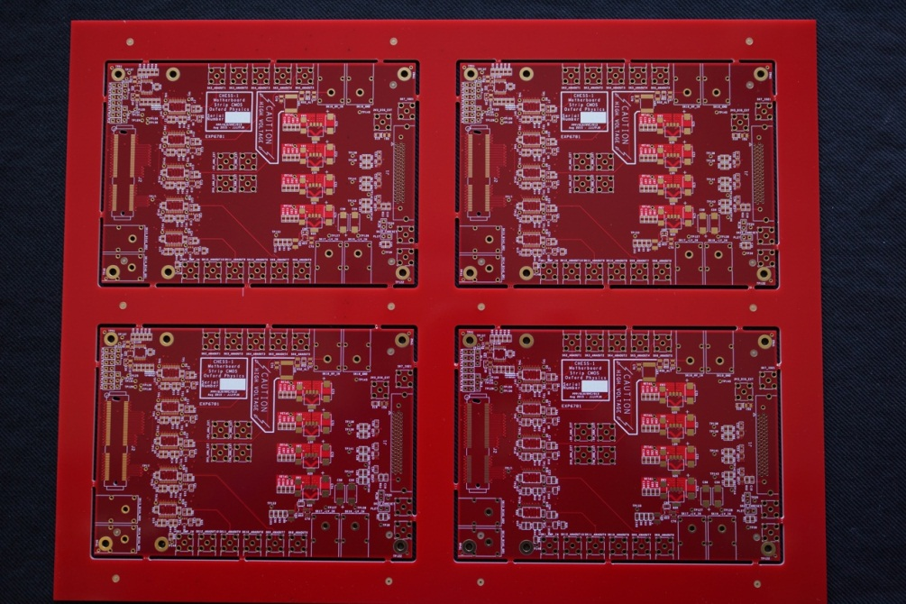
CHESS-1 motherboard status
8 panels of 4 motherboards received:
Bare panels
Front
After automated assembly
Back

Slide 3
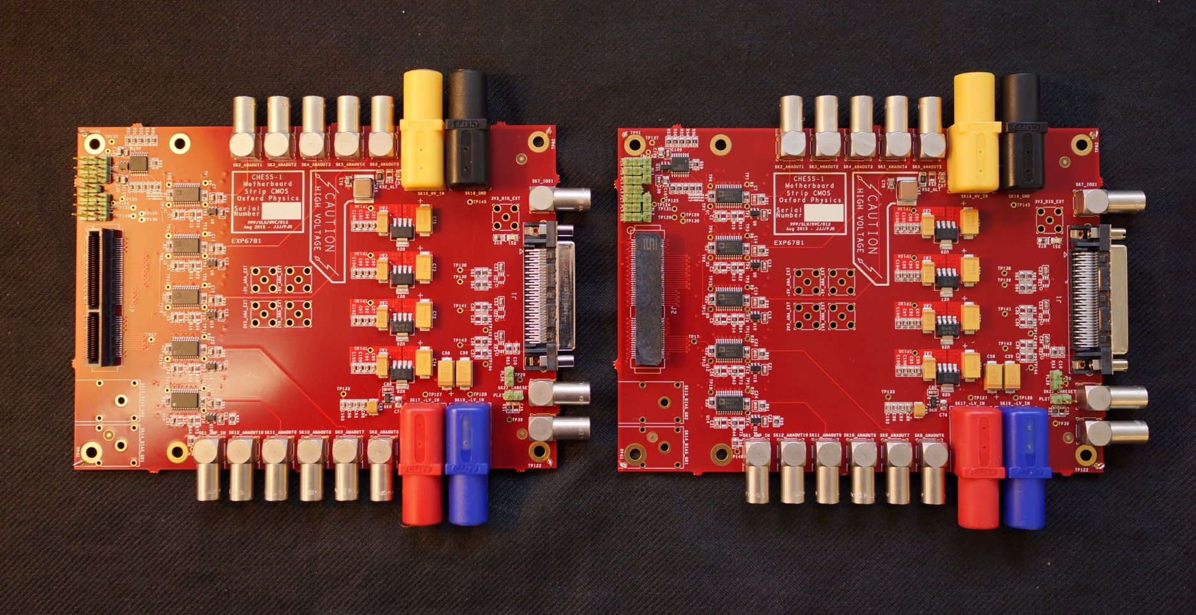
CHESS-1 motherboard status
Today, completed two boards with connectors;
Just waiting for 1 buffer IC, expected tomorrow
Daughterboard Perpendicular
Daughterboard Parallel

Slide 4
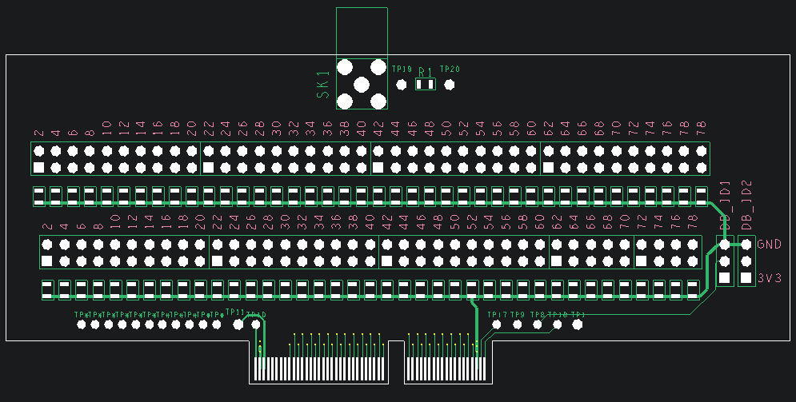
CHESS-1 motherboard next steps
Initial build is 4 boards for testing
Testing:
Basics – regulators
Integrate firmware and software control of DACs and switches
Use simple test injector daughterboard to test individual output channels (under development)
Build remainder of motherboards – see build plan, next slide
Test Daughterboard

Slide 5
CHESS-1 motherboard build plan
 | Parallel | Perpendicular | Parallel | Perpendicular | No connectors | Passives only
Institute | Lemo | Lemo | SMA | SMA | (flexible spares) |  | Institute total
Argonne | 1 |  |  |  |  |  | 1
Beijing (IHEP) |  |  | 1 |  |  |  | 1
DESY | 1 | 1 |  |  |  |  | 2
Glasgow |  |  | 1 | 1 |  |  | 2
Ljubljana |  |  | 1 | 1 |  |  | 2
Oxford | 2 | 1 |  |  |  |  | 3
RAL PPD |  |  | 1 | 1 |  |  | 2
RAL TD |  |  | 1 |  |  |  | 1
UCSC (SCIPP) |  |  | 1 | 1 |  |  | 2
Totals before spares | 4 | 2 | 6 | 4 | 0 |  | 16
Spares | 2 | 1 | 2 | 2 | 5 | 4 | 16
Totals incl. spares | 6 | 3 | 8 | 6 | 5 | 4 | 32

Slide 6
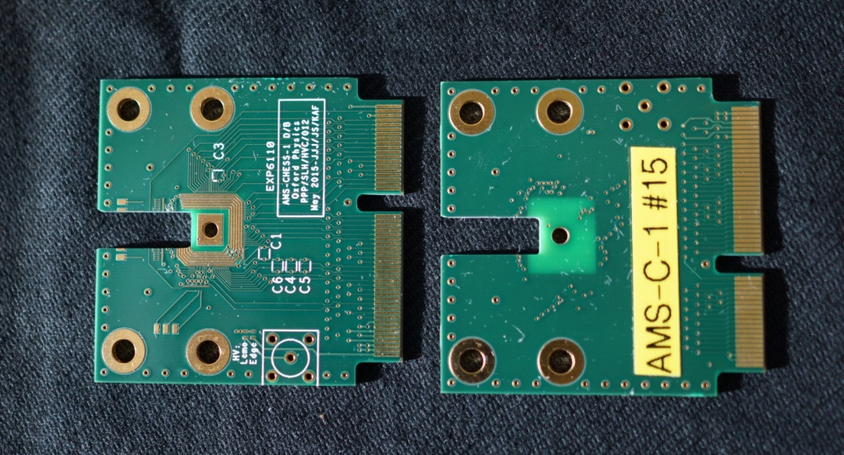
Status of other hardware
AMS-CHESS-1 Daughterboard
Bonding at RAL towards irradiation campaign at Proton Synchrotron (PS) at CERN.
Have prepared 5 AMS-CHESS-1 daughterboards with cut-out for edge TCT:
Have prepared bonding diagram for edge TCT application – see “Drawing” on DESY Indico for this week, under Status of test kit

Slide 7
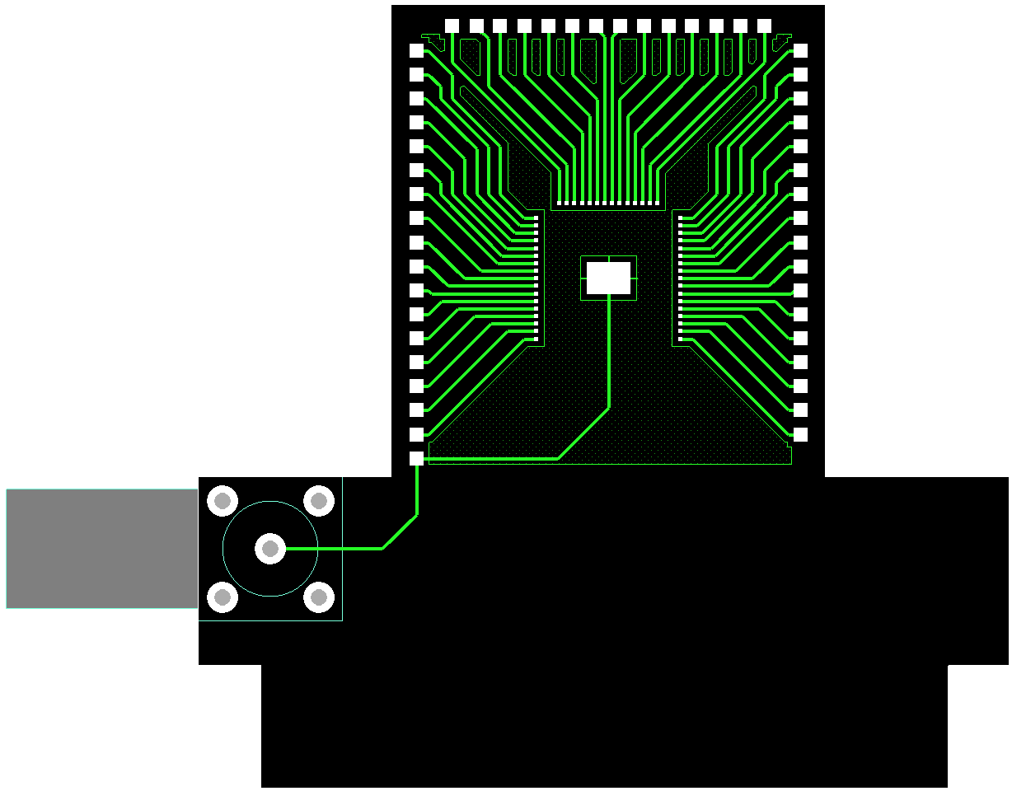
Status of other hardware
HVStripV1 Daughterboard
We are currently finalising a small update for the PS irradiation
Puts HVStripV1 chips in the same position with respect to the beam as the CHESS daughterboards
TJ-CHESS-1 Daughterboards
PonP daughterboards in hand
PonN daughterboard ready for final review – on hold for now in favour of motherboard work though

