Slide 1
Exposures at the PS
The current plan and a call for some help

Slide 2
Dates for PS exposure
PS exposure will be Nov. 4th, 5th, and 6th
All three days are likely needed.
27 GeV protons to between 1E+15 and 2E+15 n/cm²
Will be done Warm (no cold box yet)
5 AMS H35 CHESS1 devices will be exposed.
Cut-out so ready for e-TCT measurements
Grounded, but un-powered
But we should discuss this

Slide 3
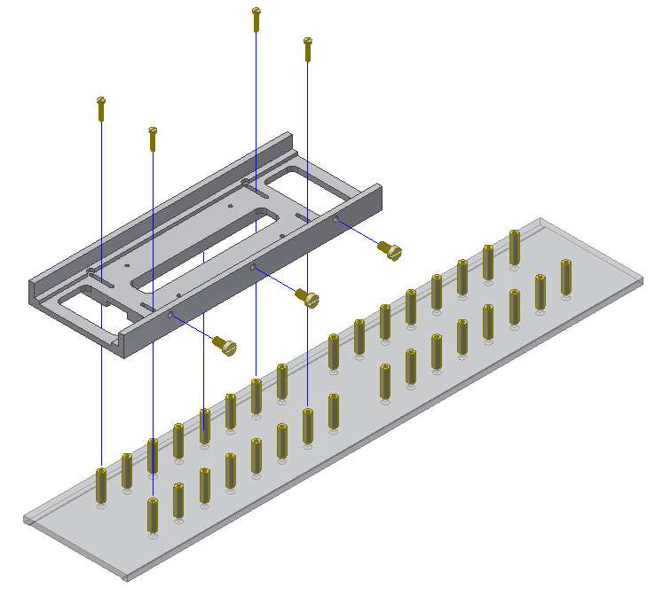
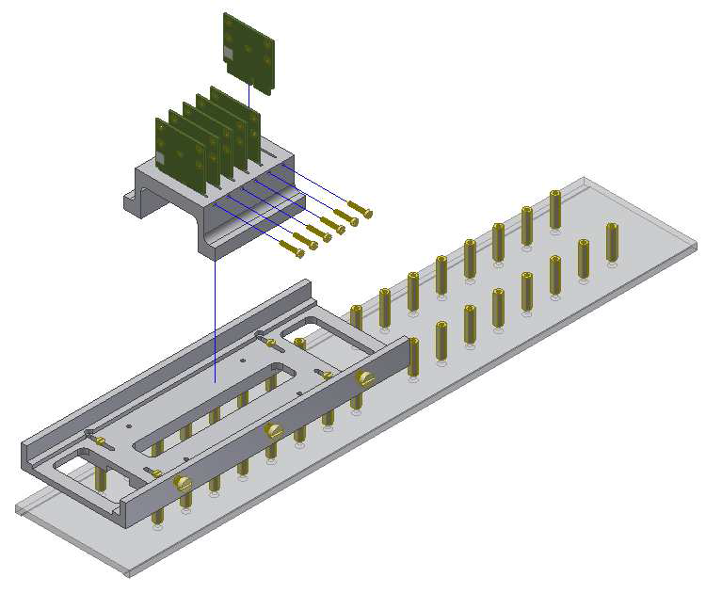
Method of loading
AMS CHESS1 Daughter cards
Platform from CERN

Slide 4
What exists
The carrier/loading system
The cut AMS CHESS boards (all 5 are cut)
The AMS CHESS1 devices

Slide 5
What is about to happen or is needed
Bond down 5 AMS CHESS1 devices
Bonding diagrams done
Bonding to happen soon
Characterise the devices
Check gain and noise of as many device sizes as possible.
Use new Motherboard
E-TCT measurements if possible
On amplified devices (two groups of amps in a position for this)
People to babysit detectors for run
CERN safety training up through Supervised access online
Personal dosimeter
Controlled access training → Must be done at CERN!!!
Request access to the control room using EDH!!!

Slide 6
Expanded programme
HVStrip1 – expose 5-6 devices
Do we have them?
Mount downstream of AMS devices
Characterization of channels
Will need help on this.
Gain and noise; charge injections and X-ray sources
4 channels minimum
Daughter cards need modifications
To put chips in line with AMS chips for beam

Slide 7
Modified HVStrip1 Daughter card
Ready to send out, go for 5 day turn around unless prohibitvely expensive Might do this in-Oxford if can be done quickly and reliably

