Slide 1
ATLAS CMOS Strip
Regular Meeting
29/09/15
HR-CHESS2 Update
D. Das, STFC-RAL, UK
29/09/15
Notes:
1

Slide 2
2
HR-CHESS2 Pre-Amplifier v2 Block Diagram
Leakage Compensation
Active Feedback
AC coupled to block leakage current, MOS device used to bias diode
Integrated AC coupling capacitor
Constant current feedback
Folded cascode architecture with source-follower inside feedback loop

Slide 3
3
HR-CHESS2 Pre-Amplifier v3 Block Diagram
Leakage Compensation
Active Feedback
- Removed source-follower from feedback loop

Slide 4
HR-CHESS2 Time-Walk Specification
Dependence of comparator fire time on signal must be < 1 BX i.e. 25ns
≤ 16 ns time difference between comparator leading edges for input signal of size
500 e- and 5000 e- with a threshold set at 275 e-

Slide 5
HR-CHESS2 Time-Walk Simulations
Specification < 16ns
Threshold adjusted for each
process corner (small differences)
Time-Walk (~1ns charge collection time)
 | NOM | FAST | SLOW
+40°C | 6.95ns | 6.5ns | 7.9ns
-40°C | 5.32ns | 4.9ns | 6.2ns
Time-Walk (~10ns charge collection time)
 | NOM | FAST | SLOW
+40°C | 10.54ns | 9.37ns | 11.02ns
-40°C | 7.5ns | 7ns | 8ns
Meets specification in all corners

Slide 6
HR-CHESS2 Design Progress Summary
Modified pre-amplifier design to make it faster & more immune to leakage current
Looking into design of pre-amplifier feedback capacitor as it’s small ≈ 1fF
Simulating Trim DAC for comparator offset compensation
Preparing for layout of the design
Preparing documentation for the first design review of HR-CHESS2
to be held mid to late October

Slide 7
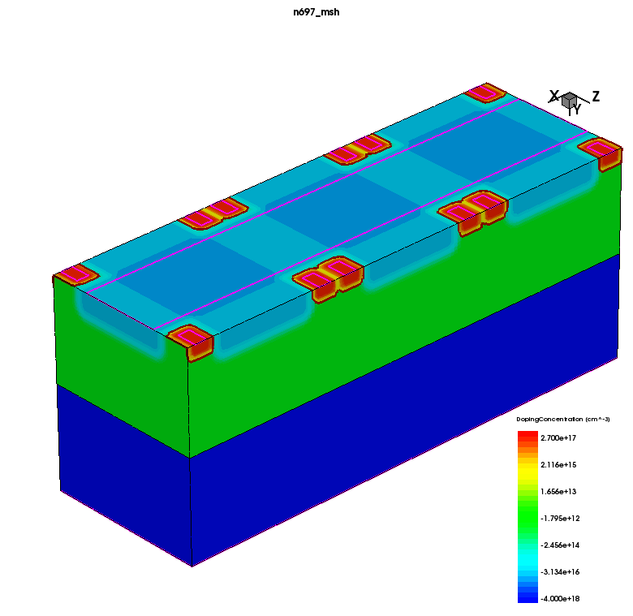
3-D structure for leakage current simulation
Pixel Volume = 40µm x 40µm x 25µm
Epi Depth = 25µm
No. of Pixels = 3
Type of Diode = N-Well/p epi
No. of Diodes per Pixel = 4
N-Well Bias = 1V
P-Well Bias = 0V
Back Contact Bias = 0 to -200V
Electronics inside Deep P-Well
Constant doping of epi and substrate
N-Well and P-Well has analytical doping profiles
Pixel 3
Pixel 2
25µm
Pixel 1
HR p epi
>1KΩ-cm
40µm
40µm
P Substrate
N-Wells

Slide 8
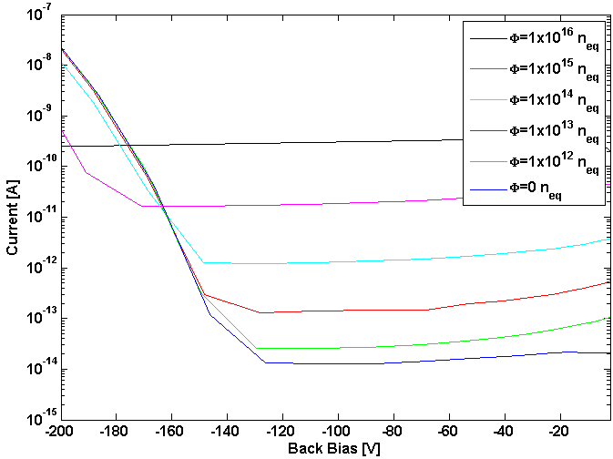
Leakage current vs bias at different fluences
Temp. = 27° C
Radiation Damage Model Used:
D. Pennicard et al. / Simulations of radiation damaged 3D detectors for the Super-LHC NIMA 592 (2008) 16–25
IEEE Trans. Nucl. Sci., vol. 53, pp. 2971–2976, 2006 “Numerical Simulation of Radiation Damage Effects in p-Type and n-Type FZ Silicon Detectors”, M. Petasecca, F. Moscatelli, D. Passeri, and G. U. Pignatel
Breakdown voltage increases
with fluence because effective
doping concentration increases
with irradiation!
Back Bias varied from 0V to -200V (until breakdown)
Current of Pixel 2 (middle) recorded
Leakage current < 500pA for fluence of 1x10¹⁶ n_{eq} [cm⁻²]

Slide 9
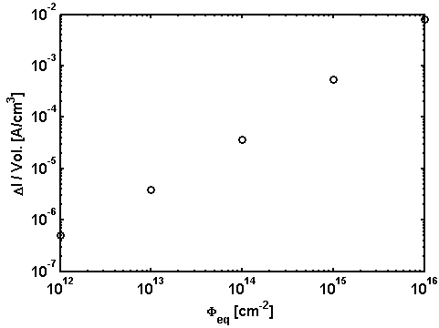
Leakage current vs geometry
During simulated irradiation dark current increases linearly with fluence:
Bias = -60V
Temp. = 27° C
Geometry | Leakage Current @ 1 x 10¹⁶ n_{eq} [cm⁻²]
40µm x 25µm x 40µm | 3.2pA
40µm x 25µm x 80µm | 6.4pA
40µm x 25µm x 120µm | 9.6pA
40µm x 25µm x 200µm | 1.6nA
40µm x 25µm x 400µm | 3.2nA
40µm x 25µm x 800µm | 6.4nA
From simulation results at 27°C:
α ≈ 80 x 10⁻¹⁸ A/m

