Slide 1
Strip-CMOS module conceptual design
Kirk Arndt, Richard Plackett
Univ. of Oxford

Slide 2
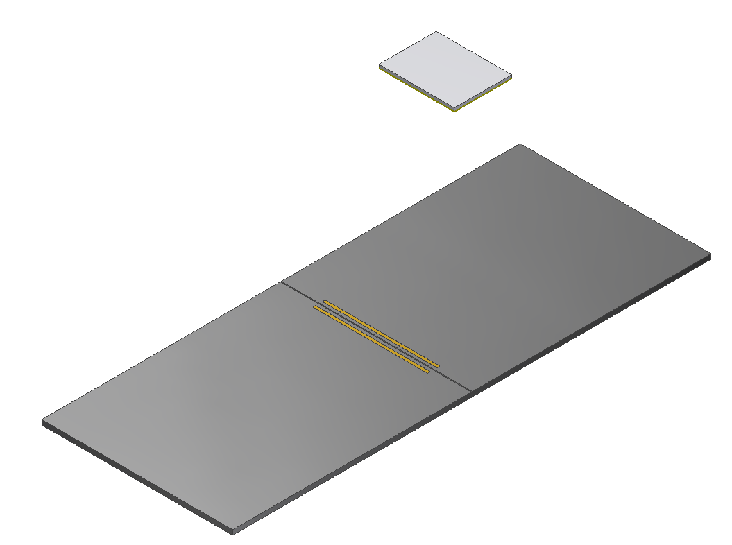
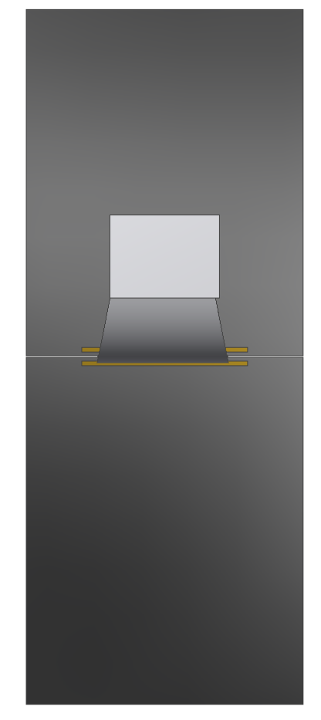
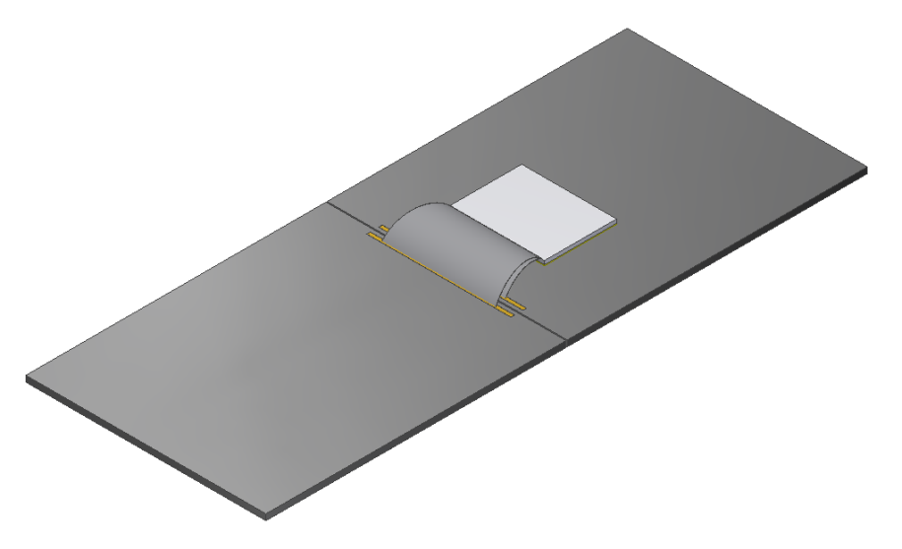
Single readout unit
1 front end ASIC
per pair of CMOS sensors
Two CMOS sensors
20 x 25 mm each
Wirebonds from single ASIC
to both CMOS sensors

Slide 3
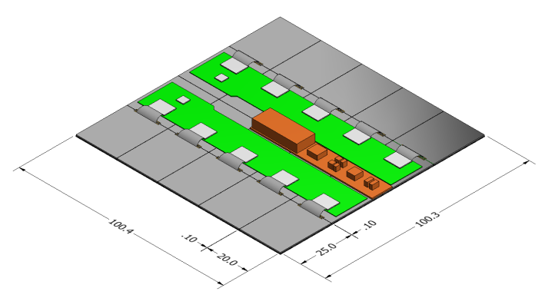
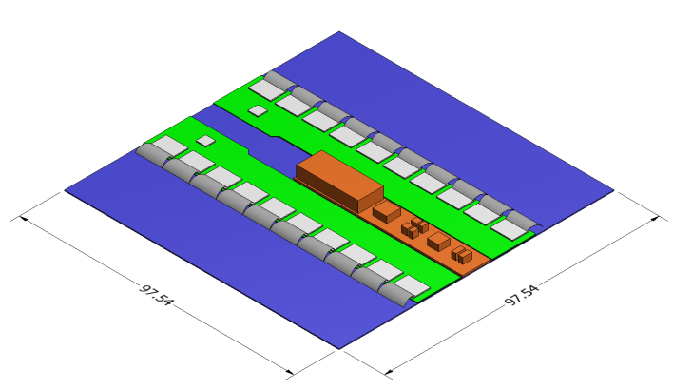
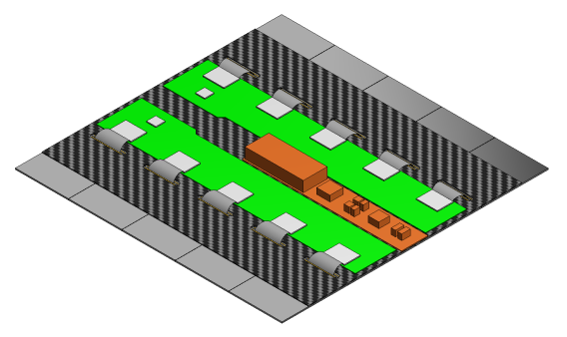
Key dimensions
strip CMOS module
w/ backside support
100.4 x 100.4 mm
ITk strip module
97.5 x 97.5 mm
strip CMOS module
w/ front side support

Slide 4
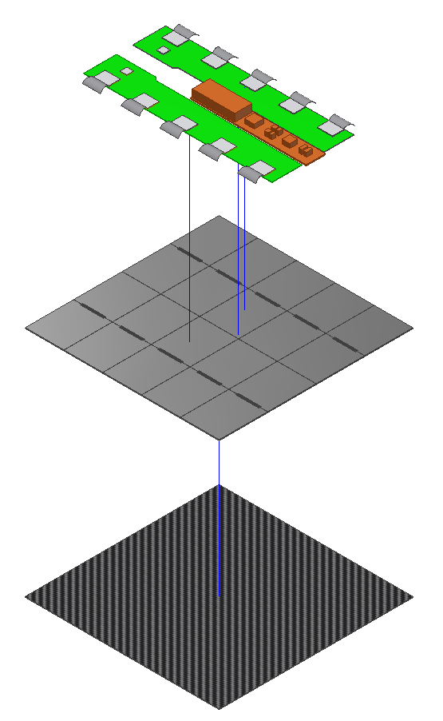
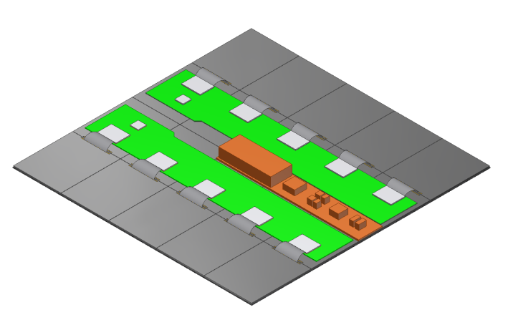
strip CMOS module w/ backside support
Composite support substrate

Slide 5
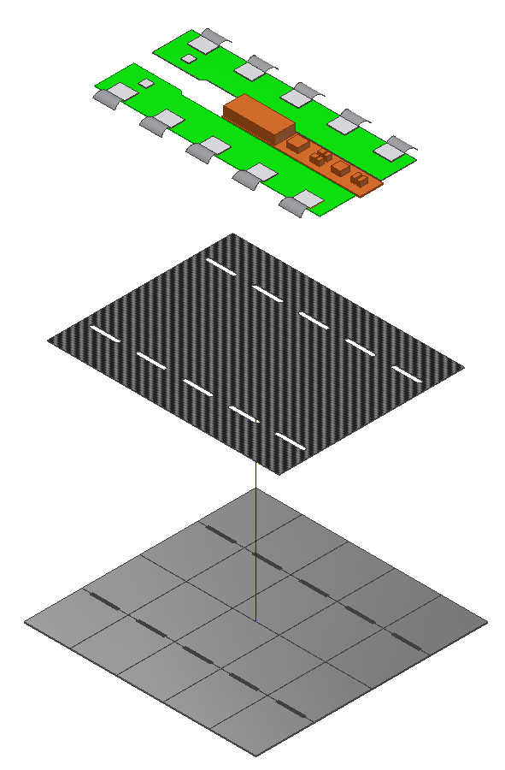
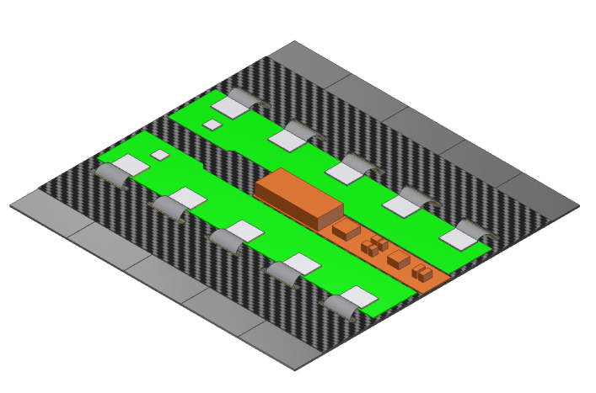
strip CMOS module w/ front side support
Composite support
substrate

Slide 6
Module stack-up
ITk strip module
strip CMOS module
w/ backside support
CMOS sensors
Composite support substrates
strip CMOS module
w/ front side support
CMOS sensors

Slide 7
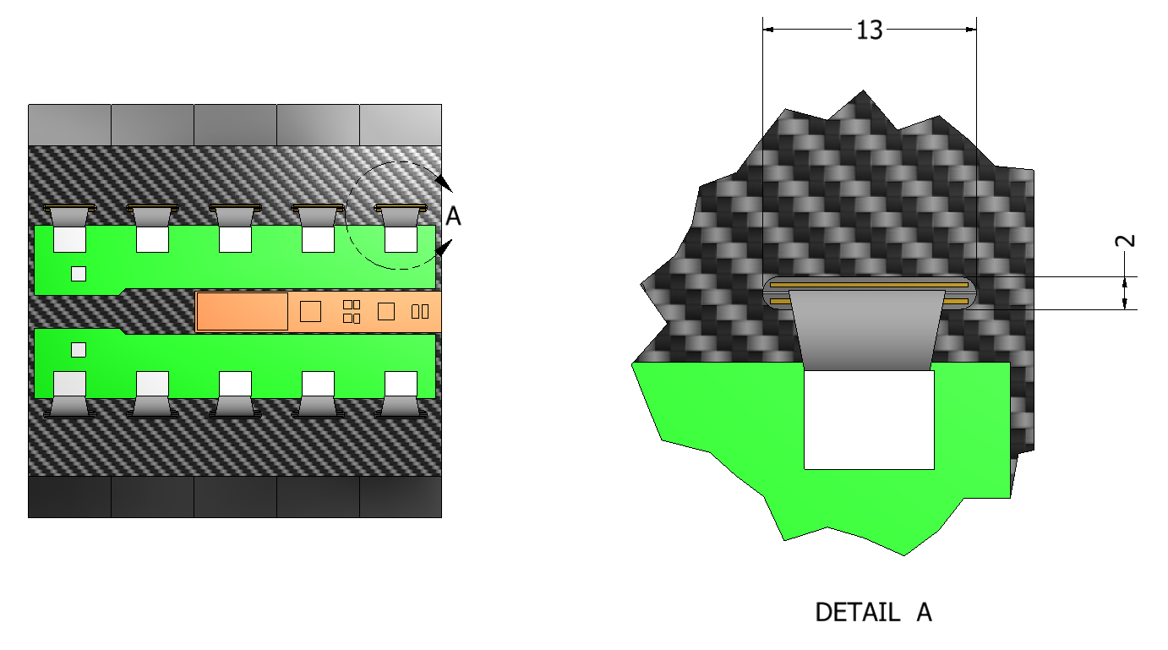
Opening in front side support substrate for wire bonds

Slide 8
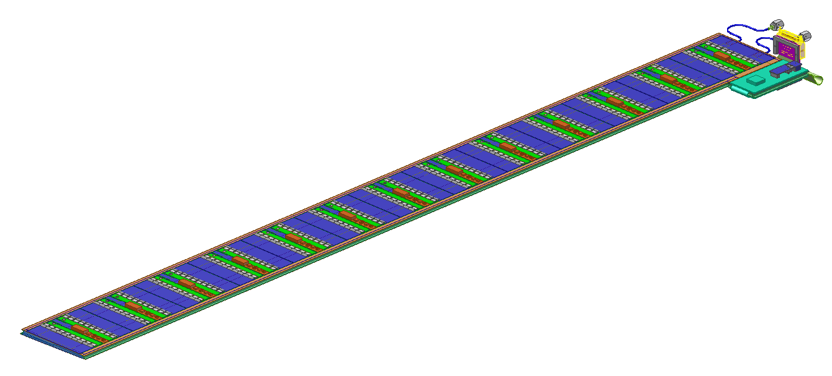
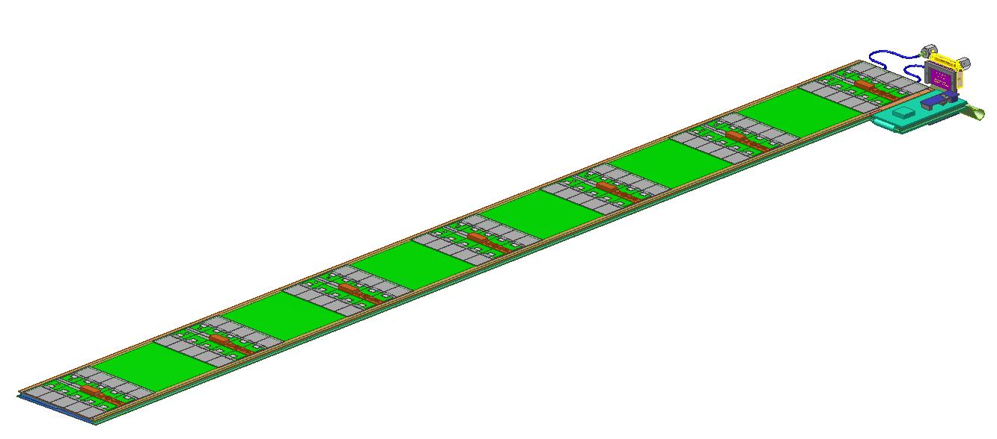
ITk strip module layout
13 modules top and
13 modules bottom (w/ stereo angle)
Strip-CMOS module layout
7 modules top and
6 modules bottom (w/o stereo angle)

