Slide 1
CMOS module
Need a module before TDR
Generate conceptual designs
Including assembly processes
Create ?FPGA versions
Work out schedule for real modules

Slide 2
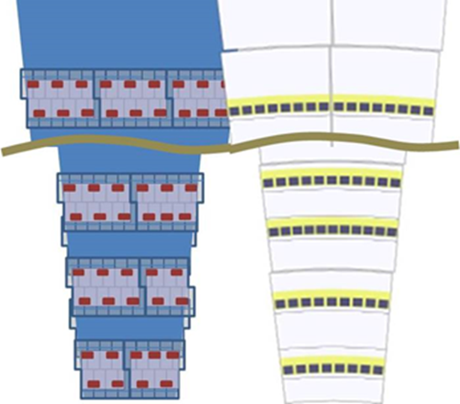
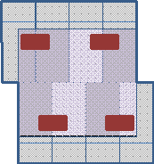
Forward & Barrel modules
Figure 9 Example of a CMOS Forward Module in the 4-4 configuration. Two rows of four un-separated reticules offset by half a reticule; each Hybrid has four ABCN’ chips.
Same sensor.
Different Hybrids
Choose sensor length & pitch to match
Barrel and Forward layouts

Slide 3
Hybrid with
DC/DC convertor per module
On board
Pure digital board – convertor integrated?
Number of ABCN’
Used as module spine ? (thick, stable)
Several shapes of modules for forward
HCC not the same
What changes to mechanics
Forward (blades+petal) may be already wide enough?
Front/back layout
More space between
Different power distribution
Impact on EoS card

Slide 4
Module Build
Current module is really straightforward
CMOS module must also be easy to assemble or cost advantage lost
Already had
“must be easy to assemble”
large number of parts not easy
Question this.
can we wire bond a large number of ‘small’ sensors to a single hybrid
can we assemble such a thing.
Evaluate the likely cost / size of reticule block trade offs
plan on modules which can assembled with blocks or with singles ?

Slide 5
What can we learn/incorporate from existing work
We need to involve existing groups

