Slide 1
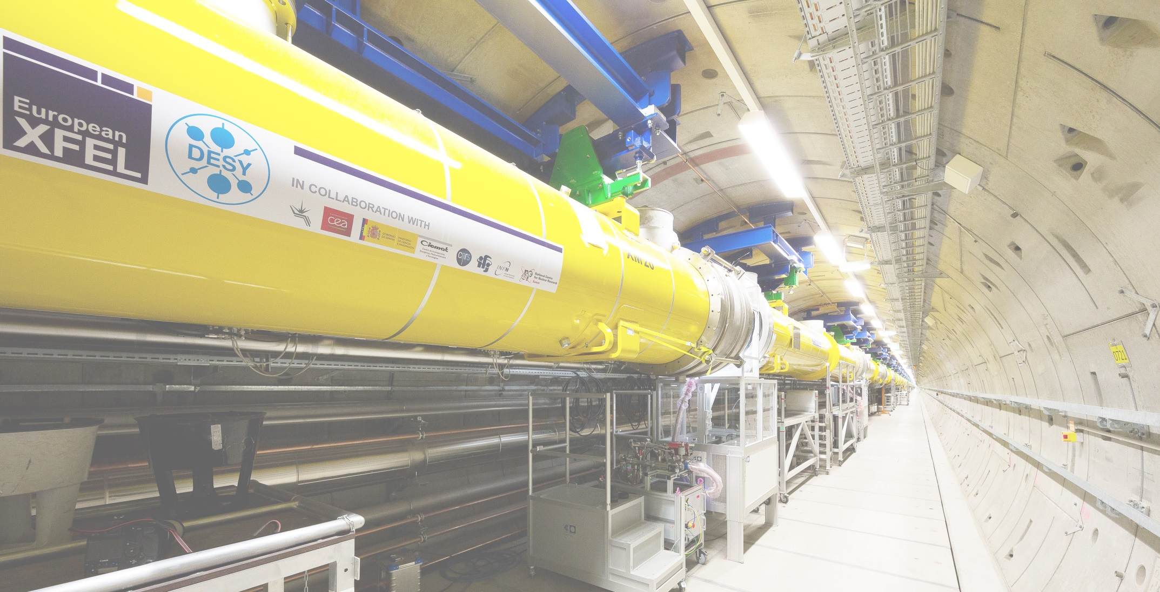
Commissioning of
Standard Electron Beam Diagnostics
D. Nölle, MDI, DESY Hamburg
For the WP-17 Team
Notes:
How to edit the title slide
Upper area: Title of your talk, max. 2 rows of the defined size (55 pt)
Lower area (subtitle): Conference/meeting/workshop, location, date,
your name and affiliation, max. 4 rows of the defined size (32 pt)
Change the partner logos or add others in the last row.

Slide 2
Outline
General Remarks
  Commissioning Steps
  System and Device Numbers
  Prerequisites
More detailed View
Summary
  Time needed for basic and advanced Commissioning

Slide 3
Commissioning of
Standard Electron Beam Diagnostics
Goal:
  Do Machine Commissioning with Diagnostics
AND NOT
  Do Diagnostics Commissioning with the Beam
Nevertheless
  It is an iterative process
  Start with poor performance, but be able to see and to improve the beam
  See signals and optimize the parameters to improve the performance of the diagnostics.
  Get both working: Beam and Diagnostics.
Therefore
  Technical Commissioning: Prepare devices, check and test interfaces and communication prior to beam operation.
  Basic Commissioning: Diagnostic guys have to join the first shifts, and support until beam operation is established.
  Advanced Commissioning: Use dedicated beam time to bring the systems to good performance.

Slide 4
Systems and component numbers in XFEL
System | Subsystem | Gun | Injektor [XTIN] | XTL | XTDs
BPM System | Button | 3 | 8 | 181 | 111
~ 480 | BPME |  |  |  | 101
 | BPMF/I |  | 3 | 19 | 5
 | BPMR |  | 1 | 29
 | Button Array |  |  | 3
 | HOM |  | 2
Charge | FCUP | 3
~ 50 | DCM | 1 | 1 | 8
 | Toroid | 1 | 3 | 16 | 15
Screens | Simple | 3
~ 75 | OTR_ABCL |  | 7 | 26 | 16
 | OTR_DE |  | 1 | 4 | 5
 | OTRS |  |  | 3
 | Beam Size Dump |  |  | 1 | 2
Wire Scanners |  |  |  | 6 | 6
12
Loss Monitors | BLM | 1 | 18 | 100 | 192
~ 320 | BHM |  | 1 | 1 | 2

Slide 5
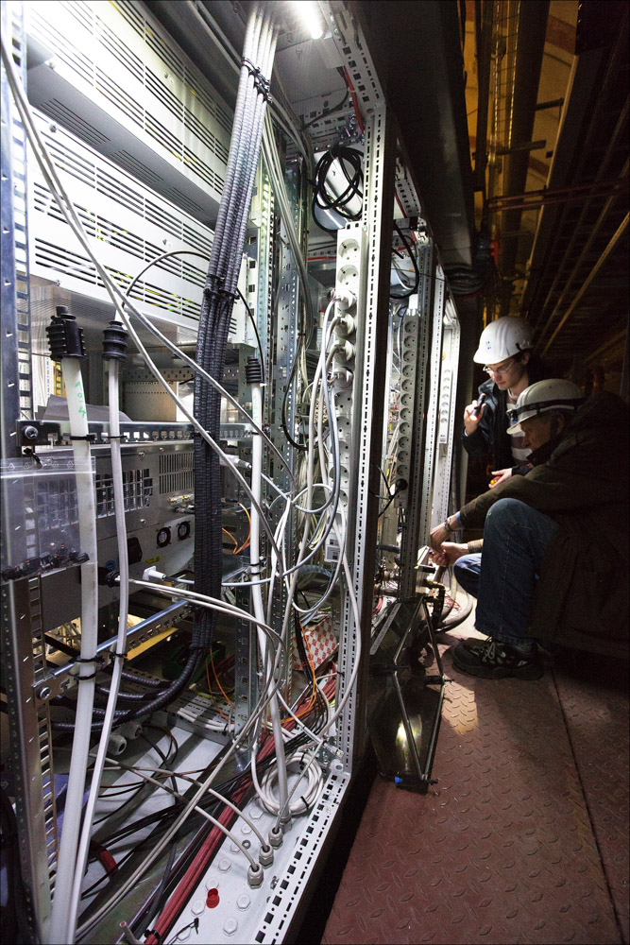
Technical Commissioning
Needs to be done before beam commissioning
  Checking measuring cables, connections -> WP-17
    Measure all BPM cables! (1-2 weeks/section, 1 team)
    Check device mapping
    Calibrate toroids with external pulser.
    See pictures from all calibration targets of the screens
    …
  Testing devices and interfaces from tunnel to BKR
  -> WP-17, WP-28, (WP-02)
    All interface cabling done and tested
    Working µTCA Infrastructure
    DOOCS ( incl. Servers), Timing, and MPS available
    216 MHz Ref line for cavity BPMs available
    Time Estimate: Hard to say! pessimistic estimate:
      1 µTCA/day -> 30 days
      2 MBU/day -> 70 days

Slide 6
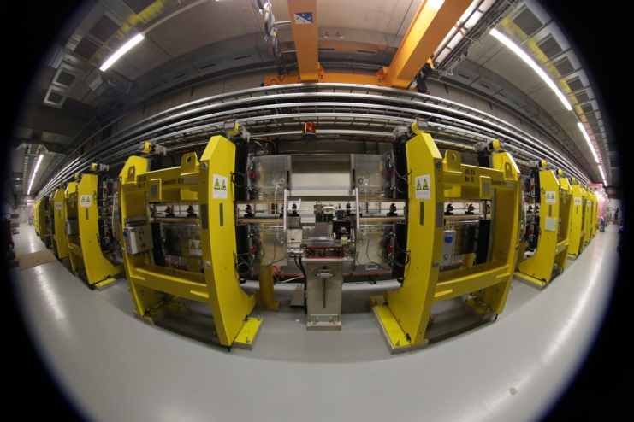
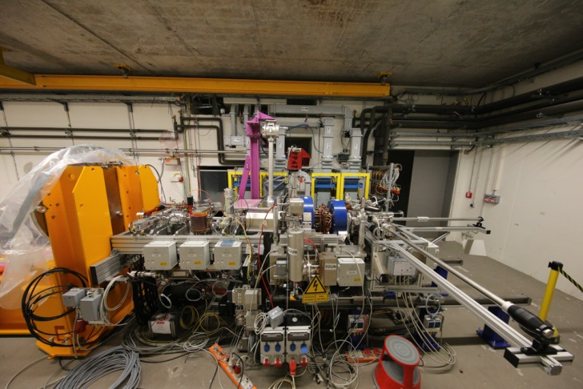
Start of Beam Commissioning
Done: FLASH and FLASH II
  Test BPMs run FLASH
  Commissioning of 17 cavity BPMs at FLASH II
  Commissioning of 60 “XFEL” BLMs at FLASH II
  Commissioning of 6 “XFEL” Screens at FLASH/FLASH II
January 2015: XFEL Gun, done
  3 BPMs, 1 Toroid, 1 DCM, 3 Screens and Faraday Cups
  Real environment in the XTIN
Upcoming: XFEL Injector
  Almost all systems are installed in the injector, except wire-scanner, and some special BPMs and Screens.
  Injector will provide all XFEL beam properties except energy.
  1 year for commissioning and debugging of the main diagnostic systems
  Procedure development for a more effective
  commissioning of the commissioning of the main LINAC.
  This will reduce the time needed to get the diagnostics into operation for the main LINAC
Fall 2016: XFEL
  Quite some number of (different) devices.

Slide 7
„Requirement Matrix“
Diagnostic System |  | Section |  |  |  | Supporting Systems (must be available) |  |  |  |  | Required for/during
System | Subsystem | Gun | Injector [XTIN] | XTL | XTDs | Timing | Device Server | Motor Controls | 216 MHz | MPS | First Beam | Few bunches | Full Performance
BPM System | Button | x | x | x | x | x | x |  |  |  | x | x | x
 | BPME |  |  |  | x | x | x |  | x |  | x | x | x
 | BPMF/I |  | x | x | x | x | x |  | x | x |  | x | x
 | BPMR |  |  | x |  | x | x |  | x |  | x | x | x
 | Button Array |  |  | x |  | x | x |  |  |  | x | x | x
 | HOM |  | x | x |  | x | x |  | x |  |  | x | x
Charge | FCUP | x |  |  |  | x | x | X |  |  | x
 | DCM | x | x | x |  | x | x |  |  |  |  |  | x
 | Toroid | x | x | x | x | x | x |  |  |  | x | x | x
 | TPS | x | x | x | x | x | x |  |  | x |  |  | x
Sceens | Simple | x |  |  |  |  |  | X |  | x | x
 | OTR_ABCL |  | x | x | x | x | x | X |  | x | x | x
 | OTR_DE |  | x | x | x | x | x | X |  | x | x | x
 | OTRS |  |  | x |  | x | x | X |  | x |  | x
 | Beam Size Dump |  |  | x | x | x | x |  |  |  |  |  | x
Wire Scanners |  |  |  | x | x | x | x | X |  | x |  |  | x
Loss Monitors | BLM | x | x | x | x | x | x |  |  | x | x | x | x
 | BHM |  | x | x | x | x | x |  |  | x |  |  | x
 | Dosimeters | x | x | x | x |  | x |  |  | x |  |  | x

Slide 8
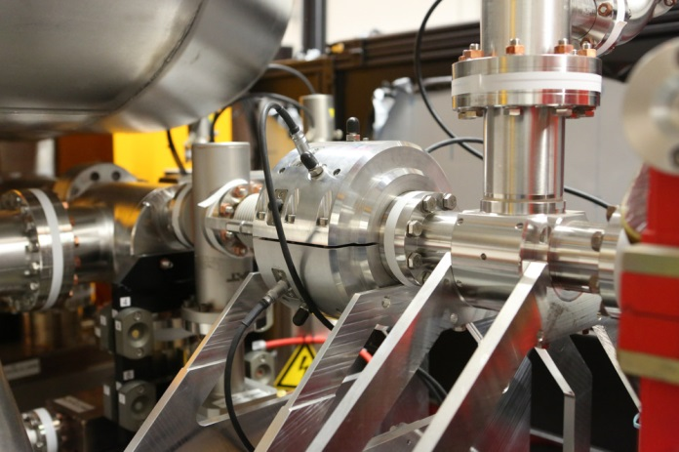
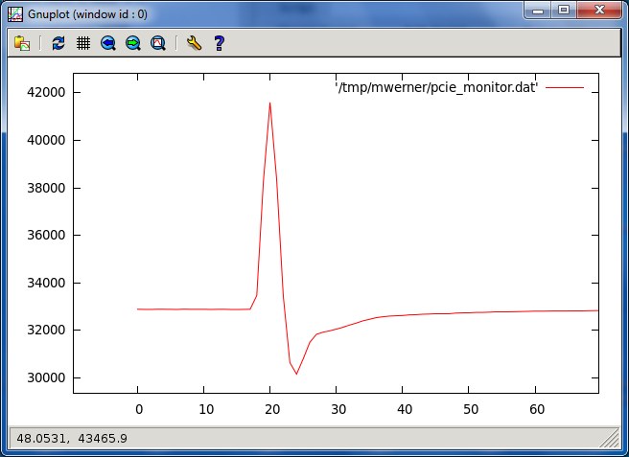
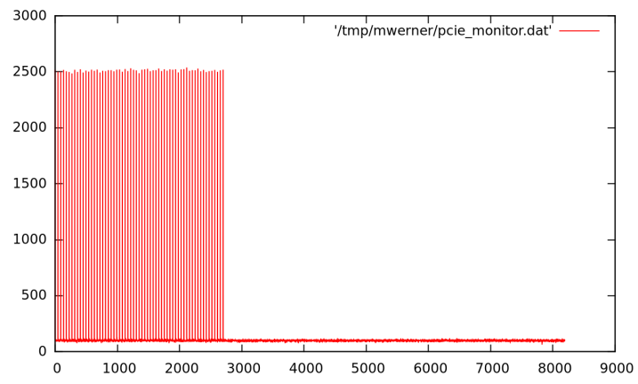
Toroid System
Prerequisite:
  µTCA Crate and 108 MHz Clock
  from Timing System
  Calibration by WP-17 done
Day 0 Performance
  Charge measurement at 4 locations
  No MPS or Transmission Interlock Alarms
  System runs with internal trigger
  As soon as a signal comes out significantly out of the noise the data is fetched from the ADC trace by Firmware and a Charge reading is delivered (accuracy % level)
Adjust timing, and go to external trigger
  Improved performance

Slide 9
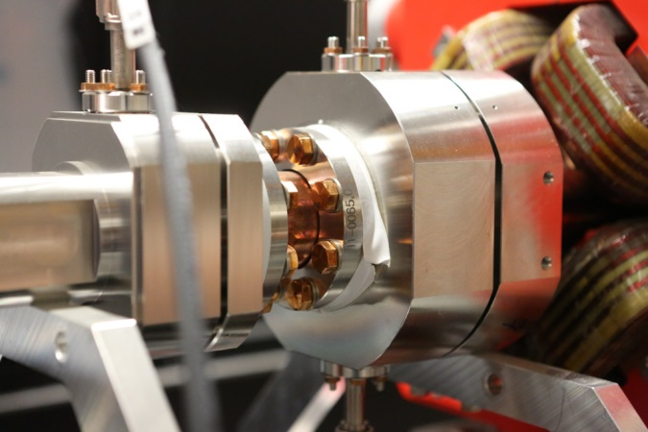
Dark Current Monitor (DCM)
Preparation:
Measured each monitor properties (ready); installation per section; ongoing
Electronics produced, tested and provided with a calibration table; ready
Cables installation per section; ongoing
Measurement of attenuation for each cable per section; ongoing
Connect
  monitor with RFFE
  RFFE with ADC
Preparation of server by MCS, test voltage output
Calculation of calibration based on monitor properties, cable attenuation, electronics calibration table; save calibration values in server

Slide 10
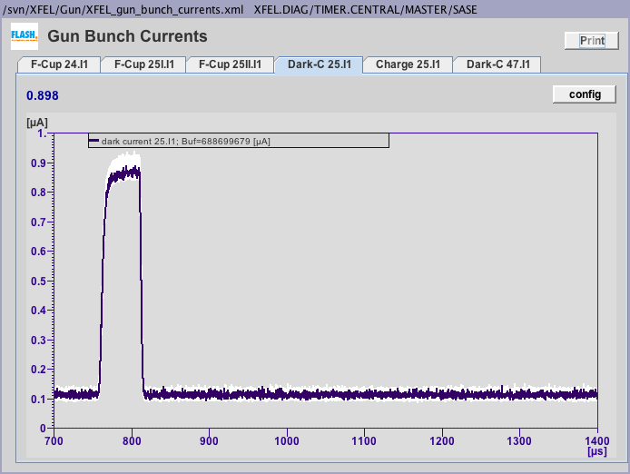
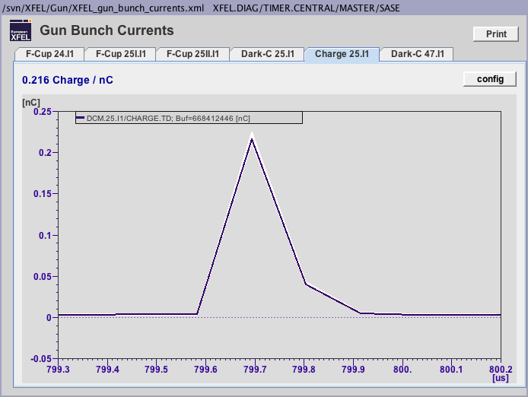
Dark Current Monitor (DCM)
Commissioning
Adjust trigger of ADC to observe dark current in the same time window like the RF
Fine adjust trigger delay to observe bunch charge signal in correct time position
Compare bunch charge values with nearby Toroid system

Slide 11
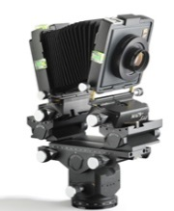
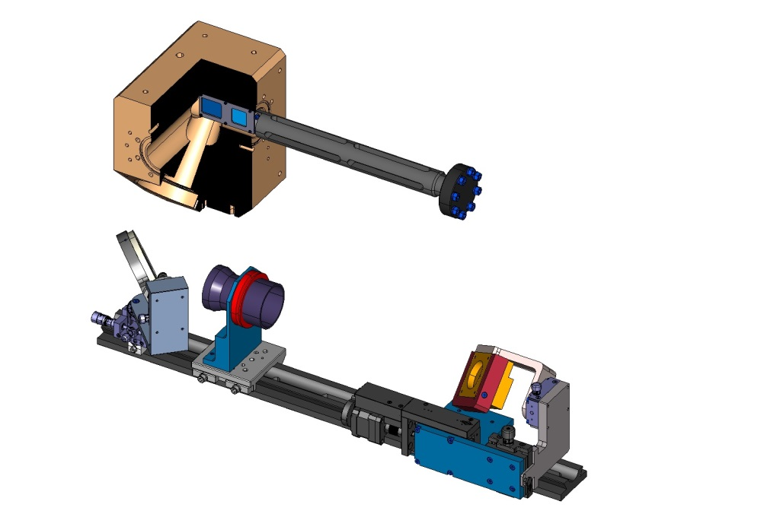
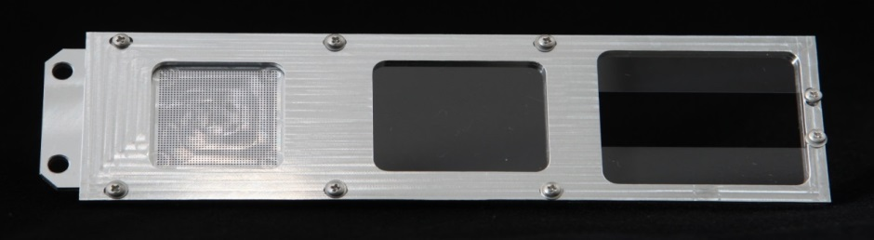
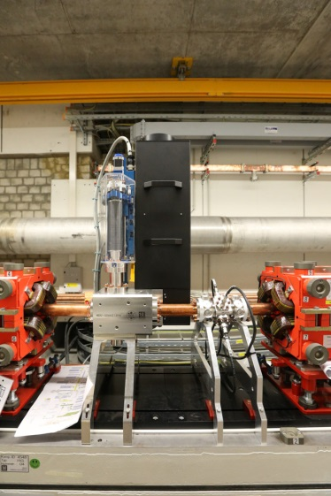
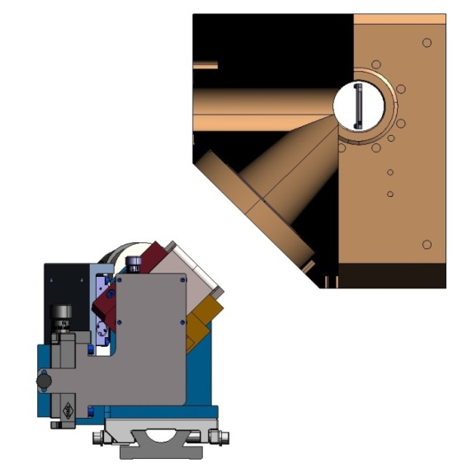
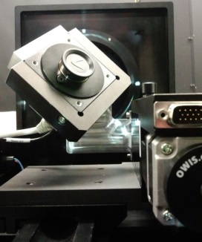
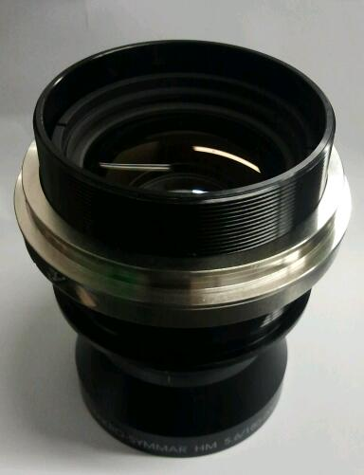
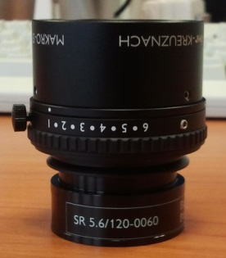
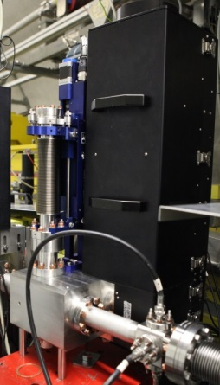

More detailed View: Screens
Optics Design Record On-Axis and Off-Axis Profiles
BEAM
Dot Grid Target(spot Ø .50mm)
200µm thick LYSO Screen (ON-Axis)
Optical Axis
1 or 2 half 200µm thick LYSO Screens (OFF-Axis)
Readout and Timing:
DOOCS, nearby µTCA System
Camera on a moving stage for focussing.
BEAM
45°
Observation
Optics Axis
Basler Aviator avA2300-25gm
2330 x 1750 pix, 5.5 µm
Monochrome, GigE
f = 180mm for 1:1
f = 120mm for 1:2
Large Area Photo Macro Lenses
from Schneider Kreuznach
BEAM
Test Setup at FLASH

Slide 12

More detailed View:
Screens
Technical Commissioning in the tunnel ( about 0.5 day/station)
  Screen system with optics installed,
  Check if the (right) screen moves, limit switches and MPS contacts are correct (at the site and in the control panels)
  Check camera power and illumination (switchable)
  Check signal path of camera till µTCA
  connection to µTCA and timing available.
  Switch to triggered mode and check readout via DOOCS
BKR or Office Work
  Take a picture from the calibration screen and check the calibration, do some refocussing if required.
  Take the next one

Slide 13
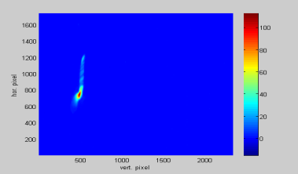
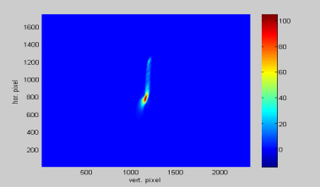
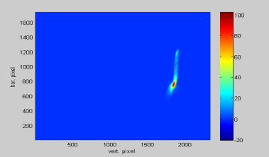
More detailed View:
Screens
Top
center
bottom
500pCOben.tif Gain330noBeam.tif
500pCMitte.tif Gain330noBeam.tif
500pCUnten.tif Gain330noBeam.tif
First beam (single bunch only)
  If technical commissioning was done well
    Find a nice picture immediately
  If not
    Move in calibration target and switch on illumination
    If you see a picture move back to screen and switch to free running mode
      Find a picture -> adjust trigger
    Else ask the operator
      If the beam should really be there, all valves open?
      to switch to the next screen
      or ask for temporary access

Slide 14
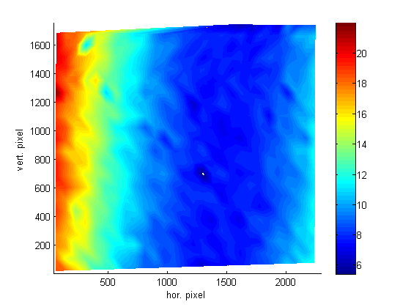
More detailed View:
Screens
System Resolution vs. Screen Position
Fine tuning of the systems
  Gain (as a function of charge)
  Exposure time
  Trigger delay
  In order to improve data rate, set region of interest.
  Check and correct calibration in ROI

Slide 15
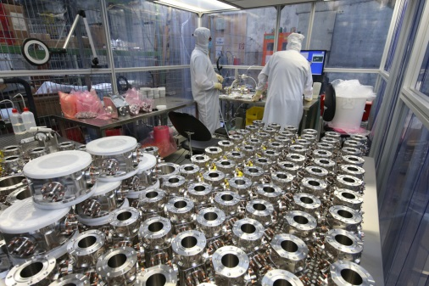
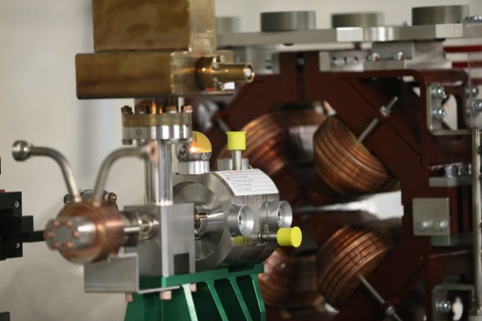
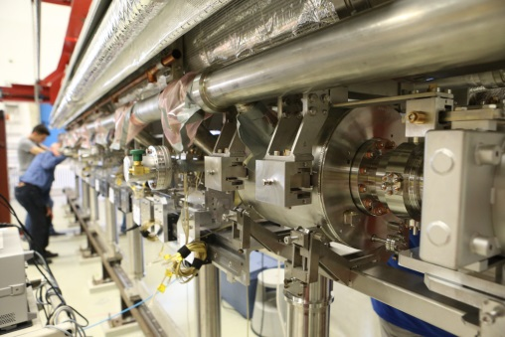
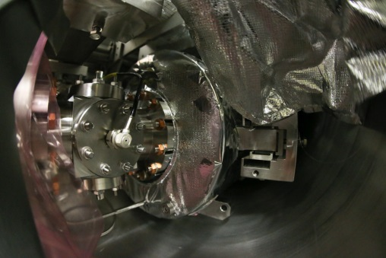
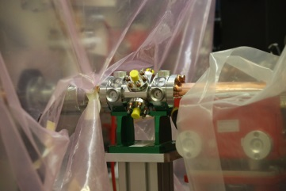
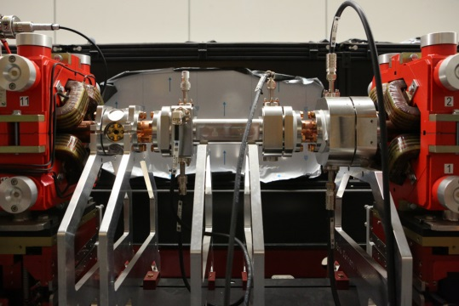
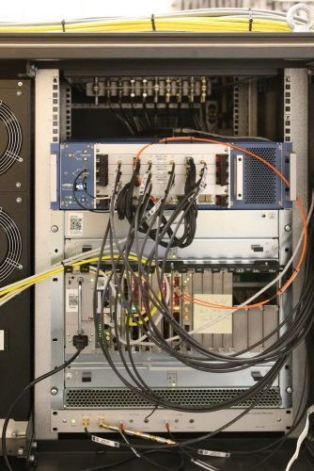
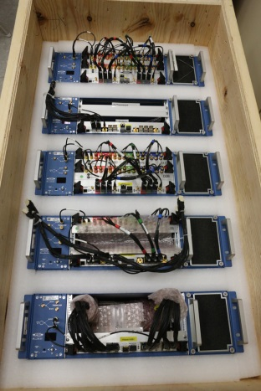
More detailed View:
BPM System
3 types of BPMs
  Button BPM for different beam pipe diameter
  Cavity BPM for 2 beam pipe diameters
  Reentrant Cavity BPM 30% of cold LINAC
Readout
  MBU (Modular BPM Unit)
    4 Button BPMs
    2 (Reentrant) Cavity BPMs,
    Cavity + 2 Buttons
  Connection to DOOCS via a FPGA-FPGA Bridge with optical fibers. Up to 4 MBU connect to 1 DAMC02 interface board.
  Timing: Decoding XFEL timing protocol (via fiber) in the MBU
  Ref. Frequency (Cavity only) 216 MHz

Slide 16
More detailed View:
Technical Commissioning BPMs
Already done or ongoing
  XFEL Type Button and Cavity BPMs at FLASH/FLASH2
  Pre-commissioning of MBU with BPMR/BPMC combination at FLASH2
Technical commissioning in the tunnel (w/o Beam)
  MBU -> Pre-calibrated Units (automated calibration in the lab with O(100) constants)
  Server, Timing, Ref. Line, and Displays tested and working
  Timing -> Check connection and Data Exchange. (BKR)
  Doocs -> Check Data Exchange with BPM, Store all Parameters (BKR)
Button BPM
  Cable -> 4 RF measurements/BPM (Atten., Phase diff,,…) (Tunnel 10 BPMs/Day), 300 BPM)
  Doocs ->Check Data Exchange with BPM, Store all Parameters (BKR)
Cavity BPM
  Pickup -> RF parameters -> Parameters into MBU (3 x Sensitivities) (Lab)
  Cable ->Measure Attenuation -> Parameter into MBU ( 3x Atten., Tunnel 5 days/undulator)
  216 MHz -> Check connection and Level (BKR)

Slide 17
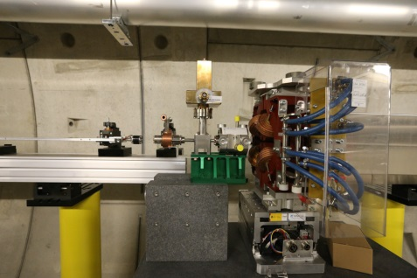
More detailed View BPMs:
Commissioning for First Beam
Basic Beam commissioning
    Technical Commissioning successful + basic orbit correction tools
    Run MBU with internal trigger
    Determine and set trigger delay for each MBU -> switch to timing system
    Get charge and offset amplitude correct to about 20% with lab calibration
Button BPM: First beam reaches BPM ( 1 shift/main LINAC or warm sections 20 BPM/Shift)
    Check sign with steerer (possible cable permutations)
    Proceed through the section
    Do a final check of signs using a single steerer and the orbit correction tool
    done
Cavity BPM ( 3-4 h/undulator): First beam reaches BPM
    Find and fix phase relations: reference to x and reference to y for large offset
    Only Reentrant: In some cases cable delay has to be adjusted to overlap all three channels (reference, x and y) to the same timing point (HW in the tunnel)
    Try to get offset amplitude smaller -> determine the sign of the offset from steerer
    Proceed like this though undulator
    Do a final check of signs using a single steerer and the orbit correction tool
    done

Slide 18
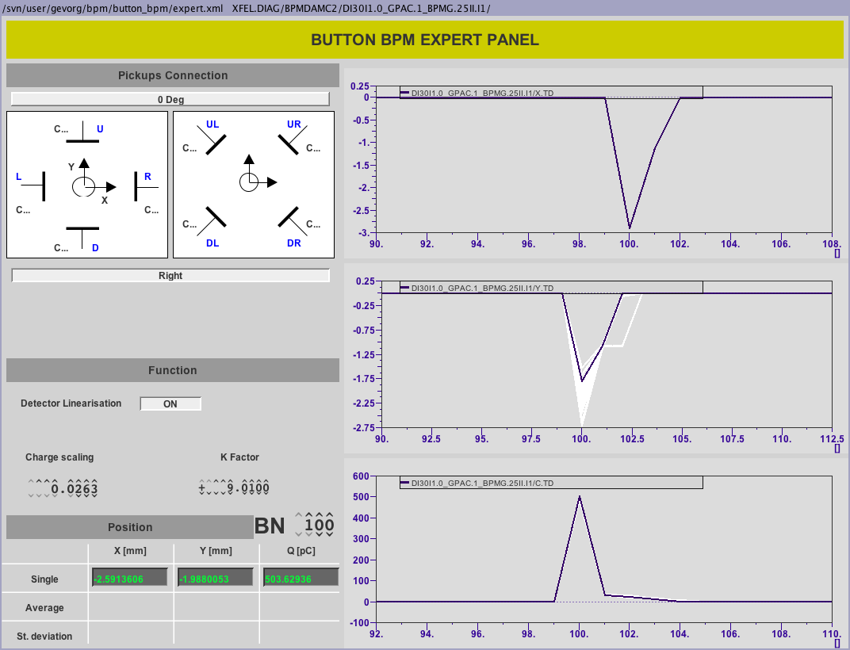
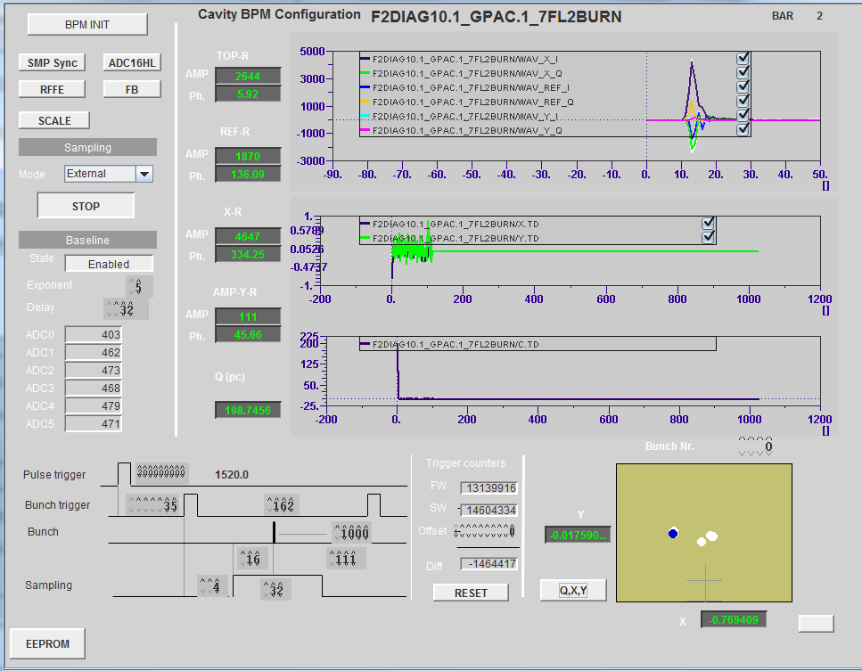
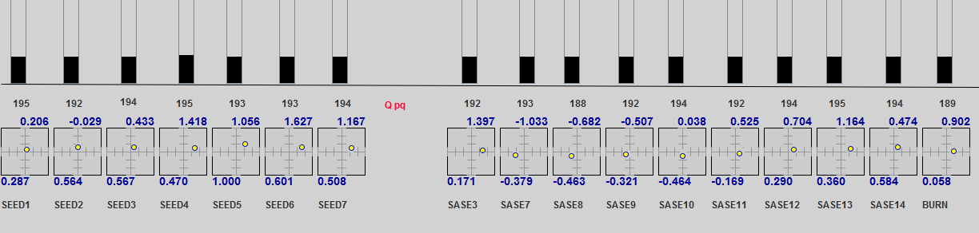
BPM: Operation Overview
Position and charge values from XFEL gun with button BPM @ 13.02.2015
Expert GUI of reentrant cavity BPM at FLASH2
Charge and Position Reading of the 17 FLASH2 Cavity BPMs

Slide 19
More detailed View:
Advanced Commissioning BPMs
Advanced Beam commissioning
  Basic Commissioning done, orbit correction tool, optics model
Button/Reentrant Cavity BPM
  For each plane and some charges and energies ( 0,5 h/ Step/Section)
    Use a single steerer and check orbit response by BPMs with optics tool box
    Calculate and Update MBU parameters
Cavity BPM
  For each plane and some charges and energies (1h/ Step/SASE undulator)
    Absolute Calibration of 1 BPM/undulator
    Use a single steerer plus optics tool to transfer the calibration to the following BPMs
    Calculate and Update MBU parameters
  Beam Based alignment not included.
  Beam based optimization of gain switching not included

Slide 20
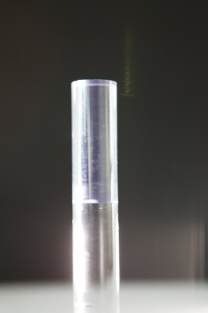
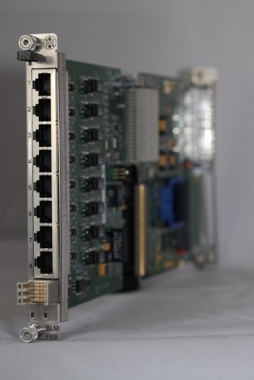
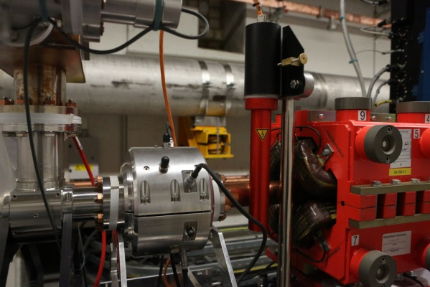
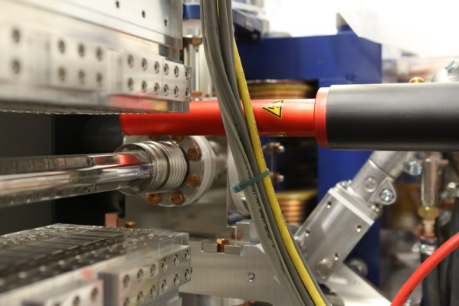
Beam Loss Monitors
Prerequisite, µTCA, MPS and timing running
Set thresholds to fixed value (never changes, only adapt sensitivity)
Analog alarm path (same threshold like in FPGA firmware) independent from timing
Set sensitivity based on FLASH2 and XFEL Gun experience from January
→ permitted losses about 50-100pC
Iterate sensitivity based on low machine activation and operation needs.

Slide 21
Wire Scanner
Needs more commissioning than screens
First beam detection difficult
Detector
  Use beam losses to adjust timing
  Use slow Scan to adjust signal level
Wire Drive; if detector is adjusted
  Run wire and adjust trigger delay

Slide 22
Summary I: Time for basic commission during first beam operation
Diagnostic System |  | Section Effort [h] |  |  |  | Detekt Beam | Aid "Fädeln" | Basic Operation | Callibration to 20% Level | Advanced callibration and optimisation | Beam Based Alignment
System | Subsystem | Gun | Injektor [XTIN] | XTL | XTDs
BPM System | Button | 2 | 3 | 16 | 8 | x | x | x | x | 0 | 0
 | BPME |  |  |  | 16 | x | x | x | x | 0 | 0
 | BPMF/I * |  | 1 | 4 | 6
 | BPMR |  | 1 | 6 |  | x | x | x | x | 0 | 0
 | Button Array |  |  | 5 |  | x | x | x | 0 | 0 | 0
 | HOM * |  | 2 | 4 |  | x | x | x
Charge | FCUP | 1 |  |  |  | x |  | x | x | 0
 | DCM | 1 | 1 | 2 |  | x | x | x | x | 0
 | Toroid | 1 | 1,5 | 4 | 2 | x | x | x | x | 0
 | TPS | 0 | 0 | 0 | 0
Sceens | Simple | 3 |  |  |  | x |  | x | x | 0
 | OTR_ABCL |  | 3 | 9 | 3 | x | x | x | x | 0
 | OTR_DE |  | 1 | 3 | 2 | x | x | x | x | 0
 | OTRS |  |  | 2 |  | x | x |  |  | 0 | 0
 | Beam Size Dump |  |  | 0 | 0
Wire Scanners |  |  |  | 0 | 0
Loss Monitors | BLM | 1 | 2 | 8 | 16 | x | x | x | x | 0
 | BHM |  | 0 | 0 | 0 |  |  |  |  | 0
 | Dosimeters | 0 | 0 | 0 | 6 |  |  | x | x | 0
Sum | 146,5 | 9 | 15,5 | 63 | 59

Slide 23
Summary II:
Advanced Commissioning; dedicated beamtime
Diagnostic System |  | Duration per item [h] | Section time for full commission work (exclusive) [h] |  |  |  | Per-formance require-ment | Charge Variation | Orbit Variation | Required for/during |  | Advanced calibration and optimization | Beam Based Align-ment
System | Subsystem |  | Gun | Injektor [XTIN] | XTL | XTDs | long trains all reprates | full range jitter < 1 % | jitter < 0.5 sigma | Few bunches | Full Performance |  | needs special effort
BPM System | Button | 0,3 | 1 | 4,8 | 54 | 33,3 | partially | yes | yes | x | x | x | 0
 | BPME | 0,5 |  |  |  | 50 | partially | yes | yes | x | x | x | 0
 | BPMF/I | 1 |  | 3 | 19 | 5 | partially | yes | yes | x | x | x | 0
 | BPMR | 0,3 |  | 1 | 9,6 |  | partially | yes | yes | x | x | x | 0
 | Button Array | 4 |  |  | 12 |  | partially | yes | yes | x | x | x | 0
 | HOM | 4 |  | 8 |  |  | partially | yes | yes | x | x | x
Charge | FCUP | 0,5 | 1,5 |  |  |  |  | yes |  | x | x | x
 | DCM | 0,5 | 0,5 | 0,5 | 4 |  |  | yes |  | x | x | x
 | Toroid | 0,3 | 0,3 | 0,9 | 4,8 | 4,5 | partially | yes |  | x | x | x
 | TPS | x | 0 | 8 | 12 | 12 | yes | yes |  |  | x | x
Sceens | Simple | 0,5 | 1,5 |  |  |  | Single | yes | yes |  |  | x
 | OTR_ABCL | 1 |  | 7 | 26 | 16 | Single | yes | yes | x |  | x
 | OTR_DE | 1 |  | 1 | 4 | 5 | Single | yes | yes | x |  | x
 | OTRS | 2,5 |  |  | 7,5 |  | Single | yes | yes | x |  | x
 | Beam Size Dump | 4 |  |  | 4 | 8 |  | yes | yes |  | x
Wire Scanners |  | 4 |  |  | 24 | 24 | yes* | yes |  |  | x | x
Loss Monitors | BLM | 0,2 | 1 | 3,6 | 20 | 38,4 | yes | yes | yes | x | x | x
 | BHM | 2 |  | 2 | 2 | 4 | yes | yes | yes |  | x | x
 | Dosimeters | x | 0 | 16 | 16 | 32 |  |  |  |  | x | x
Sum | 512,7 |  | 5,8 | 55,8 | 218,9 | 232,2 | .

Slide 24
The End
Thanks to all colleagues contributing to the work presented here:
W. Decking
C. Simon et al.
B. Keil et al.
M. Pelzer
S. Vilcins
C. Wiebers
M. Werner
I. Krouptchenkov
A. Kaukher
T. Wamsat
M. Holz
J. Lund-Nielsen
J. Neugebauer
K. Knaack
H. Tiessen
T. Lensch
F. Krivan
A. Delfs
R. Neumann
R. Neumann
N. Wentowski
D. Lipka
M. Drewitsch
I. Kundoch
D. Bandke
B. Lorbeer
A. Ziegler
M. Steckel & MDI5
R. Barrett
V. Gharybian
G. Kube
K. Wittenburg
F. Schmidt-Föhre
N. Baboi
J. Kruse
D. Renner
C. Behrens
R. Susen
P. Smirnov
J. Neugebauer
Z. Pisarov
B. Lemcke
H.T. Duhme

