Slide 1
Status of the DSSC Project
Matteo Porro
For the DSSC Collaboration

Slide 2
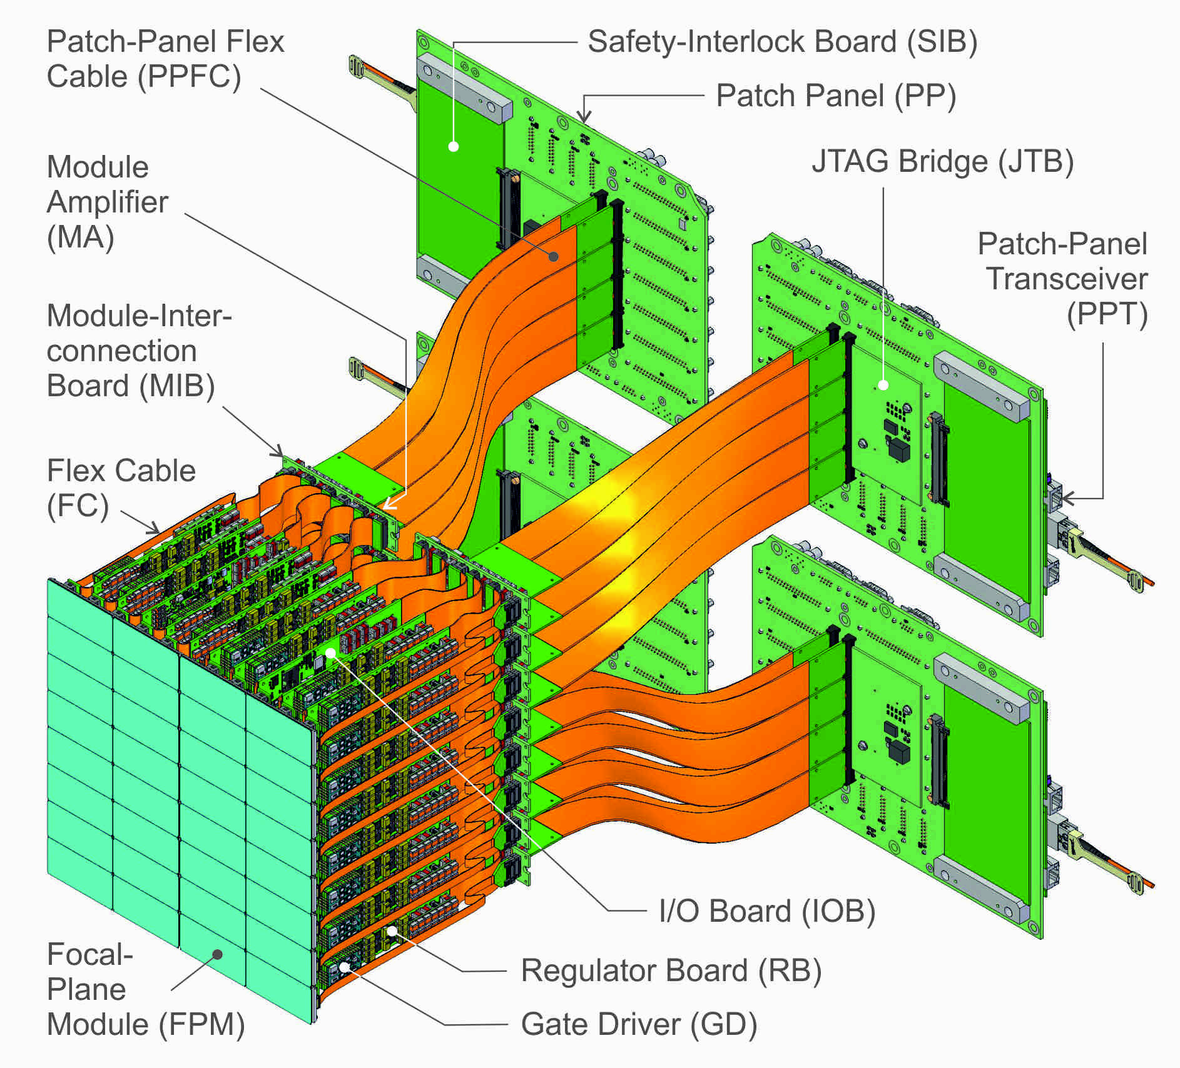
Sensor and focal plane architecture
Non Linear DEPFET
Intrinsic low noise
Intrinsic signal compression
Mini SDD array
Linear response
Simplified technology
Readout concept
Full parallel readout
Analog shaping
8-9 bit digitization in pixel
In-pixel SRAM (800 frames/bunch)
Power cycling
10.7 kW peak power
240 W average power
Focal Plane composition
1024x 1024 pixels
16 ladders (512 x 128)
32 monolithic sensors 128x256
256 Readout ASICS 64 x64
K. Hansen, DESY
Mini-SDD camera by end 2017
Two ladder cameras (Mini-SDD and DEPFET) by middle of 2016
DEPFET camera to follow

Slide 3
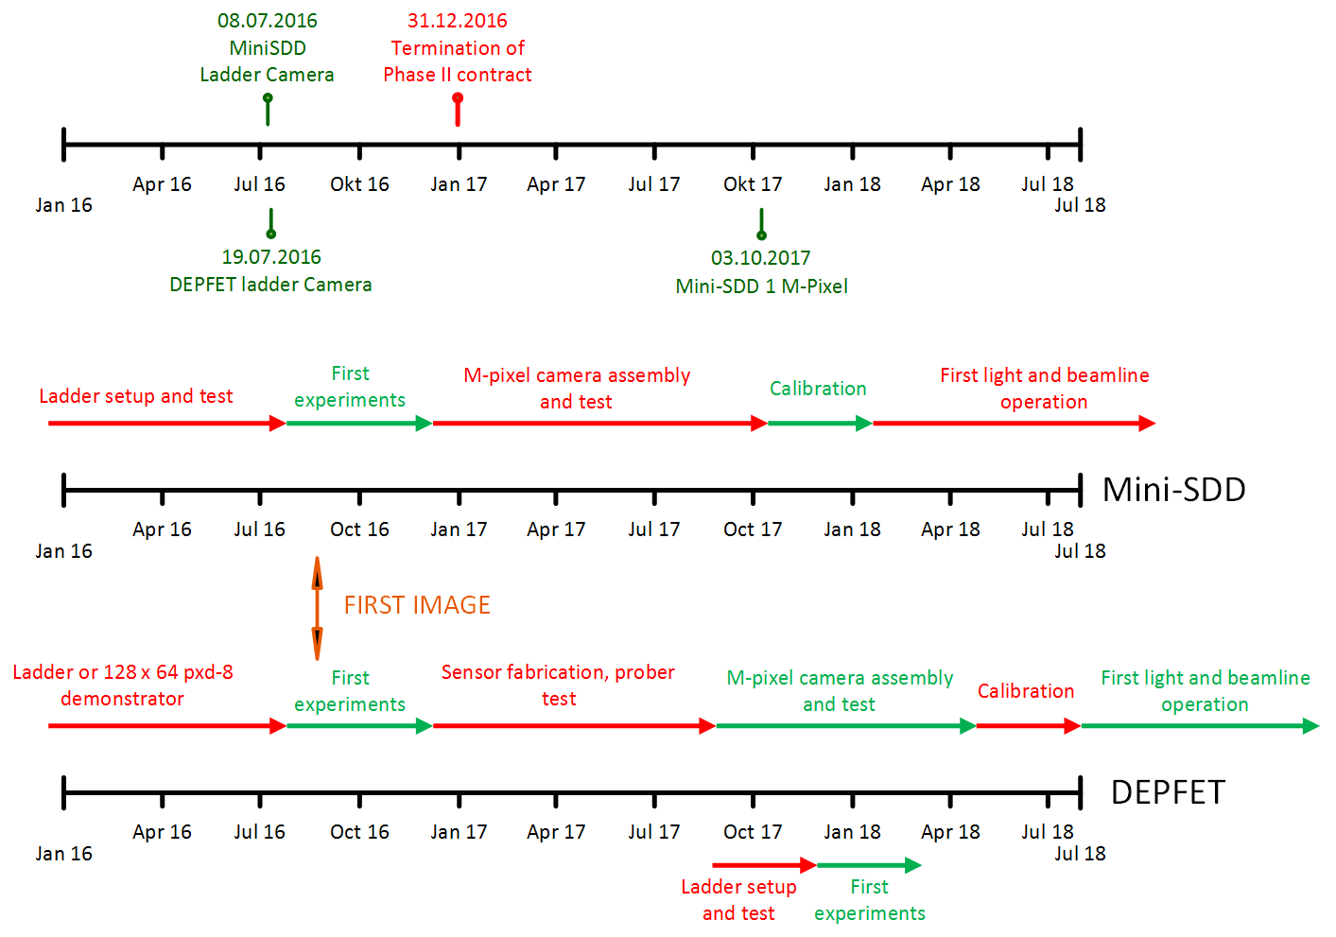
Time plan - overview
Foreseen in Phase II contract

Slide 4
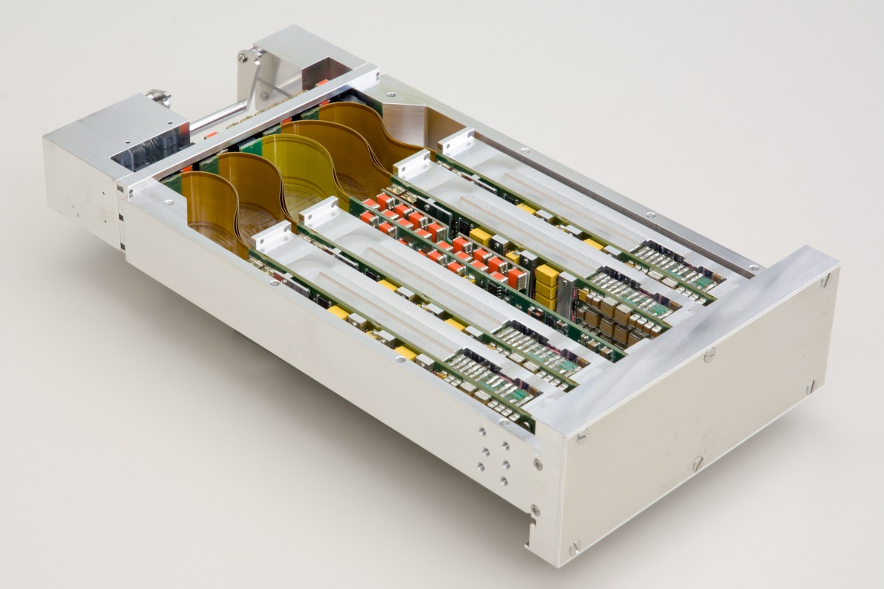
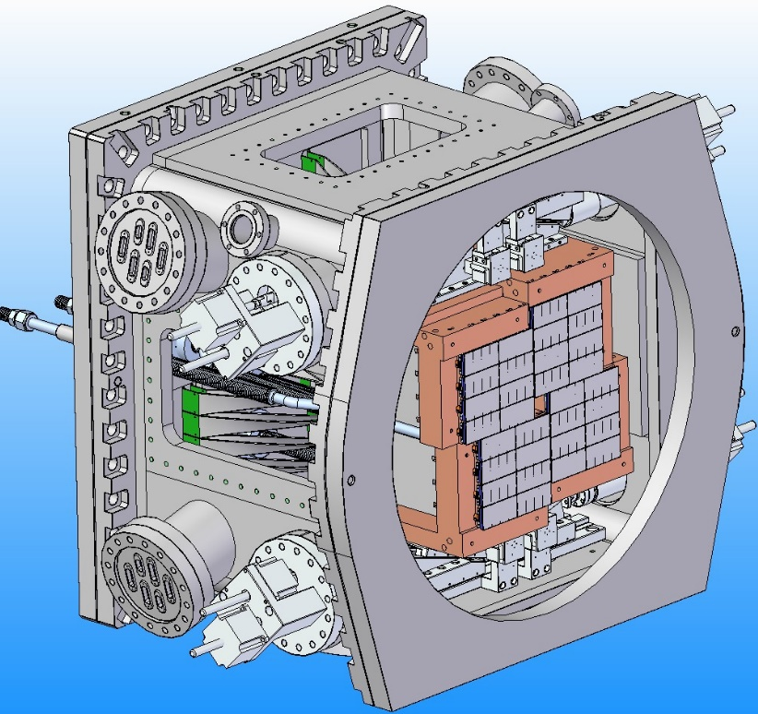
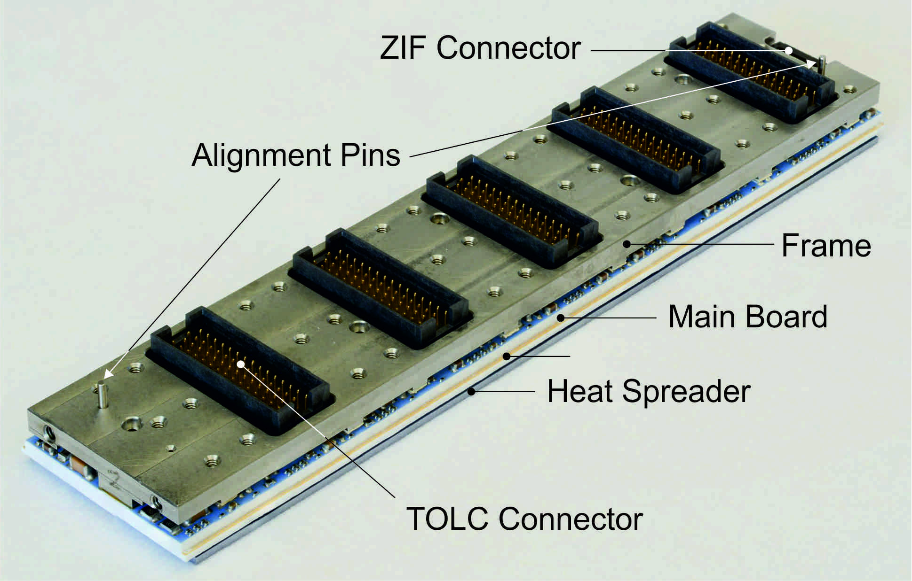
DSSC ladder camera
(C. Wunderer, DESY)
DESY FEC
(K. Hansen et al, DESY FEC)
Module-Interconnection Board
with Module Amplifier
Focal-Plane Case
with Sub Module
I/O Board
Regulator Board with Gate Driver
Mini-SDD and DEPFET based systems (512x128)
⇒ ladder test-stand
⇒ ladder cameras

Slide 5
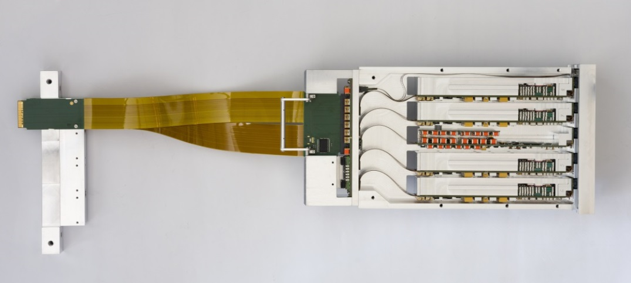
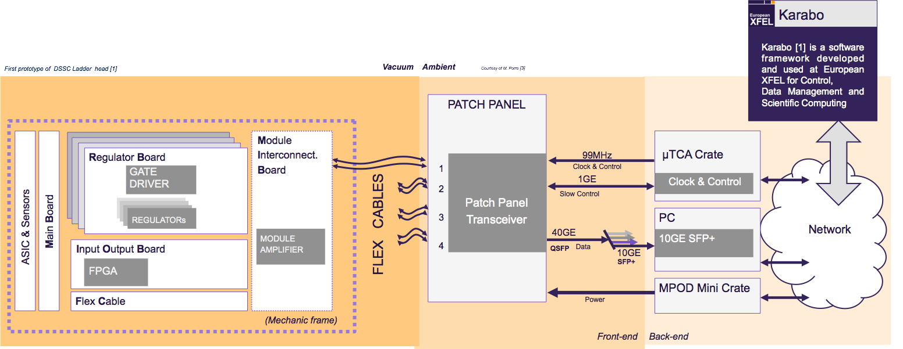
Ladder prototype
and backend electronics
128x512 pixels
Full electronic chain as in final camera
Full integration into the XFEL.EU software frame
To be operated in the same conditions
(vacuum, T…)
In vacuum
Outside vacuum
(M. Donato - XFEL.EU, K. Hansen – DESY FEC, A. Kugel, M. Kirchgessner – Heidelberg)

Slide 6
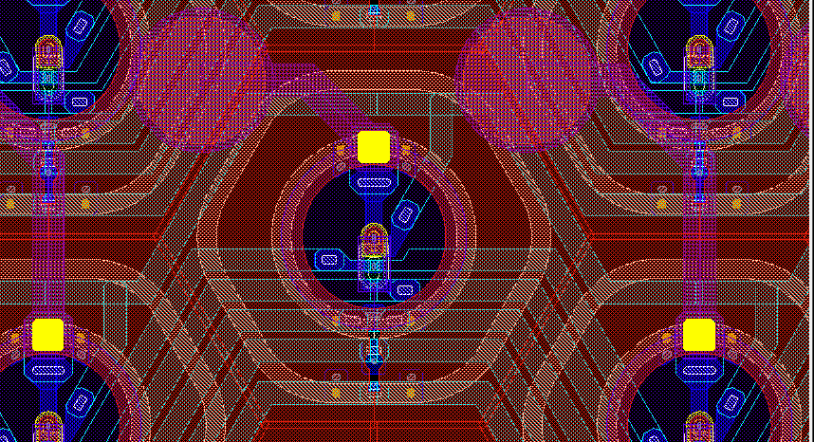
Mini-SDD sensor motivations and main characteristics
Large area DEPFET arrays will be used to build detector ladder cameras (512 x 128 pixels)
For the full camera an additional DEPFET production is needed
We need an increase of availability of DEPFET sensors with reduced production time establishing an industrial fabrication process (accomplished by PNSensor)
A simplified sensor has been produced
mini-SDDs with passive collecting anode
Same geometry of DEPFET devices
Linear response
the mini-SDD sensor has reduced performance but it will allow one to:
Test the full-system in advance
perform a large fraction of the foreseen experiments at low energy
136 µm
DEPFET (PNSensor, MPG HLL)
2x poly, 2x Al, 1x Cu
11 implantations
Mini-SDD (MPG HLL)
1x Al, 1x Cu
2(3) implantations

Slide 7
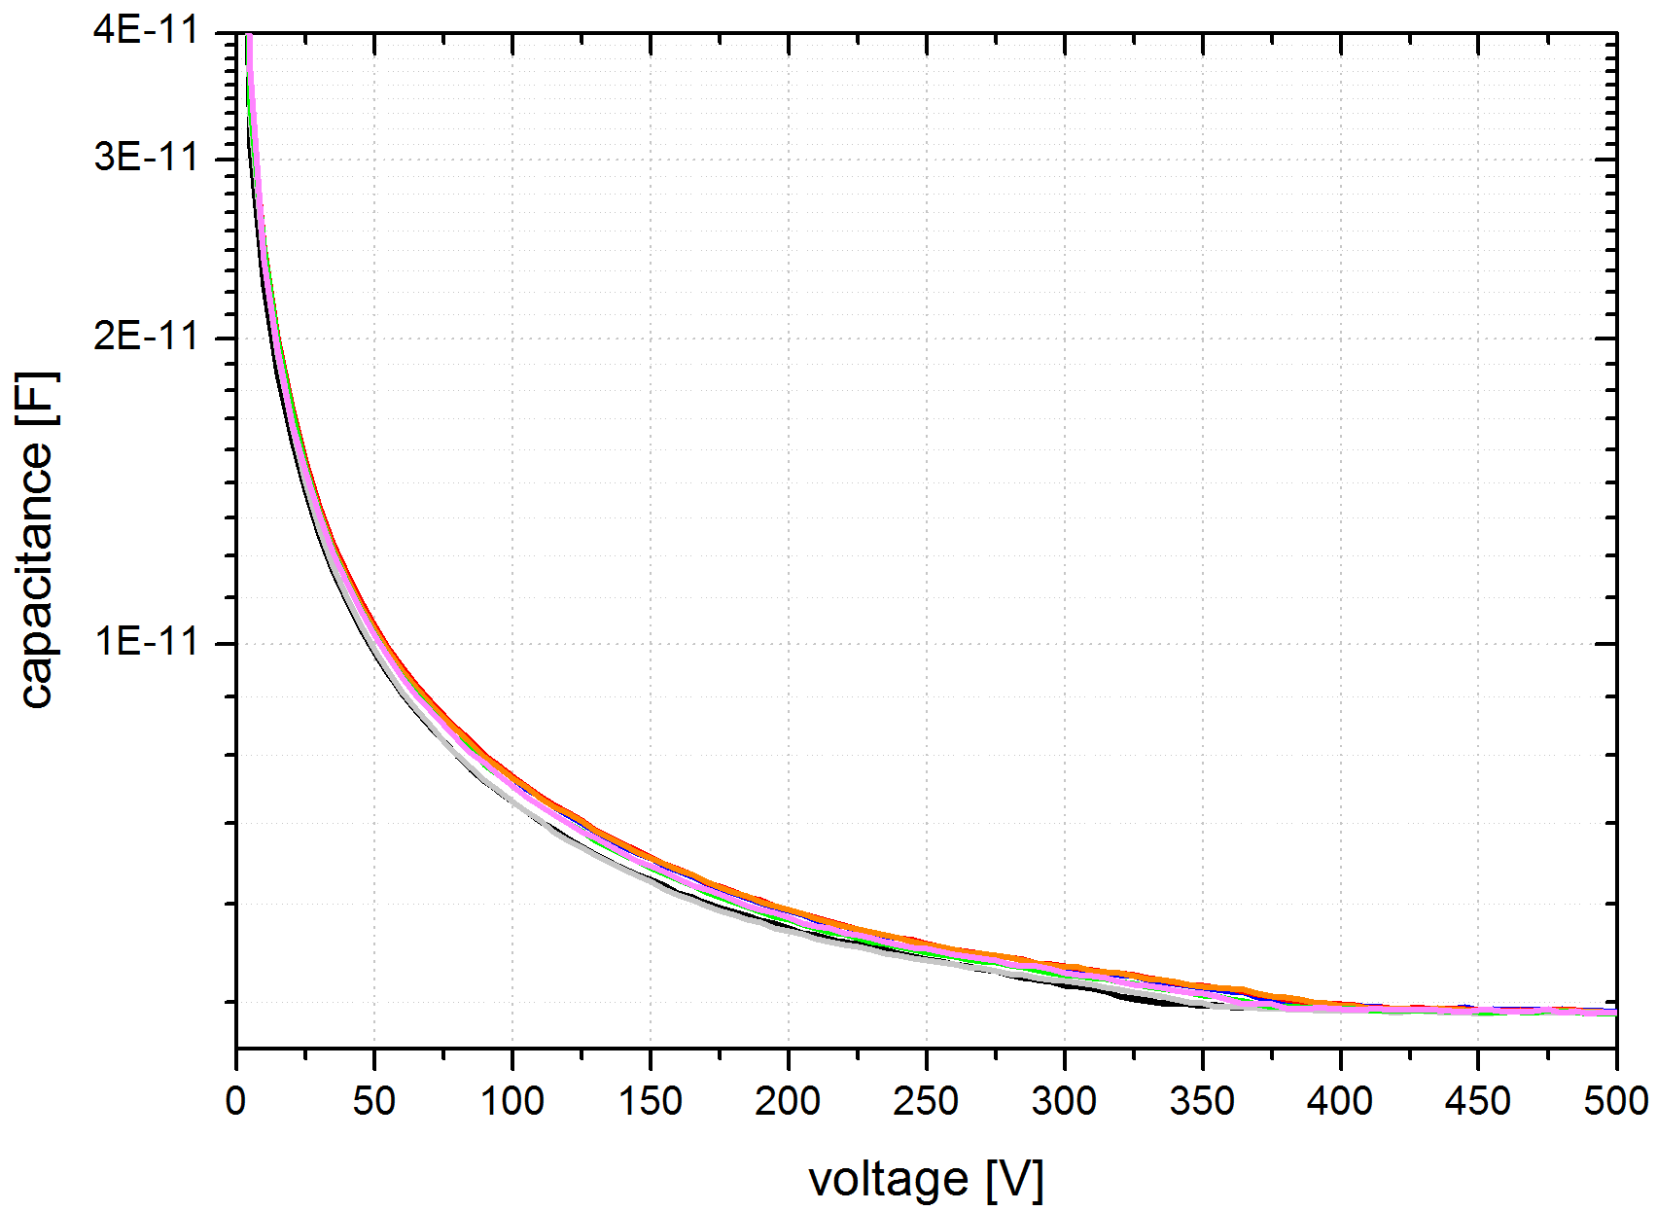
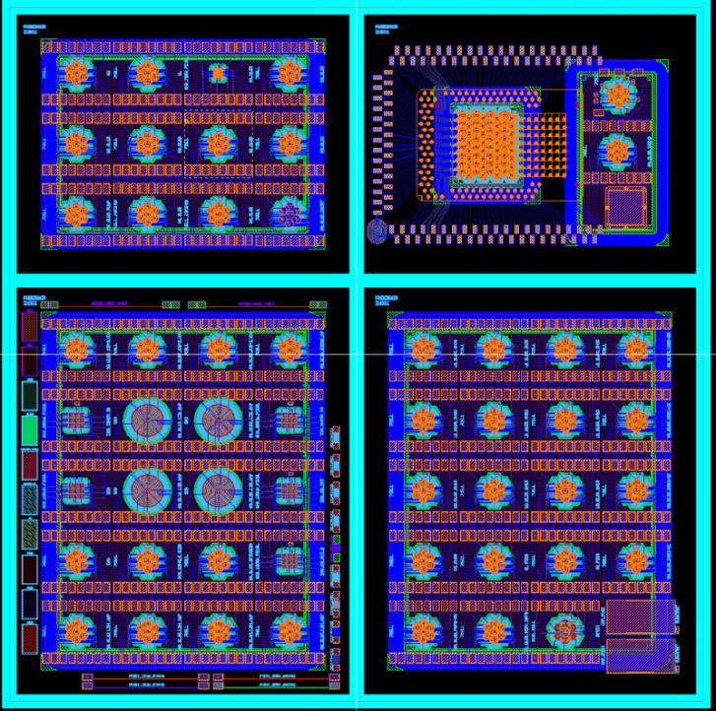
DEPFETs in Industrial-Scale CMOS Fab
First production of diode test structures (12 wafers 8 inch)
Large Diodes 5x5 mm^2
Small Diodes 1x1 mm^2
Technology test structures
Test results
Depletion voltage is below 400 V
Leakage current is typ. < 1 nA /cm2 at full depletion
Distribution of leakage current is homogeneous across the wafer
Double sided processing of DEPFET devices with very sensitive entrance windows is possible in the CMOS Fab
First DEPFETs will be available in April
7-cell clusters
Macropixels
3x3 matrix (smaller pixels)
8x8 matrix (UBM required)

Slide 8
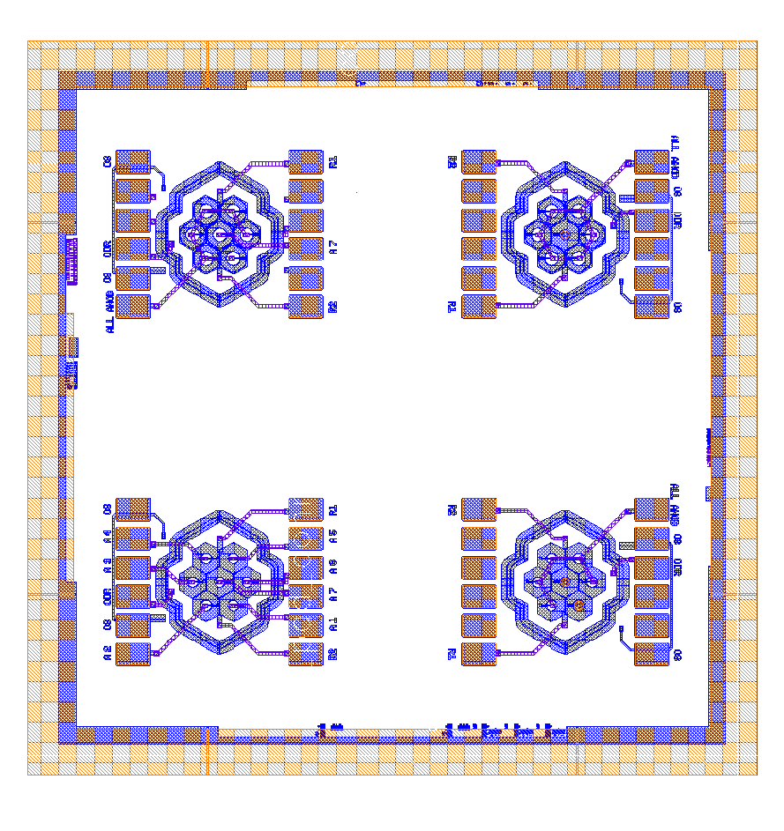
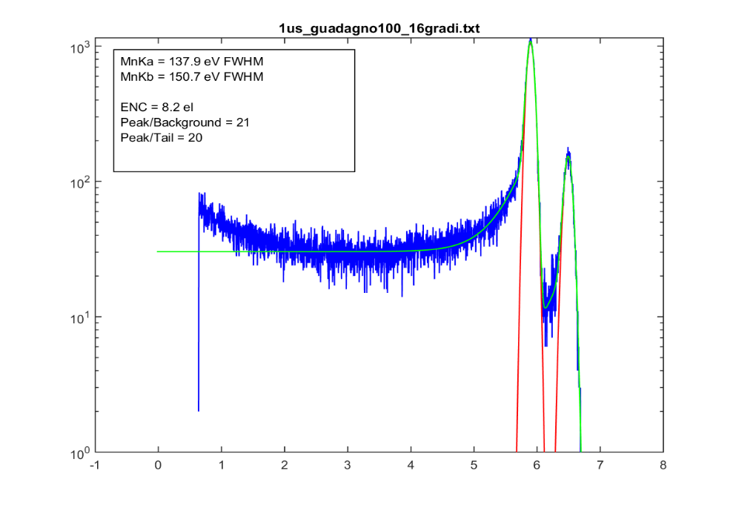
Verification of MiniSDD functionality
The functionality of the MiniSDD pixel has been verified with CUBE external charge preamplifier:
Gaussian
Shaper
MCA
CUBE
Test made with four shaping times: 1 us, 500 ns,375ns and 250 ns
Two different temperatures : 16° C and -10° C
Test leaving floating the Ring1 at 16° C
ENC summary
Shaping time (ns) | T=16° C | T=-10°C | R1 floating (T=16° C)
1000 | 8.2 | 7.3 | 8.2
500 | 8.6 | 8 | 9.1
375 | 9.2 | 8.4 | 9.8
250 | 9.7 | 9.4 | 10.4
Counts
Energy (keV)

Slide 9
ASIC - Reminder: DEPFET vs. Mini-SDD
Originally DEPFET sensors + Low impedance current mode input FE were chosen by DSSC because this combination solves several challenges:
low noise (low input cap, internal amplification)
high compression (increasing cap. of internal gate with fill level)
low crosstalk (primary charge confined to internal gate, low Z_{in})
power supply rejection
After withdrawal of MPE / HLL from DSSC, we had to move to Mini-SDD
All above challenges must now be handled in the FE, which puts additional burden on the FE.
This challenging FE had to be implemented in fairly short time.
The FE version in F1 was only a first shot
F1 (containing both FE types) has still sub-optimal performance for Day-0
It will be used for the first focal ladder cameras (128 x 512)
We are working on a better Day-0 FE for the planned F2 chip
As new DEPFET are planned for the future, we need to go in parallel…

Slide 10
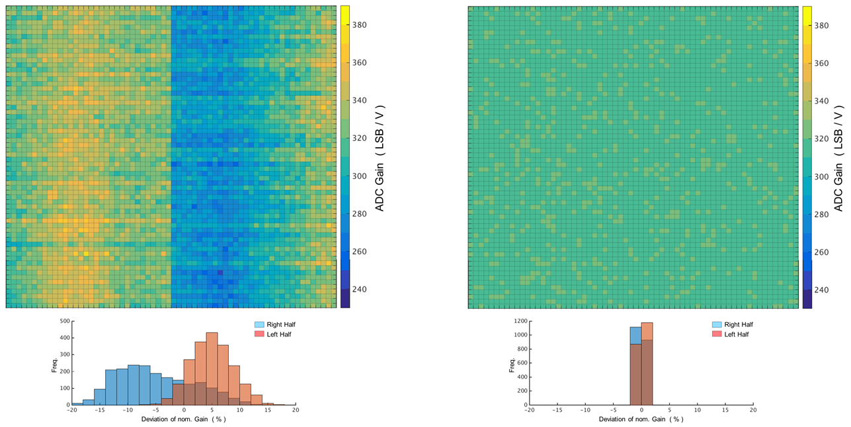
F1 (64 x 64) ASIC - ADC Operation
ADC can be operated on FULL chip in parallel.
Gains can be trimmed to nominal value:
Gain variations are well understood by simulations including voltage drops
99% pixels have DNL (in range of 20 bins) < 0.5 LSB
25% trim range is required for this. If nominal gain is trimmed, required trim bins are not centred, so that low contingency is left on 'one side'

Slide 11
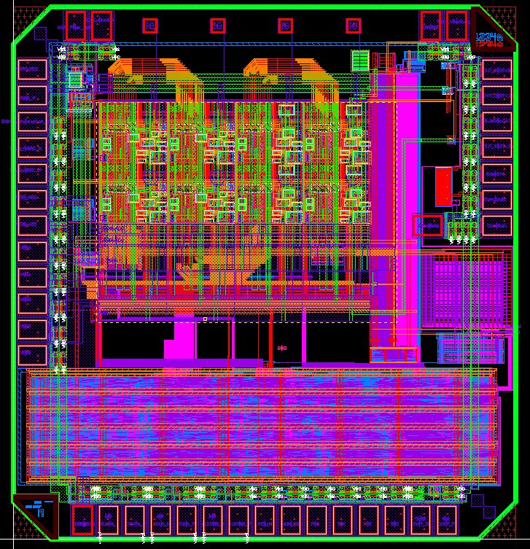
ASIC - New Designs
New design ideas have been invented to address the problems of
power supply sensitivity
Matching
(compression)
A test chip DSSC_D0M1 with 2 x 4 pixels has been submitted in August
It will be back in Mannheim 7.12
It contains 3 types of FE
A test setup is very similar to previous test chips & ready
A MM7 8 x 16 ASIC with the pixel electronics foreseen for the final large format ASIC will be submitted in February 2016
The final F2 64 x 64 ASIC will be submitted in July 2016
DSSC_D0M1

Slide 12
Module WP - assembly
Bare Module Assembly – Flip Chip
The Flip-chip process development has started and it is still in progress. Cu UBM Quality is a Problem for both Productions, PXD-8 & mini-SDD
We successfully flipped 2 samples of 64 x64 MiniSDD sensors and the backside protection has been verified.
Sub-Module
Sub Modules shows Deflections around 46 µm & Tilting Angles between -0.077° and 0.049° → Mounting Concept in Preparation

Slide 13
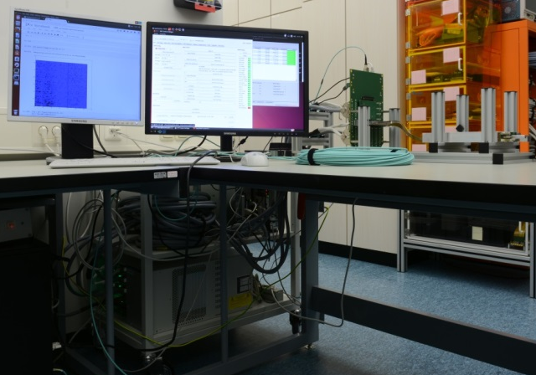
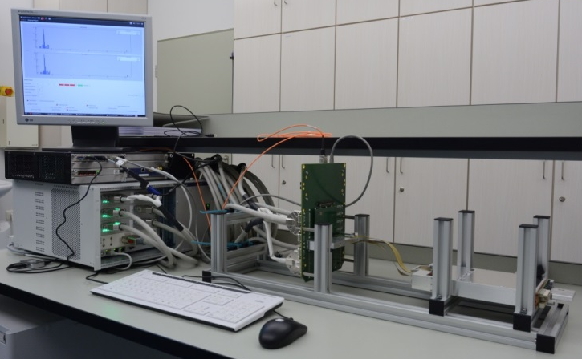
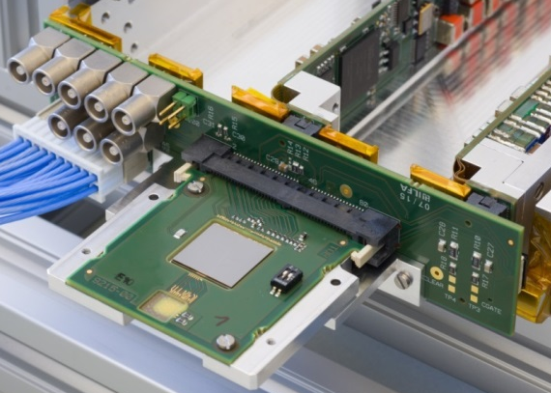
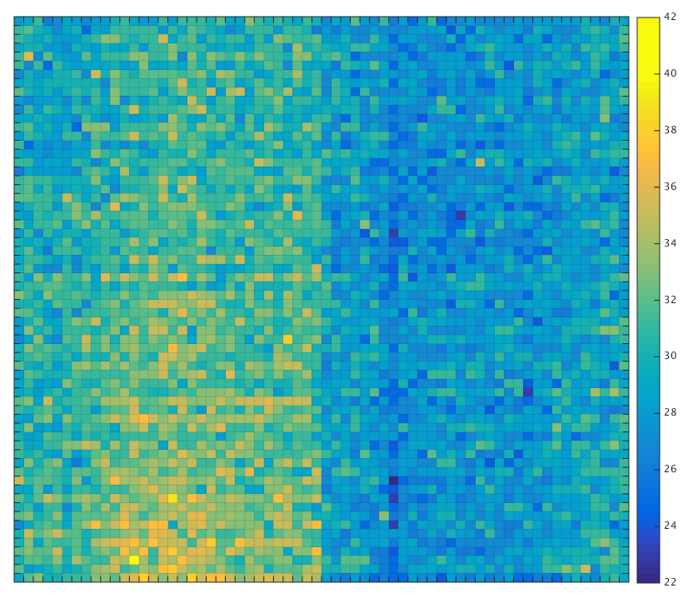
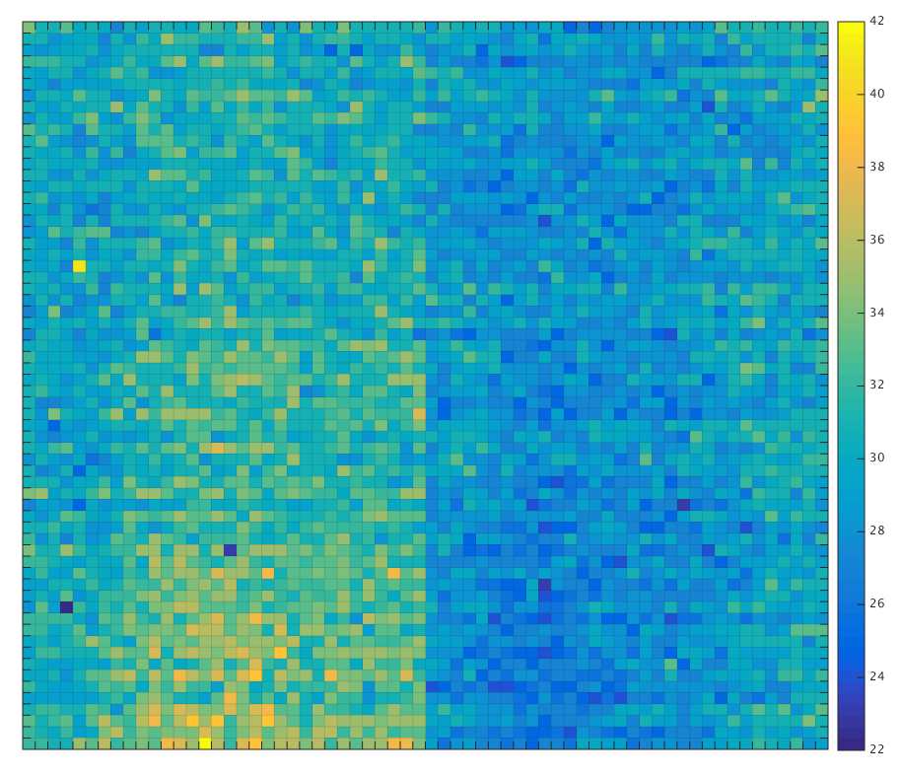
Ladder Systems
Lab-Test System
Ladder Camera
DUT
MTCA Crate w/ 10-GE Link
MB Replacement
PP w/ PPT
FE Carrier
Ladder Set
MTCA Crate
MPOD-mini Crate
PPFC
F1 on Interposer
PC w/ 10-GE Link
7-ch DEPFET
Dark Images
Next Steps
Tests with 7-ch DEPFETs
wait for FE Carrier for Baby-Bare Modules
Tests with Baby-Bare Modules
ADC Unit (LSB)
ADC Unit (LSB)
Current Sink: Off
FE: Buffer Mode
I_{ramp} Setting: 13
defect Pixel
whole Signal Chain from ASIC Filter to Back-End Computing works
two F1-Chips show 2 defect Pixel each, one F1 Chip without defect Pixel

Slide 14
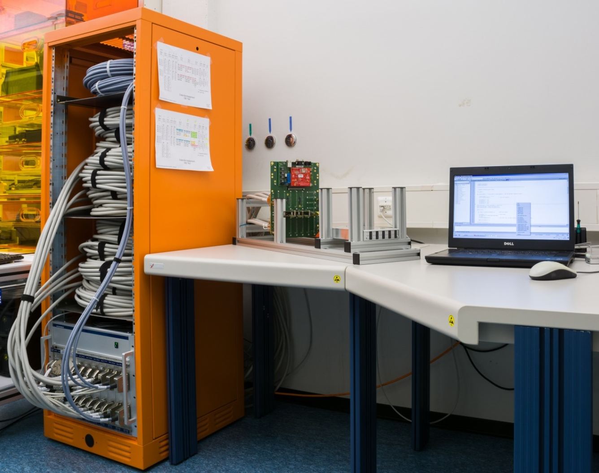
Quadrant-Test Stand
SIB w/ µC
LV/HV Cables
Next Steps
Implementation of PPT & IOB
Temperature-dependent Measurement with SIB’s Sensors
PLC Cables
Ladder Set
PP w/ Ladder Interface
Sensors: T & P
MPOD Crate w/ 10 PS
Mini-Sensor Boards
whole Power/Signal Chain from Crate to Camera-Head Interface works
SIB’s Main Functions successfully tested

Slide 15
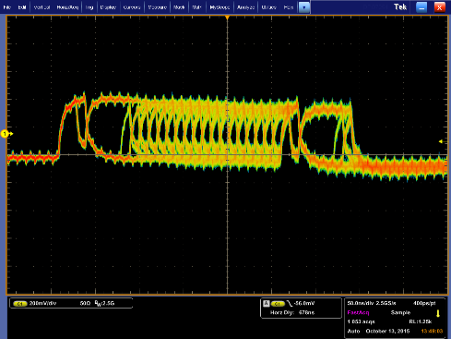
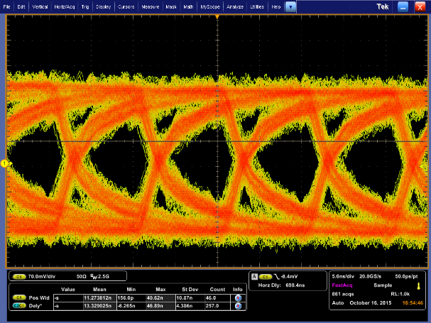
DAQ
3 out of 10 PPTv2 boards have been produced
One minor termination bug was solved by a small patch board mounted on the bottom side of the PPT
This patch will be integrated in the bottom layer of the PCB for the remaining 7 PPTv2 boards (change of one mask only)
C&C signal quality has been successfully verified (with patch board) @ 100 MHz operation:
30m cable (CAT6, CAT7 same)
Eye-opening fits LVDS spec. of 100mV
Bit Error Rate Test (Random pattern) ~ 5.35E-12
@10Hz Start Cmd +
32Bit TrainID+
8Bit BunchPatternID+
8Bit CRC
5ns
x
100mV

Slide 16
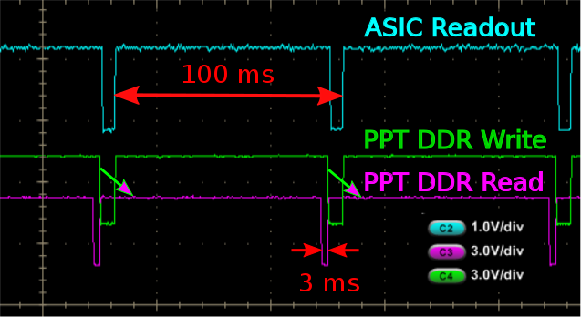
DAQ - 10 Hz Operation Mode
All burst and readout state machines in ASIC, IOB and PPT have to run synchronously
All Fifos and SRAMs have to be reset/initialized before each burst
Readout chain must have finished before next burst
Per 10Gbit Link: 16 chips x 4096 pixels x 800 words x 16 bit = 838.860.800 bit Link capacity in 94 ms (no headers…): 940.000.000 bit
10 Hz operation with C&C signals
runs stable
green: PPT receives data from ASIC and writes it to DDR3 buffer
purple: PPT sends (reordered) train data from DDR3 to train builder

Slide 17
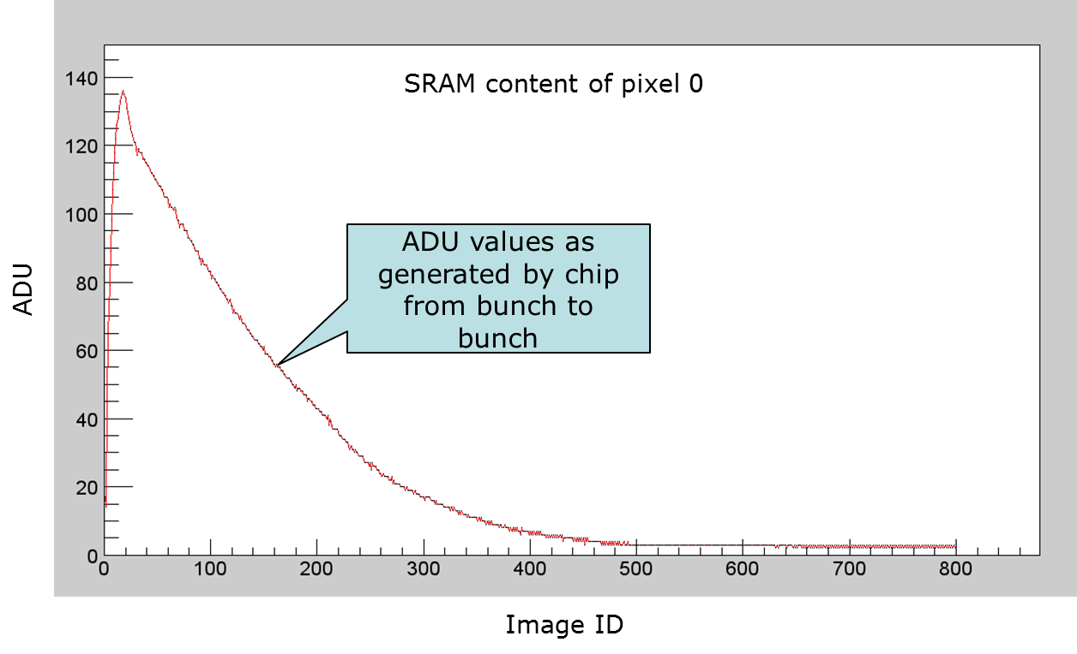
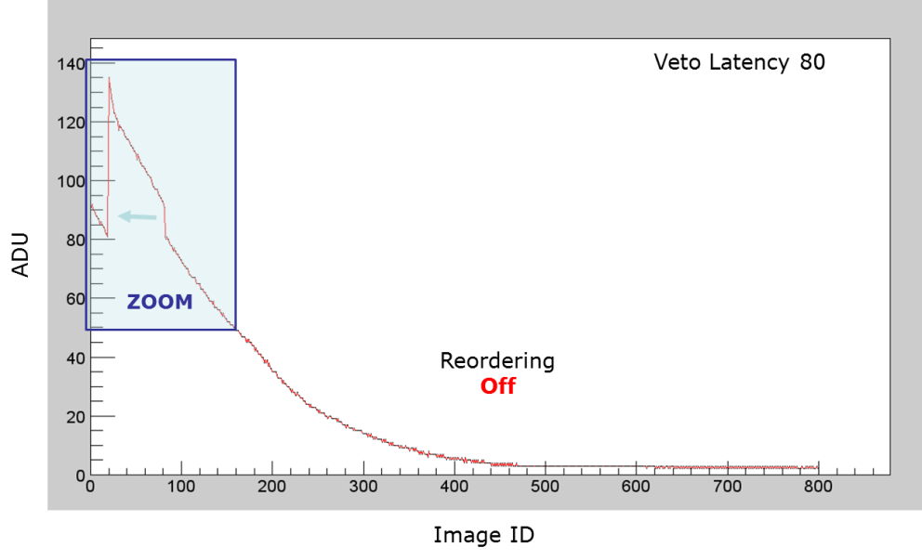
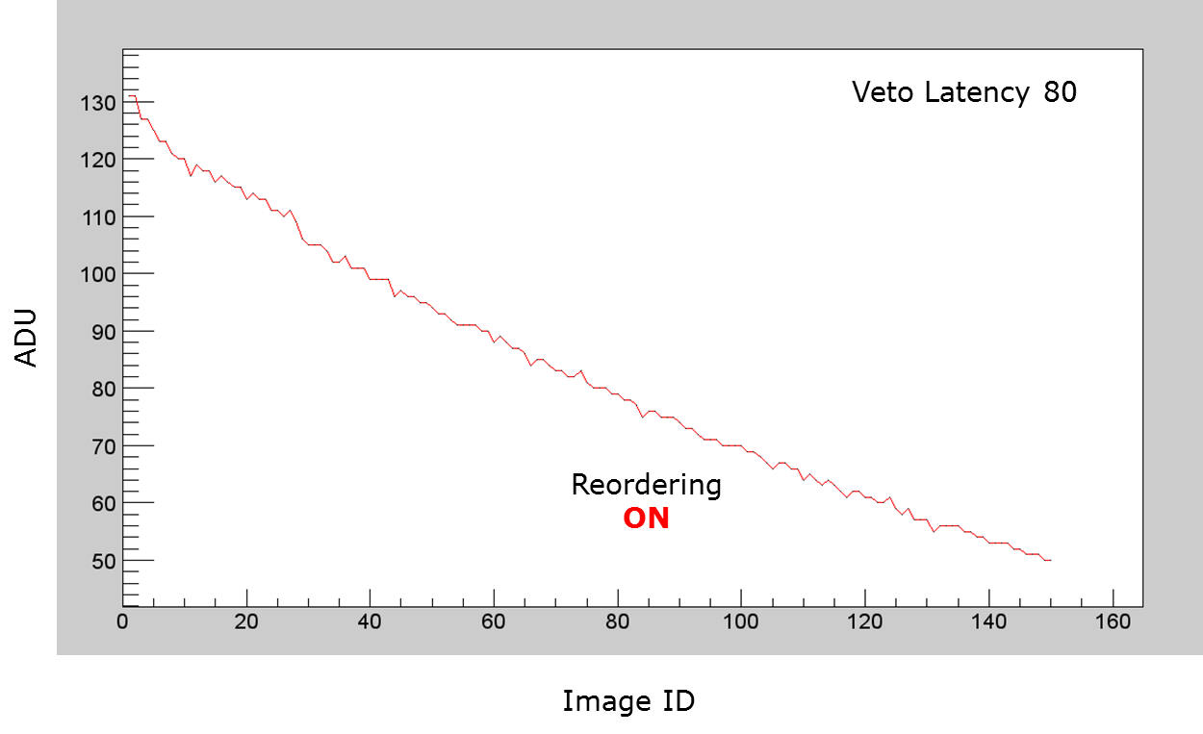
DAQ - Veto & reordering
Real hardware has been used to test Veto Mechanism in detail:
Full readout chain including the readout ASIC is included
Start triggers have been received in 10 Hz rate
F1 ASIC operated with rapidly changing ADC values to visualize the veto correction
Veto signals generated
internally (in ppt, at the beginning of a burst)
from C&C via veto command
Veto-reordering was also verified in digital simulation.

Slide 18
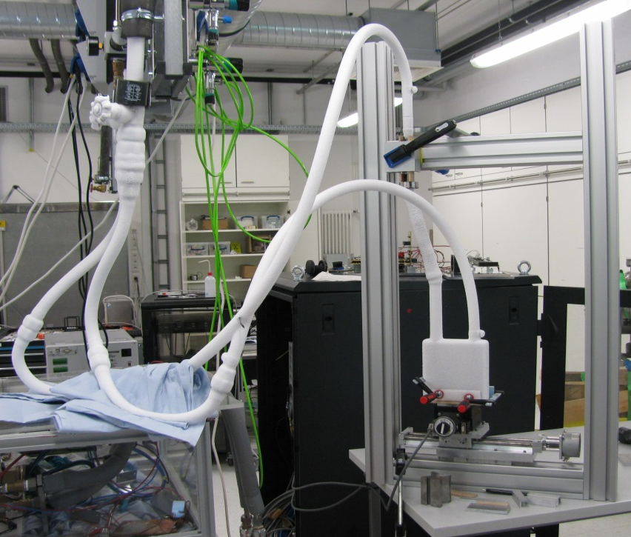
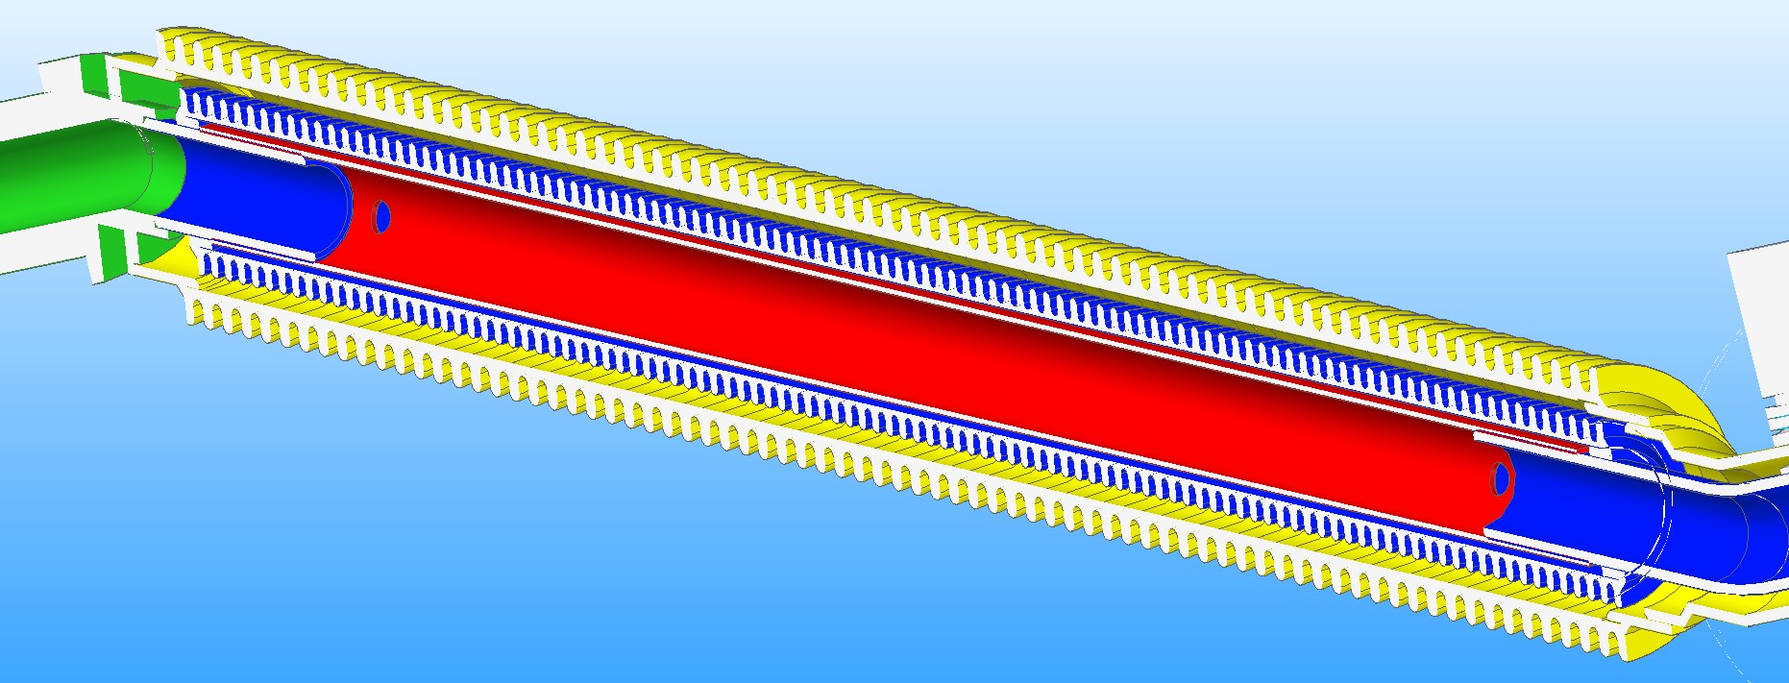
Thermal/Mechanics 1/2
The coolant pipe architecture is fully qualified
100 cycles warm => passed vacuum check afterwards
2000 cycles moving along outer edges of a 14×14mm² square with coolant (-60°C at outset) circulating inside => again passed vacuum check afterwards

Slide 19
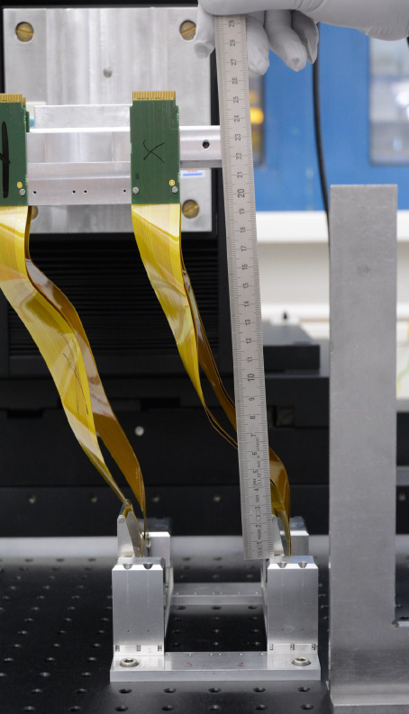
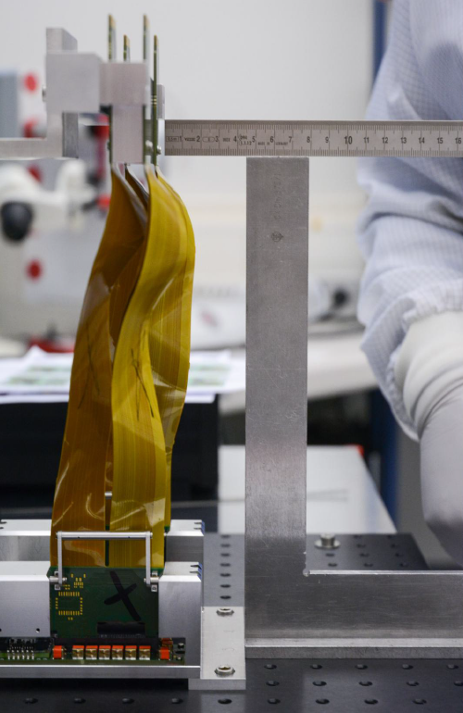
Thermal/Mechanics 2/2
1:1 Mock-up used for verifications
In June 2015, attempts to place the Patch Panel Flex Cables (PPFC) revealed mismatch between PPFC and chamber design length
Flex cables will be made longer (~5.5 cm)
No need to change the vacuum chamber design
No need to move cooling pipes
Next Steps:
finalize fabrication drawings & order cooling blocks
finalize “Pflichtenheft” for the vacuum vessel & get that ordered
(XY motion stage has already been ordered)
We try to learn as much as possible from AGIPD mechanics implementation before placing orders for DSSC components

Slide 20
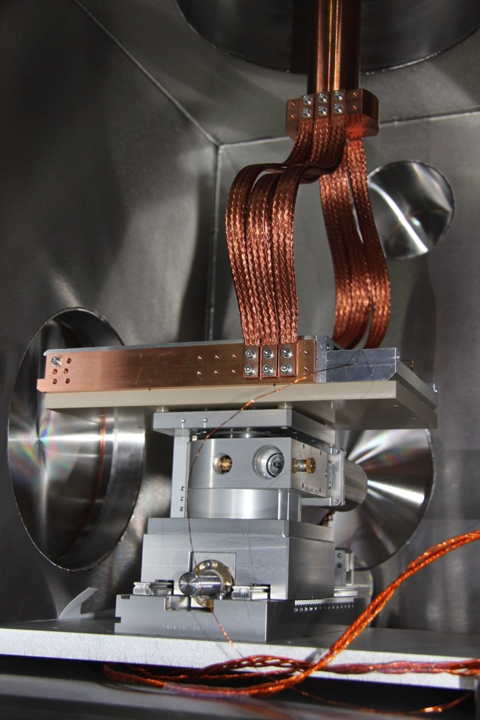
DSSC ladder vacuum test stand, FENICE
Chiller
FENICE installed, vacuum system working (best reached pressure ~ 5 x 10⁻⁷ mbar).
Cooling system ready to be switched on
First tests on PLC performed, stages move.
Cold head
prolongation
Inside FENICE:
Stages, insulating plate,
ladder mechanics (from FeC) copper braids to the chiller
Flange with electronic feedthrough assembled with FeC
FENICE
Copper braids
Ladder
Peek plate
Stages
Positioning plate

Slide 21
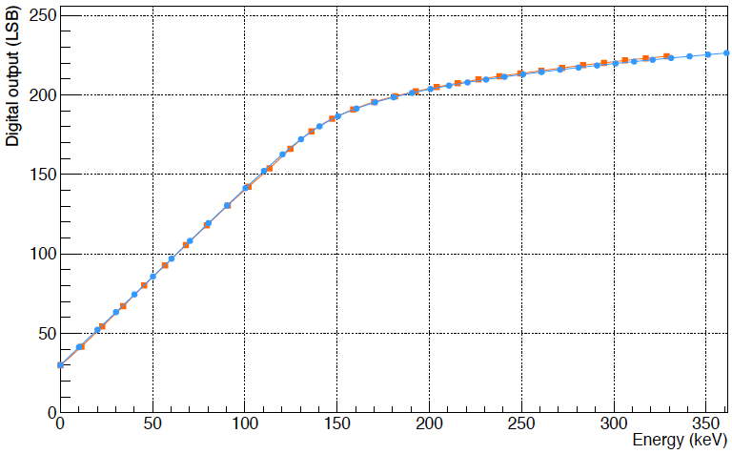
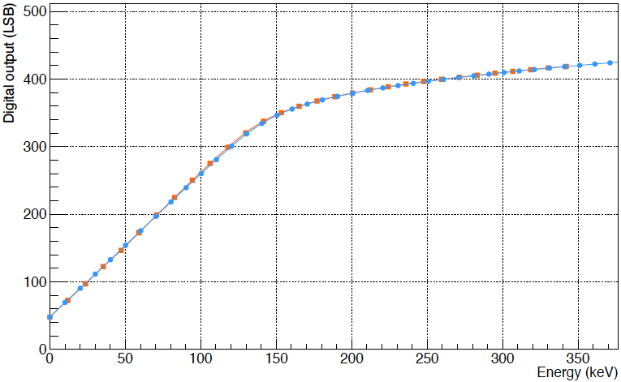
Experimental Calibration of Non-linear System Characteristic II
NLSC: non-linear relation between signal charge collected in
DEPFET pixel and corresponding digital output
Verification of DSSC prototype (8-bit read-out) NLSC:
comparison to independent SPIX NLSC (14-bit read-out)
Agreement within statistical and systematic uncertainties
1 keV/LSB
pxd-7
short gate
½ keV/LSB
¹⁰⁹Cd DSSC
⁵⁵Fe SPIX
¹⁰⁹Cd DSSC
⁵⁵Fe SPIX

Slide 22
Summary
SENSOR
MiniSDD sensors are available and will be used for ladder camera and 1 Mpixel camera
Pxd-8 DEPFETs will be used for the ladder camera.
A new DEPFET production in industrial scale CMOS fab has started
ASIC
F1 ASIC has been characterized in depth. Measurements with sensors was not yet possible
Optimization of the design of the front-end for MiniSDD is ongoing for the F2 ASIC
CAMERA HEAD
The flip-chip has started. 2 MiniSDD 64 x 64 sensors have been flipped to F1 ASICs
Deflections of the sub module have been measured and macro assembly concept is in preparation
The full electronics readout chain is complete and in operation
LADDER CAMERA
FENICE installed, vacuum system working (best reached pressure ~ 5 x 10-7 mbar).
Cooling system ready to be switched on
First tests on PLC performed
MECHANICS
Double-walled coolant pipe architecture is fully qualified
1:1 Mock-up used for verifications
DAQ
3 PPTs have been produced and the C&C signal quality at 100 MHz has been verified
10 Hz operation with C&C signals runs stable
The VETO and reordering mechanism has been successfully tested in hardware and simulation
CALIBRATION
Calibration for 1 keV/LSB and ½ keV/LSB with 55Fe. Calibration with DSSC 8-bit resolution has been compared with calibration obtained with the 14 bit SPIX setup
The path to scale the calibration procedure to 1 M pixels is under study.

Slide 23
BACKUP

Slide 24
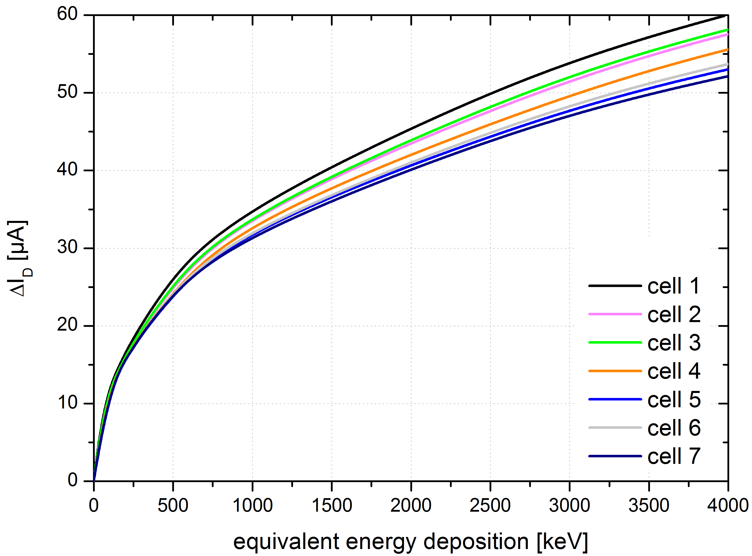
Non Linear DEPFET reminder
Measured output response
ENC=9 el. r.m.s.
f_{EQ}=3.3 MHz
(Porro et al., “Development of the DEPFET Sensor With Signal Compression … “, IEEE TNS, Oct. 2012)
⁵⁵Fe

Slide 25
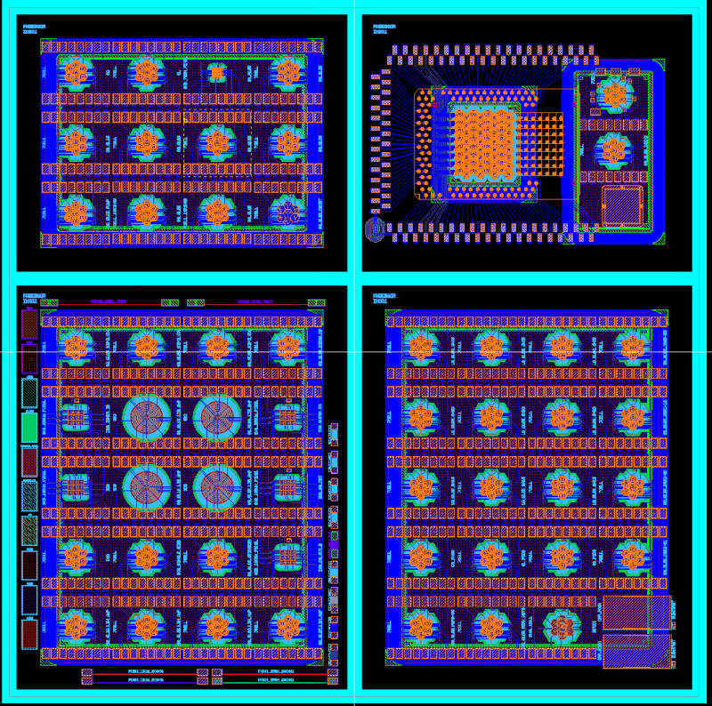
DEPFETs in Industrial-Scale CMOS Fab
New 8 inch wafers show a very high quality
Depletion voltage is below 400 V
Leakage current is typ. < 1 nA /cm² at full depletion (150 diodes measured)
Not a single voltage breakdown occurred on reverse biased diodes
Distribution of leakage current is homogeneous across the wafer
Double sided processing of DEPFET devices with very sensitive entrance windows is possible in the CMOS Fab
First DEPFETs will be available in April
7-cell clusters
Macropixels
3x3 matrix (smaller pixels)
8x8 matrix (UBM required)

Slide 26
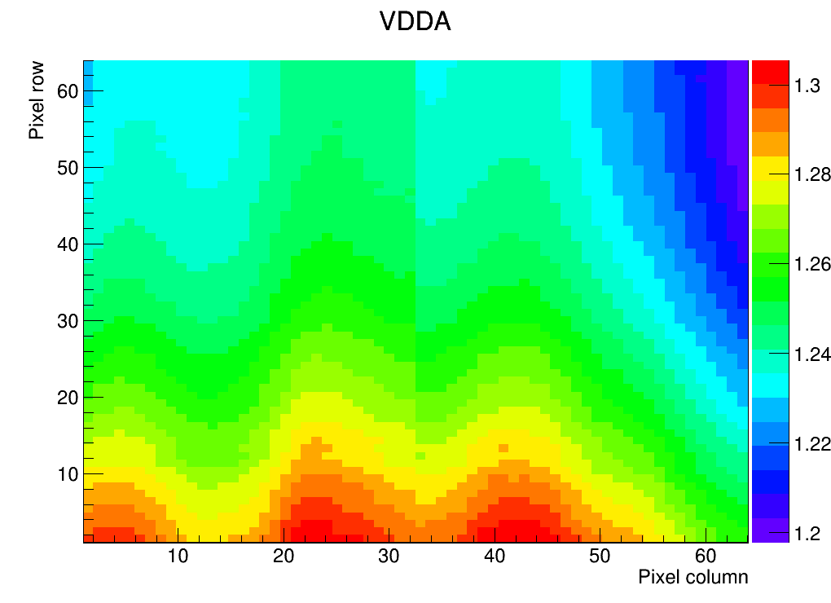
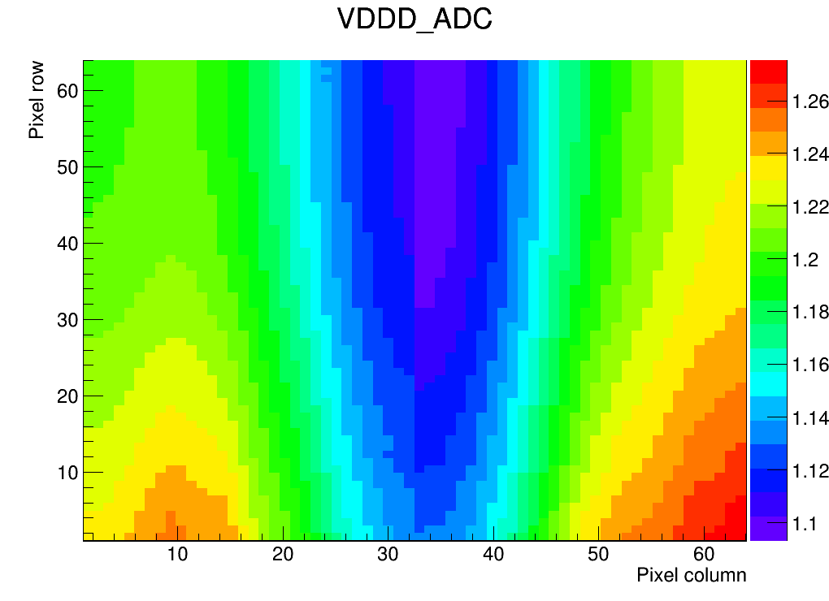
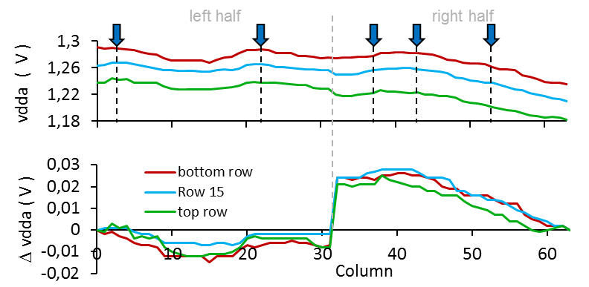
ASIC - Measured Voltage Drops
A nice monitoring feature allows for measuring of all voltages in each pixel:
Measurements by HD (left) and DESY (right) are consistent
Vertical drops are as expected
A large horizontal component is a bad surprise. Total drops are 110 / 180mV
Shape can be reproduced by careful (a posteriori) simulation of extracted power nets, taking into account bump positions
Optimal bump position should reduce the hor. drop from 50mV to ~20mV. We therefore foresee to change the pad assignment in F2

Slide 27
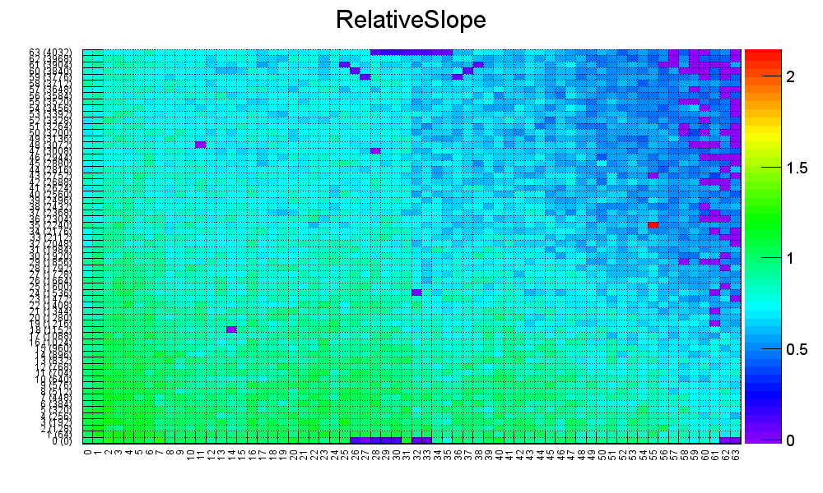
Operation of all D0 FEs (no Sensor)
Nearly all Day0-pixels can be operated in parallel. Gain map in all pixels:
Large dispersion in gains, but most pixels alive
Noise is high due to large cap of interposer, mainly (see later)
pixels connected on interposer
-> large cap
~80 bad pixels (2%)
Reference
slope = 1

Slide 28
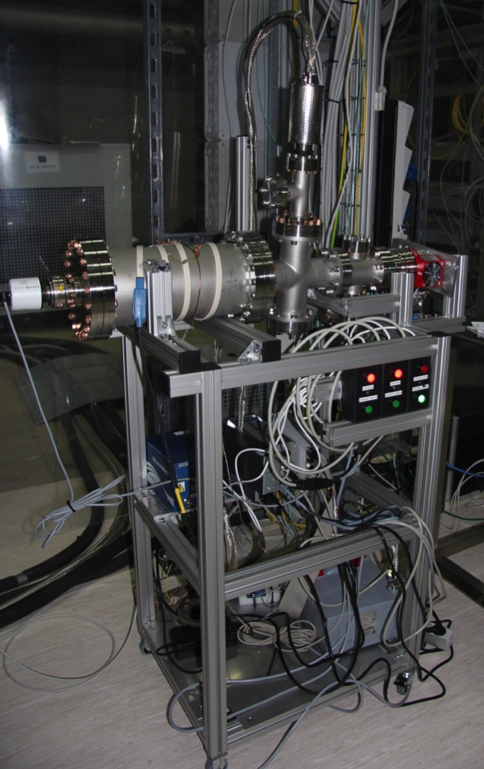
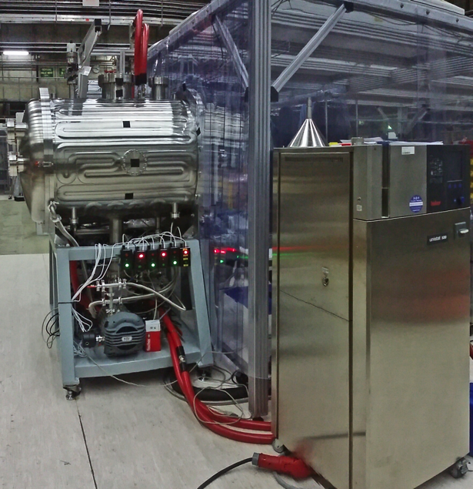
Vacuum qualification infrastructure
Vacuum qualification of the ladder components and of the full ladder performed
REHA vacuum and heating system working, PLC under test
BigPipe upgraded and routinely used for vacuum qualification tests
RGA
BigPipe
RHEA: Residual gas analysis and thermal qualification chamber

