Slide 1
Overview and Status of the AGIPD Project
December 2015- XDAC - Meeting

Slide 2
AGIPD ASIC
AGIPD 1.0
Pixel (×4096)
Readout chain
Preamplifier stage
CDS stage
Pixel buffer
Double column
buffer (×64)
Offchip drver
(×4)
Preamp RST
CDS RST
Storage
cell matrix
PXB RST
C_{f, high}
C_{f, CDS}
C_{f, PXB}
odd row
Mux
C_{f, mid}
C_{couple}
C_{f, low}
even row
Dynamic
gain
switching
DAC
V_{ref}
Storage
cell matrix
Cmd based IF, periphery, DACs
Analog RAM
352 images
Adaptive gain
C_{f}=60fF, 3pF, 10pF
Correlated double
sampling

Slide 3
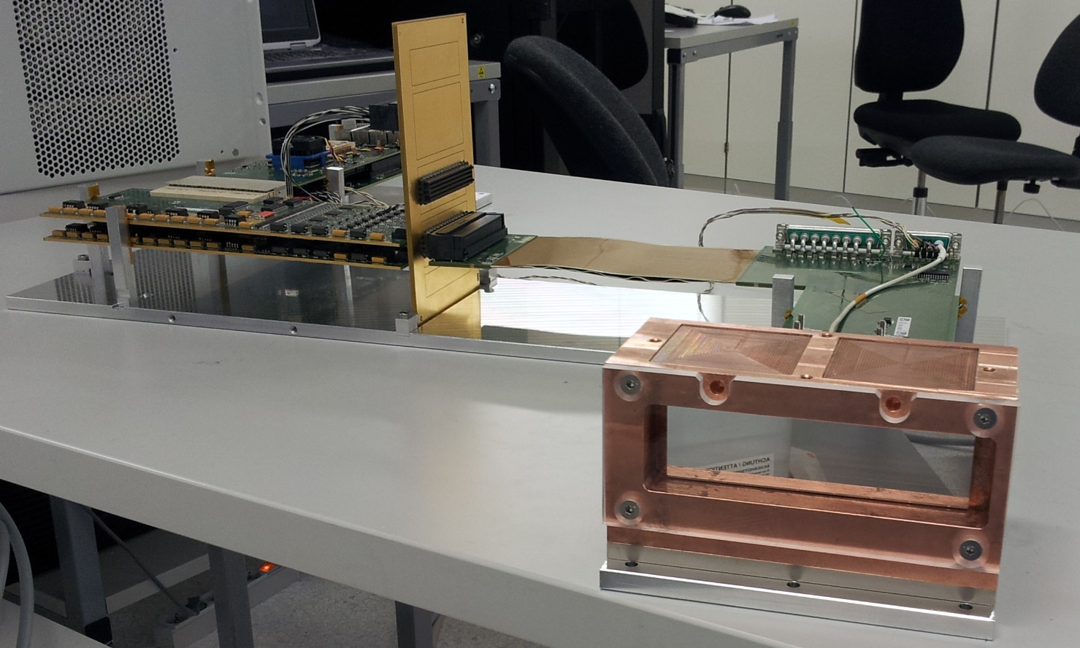
Module
2 x 8 chips = 128 x 512 pixels

Slide 4
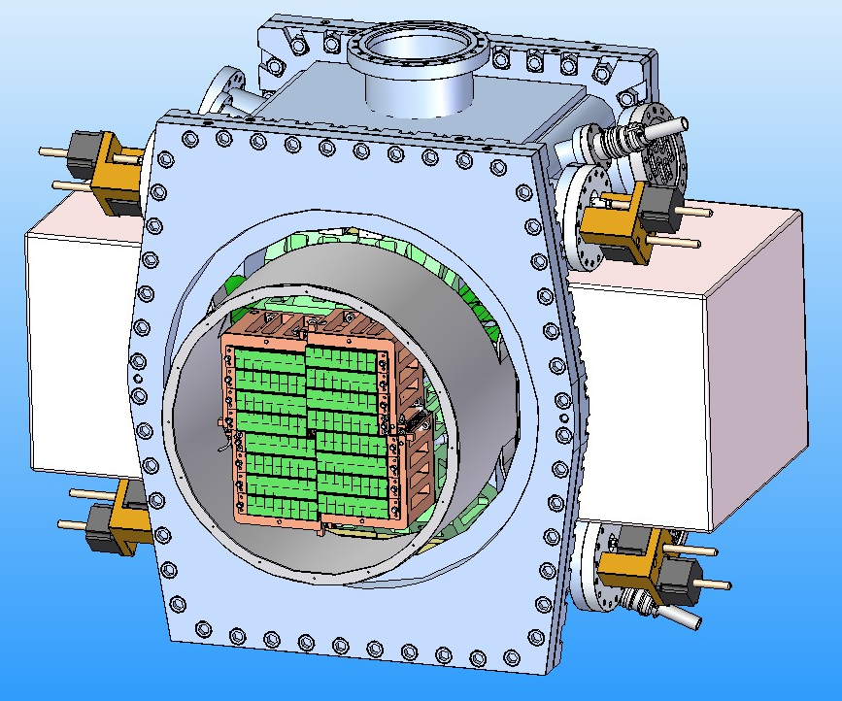
AGIPD 1Mpixel-system
Independently movable quadrants
Image plane out of vessel
Modules of 2x8 chips
Variable hole in
size & shape
External electronics

Slide 5
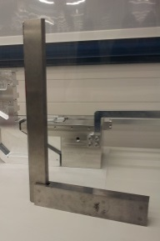
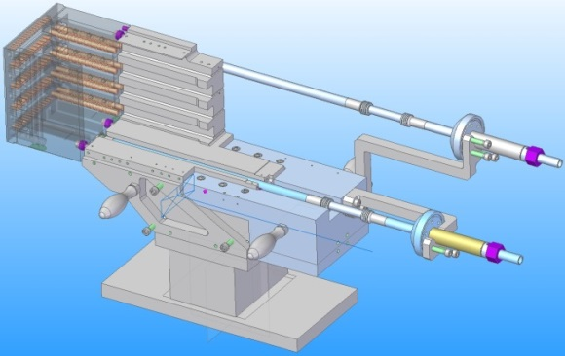
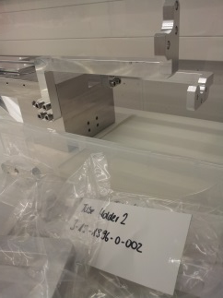
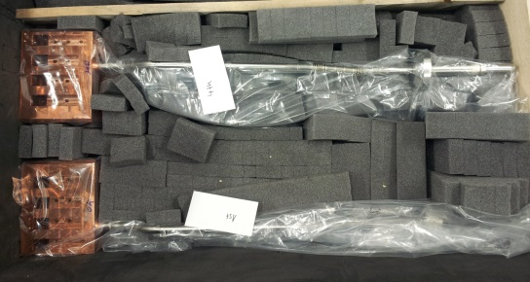
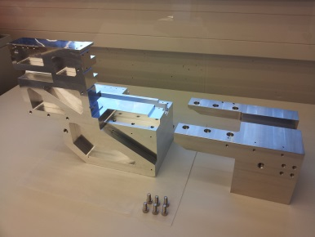
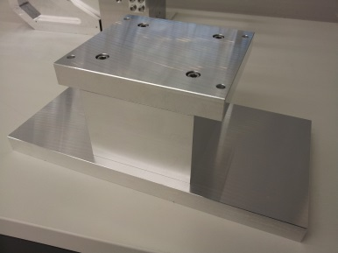
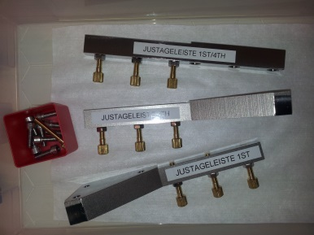
Mechanical System Assembly started
Cooling blocks, adapters, counter weights, mounting tables + tubes holders, parts for adjustment of cooling blocks
Cooling blocks: ready (2 pcs.)
Adapters: ready
Counter weights: ready
Mounting tables: ready
Tube Holders: ready
Parts for Adjustment: ready

Slide 6
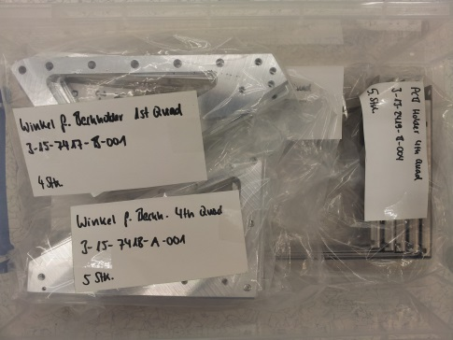
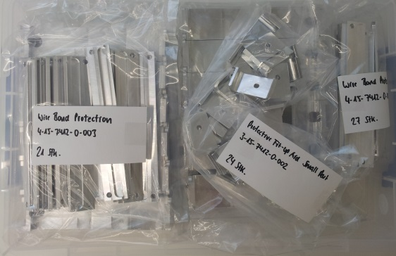
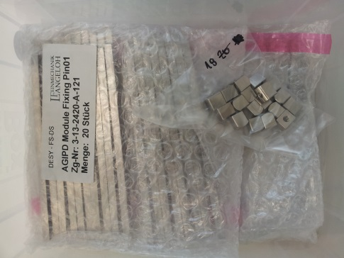
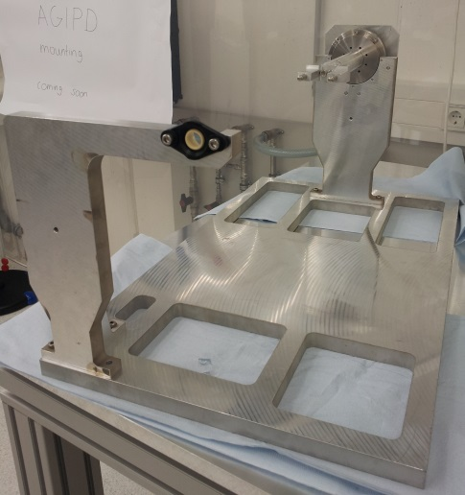
Mechanical System Assembly started
Holders and bits and pieces to
assemble the quadrants
→ ready
Device to turn assembled
quadrants
→ ready
6

Slide 7
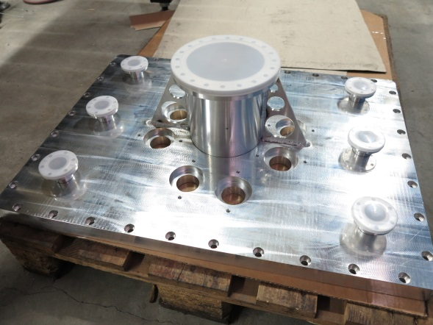
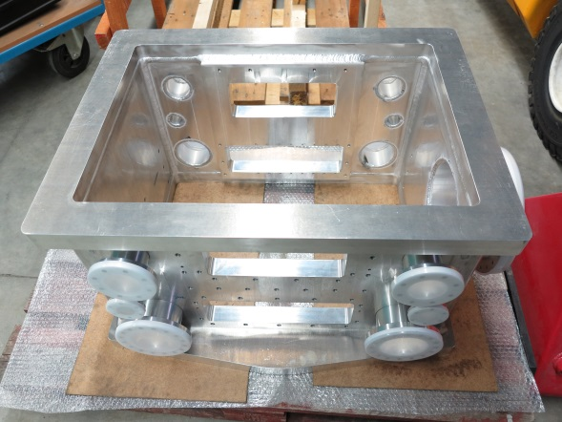
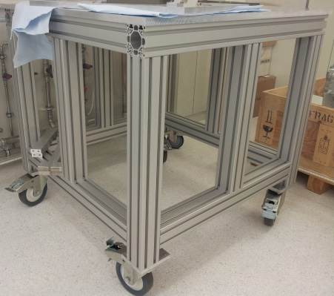
Vacuum chambers nearly finished
Vacuum chambers
→ delivery scheduled for week 50
Tables for vacuum chambers: ready

Slide 8
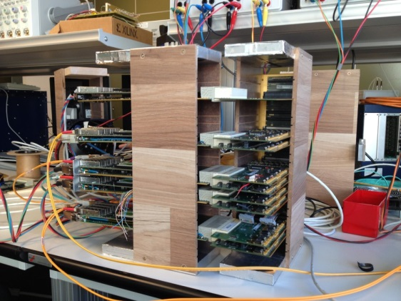
Firmware ready for multi-modules
Status
  Pixel descrambling in FW ✓
  Prototype: Ctrl FPGA←→ 4x Readout (Quadrant)
    All 4 simultaneously working modules behavior as expect ✓
    No ASICs Module attached yet: More tests!
  Real time parameters adjustment for different systems (network parameters, readout modes, delays, automatic ADC tuning, …) ✓
  Dedicated Readout configuration regardless number of used modules and type of Back-up system ✓
  Versatile communication protocol ✓( already implemented in TANGO server, moving to KARABO)
  10GE train data in XFEL Train builder format ✓
  10GE Train images can be sorted in increasing Pulse Id order✓

Slide 9
Calibration framework established
Detector instrument
1-Operation AGIPD module
Patterns
  Biasing to be optimized for -20C
  Data acquisition at 1G (Java) and data in binary files
  Data acquisition at 10G (TANGO) and data in HDF5 files
Raw measurements
2-Data processing
3-N-tuple
  5 groups of data
  Gain and gain bits for H/M/L evaluated according to the information from PC, CS, and X-ray.
  Evaluation of noise
  Quantification of droop
  Results in 3D matrix shape for each
    D1: Pixel X
    D2: Pixel Y
    D3: Cell
Data from PC
Data from CS
Gain from X-ray
Dark (noise)
Droop
Gains for H/M/L
Gain bits for H/M/L
Noise value
Droop effect
Event structure
Each module has 512 (pixel Y) x 128 (pixel X) x 352 (cells/pixel) = 23068672 memory units (=events).
  Define criterion of quality:
    Which magnitudes to evaluate?
    Which threshold?
Gains for H/M/L
Gain bits for H/M/L
Noise value
Droop effect
6-Exit loop
Pixel X
Pixel Y
Cell
  According to fraction of units recovered?
  Fixed #iterations?
  Fixed #good units?
4-Report
Pixel X
Pixel Y
Cell
Measurements
2D matrix (1 event per row).
  Include extra processed information: electronically dead? disconnected?
5-Reprocess data
  Define better approaches to the fittings
  Reinsert new data into old one

Slide 10
ASIC redesigned and “submitted”
AGIPD1.0 is already useable for first experiments
All non-perfect issues observed in AGIPD 1.0 understood and remediated in AGIPD 1.1
AGIPD 1.1 uploaded to MOSIS end of November; usual discussions ongoing
If all goes well AGIPD 1.1 back in April 2016

Slide 11
Status summary
Mechanical integration ongoing
First version Firmware for multi-modules working
Calibration framework established and most routines coded (remaining work not to be underestimated)
ASIC redesign finished and uploaded to MOSIS

Slide 12
Planning
Assembly of mechanics (1st part) finished January; 2nd part April 2016
Electronics and operational testing multi-module system finished early 2016
Calibration framework finished early 2016
Assembly and testing entire system finished June 2016
Delivery to XFEL summer 2016
Replacement of AGIPD1.0 with AGIPD 1.1 possible before first beam

