Slide 1
TCT measurements with CHESS-1 chip

Slide 2
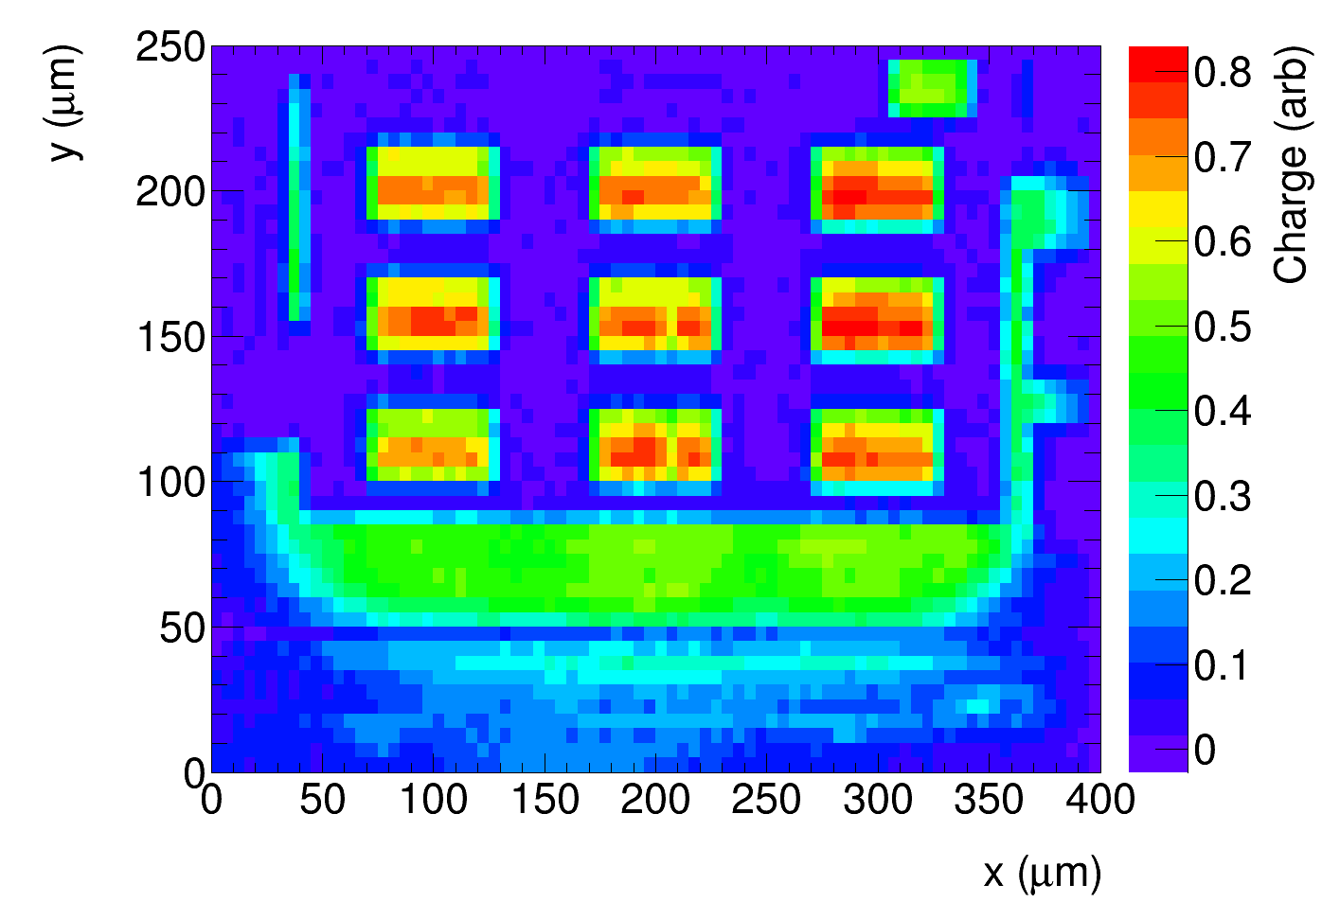
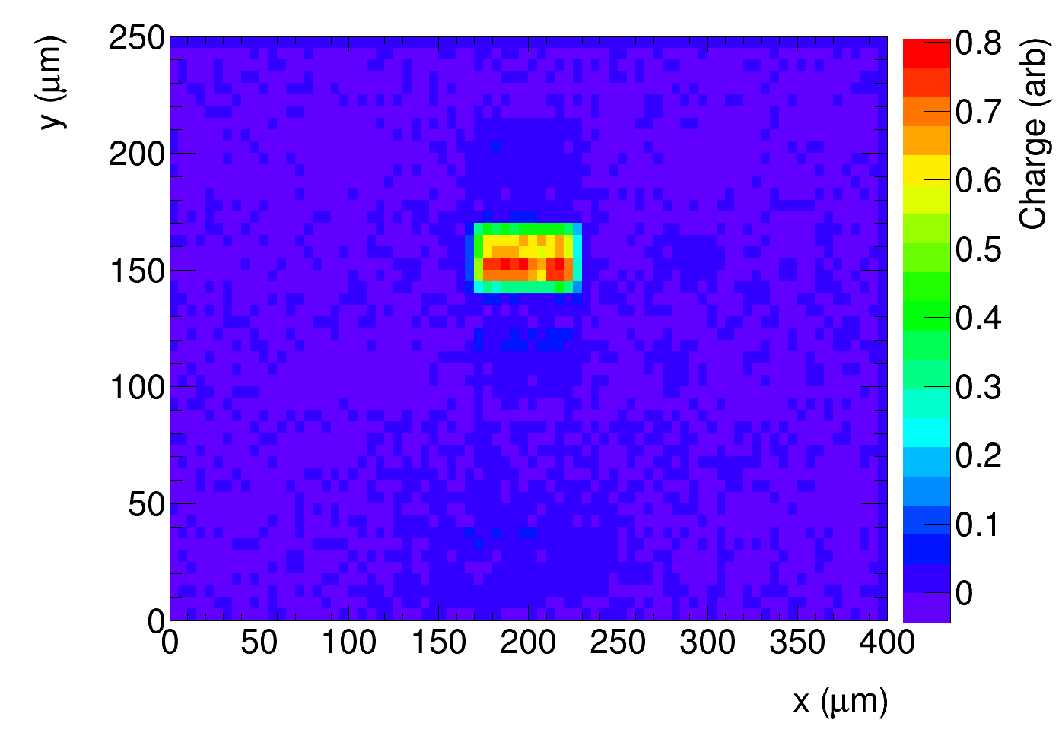
Reminder: Top TCT on PPA9
(from 1st of September)
only n-well can be seen, other
are covered by metal
Beam direction
Substrate
45 um
Periphery
Signal
100 um
Periphery + signal to HV and readout
Only signal to readout:
(all pixels to HV):
45 μm
100 μm
no cross talk, no charge
from the low edge

Slide 3
Top -TCT with passive pixel array PPA10 on Chess 1
➔ no contact rings around pixels => not covered with metal
measured with chip irradiated to 2e15 with neutrons
PPA10
Chess1
periphery
substrate
signal

Slide 4
Pixel length
NWELL length
Pixel width
NWELL width
A
B
nwell dimension ~ 51 um x 19 um
structure PPA10 has A = B = 0 (no substrate contact between n-wells).
substrate contact on the edge of the structure.

Slide 5
connections
narrow (FWHM ~ 7 μm) laser beam
➔ measure with IR ( 1 mm absorption length) and red light (3 μm absorption length)
perimeter to HV
(and readout)
Laser beam
HV
scope
GND
substrate
to ground
signal to HV and readout via Bias-T
in all plots bias voltage was 120 V

Slide 6
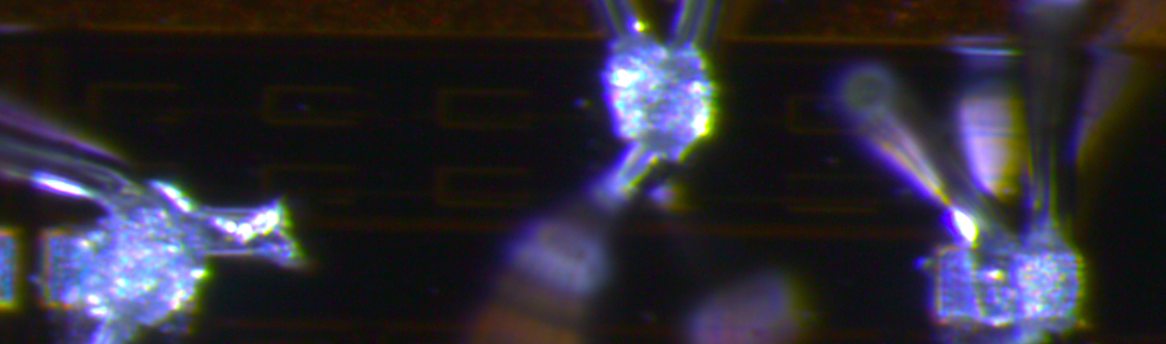
Red light (λ = 640 nm),3 μm absorption length
all pixels connected to readout
Photo of the structure
Bond-wires
n-well: absorption in the well (less light into E field under the junction)
Charge
structure
border
not processed
area
Bond pads and shade of bond wires

Slide 7
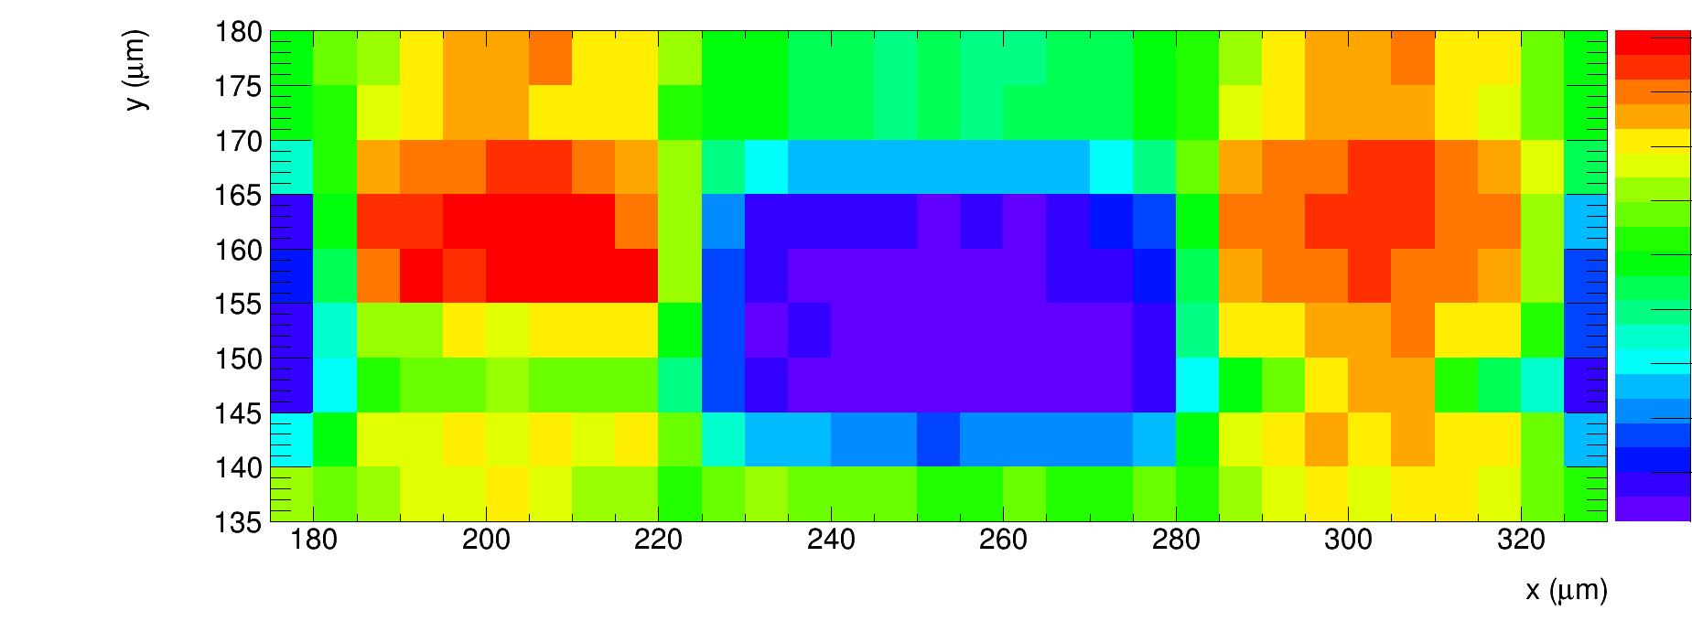
Red light (λ = 640 nm),3 μm absorption length
all pixels connected to readout,
Zoom on one pixel:
Pixel length 100 μm
20 μm
50 μm
(n-well)

Slide 8
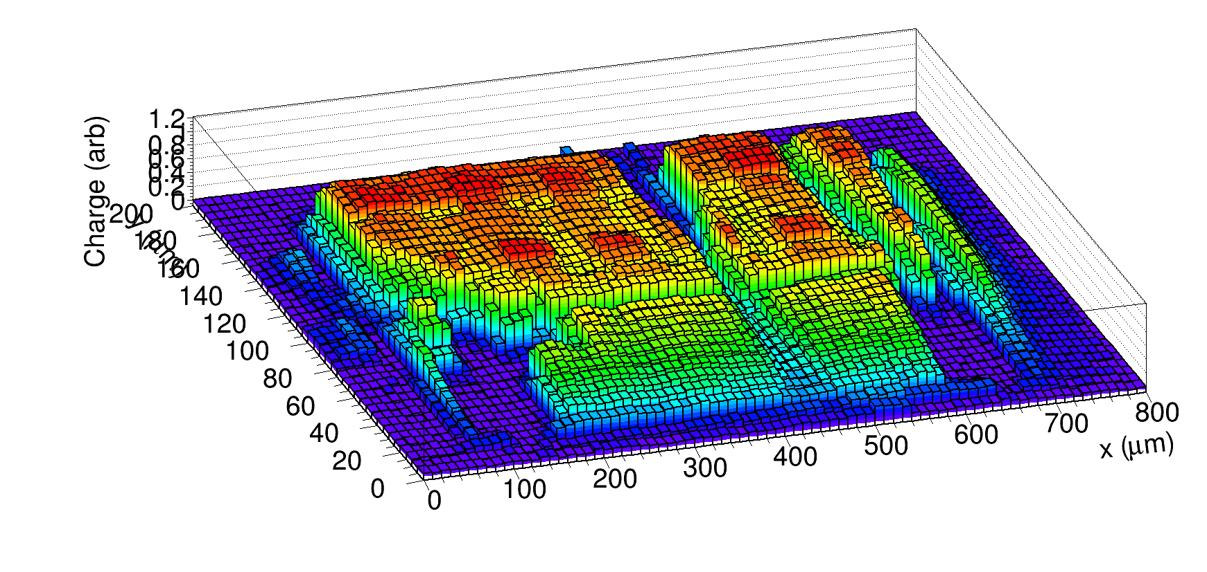
IR light – 1 mm absorption length, simulates MIP
all pixels read out
➔ no large variations of collected charge across the surface

Slide 9
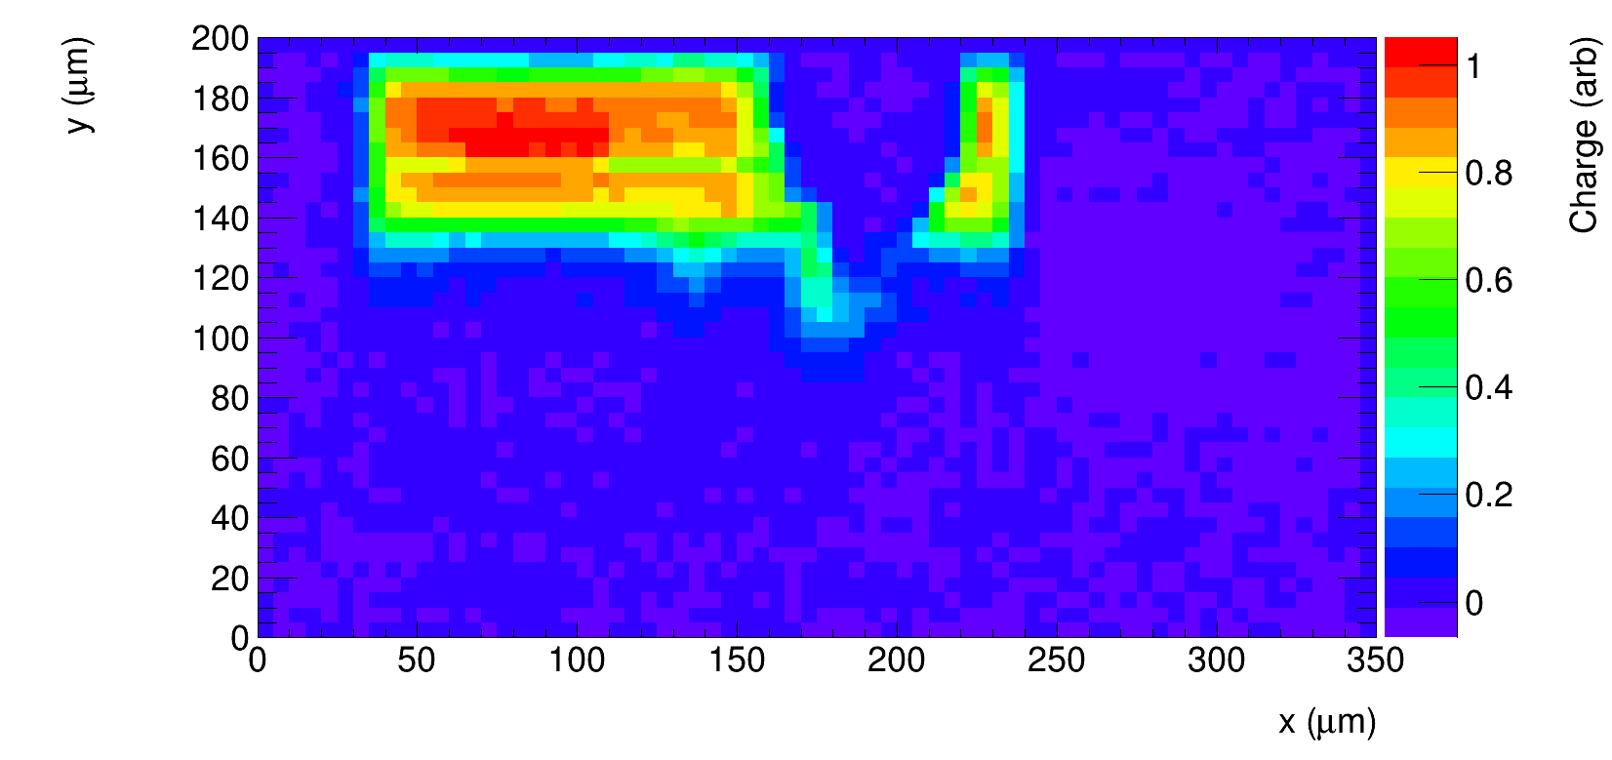
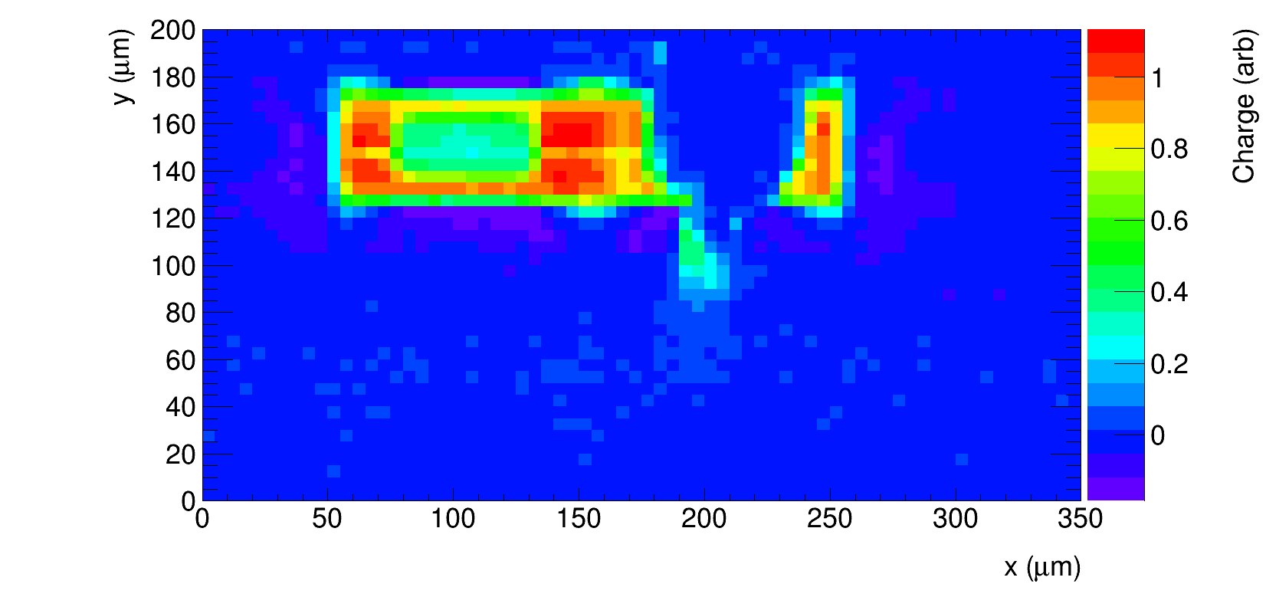
only signal pixel read out
→ in this structure 2 n-wells from 1 pixel
200 μm (two n-wells )
Red laser
IR laser
red laser
charge only from signal pixel
➔ no cross talk
reflection from bond wire

Slide 10
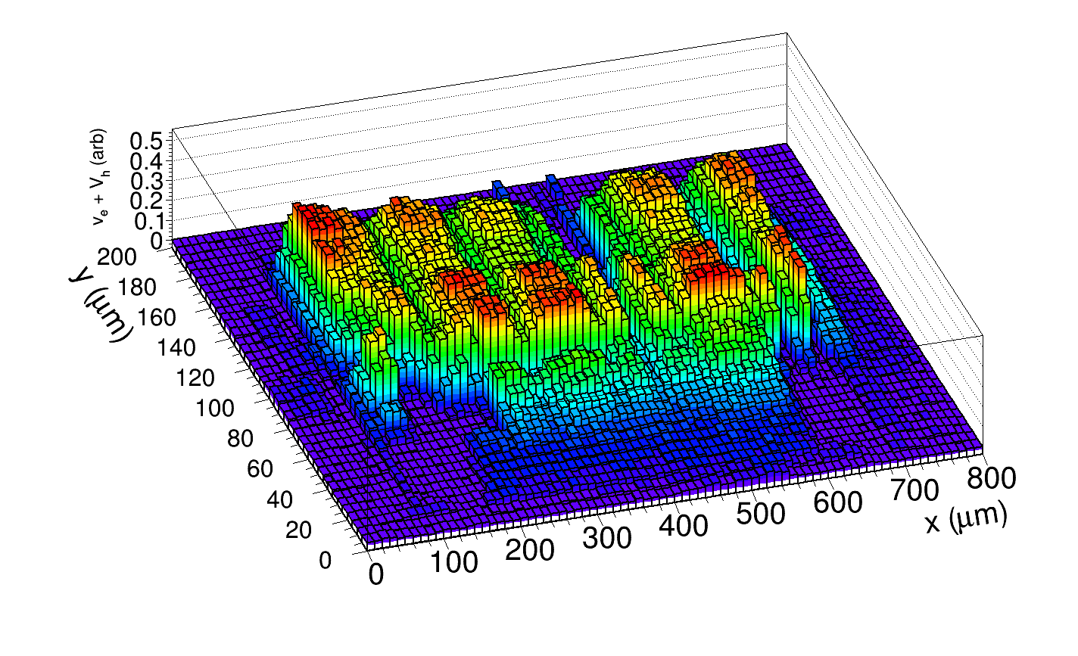
IR lase, velocity (tells something about average electric field)
indicates bands of lower field between pixels
➔ gaps only in y direction → maybe becasue of larger distance between n-wells
in this direction?

Slide 11
Summary
TCT measurement with narrow laser beam directed to the top of PPA10 structure
(irradiated with 2e15 neutrons, bias 120 V)
structure PPA10 not covered by metal
can clearly see n-wells
no large variation of charge collection across the surface with IR light
lower field regions between n-wells
would be interesting to measure this before irradiation

