Slide 1
Status of test kit 27 October 2015
J. J. John
with help from many colleagues

Slide 2
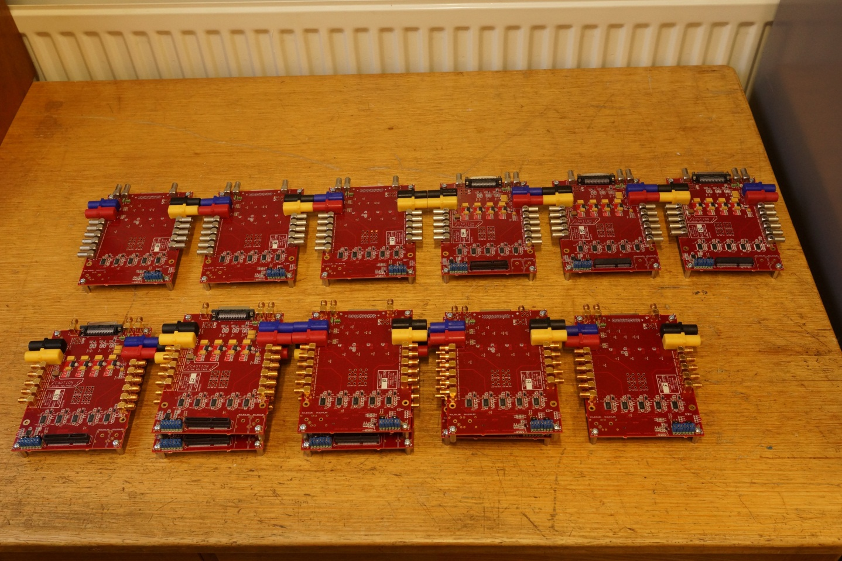
CHESS-1 motherboard – build status
Assembled as planned:
 | Parallel | Perpendicular | Parallel | Perpendicular | Spares to be completed as needed
 | Lemo | Lemo | SMA | SMA |  | Total
Totals before spares | 4 | 2 | 6 | 4 | 0 | 16
Spares | 2 | 1 | 2 | 2 | 9 | 16
Totals incl. spares | 6 | 3 | 8 | 6 | 9 | 32

Slide 3
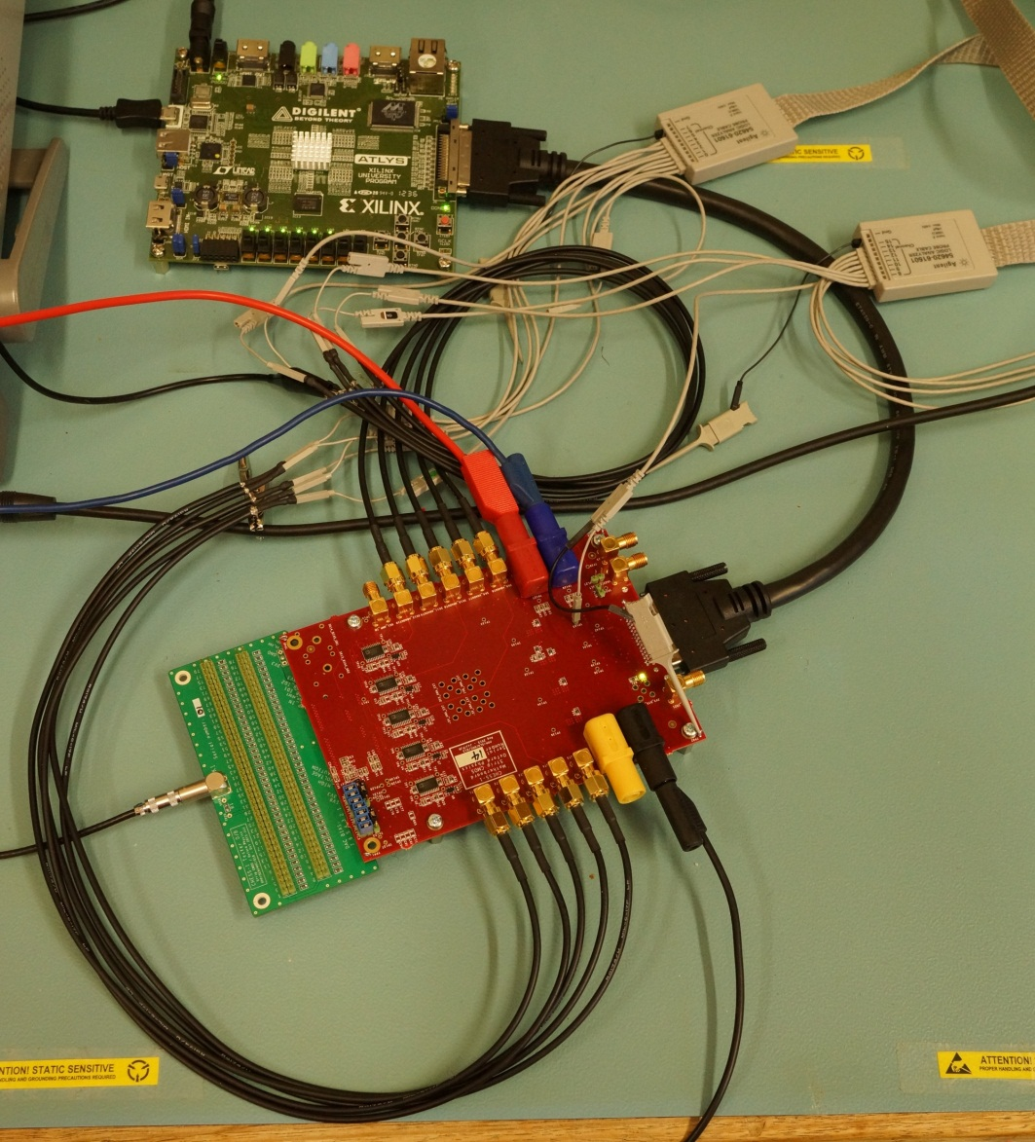
CHESS-1 motherboard – testing status
Firmware and software are functional and complete for control of the boards (signal switches and bias DAC). Thank you to Luigi and Matt.
Currently testing each motherboard.
Mid-way through – testing switches now.
Test procedure:
Test regulators (6)
Test DACs (7 channels)
all off, 3.3V, 3V, 0.5V, plus individual settings.
Test switches (79 channels)
no channels shorted
test each channel with a test signal, 10 outputs in parallel
Will complete and ship this week – will need help from RAL (Jens!)
3

Slide 4
Status of other hardware
AMS-CHESS-1 Daughterboard
Towards irradiation campaign at Proton Synchrotron (PS) at CERN, have bonded:
5 AMS-CHESS-1 daughterboards with cut-out for edge TCT
4 standard AMS-CHESS-1 daughterboards
Tester Daughterboards
Received back and used to test switches of CHESS-1 motherboards.
I will include one per institute in the motherboard shipment, to help get started with the motherboards.
TJ-CHESS-1 Daughterboards
Need to prepare bonding diagram for PonP daughterboards next

