Slide 1
the built-in amplifier performance in HV-CMOS CHESS1
Vitaliy Fadeyev, Zach Galloway , Herve Grabas
Alexander Grillo , Zhijun Liang , Abe Seiden
Jennifer Volk, Forest Martinez-Mckinney
University of California, Santa Cruz

Slide 2
CHESS1 bonded for testing
CHESS1 chip Mount on daughter board
Thanks to Jaya John and Oxford group to design daughter board for CHESS1 chip

Slide 3
CHESS1 amplifier
A low noise built-in amplifier into the CHESS1 chip to improve the signal to noise ratio.
Bias | Description | Config (V)
VNBias | Bias for the NWELL | 0.4
Casc | Cascode voltage | 2.6
VPLoad | Pmos Load voltage | 2.1
iN | Amplifier bias current | 1.0
iNSF | Source Follower Bias | 0.49
iFB | Feedback current | 2.664
IFB
3.3
3.3
Out
Load
Casc
InSF
In

Slide 4
Isolated amplifier test Setup
built-in amplifier
9ns falltime
Pulser
CHESS1
Scope
Buffer

Slide 5
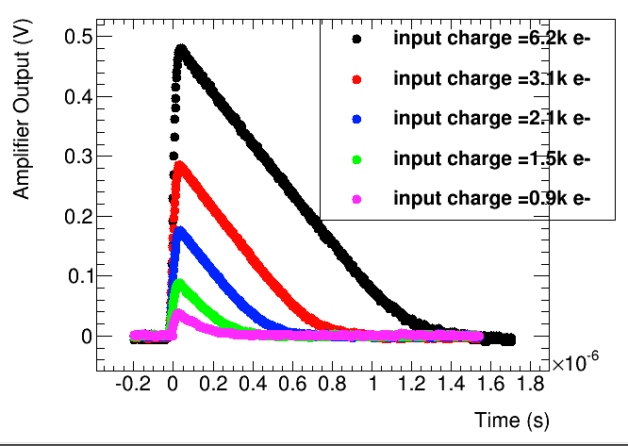
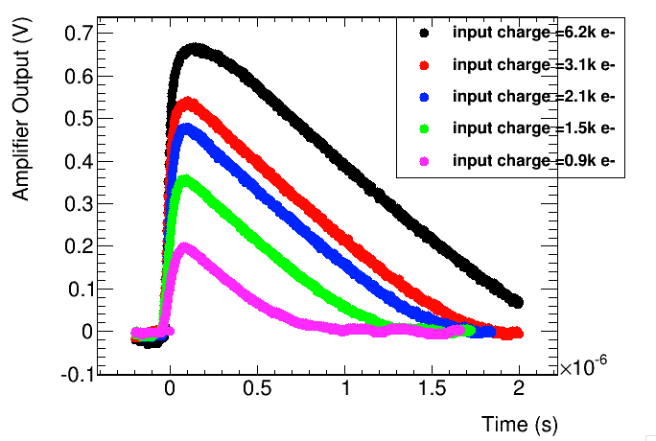
Pulse shape
Before irradiation
After 3Mrad gamma irradiation

Slide 6
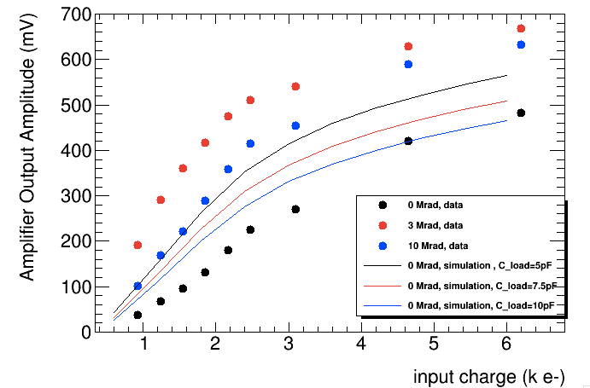
Response curve
df

Slide 7
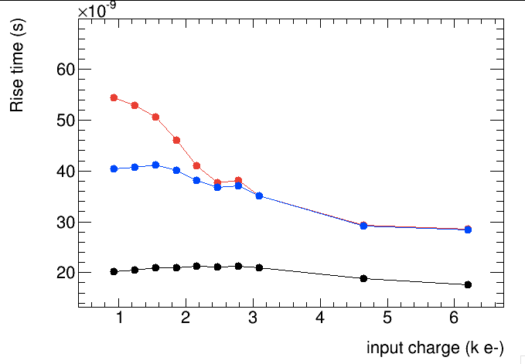
Rise time
df

Slide 8
Summary
The gain increased after radiation
Rise time and deadtime(pulse width) increased after radiation

