Slide 1
Status of test kit 10 November 2015
J. J. John
with help from many colleagues

Slide 2
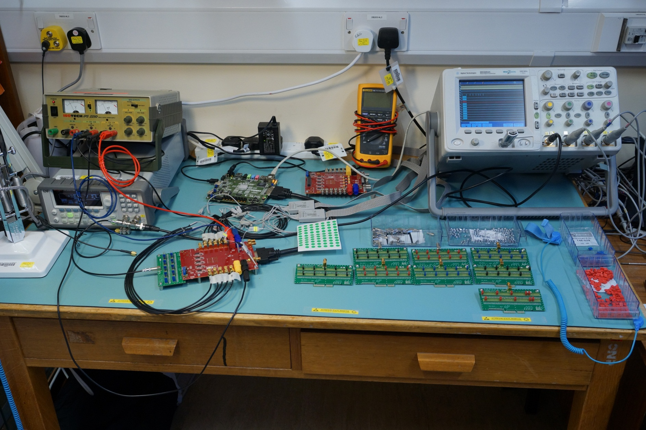
CHESS-1 motherboard – status
Completed testing of motherboards for institutions:

Slide 3
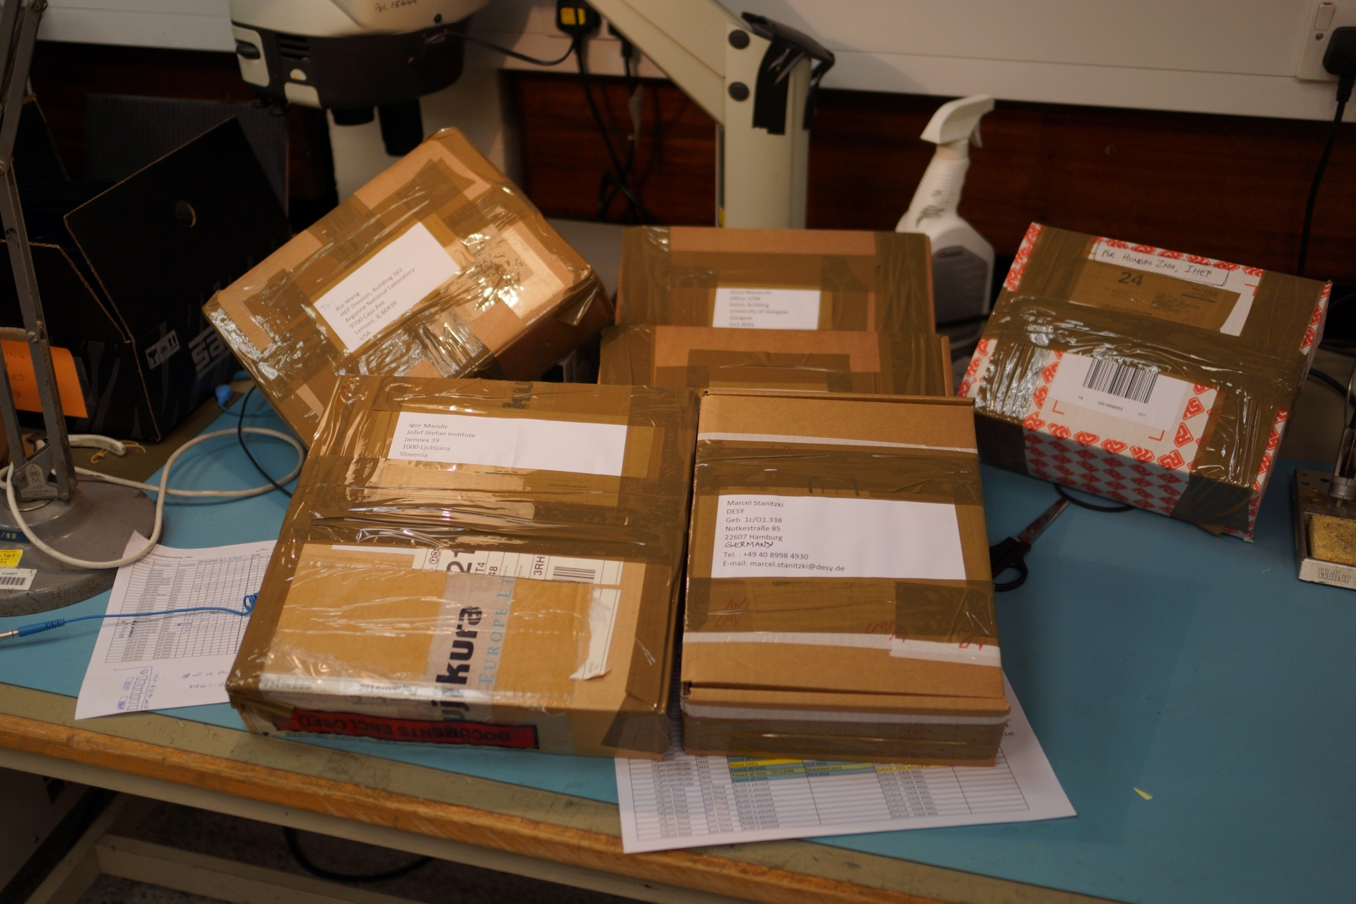
CHESS-1 motherboard – status
Shipped today – thanks to Jens for shipping from RAL:

Slide 4
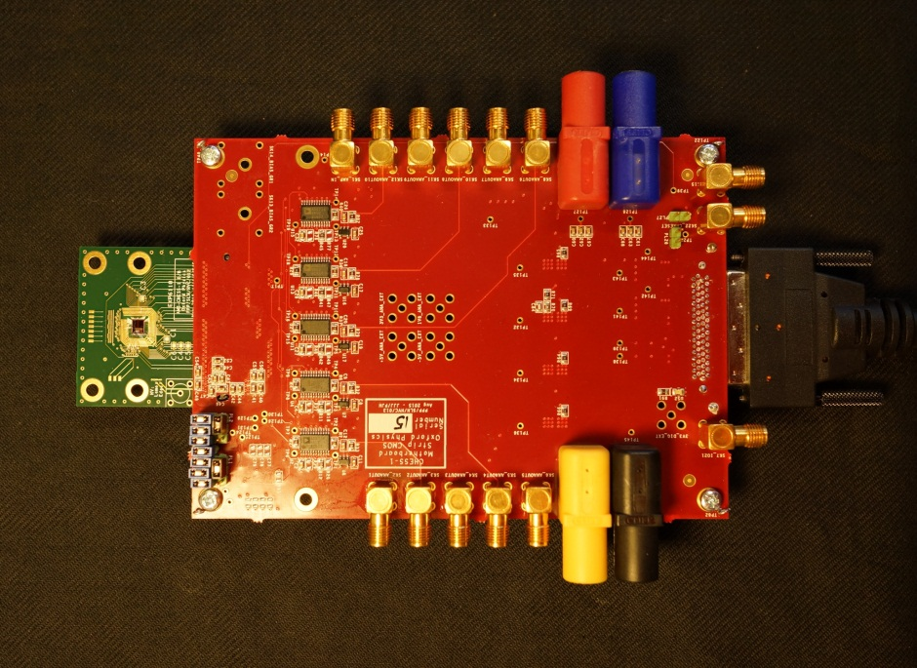
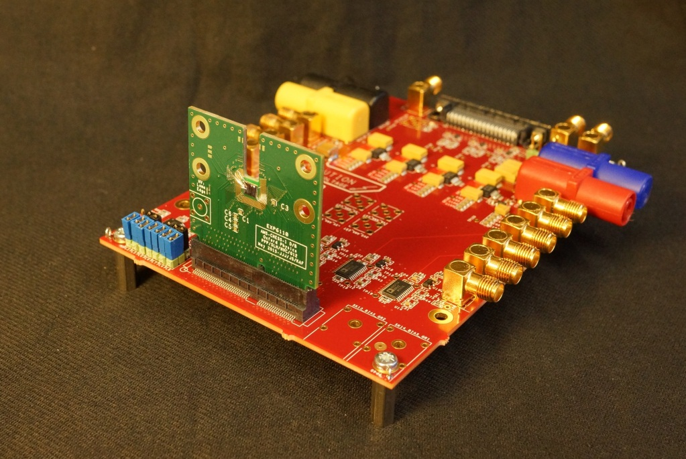
CHESS-1 motherboard – in use
CHESS-1 Motherboard
Parallel orientation
CHESS-1 Motherboard
Perpendicular orientation
mainly for edge TCT testing

Slide 5
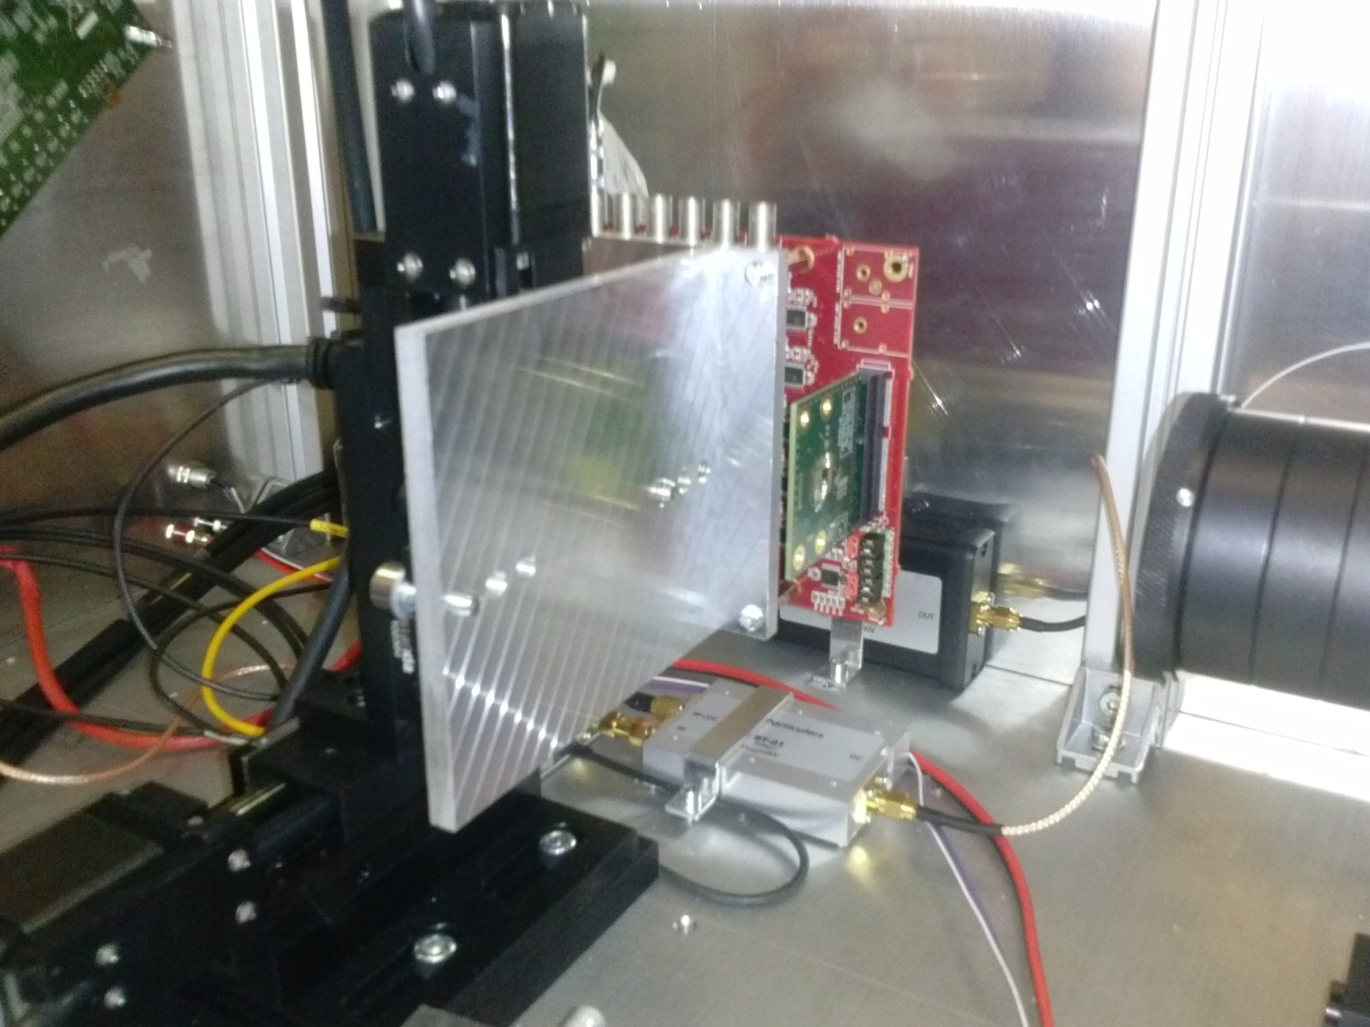
CHESS-1 motherboard – in use
Motherboard shown mounted to laser system

Slide 6
Towards CHESS-2 DAQ system
Initial discussion about the hardware for CHESS-2 held on 30 October
Materials here: https://indico.desy.de/conferenceDisplay.py?confId=13460

