Slide 1
CHESS2 update
Dec 8, 2015

Slide 2
Update list
Update on the complete simulations – Pixel side, follow up from previous presentation.
Update on the bias blocks used for all biases.
Conclusion.

Slide 3
CHESS2 pixels
Injection
IFB
RowENB
RAMWrEn
3.3
ColENB
1.8
Load
Th
1/2
Casc
1/2/4/8
InSF
Comp
In
Baseline

Slide 4
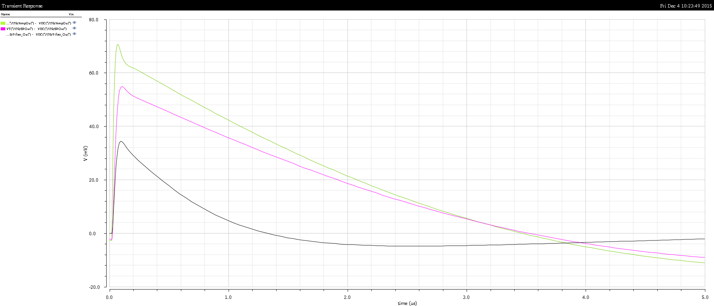
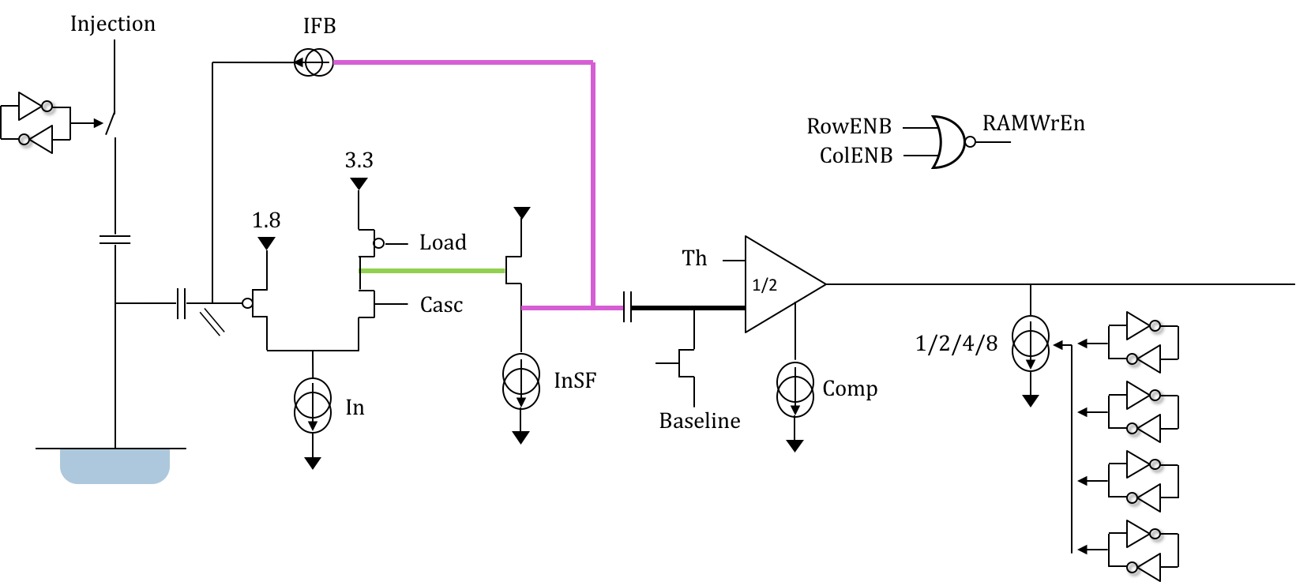
Amplifier response at 700e
Signal to noise: 8.3
Risetime: 42.3ns

Slide 5
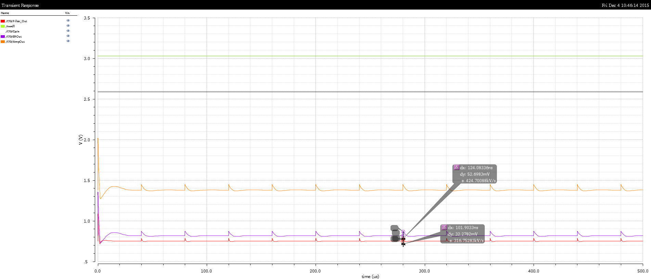
Response for repetitive inpulses

Slide 6
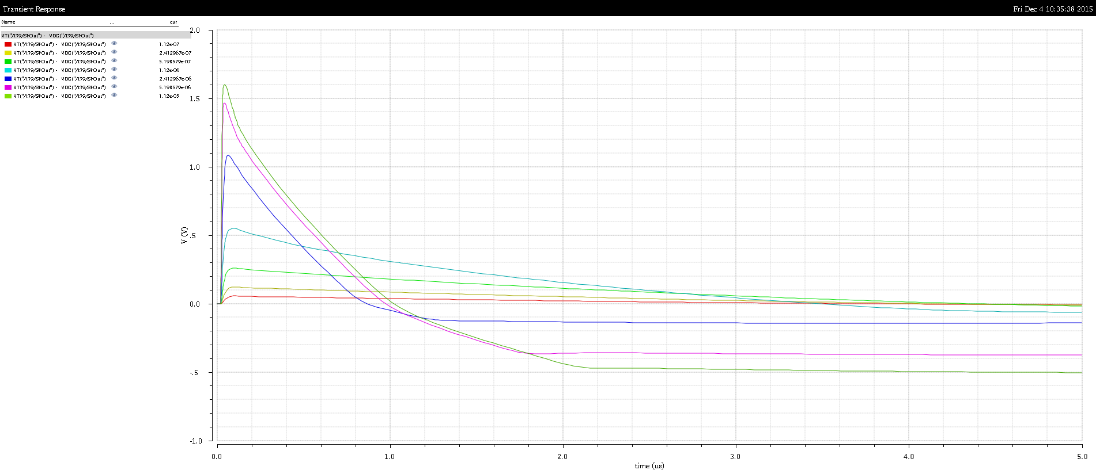
Response from 700 to 70 000e [AC only]

Slide 7
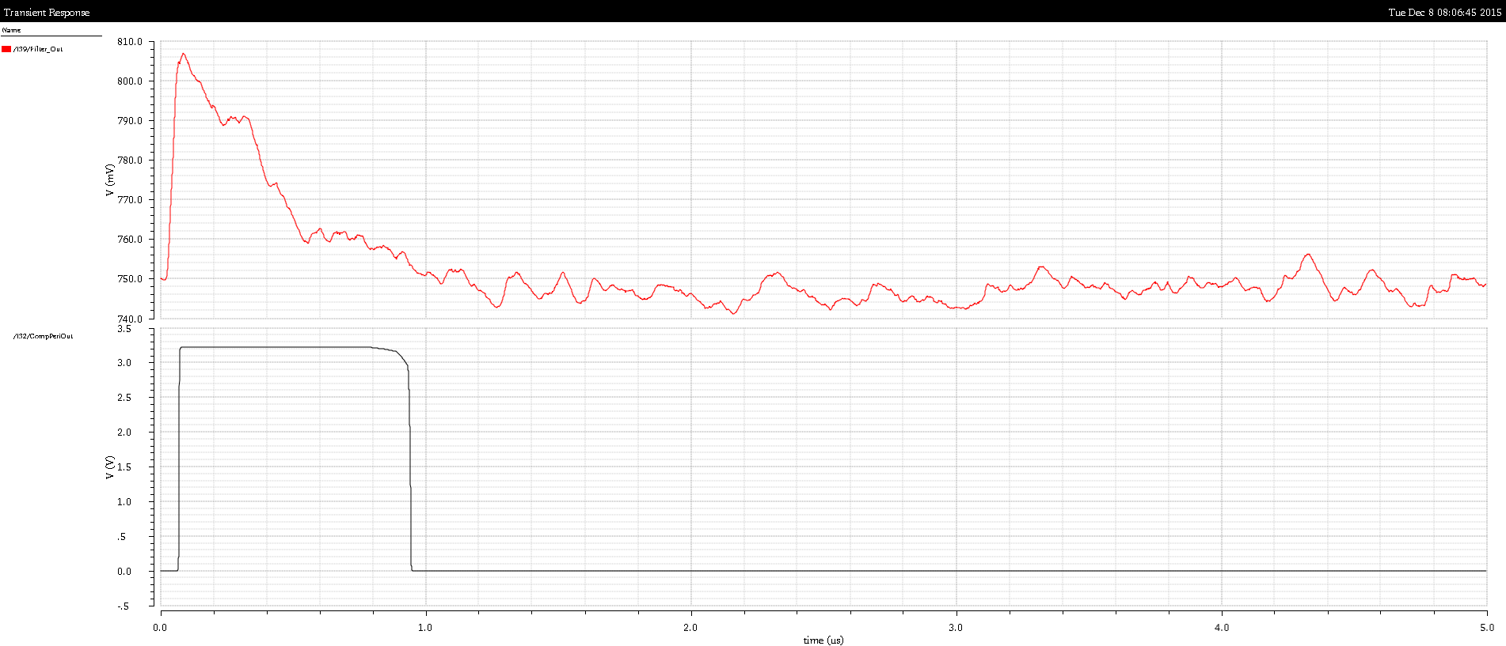
Typical signals with simulated noise

Slide 8
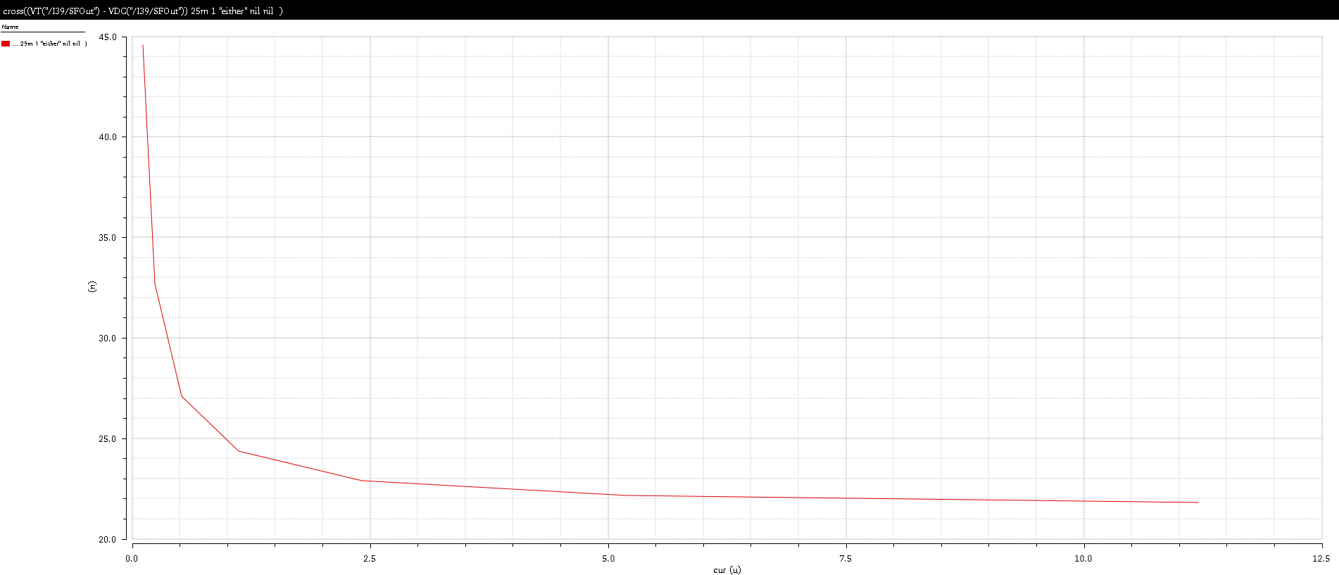
Crossing time Th = ½ Max
At the output of the amplifier

Slide 9
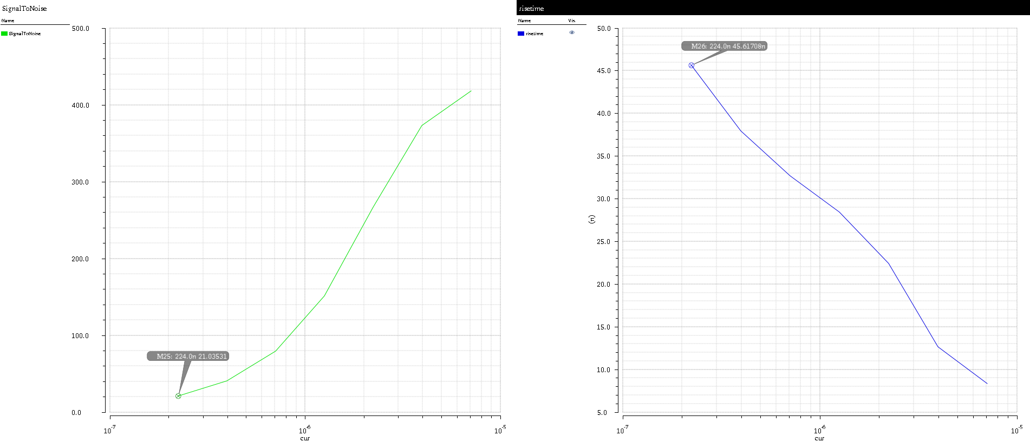
SNR and Risetime from 1400e to 70000e
Risetime = 45ns for 1400e
SNR = 21 for 1400e

Slide 10
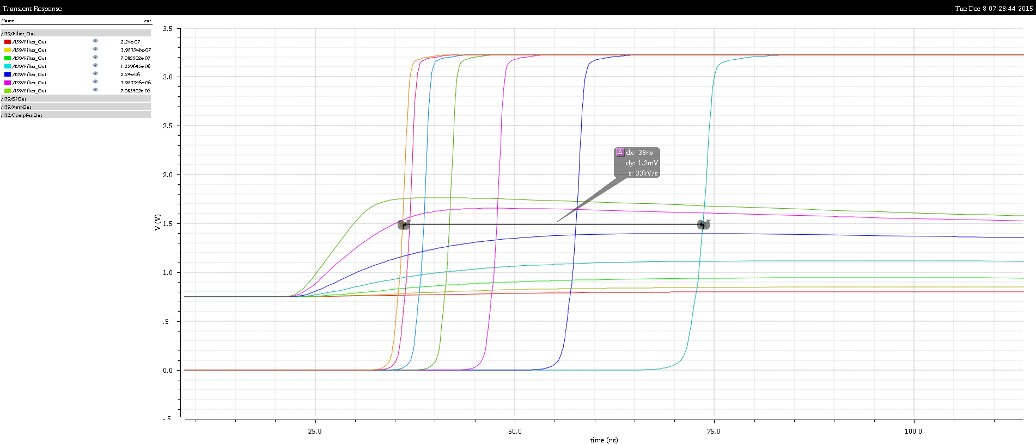
Comparator Output
Delta = 38ns
Bias current of the comparator
need to be increased slightly.

Slide 11
Bias block
- Bias source from library is not radiation hard and not isolated from HV.
- New bias source designed:
  Self-starting (on power-up)
  Supply independent
  Temperature compensated
  Low noise 1.7nA for a 6.5uA current source (10pF filter)
  Low number of transistors (easy layout)

Slide 12
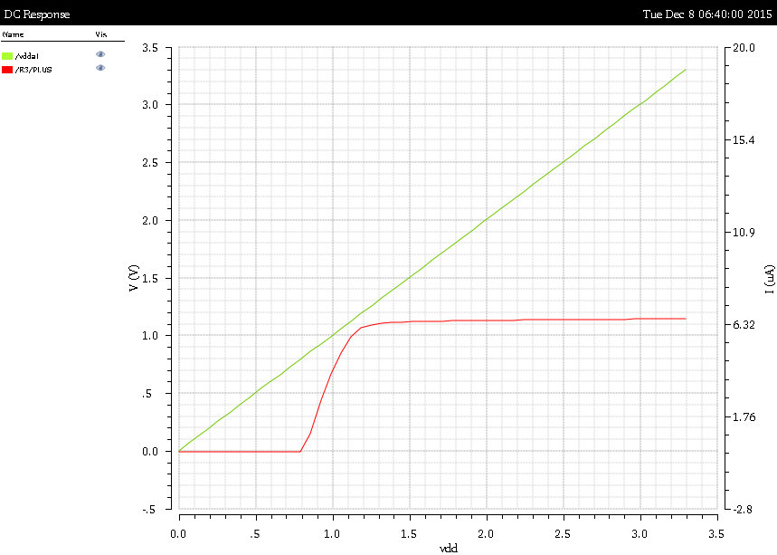
Simulation – Supply independence
Power supply ramped from 0 to 3.3V
Current output

Slide 13
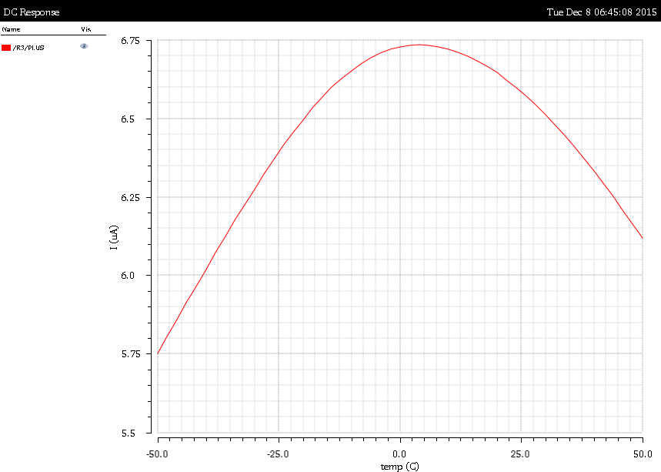
Temperature independence
Current variation from -50C to 50C

Slide 14
Conclusion
The signal to noise ratio issue found previously has been fixed
  Better bias conditions on the filters and of the amplifier.
  Signal to noise ratio considering the peak of Landau is OK.
The time-walk is still too large
  Adjustments to be made increasing the power consumption on the comparator (programmable)
Bias block meets specifications, layout in progress.
Nothing to report from SLAC today.

