Slide 1
ATLAS CMOS Strip
Regular Meeting
08/12/15
HR-CHESS2-TJ Update
D. Das, STFC-RAL, UK
08/12/15
Notes:
1

Slide 2
HR-CHESS2-TJ Chip Block Diagram
Updated
Main Functional Blocks:
Fast Pre-Amplifier <10ns peaking time
Comparator with threshold trim
HIT Encoding
Strip Encoding
Data Output
Calibration
PLL
LVDS TX/RX
Bias*
Timing generation*
CONFIG & DEBUG Register*
1 Strip dedicated for testing*
*Added & simulated recently
Notes:
2

Slide 3
DEBUG register to
test digital back-end
Notes:
3

Slide 4
CONFIG register for
calibration and masking
Notes:
4

Slide 5
Test/debug channel
From STRIP1
Notes:
5

Slide 6
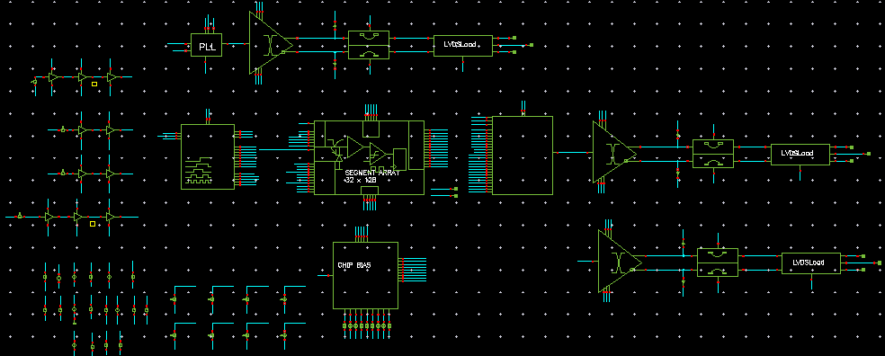
Top-level Simulation
Test bench
Full-chip simulation; added PLL, timing generation block, BIAS block, and LVDS stages
to the existing top-level simulation
LVDS
PLL CLK OUT
Timing
STRIP
Encoding
+
Data Output
LVDS
Data
LVDS
SYNC
NOT simulated in this top-level test bench:
Configuration and Debug registers
Test debug column circuitry
Notes:
6

Slide 7
Top-level simulation setup
We simulate 7 Strips being hit in 2 adjacent bunch crossings
3 hits in BX1 and 4 hits in BX2
For each strip that was hit the last Segment/Pixel was hit
7-bit Strip address is binary coded
Goal is to detect and read out these hits for each BX and output their address inside 2 BX periods or 50 ns
Clock period used in simulation is 320 MHz
The Hit addresses corresponding to each bunch crossing are then stored and readout through LVDS stages every 25 ns.
Table below shows the Hit locations and corresponding 7-bit Strip address (binary coded).
Valid Addresses
Segment: 0 to 31
Strip: 1 to 127
Hits | Data 6 | Data 5 | Data 4 | Data 3 | Data 2 | Data 1 | Data 0 | Strips | BX
1 | 0 | 0 | 0 | 0 | 1 | 0 | 0 | 4 | 1
2 | 0 | 0 | 0 | 1 | 0 | 0 | 1 | 9 | 1
3 | 0 | 1 | 0 | 0 | 0 | 1 | 0 | 34 | 1
4 | 0 | 1 | 1 | 0 | 1 | 1 | 1 | 55 | 2
5 | 1 | 0 | 0 | 0 | 1 | 1 | 0 | 70 | 2
6 | 1 | 0 | 1 | 1 | 1 | 1 | 0 | 94 | 2
7 | 1 | 1 | 1 | 1 | 1 | 1 | 1 | 127 | 2
Data 4 | Data 3 | Data 2 | Data 1 | Data 0 | Segment
1 | 1 | 1 | 1 | 1 | 31
Notes:
7

Slide 8
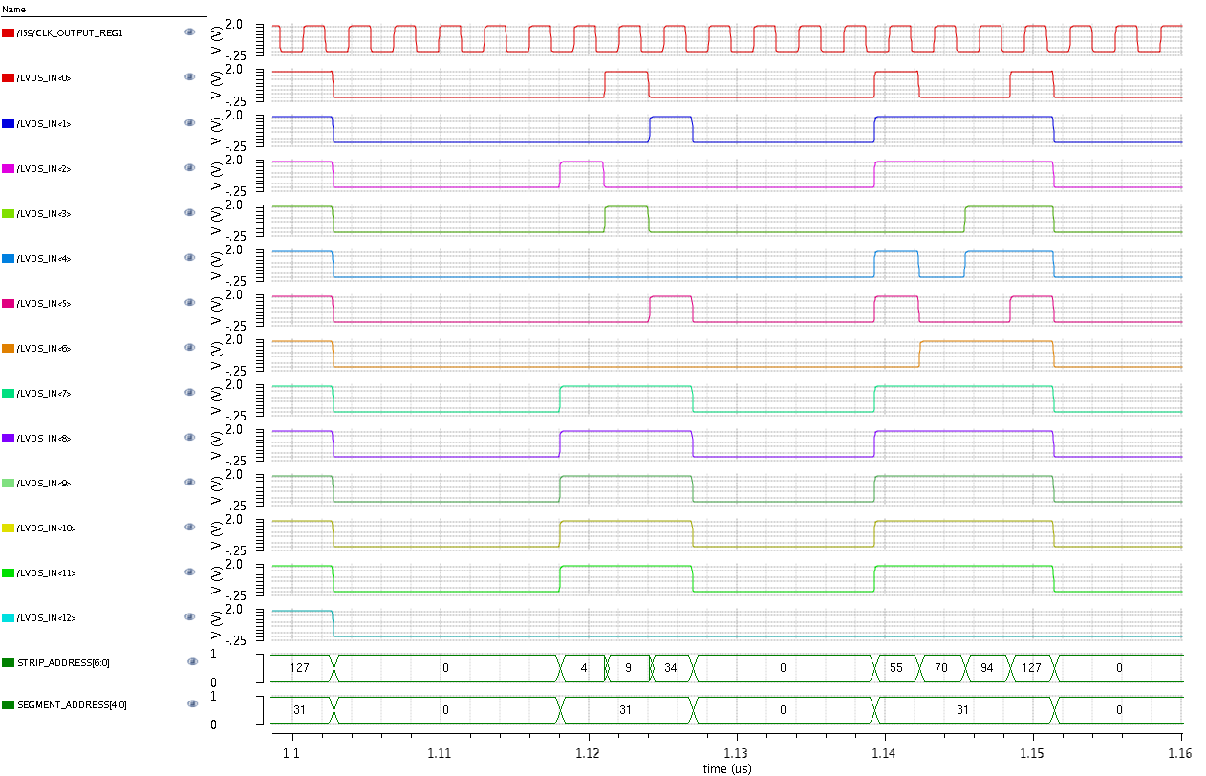
Top-Level simulation
data in CMOS logic level
Temp=27C
Nominal corner
Clock=320MHz
Hits | Strips | BX
1 | 4 | 1
2 | 9 | 1
3 | 34 | 1
4 | 55 | 2
5 | 70 | 2
6 | 94 | 2
7 | 127 | 2
Valid Addresses
Segment: 0 to 31
Strip: 1 to 127
Data 4 | Data 3 | Data 2 | Data 1 | Data 0 | Segment
1 | 1 | 1 | 1 | 1 | 31
Notes:
8

Slide 9
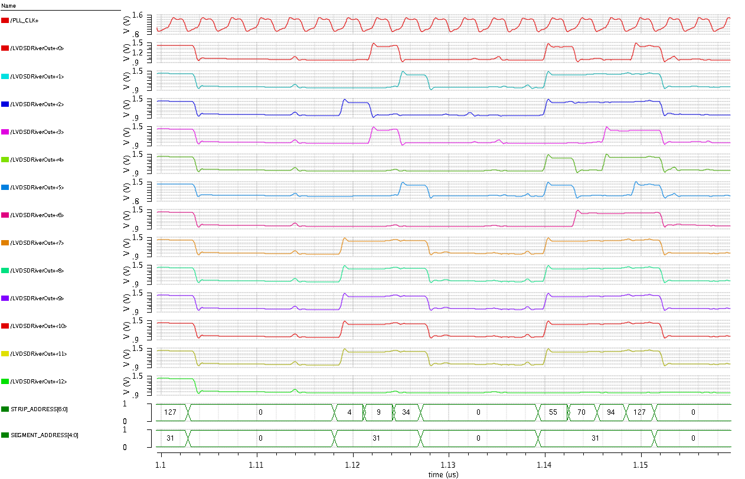
Top-Level simulation
Data at the output of LVDS drivers
LVDS drivers
have load
equivalent of
75 cm cable
Hits | Strips | BX
1 | 4 | 1
2 | 9 | 1
3 | 34 | 1
4 | 55 | 2
5 | 70 | 2
6 | 94 | 2
7 | 127 | 2
Valid Addresses
Segment: 0 to 31
Strip: 1 to 127
Data 4 | Data 3 | Data 2 | Data 1 | Data 0 | Segment
1 | 1 | 1 | 1 | 1 | 31
Notes:
9

Slide 10
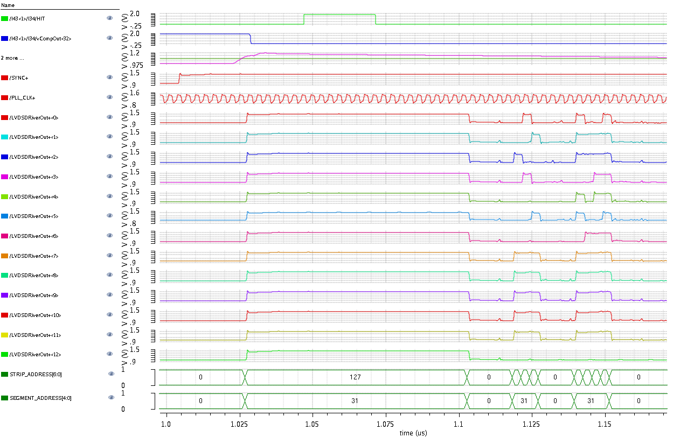
Top-Level simulation
Detail view
HIT
Comparator Out
Pre-Amp Out & Threshold
SYNC (LVDS)
CLK (LVDS)
STRIP_ADDRESS [0] (LVDS)
HIT @ BX1
STRIP_ADDRESS [1] (LVDS)
STRIP_ADDRESS [2] (LVDS)
STRIP_ADDRESS [3] (LVDS)
STRIP_ADDRESS [4 (LVDS)
STRIP_ADDRESS [5] (LVDS)
STRIP_ADDRESS [6] (LVDS)
SEGMENT_ADDRESS [1] (LVDS)
SEGMENT_ADDRESS [2] (LVDS)
SEGMENT_ADDRESS [3] (LVDS)
SEGMENT_ADDRESS [4] (LVDS)
SEGMENT_ADDRESS [5] (LVDS)
FLAG (LVDS)
Notes:
10

Slide 11
PLL 320MHz CLOCK
Measured Results from PLL+LVDS Driver
PLL 320MHz
Clock from
LVDS Output
REF: 20MHz
Clock seen at
CMOS Output
Low jitter of <60 pico sec
on the PLL clock
Notes:
11

