Slide 1
Status & Summary from last meeting
Way Forward
Modules Design
Petal Layouts

Slide 2
Way Forward
Possible interest expressed
Identify Folks willing to:
Consider module concepts, including assembly
Will help but not drive
Interact with petal/stave designers over sensor sizes, power, new tape layout, …(probably subsumed into first)
Work on hybrid electrical design & sensor backend layouts
Interact with chip designers over HCC/ABCN’/EoS
Build dummy modules & then Build electrical modules
Evaluate thermal performance of staves/petals
(Transverse thermal conductivity dominated by silicon)
ABCn’ FPGA version
Test
Electrical
mechanical

Slide 3
Organisation:
Meet regularly & report to main meeting
Monthly
Generates deadlines for work
Goals for end of calendar 2015 :
Conceptual module design selected
Detailed sensor layout agreed to match existing mechanics
Assembly process
Dummy module planned & parts on order

Slide 4
Module Concepts
Two basic variants identified
(half shown, reflected through LHS)
stripCMOS module - A
Sensor
ABCn’
Baseboard
thermally conductive
rigid
low mass
Hybrid
Baseboard may be hybrid
Extra mass?

Slide 5
stripCMOS module - GK
ABCn’
Sensor
Hybrid

Slide 6
Circle (x2)
Max X by Max Y (x2)
cant have both at the same time (maybe)
X < 22 mm
Y < 26 mm
Whole reticule must fit inside a circle of diameter 31.112 mm
(so max sized square has a side of length 21.9995 mm)
( y_{max} = sqrt[967.9565 – x²] )
(20,23.83); (19,24.64); …
AMS 350
Reticule size limitations

Slide 7
10cm
47.66
20 x 23.83 reticules
10 x 43 active
Use of wafer?
Not good width to make blocks
Barrel relatively ‘easy’

Slide 8
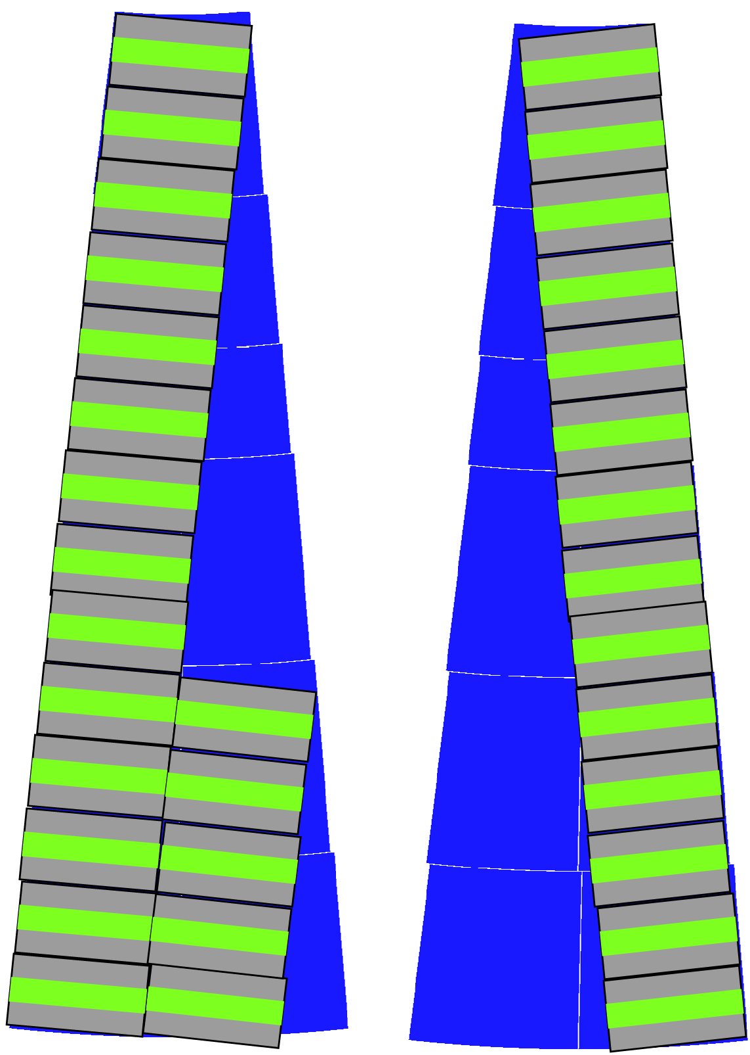
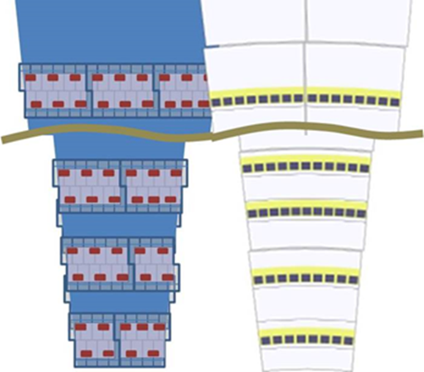
Petal Concepts
Ragged edge vs Thermal asymmetry

Slide 9
Summary
Still need to identify someone to drive concepts
In interim will be done by Marcel, Richard, Vitaliy
Need to identify a route for ABCn’ FPGA version
Ideas for people to date not viable
Once monthly meetings
Goals for 2015 identified

