Slide 1
CMOS Petal Design First Ideas ..
Richard, Marcel, Vitaliy

Slide 2
Assumptions
Need to cover same sensor area as baseline petal
Can’t do trapezoids etc in CMOS
But we can use front and back of the petal
As these are 3D space points, rotation, etc, don’t matter
Keep it simple
Tile Petal with one set of sensor
Stay close to barrel design

Slide 3
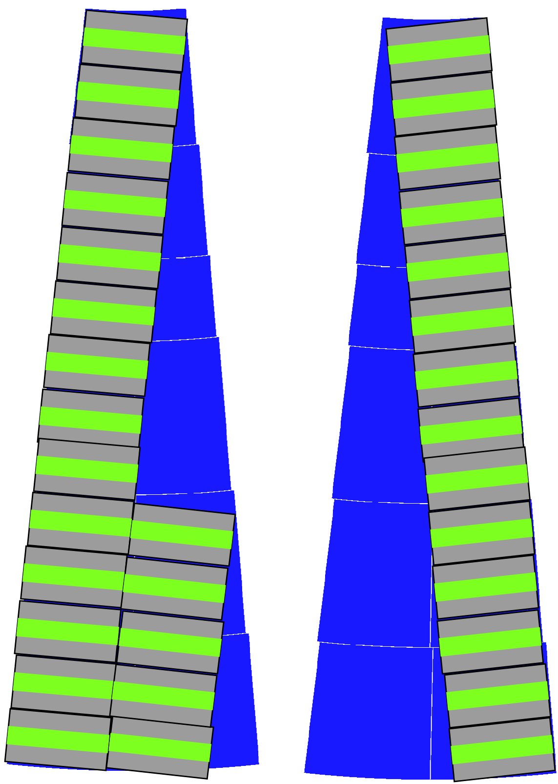
New Idea
Petal Module
Basic building block
4 x 8 cm
8 chips (2 x 2 cm)
Front Side
20 Modules
Back Side
15 Modules
35 Modules per Petal
Front
Back

Slide 4
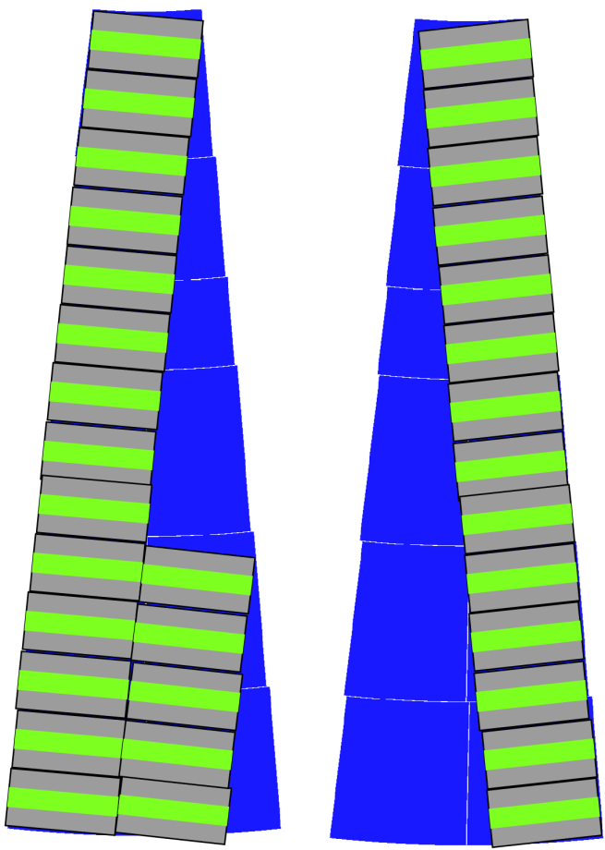
Overlap…
There is a non-zero overlap between front and back
Red area is where one will get 2 3D Points (bonus ..)

Slide 5
Gaps …
There are “non-zero gaps
Butting modules
Dead area from end-of-chip electronics
Idea: Staggering
May introduce some bonding issues ….

Slide 6
Food for thought
If we are lucky (and all fits ..)
One set of “Module” for the Tracker
Questions
Will Tracking be able to cope with ~5 degree rotated pixels of 40 x 800 µm?
Bustape, Power, etc will need adjustments
Which gaps are tolerable ?

