Slide 1
Photoinjector Characterization and Alignment
Current Status
Yauhen Kot
XFEL Commissioning and Operation Meeting
21.10.2015

Slide 2
Outline
1. Basic overview over the injector and methods for its simulation
2. Working points for the operation
- with single bunch
- with two bunch charges in the same train
3. Cathode laser shapes
- Flat top and gaussian laser shape
- other laser shapes
4. Beam based alignment. Status
- laser alignment
- solenoid alignment

Slide 3
Outline
1. Basic overview over the injector and for methods for its simulation
2. Working points for the operation
- with single bunch
- with two bunch charges in the same train
3. Cathode laser shapes
- Flat top and gaussian laser shape
- other laser shapes
4. Beam based alignment. Status
- laser alignment
- solenoid alignment

Slide 4
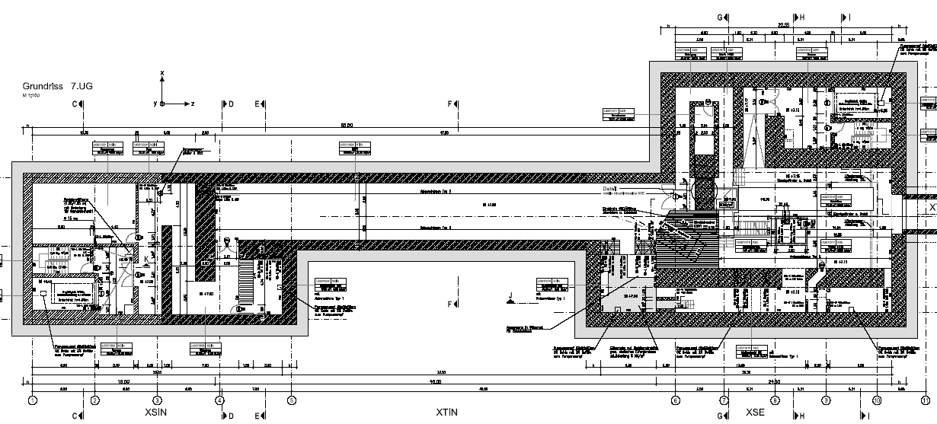
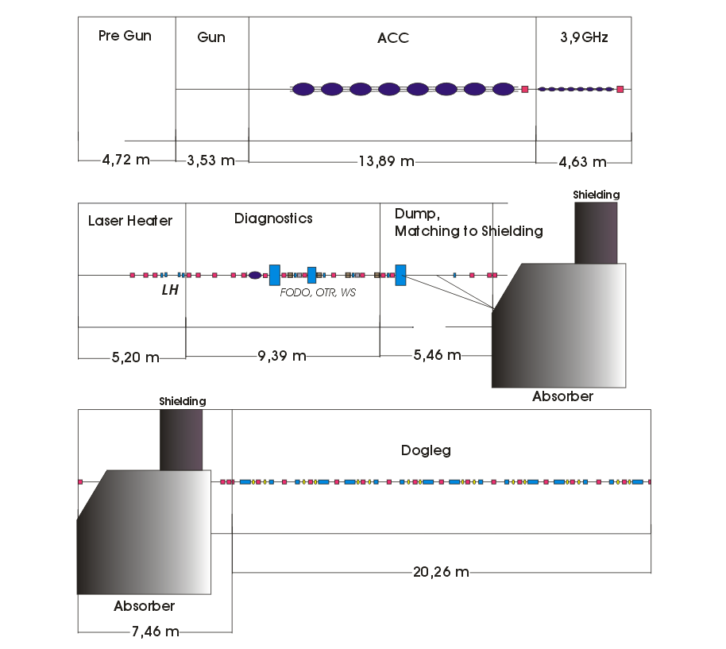
XFEL Injector Lattice Layout
Gives place for:
- Photoinjector Gun
ACC1 and ACC39
Laser heater
Diagnostics section
(1.5 76° FODO-cells with 4 OTR)
TDS
Spare place of about 3m for the
dump exchange
6.5m long shielding
20m long Dogleg for the vertical
Displacement of the beam (2.75m)

Slide 5
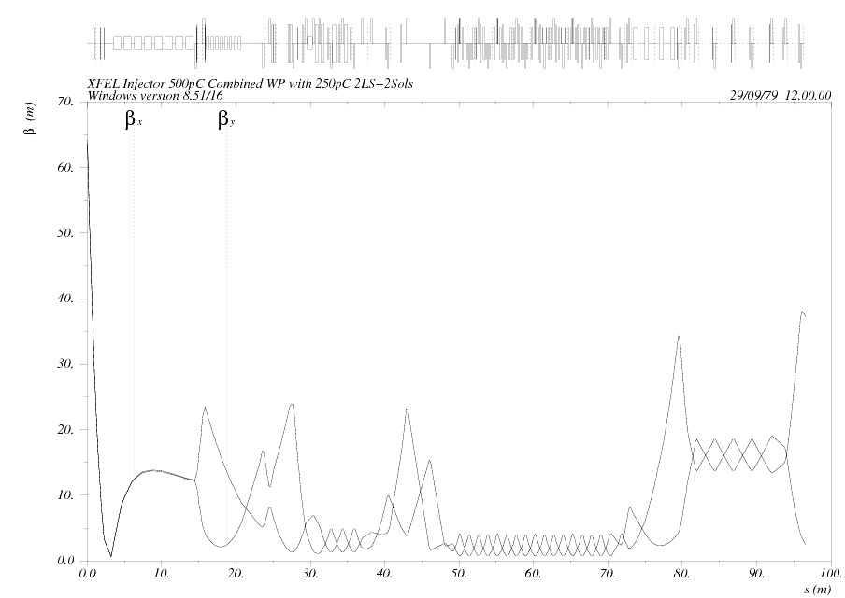
Beam Optical Functions in the Injector
Three regions of the injector divided by:
- end of the 1st accelerating module ACC1 at 14.448m
- begin of the diagnostics section at DIACORE at 29.559m
Gun
LH
M_{0,1}
E₀=130MeV
M_{0,3}
BC0
DL
Depends on
- bunch charge
solenoid field
gun gradient
RF focussing
Fixed beam optical functions
→ to be used as reference optics
Matching region
6 Quadrupoles

Slide 6
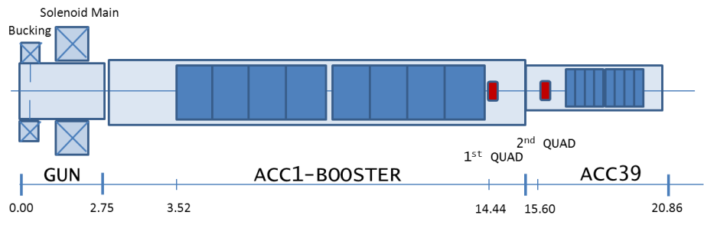
XFEL Photo Injector Setup used in the Simulations
RF-Gun | Cathode Laser | Booster | ASTRA
Field Balance= 1.04 | Temporal Profile: Flat Top 20/2ps Gauss 5.25-6.25ps rms (FWHM: 12.36-14.71ps) Other shapes | ACC1: 8xTESLA cavities: 1st cavity centered at z=4.0401m → 1st iris at z=3.637m | 200K particles
E_{cath}=60.00MV/m | Transverse: radial homogeneous | E_{peak}=34.42MV/m Phase=6.31 degree | Rotational symmetry Mesh: NradxNlong=40x100
Solenoid: main centered at z=0.276m Bucking coil at compensation |  |  | Tuned Parameters: Main solenoid peak field Laser rms spot size Rms bunch length Gun launch phase
Goals & Tasks: - minimized transverse emittance at the 1st quadrupole (z=14.44m) - satisfy claimed design specifications → baseline UND - matchable optics → β<100m, |α|<5 @1st quadrupole - 2 different bunch charges in the same bunch train

Slide 7
Outline
1. Basic overview over the injector and for methods for its simulation
2. Working points for the operation
- with single bunch
- with two bunch charges in the same train
3. Cathode laser shapes
- Flat top and gaussian laser shape
- other laser shapes
4. Beam based alignment. Status
- laser alignment
- solenoid alignment

Slide 8
Working Points for the Single Bunch Charge Operation
Requirements and assumed gun settings:
1.
Gun and Laser Parameters
Gun Peak E-Field | 60MV/m
Gun Phase | -1.9
Laser Pulse | FT 2/20\2ps
2.
3.
Matching ability condition
Twiss functions after the 1st accelerating module
β<100m; |α|<5
Minimum emittance
Results:
working points and summary over beam parameters at 1st quadrupole for the operation of the XFEL injector with different bunch charges
 | Working Point |  | Emittance and twiss functions after 1st accelerating module (at s=14.448m)
Q, [pC] | MaxB1, [T] | XYrms, [mm] | ε, [m⁻⁶] | β, [m] | α
20 | 0.2196 | 0.057 | 0.0824 | 132.00 | -9.483
100 | 0.2206 | 0.100 | 0.1925 | 161.10 | -11.21
250 | 0.2220 | 0.180 | 0.2982 | 42.13 | -2.305
500 | 0.2224 | 0.285 | 0.4391 | 19.81 | -0.6045
1000 | 0.2226 | 0.440 | 0.7091 | 8.729 | 0.0299
Matchable beam optics for higher bunch charges (above 100pC)
Not matchable beam optics for lower bunch charges (below 100pC)

Slide 9
Outline
1. Basic overview over the injector and for methods for its simulation
2. Working points for the operation
- with single bunch
- with two bunch charges in the same train
3. Cathode laser shapes
- Flat top and gaussian laser shape
- other laser shapes
4. Beam based alignment. Status
- laser alignment
- solenoid alignment

Slide 10
Similarity of the Beam Optical Functions
(for two different bunch charges in the same train)
Range of values for the laser beam size is defined by:
100% transmission point prior to local max β
As small as possible for proper FEL operation
Combined working points are imaginable
at the intersections of the according curves
Scans are taken for solenoid field of MaxB_{Sol}=0.2220T
and gun peak electric field of MaxE_{gun}=60MV/m

Slide 11
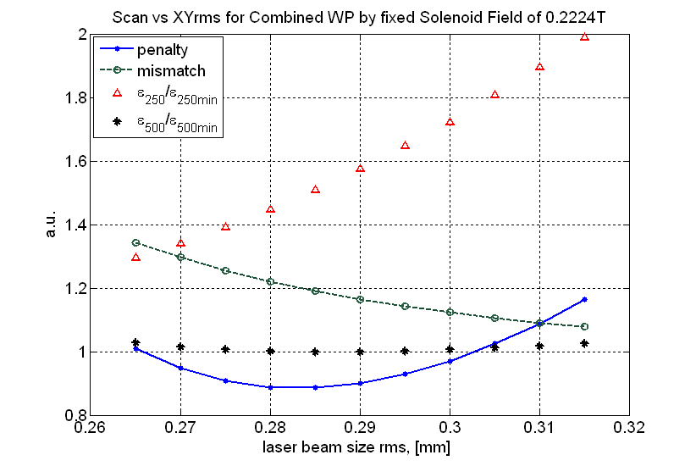

Combined WP for Different Charge Pairs
pen$=\frac{{Δε}_{1}}{ε_{10}}+\frac{{Δε}_{2}}{ε_{20}}+2{(ξ}_{1→2}−1)$
Combined WPs are possible on cost of the emittance growth of the lower bunch charge
Combined working points for different bunch charge pairs. Basic design of the XFEL injector
Pair, [pC] | WP |  | Δε₁, % | Δε₂, % | ξ_{1→2} | pen
 | MaxB1, [T] | XY, [mm]
100/250 | 0.2220 | 0.2050 | 74.8 | 1.7 | 1.403 | 1.4871
250/500 | 0.2224 | 0.2850 | 50.1 | 0.0 | 1.192 | 0.8869
500/1000 | 0.2226 | 0.4000 | 51.7 | 4.1 | 1.194 | 0.9569

Slide 12
Combined WP for Operation with Two Cathode Lasers
Scans over the Solenoid Peak Field
for Bunch Charge Pairs 500/250pC and 250/100pC
Significant improvement of the emittance and penalty functions for both pairs
 | Single System |  | Two Lasers
 | ξ_{1→2} | pen | ξ_{1→2} | pen
500/250pC | 1.192 | 0.8869 | 1.0264 | 0.1058
250/100pC | 1.403 | 1.4871 | 1.0342 | 0.0842

Slide 13
Combined WP for Operation with Two Cathode Lasers
Scans over the Solenoid Peak Field for other Bunch Charge Pairs
Combined working points for XFEL injector with two laser systems on the cathode
Bunch pair | MaxB,[T] | XY₁,[μm] | XY₂,[μm] | ε₁,[m⁻⁶] | ε₂,[m⁻⁶] | ξ_{1→2} | pen
1nC/500pC | 0.2226 | 395 | 310 | 0.7492 | 0.4506 | 1.0675 | 0.1502
1nC/250pC | 0.2228 | 380 | 240 | 0.8156 | 0.3765 | 1.0902 | 0.5859
1nC/100pC | 0.2230 | 375 | 167.5 | 0.8714 | 0.3167 | 1.0647 | 0.9916
1nC/20pC | 0.2230 | 390 | 81 | 0.7854 | 0.1384 | 1.0448 | 0.8139
500pC/250pC | 0.2224 | 265 | 210 | 0.4522 | 0.3069 | 1.0264 | 0.1058
500pC/100pC | 0.2226 | 265 | 152.5 | 0.4596 | 0.2430 | 1.0451 | 0.3898
500pC/20pC | 0.2228 | 270 | 71 | 0.4648 | 0.1229 | 1.0270 | 0.5880
250pC/100pC | 0.2220 | 170 | 122.5 | 0.3031 | 0.1949 | 1.0342 | 0.0842
250pC/20pC | 0.2226 | 200 | 69 | 0.3137 | 0.1158 | 1.0412 | 0.5187
100pC/20pC | 0.2222 | 137.5 | 67 | 0.2019 | 0.1032 | 1.0612 | 0.4025
Given the second laser system at the cathode
operation with any bunch charge pair becomes conceivable

Slide 14
Outline
1. Basic overview over the injector and for methods for its simulation
2. Working points for the operation
- with single bunch
- with two bunch charges in the same train
3. Cathode laser shapes
- Flat top and gaussian laser shape
- other laser shapes
4. Beam based alignment. Status
- laser alignment
- solenoid alignment

Slide 15
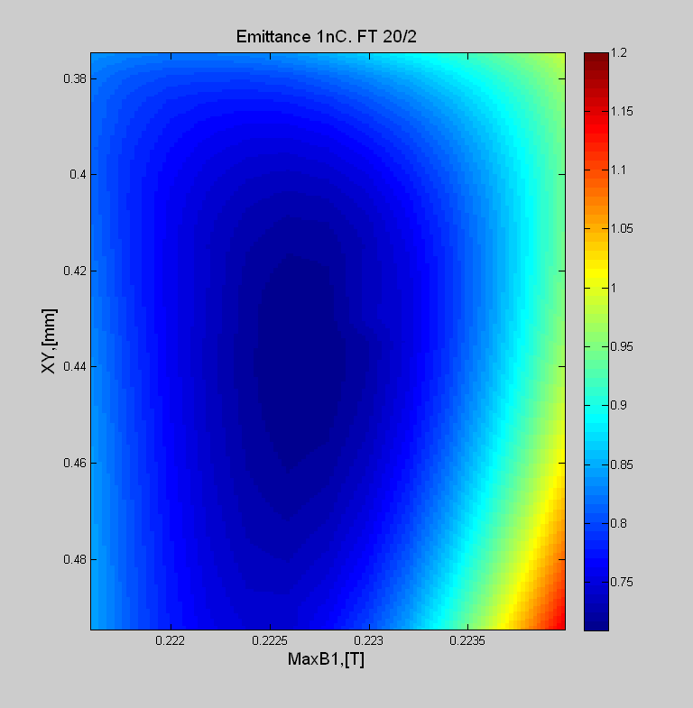
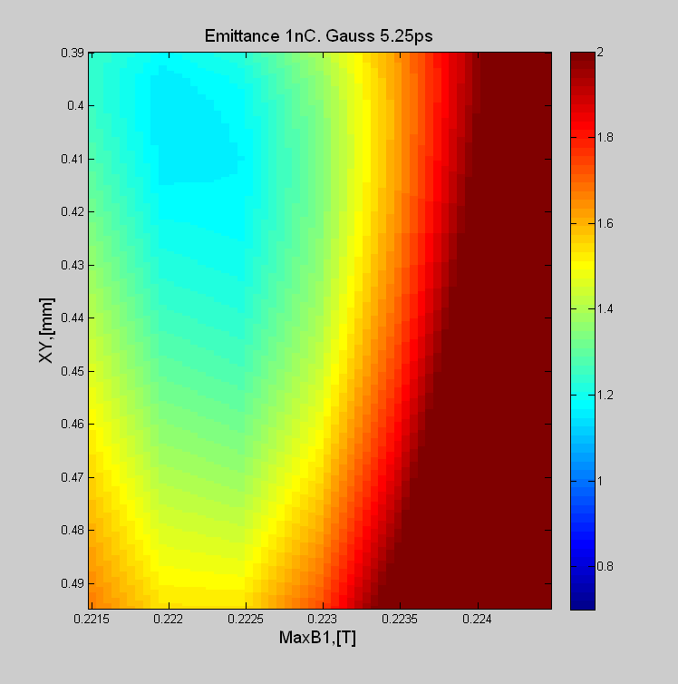
2D Scan for 1nC Bunch vs Solenoid Field and Laser Spot Size
(12.36ps FWHM)
working point for the best emittance
ε^{pr}_{min}=0.704m⁻⁶
ε^{pr}_{min}=1.107m⁻⁶
100% transmission at XY=0.370mm
100% transmission at XY=0.380mm
Length of the gaussian laser pulse is adjusted to get the same bunch length as in the case of Flat Top

Slide 16
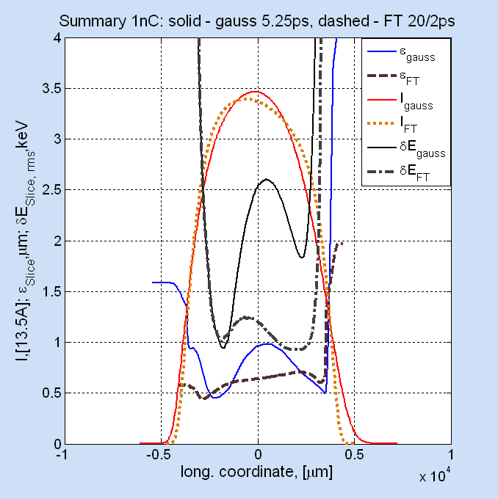
Summary: Comparison for 1nC Bunch. FT vs. Gauss
Charge | 1nC
Laser form | Flat Top | Gauss
Laser rms, [ps] | 20/2 | 5.25
ε^{pr}_{s=14.44m}, [mrad] | 0.704 | 1.107
ε^{sl,av}_{s=14.44m}, [mrad] | 0.63 | 0.70-0.80
ε^{sl,min}_{s=14.44m}, [mrad] | 0.439 | 0.449
ε^{sl,max}_{s=14.44m}, [mrad] | 0.704 | 0.983
δE^{sl,av},rms [keV] | 1.1 | 2.0
Ip, [A] | 45.8 | 46.8
τ rms, [mm] | 2.031 | 2.103
Projected emittance and slice energy
spread become significantly worse
NB: Emittance calculation for the gaussian case without tails!

Slide 17
Outline
1. Basic overview over the injector and for methods for its simulation
2. Working points for the operation
- with single bunch
- with two bunch charges in the same train
3. Cathode laser shapes
- Flat top and gaussian laser shape
- other laser shapes
4. Beam based alignment. Status
- laser alignment
- solenoid alignment

Slide 18
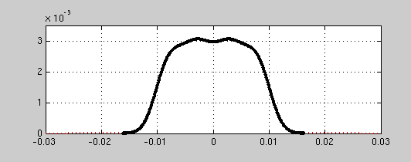
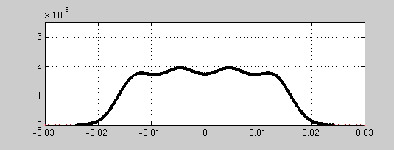
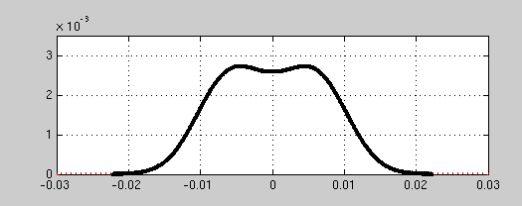
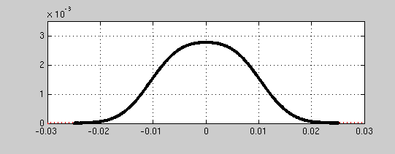
Summary for Other Laser Shapes
Evaluated at the end of the 1st accelerating module ACC1 Vgun=50.0MV/m, Vboo=23.42MV/m in all cases MaxB1 and XYrms adjusted for the best emittance
Laser profile | ε^{pr} [μm] | ε^{sl,peak} [μm] | ε^{sl,av} [μm] | δE^{sl,peak} [keV] | τ,[mm] | I^{peak},[A]
FT 2/20\ps | 1.025 | 0.989 | 0.941 | 0.663 | 2.103 | 44.9
Gauss 14ps FWHM | 1.460 | 1.302 | 1.046 | 1.163 | 2.393 | 41.1
5 – 3.8 | 0.985 | 0.796 | 0.752 | 0.940 | 2.317 | 41.0
7 – 6.08 | 0.820 | 0.515 | 0.536 | 0.678 | 2.981 | 31.2
10 – 17.7 | 0.988 | 0.749 | 0.697 | 1.068 | 2.576 | 36.8
12 – 18.0 | 1.045 | 0.795 | 0.692 | 1.264 | 2.668 | 36.2

Slide 19
Summary: Different Cathode Laser Shapes
Simulations indicate a better emittance of the new laser shapes (double-gauss like, four times gauss like) than that of the Gaussian distribution and even of the Flat Top.
Most probably it is bought by bunch lengthening due to longer laser pulse at the cathode
Rms slice energy spread is significantly larger than in the FT case and comparable to the gauss distribution
Mostly comfortable slice beam optical functions

Slide 20
Outline
1. Basic overview over the injector and for methods for its simulation
2. Working points for the operation
- with single bunch
- with two bunch charges in the same train
3. Cathode laser shapes
- Flat top and gaussian laser shape
- other laser shapes
4. Beam based alignment. Status
- laser alignment
- solenoid alignment

Slide 21
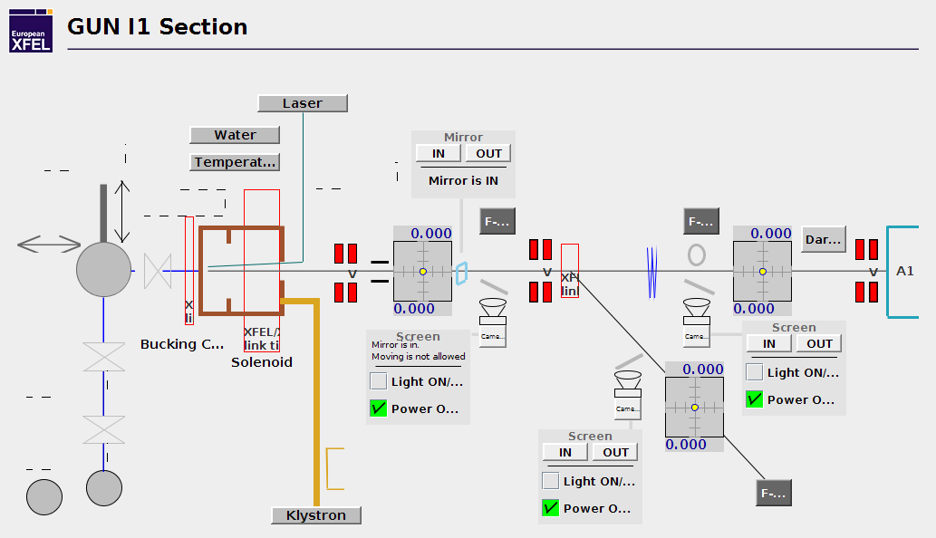
Gun I1 Section
BPMG.24.I1
s=1.05m
BPMG.25.I1
s=2.15m
Two BPMs can be used for the alignment

Slide 22

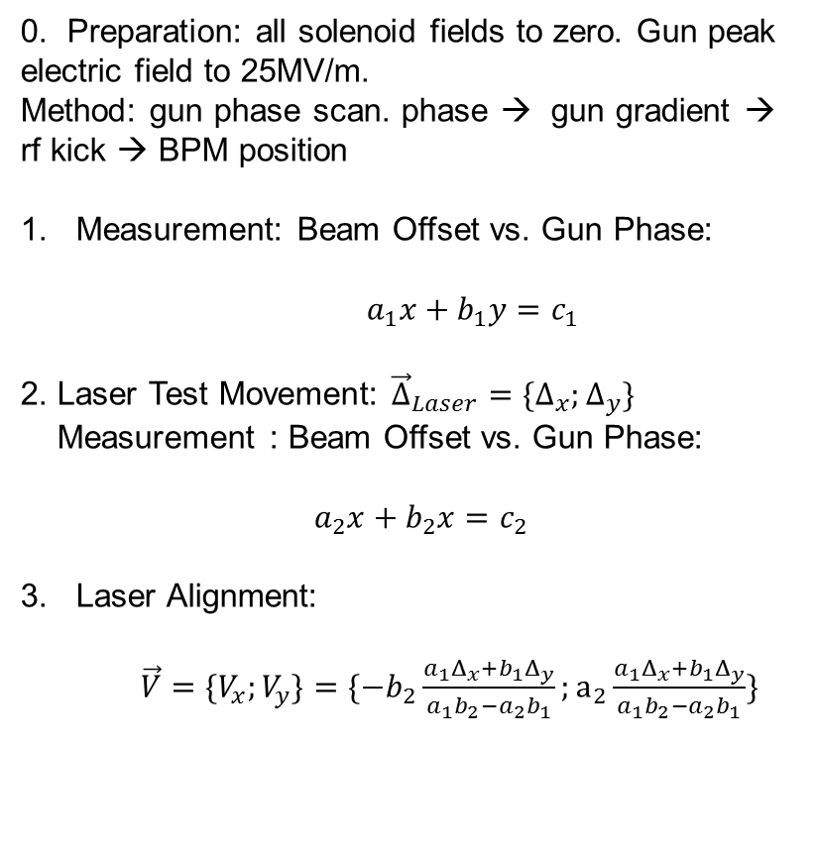


Cathode Laser BBA
0. Preparation: all solenoid fields to zero. Gun peak electric field to 25MV/m.
Method: gun phase scan. phase → gun gradient → rf kick → BPM position
Measurement: Beam Offset vs. Gun Phase:
$a_{1}x+b_{1}y=c_{1}$
2. Laser Test Movement: ${\vec{Δ}}_{Laser}={\{Δ}_{x};Δ_{y}\}$
Measurement : Beam Offset vs. Gun Phase:
$a_{2}x+b_{2}x=c_{2}$
Laser Alignment:
$\vec{V}=\{V_{x};V_{y}\}=\{−b_{2}\frac{a_{1}Δ_{x}+b_{1}Δ_{y}}{a_{1}b_{2}−a_{2}b_{1}};a_{2}\frac{a_{1}Δ_{x}+b_{1}Δ_{y}}{a_{1}b_{2}−a_{2}b_{1}}\}$
$${\vec{Δ}}_{Laser}$$
$$\vec{V}$$

Slide 23
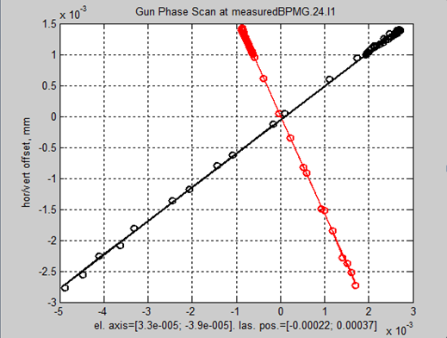


Simulations of the Cathode Laser BBA
Gun Phase Scan simulated at BPMG.24.I1
$${\vec{Δ}}_{Laser}$$
assumed initial
laser offset
laser offset after
the test movement
$$\vec{V}$$
Step 2
Step 1
Assumptions done:
Electrical axis at {0;0}. To be found in the simulations
Initial laser offset at {-0.25mm;0.40mm}
Laser jitter 30μm rms
Scan phase for 10-90 deg
Gun peak electric field: 25MV/m

Slide 24
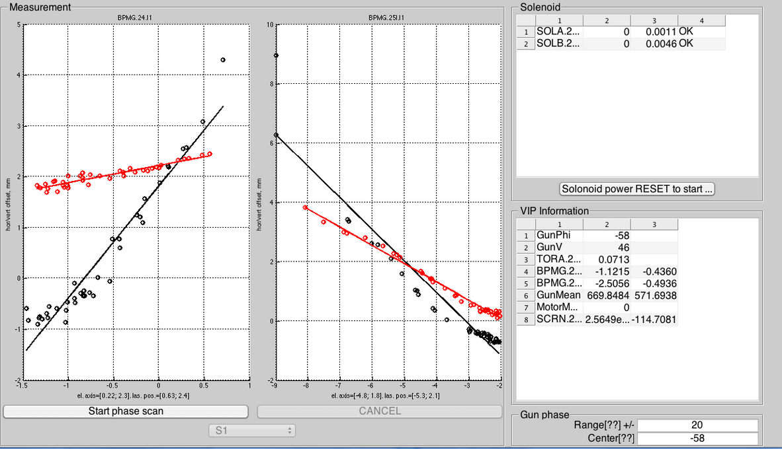
Laser BBA. Before Alignment

Slide 25
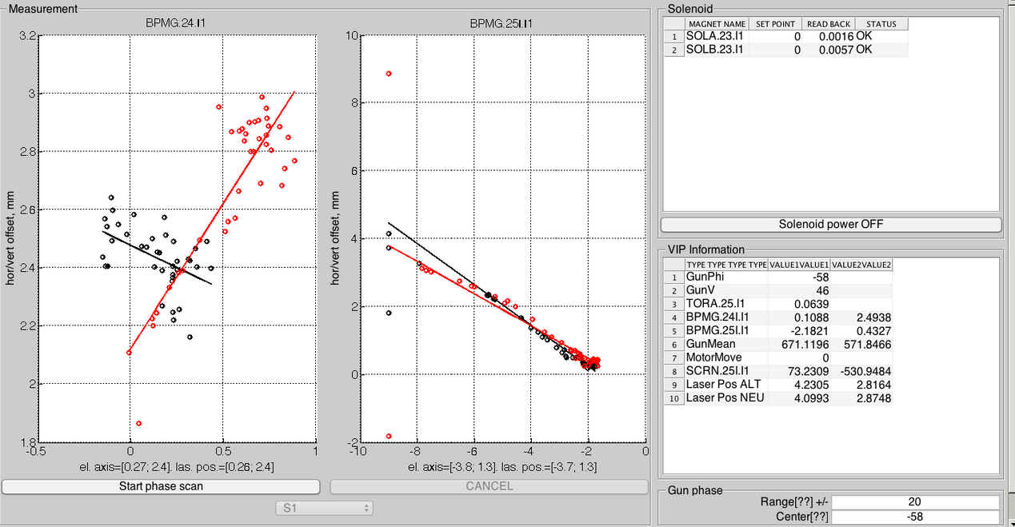
Laser BBA. After Performing the Alignment
Electric Axis = Laser Position

Slide 26
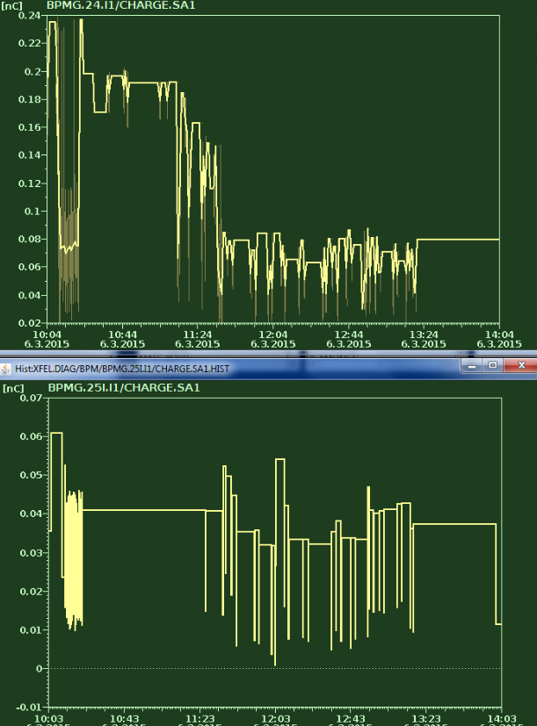
Transmission during Laser BBA. Charge Issues
charge jitter limit about 0.05nC. Couldn’t measure the bunch charge reliably below 0.05nC.
100% transmission to the BPMG.24.I1. Reliable results for laser BBA achieved.
About 50% transmission to BPMG.25.I1 → not suitable for the laser BBA

Slide 27
Outline
1. Basic overview over the injector and for methods for its simulation
2. Working points for the operation
- with single bunch
- with two bunch charges in the same train
3. Cathode laser shapes
- Flat top and gaussian laser shape
- other laser shapes
4. Beam based alignment. Status
- laser alignment
- solenoid alignment

Slide 28
Solenoid Alignment. Status
Elements | Status
Movers | Available, installed
Aluminium frame with Beckhoff’s encoders | Missing, on the way
Cabling | Available, not connected
Software | To be overtaken from PITZ. Available under LabView but not in jddd
Alignment method | Improved, prepared

Slide 29
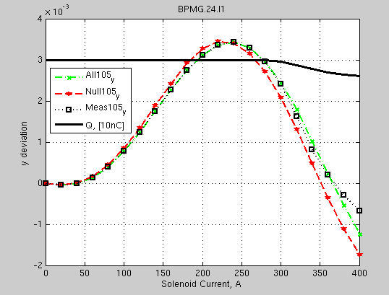
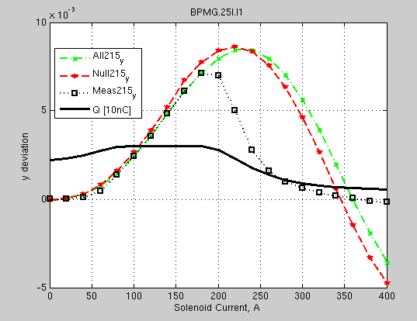
Solenoid Alignment. Window with 100% Transmission
Assumptions and Methods:
Pipe aperture r=20.25mm. Particles with deviation more than 20.25mm
from the BPM center considered as lost.
ASTRA 2D with 200kParticles. Nlong x Nrad =100x40. with SF
Bunch Charge = 30pC.
XYrms=0.10mm
Gun: MaxE=25MV/m Phase=40deg
Gun offsets: no
Solenoid Offsets: [0.5; 0.7; -0.2; 0.3]
Files: gun41cavity.txt; Main2003_3m; Buck2003_0
Bucking Coil: off
Jitter: no
Expect full transmission in the range of [0:300] A
for BPMG.24.I1
Expect full transmission in [80:180] A
for BPMG.25.I1

Slide 30
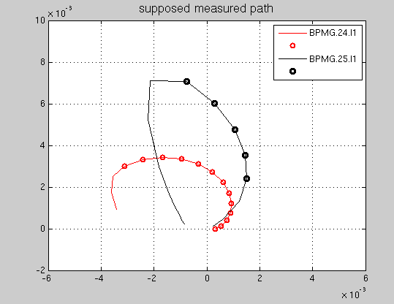


Measured Path. Simulations for S=[0.5 0.7 -0.2 0.3]
$$\vec{S}=[S_{xoff},S_{yoff}, S_{xrot},S_{yrot}]∈R_{s}$$
Tracking from the cathode to the BPM
can be defined as some transformation
$B$ with
$$\vec{S}∈R_{s}→\vec{X}∈R_{BPM}$$

Slide 31
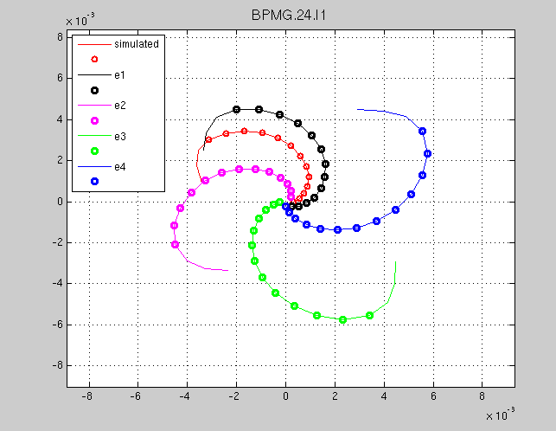

Path for Basis Solenoid Offsets
$$e_{i}∈R_{s}:$$
$$e=$$
[Sxoff Syoff Sxrot Syrot]
[mm mm mrad mrad]
[ 1 0 0 0 ]
[ 0 1 0 0 ]
[ 0 0 1 0 ]
[ 0 0 0 1 ]

Slide 32


Build Basis Vectors
$$\vec{Β}\left(\vec{e_{i}}\right)=\vec{B}\left(\vec{e_{i}},I_{max}\right)−\vec{B}({\vec{e}}_{i}, I_{min})$$
$$I_{min}=60A$$
$$I_{max}=300A$$
e₁
Name | Values
 | [mm mm]
e₁ | [-3.34; 4.31]
e₂ | [-4.24; -3.42]
e₃ | [4.66; -4.77]
e₄ | [4.77; 4.65]
e₄
A
e₂
e₃

Slide 33
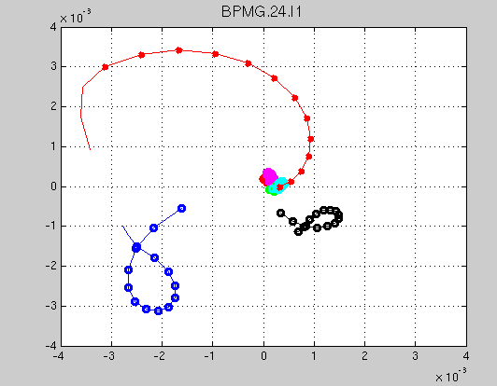
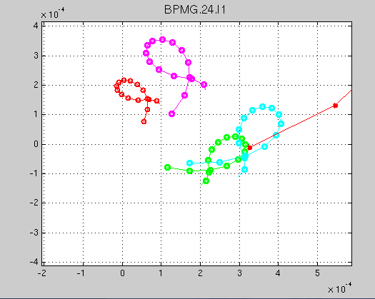
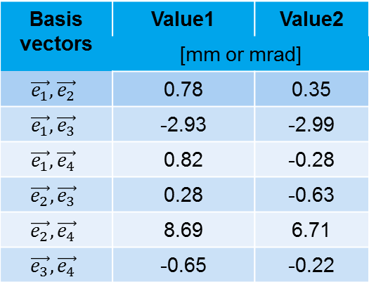
1st Solenoid Movement
Develop the measured path in a basis of two vectors
Basis vectors | Value1 | Value2
 | [mm or mrad]
$$\vec{e_{1}},\vec{e_{2}}$$ | 0.78 | 0.35
$$\vec{e_{1}},\vec{e_{3}}$$ | -2.93 | -2.99
$$\vec{e_{1}},\vec{e_{4}}$$ | 0.82 | -0.28
$$\vec{e_{2}},\vec{e_{3}}$$ | 0.28 | -0.63
$$\vec{e_{2}},\vec{e_{4}}$$ | 8.69 | 6.71
$$\vec{e_{3}},\vec{e_{4}}$$ | -0.65 | -0.22
Path at the BPMG.24.I1 before and after 1st solenoid move
1st solenoid correction leads to a ‘point-like’ path on the BPM. The point doesn’t coincide with the BPM center.

Slide 34
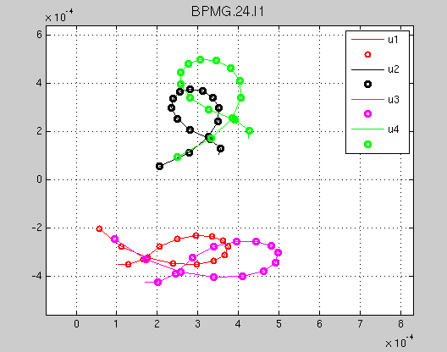
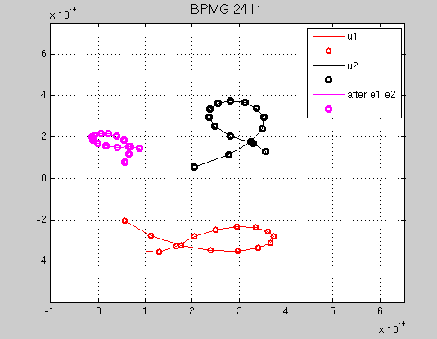
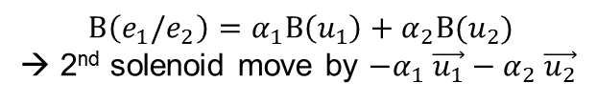

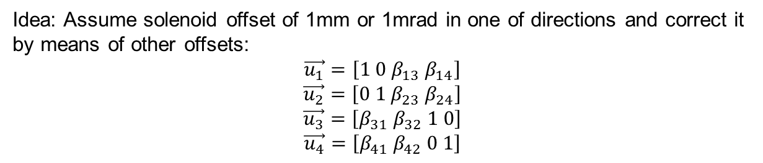


2nd Solenoid Movement
Idea: Assume solenoid offset of 1mm or 1mrad in one of directions and correct it by means of other offsets:
$$\vec{u_{1}}=\left[1 0 β_{13} β_{14}\right]$$
$$\vec{u_{2}}=\left[0 1 β_{23} β_{24}\right]$$
$$\vec{u_{3}}=\left[β_{31} β_{32} 1 0\right]$$
$$\vec{u_{4}}=\left[β_{41} β_{42} 0 1\right]$$
$$Β\left(e_{1}/e_{2}\right)$$
$$Β\left(u_{2}\right)$$
$$Β\left(u_{1}\right)$$
$$Β\left(e_{1}/e_{2}\right)=α_{1}Β\left(u_{1}\right)+α_{2}Β(u_{2})$$
→ 2nd solenoid move by $−α_{1} \vec{u_{1}}−α_{2} \vec{u_{2}}$

Slide 35
Summary: Beam Based Alignment
Procedure for the laser beam based alignment is established. Correct results have been achieved at the first BPM (BPMG.24.I1).
It was not possible to get 100% transmission up to the second BPM (BPMG.25.I1) and thus it was not suitable for the laser BBA.
Solenoid Alignment: Procedure is prepared but not implemented yet.
Missing for the Solenoid Alignment: encoder for the measurement of the solenoid movement. (is on the way and is going to be installed these days)

Slide 36
Parameters at the End of the ACC1 for 1nC Bunch Charge
Charge | 1nC
Laser form | Flat Top | Gauss | Gauss | Baseline UND
Laser rms, [ps] | 20/2 | 6.25 | 5.25
ε^{pr}_{s=14.44m}, [mrad] | 0.704 | 1.053 | 1.107
ε^{sl,av}_{s=14.44m}, [mrad] | 0.63 | 0.65-0.75 | 0.70-0.80 | 0.92
ε^{sl,min}_{s=14.44m}, [mrad] | 0.439 | 0.401 | 0.449 | 0.75
ε^{sl,max}_{s=14.44m}, [mrad] | 0.704 | 0.874 | 0.983 | 1.09
δE^{sl,av},rms [keV] | 1.1 | 1.9 | 2.0 | 450 (wo LH)
Ip, [A] | 45.8 | 42.7 | 46.8 | 5000
τ rms, [mm] | 2.031 | 2.294 | 2.103 | 0.0766 (FWHM)
Comparison Gauss vs FT:
- 57% increase of the projected emittance for the same bunch length

