Slide 1
Experience with CHESS-1 DAQ 30 October 2015
J. J. John (Oxford)
with help from many colleagues

Slide 2
Testing methodology – sensors for LHC Upgrades
Background: testing candidate CMOS sensors for LHC phase 2 upgrades of the strip layers of the inner tracker (“ITk”)
Test approach:
Characterise sensors
Send sensors for irradiation campaigns
Store and ship cold (below 0°C)
Re-characterise the sensors – also keeping cold – learn about radiation effects
Testing methods:
Using sources such as Iron 55, Strontium 90
Using pulsed laser systems such as from Particulars (Slovenia)
Transient Current Technique (TCT), both from top of device and into the edge of the device (edge TCT)
Sensors often mounted on stages during source and laser testing

Slide 3
Constraints guiding design of sensor electronics
Sensor support boards should be low-mass, low activation, as far as practical
For CHESS-1 we avoided solder, connectors and metallic components on the sensor boards
It should be easy to interchange sensor boards
Need to consider how to cool irradiated sensor boards during testing
Sensor boards should be mountable on stages for source and laser testing
3

Slide 4
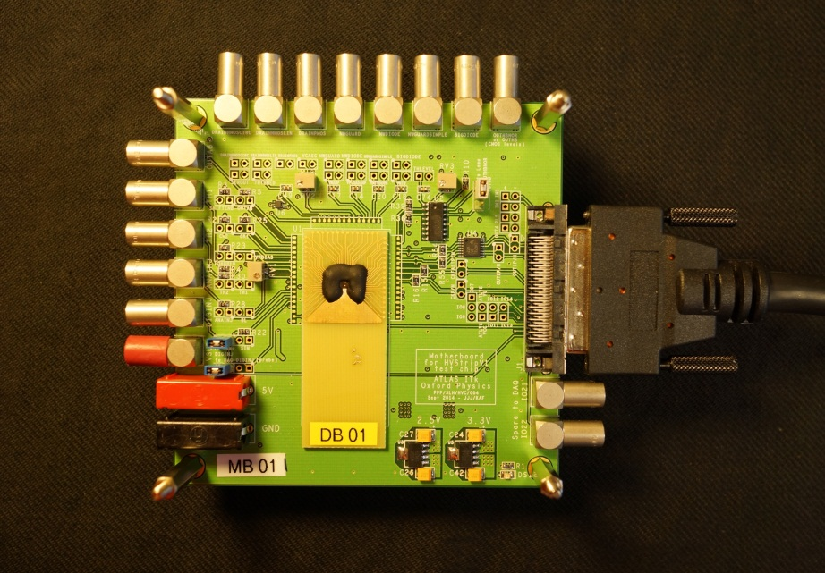
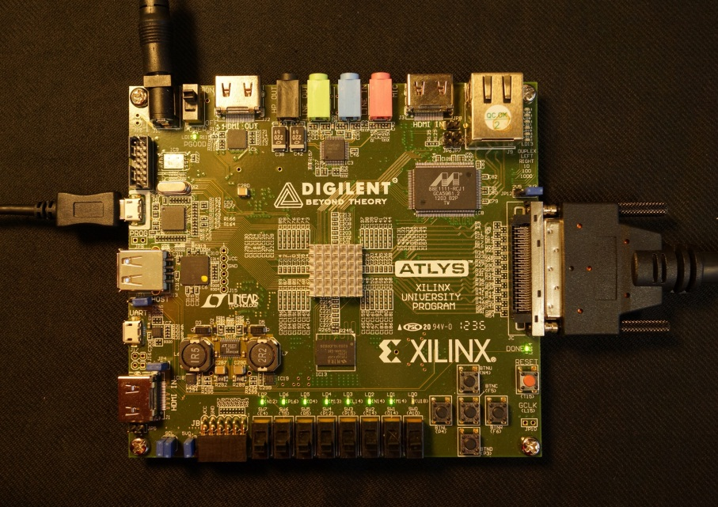
Experience with HVStripV1
Single-sided daughterboard/sensor board
Wire bonded down to motherboard
Low mass, but less flexible
required re-bonding after irradiation, or to change between sensors
Used Digilent Atlys board as DAQ, running “ITSDAQ” firmware used by ATLAS Strip community
3

Slide 5
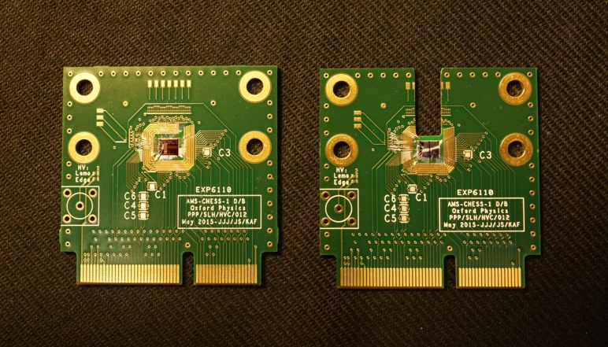
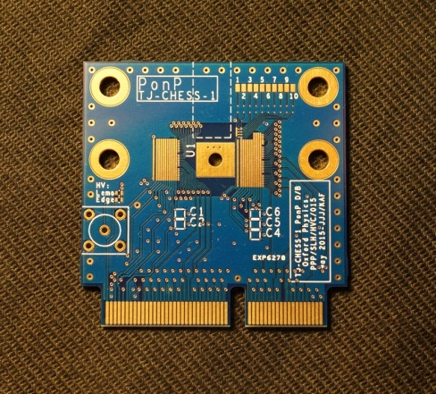
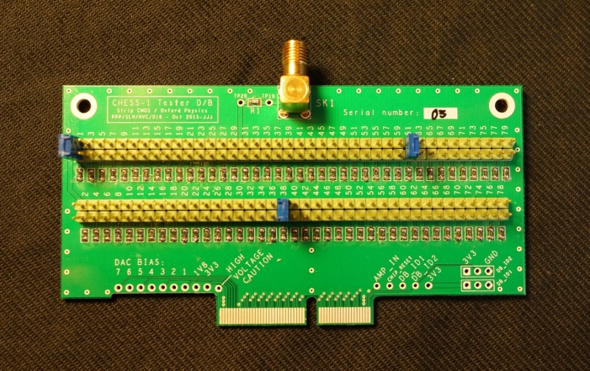
Experience with CHESS-1
Decided on sensor boards with an edge connector, for each of changing over
Also useful given multiple flavours of device:
AMS-CHESS-1, Tower Jazz CHESS-1 “P on N”, Tower Jazz CHESS-1 “P on P”
Used wire-bondable capacitors on boards, per chip designers’ advice
AMS-CHESS-1 Daughterboard
TJ-CHESS-1 DB
for P on P sensor
Tester DB
for verification
and getting groups started
Standard and cut for Edge TCT
3

Slide 6
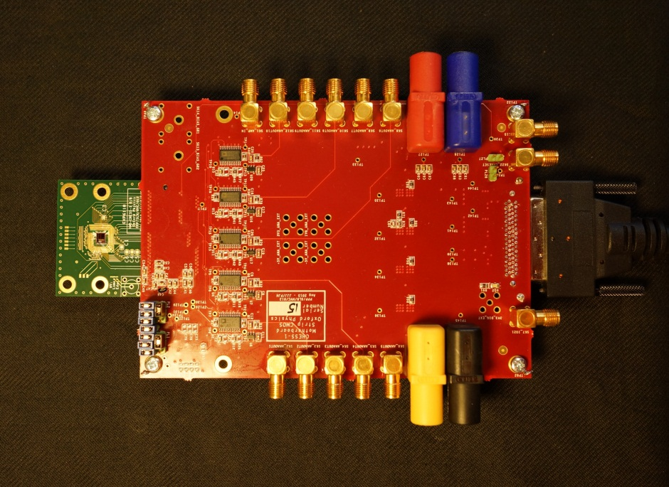
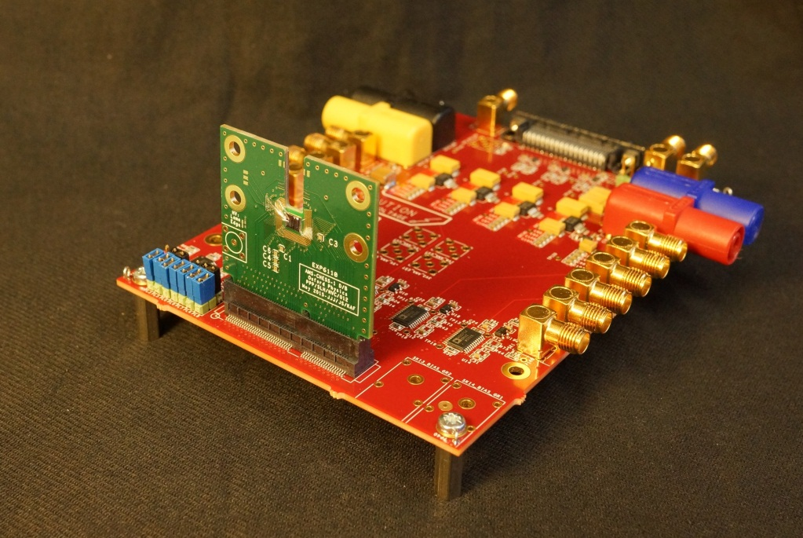
Experience with CHESS-1
Motherboard supplies biases, provides bias DAC and controls switches to select from among 79 analogue output channels (the specifics aren’t applicable to CHESS-2)
Has Samtec “MEC6” sockets for daughterboard edge connector
Switches and bias DAC controlled by Digilent Atlys DAQ
CHESS-1 Motherboard
Parallel orientation
CHESS-1 Motherboard
Perpendicular orientation
mainly for edge TCT testing
3

Slide 7
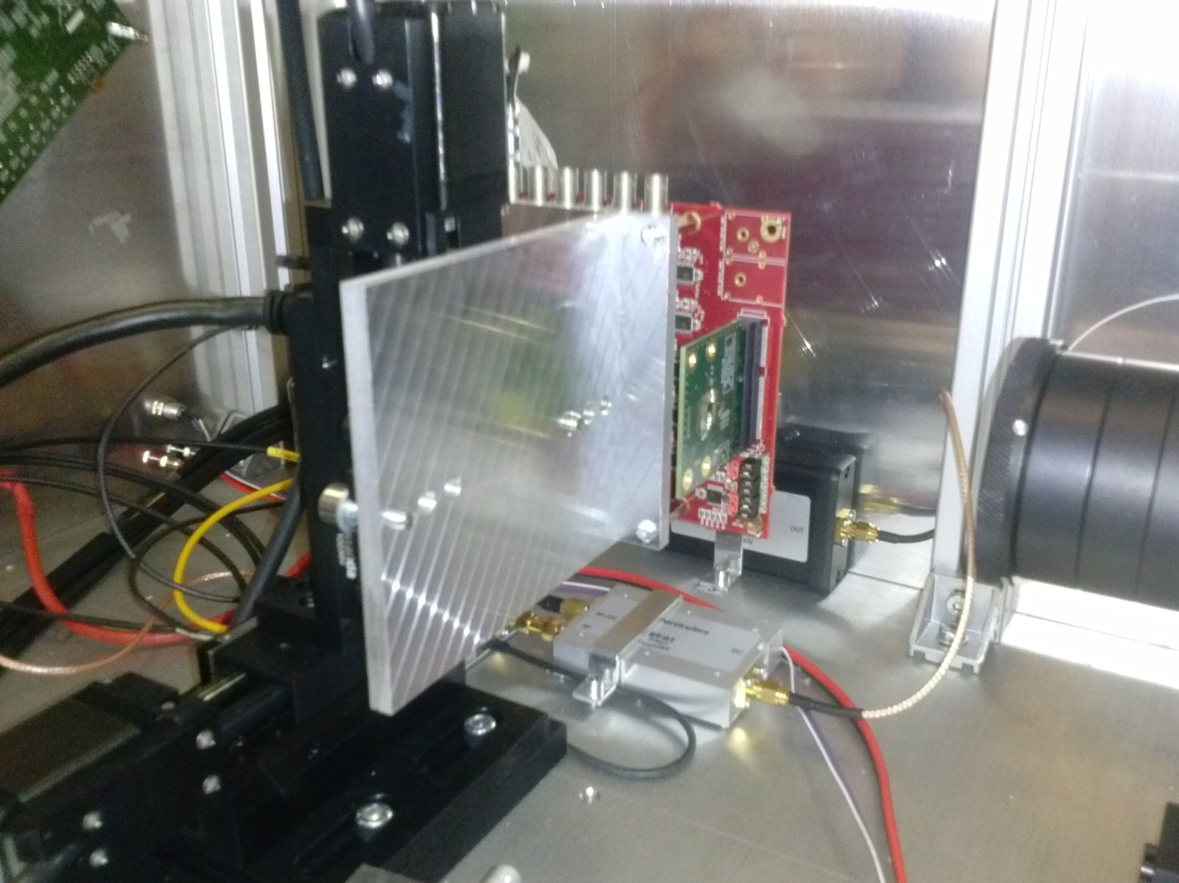
Experience with CHESS-1
Motherboard shown mounted to laser system

