Slide 1
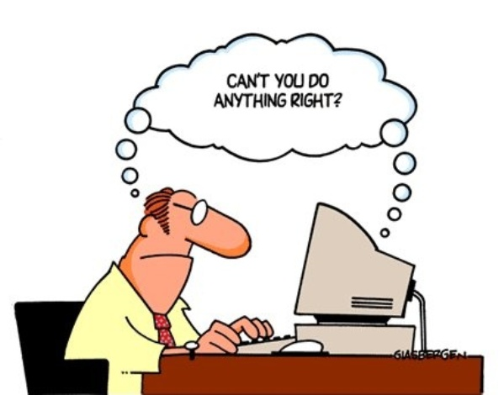
Software Testing in ½ hour
Overview of concepts
Food for thought
Suggestions for further learning
Topics for discussion
Maria Grazia Pia
INFN Genova, Italy
Maria.Grazia.Pia@cern.ch
http://www.ge.infn.it/geant4/training/APC2016/

Slide 2
Why testing software?
To show that it does what it is intended to do
To discover defects before it is put into use
Testing cannot demonstrate
that the software is free of defects
or that it will behave as specified in every circumstance
“Program testing can be used to show the presence of bugs, but never to show their absence!”
E. W. Dijkstra et al., Structured programming, 1972

Slide 3
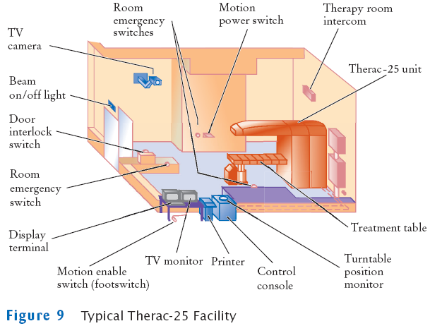
Therac 25
Radiation therapy machine
6 massive overdose cases,
1985-1987
Caused by
poor software engineering practices
A commission concluded that the primary reason should be attributed to bad software design and development practices,
and not explicitly to several coding errors that were found
The software was designed so that it was realistically impossible
to test it in a clean automated way
Safety analysis of the system excluded software
N. Leveson, C. S. Turner, An Investigation of the Therac-25 Accidents, IEEE Computer, vol. 26, no. 7, pp. 18-41, 1993.

Slide 4
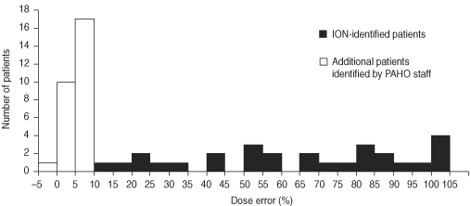
The Panama accidents
28 radiation therapy patients were overexposed in 2000-2001
23 of them had died by September 2005
18 of the deaths were from radiation effects
A modified protocol was used
without verification and validation
The software permitted incorrect forms of data entry, which in turn led to miscalculation of treatment time
Therapy planning software from Multidata delivered different doses depending on the order in which data were entered
IAEA, Investigation of an Accidental Exposure of Radiotherapy Patients in Panama: Report of a Team of Experts, 2001
C. Borras et al., Clinical effects in a cohort of cancer patients overexposed during external beam pelvic radiotherapy, Int. J. Radiation Oncology Biol. Phys., vol.59, pp. 538-550, 2004
C. Borras et al., Overexposure of radiation therapy patients in Panama: problem recognition and follow-up measures, Rev. Panam. Salud Publica, vol.20, n.2-3, pp. 173-187, 2006

Slide 5

Ariane 5 maiden flight
~40 seconds after initiation of
the flight sequence, the launcher veered off its flight path, broke up and exploded
4 June 1996
Credit: ESA
The primary cause was found to be a piece of software retained from the previous launcher systems, which was not required during the flight of Ariane 5.
The software contained implicit assumptions about the parameters, which were safe for Ariane 4, but not for Ariane 5.
Relative difference of the energy deposited by ~60 MeV protons in water, when Geant4 Precompound model was used standalone or through the Binary Cascade model
M. G. Pia et al., Physics-related epistemic uncertainties of proton depth dose simulation, IEEE Trans. Nucl. Sci., vol. 57, no. 5, pp. 2805-2830, 2010

Slide 6
V&V
Testing is part of the process of
Software Verification and Validation
Verification
The process of providing objective evidence that the software and its associated products conform to requirements.
Are we building the product right?
Validation
The process of providing evidence that the software and its associated products solve the right problem (e.g., correctly model physical laws and use the proper system assumptions), and satisfy intended use and user needs.
Are we building the right product?

Slide 7
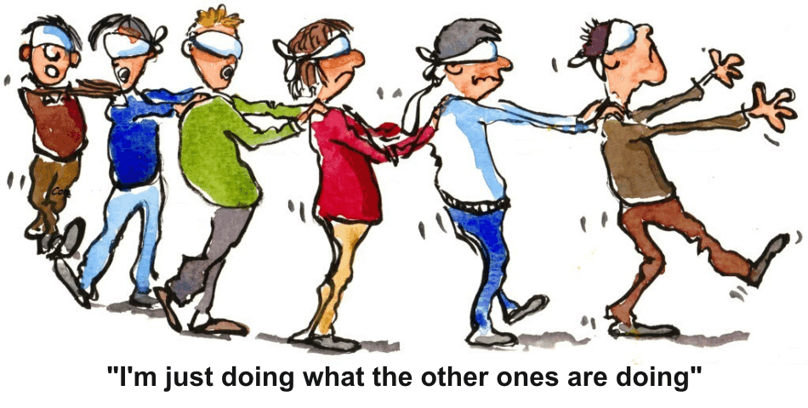
How do you trust the software you use?

Slide 8
Multiple perspectives
Levels of testing
Unit
Integration
System
Acceptance
Regression testing
Performance testing
Stress testing
Static testing
Functional/non-functional testing
Configuration testing
Black/white-box testing
Security testing
Test coverage
Test harness
Test automation
Test cases
Test planning
Test frameworks
…etc.
No time to cover all topics!

Slide 9
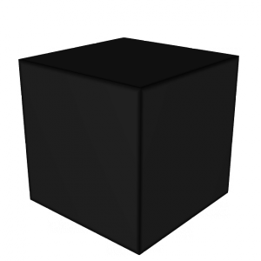
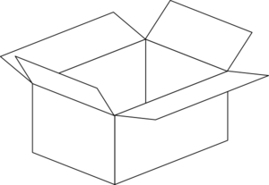
Testing strategies
input
output
Knowledge of the
source code is used
to design defect tests
Systematic approach
Focus on program coverage
Only considers software behaviour
Based on functional specifications
Good practice: a combination of both strategies

Slide 10
Epistemology
How to test it?
Calibrated?
…more about “magic numbers” in Refactoring
G4HadronElastic
G4double dd = 10.;
G4Pow* g4pow = G4Pow::GetInstance();
if (A <= 62) {
bb = 14.5*g4pow->Z23(A);
aa = g4pow->powZ(A, 1.63)/bb;
cc = 1.4*g4pow->Z13(A)/dd;
} else {
bb = 60.*g4pow->Z13(A);
aa = g4pow->powZ(A, 1.33)/bb;
cc = 0.4*g4pow->powZ(A, 0.4)/dd;
}
G4ChipsAntiBaryonElasticXS
lastPAR[43]=920.+03*a8*a3; lastPAR[44]=93.+.0023*a12;
G4GoudsmitSaundersonMscModel
if(i>=19)ws=cos(sqrtA);
G4EmCorrections
if(15 >= iz) {
if(3 > j) { tet = 0.25*Z2*(1.0 + 5*Z2*alpha2/16.); }
else { tet = 0.25*Z2*(1.0 + Z2*alpha2/16.); }
}
G4UrbanMscModel
coeffc1 = 2.3785 - Z13*(4.1981e-1 - Z13*6.3100e-2);

Slide 11
Test cases
Require domain knowledge
  Guidance from use cases, user stories, scenarios…
  Requirements, specifications and designs provide guidance at a higher level of abstraction and generality
Require source code knowledge
  Code-based control
  Logic and sequence defects
  Initialization and data flow defects
Software testing requires studying both the problem domain and the source code in depth

Slide 12
Levels of testing
Unit
testing
Test individual pieces of the system as they are created
Integration
testing
Test sets of interoperating or communicating units or components
System
testing
Test the entire system
Acceptance testing
Demonstrate that the product is ready for release
Usually performed by users

Slide 13
Regression testing
A regression is a feature (function, attribute) that used to work and no longer does
It is usually related to some change
A change or bug fix creates a new bug
A change or bug fix reveals an existing bug
A change or bug fix in one area breaks something in another area
Risk mitigation strategies
Run all tests
requires automation
Run part of the tests
based on
traceability
change analysis
quality risk analysis

Slide 14
Not only running code…
Static testing
Inspections and reviews
Analyze and check:
Requirements
Design models
Source code
Proposed tests
…
Can spot defects that would not be seen through running tests
Pair programming can be seen as a static testing method (continuous code review)
Pill of advice: train yourself to do peer reviews!

Slide 15
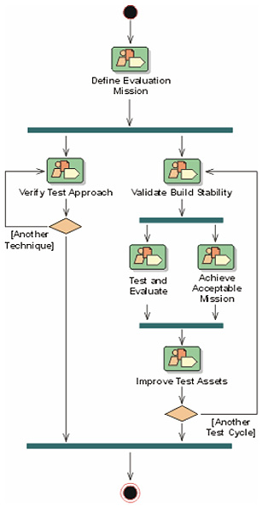
Test process
helps staying focused
Workflow in the RUP
Test
cycle
Test Plan
Test Ideas
Test Cases
Tests
Test Suites
Test Evaluation Summary
Defect and Defect List
Workload Model
Each iteration can contain multiple
test cycles
Focus on concepts,
not on formalities or paperwork!

Slide 16
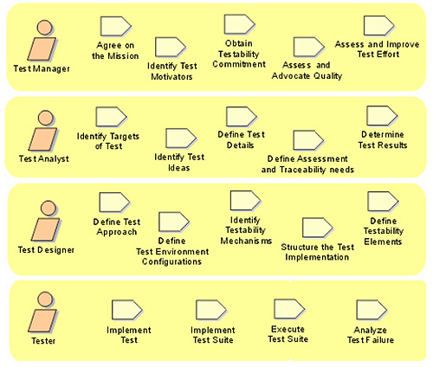
Test process
A person can play multiple roles
Roles
and activities
in the RUP
Guidance
rather than prescription

Slide 17
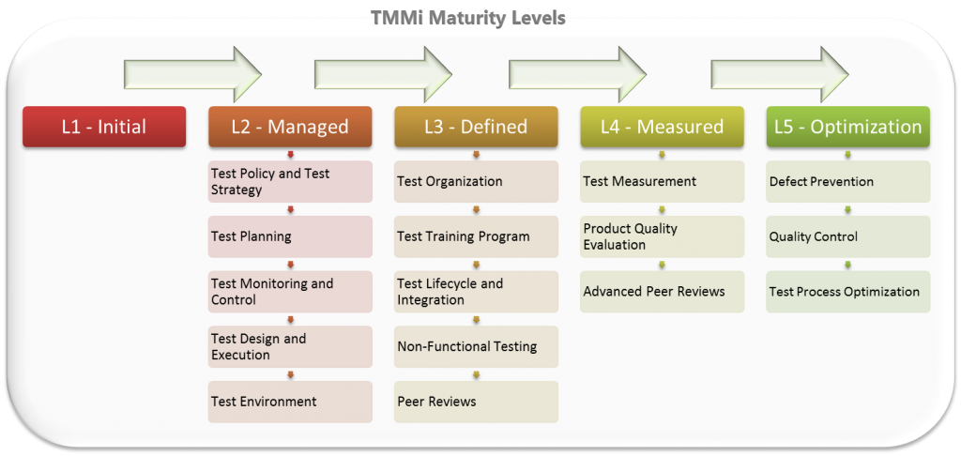
How good is my testing process?
http://tmmi.org/
Inspiration and guidance for improvement

Slide 18
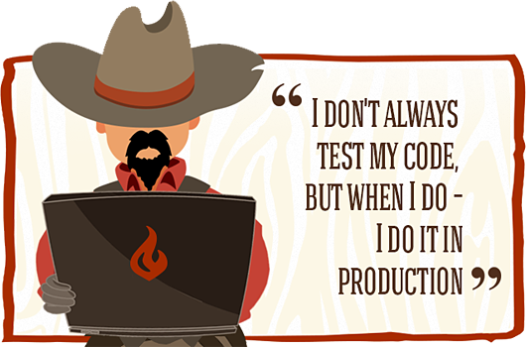
Unit testing
Unit = smallest testable part
Procedural Programming: a function
Object Oriented Programming: a class
Unit testing contributes to risk mitigation:
Issues are found at an early stage
Can be resolved minimizing the impact on other parts of the code
Helps in changing and maintaining the code
Facilitates regression testing

Slide 19
Good characteristics of unit tests
It should be automated and repeatable
  Unit test frameworks
Once a test is written, it should remain for
future use
  Unit tests should be documented
  Planning and infrastructure for running
Anyone should be able to run existing unit tests
  Domain knowledge required to design a test
  Not to execute it: self-explaining result
19

Slide 20
Pyramid and ice-cream testing
best practice
manual testing
system
system
integration
cost of development/maintenance
integration
unit
unit
volume of test development
volume of test development

Slide 21
Unit test frameworks
Tools enabling programmers to:
describe every test as a simple script
specify the test configuration, the input and an assertion describing the expected pass/fail criteria (oracle)
run a set of tests as an automated process
Pioneers: xUnit family
  JUnit, CppUnit…
Modern tools
  Boost Test Library, Google Test, catch, cgreen...
21

Slide 22
Google unit test framework
AKA Google Test, googletest, gtest
Unit testing framework for C++ code
Follows xUnit concept
Open source
Assertion
Check whether a condition is true
Success, non-fatal failure, fatal failure
Tests
Use assertions
Test case
Contains one or more tests
Test program
Can contain multiple test cases
A class for common objects and functionality shared by multiple tests
Test fixture
22

Slide 23

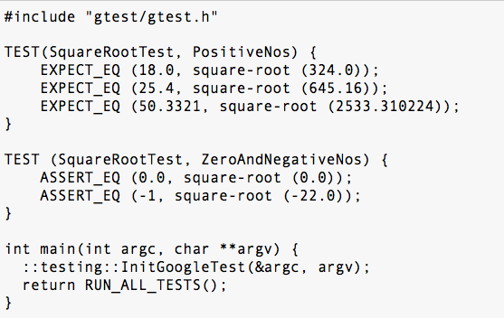
Example: unit test for a square root function
Creates a hierarchy named SquareRootTest
PositiveNos is a test
execution continues even if there is a failure
aborts if there is a failure
initializes the framework
automatically detects and runs all the tests defined using the TEST macro

Slide 24
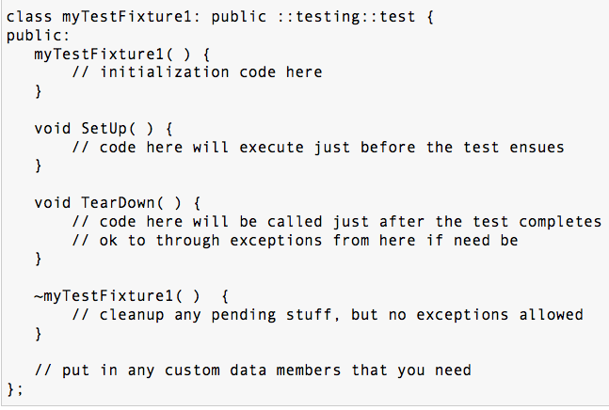
A test fixture class
Use with the TEST_F macro instead of TEST
derived from the ::testing::test class in gtest.h

Slide 25
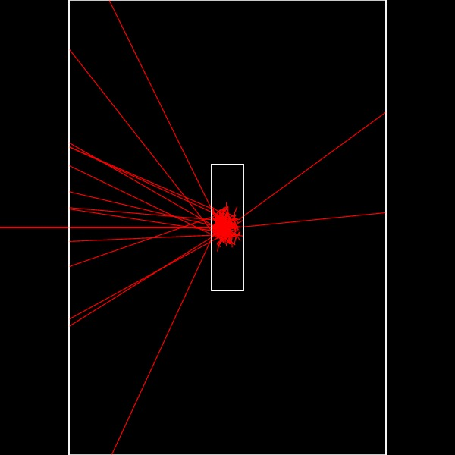
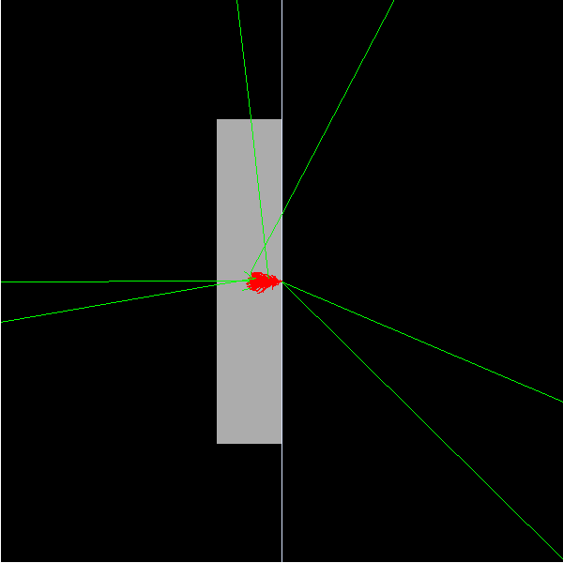
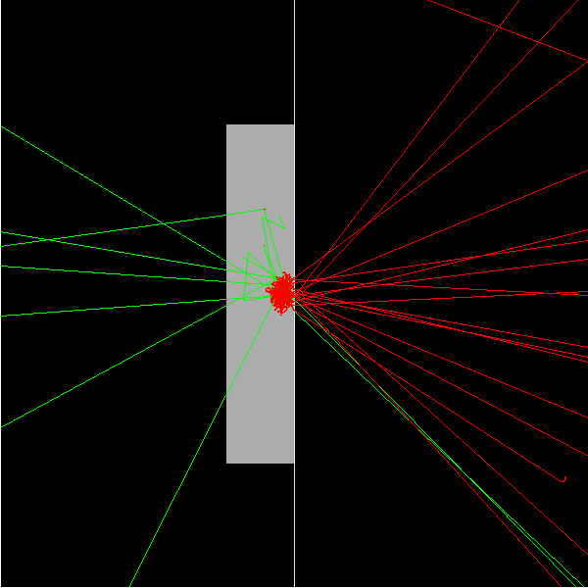
Passed ≠ exempt from flaws
“Testing shows the presence, not the absence of bugs.” E.W. Dijkstra,
Software Engineering Techniques, J. N. Buxton and B. Randell eds., 1970
G4eSingleCoulombScatteringModel
Geant4 10.2
Developer’s test
Physical expectation: a fraction of electrons is backscattered
(consistent with experiment)
No backscattered electrons are observed

Slide 26
Testable software
Detector design, experimental strategies, physics results depend critically on software
…which is often untested (partially tested) because it is untestable
  or became untestable in the course of its evolution
Making software testable
  Improving software design (refactoring)
  Breaking dependencies (techniques à la Feathers)
  Embedding testability in the software design
Testability must be maintained
  through the evolution of the whole software system
Epistemological issues
  domain knowledge and implementation details
26

Slide 27
Discipline of software engineering
Most of these problems can be easily solved
if we simply write tests as we develop our code
  …and we maintain the tests
  …and we regularly execute them
  …and we investigate the reasons for failure
If a test is hard to write, that means that we have to find a different design which is testable
It is always possible
Software design reviews: care about testability
27

Slide 28
Hands-on exercise
Refactoring is intertwined with unit testing
In the refactoring exercise get acquainted with:
  Associating software development and change with unit testing
  A unit test framework: GoogleTest
  Test automation
  Regression testing
Apply what you learn at the APC school to your own software development environment!
28

